Slide 1

03
Activities In
Halloween
Notes:
This is Jennifer, I will be talking about activities in Halloween.

Slide 2
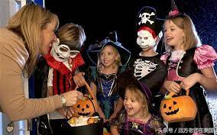
Trick-or-treating
Children dressed in costume
Travel from house to house
Ask for treats with the phrase “trick or treat”
Notes:
On Halloween, dozens of children dressed in costumes go from door to door asking for treats with the phrase “trick or treat”. Usually, the treat is some kinds of candies. Children can tell whether the homeowners are willing to hand out treats or not by the Halloween decorations outside their doors. Sometimes, the homeowners leave treats available on their porches for children to take freely.

Slide 3
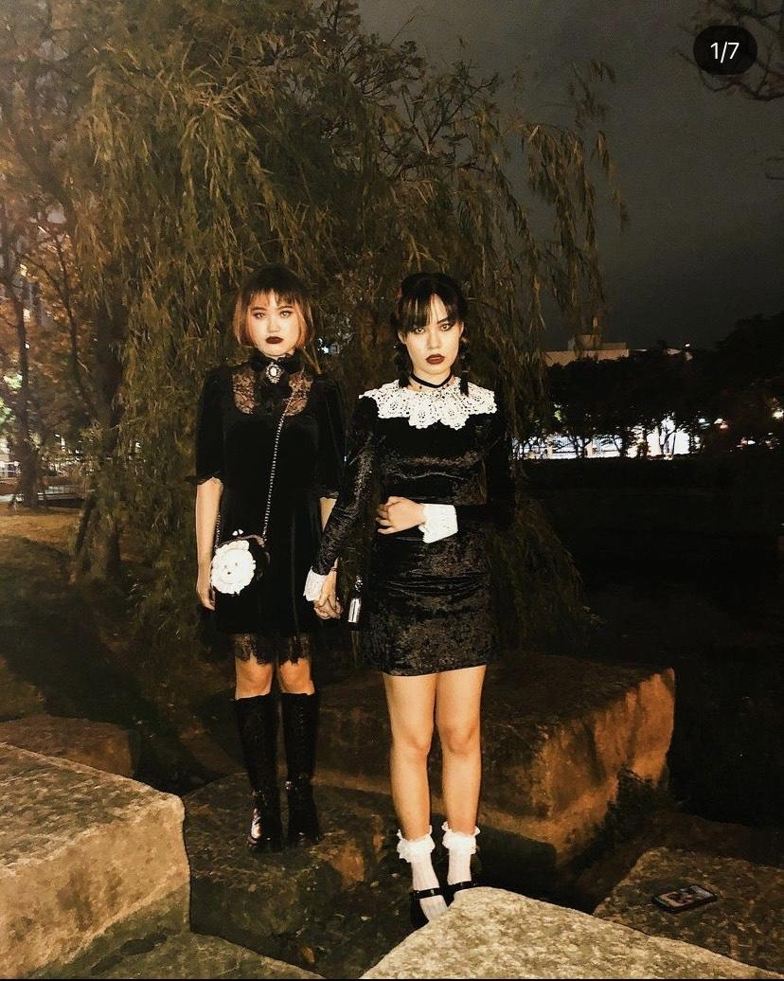
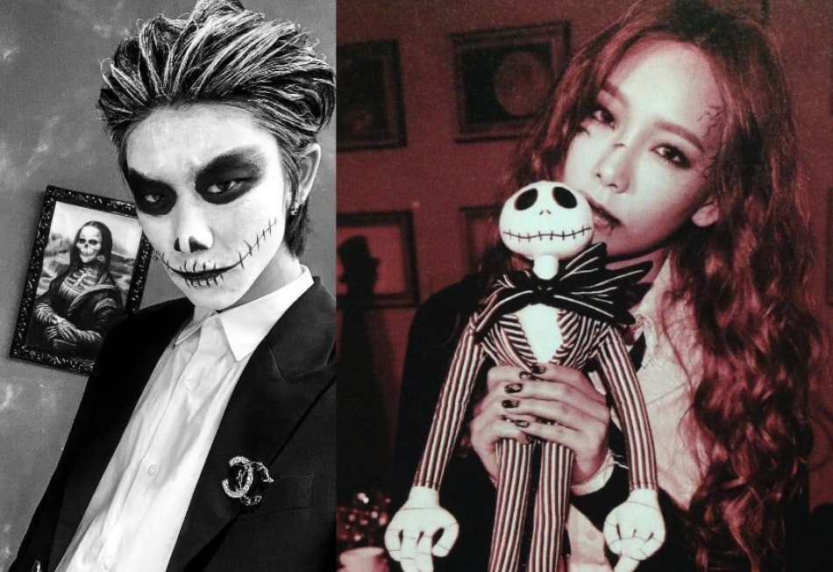
Dressing up
Wear mask to avoid being recognized by ghosts.
Costumes are not only based on horror themes but also famous characters.
Notes:
On Halloween, when it was believed that came back to Earth, people would wear masks to prevent being recognized by them. Halloween costumes are traditionally monsters such as ghosts, skeletons, witches and devils. Costumes are also based on characters from television shows, films, and other pop culture icons. This is how my friends dresses on Halloween.

Slide 4
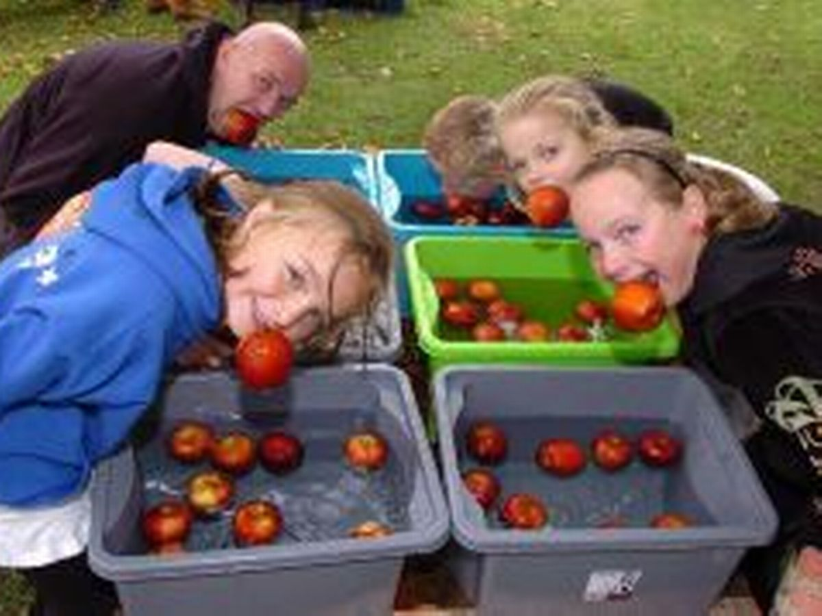
Apple bobbing
Also called Duck-apple
Roman festival held on the same day as Samhain for remembering Pomona.
Contestants must bite one of the apple without using their hands.
Notes:
Apple bobbing, which is also called Duck-apple, was a Roman festival taken place the same day as Samhain for remembering Pomona, the goddess of the trees and fruits. The contestants sometimes are blindfolded, and they must take one bite from one of the apples without using their hands.

Slide 5
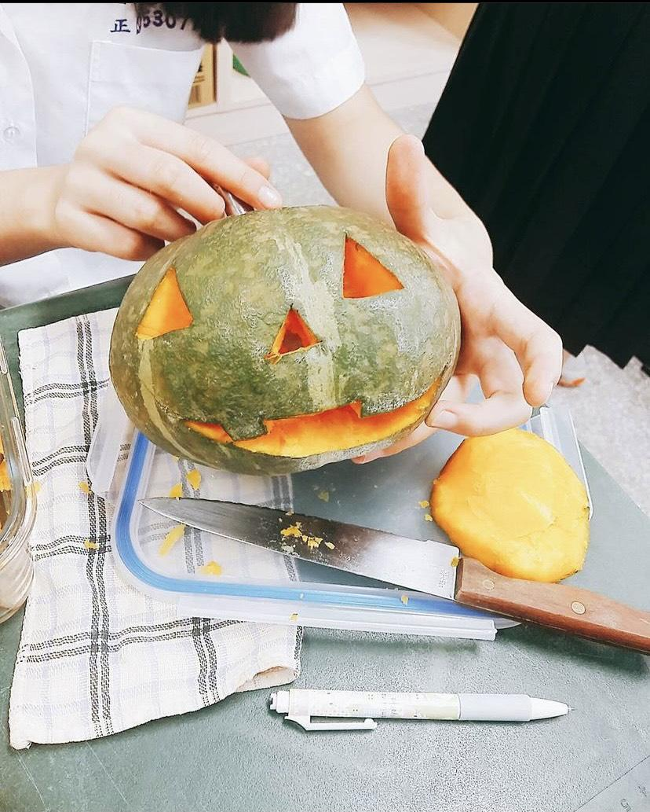
Make Jack-o’-lantern
Pumpkins are official fruit of Halloween
In superstition, lanterns welcome good spirits and protect against malevolent ones.
Notes:
We all know that when it comes to Halloween, pumpkins take an extremely important role. In superstition, lanterns welcome good spirits and protect against malicious ones. According to an Irish legend, Jack was a man who could not enter heaven because he was a miser. He couldn’t enter hell either,because he had played jokes on the devil. So, he was doomed to wander around with a lantern until Judgement Day.

Slide 6
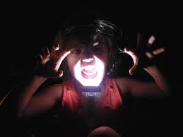
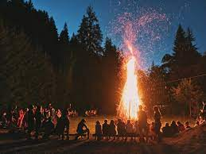
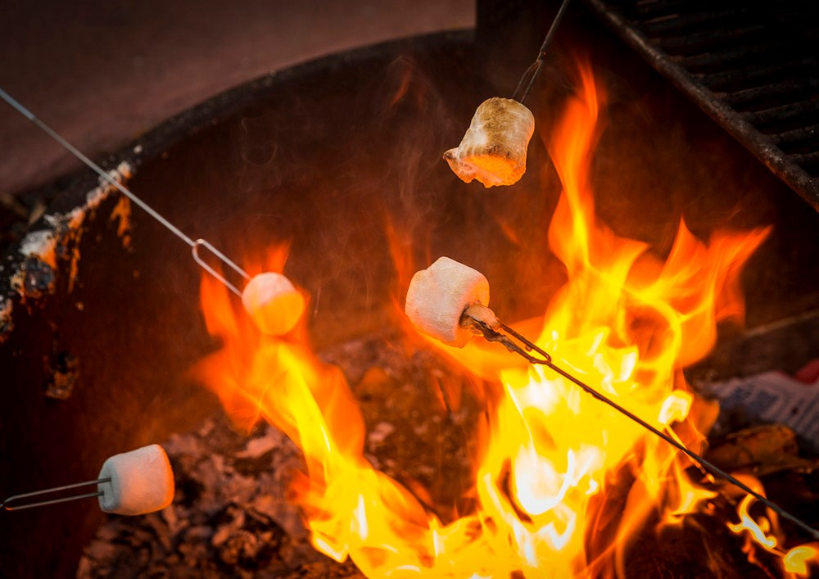
Make a bonfire
Traced back to the celebration of Samhain
Bone fire became bonfire
Personal and symbolic items were also burned for protection against sickness and bad fortune.
Notes:
The origin of bonfire can be traced back to the celebration of Samhain. Bonfires were lit to ensure the sun would return after the long, hard winter. During the festival, Druid priests would throw the bones of cattle into the flames, hence the name, “bone fire”later became “bonfire”. Personal and symbolic items were also burned for protection against sickness and bad fortune. However, what do we do at a bonfire nowadays? We can roast marshmallows and tell ghost stories.

Slide 7
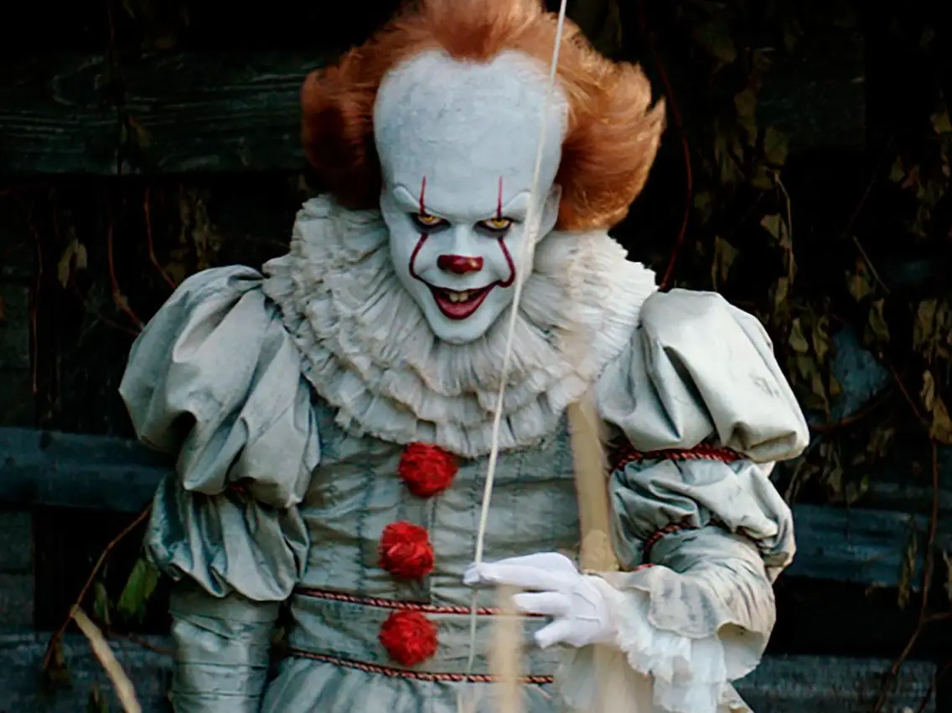
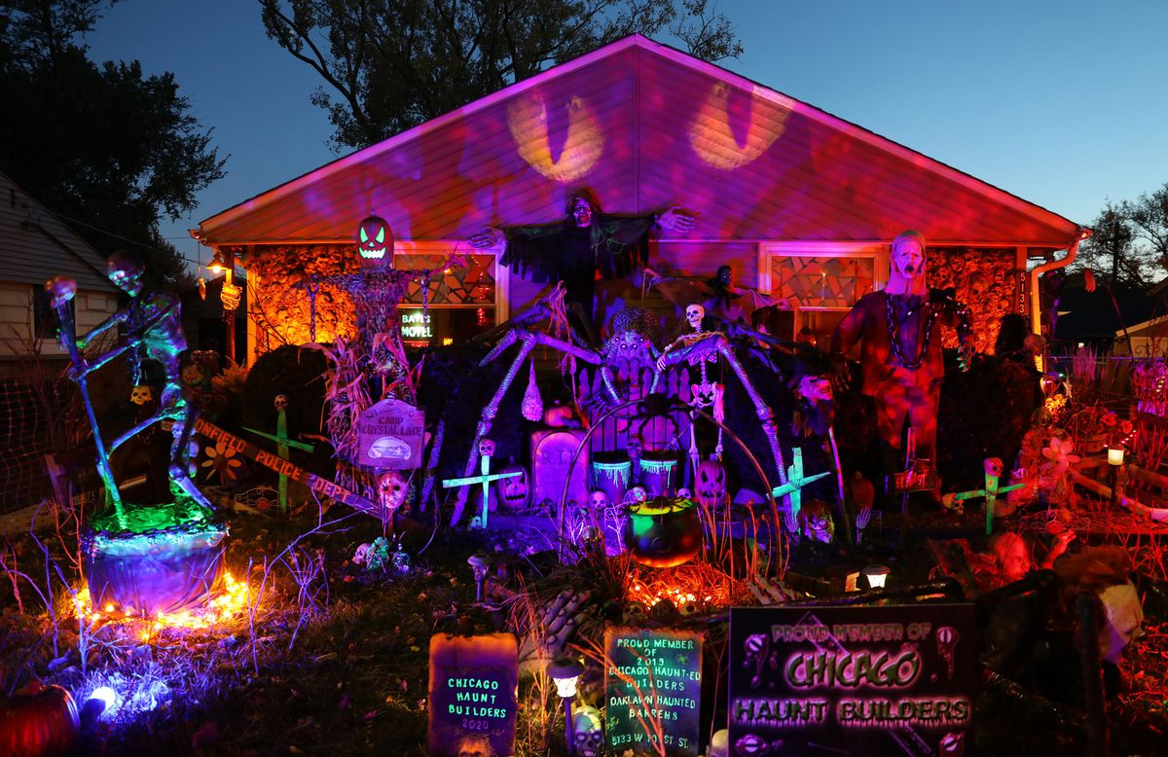
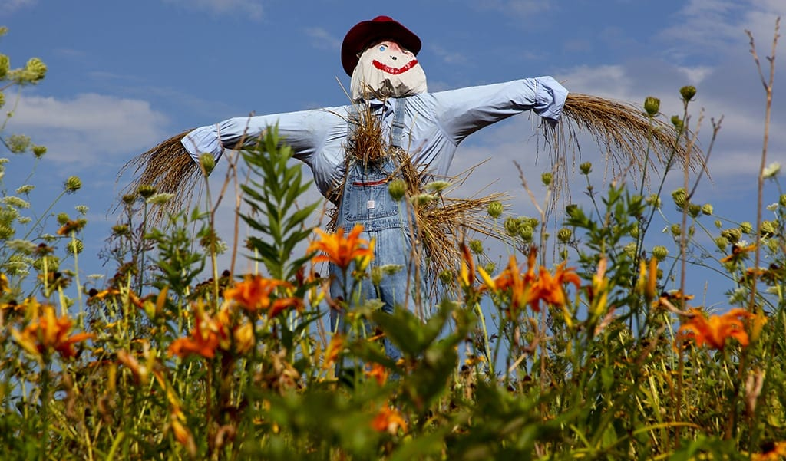
And…?
Notes:
What else can we do on the Halloween? We can watch horror films, make a scarecrow and decorate the house to enhance the atmosphere of Halloween.

Slide 8

And…?

