Slide 1

Group Presentation
Rats/Cats/Toads in different cultures
107042007 張嘉芸 Cherry
107096036 劉恩佑 Tony
109041025 洪睿謙 Ray

Slide 2
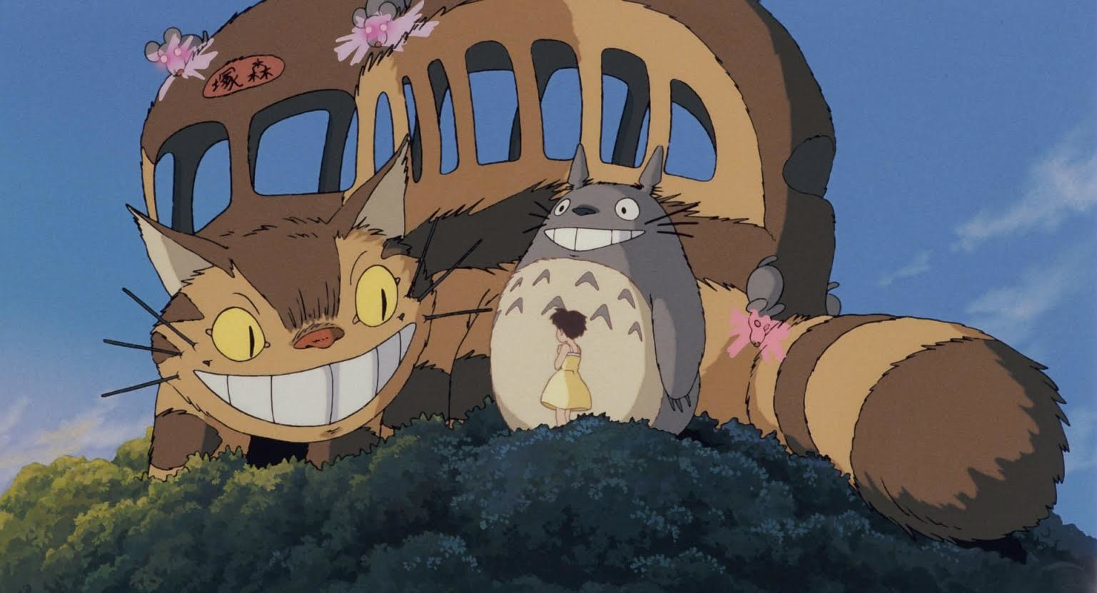

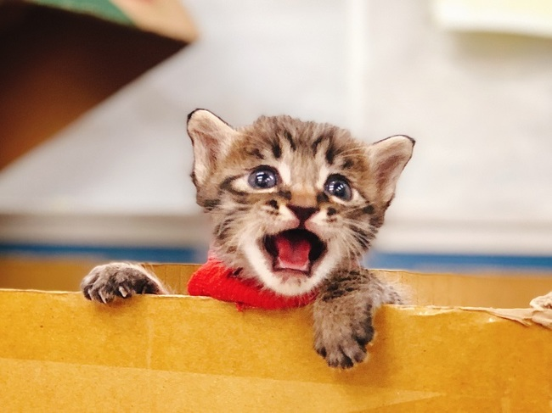
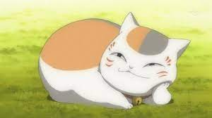

CATS
Notes:
cat bus in “My Neighbor Totoro” it has a cat appearance function of a bus
cat monster called Nyanko Sensei BECAUSE IT HELPS character

Slide 3
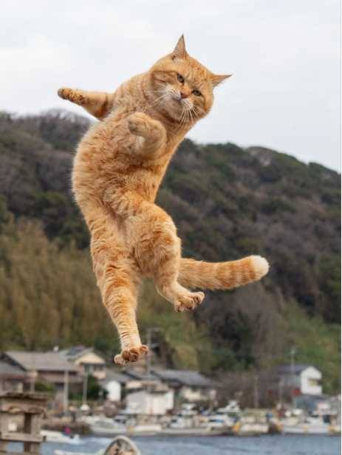
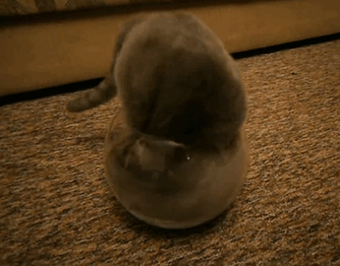
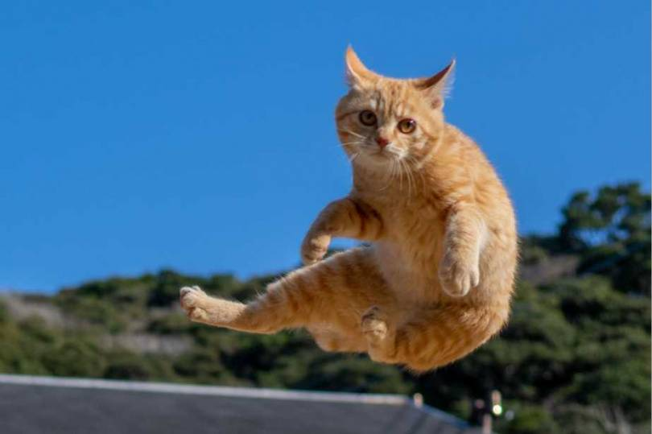
CATS
SMART
●Normal→mew/meow
●Satisfied,Relaxed→purr
●Hunting→pounce
INDEPENDENT
UNFETTERED
FLUID
Notes:
change itself from solid to liquid
mew:mi u
Felidae(filidi):tiger,lion,leopard(leperd)

Slide 4
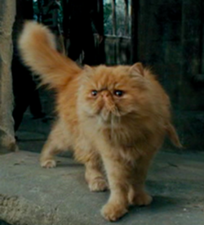
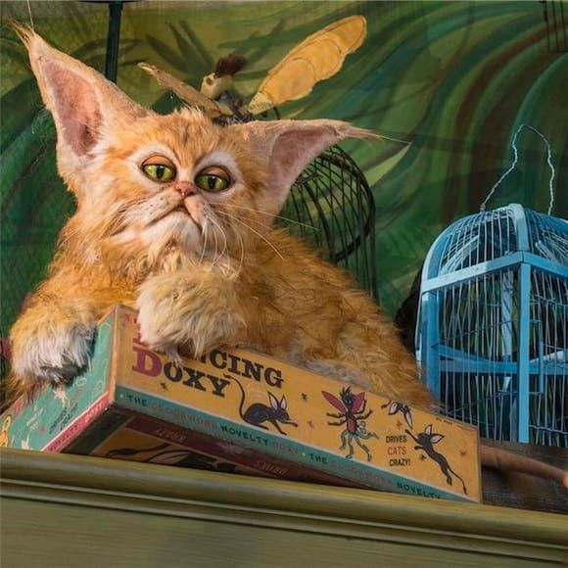
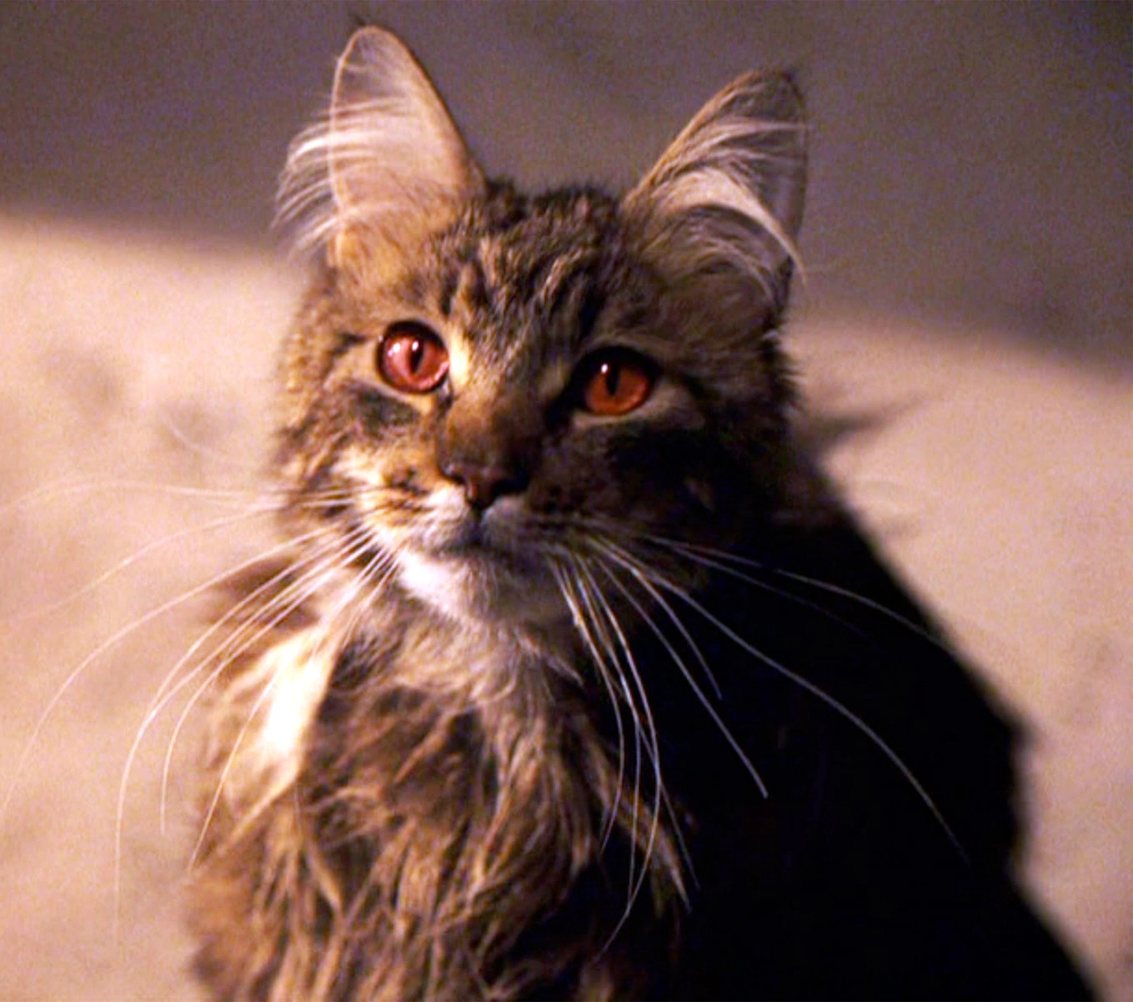
CATS
01
HARRY
POTTER
Crookshanks:a hybrid Kneazle
Mrs. Norris:Filch’s cat
Notes:
Kneazle:像貓
smart:
歪腿can tell that the black dog is Sirius Black and Ron’s pet rat is actually Peter Pettigrew
太太:has a negative image,I think it’s much like sly

Slide 5
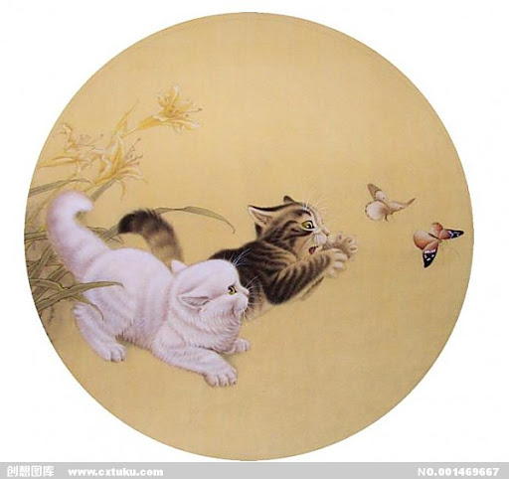
CATS
02
CHINESE CULTURES
Symbols of good fortune
Not in the Chinese Zodiac
Notes:
the pronunciation of cat combined with butterfly in chinese sounds like the word means 80~90 years old, it’s a symbol of longevity

Slide 6
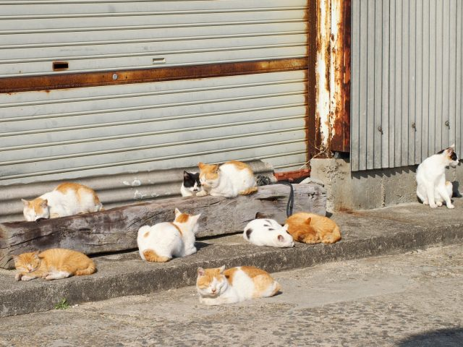
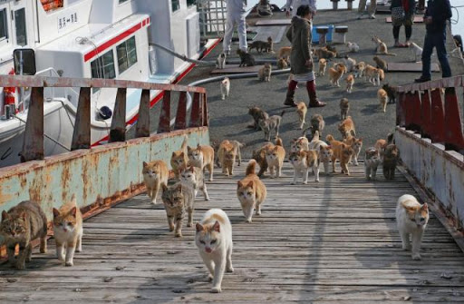
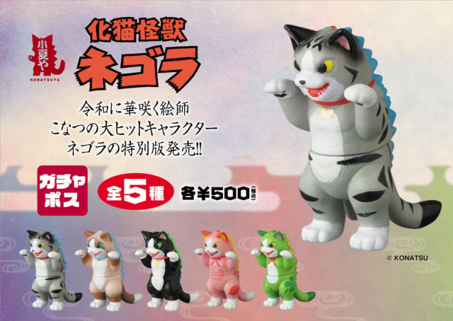
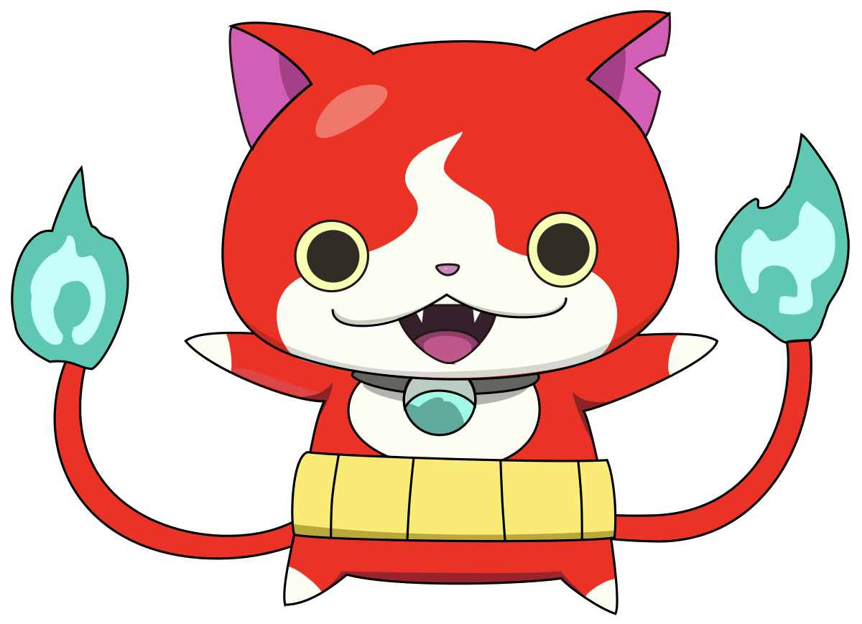
CATS
03
JAPANESE CULTURES
Love cats→several “Cat Island”
2/22:Day of cats
Cat monsters:very old cats
Notes:
Japanese nowadays Crazy about cats so that/the number of cats is more than people/one of the islands has a cat god
2日文發音像mew

Slide 7
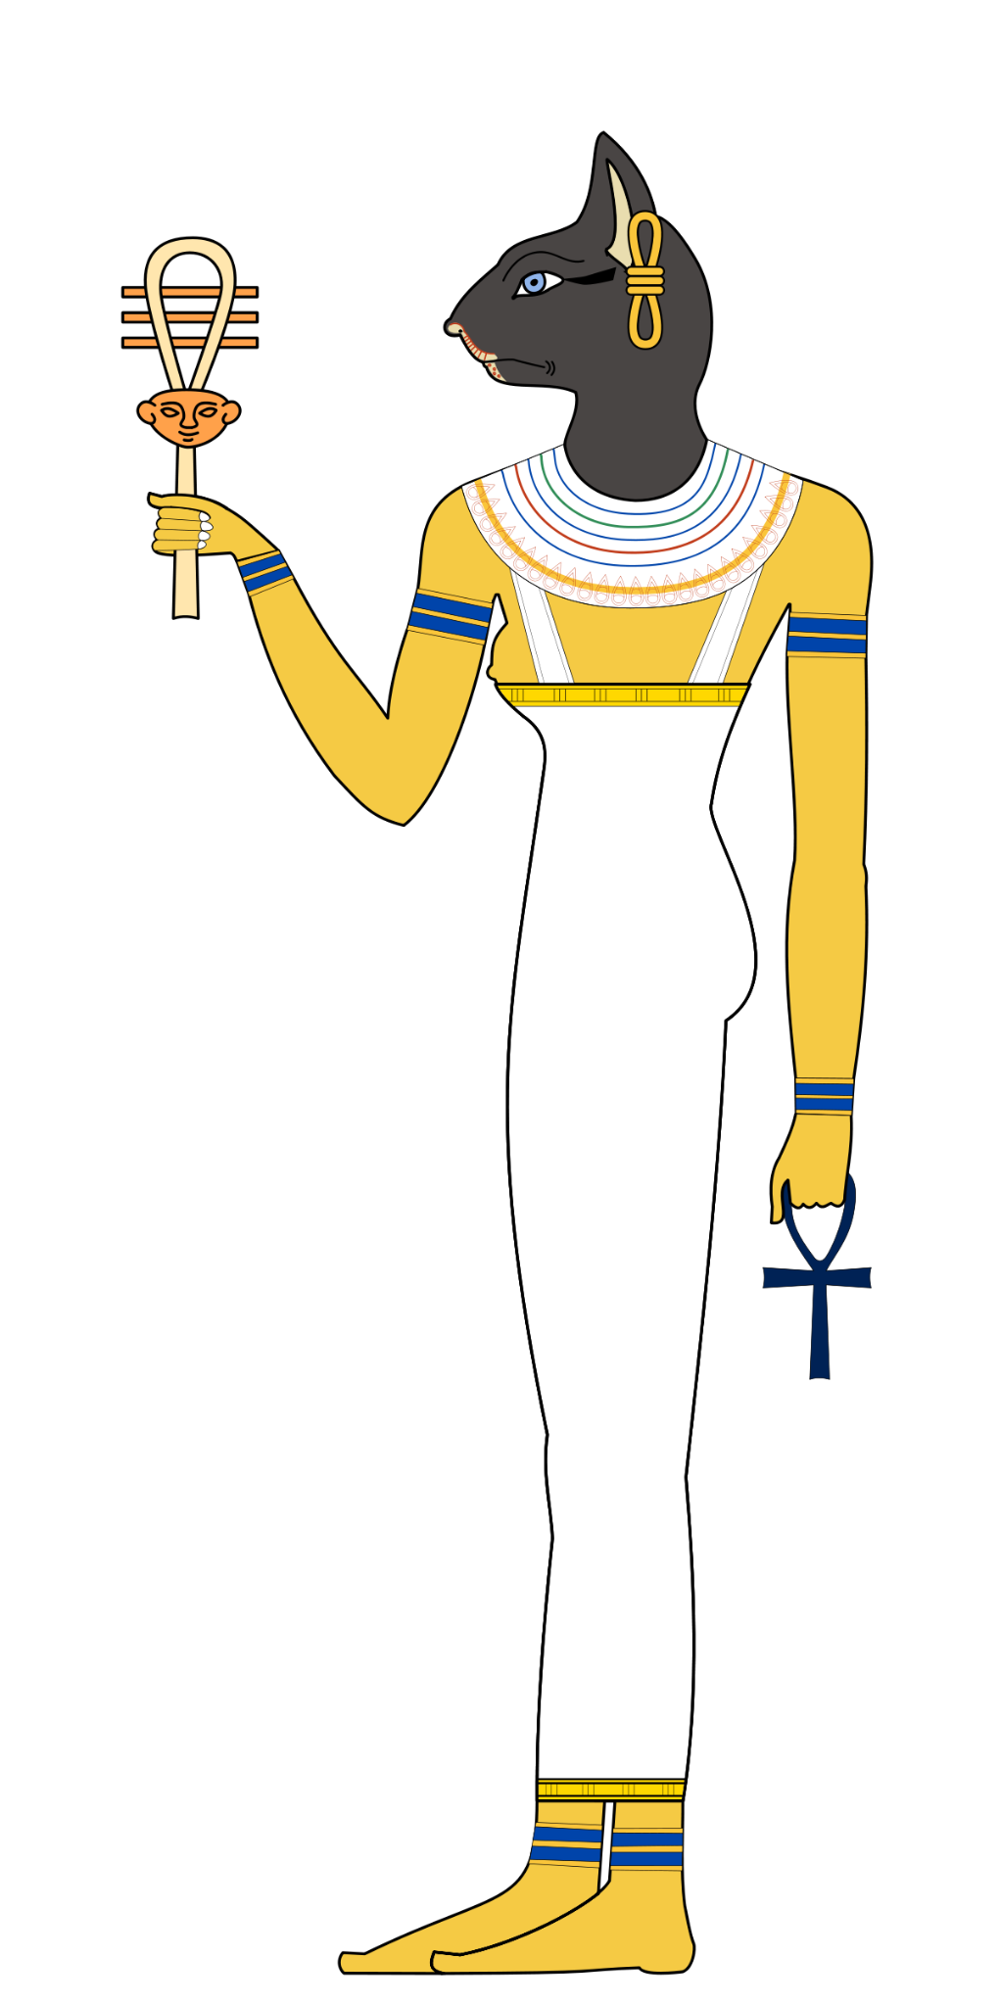
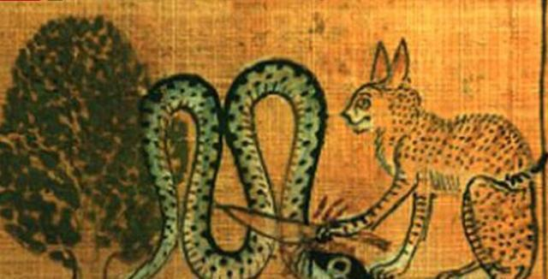
CATS
04
EGYPTIAN
CULTURES
Bastet:cat goddess
Symbol of luminosity,
holy creature
Notes:
Bastet:cat head ,human body
Eygptian myth:she represents the god of sun to fight with A pophis/Apep,which is portrayed as a giant snake and the symbol of dark,and then she defeat it ,let the sun shine again
cat mummy

Slide 8
THANKS

