Slide 1
Monte-Carlo method and Parallel computing
An introduction to GPU programming Mr. Fang-An Kuo, Dr. Matthew R. Smith
NCHC Applied Scientific Computing Division

Slide 2
NCHC
National Center for High-performance Computing.
3 Branches across Taiwan – HsinChu, Tainan and Taichung.
Largest of Taiwan’s National Applied Research Laboratories (NARL).
www.nchc.org.tw
2

Slide 3
NCHC
Our purpose:
Taiwan’s premier HPC provider.
TWAREN: A high speed network across Taiwan in support of educational/industrial institutions.
Research across very diverse fields: Biotechnology, Quantum Physics, Hydraulics, CFD, Mathematics, Nanotechnology to name a few.
3

Slide 4
Outline
An introduction to HPC machine in Taiwan
Parallel Computation
General parallel computing on PC cluster/SMP machine
Accelerated processing unit, GPU
An introduction to Taiwan HPC Facilities
GPU programming CUDA : An example dot product
Monte-Carlo method
Summany

Slide 5

Most popular Parallel Computing Method
MPI/PVM
OpenMP/Posix Thread
Others , like CUDA

Slide 6
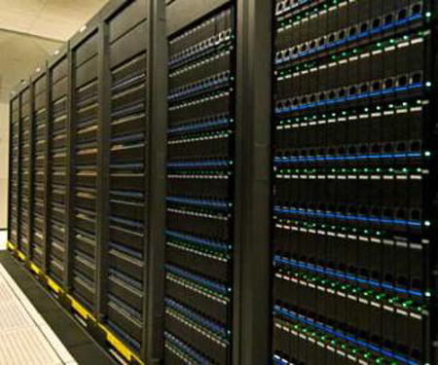
MPI (Message Passing Interface)
An API specification that allows processes to communicate with one another by sending and receiving messages.
A MPI parallel program is running on a distributed memory system.
The principal MPI–1 model has no shared memory concept, and MPI–2 has only a limited distributed shared memory concept.

Slide 7
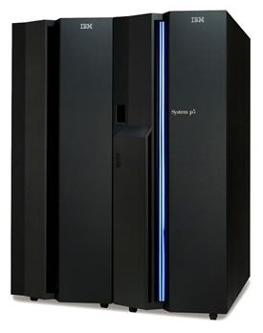
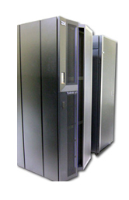
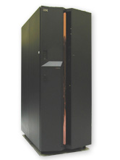
OpenMP (Open Multi-Processing)
An API that supports multi-platform shared memory multiprocessing programming in C, C++, and Fortran.
A hybrid model of parallel programming can run on a computer cluster using both OpenMP and MPI.

Slide 8
GPGPU
GPGPU = General scientific Programming on Graphics Processing Units.
Massively parallel computation using GPU is a cost/size/power efficient alternative to conventional high performance computing.
GPGPU has been long established as a viable alternative with many applications…

Slide 9
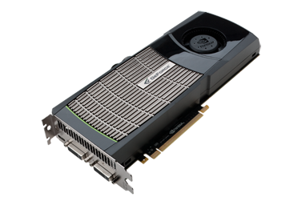
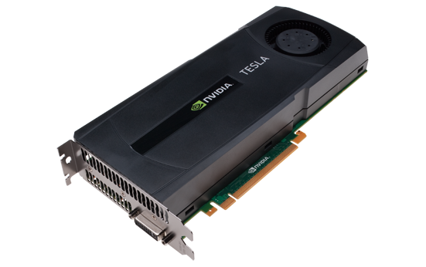
GPGPU
CUDA (Compute Unified Device Architecture)
CUDA is a C-like GPGPU computing language helps us do general propose computations on GPU.
Gaming card
Computing card

Slide 10
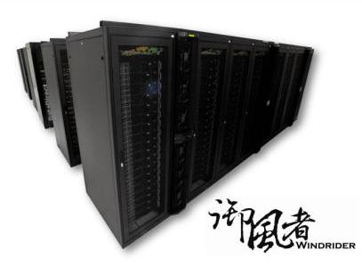
HPC Machine in Taiwan
ALPS(42th of Top 500)
IBM1350
SUN GPU cluster
Personal SuperComputer

Slide 11
ALPS(御風者)
ALPS(Advanced Large-scale Parallel Supercluster, 42th of Top 500 SuperComputers) has 25600 cores and provides 177+ Teraflops
Movie : http://www.youtube.com/watch?v=-8l4SOXMlng&feature=player_embedded

Slide 12
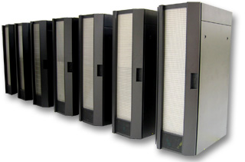
HPC Machine
Our Facilities:
IBM1350 (iris) - > 500 nodes
(Mixed Groups of Woodcrest
and newer Xeon Intel processors)
HP Superdome, Intel P595
Formosa Series of Computers:
Homemade supercomputers, built to custom by NCHC. Currently: Formosa III,IV just came online, Formosa V are under design.
12

Slide 13
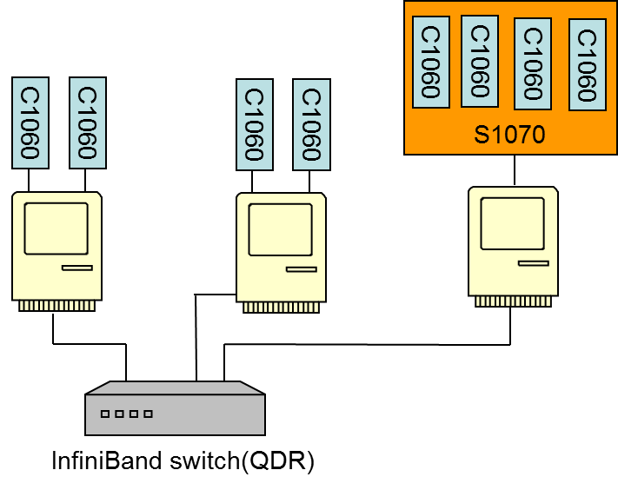
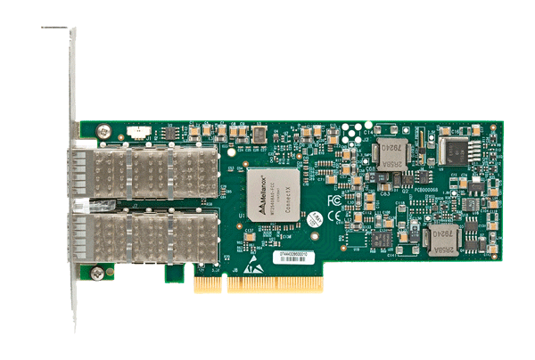

Network connection
InfiniBand 4x QDR – 40Gbps, average 1 $μs$ latency
InfiniBand card

Slide 14
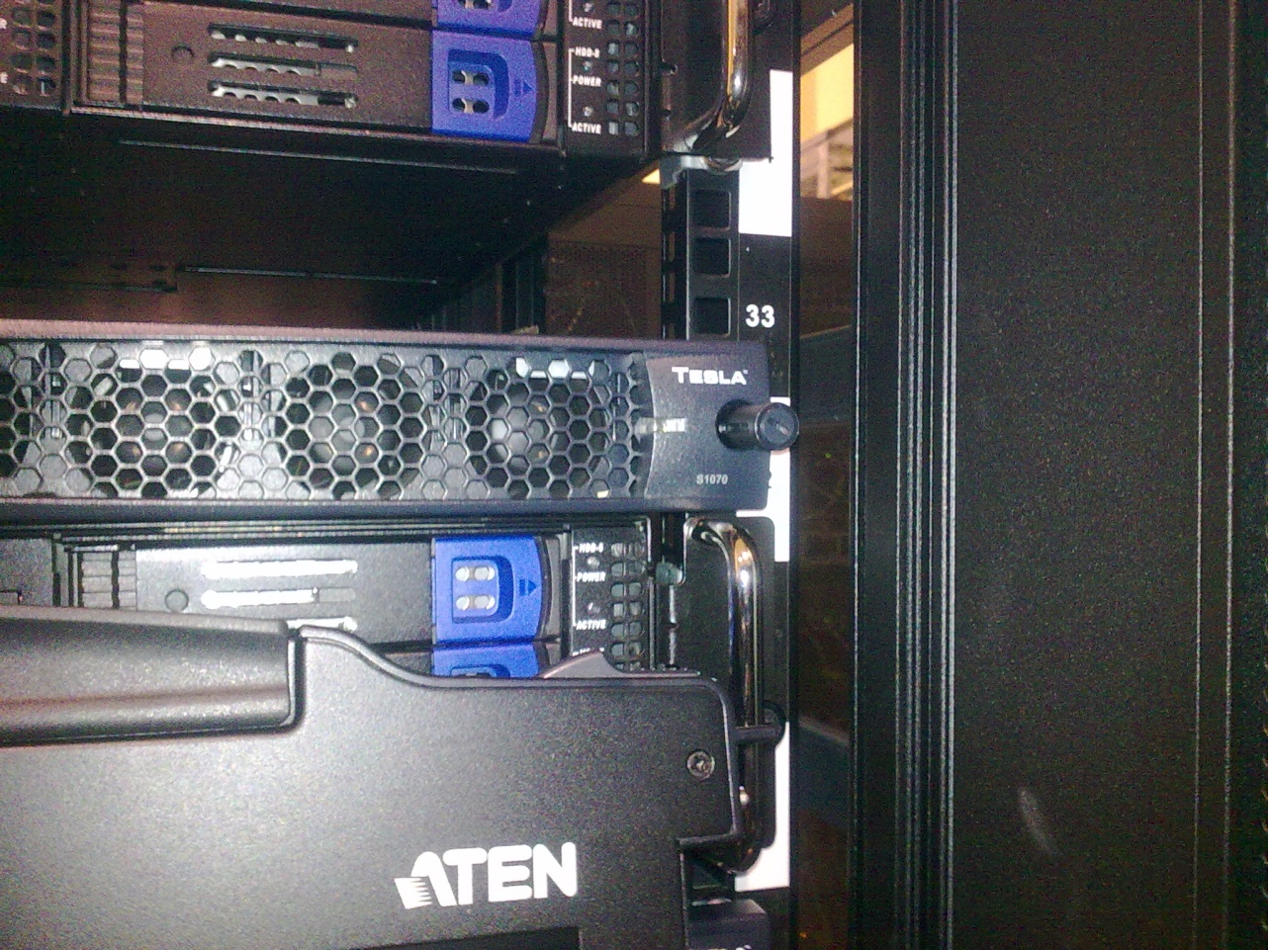
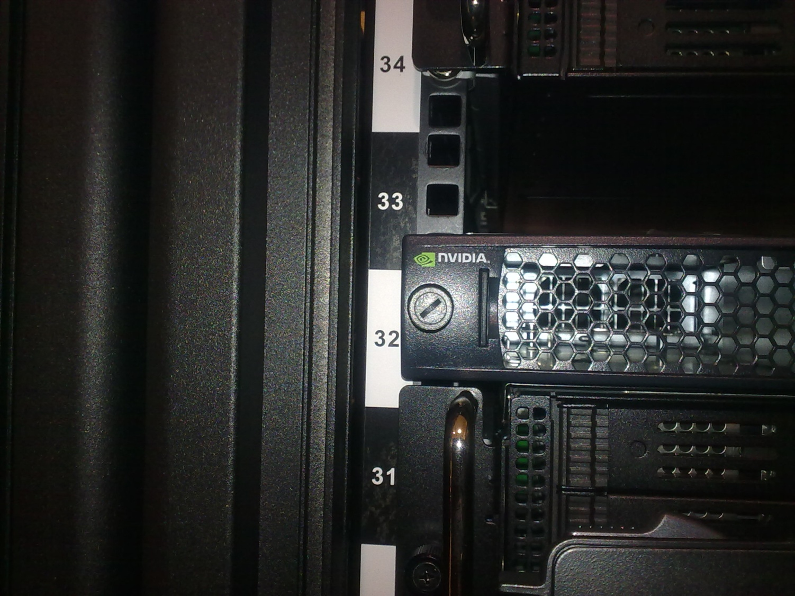
Hybrid CPU/GPU @ NCHC (I)
14
Notes:
14

Slide 15
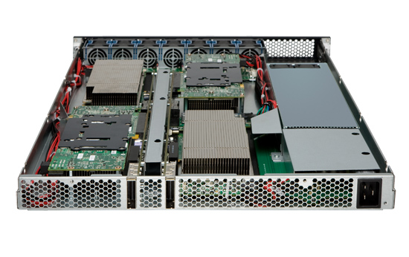
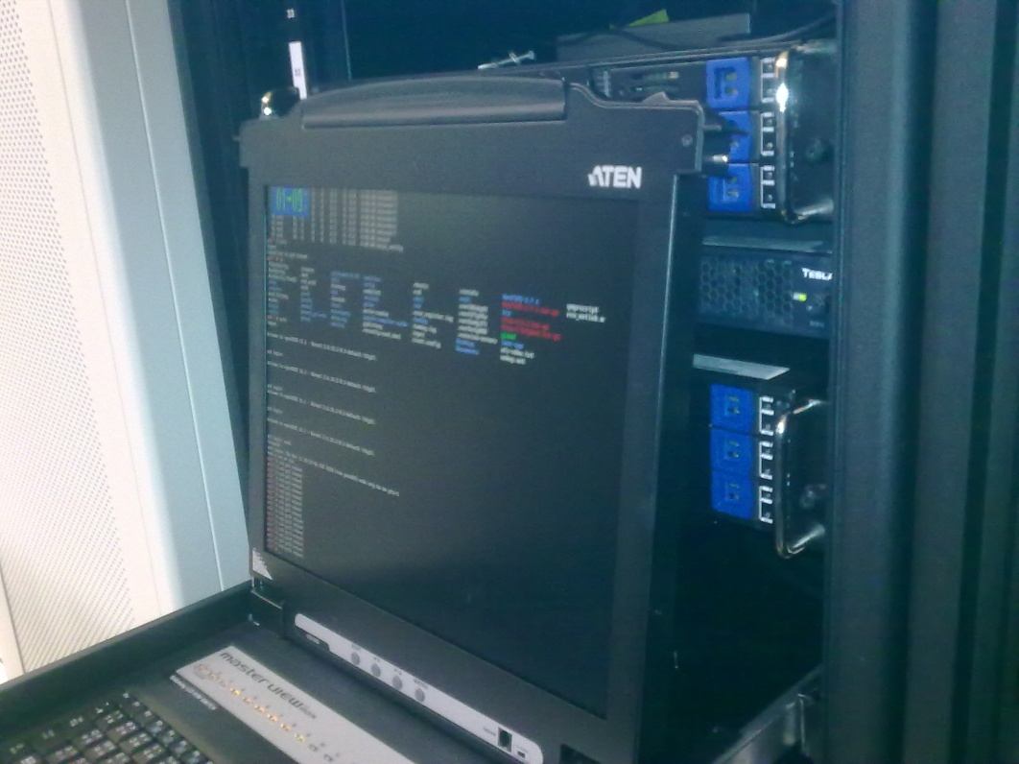
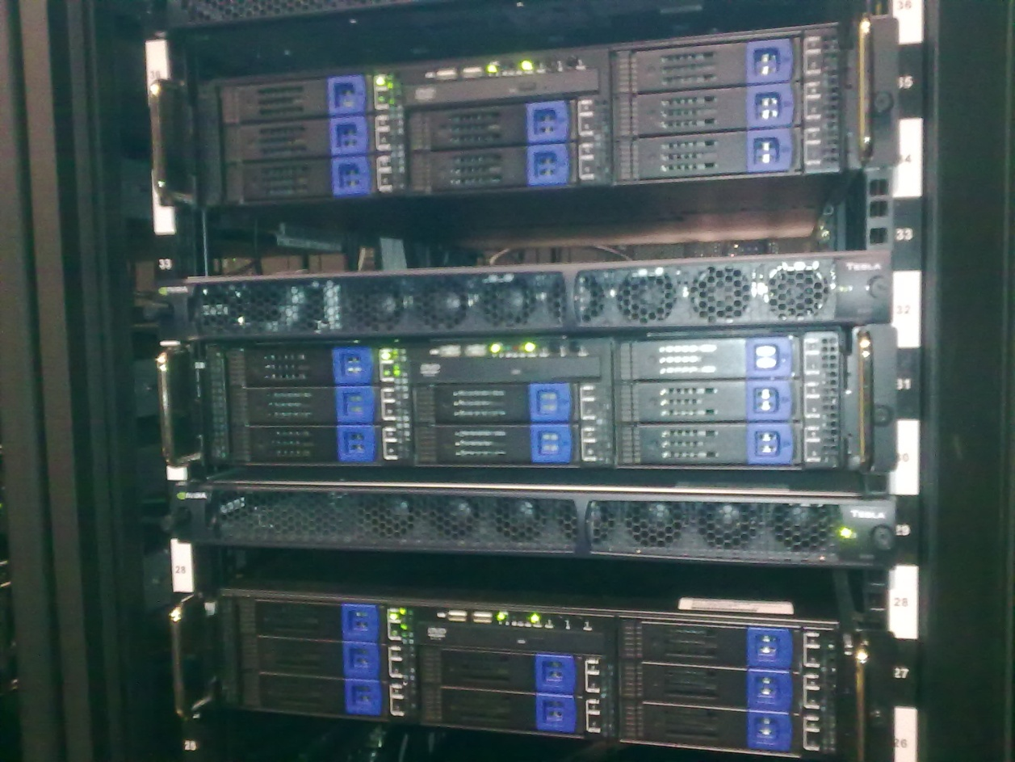
Hybrid CPU/GPU @ NCHC (II)
15
Notes:
15

Slide 16
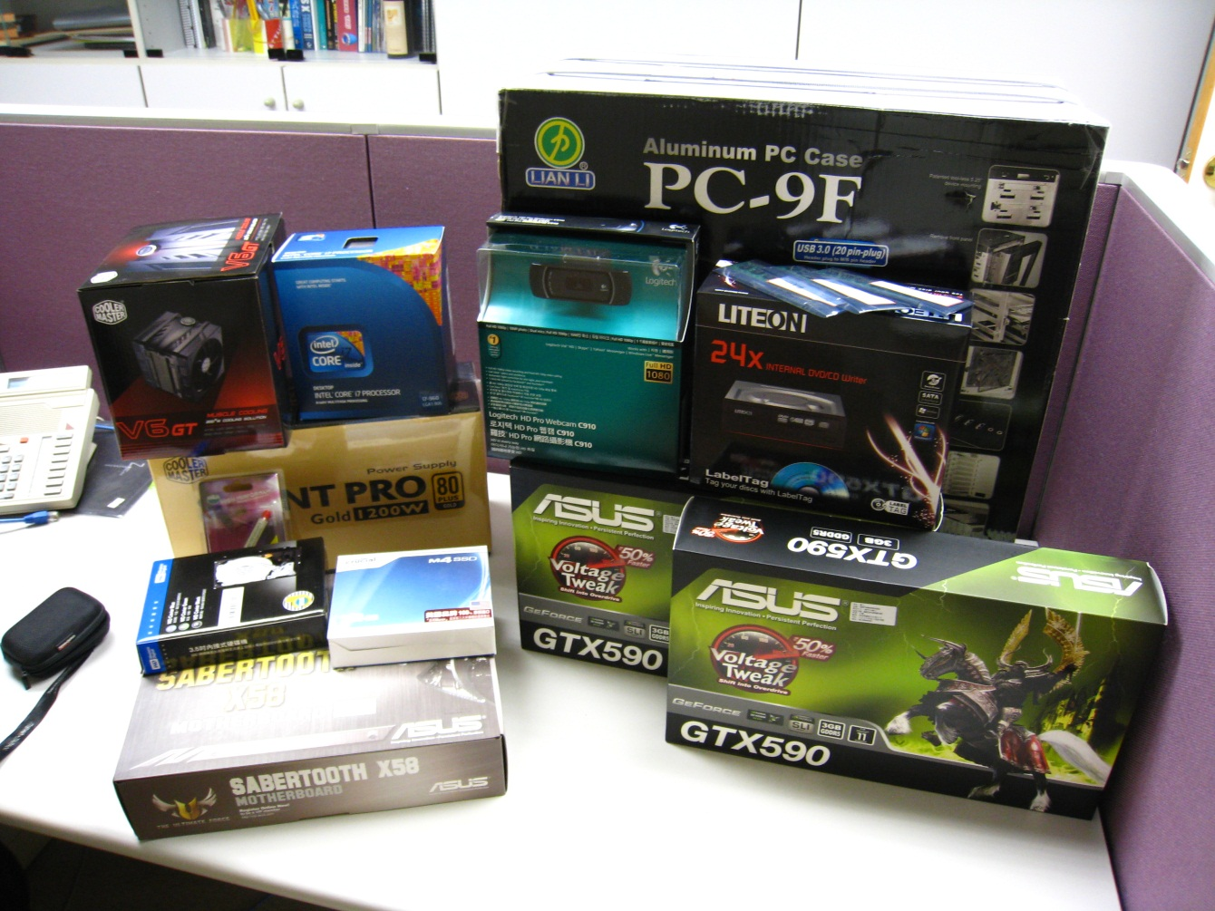
My colleague’s new toy

Slide 17
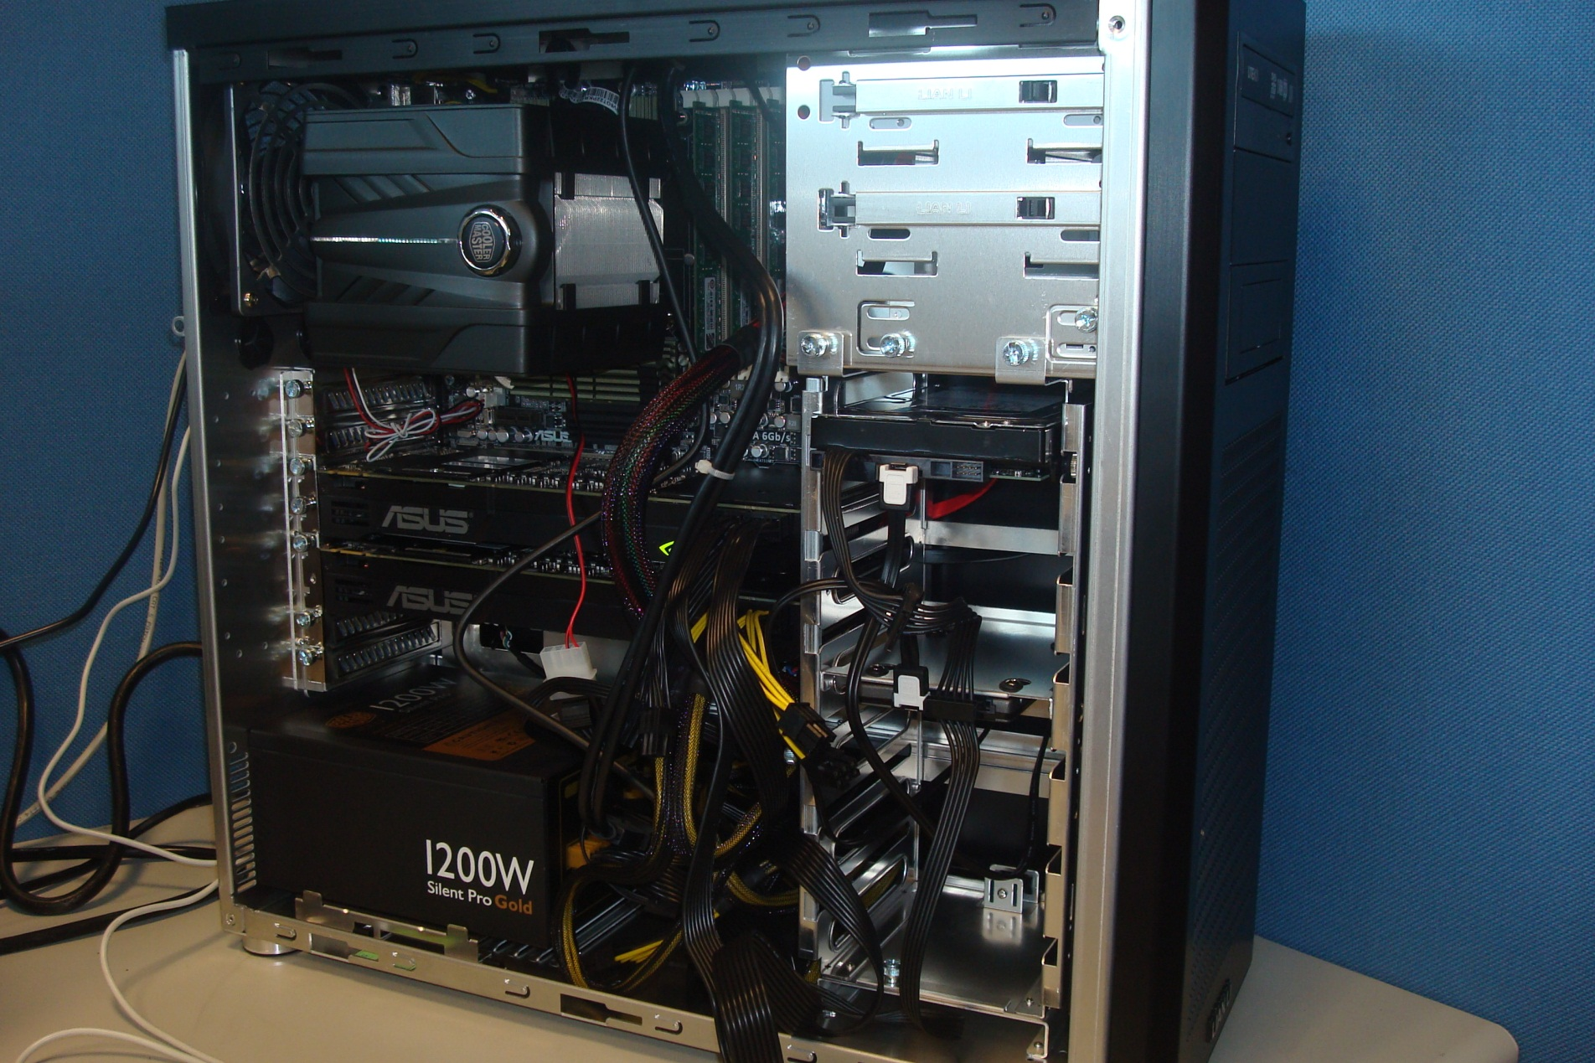

Slide 18
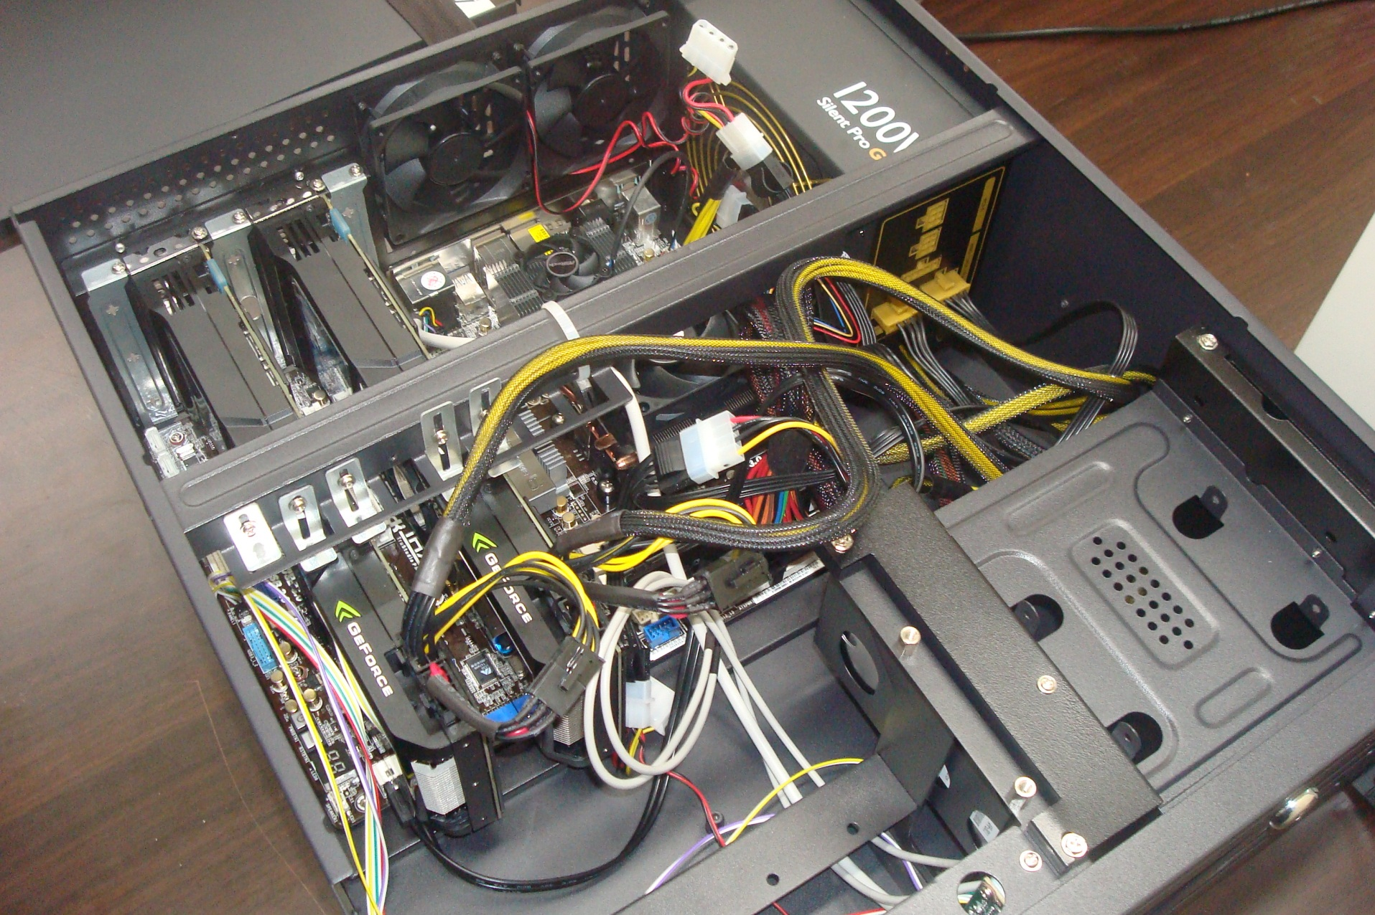

Slide 19
GPGPU Language
- CUDA
Hardware Architecture
CUDA API
Example

Slide 20
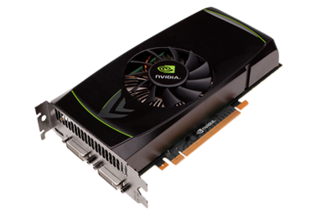
GPGPU
NVIDIA GTX460
Graphics card version | GTX 460 1GB GDDR5 | GTX 460 768MB GDDR5 | GTX 460 SE
CUDA Cores | 336 | 336 | 288
Graphics Clock (MHz) | 675 MHz | 675 MHz | 650 MHz
Processor Clock (MHz) | 1350 MHz | 1350 MHz | 1300 MHz
Texture Fill Rate (billion/sec) | 37.8 | 37.8 | 31.2
Single Precision floating point performance | 0.9 TFlops | 0.9 TFlops | 0.74 TFlops
*http://www.nvidia.com/object/product-geforce-gtx-460-us.html
20

Slide 21
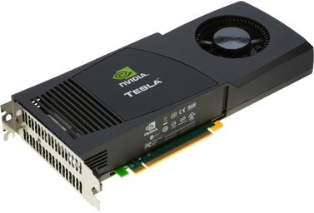
GPGPU
NVIDIA Tesla C1060*
Form Factor | 10.5" x 4.376", Dual Slot
# of Tesla GPUs | 1
# of Streaming Processor Cores | 240
Frequency of processor cores | 1.3 GHz
Single Precision floating point performance (peak) | 933 GFlops
Double Precision floating point performance (peak) | 78 GFlops
Floating Point Precision | IEEE 754 single & double
Total Dedicated Memory | 4 GDDR3
Memory Speed | 1600MHz
Memory Interface | 512-bit
Memory Bandwidth | 102 GB/sec
*http://en.wikipedia.org/wiki/Nvidia_Tesla

Slide 22
GPGPU
NVIDIA Tesla S1070*
# of Tesla GPUs | 4
# of Streaming Processor Cores | 960 (240 per processor)
Frequency of processor cores | 1.296 to 1.44 GHz
Single Precision floating point performance (peak) | 3.73 to 4.14 TFlops
Double Precision floating point performance (peak) | 311 to 345 GFlops
Floating Point Precision | IEEE 754 single & double
Total Dedicated Memory | 16 GDDR3
Memory Interface | 512-bit
Memory Bandwidth | 408 GB/sec
Max Power Consumption | 800 W (typical)

Slide 23
GPGPU
NVIDIA Tesla C2070*
Form Factor | 10.5" x 4.376", Dual Slot
# of Tesla GPUs | 1
# of Streaming Processor Cores | 448
Frequency of processor cores | 1.15 GHz
Single Precision floating point performance (peak) | 1030 GFlops
Double Precision floating point performance (peak) | 515 GFlops
Floating Point Precision | IEEE 754-2008 single & double
Total Dedicated Memory | 6 GDDR5
Memory Speed | 3132MHz
Memory Interface | 384-bit
Memory Bandwidth | 150 GB/sec
*http://en.wikipedia.org/wiki/Nvidia_Tesla

Slide 24
GPGPU
We have the increasing popularity of computer gaming to thank for the development of GPU hardware.
History of GPU hardware lies in support for visualization and display computations.
Hence, traditional GPU architecture leans towards an SIMD parallelization philosophy.

Slide 25
The CUDA Programming Model

Slide 26
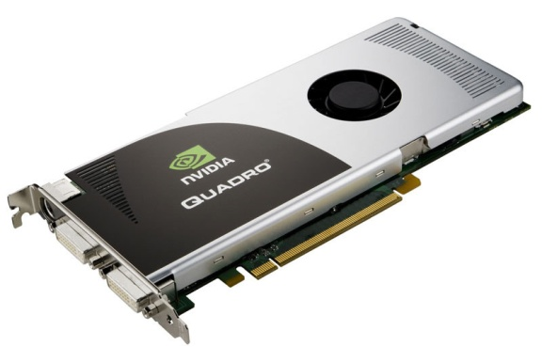
GPU Parallel Code (Friendly version)
1. Allocate memory on HOST

Slide 27

GPU Parallel Code (Friendly version)
2. Allocate memory on DEVICE
Memory Allocated (h_A, h_B)
h_A properly defined

Slide 28
GPU Parallel Code (Friendly version)
3. Copy data from HOST to DEVICE
Memory Allocated (h_A, h_B)
Memory Allocated (d_A, d_B)
h_A properly defined

Slide 29
GPU
GPU Parallel Code (Friendly version)
4. Perform computation on device
Memory Allocated (h_A, h_B)
Memory Allocated (d_A, d_B)
h_A properly defined
d_A properly defined

Slide 30
GPU Parallel Code (Friendly version)
5. Copy data from DEVICE to HOST
Memory Allocated (h_A, h_B)
Memory Allocated (d_A, d_B)
h_A properly defined
d_A properly defined
Computation OK (d_B)

Slide 31

GPU Parallel Code (Friendly version)
6. Free memory on HOST and DEVICE
Memory Allocated (h_A, h_B)
Memory Allocated (d_A, d_B)
h_A properly defined
d_A properly defined
h_B properly defined
Computation OK (d_B)

Slide 32


GPU Parallel Code (Friendly version)
Complete
Memory Allocated (h_A, h_B)
Memory Allocated (d_A, d_B)
h_A properly defined
d_A properly defined
h_B properly defined
Computation OK (d_B)
Memory Freed (h_A, h_B)
Memory Freed (d_A, d_B)

Slide 33
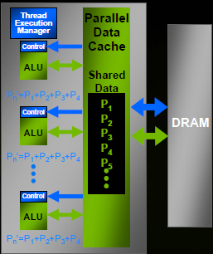
GPU Computing Evolution
The procedure of CUDA program execution
Set a GPU Device ID in Host
Memory transport, Host to Device (H2D)
H2D
D2H
Kernel execution
Device
Host
Memory transport, Device to Host (D2H)
NVIDIA CUDA GPU
parallel execution through cache
Notes:
CPU,GPGPU,Nvidia GPU的資料傳遞,與處理過程說明

Slide 34
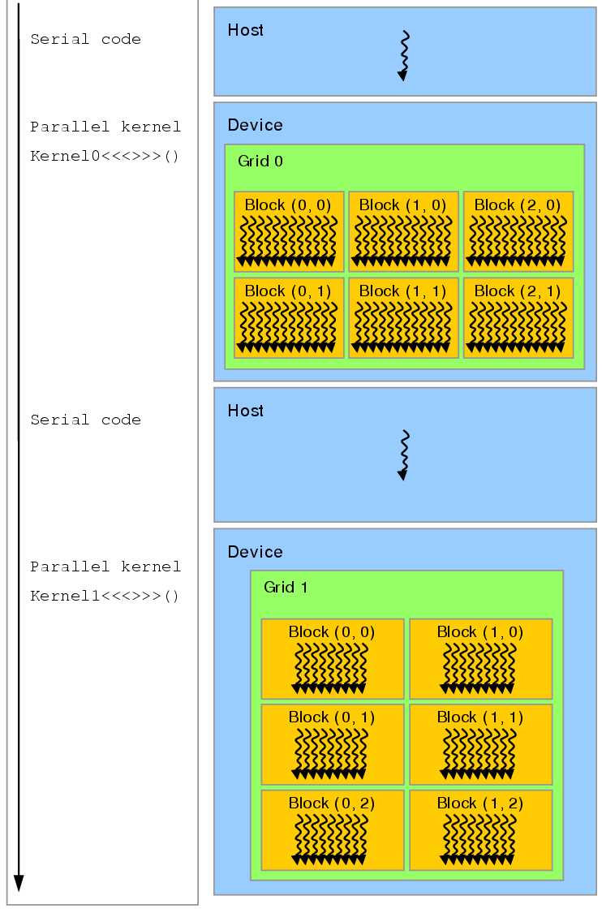

Slide 35
Hardware
Software(OS)
Computer Core
Threads
L1/L2/L3 Cache
Register(local memory)/Data cache/Instruction prefetch
Thread 1
Hyper Threading/ Core overlapping
:
1 Core
Thread 2

Slide 36
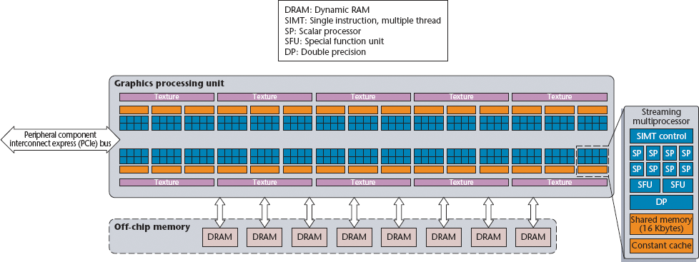
GPGPU
NVIDIA C1060 GPU architecture
Global memory
Jonathan Cohen, Michael Garland, "Solving Computational Problems with GPU Computing," Computing in Science and Engineering, 11 [5], 2009.

Slide 37
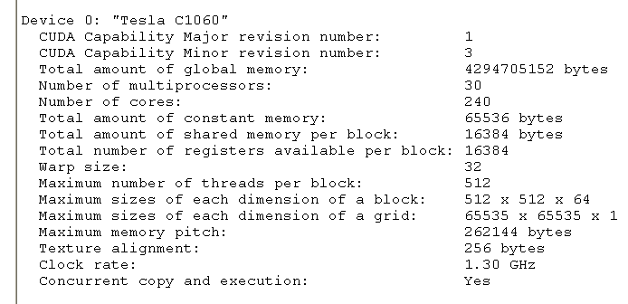

Slide 38
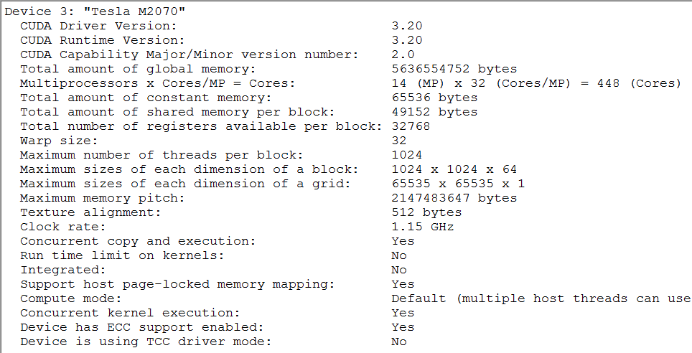

Slide 39
Register
G80 : 8K
GT200 : 16K
Fermi : 32K
16K/48K
64K
6GB, Telsa 2070
Globel memory, non-cache
Notes:
新舊版本SM的內部記憶體比較

Slide 40
CUDA code
The application runs on the CPU (host)‏
Compute intensive parts are delegated to the GPU (device)‏
These parts are written as C functions (kernels)‏
The kernel is executed on the device simultaneously by N threads per block (N<=512, or N<=1024 only for Fermi device)

Slide 41
The CUDA Programming Model
Compute intensive tasks are defined as kernels
The host delegates kernels to the device
The device executes a kernel with N parallel threads
Each thread has a thread ID, a block ID
The thread/block ID is accessible in a kernel via the threadIdx/blockIdx variable
threadIdx
blockIdx
Thread

Slide 42
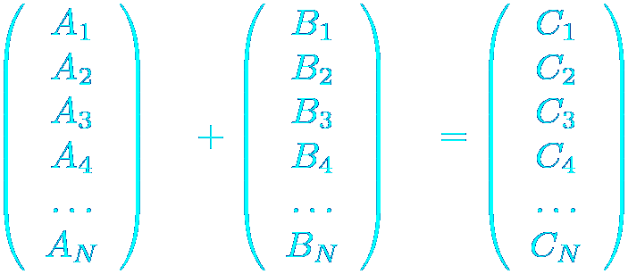
CUDA Thread (SIMD) vs. CPU serial calculation
CPU version
GPU version
Thread 1
Thread 1
Thread 2
Thread 3
Thread 4
Thread 9
Notes:
SIMT模型介紹

Slide 43
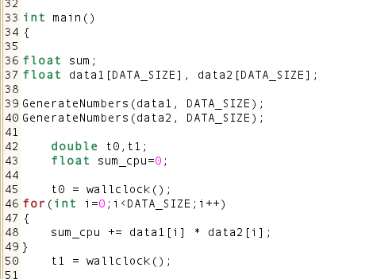
Dot product via C++
SISD (Single Instruction Single Data)
In general, using a “for loop” via one thread in CPU computing.

Slide 44
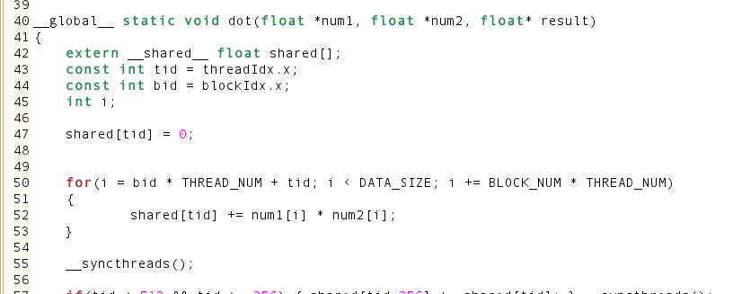
Dot product via CUDA
SIMD (Single Instruction Multiple Data)
Using a “parallel loop” via many threads in GPU computing.

Slide 45
CUDA API

Slide 46
The CUDA API
Minimal extension to C
i.e. CUDA is a C-like computer language.
Consists of a runtime library
CUDA Header file
Host component: runs on host
Device component: runs on device
Common component: runs on both
Only those C functions can run on device that are included in this component

Slide 47
CUDA Header file
cuda.h
Include cuda modulo.
cuda_runtime.h
Include cuda runtime api.

Slide 48
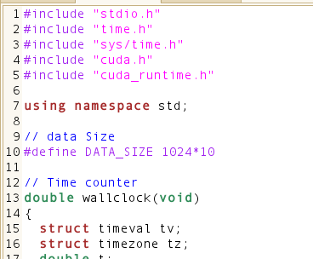
Header file
#include "cuda.h“
CUDA Header file
#include "cuda_runtime.h“
CUDA Runtime API

Slide 49
Device selection (initialize GPU device)
Device Management
cudaSetDevice()‏
Initial GPU code
Sets the device to be used
MUST be set before calling any __global__ function
Device 0 used by default

Slide 50
Device information
See deviceQuery.cu in the deviceQuery project
cudaGetDeviceCount (int* count)‏
cudaGetDeviceProperties (cudaDeviceProp* prop)‏
cudaSetDevice (int device_num)‏
Device 0 set be default

Slide 51
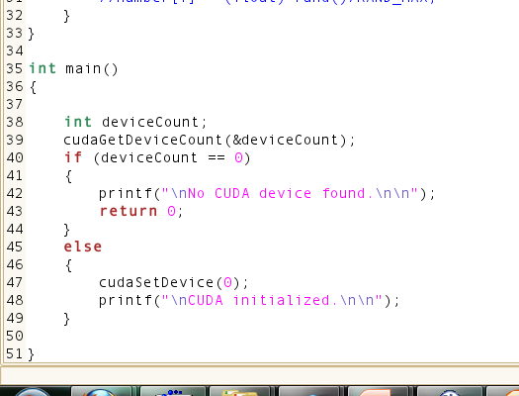
Initialize CUDA Device
cudaGetDeviceCount(&deviceCount);
Get the total number of GPU device
cudaSetDevice(0);
To
initialize the GPU device ID=0.
Maybe ID=0,1,2,3, or others in multiGPU environment .
Notes:
Dot0.cu

Slide 52
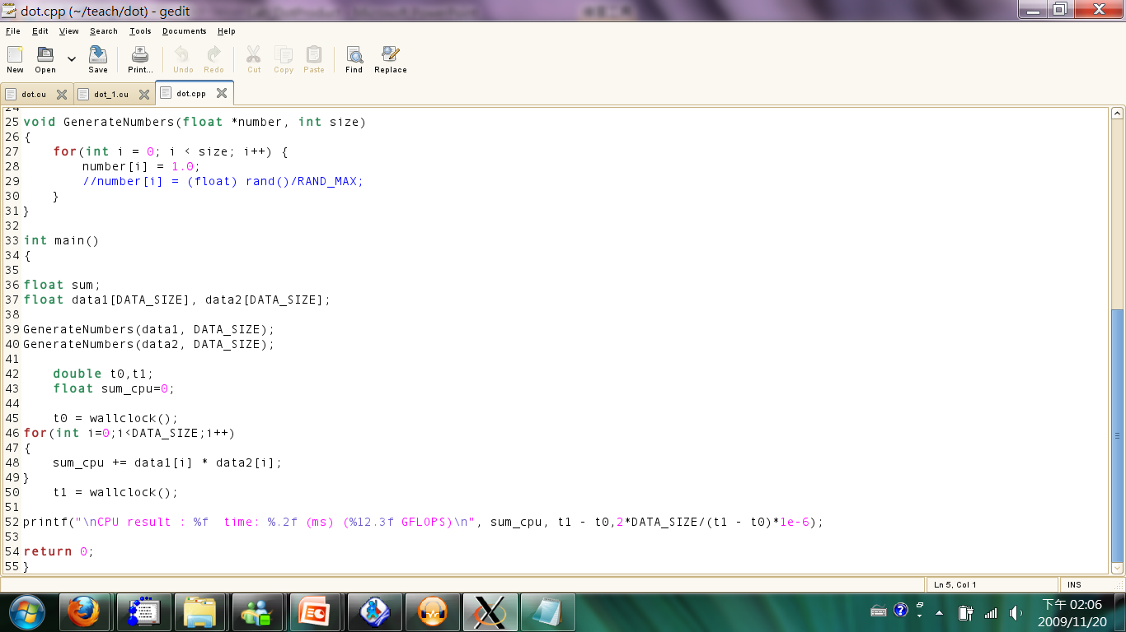
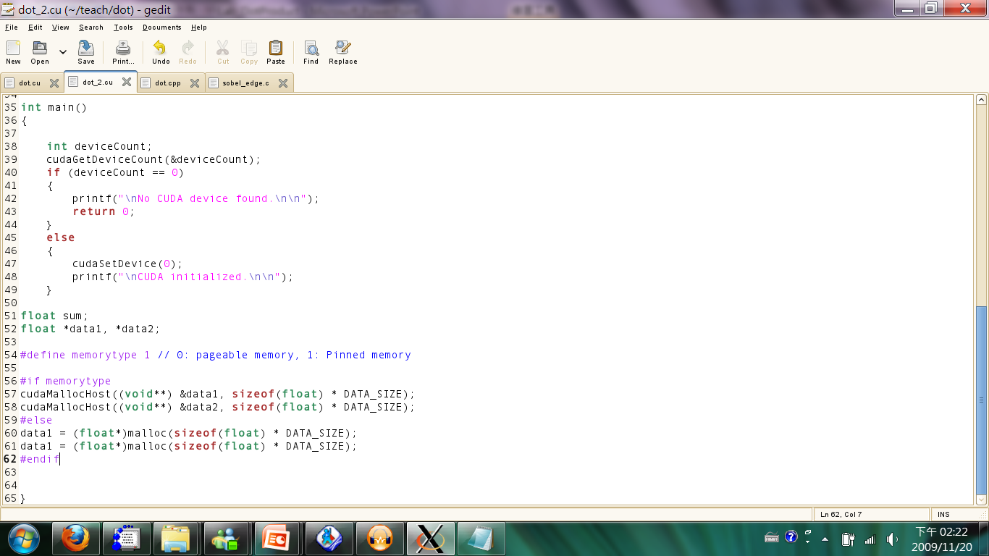
Memory allocation in Host
Create these variables(mean its name) in program register and allocate system memory to the variable.
First Create these variables in program register.
Second, allocate system memory to these variables by Pageable mode
Method I
Method II

Slide 53
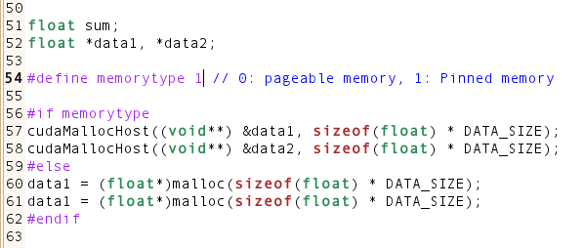
Memory allocation in Host
First, Create some variables(its names) in Host
Second, Allocate GPU device memory to these variables of Host by Pinned memory.
Method III
Notes:
Dot1.cu

Slide 54
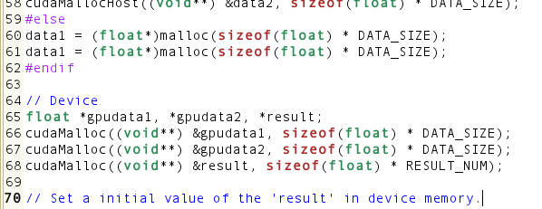
Memory allocation in Device
data1 <> gpudata1
data2 <> gpudata2
sum <> result (array)
RESULT_NUM is equal to the block number
Notes:
Dot2.cu

Slide 55
Memory Management
Memory transfers in both Host and Devcie
cudaMemcpy( void* dst, const void* src, size_t count, enum cudaMemcpyKind kind)
Copies count bytes from the memory area pointed to by src to the memory area pointed to by dst,
where kind is one of cudaMemcpyHostToHost, cudaMemcpyHostToDevice, cudaMemcpyDeviceToHost, or cudaMemcpyDeviceToDevice specifies the direction of the copy
The memory areas may not overlap
Calling cudaMemcpy() with dst and src pointers that do not match the direction of the copy results in an undefined behavior.

Slide 56
Memory Management
Pointer : dst,src
Integer : count
Memory transfers from Device(dst) to Host(src)
E.g. cudaMemcpy(dst, src, count, cudaMemcpyDeviceToHost)
Memory transfers from Host(src) to Device(dst)
E.g. cudaMemcpy(dst, src, count, cudaMemcpyHostToDevice)

Slide 57
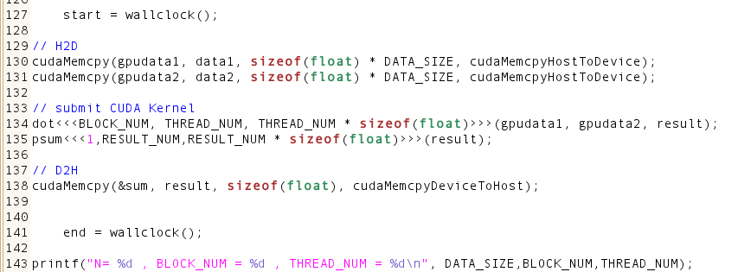
Memory copy
Host to Device
Device to Host
Notes:
Dot3.cu

Slide 58
Device component
Extensions to C
4 extensions
Function type qualifiers
__global__ void , __device__ , __host__
Variable type qualifiers
Kernel calling directive
5 built-in variables
Don’t suppose recursion in kernel function ( __device__ , __global__ )
Notes:
如何定義function 是屬於device還是host還是共有的

Slide 59
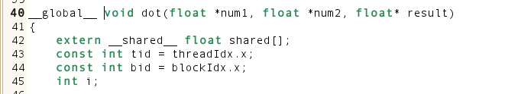
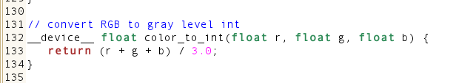
Function type qualifiers
__global__ void
__device__
__host__
: GPU Kernel
: GPU Function

Slide 60
Variable type qualifiers
__device__
Resides in global memory
Lifetime of the application
Accessible from
All threads in the grid
Can be used with __constant__

Slide 61
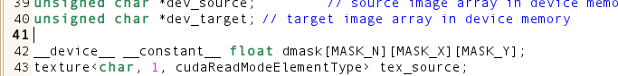
Variable type qualifiers
__constant__
Resides in constant memory
Lifetime of the application
Accessible from
All threads in the grid
Host
Can be used with __device__

Slide 62
Variable type qualifiers
__shared__
Resides in shared memory
Lifetime of the block
Accessible from
All threads in the block
Can be used with __device__
Values assigned to __shared__ variables are guaranteed to be visible to other threads in the block only after a call to __syncthreads()‏

Slide 63
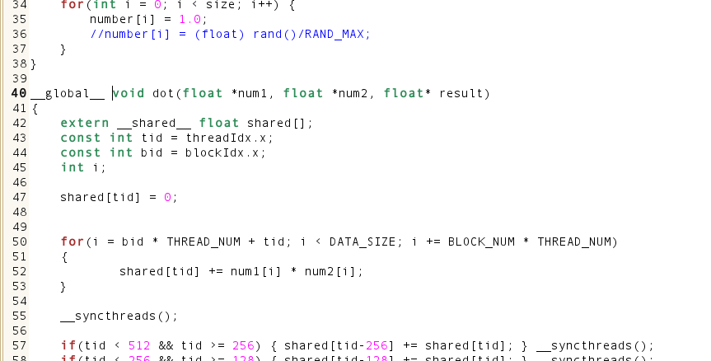
Shared memory in a block/thread of GPU Kernels

Slide 64
Variable type qualifiers - caveat
__constant__ variables are read only from device code
Can be set through host
__shared__ variables cannot be initialized on declaration
Unqualified variables in device code are created in registers
Large structures may be placed in local memory, SLOW

Slide 65
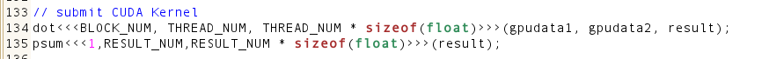
Kernel calling directive
Must for calls to __global__ functions
Specifies
Number of threads that will execute the function
Amount of shared memory to be allocated per block, optional

Slide 66
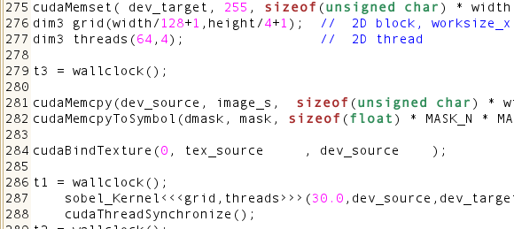
Kernel execution
Maximum number of threads is 512 (Fermi : 1024)
2D blocks/ 2D threads

Slide 67
The CUDA API
Extensions to C
4 extensions
Function type qualifiers
__global__ void , __device__ , __host__
Variable type qualifiers
Kernel calling directive
5 built-in variables
Don’t suppose recursion in kernel function ( __device__ , __global__ )

Slide 68
5 built-in variables
gridDim
Of type dim3
Contains grid dimensions
Max : 65535 x 65535 x 1
blockDim
Of type dim3
Contains block dimensions
Max : 512x512x64
Fermi : 1024x1024x64

Slide 69
5 built-in variables
blockIdx
Of type uint3
Contains block index in the grid
threadIdx
Of type uint3
Contains thread index in the block
Max : 512, Fermi : 1024
warpSize
Of type int
Contains #threads in a warp

Slide 70
5 built-in variables - caveat
Cannot have pointers to these variables
Cannot assign values to these variables

Slide 71
CUDA Runtime component
Used by both host and device
Built-in vector types
char1, uchar1, char2, uchar2, char3, uchar3, char4, uchar4, short1, ushort1, short2, ushort2, short3, ushort3, short4, ushort4, int1, uint1, int2, uint2, int3, uint3, int4, uint4, long1, ulong1, long2, ulong2, long3, ulong3, long4, ulong4, float1, float2, float3, float4, double2
Default constructors float a,b,c,d; float4 f4 = make_float4 (a,b,c,d); // f4.x=a f4.y=b f4.z=c f4.w=d

Slide 72
CUDA Runtime component
Built-in vector types
dim3
Based on uint3
Uninitialized values default to 1
Math functions
Full listing in Appendix B of programming guide
Single and Double (sm>= 1.3) precision floating point functions

Slide 73
Compiler & optimization

Slide 74
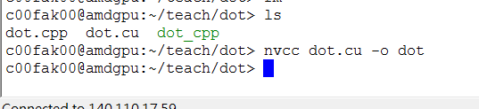
The NVCC compiler (Linux/Windows command mode)
Separates device code and host code
Compiles device code into binary, cubin object
Host code is compiled by some other tool, e.g. g++
Nvcc <file> -o <output file> -lcuda

Slide 75
Memory optimizations
cudaMallocHost() instead of malloc()‏
cudaFreeHost() instead of free()‏
Use with caution
Pinning too much memory leaves little memory for the system

Slide 76
Synchronization

Slide 77
Synchronization
All kernel launches are asynchronous
Control returns to host immediately
Kernel executes after all previous CUDA calls have completed
Host and device can run simultaneously

Slide 79
Synchronization
cudaMemcpy() is synchronous
Control returns to host after copy completes
Copy starts after all previous CUDA calls have completed
cudaThreadSynchronize()
Blocks until all previous CUDA calls complete

Slide 80
Synchronization
__syncthreads or cudaThreadSynchronize ?
__syncthreads()‏
Invoked from within device code
Synchronizes all threads in a block
Used to avoid inconsistencies in shared memory
cudaThreadSynchronize()‏
Invoked from within host code
Halts execution until device is free

Slide 81
Dot product via CUDA

Slide 82
CUDA programming – step-by-step
Initialize GPU device
Memory allocation on CPU and GPU
Initialize data on host/CPU and Device/GPU
Memory copy
Build your CUDA Kernels
Submit kernels
Receive these results from GPU device

Slide 83
Dot product in C/C++

Slide 84
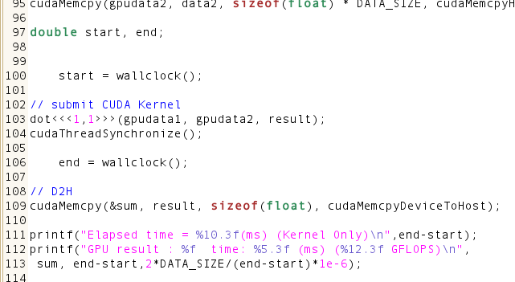
One block and one thread
Timer
Block=1, thread=1
Synchronize in Host
Output the result
Notes:
Dot4.cu

Slide 85
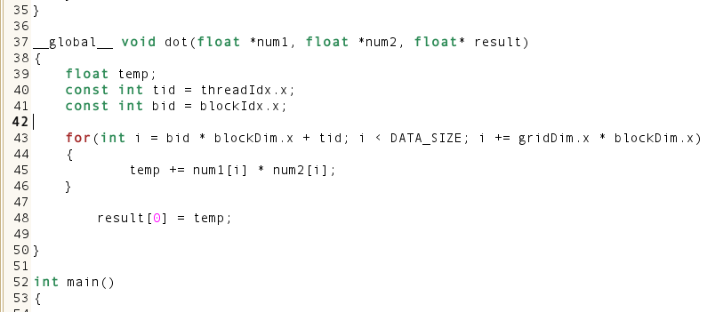
One block and one thread
CUDA kernel : dot
Notes:
Dot4.cu

Slide 86
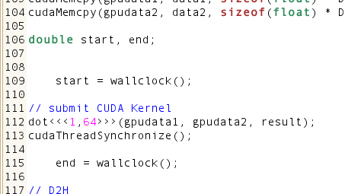
One block and many threads
Use 64 threads in one block
Notes:
Dot5.cu

Slide 87
Parallel loop for dot product
data :
10 | 1 | 8 | -1 | 0 | -2 | 3 | 5 | -2 | -3 | 2 | 7 | 0 | 11 | 0 | 2
Thread ID :
0
1
2
3
4
5
6
7

Slide 88
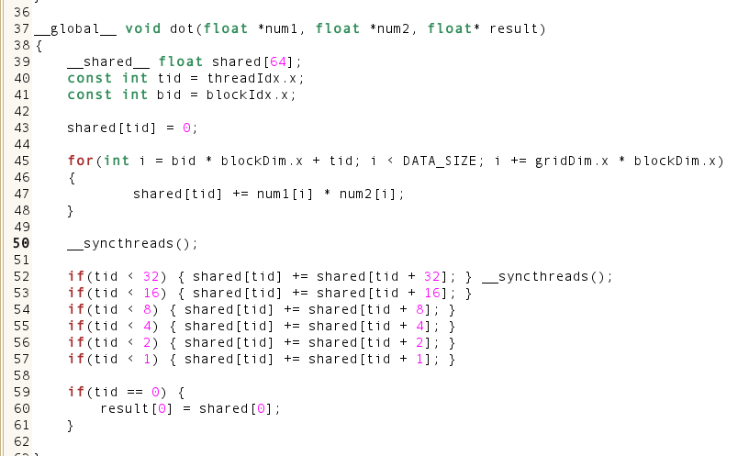
Reduction using shared memory
Add ‘shared memory’
Initial the shared memory by 64 threads (tid)
Synchronize all threads in a block
Reduction by using shared memory
Notes:
Dot5.cu

Slide 89
Parallel Reduction
Tree-based approach used within each thread block
Need to be able to use multiple thread blocks
To process very large arrays
To keep all multiprocessors on the GPU busy
Each thread block reduces a portion of the array
But how do we communicate partial results between thread blocks?
3
1
7
0
4
1
6
3
4
7
5
9
11
14
25
From CUDA SDK ‘reduction’

Slide 90
Parallel Reduction: Interleaved Addressing
Values (shared memory)
10 | 1 | 8 | -1 | 0 | -2 | 3 | 5 | -2 | -3 | 2 | 7 | 0 | 11 | 0 | 2
Step 1 Stride 1
Thread IDs
0
2
4
6
8
10
12
14
Values
11 | 1 | 7 | -1 | -2 | -2 | 8 | 5 | -5 | -3 | 9 | 7 | 11 | 11 | 2 | 2
Step 2 Stride 2
Thread IDs
0
4
8
12
Values
18 | 1 | 7 | -1 | 6 | -2 | 8 | 5 | 4 | -3 | 9 | 7 | 13 | 11 | 2 | 2
Step 3 Stride 4
Thread IDs
0
8
Values
24 | 1 | 7 | -1 | 6 | -2 | 8 | 5 | 17 | -3 | 9 | 7 | 13 | 11 | 2 | 2
Step 4 Stride 8
Thread IDs
0
Values
41 | 1 | 7 | -1 | 6 | -2 | 8 | 5 | 17 | -3 | 9 | 7 | 13 | 11 | 2 | 2
From CUDA SDK ‘reduction’

Slide 91
Values (shared memory)
10 | 1 | 8 | -1 | 0 | -2 | 3 | 5 | -2 | -3 | 2 | 7 | 0 | 11 | 0 | 2
Step 1 Stride 8
Thread IDs
0
1
2
3
4
5
6
7
Values
8 | -2 | 10 | 6 | 0 | 9 | 3 | 7 | -2 | -3 | 2 | 7 | 0 | 11 | 0 | 2
Step 2 Stride 4
Thread IDs
0
1
2
3
Values
8 | 7 | 13 | 13 | 0 | 9 | 3 | 7 | -2 | -3 | 2 | 7 | 0 | 11 | 0 | 2
Step 3 Stride 2
Thread IDs
0
1
Values
21 | 20 | 13 | 13 | 0 | 9 | 3 | 7 | -2 | -3 | 2 | 7 | 0 | 11 | 0 | 2
Step 4 Stride 1
Thread IDs
0
Values
41 | 20 | 13 | 13 | 0 | 9 | 3 | 7 | -2 | -3 | 2 | 7 | 0 | 11 | 0 | 2
From CUDA SDK ‘reduction’

Slide 92
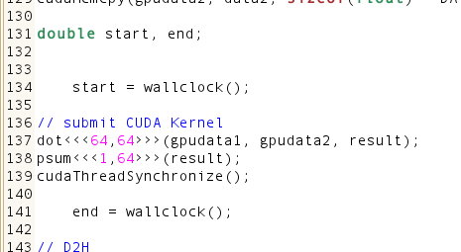
Many blocks and many threads
64 blocks and 64 threads per block
Sum all result from these blocks
Notes:
Dot6.cu

Slide 93
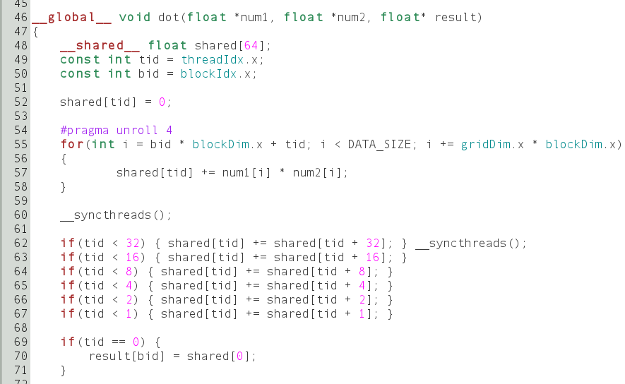
Dot Kernel

Slide 94

Reduction kernel : psum
Notes:
Dot6.cu

Slide 95
Monte-Carlo Method via CUDA
Pi estimation

Slide 96

Figure 1

Slide 97
Assuming the following
Ux, Uy are two random variables from Uniform [0,1] , these sampling data of Ux and Uy can be written as
The indicator Function will be defined by

Slide 98
Monte-Carlo Sampling
Points An(Ux,Uy) are samples in the area of figure 1, we can estimate circle measure by the probability value which a point is inside of the circle.
The probability value P = =

Slide 99
Algorithm of CUDA
Everything is as the same as dot product.

Slide 100


CUDA codes (RNG on CPU and GPU)
* Simulation (Statistical Modeling and Decision Science) (4th Revised edition)

Slide 101

CUDA codes (Sampling function)

Slide 102

CUDA codes (Pi)

Slide 103
Questions ?

Slide 104
For more information, contact:
Fang-An Kuo (NCHC)
Email: mathppp@nchc.narl.org.tw mathppp@gmail.com

