Slide 1
Review of Elementary Probability Theory
Chuan-Hsiang Han
September 30, 2009

Slide 2
1. Probability Space
For any given random experiment, the set Ω is defined by the collection of all possible random outcomes of that experiment. Each outcome is called “sample” and Ω is called “sample space.”

Slide 3
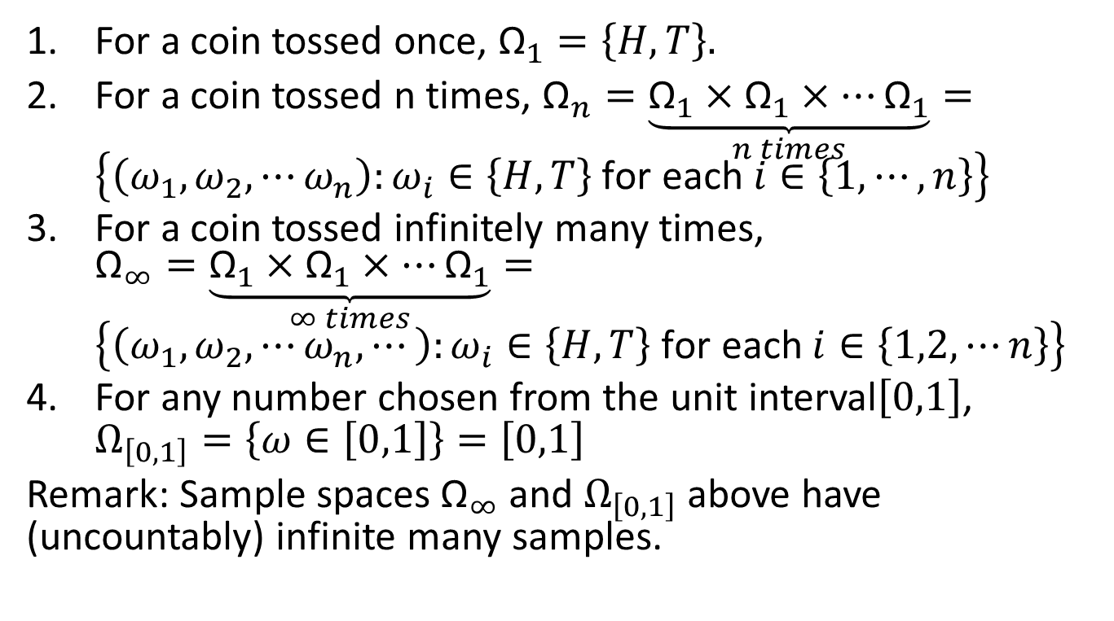
Example 1
For a coin tossed once, ${\text{Ω}}_{1}=\left\{H,T\right\}.$
For a coin tossed n times, ${\text{Ω}}_{n}=\underset{n times}{\underbrace{{\text{Ω}}_{1}×{\text{Ω}}_{1}×⋯{\text{Ω}}_{1}}}=\left\{\left(ω_{1},ω_{2},⋯ω_{n}\right):ω_{i}∈\left\{H,T\right\} \text{for} \text{each} i∈\left\{1,⋯,n\right\}\right\}$
For a coin tossed infinitely many times, ${\text{Ω}}_{∞}=\underset{∞ times}{\underbrace{{\text{Ω}}_{1}×{\text{Ω}}_{1}×⋯{\text{Ω}}_{1}}}=\left\{\left(ω_{1},ω_{2},⋯ω_{n},⋯\right):ω_{i}∈\left\{H,T\right\} \text{for} \text{each} i∈\left\{1,2,⋯n\right\}\right\}$
For any number chosen from the unit interval$\left[0,1\right]$, $Ω_{\left[0,1\right]}=\left\{ω∈\left[0,1\right]\right\}=\left[0,1\right]$
Remark: Sample spaces ${\text{Ω}}_{∞}$ and $Ω_{\left[0,1\right]}$ above have (uncountably) infinite many samples.

Slide 4
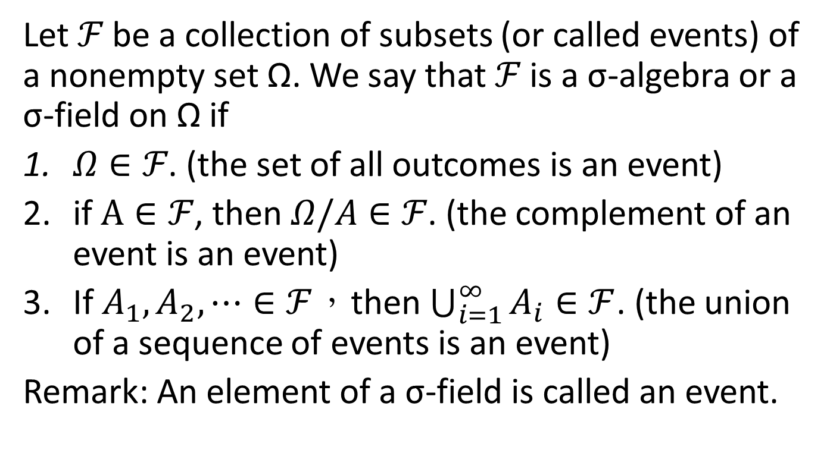
Definition 1
Let $ℱ$ be a collection of subsets (or called events) of a nonempty set Ω. We say that $ℱ$ is a σ-algebra or a σ-field on Ω if
$Ω∈ℱ$. (the set of all outcomes is an event)
if $A∈ℱ$, then $Ω/A∈ℱ$. (the complement of an event is an event)
If $A_{1},A_{2},⋯∈ℱ$，then $\bigcup_{i=1}^{∞}{A_{i}}∈ℱ$. (the union of a sequence of events is an event)
Remark: An element of a σ-field is called an event.

Slide 5
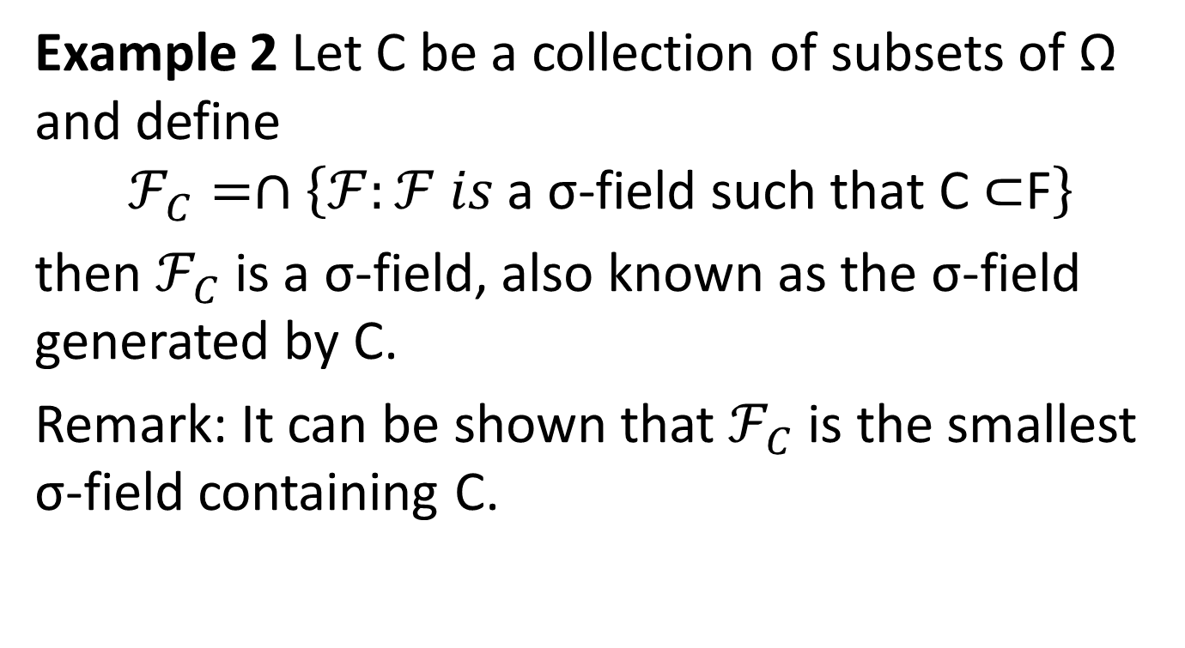
Example 2 Let C be a collection of subsets of Ω and define
$$ℱ_{C}=∩\left\{ℱ:ℱ is \text{a} \text{σ}\text{−}\text{field} \text{such} \text{that} \text{C}\text{ ⊂}\text{F}\right\}$$
then $ℱ_{C}$ is a σ-field, also known as the σ-field generated by C.
Remark: It can be shown that $ℱ_{C}$ is the smallest σ-field containing C.

Slide 6
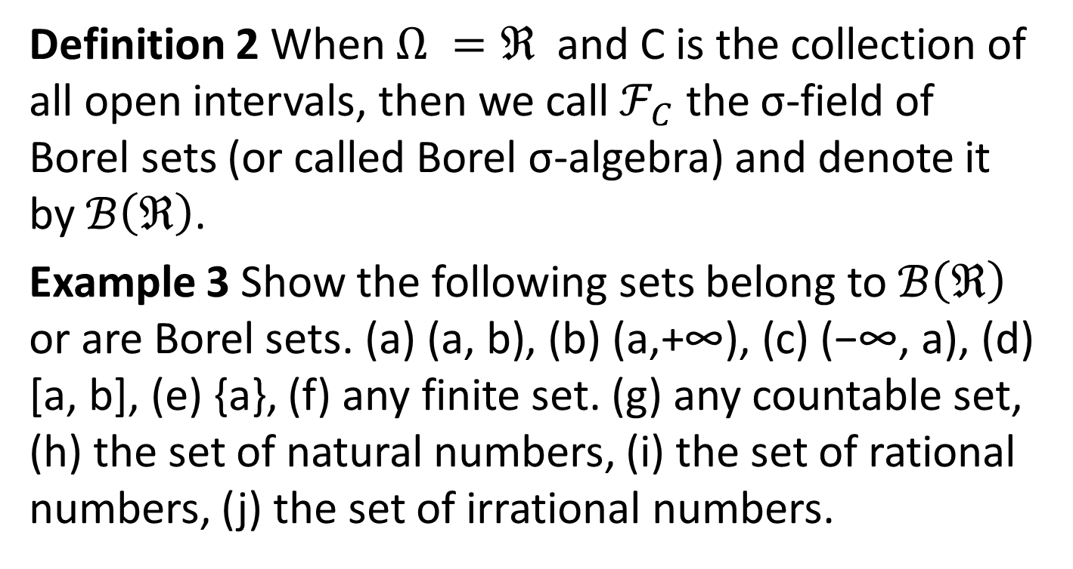
Definition 2 When $Ω =ℜ$ and C is the collection of all open intervals, then we call $ℱ_{C}$ the σ-field of Borel sets (or called Borel σ-algebra) and denote it by $ℬ\left(ℜ\right)$.
Example 3 Show the following sets belong to $ℬ\left(ℜ\right)$ or are Borel sets. (a) (a, b), (b) (a,+∞), (c) (−∞, a), (d) [a, b], (e) {a}, (f) any finite set. (g) any countable set, (h) the set of natural numbers, (i) the set of rational numbers, (j) the set of irrational numbers.

Slide 7
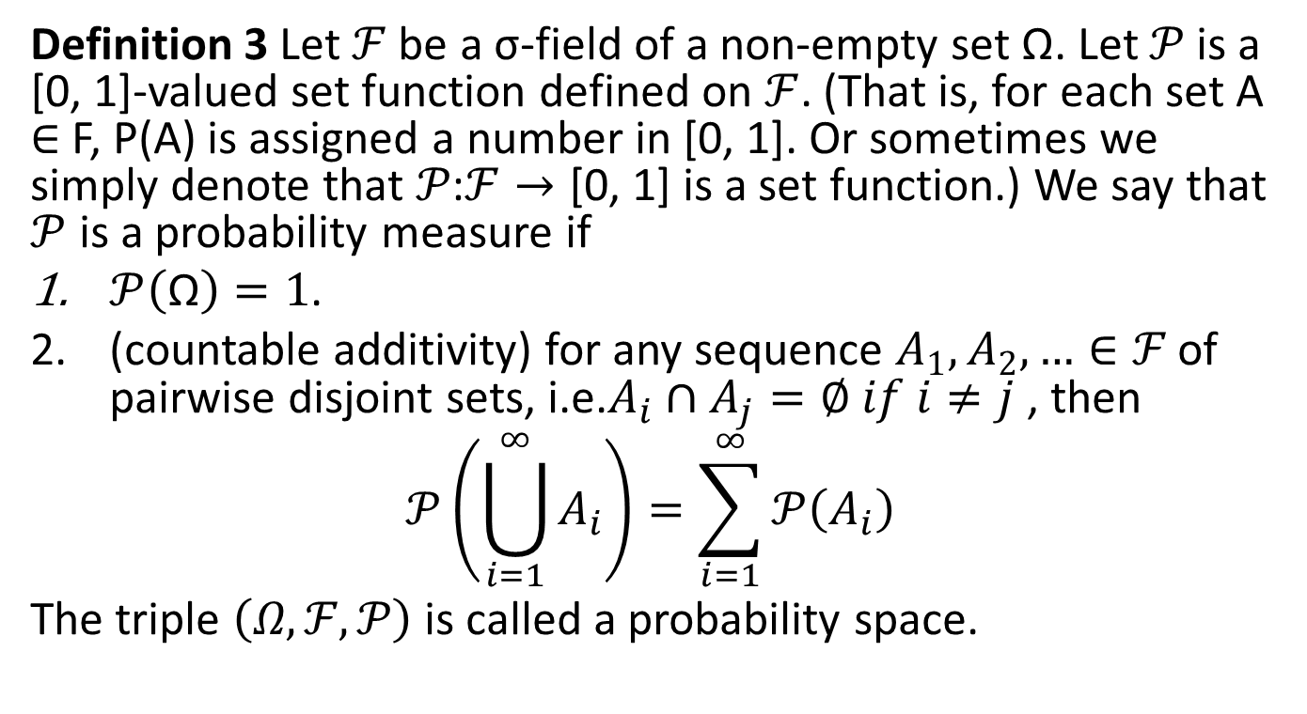
Definition 3 Let $ℱ$ be a σ-field of a non-empty set Ω. Let $𝒫$ is a [0, 1]-valued set function defined on $ℱ$. (That is, for each set A ∈ F, P(A) is assigned a number in [0, 1]. Or sometimes we simply denote that $𝒫\text{:}ℱ→\text{[0, 1]}$ is a set function.) We say that $𝒫$ is a probability measure if
$𝒫\left(\text{Ω}\right)=1$.
(countable additivity) for any sequence $A_{1},A_{2},…∈ℱ$ of pairwise disjoint sets, i.e.$A_{i}∩A_{j}=∅ if i≠j$ , then
$$𝒫\left(\bigcup_{i=1}^{∞}{A_{i}}\right)=\sum_{i=1}^{∞}{𝒫\left(A_{i}\right)}$$
The triple $\left(Ω,ℱ,𝒫\right)$ is called a probability space.

Slide 8
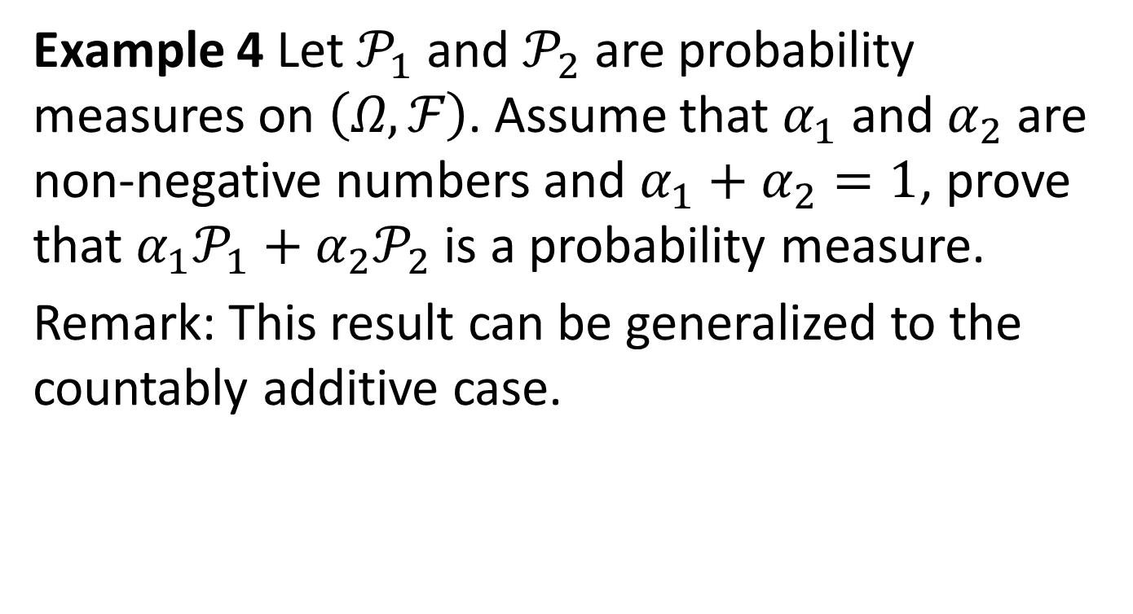
Example 4 Let $𝒫_{1}$ and $𝒫_{2}$ are probability measures on $\left(Ω,ℱ\right)$. Assume that $α_{1}$ and $α_{2}$ are non-negative numbers and $α_{1}+α_{2}=1$, prove that $α_{1}𝒫_{1}+α_{2}𝒫_{2}$is a probability measure.
Remark: This result can be generalized to the countably additive case.

Slide 9
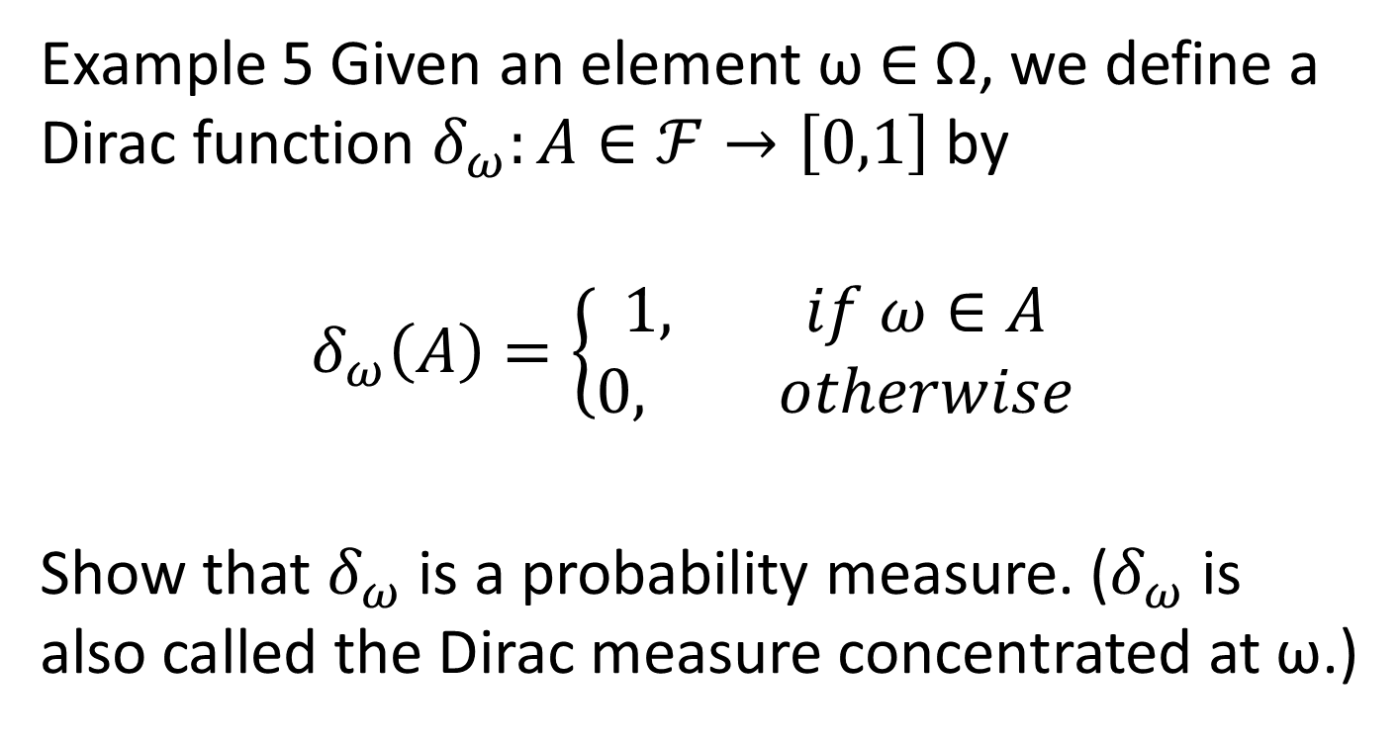
Example 5 Given an element ω ∈ Ω, we define a Dirac function $δ_{ω}:A∈ℱ→\left[0,1\right]$ by
$$δ_{ω}\left(A\right)=\left\{\begin{aligned}1, if ω∈A \\ &0, otherwise\end{aligned}\right.$$
Show that $δ_{ω}$ is a probability measure. ($δ_{ω}$ is also called the Dirac measure concentrated at ω.)

Slide 10
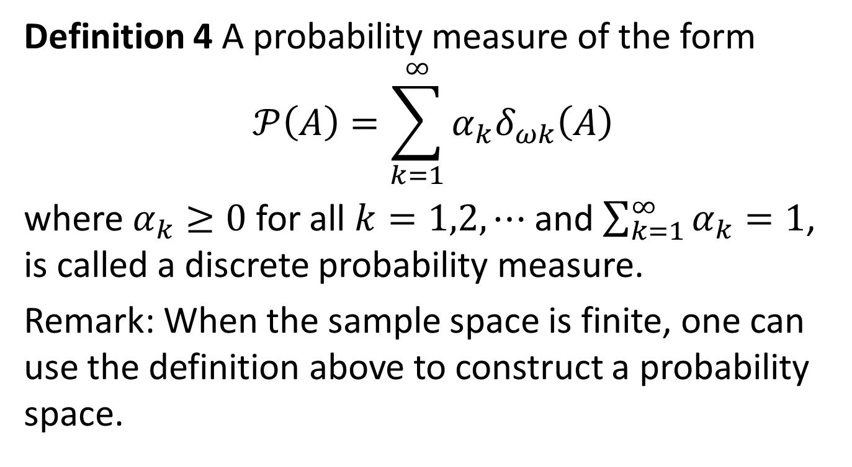
Definition 4 A probability measure of the form
$$𝒫\left(A\right)=\sum_{k=1}^{∞}{α_{k}δ_{ωk}\left(A\right)}$$
where $α_{k}≥0$ for all $k=1,2,⋯$ and $\sum_{k=1}^{∞}{α_{k}=1}$, is called a discrete probability measure.
Remark: When the sample space is finite, one can use the definition above to construct a probability space.

Slide 11
Example 6 (Construction of infinite probability space) check example 1.1.4 in the textbook. (Note that one can use the notion of product probability to define a probability in an infinite space.)

Slide 12
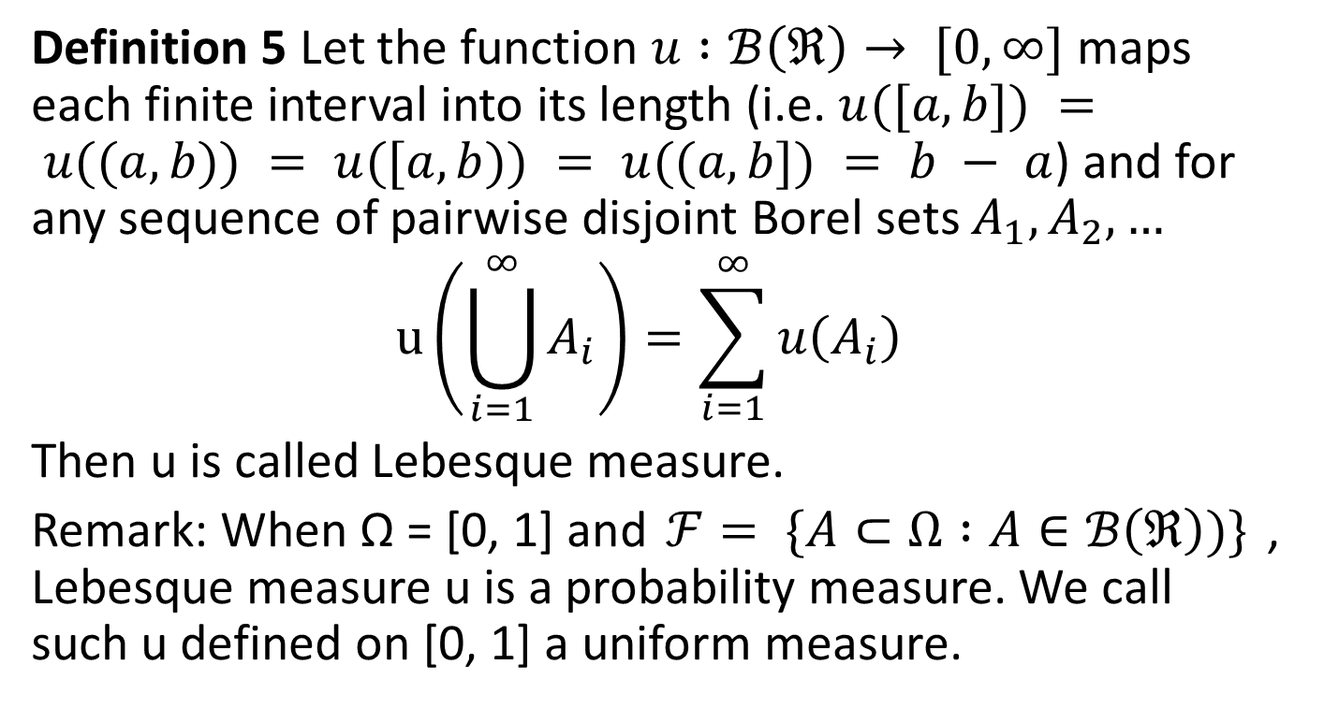
Definition 5 Let the function $u :ℬ\left(ℜ\right)→ [0,∞]$maps each finite interval into its length (i.e. $u([a, b]) = u((a, b)) = u([a, b)) = u((a, b]) = b − a$) and for any sequence of pairwise disjoint Borel sets $A_{1},A_{2},…$
$$u\left(\bigcup_{i=1}^{∞}{A_{i}}\right)=\sum_{i=1}^{∞}{u\left(A_{i}\right)}$$
Then u is called Lebesque measure.
Remark: When Ω = [0, 1] and $ℱ= \{A⊂Ω :A∈ℬ\left(ℜ\right))\}$, Lebesque measure u is a probability measure. We call such u defined on [0, 1] a uniform measure.

Slide 13
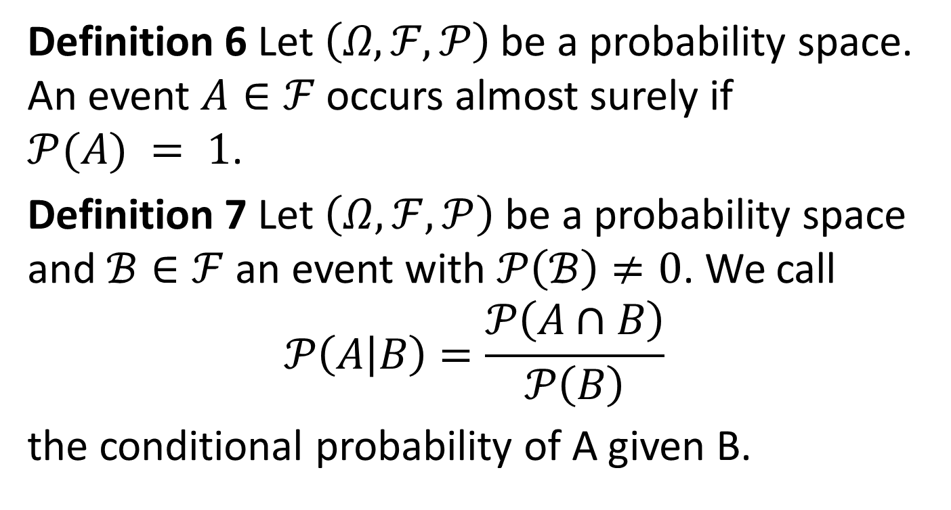
Definition 6 Let $\left(Ω,ℱ,𝒫\right)$be a probability space. An event $A∈ℱ$occurs almost surely if $𝒫(A) = 1$.
Definition 7 Let $\left(Ω,ℱ,𝒫\right)$ be a probability space and $ℬ∈ℱ$an event with $𝒫\left(ℬ\right)≠0$. We call
$$𝒫\left(A\left|B\right.\right)=\frac{𝒫\left(A∩B\right)}{𝒫\left(B\right)}$$
the conditional probability of A given B.

Slide 14
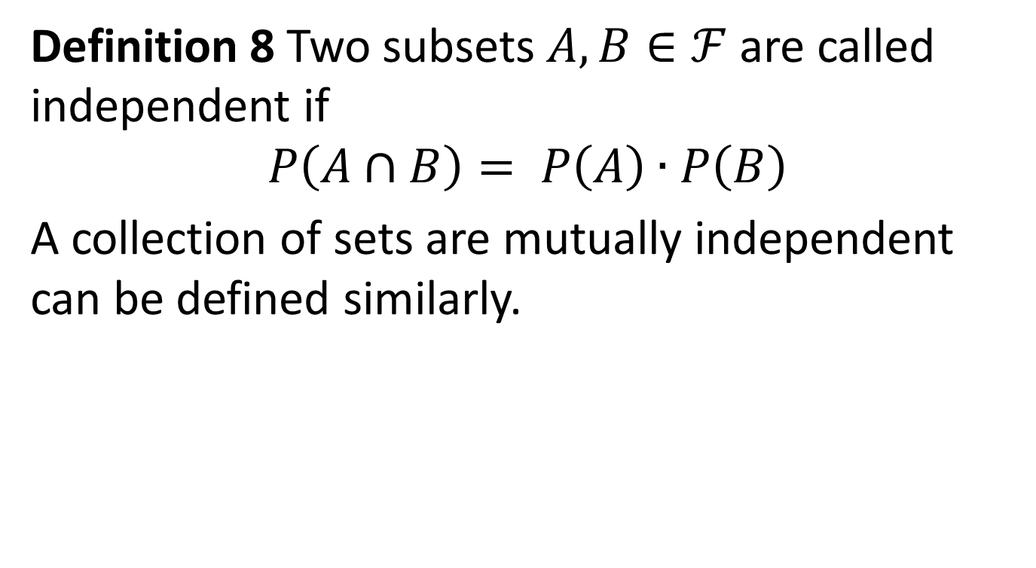
Definition 8 Two subsets $A,B∈ℱ$are called independent if
$$P\left(A∩B\right)= P\left(A\right)∙P\left(B\right)$$
A collection of sets are mutually independent can be defined similarly.

Slide 15
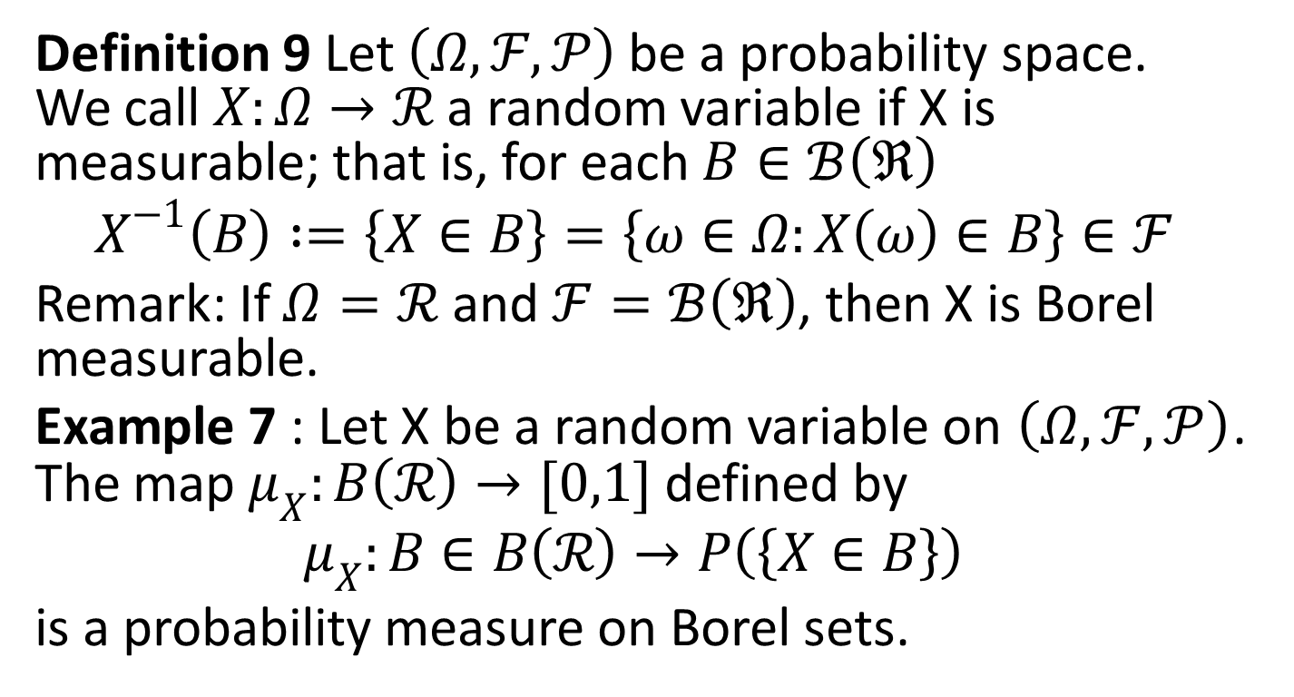
2. Random Variables and Distributions
Definition 9 Let $\left(Ω,ℱ,𝒫\right)$be a probability space. We call $X:Ω→ℛ$ a random variable if X is measurable; that is, for each $B∈ℬ\left(ℜ\right)$
$$X^{−1}\left(B\right)∶=\left\{X∈B\right\}=\left\{ω∈Ω:X\left(ω\right)∈B\right\}∈ℱ$$
Remark: If $Ω=ℛ$and $ℱ=ℬ\left(ℜ\right)$, then X is Borel measurable.
Example 7 : Let X be a random variable on $\left(Ω,ℱ,𝒫\right)$. The map $μ_{X}:B\left(ℛ\right)→[0,1]$ defined by
$$μ_{X}:B∈B\left(ℛ\right)→P\left(\left\{X∈B\right\}\right)$$
is a probability measure on Borel sets.

Slide 16
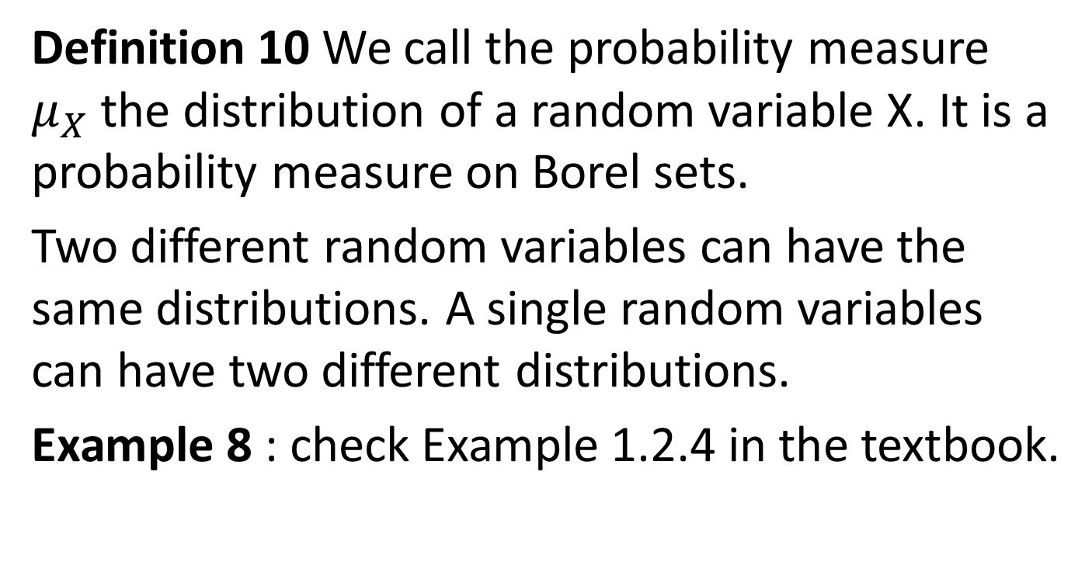
Definition 10 We call the probability measure $μ_{X}$ the distribution of a random variable X. It is a probability measure on Borel sets.
Two different random variables can have the same distributions. A single random variables can have two different distributions.
Example 8 : check Example 1.2.4 in the textbook.

Slide 17
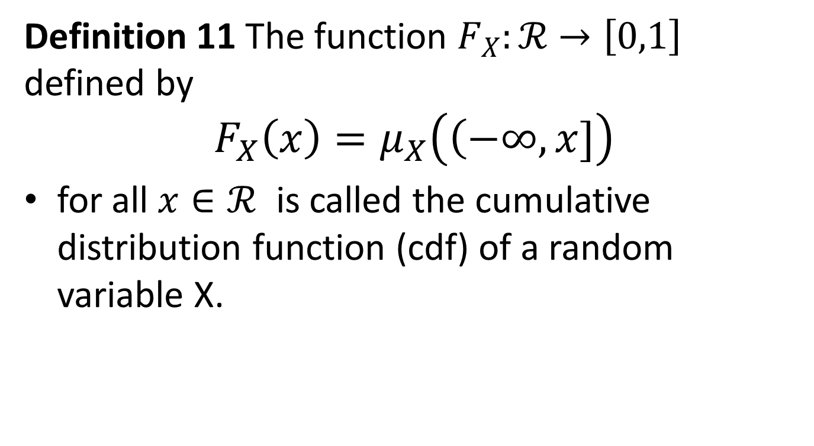
Definition 11 The function $F_{X}:ℛ→\left[0,1\right]$ defined by
$$F_{X}\left(x\right)=μ_{X}\left(\left(−∞,x]\right.\right)$$
for all $x∈ℛ$ is called the cumulative distribution function (cdf) of a random variable X.

Slide 18
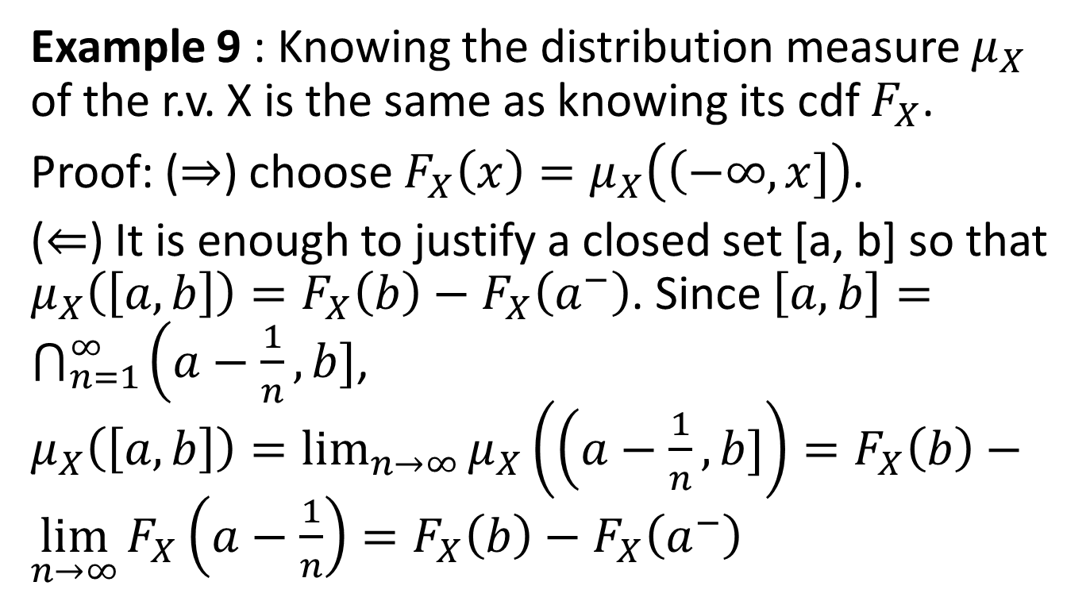
Example 9 : Knowing the distribution measure $μ_{X}$ of the r.v. X is the same as knowing its cdf $F_{X}$.
Proof: (⇒) choose $F_{X}\left(x\right)=μ_{X}\left(\left(−∞,x]\right.\right)$.
(⇐) It is enough to justify a closed set [a, b] so that $μ_{X}\left(\left[a, b\right]\right)=F_{X}\left(b\right)−F_{X}\left(a^{−}\right)$. Since $\left[a, b\right]=\bigcap_{n=1}^{∞}{\left(a−\frac{1}{n},b]\right.}$, $μ_{X}\left(\left[a, b\right]\right)=\lim_{n→∞}{μ_{X}\left(\left(a−\frac{1}{n},b]\right.\right)}=F_{X}\left(b\right)−\lim_{n→∞}{F_{X}\left(a−\frac{1}{n}\right)}=F_{X}\left(b\right)−F_{X}\left(a^{−}\right)$

Slide 19
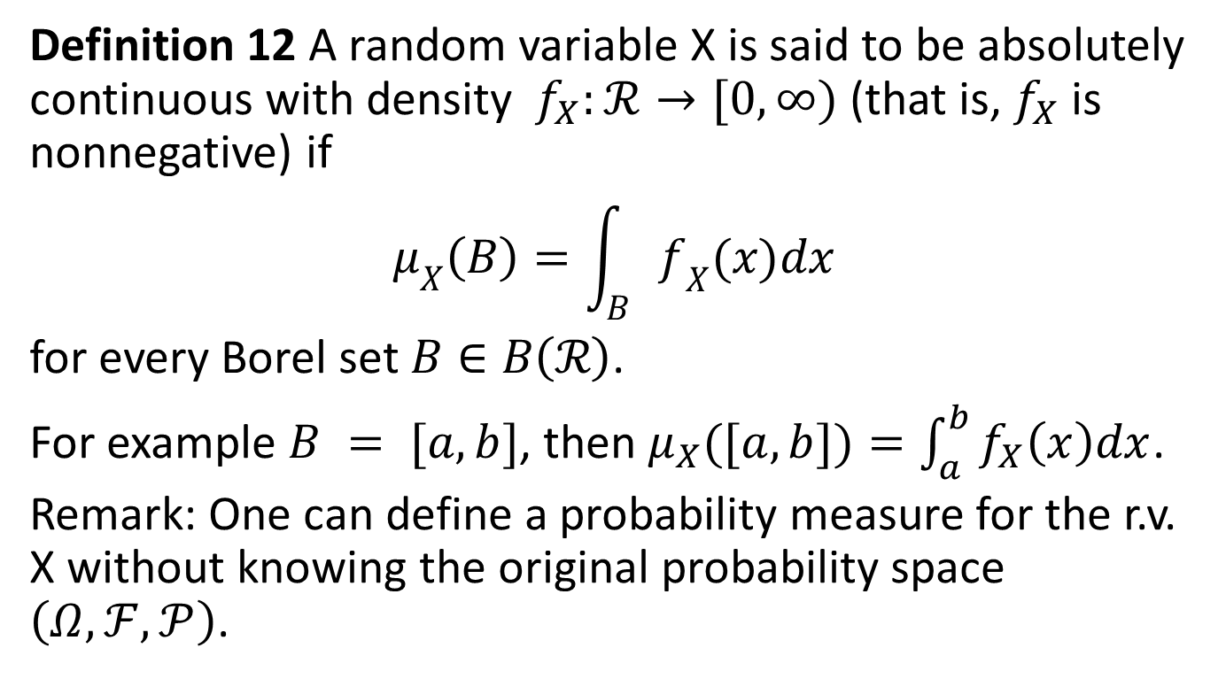
Definition 12 A random variable X is said to be absolutely continuous with density $f_{X}:ℛ→[0,∞)$(that is, $f_{X}$ is nonnegative) if
$$μ_{X}\left(B\right)=\int_{B}{f_{X}(x)dx}$$
for every Borel set $B∈B\left(ℛ\right)$.
For example $B = [a, b]$, then $μ_{X}([a, b])=\int_{a}^{b}{f_{X}\left(x\right)dx}$.
Remark: One can define a probability measure for the r.v. X without knowing the original probability space $\left(Ω,ℱ,𝒫\right)$.

Slide 20
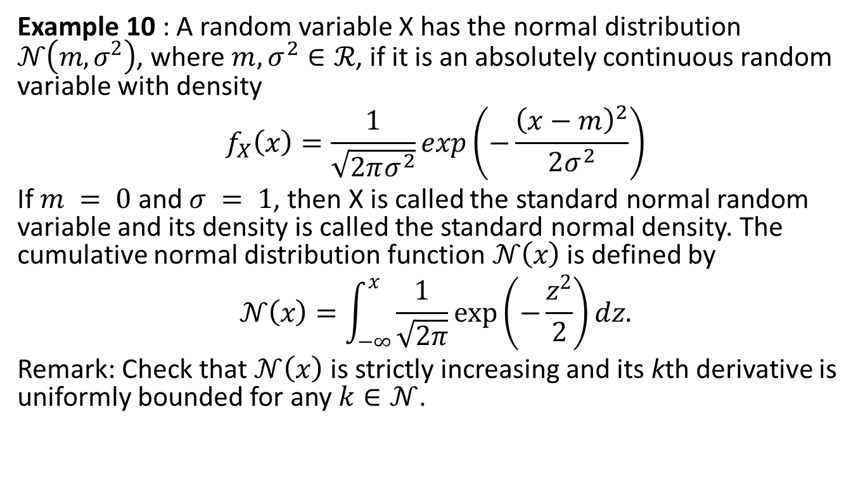
Example 10 : A random variable X has the normal distribution $𝒩\left(m,σ^{2}\right)$, where $m,σ^{2}∈ℛ$, if it is an absolutely continuous random variable with density
$$f_{X}\left(x\right)=\frac{1}{\sqrt{2πσ^{2}}}exp\left(−\frac{{\left(x−m\right)}^{2}}{2σ^{2}}\right)$$
If $m = 0$and $σ = 1$, then X is called the standard normal random variable and its density is called the standard normal density. The cumulative normal distribution function $𝒩\left(x\right)$ is defined by
$$𝒩\left(x\right)=\int_{−∞}^{x}{\frac{1}{\sqrt{2π}}exp\left(−\frac{z^{2}}{2}\right)dz.}$$
Remark: Check that $𝒩\left(x\right)$ is strictly increasing and its kth derivative is uniformly bounded for any $k∈𝒩$.

Slide 21
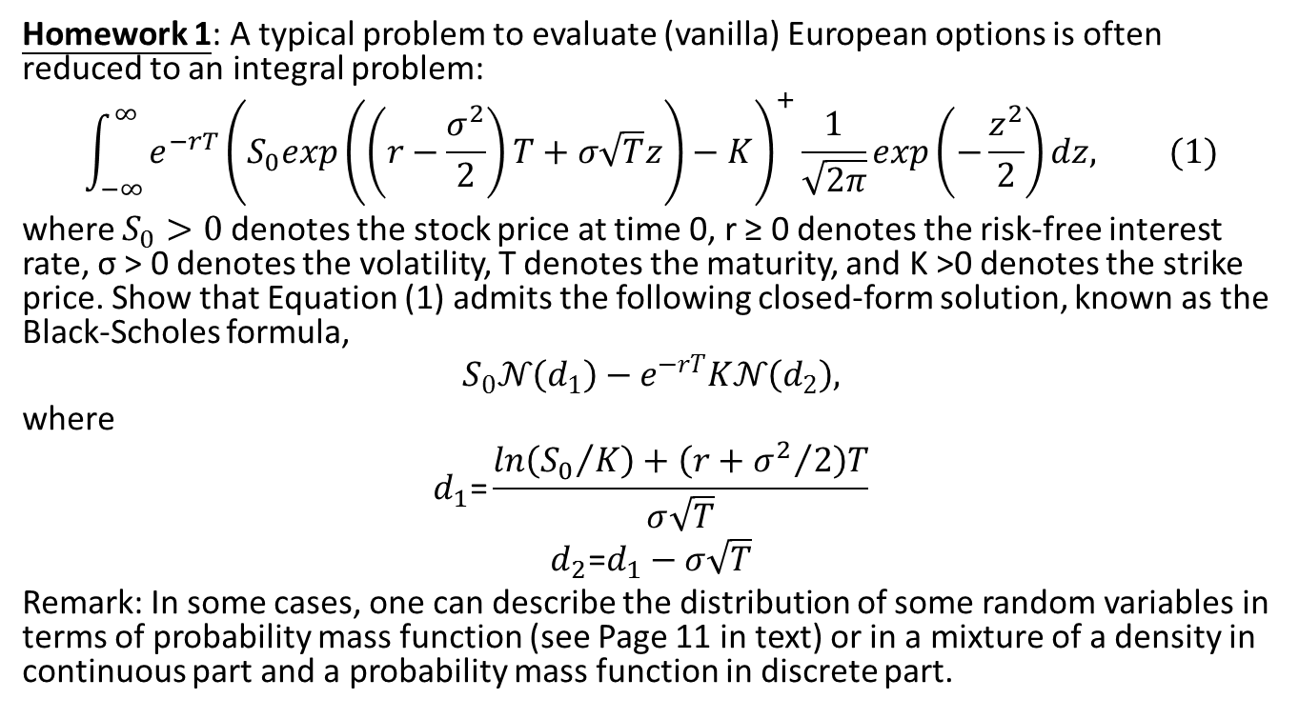
Homework 1: A typical problem to evaluate (vanilla) European options is often reduced to an integral problem:
$$\int_{−∞}^{∞}{e^{−rT}{\left(S_{0}exp\left(\left(r−\frac{σ^{2}}{2}\right)T+σ\sqrt{T}z\right)−K\right)}^{+}\frac{1}{\sqrt{2π}}exp}\left(−\frac{z^{2}}{2}\right)dz, (1)$$
where $S_{0}>0$ denotes the stock price at time 0, r ≥ 0 denotes the risk-free interest rate, σ > 0 denotes the volatility, T denotes the maturity, and K >0 denotes the strike price. Show that Equation (1) admits the following closed-form solution, known as the Black-Scholes formula,
$$S_{0}𝒩\left(d_{1}\right)−e^{−rT}K𝒩\left(d_{2}\right),$$
where
$$d_{1}\text{=}\frac{ln\left({S_{0}}/K\right)+\left(r+{σ^{2}}/2\right)T}{σ\sqrt{T}}$$
$$d_{2}\text{=}d_{1}−σ\sqrt{T}$$
Remark: In some cases, one can describe the distribution of some random variables in terms of probability mass function (see Page 11 in text) or in a mixture of a density in continuous part and a probability mass function in discrete part.

Slide 22
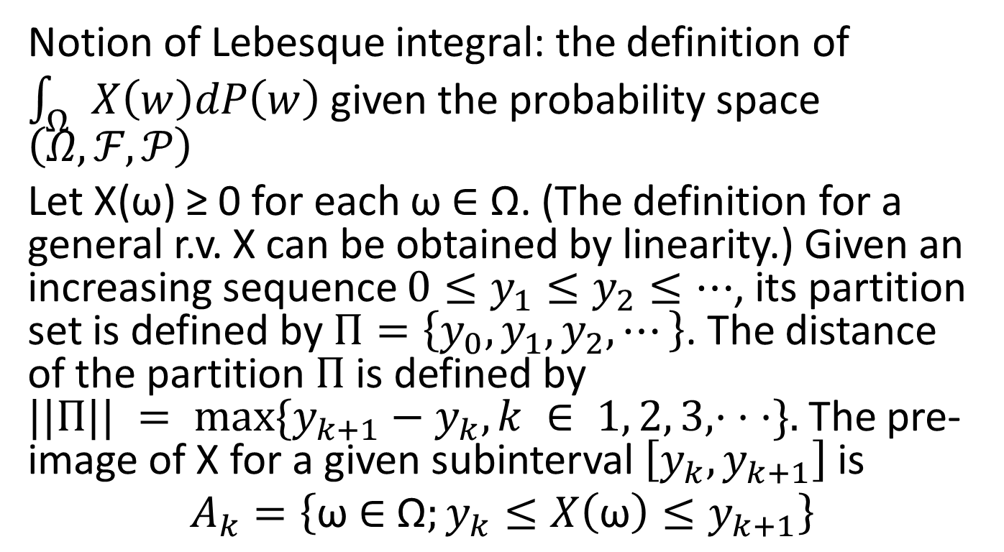
3. Expectations
Notion of Lebesque integral: the definition of $\int_{Ω}{X\left(w\right)dP\left(w\right)}$ given the probability space $\left(Ω,ℱ,𝒫\right)$
Let X(ω) ≥ 0 for each ω ∈ Ω. (The definition for a general r.v. X can be obtained by linearity.) Given an increasing sequence $0≤y_{1}≤y_{2}≤⋯$, its partition set is defined by $Π=\left\{y_{0},y_{1},y_{2},⋯\right\}$. The distance of the partition $Π$ is defined by $||Π|| = max⁡\{y_{k+1}−y_{k}, k ∈ 1, 2, 3, · · ·\}.$ The pre-image of X for a given subinterval $\left[y_{k},y_{k+1}\right]$ is
$$A_{k}=\left\{\text{ω}\text{ ∈ }\text{Ω};y_{k}≤X\left(\text{ω}\right)≤y_{k+1}\right\}$$

Slide 23
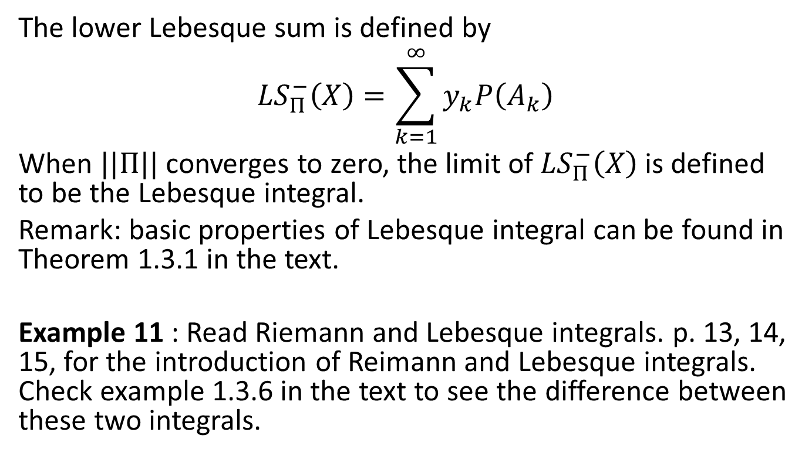
The lower Lebesque sum is defined by
$${LS}_{Π}^{−}\left(X\right)=\sum_{k=1}^{∞}{y_{k}P\left(A_{k}\right)}$$
When $||Π||$converges to zero, the limit of ${LS}_{Π}^{−}\left(X\right)$ is defined to be the Lebesque integral.
Remark: basic properties of Lebesque integral can be found in Theorem 1.3.1 in the text.
Example 11 : Read Riemann and Lebesque integrals. p. 13, 14, 15, for the introduction of Reimann and Lebesque integrals. Check example 1.3.6 in the text to see the difference between these two integrals.

Slide 24
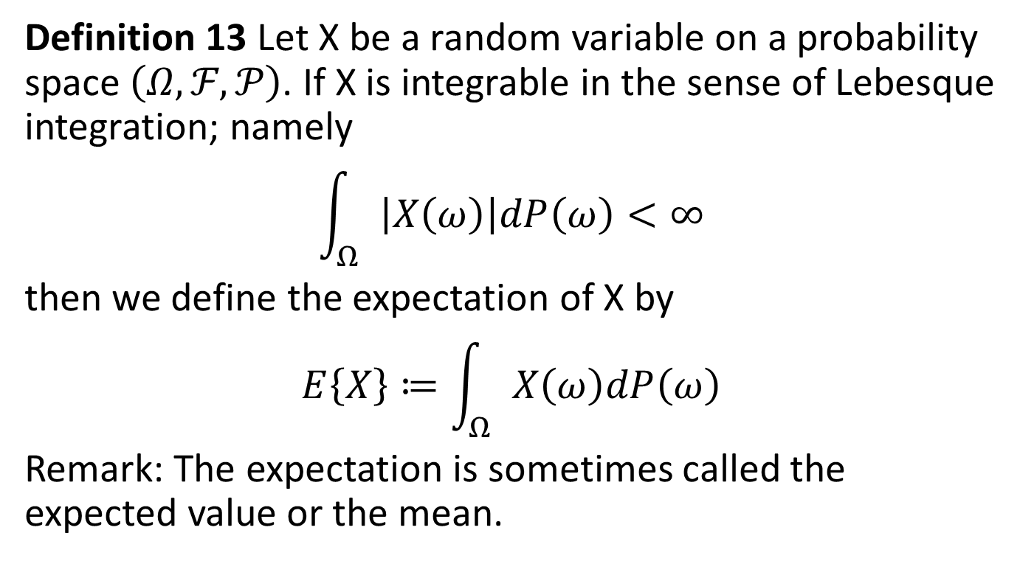
Definition 13 Let X be a random variable on a probability space $\left(Ω,ℱ,𝒫\right)$. If X is integrable in the sense of Lebesque integration; namely
$$\int_{Ω}{\left|X\left(ω\right)\right|dP\left(ω\right)<∞}$$
then we define the expectation of X by
$$E\left\{X\right\}≔\int_{Ω}{X\left(ω\right)dP\left(ω\right)}$$
Remark: The expectation is sometimes called the expected value or the mean.

Slide 25
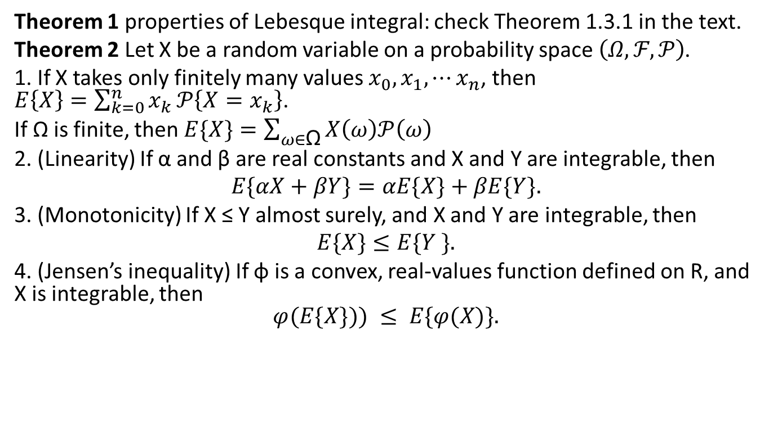
Theorem 1 properties of Lebesque integral: check Theorem 1.3.1 in the text.
Theorem 2 Let X be a random variable on a probability space $\left(Ω,ℱ,𝒫\right)$.
1. If X takes only finitely many values $x_{0},x_{1},⋯x_{n}$, then $E\left\{X\right\}=\sum_{k=0}^{n}{x_{k}}𝒫\left\{X=x_{k}\right\}$.
If Ω is finite, then $E\{X\}=\sum_{ω∈\text{Ω}}{X\left(ω\right)𝒫\left(ω\right)}$
2. (Linearity) If α and β are real constants and X and Y are integrable, then
$$E\{αX+βY\}=αE\{X\}+βE\{Y\}.$$
3. (Monotonicity) If X ≤ Y almost surely, and X and Y are integrable, then
$$E\{X\}≤E\{Y \}.$$
4. (Jensen’s inequality) If φ is a convex, real-values function defined on R, and X is integrable, then
$$φ(E\{X\})) ≤ E\{φ(X)\}.$$

Slide 26
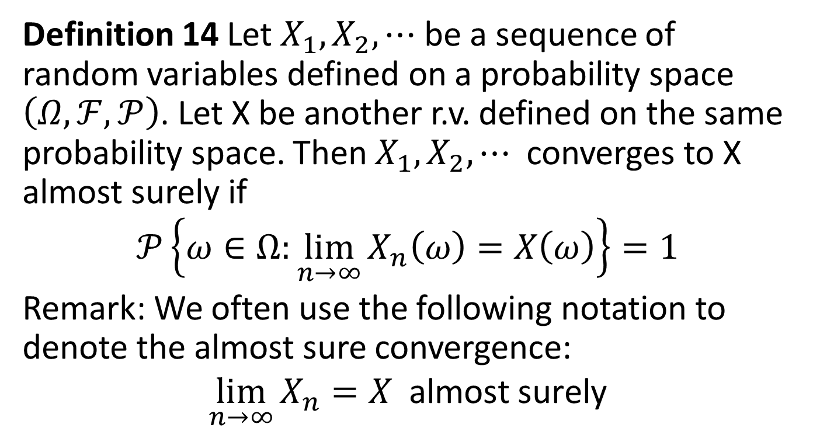
4. Convergence of Integrals
Definition 14 Let $X_{1},X_{2},⋯$ be a sequence of random variables defined on a probability space $\left(Ω,ℱ,𝒫\right)$. Let X be another r.v. defined on the same probability space. Then $X_{1},X_{2},⋯$ converges to X almost surely if
$$𝒫\left\{ω∈Ω:\lim_{n→∞}{X_{n}\left(ω\right)}=X\left(ω\right)\right\}=1$$
Remark: We often use the following notation to denote the almost sure convergence:
$$\lim_{n→∞}{X_{n}}=X \text{almost} \text{surely}$$

Slide 27
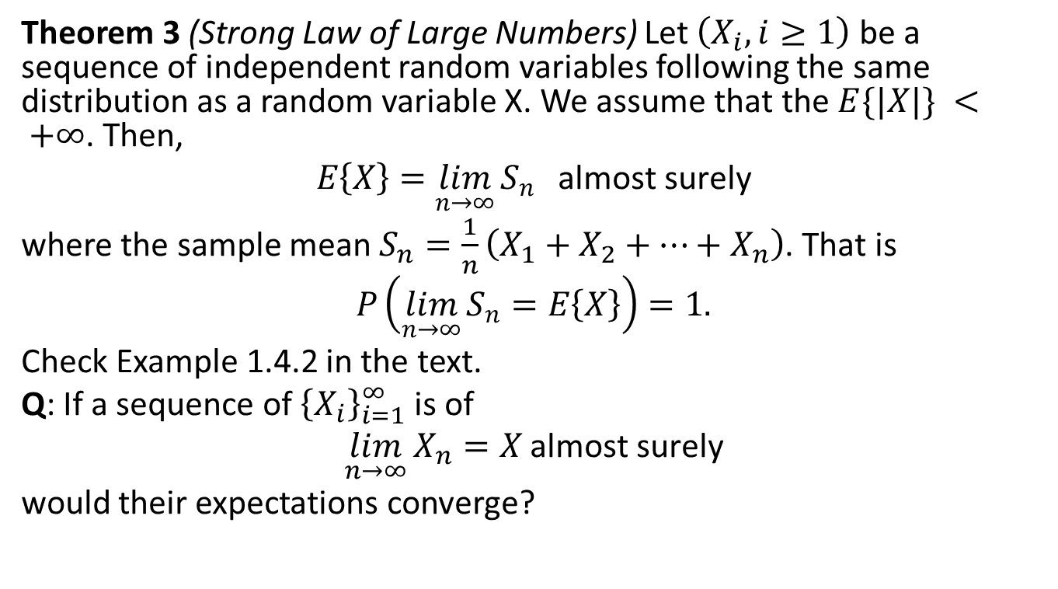
Theorem 3 (Strong Law of Large Numbers) Let $\left(X_{i},i≥1\right)$ be a sequence of independent random variables following the same distribution as a random variable X. We assume that the $E\{|X|\} < +∞$. Then,
$$E\left\{X\right\}=\lim_{n→∞}{S_{n}} \text{almost} \text{surely}$$
where the sample mean $S_{n}=\frac{1}{n}\left(X_{1}+X_{2}+⋯+X_{n}\right)$. That is
$$P\left(\lim_{n→∞}{S_{n}=E\left\{X\right\}}\right)=1.$$
Check Example 1.4.2 in the text.
Q: If a sequence of ${\left\{X_{i}\right\}}_{i=1}^{∞}$ is of
$$\lim_{n→∞}{X_{n}=X}\text{almost} \text{surely}$$
would their expectations converge?

Slide 28
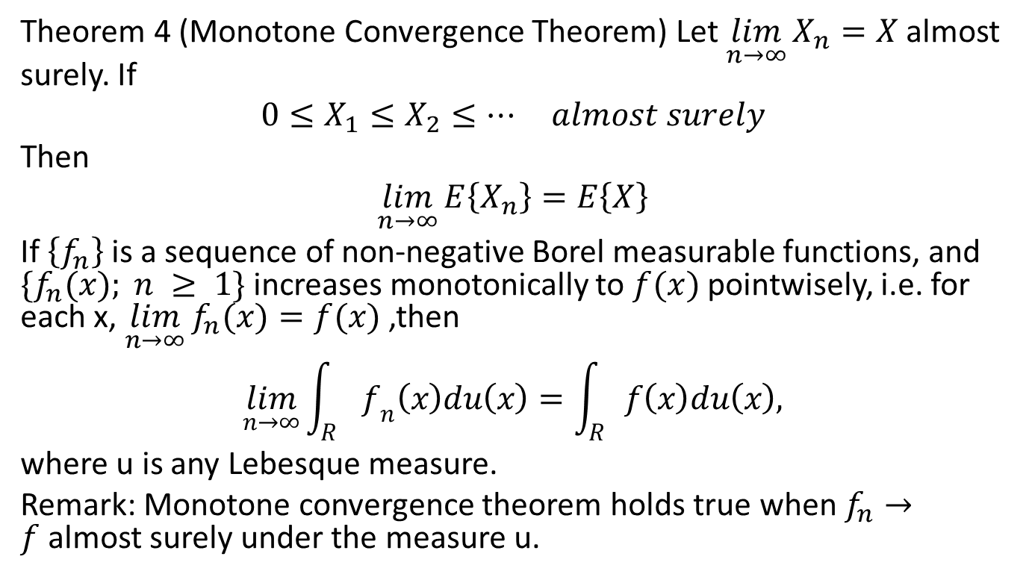
Theorem 4 (Monotone Convergence Theorem) Let $\lim_{n→∞}{X_{n}=X}$almost surely. If
$$0≤X_{1}≤X_{2}≤⋯ almost surely$$
Then
$$\lim_{n→∞}{E\left\{X_{n}\right\}=E\left\{X\right\}}$$
If $\left\{f_{n}\right\}$ is a sequence of non-negative Borel measurable functions, and $\{f_{n}(x); n ≥ 1\}$increases monotonically to $f(x)$ pointwisely, i.e. for each x, $\lim_{n→∞}{f_{n}(x)=f(x)}$,then
$$\lim_{n→∞}{\int_{R}{f_{n}\left(x\right)du\left(x\right)=\int_{R}{f\left(x\right)du\left(x\right),}}}$$
where u is any Lebesque measure.
Remark: Monotone convergence theorem holds true when $f_{n}→f$almost surely under the measure u.

Slide 29
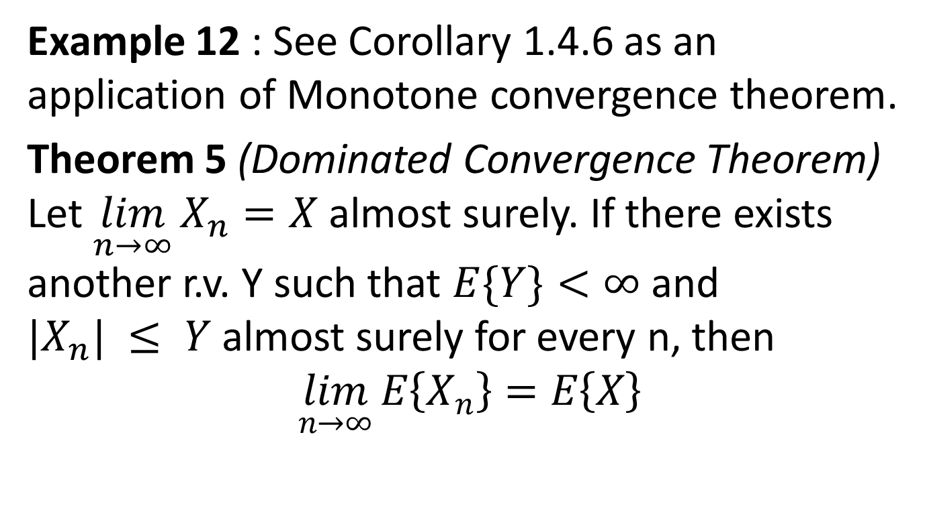
Example 12 : See Corollary 1.4.6 as an application of Monotone convergence theorem.
Theorem 5 (Dominated Convergence Theorem) Let $\lim_{n→∞}{X_{n}=X}$almost surely. If there exists another r.v. Y such that $E\{Y\}<∞$and $|X_{n}| ≤ Y$almost surely for every n, then
$$\lim_{n→∞}{E\left\{X_{n}\right\}=E\left\{X\right\}}$$

Slide 30
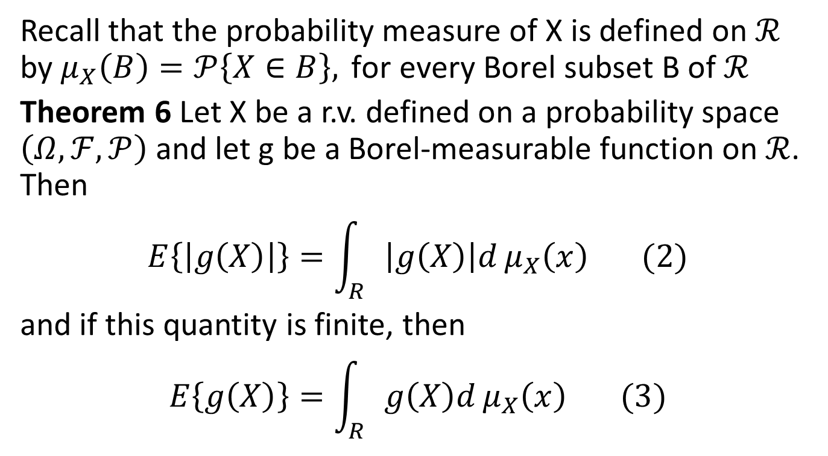
5 Computation of Expectations
Recall that the probability measure of X is defined on $ℛ$ by $μ_{X}\left(B\right)=𝒫\left\{X∈B\right\}, \text{for} \text{every} \text{Borel} \text{subset} \text{B} \text{of} ℛ$
Theorem 6 Let X be a r.v. defined on a probability space $\left(Ω,ℱ,𝒫\right)$ and let g be a Borel-measurable function on $ℛ$. Then
$$E\left\{\left|g\left(X\right)\right|\right\}=\int_{R}{\left|g\left(X\right)\right|d}μ_{X}\left(x\right) (2)$$
and if this quantity is finite, then
$$E\left\{g\left(X\right)\right\}=\int_{R}{g\left(X\right)d}μ_{X}\left(x\right) (3)$$

Slide 31
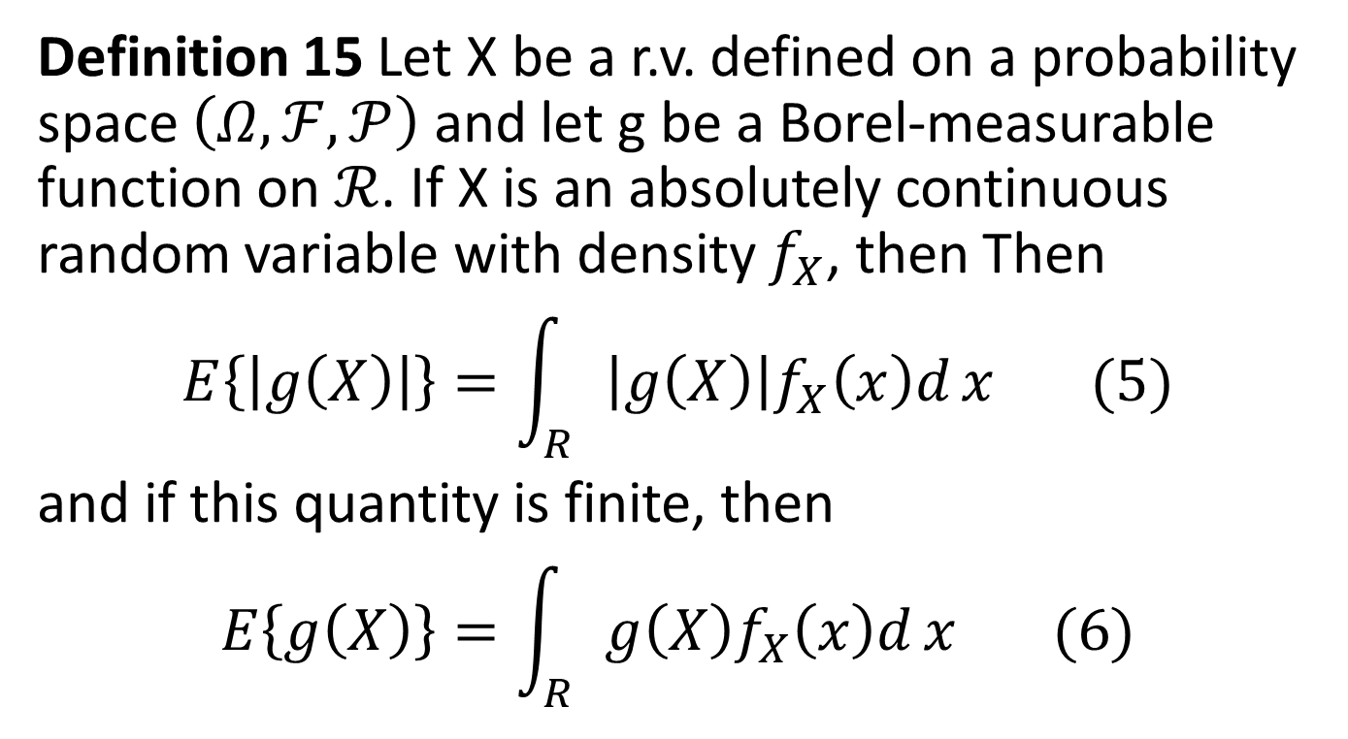
Definition 15 Let X be a r.v. defined on a probability space $\left(Ω,ℱ,𝒫\right)$ and let g be a Borel-measurable function on $ℛ$. If X is an absolutely continuous random variable with density $f_{X}$, then Then
$$E\left\{\left|g\left(X\right)\right|\right\}=\int_{R}{\left|g\left(X\right)\right|f_{X}\left(x\right)d}x (5)$$
and if this quantity is finite, then
$$E\left\{g\left(X\right)\right\}=\int_{R}{g\left(X\right)f_{X}\left(x\right)d}x (6)$$

Slide 32
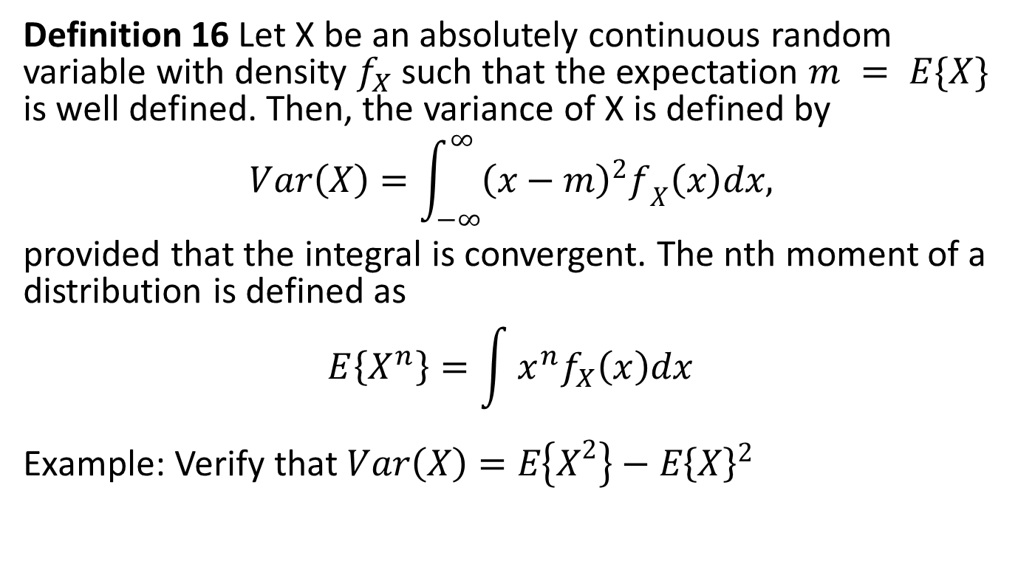
Definition 16 Let X be an absolutely continuous random variable with density $f_{X}$ such that the expectation $m = E\{X\}$ is well defined. Then, the variance of X is defined by
$$Var\left(X\right)=\int_{−∞}^{∞}{{\left(x−m\right)}^{2}f_{X}\left(x\right)dx,}$$
provided that the integral is convergent. The nth moment of a distribution is defined as
$$E\left\{X^{n}\right\}=\int{x^{n}f_{X}\left(x\right)dx}$$
Example: Verify that $Var\left(X\right)=E\left\{X^{2}\right\}−E{\left\{X\right\}}^{2}$

Slide 33
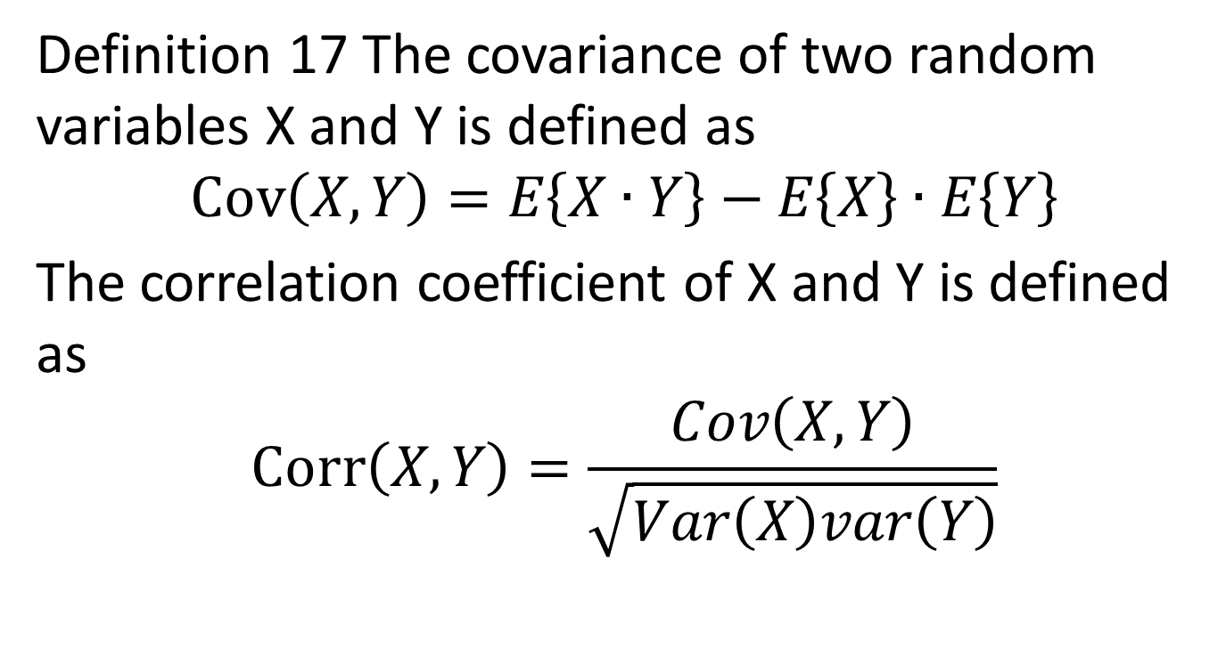
Definition 17 The covariance of two random variables X and Y is defined as
$$Cov\left(X,Y\right)=E\left\{X∙Y\right\}−E\left\{X\right\}∙E\left\{Y\right\}$$
The correlation coefficient of X and Y is defined as
$$Corr\left(X,Y\right)=\frac{Cov\left(X,Y\right)}{\sqrt{Var\left(X\right)var\left(Y\right)}}$$

Slide 34
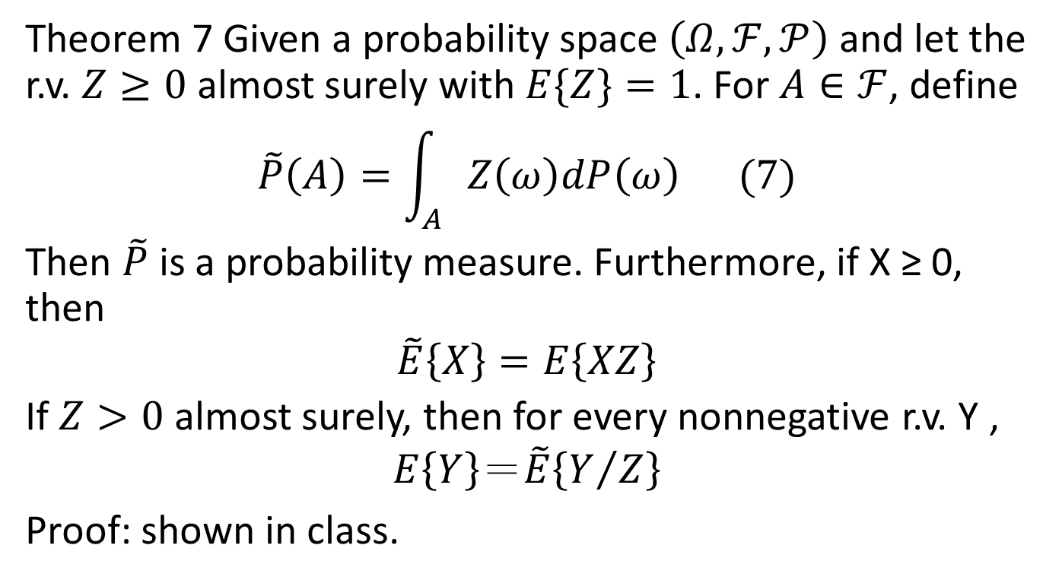
6 Change of Measure
Theorem 7 Given a probability space $\left(Ω,ℱ,𝒫\right)$ and let the r.v. $Z≥0$almost surely with $E\{Z\}=1$. For $A∈ℱ$, define
$$\tilde{P}\left(A\right)=\int_{A}{Z\left(ω\right)dP\left(ω\right) (7)}$$
Then $\tilde{P}$ is a probability measure. Furthermore, if X ≥ 0, then
$$\tilde{E}\left\{X\right\}=E\left\{XZ\right\}$$
If $Z>0$almost surely, then for every nonnegative r.v. Y ,
$$E\left\{Y\right\}＝\tilde{E}\left\{Y/Z\right\}$$
Proof: shown in class.

Slide 35
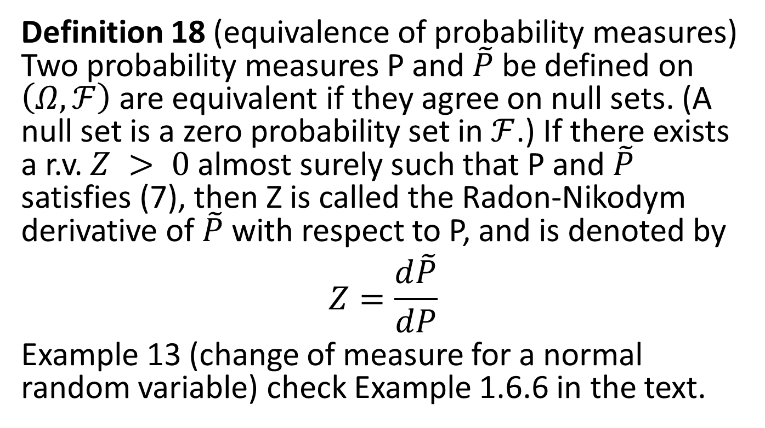
Definition 18 (equivalence of probability measures) Two probability measures P and $\tilde{P}$ be defined on $\left(Ω,ℱ\right)$are equivalent if they agree on null sets. (A null set is a zero probability set in $ℱ$.) If there exists a r.v. $Z > 0$almost surely such that P and $\tilde{P}$ satisfies (7), then Z is called the Radon-Nikodym derivative of $\tilde{P}$ with respect to P, and is denoted by
$$Z=\frac{d\tilde{P}}{dP}$$
Example 13 (change of measure for a normal random variable) check Example 1.6.6 in the text.

Slide 36
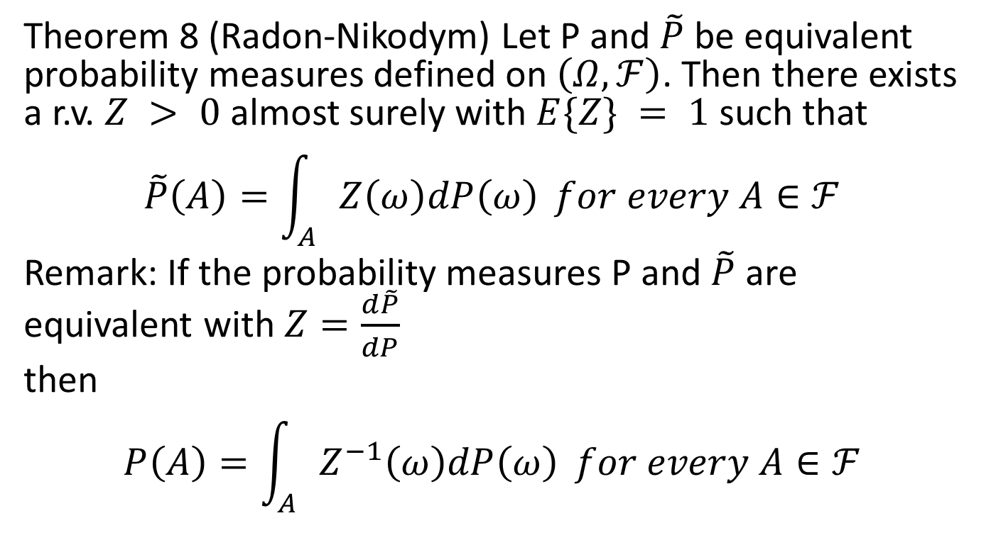
Theorem 8 (Radon-Nikodym) Let P and $\tilde{P}$ be equivalent probability measures defined on $\left(Ω,ℱ\right)$. Then there exists a r.v. $Z > 0$almost surely with $E\{Z\} = 1$such that
$$\tilde{P}\left(A\right)=\int_{A}{Z\left(ω\right)dP\left(ω\right)} for every A∈ℱ$$
Remark: If the probability measures P and $\tilde{P}$ are equivalent with $Z=\frac{d\tilde{P}}{dP}$
then
$$P\left(A\right)=\int_{A}{Z^{−1}\left(ω\right)dP\left(ω\right)} for every A∈ℱ$$

Slide 37
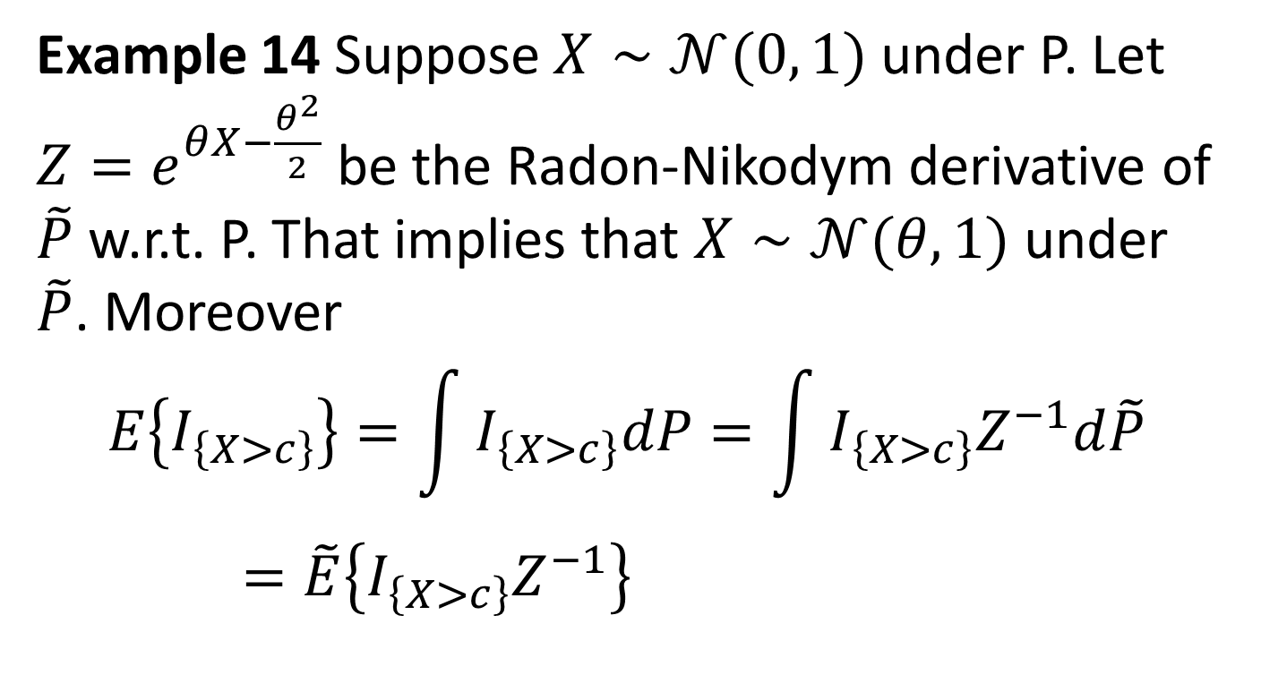
Example 14 Suppose $X∼𝒩(0, 1)$under P. Let $Z=e^{θX−\frac{θ^{2}}{2}}$ be the Radon-Nikodym derivative of $\tilde{P}$ w.r.t. P. That implies that $X∼𝒩(θ, 1)$ under $\tilde{P}$. Moreover
$$E\left\{I_{\left\{X>c\right\}}\right\}=\int{I_{\left\{X>c\right\}}dP}=\int{I_{\left\{X>c\right\}}Z^{−1}d\tilde{P}}=\tilde{E}\left\{I_{\left\{X>c\right\}}Z^{−1}\right\}$$

