Slide 1
Information and Conditioning
Chuan-Hsiang Han
Oct. 28, 2009

Slide 2
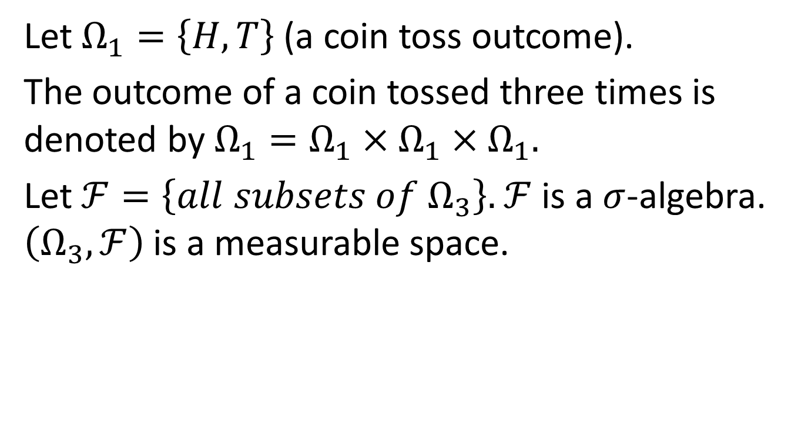
A three period coin-toss example
Let $Ω_{1}=\left\{H,T\right\}$ (a coin toss outcome).
The outcome of a coin tossed three times is denoted by $Ω_{1}=Ω_{1}×Ω_{1}×Ω_{1}.$
Let $ℱ=\left\{all subsets of Ω_{3}\right\}.$ $ℱ$is a $σ$-algebra. $\left(Ω_{3},ℱ\right)$is a measurable space.

Slide 3
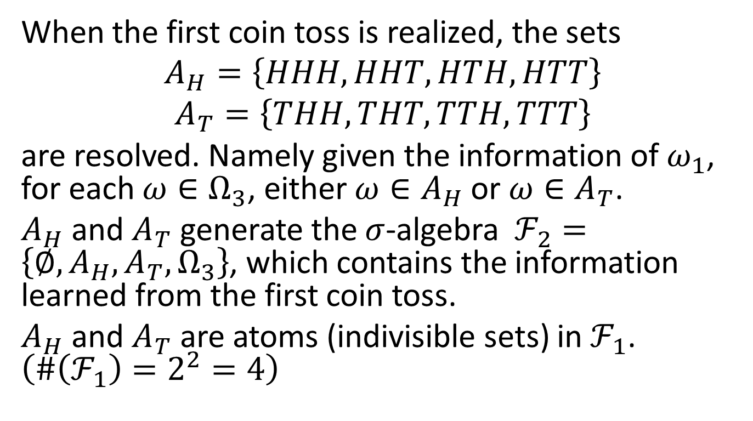
A three period example: at period one
When the first coin toss is realized, the sets
$$A_{H}=\left\{HHH,HHT,HTH,HTT\right\}$$
$$A_{T}=\left\{THH,THT,TTH,TTT\right\}$$
are resolved. Namely given the information of $ω_{1}$, for each $ω∈Ω_{3}$, either $ω∈A_{H}$ or $ω∈A_{T}$.
$A_{H}$ and $A_{T}$ generate the $σ$-algebra $ℱ_{2}=\left\{∅,A_{H},A_{T},Ω_{3}\right\}$, which contains the information learned from the first coin toss.
$A_{H}$ and $A_{T}$ are atoms (indivisible sets) in $ℱ_{1}$. $\left(\#\left(ℱ_{1}\right)=2^{2}=4\right)$

Slide 4
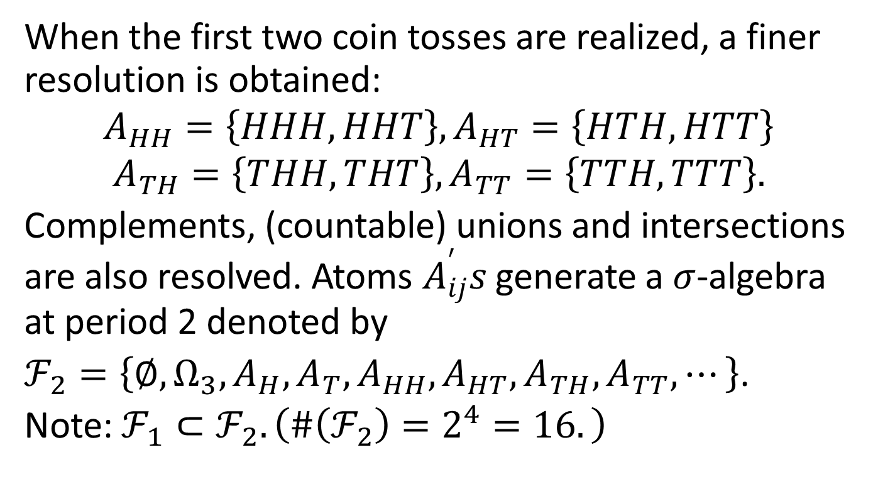
A three period example: at period two
When the first two coin tosses are realized, a finer resolution is obtained:
$$A_{HH}=\left\{HHH,HHT\right\}, A_{HT}=\left\{HTH,HTT\right\}$$
$$A_{TH}=\left\{THH,THT\right\},A_{TT}=\left\{TTH,TTT\right\}.$$
Complements, (countable) unions and intersections are also resolved. Atoms $A_{ij}^{′}s$ generate a $σ$-algebra at period 2 denoted by
$ℱ_{2}=\left\{∅,Ω_{3},A_{H},A_{T},A_{HH},A_{HT},A_{TH},A_{TT},⋯\right\}$.
Note: ${ℱ_{1}⊂ℱ}_{2}.\left(\#\left(ℱ_{2}\right)=2^{4}=16.\right)$

Slide 5
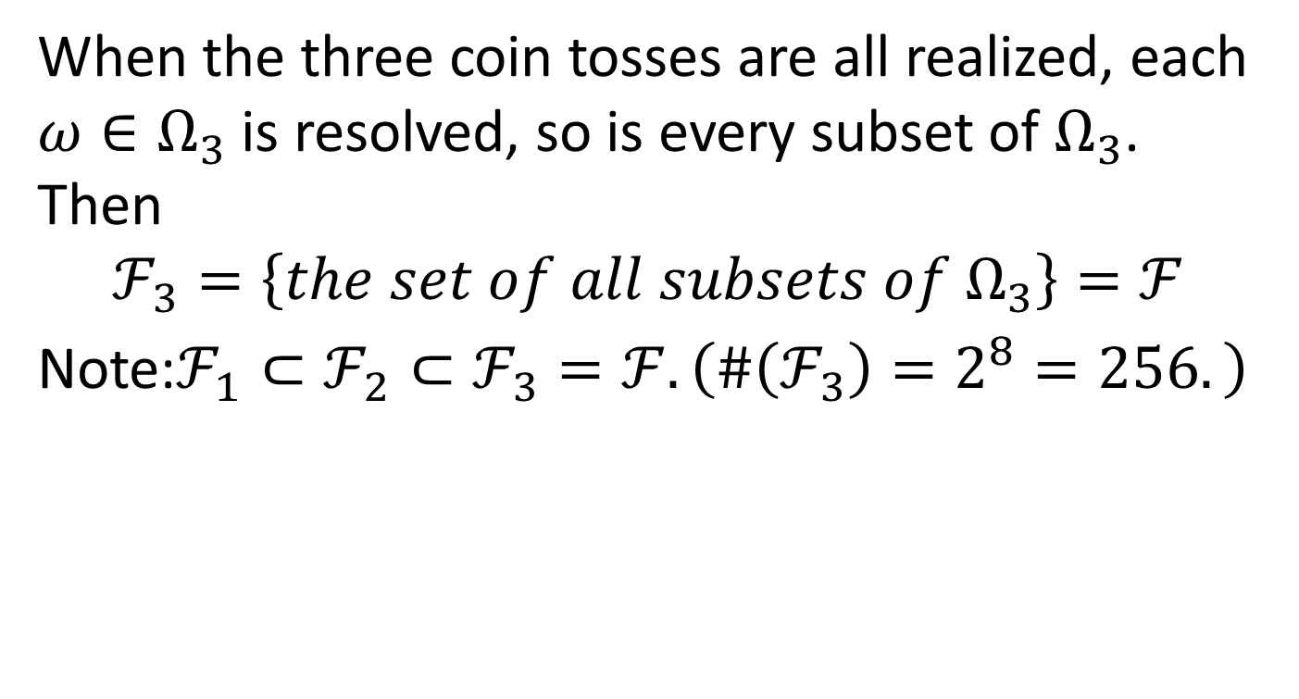
A three period example: at period three
When the three coin tosses are all realized, each $ω∈Ω_{3}$ is resolved, so is every subset of $Ω_{3}$. Then
$$ℱ_{3}=\left\{the set of all subsets of Ω_{3}\right\}=ℱ$$
Note:${ℱ_{1}⊂ℱ}_{2}⊂ℱ_{3}=ℱ.\left(\#\left(ℱ_{3}\right)=2^{8}=256.\right)$

Slide 6
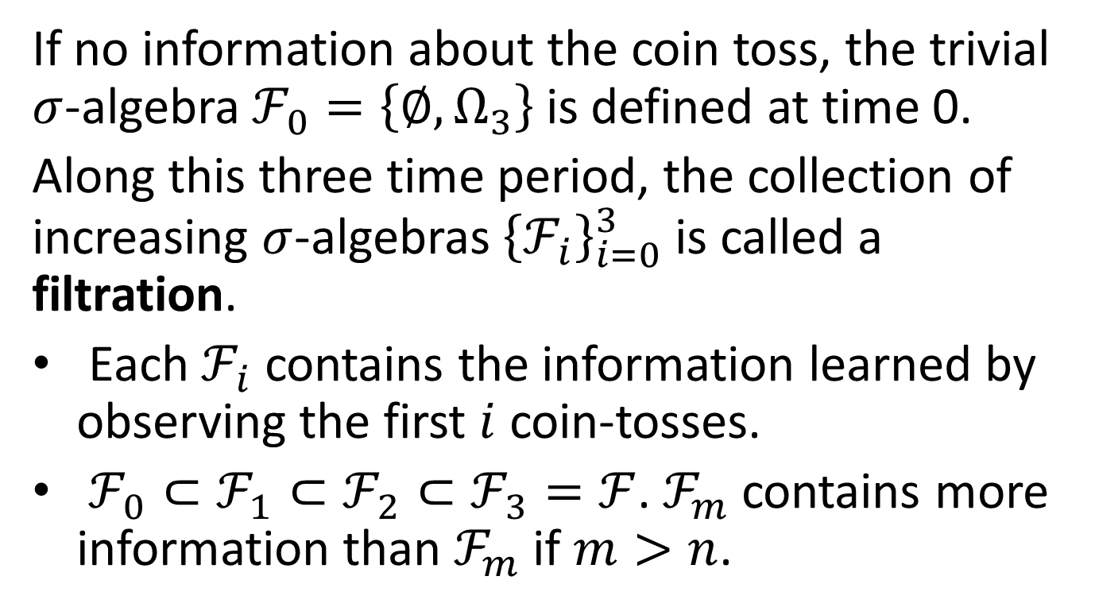
A three period example revised
If no information about the coin toss, the trivial $σ$-algebra $ℱ_{0}=\left\{∅,Ω_{3}\right\}$ is defined at time 0.
Along this three time period, the collection of increasing $σ$-algebras ${\left\{ℱ_{i}\right\}}_{i=0}^{3}$ is called a filtration.
Each $ℱ_{i}$ contains the information learned by observing the first $i$ coin-tosses.
$ℱ_{0}⊂{ℱ_{1}⊂ℱ}_{2}⊂ℱ_{3}=ℱ$. $ℱ_{m}$ contains more information than $ℱ_{m}$if $m>n$.

Slide 7
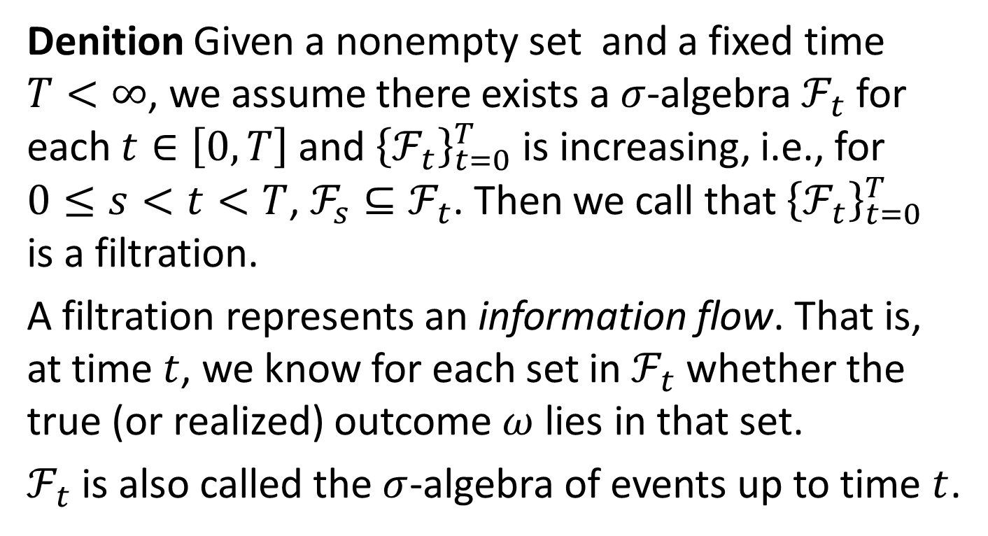
Filtration
Denition Given a nonempty set and a fixed time $T<∞$, we assume there exists a $σ$-algebra $ℱ_{t}$ for each $t∈\left[0,T\right]$ and ${\left\{ℱ_{t}\right\}}_{t=0}^{T}$ is increasing, i.e., for $0≤s<t<T$, ${ℱ_{s}⊆ℱ}_{t}$. Then we call that ${\left\{ℱ_{t}\right\}}_{t=0}^{T}$ is a filtration.
A filtration represents an information flow. That is, at time $t$, we know for each set in $ℱ_{t}$ whether the true (or realized) outcome $ω$ lies in that set.
$ℱ_{t}$ is also called the $σ$-algebra of events up to time $t$.

Slide 8
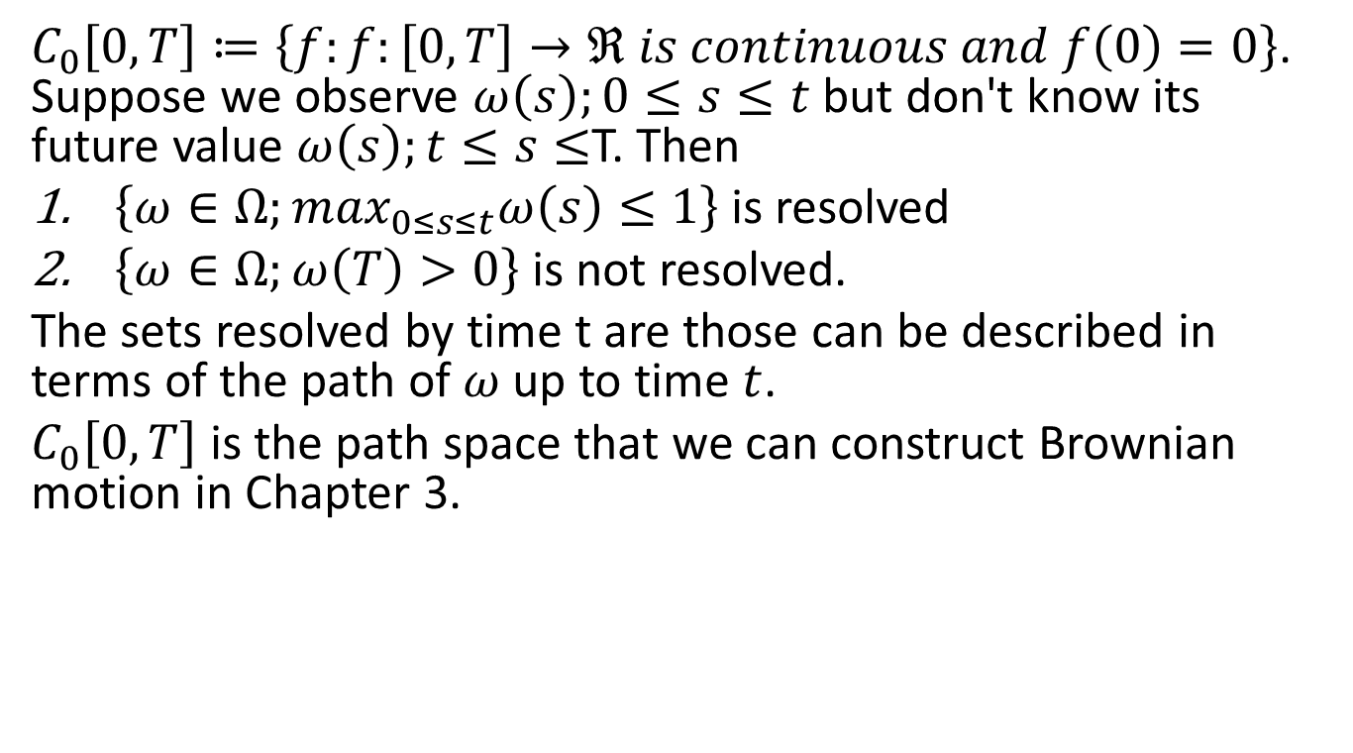

An infinite Space $Ω=C_{0}\left[0,T\right]$
$C_{0}\left[0,T\right]≔\left\{f:f:\left[0,T\right]→ℜ is continuous and f\left(0\right)=0\right\}$. Suppose we observe $ω\left(s\right);0≤s≤t$ but don't know its future value $ω\left(s\right);t≤s≤$T. Then
$\left\{ω∈Ω;\max_{0≤s≤t}ω\left(s\right)≤1\right\}$ is resolved
$\left\{ω∈Ω;ω\left(T\right)>0\right\}$ is not resolved.
The sets resolved by time t are those can be described in terms of the path of $ω$ up to time $t$.
$C_{0}\left[0,T\right]$ is the path space that we can construct Brownian motion in Chapter 3.

Slide 9

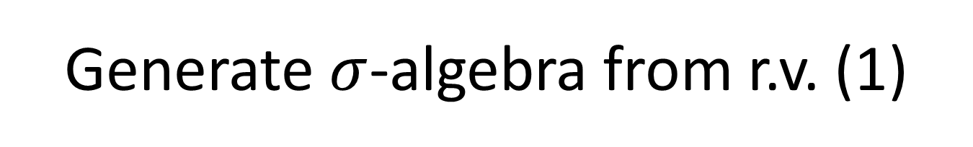
Generate $σ$-algebra from r.v. (1)
Denition Let $X$ be a r.v. defined on $\left(Ω,ℱ\right)$.
The $σ$-algebra generated by $X$ is defined by
$$σ\left(X\right)=\left\{X^{−1}\left(B\right):for any Borel set B\right\}.$$
EX: check example 2.1.4 in the text.

Slide 10
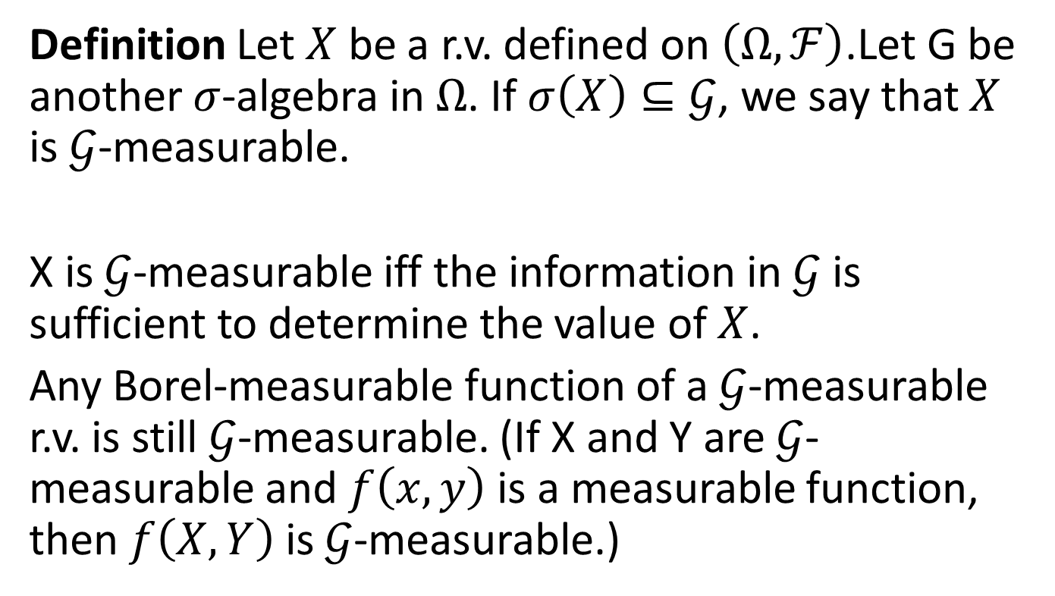
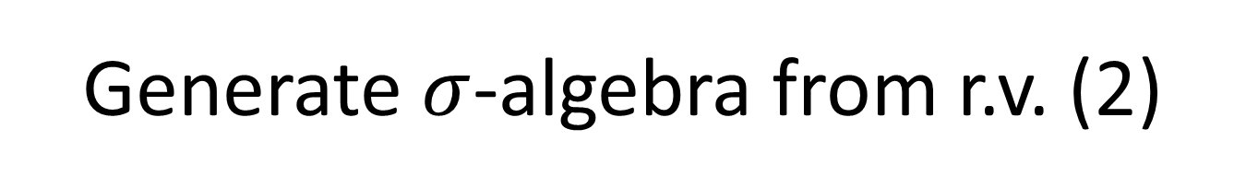
Generate $σ$-algebra from r.v. (2)
Definition Let $X$ be a r.v. defined on $\left(Ω,ℱ\right)$.Let G be another $σ$-algebra in $Ω$. If $σ\left(X\right)⊆𝒢$, we say that $X$ is $𝒢$-measurable.
X is $𝒢$-measurable iff the information in $𝒢$ is sufficient to determine the value of $X$.
Any Borel-measurable function of a $𝒢$-measurable r.v. is still $𝒢$-measurable. (If X and Y are $𝒢$-measurable and $f\left(x,y\right)$ is a measurable function, then $f\left(X,Y\right)$ is $𝒢$-measurable.)

Slide 11
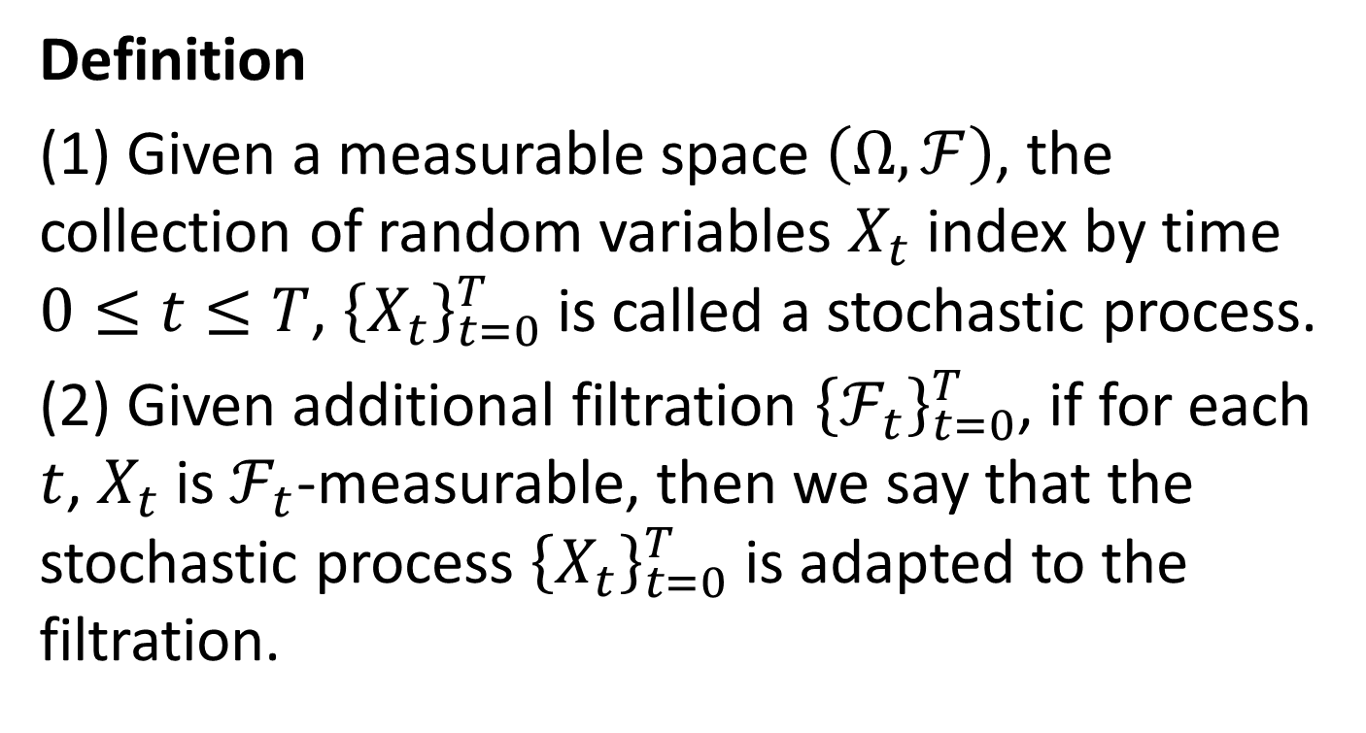
Stochastic Processes
Definition
(1) Given a measurable space $\left(Ω,ℱ\right)$, the collection of random variables $X_{t}$ index by time $0≤t≤T$, ${\left\{X_{t}\right\}}_{t=0}^{T}$ is called a stochastic process.
(2) Given additional filtration ${\left\{ℱ_{t}\right\}}_{t=0}^{T}$, if for each $t$, $X_{t}$ is $ℱ_{t}$-measurable, then we say that the stochastic process ${\left\{X_{t}\right\}}_{t=0}^{T}$ is adapted to the filtration.

Slide 12
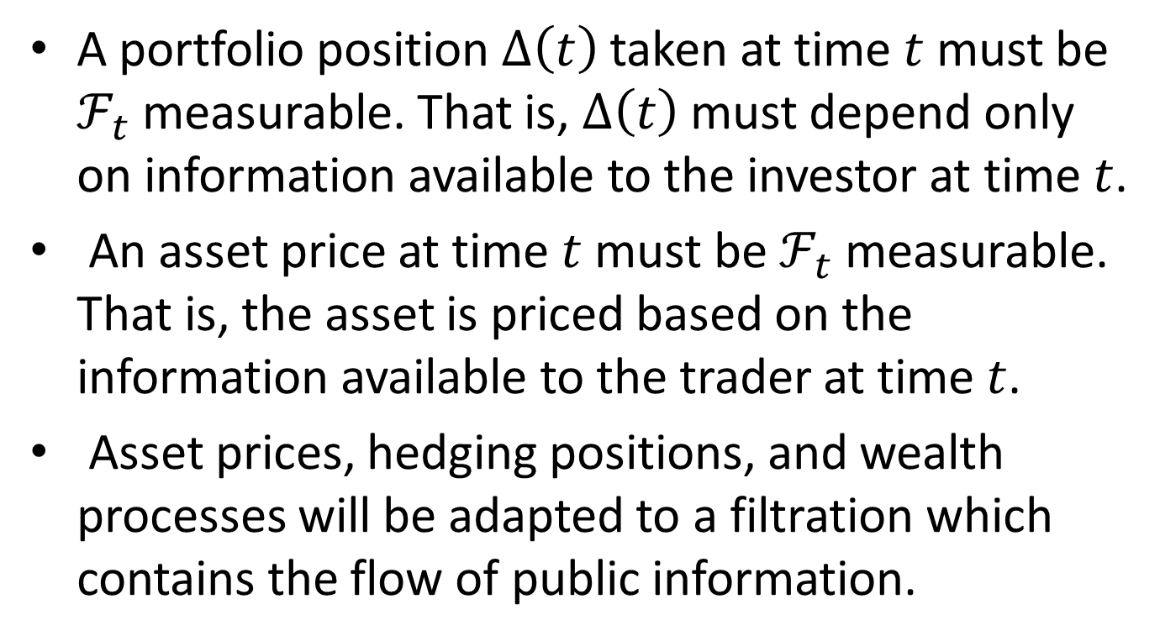
Financial applications
A portfolio position $∆\left(t\right)$ taken at time $t$must be $ℱ_{t}$ measurable. That is, $∆\left(t\right)$ must depend only on information available to the investor at time $t$.
An asset price at time $t$ must be $ℱ_{t}$ measurable. That is, the asset is priced based on the information available to the trader at time $t$.
Asset prices, hedging positions, and wealth processes will be adapted to a filtration which contains the flow of public information.

Slide 13
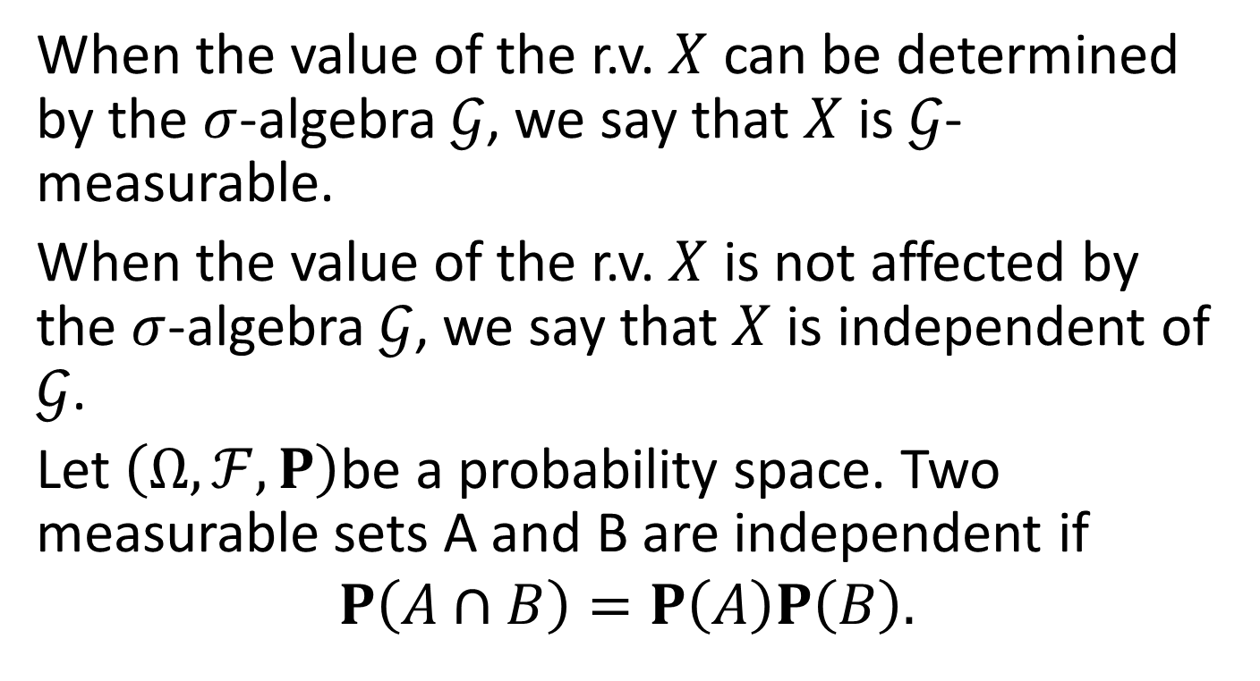
Independence (1)
When the value of the r.v. $X$ can be determined by the $σ$-algebra $𝒢$, we say that $X$ is $𝒢$-measurable.
When the value of the r.v. $X$ is not affected by the $σ$-algebra $𝒢$, we say that $X$ is independent of $𝒢$.
Let $\left(Ω,ℱ,P\right)$be a probability space. Two measurable sets A and B are independent if
$$P\left(A∩B\right)=P\left(A\right)P\left(B\right).$$

Slide 14
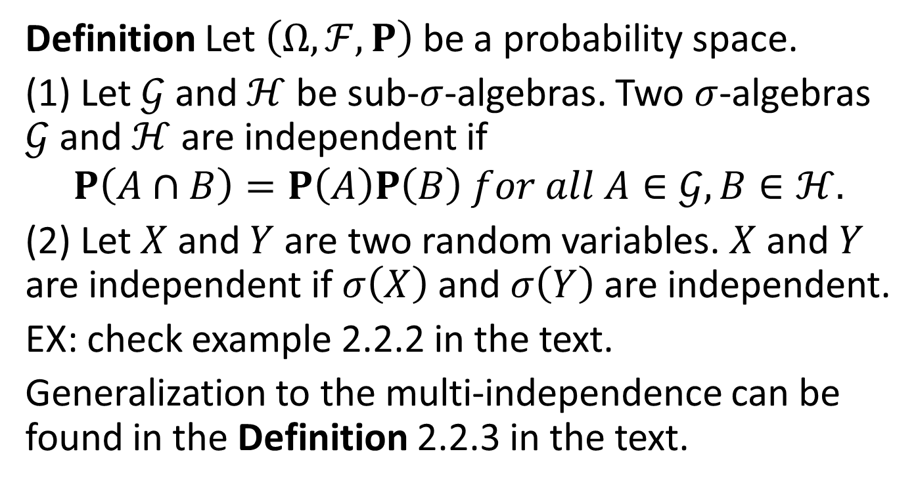
Independence (2)
Definition Let $\left(Ω,ℱ,P\right)$ be a probability space.
(1) Let $𝒢$ and $ℋ$ be sub-$σ$-algebras. Two $σ$-algebras $𝒢$ and $ℋ$ are independent if
$$P\left(A∩B\right)=P\left(A\right)P\left(B\right) for all A∈𝒢,B∈ℋ.$$
(2) Let $X$ and $Y$ are two random variables. $X$ and $Y$ are independent if $σ\left(X\right)$ and $σ\left(Y\right)$ are independent.
EX: check example 2.2.2 in the text.
Generalization to the multi-independence can be found in the Definition 2.2.3 in the text.

Slide 15

Independence (3)
Theorem 2.2.5. Let $X$ and $Y$ be independent random variables, and let f and g be Borel-measurable functions on $ℜ$. Then $f\left(X\right)$ and $g\left(Y\right)$ are independent random variables.

Slide 16
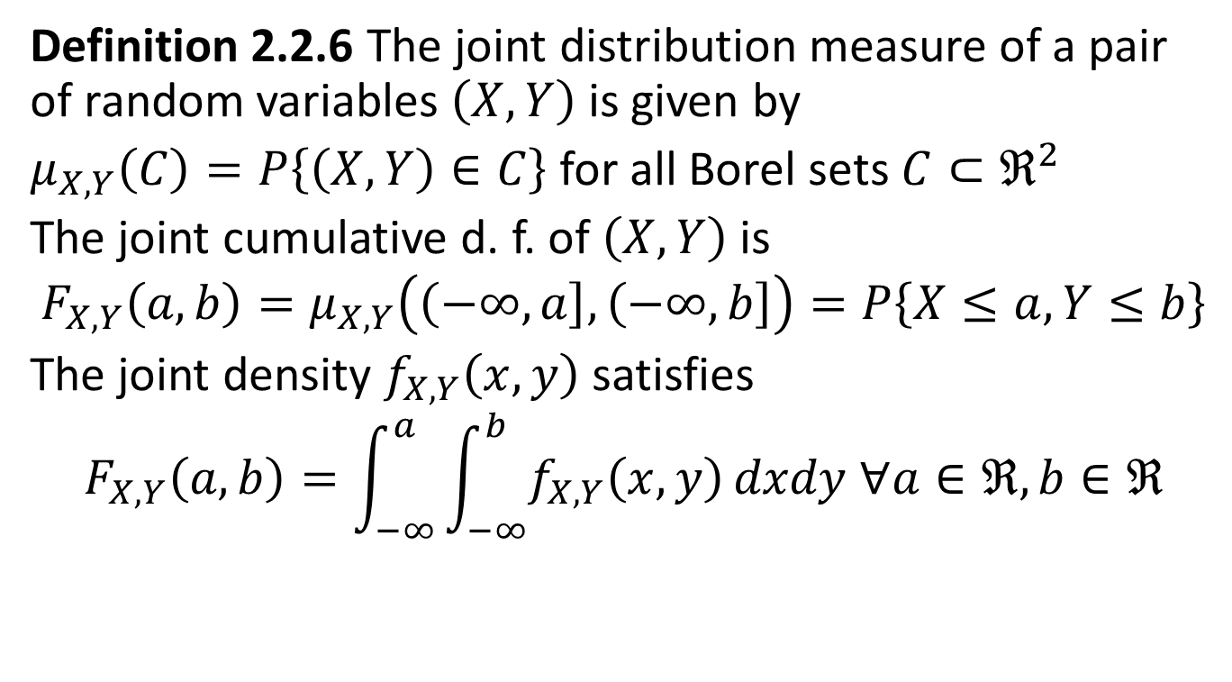
Joint Distribution
Definition 2.2.6 The joint distribution measure of a pair of random variables $\left(X,Y\right)$ is given by
$μ_{X,Y}\left(C\right)=P\left\{\left(X,Y\right)∈C\right\}$ for all Borel sets $C⊂ℜ^{2}$
The joint cumulative d. f. of $\left(X,Y\right)$ is
$$F_{X,Y}\left(a,b\right)=μ_{X,Y}\left(\left(−∞,\left.a\right]\right.,\left(−∞,\left.b\right]\right.\right)=P\left\{X≤a,Y≤b\right\}$$
The joint density $f_{X,Y}\left(x,y\right)$ satisfies
$$F_{X,Y}\left(a,b\right)=\int_{−∞}^{a}{\int_{−∞}^{b}{f_{X,Y}\left(x,y\right)}}dxdy ∀a∈ℜ,b∈ℜ$$

Slide 17
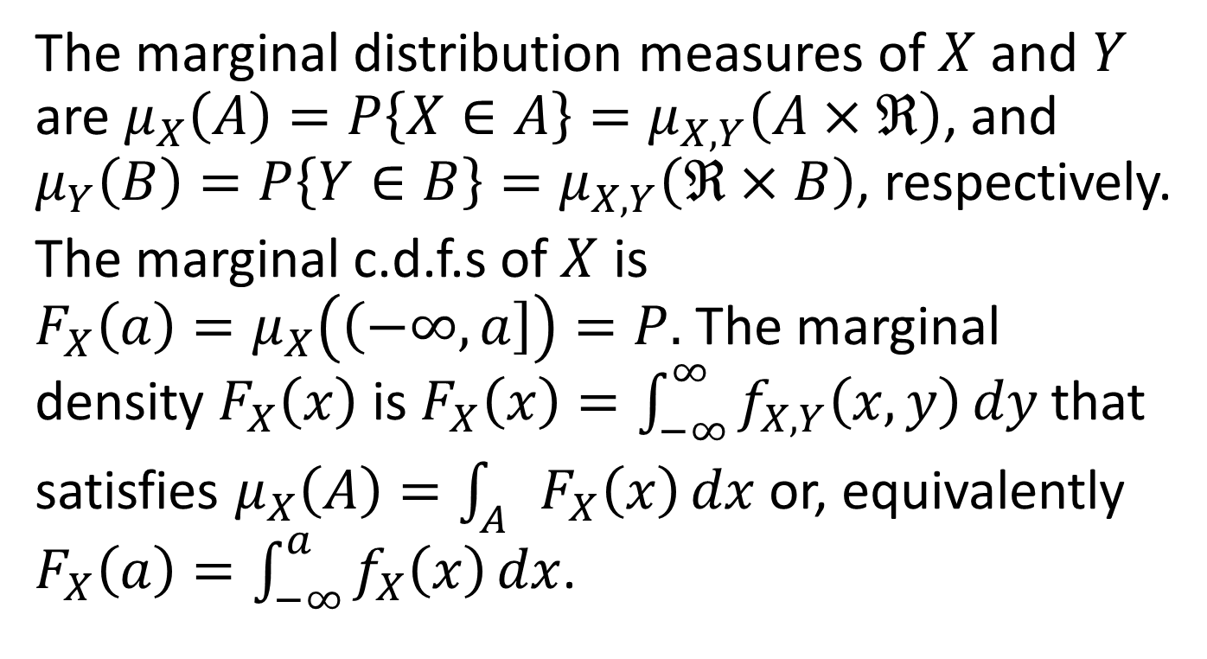
Marginal Distribution
The marginal distribution measures of $X$ and $Y$ are $μ_{X}\left(A\right)=P\left\{X∈A\right\}=μ_{X,Y}\left(A×ℜ\right)$, and $μ_{Y}\left(B\right)=P\left\{Y∈B\right\}=μ_{X,Y}\left(ℜ×B\right)$, respectively.
The marginal c.d.f.s of $X$ is $F_{X}\left(a\right)=μ_{X}\left(\left(−∞,\left.a\right]\right.\right)=P.$The marginal density $F_{X}\left(x\right)$ is $F_{X}\left(x\right)=\int_{−∞}^{∞}{f_{X,Y}\left(x,y\right)}dy$that satisfies $μ_{X}\left(A\right)=\int_{A}{F_{X}\left(x\right)}dx$ or, equivalently $F_{X}\left(a\right)=\int_{−∞}^{a}{f_{X}\left(x\right)}dx$.

Slide 18
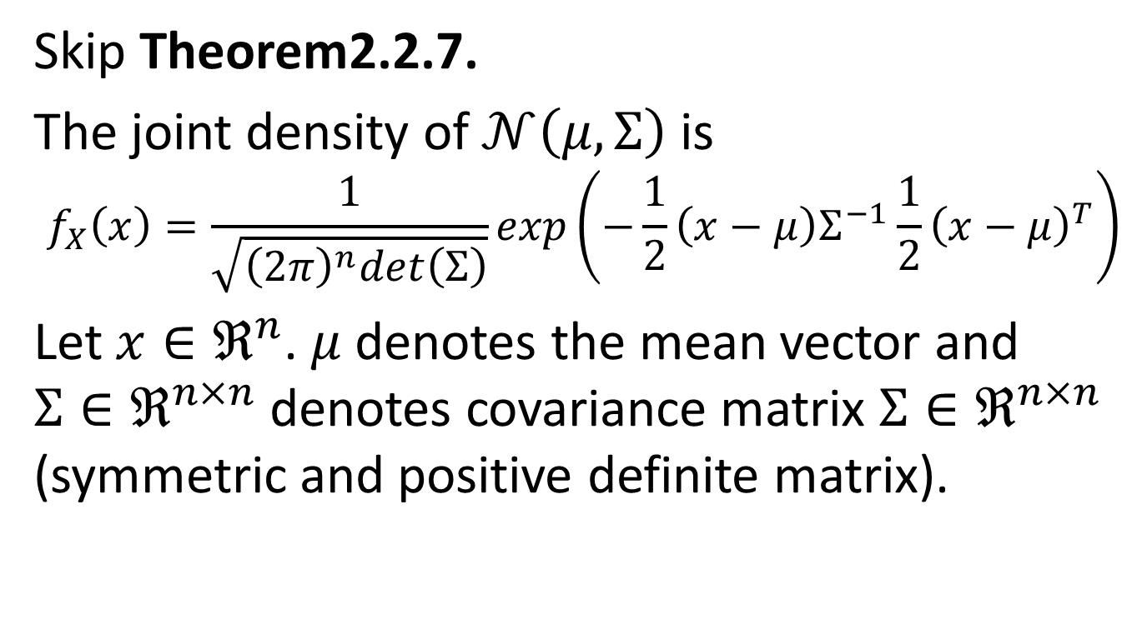
Jointly Normal Random Variables
Skip Theorem2.2.7.
The joint density of $𝒩\left(μ,Σ\right)$ is
$$f_{X}\left(x\right)=\frac{1}{\sqrt{{\left(2π\right)}^{n}det\left(Σ\right)}}exp\left(−\frac{1}{2}\left(x−μ\right)Σ^{−1}{\frac{1}{2}\left(x−μ\right)}^{T}\right)$$
Let $x∈ℜ^{n}$. $μ$ denotes the mean vector and $Σ∈ℜ^{n×n}$ denotes covariance matrix $Σ∈ℜ^{n×n}$ (symmetric and positive definite matrix).

Slide 19
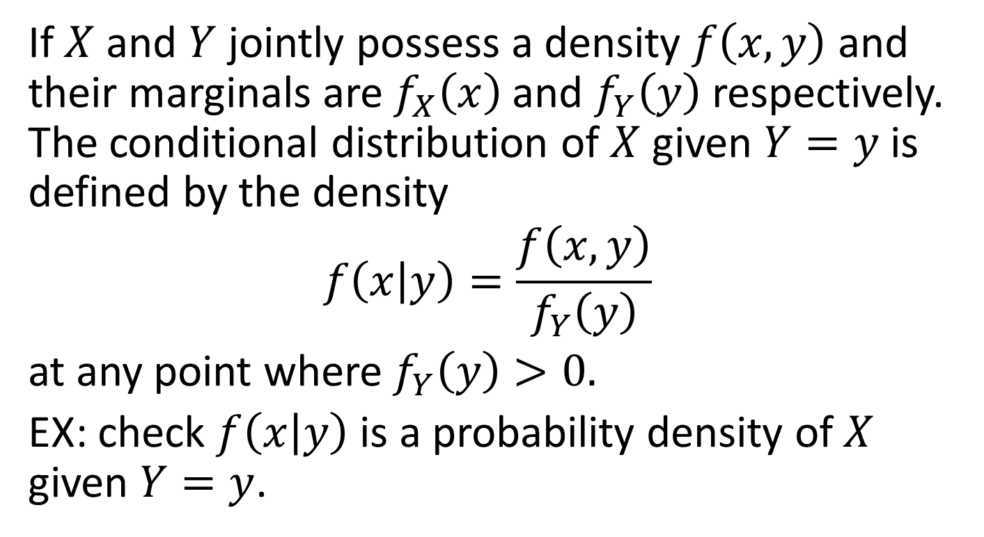
Conditioning (1)
If $X$ and $Y$ jointly possess a density $f\left(x,y\right)$ and their marginals are $f_{X}\left(x\right)$ and $f_{Y}\left(y\right)$ respectively. The conditional distribution of $X$ given $Y=y$ is defined by the density
$$f\left(x\left|y\right.\right)=\frac{f\left(x,y\right)}{f_{Y}\left(y\right)}$$
at any point where $f_{Y}\left(y\right)>0.$
EX: check $f\left(x\left|y\right.\right)$ is a probability density of $X$ given $Y=y$.

Slide 20
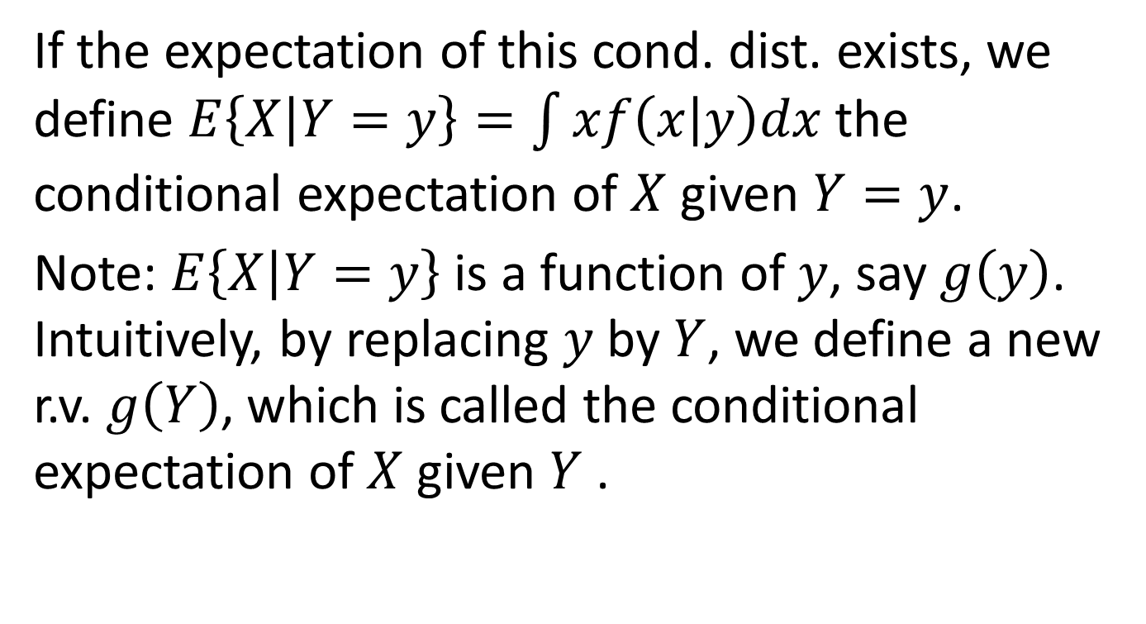
Conditioning (2)
If the expectation of this cond. dist. exists, we define $E\left\{\left.X\right|Y=y\right\}=\int{xf\left(x\left|y\right.\right)dx}$ the conditional expectation of $X$ given $Y=y$.
Note: $E\left\{\left.X\right|Y=y\right\}$ is a function of $y$, say $g\left(y\right)$. Intuitively, by replacing $y$ by $Y$, we define a new r.v. $g\left(Y\right)$, which is called the conditional expectation of $X$ given $Y$ .

Slide 21
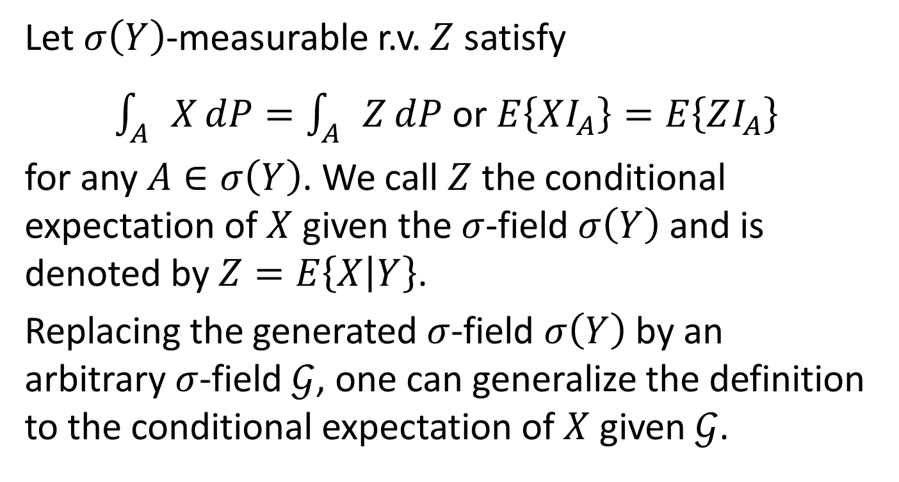
Conditioning (3) - General Case
Let $σ\left(Y\right)$-measurable r.v. $Z$ satisfy
$\int_{A}{X}dP=\int_{A}{Z}dP$ or $E\left\{XI_{A}\right\}=E\left\{ZI_{A}\right\}$
for any $A∈σ\left(Y\right)$. We call $Z$ the conditional expectation of $X$ given the $σ$-field $σ\left(Y\right)$ and is denoted by $Z=E\left\{X\left|Y\right.\right\}$.
Replacing the generated $σ$-field $σ\left(Y\right)$ by an arbitrary $σ$-field $𝒢$, one can generalize the definition to the conditional expectation of $X$ given $𝒢$.

Slide 22
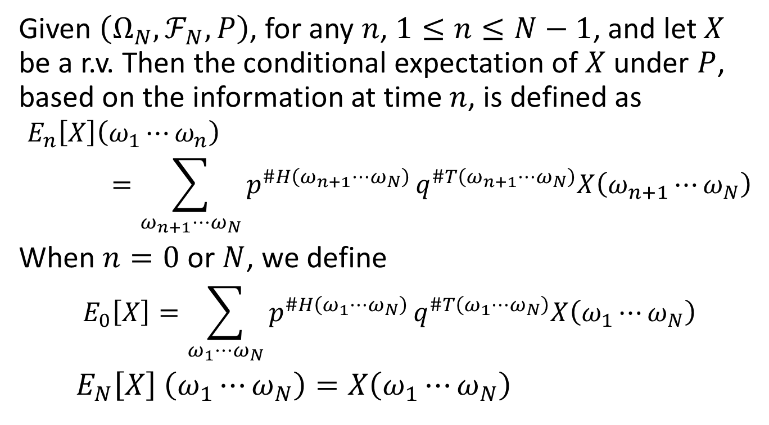
N Coin Tosses
Given $\left(Ω_{N},ℱ_{N},P\right)$, for any $n$, $1≤n≤N−1$, and let $X$ be a r.v. Then the conditional expectation of $X$ under $P$, based on the information at time $n$, is defined as
$$E_{n}\left[X\right]\left(ω_{1}⋯ω_{n}\right)=\sum_{ω_{n+1}⋯ω_{N}}{p^{\#H\left(ω_{n+1}⋯ω_{N}\right)}}q^{\#T\left(ω_{n+1}⋯ω_{N}\right)}X\left(ω_{n+1}⋯ω_{N}\right)$$
When $n=0$ or $N$, we define
$$E_{0}\left[X\right]=\sum_{ω_{1}⋯ω_{N}}{p^{\#H\left(ω_{1}⋯ω_{N}\right)}}q^{\#T\left(ω_{1}⋯ω_{N}\right)}X\left(ω_{1}⋯ω_{N}\right)$$
$E_{N}\left[X\right]$ $\left(ω_{1}⋯ω_{N}\right)=X\left(ω_{1}⋯ω_{N}\right)$

Slide 23
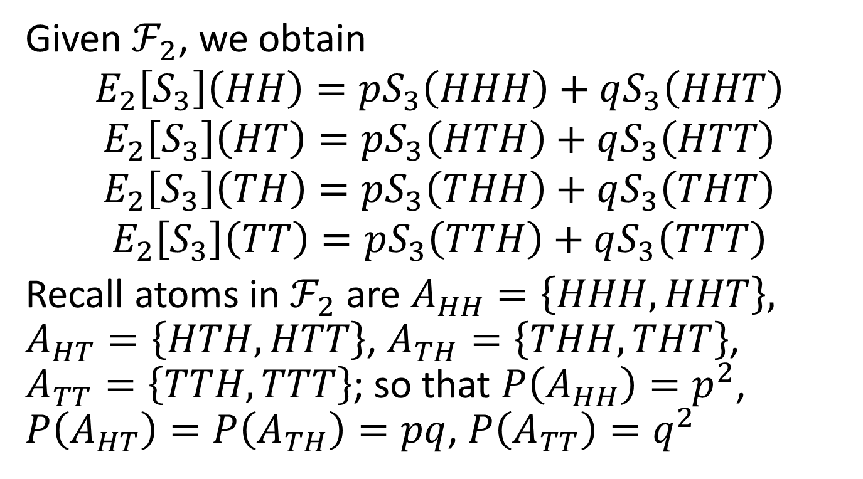
Revisit 3 Period Binomial Model
Given $ℱ_{2}$, we obtain
$$E_{2}\left[S_{3}\right]\left(HH\right)=pS_{3}\left(HHH\right)+qS_{3}\left(HHT\right)$$
$$E_{2}\left[S_{3}\right]\left(HT\right)=pS_{3}\left(HTH\right)+qS_{3}\left(HTT\right)$$
$$E_{2}\left[S_{3}\right]\left(TH\right)=pS_{3}\left(THH\right)+qS_{3}\left(THT\right)$$
$$E_{2}\left[S_{3}\right]\left(TT\right)=pS_{3}\left(TTH\right)+qS_{3}\left(TTT\right)$$
Recall atoms in $ℱ_{2}$ are $A_{HH}=\left\{HHH,HHT\right\},$ $A_{HT}=\left\{HTH,HTT\right\}$, $A_{TH}=\left\{THH,THT\right\}$, $A_{TT}=\left\{TTH,TTT\right\}$; so that $P\left(A_{HH}\right)=p^{2}$, $P\left(A_{HT}\right)=P\left(A_{TH}\right)=pq$, $P\left(A_{TT}\right)=q^{2}$

Slide 24
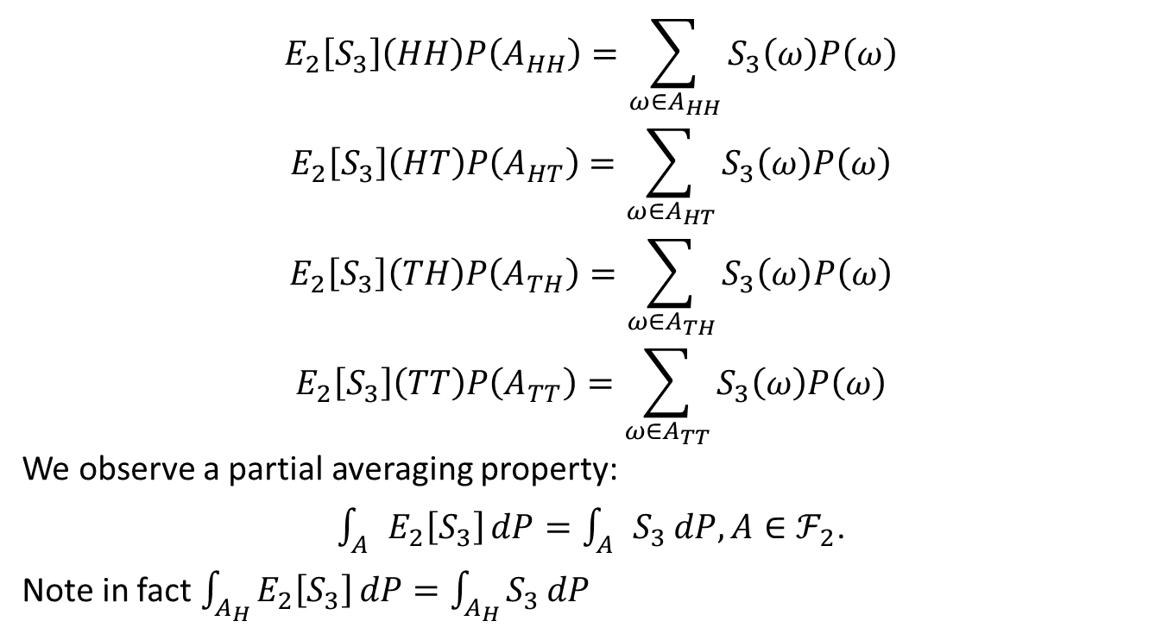
$$E_{2}\left[S_{3}\right]\left(HH\right)P\left(A_{HH}\right)=\sum_{ω∈A_{HH}}{S_{3}\left(ω\right)P\left(ω\right)}$$
$$E_{2}\left[S_{3}\right]\left(HT\right)P\left(A_{HT}\right)=\sum_{ω∈A_{HT}}{S_{3}\left(ω\right)P\left(ω\right)}$$
$$E_{2}\left[S_{3}\right]\left(TH\right)P\left(A_{TH}\right)=\sum_{ω∈A_{TH}}{S_{3}\left(ω\right)P\left(ω\right)}$$
$$E_{2}\left[S_{3}\right]\left(TT\right)P\left(A_{TT}\right)=\sum_{ω∈A_{TT}}{S_{3}\left(ω\right)P\left(ω\right)}$$
We observe a partial averaging property:
$\int_{A}{E_{2}\left[S_{3}\right]}dP=\int_{A}{S_{3}}dP, A∈ℱ_{2}$.
Note in fact $\int_{A_{H}}{E_{2}\left[S_{3}\right]}dP=\int_{A_{H}}{S_{3}}dP$

Slide 25
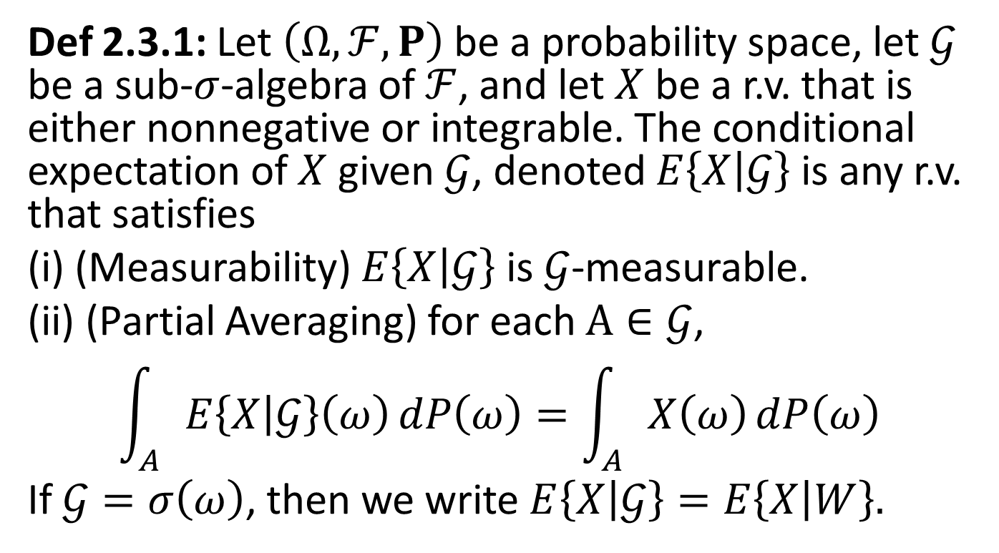
Conditional Expectation
Def 2.3.1: Let $\left(Ω,ℱ,P\right)$ be a probability space, let $𝒢$ be a sub-$σ$-algebra of $ℱ$, and let $X$ be a r.v. that is either nonnegative or integrable. The conditional expectation of$X$ given $𝒢$, denoted $E\left\{X\left|𝒢\right.\right\}$ is any r.v. that satisfies
(i) (Measurability) $E\left\{X\left|𝒢\right.\right\}$ is $𝒢$-measurable.
(ii) (Partial Averaging) for each $A∈𝒢$,
$$\int_{A}{E\left\{X\left|𝒢\right.\right\}\left(ω\right)}dP\left(ω\right)=\int_{A}{X\left(ω\right)}dP\left(ω\right)$$
If $𝒢=σ\left(ω\right)$, then we write $E\left\{X\left|𝒢\right.\right\}=E\left\{X\left|W\right.\right\}.$

Slide 26
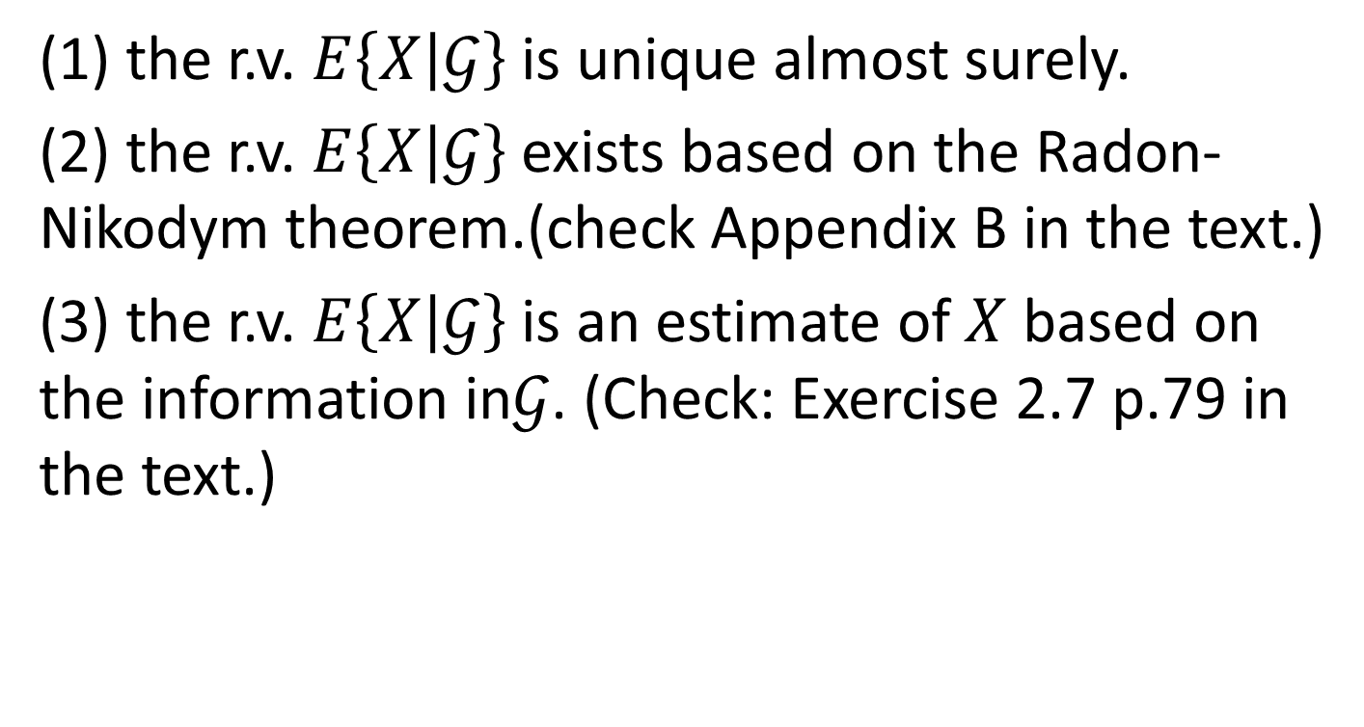
Some Remarks
(1) the r.v. $E\left\{X\left|𝒢\right.\right\}$ is unique almost surely.
(2) the r.v. $E\left\{X\left|𝒢\right.\right\}$ exists based on the Radon-Nikodym theorem.(check Appendix B in the text.)
(3) the r.v. $E\left\{X\left|𝒢\right.\right\}$ is an estimate of $X$ based on the information in$𝒢$. (Check: Exercise 2.7 p.79 in the text.)

Slide 27
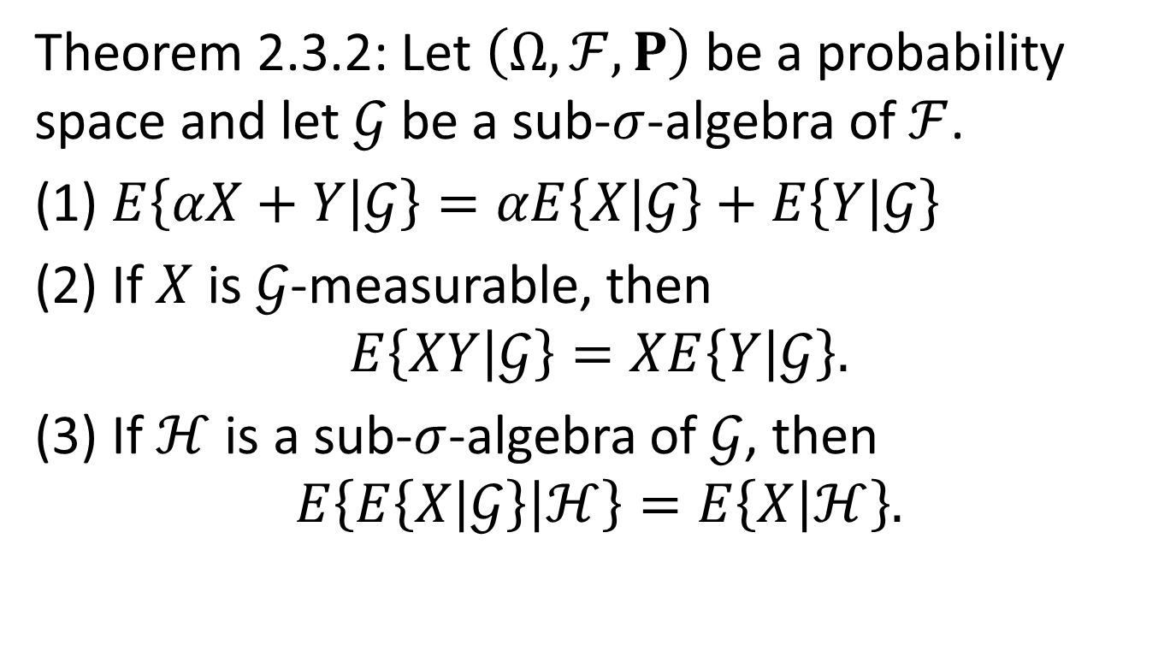
Properties of Conditional Expectation (1)
Theorem 2.3.2: Let $\left(Ω,ℱ,P\right)$ be a probability space and let $𝒢$ be a sub-$σ$-algebra of $ℱ$.
(1) $E\left\{αX+Y\left|𝒢\right.\right\}=αE\left\{X\left|𝒢\right.\right\}+E\left\{Y\left|𝒢\right.\right\}$
(2) If $X$ is $𝒢$-measurable, then
$$E\left\{XY\left|𝒢\right.\right\}=XE\left\{Y\left|𝒢\right.\right\}.$$
(3) If $ℋ$ is a sub-$σ$-algebra of $𝒢$, then
$$E\left\{E\left\{X\left|𝒢\right.\right\}\left|ℋ\right.\right\}=E\left\{X\left|ℋ\right.\right\}.$$

Slide 28

Properties of Conditional Expectation (2)
(4) If $X$ is independent of $𝒢$, then
$$E\left\{X\left|𝒢\right.\right\}=E\left\{X\right\}$$
(5) If $φ\left(x\right)$ is a convex function, then
$$E\left\{φ\left(X\right)\left|𝒢\right.\right\}=φ\left(E\left\{X\left|𝒢\right.\right\}\right)$$

Slide 29
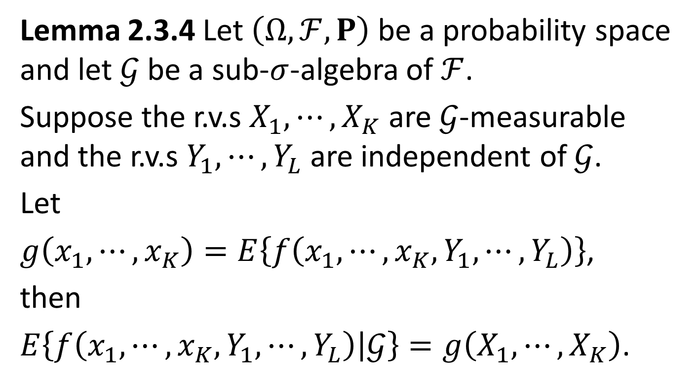
Computing Conditional expectations by independence
Lemma 2.3.4 Let $\left(Ω,ℱ,P\right)$ be a probability space and let $𝒢$ be a sub-$σ$-algebra of $ℱ$.
Suppose the r.v.s $X_{1},⋯,X_{K}$ are $𝒢$-measurable and the r.v.s $Y_{1},⋯,Y_{L}$are independent of $𝒢$.
Let
$g\left(x_{1},⋯,x_{K}\right)=E\left\{f\left(x_{1},⋯,x_{K},Y_{1},⋯,Y_{L}\right)\right\}$,
then
$E\left\{f\left(x_{1},⋯,x_{K},Y_{1},⋯,Y_{L}\right)\left|𝒢\right.\right\}=g\left(X_{1},⋯,X_{K}\right)$.

Slide 30
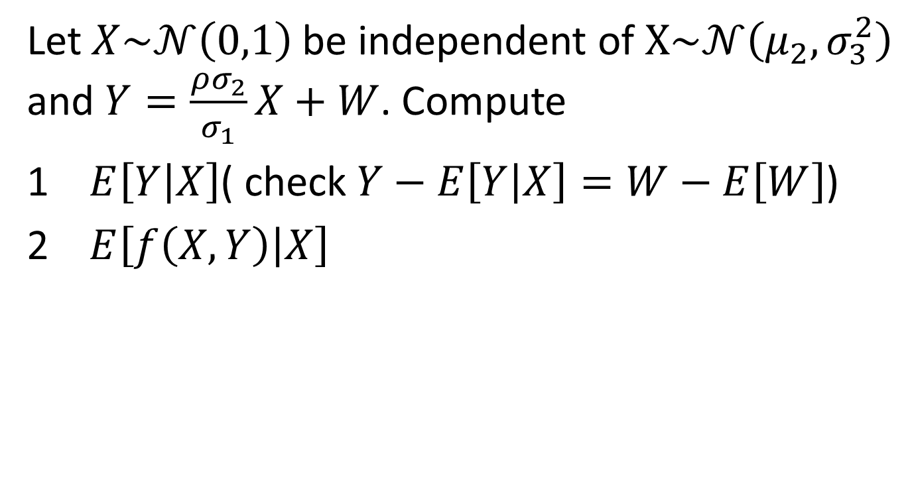
Example 2.3.3
Let $X\sim 𝒩\left(0,1\right)$ be independent of $X\sim 𝒩\left(μ_{2},σ_{3}^{2}\right)$ and $Y=\frac{ρσ_{2}}{σ_{1}}X+W$. Compute
1 $E\left[Y\left|X\right.\right]$( check $Y−E\left[Y\left|X\right.\right]=W−E\left[W\right]$)
2 $E\left[f\left(X,Y\right)\left|X\right.\right]$

Slide 31
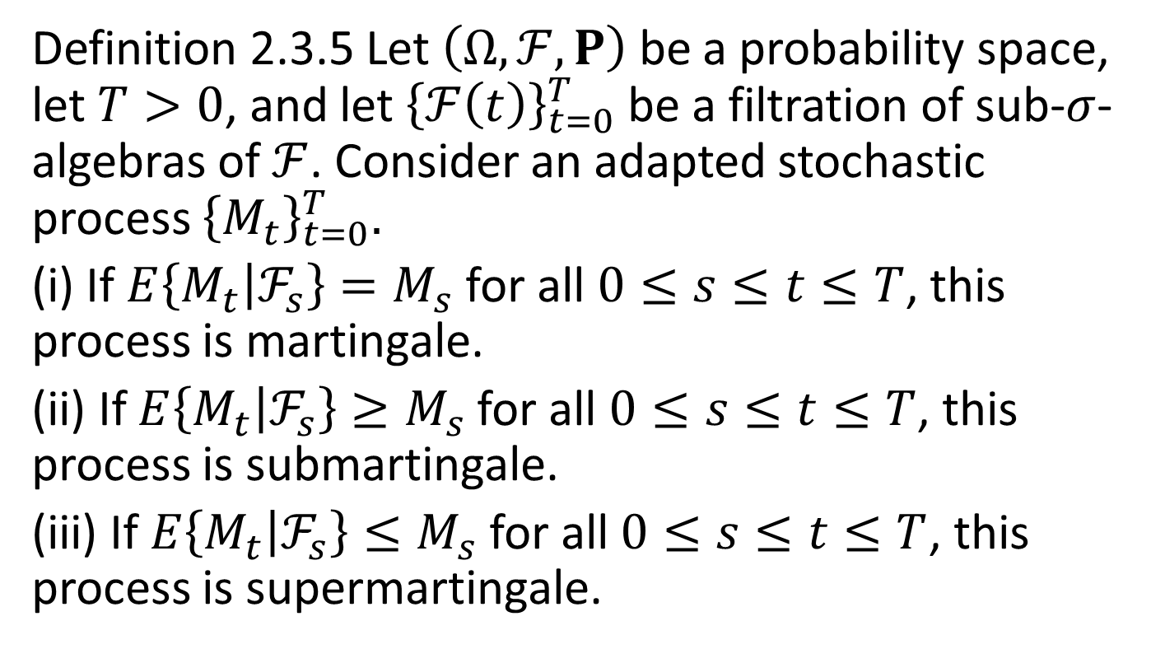
Martingale Property
Definition 2.3.5 Let $\left(Ω,ℱ,P\right)$ be a probability space, let $T>0$, and let ${\left\{ℱ\left(t\right)\right\}}_{t=0}^{T}$ be a filtration of sub-$σ$-algebras of $ℱ$. Consider an adapted stochastic process ${\left\{M_{t}\right\}}_{t=0}^{T}.$
(i) If $E\left\{M_{t}\left|ℱ_{s}\right.\right\}=M_{s}$ for all $0≤s≤t≤T$, this process is martingale.
(ii) If $E\left\{M_{t}\left|ℱ_{s}\right.\right\}≥M_{s}$ for all $0≤s≤t≤T$, this process is submartingale.
(iii) If $E\left\{M_{t}\left|ℱ_{s}\right.\right\}≤M_{s}$ for all $0≤s≤t≤T$, this process is supermartingale.

Slide 32
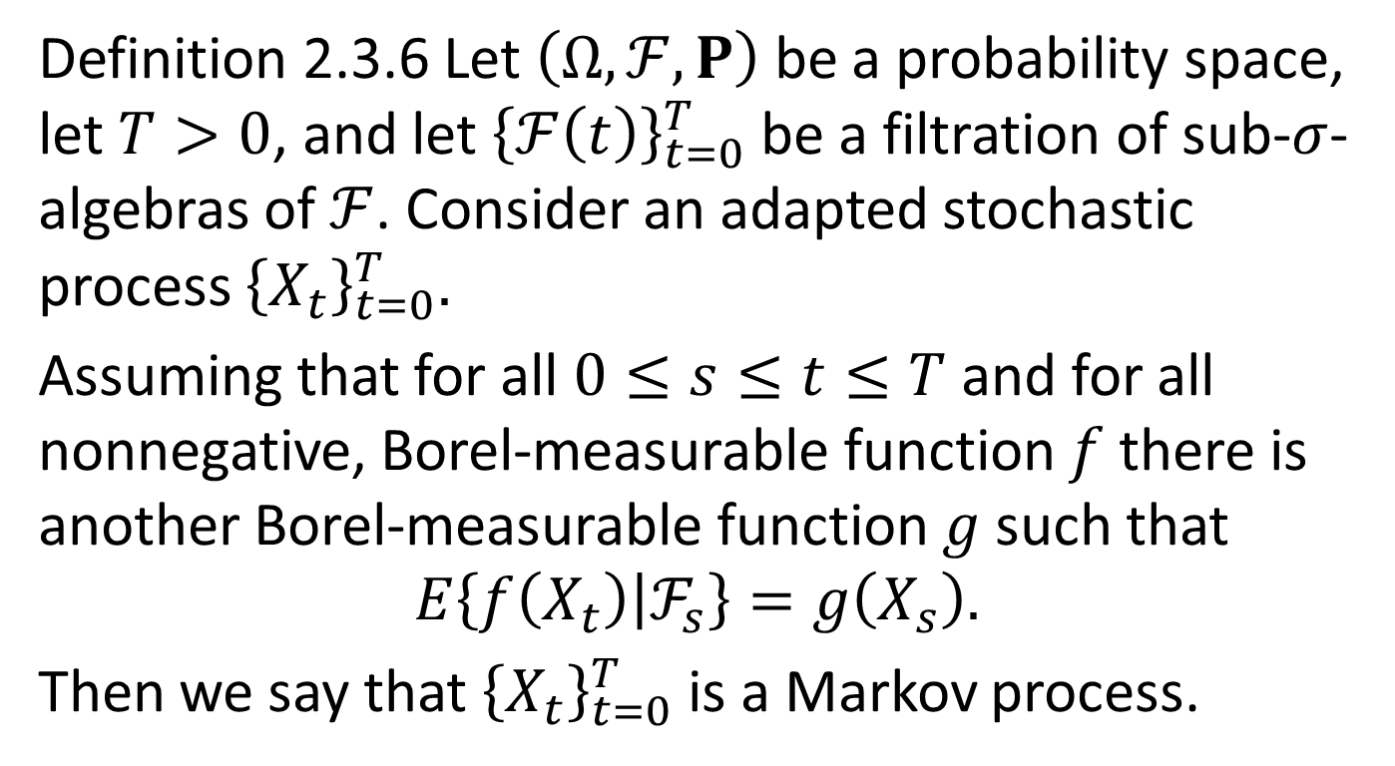
Markov Property
Definition 2.3.6 Let $\left(Ω,ℱ,P\right)$ be a probability space, let $T>0$, and let ${\left\{ℱ\left(t\right)\right\}}_{t=0}^{T}$ be a filtration of sub-$σ$-algebras of $ℱ$. Consider an adapted stochastic process ${\left\{X_{t}\right\}}_{t=0}^{T}.$
Assuming that for all $0≤s≤t≤T$ and for all nonnegative, Borel-measurable function $f$ there is another Borel-measurable function $g$ such that
$$E\left\{f\left(X_{t}\right)\left|ℱ_{s}\right.\right\}=g\left(X_{s}\right).$$
Then we say that ${\left\{X_{t}\right\}}_{t=0}^{T}$ is a Markov process.

