Slide 1

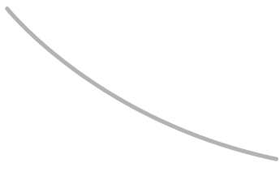

R. GLENN HUBBARD
ANTHONY PATRICK O’BRIEN
Economics
FOURTH EDITION

Slide 2

15
Monopoly and Antitrust Policy
CHAPTER
Chapter Outline and
Learning Objectives
15.1 | Is Any Firm Ever Really a Monopoly?
15.2 | Where Do Monopolies Come From?
15.3 | How Does a Monopoly Choose Price and Output?
15.4 | Does Monopoly Reduce Economic Efficiency?
15.5 | Government Policy toward Monopoly

Slide 3
新聞時事
台灣各縣市有線電視業者
行政區 | 家數 | 業者名稱
基隆市 | 1 | 吉隆有線電視
新竹縣 | 1 | 北視有線電視
新竹市 | 1 | 新竹振道有線電視
南投縣 | 1 | 中投有線電視
嘉義市 | 1 | 世新有線電視
台東縣 | 1 | 東台有線電視
澎湖縣 | 1 | 澎湖有線電視

Slide 4
The economic model of monopoly provides a benchmark for the extreme where a firm is the only one in its market and, therefore, faces no competition from other firms supplying its product.
The monopoly model is also useful in analyzing situations in which firms agree to collude, or not compete, and act together as if they were a monopoly.

Slide 5
Is Any Firm Ever Really a Monopoly?
15.1 LEARNING OBJECTIVE
Define monopoly.
Monopoly (獨占) A firm that is the only seller of a good or service that does not have a close substitute.

Slide 6
Where Do Monopolies Come From?
15.2 LEARNING OBJECTIVE
Explain the four main reasons monopolies arise.

Slide 7
Barriers to entry may be high enough to keep out competing firms for four main reasons:
1. A government blocks the entry of more than one firm into a market.
2. One firm has control of a key resource necessary to produce a good.
3. There are important network externalities in supplying the good or service.
4. Economies of scale are so large that one firm has a natural monopoly.
Government Action Blocks Entry
In the United States, governments block entry in two main ways:
1. By granting a patent or copyright to an individual or a firm, giving it the exclusive right to produce a product
2. By granting a firm a public franchise, making it the exclusive legal provider of a good or service

Slide 8
Patents, Copyrights, and Public Franchises
Patent (專利) The exclusive right to a product for a period of 20 years from the date the patent is filed with the government.
Pharmaceutical firms apply for patents about 10 years before they begin to sell a new prescription drug, after which most earn economic profits for 20 years.
After the patent has expired, other firms are free to legally produce chemically identical drugs called generic drugs, whose competition will eliminate the increasing profits the original firm had been earning during the time remaining on the patent, which is usually about 10 years.
Copyright (著作權) A government-granted exclusive right to produce and sell a creation.
After a creator’s death, his or her heirs retain this exclusive right for 70 years.
Public franchise (公共特許經營權) A government designation that a firm is the only legal provider of a good or service.
Public enterprises, through which governments may decide to provide certain services directly to consumers rather than rely on private firms, are more common in Europe than in the United States.

Slide 9
Control of a Key Resource 控制一個關鍵資源
Most resources, including raw materials such as oil or iron ore, are widely available from a variety of suppliers, but before World War II, the Aluminum Company of America (Alcoa) and the International Nickel Company of Canada were two monopolies based on control of a key resource.
Network Externalities 網路外部性
Network externalities A situation in which the usefulness of a product increases with the number of consumers who use it.
From a firm’s point of view, network externalities can set off a virtuous cycle:
If a firm can attract enough customers initially, it can attract additional customers because the value of its product has been increased by more people using it, which attracts even more customers, and so on.

Slide 10
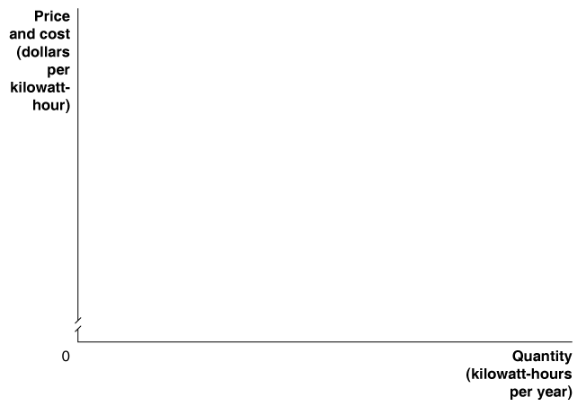
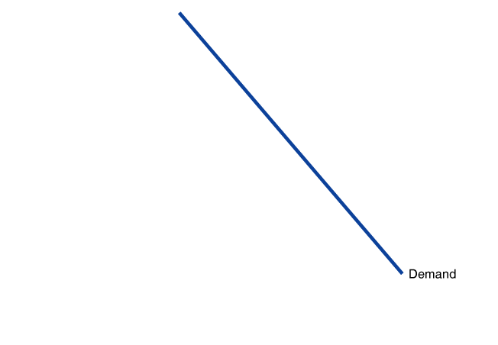
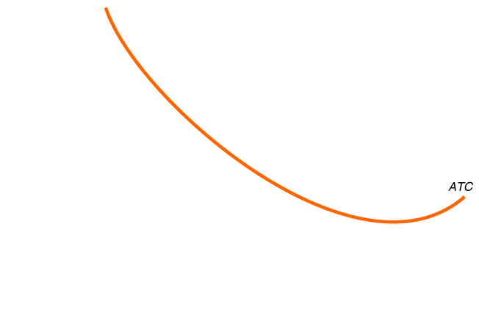
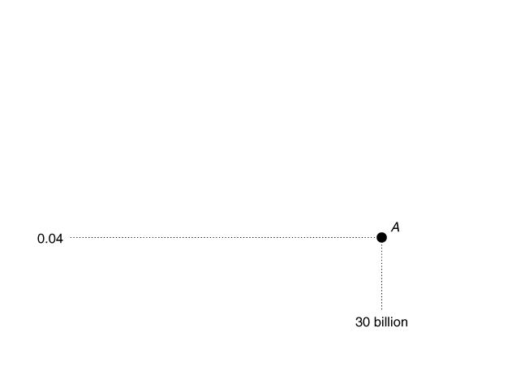
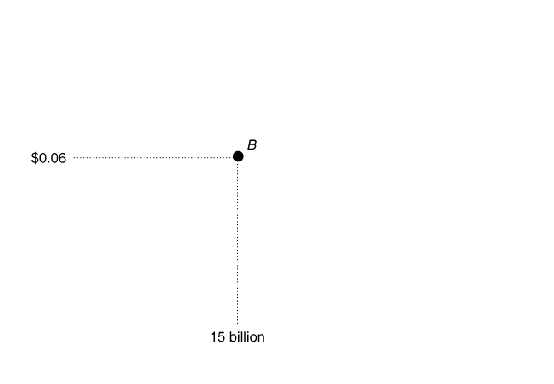
Natural monopoly (自然獨占) A situation in which economies of scale are so large that one firm can supply the entire market at a lower average total cost than can two or more firms.
Figure 15.1
Average Total Cost Curve for a Natural Monopoly
With a natural monopoly,
the average total cost curve is still falling when it crosses the demand curve (point A).
If only one firm is producing electric power in the market,
and it produces where the average cost curve intersects the demand curve,
average total cost will equal $0.04 per kilowatt-hour of electricity produced.
If the market is divided between two firms,
each producing 15 billion kilowatt-hours,
the average cost of producing electricity rises to $0.06 per kilowatt-hour (point B).
In this case, if one firm expands production, it can move down the average total cost curve,
lower its price, and drive the other firm out of business.

Slide 11
How Does a Monopoly Choose Price and Output?
15.3 LEARNING OBJECTIVE
Explain how a monopoly chooses price and output.

Slide 12
A monopoly differs from other firms in that a monopoly’s demand curve is the same as the demand curve for the product.
Marginal Revenue Once Again
Recall that firms in perfectly competitive markets are price takers because they face horizontal demand curves.
All other firms, including monopolies, are price makers because they face a downward-sloping demand curve as well as a downward-sloping marginal revenue curve.
Remember that when a firm cuts the price of a product, one good thing happens,
and one bad thing happens:
The good thing. It sells more units of the product.
The bad thing. It receives less revenue from each unit than it would have received at the higher price.

Slide 13
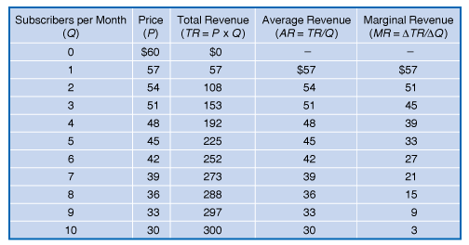
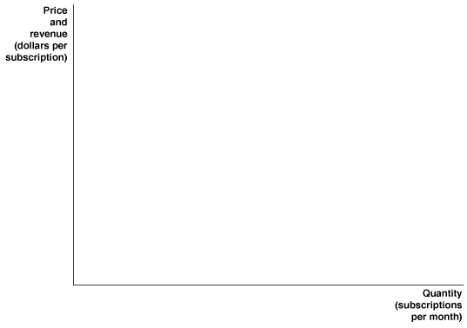
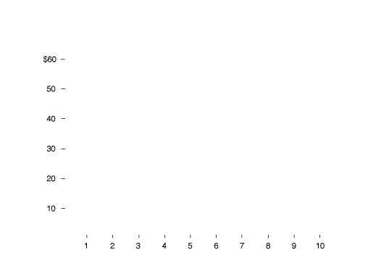
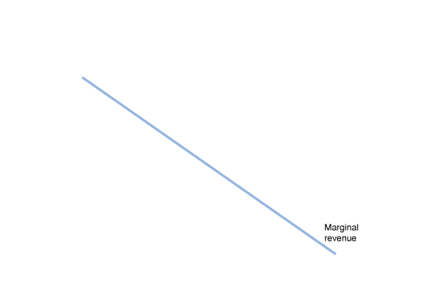
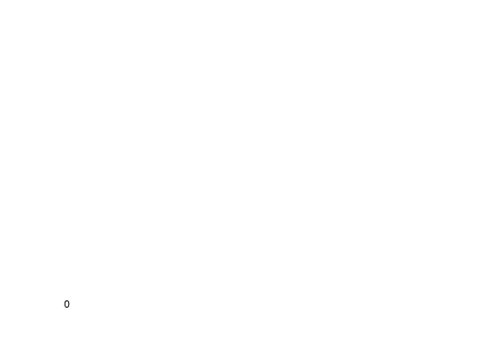
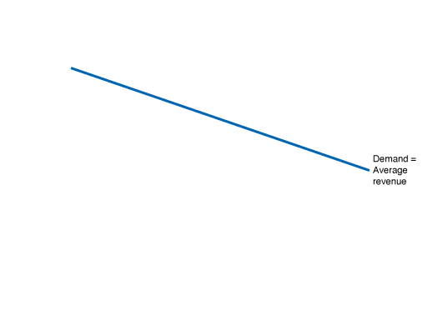
Figure 15.2
Calculating a Monopoly’s Revenue
Time Warner Cable faces a downward-sloping demand curve for subscriptions to basic cable.
To sell more subscriptions, it must cut the price.
When this happens, it gains revenue from selling more subscriptions but loses revenue from selling them at a lower price than it could have.
The firm’s marginal revenue is the change in revenue from selling another subscription.
We can calculate marginal revenue by subtracting the revenue lost as a result of a price cut from the revenue gained.
The table shows that Time Warner’s marginal revenue is less than the price for every subscription sold after the first subscription.
Therefore, Time Warner’s marginal revenue curve will be below its demand curve.

Slide 14
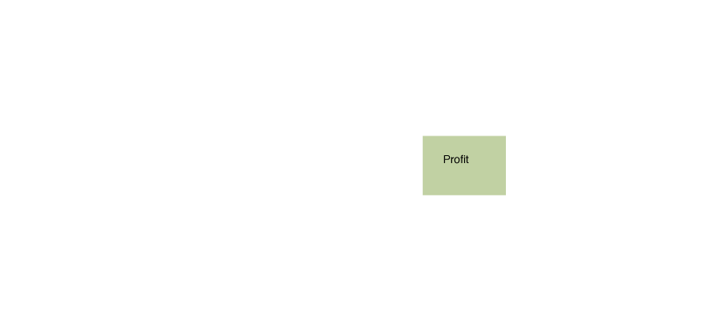
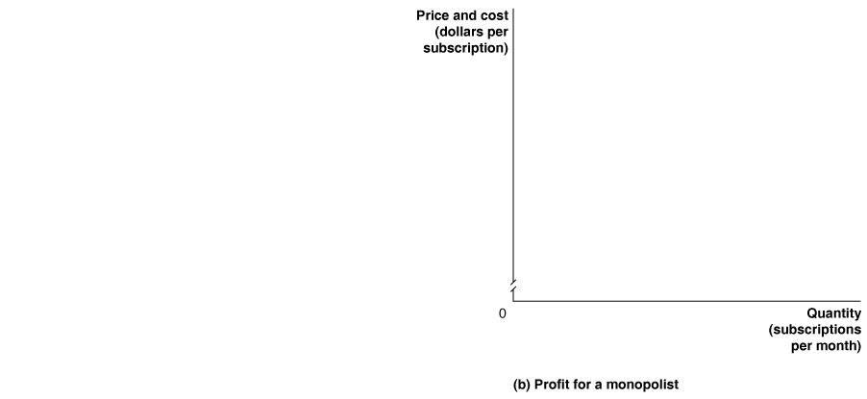
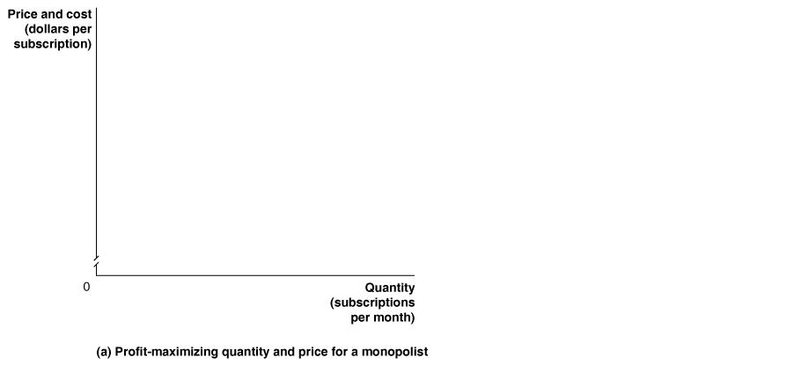
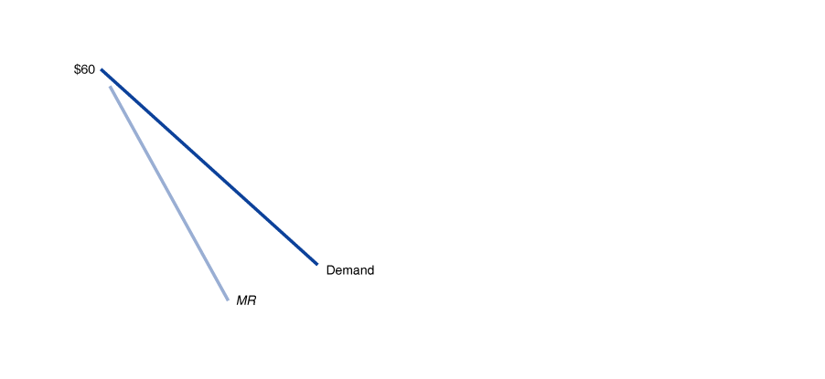
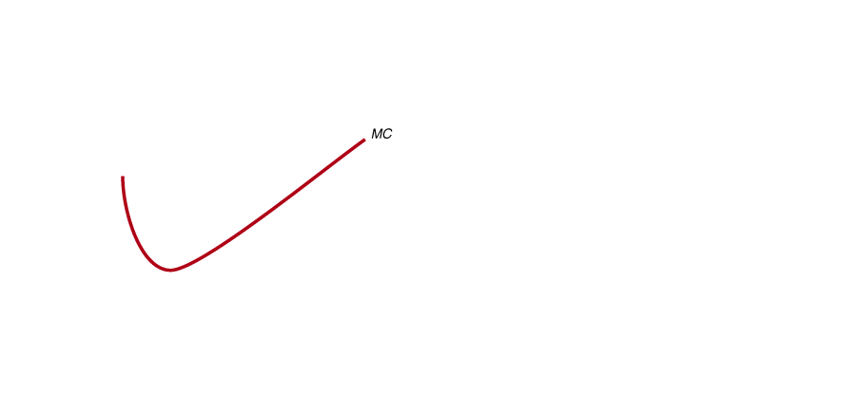
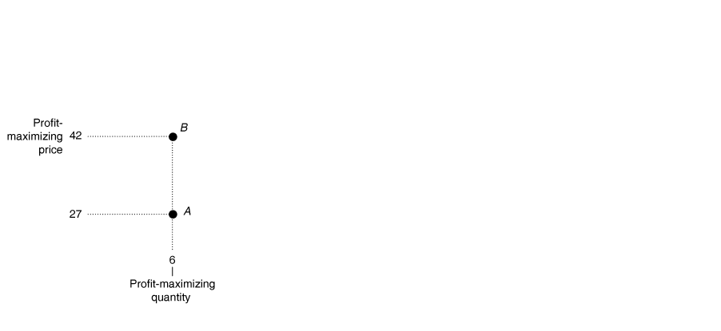
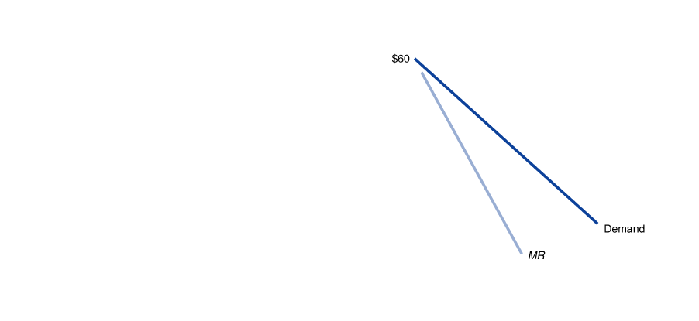
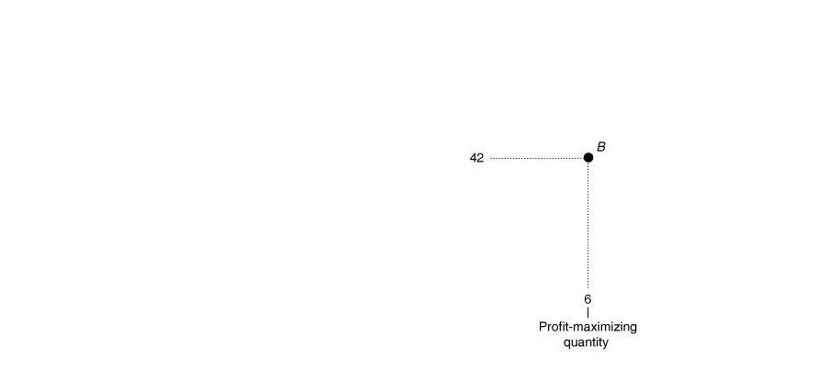
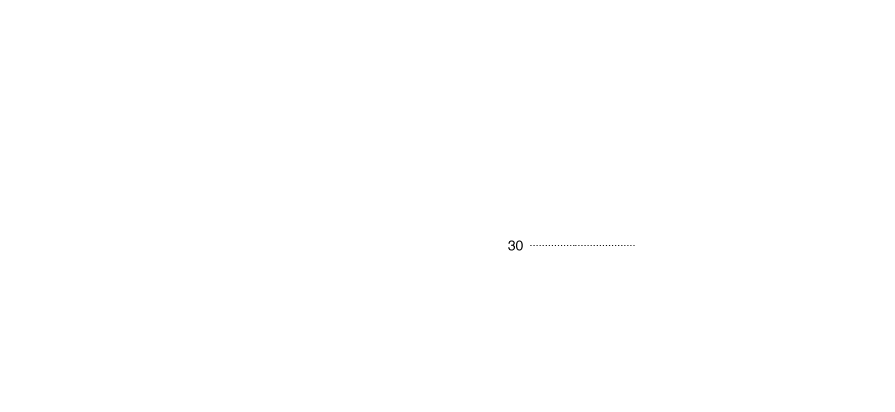
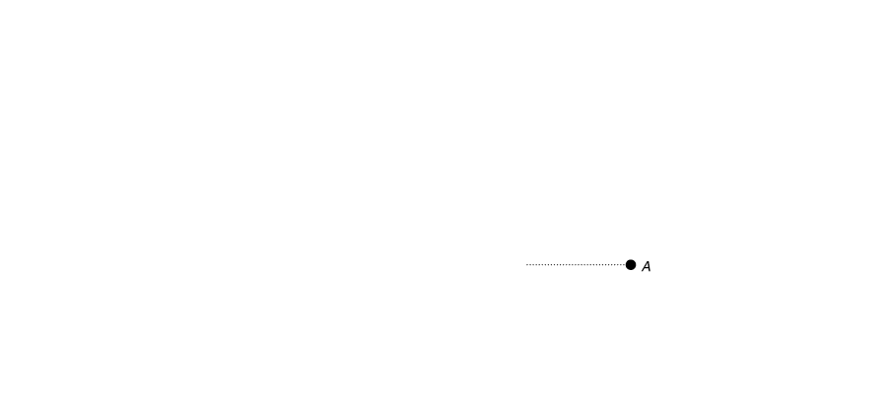
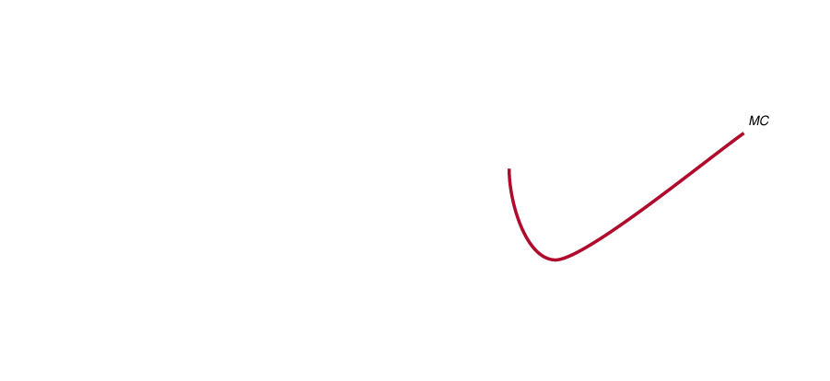
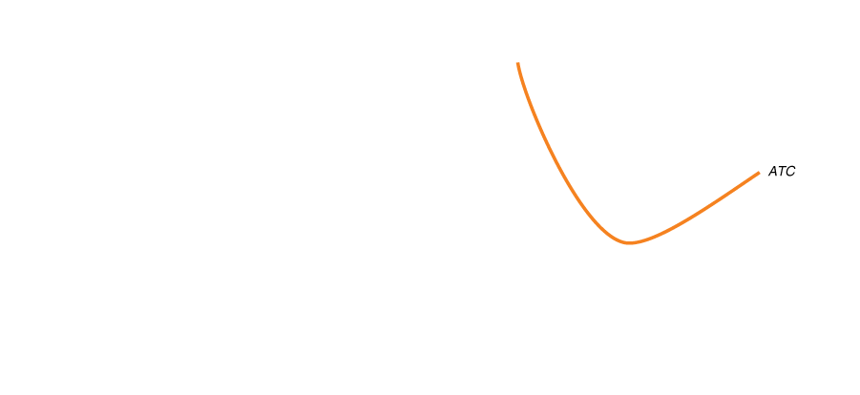
Figure 15.3
Profit-Maximizing Price and Output for a Monopoly
Panel (a) shows that to maximize profit, Time Warner should sell subscriptions up to the point where the marginal revenue from selling the last subscription equals its marginal cost (point A). In this case, the marginal revenue from selling the sixth subscription and the marginal cost are both $27. Time Warner maximizes profit by selling 6 subscriptions per month and charging a price of $42 (point B).
In panel (b), the green box represents Time Warner’s profit. The box has a height equal to $12, which is the price of $42 minus the average total cost of $30, and a base equal to the quantity of 6 cable subscriptions. Time Warner’s profit therefore equals $12 × 6 = $72.

Slide 15
If other factors remain unchanged, monopolists can continue to earn economic profits, even in the long run, without facing competition; new firms will not enter the market.
Don’t Let This Happen to You
Don’t Assume That Charging a Higher Price Is Always More Profitable for a Monopolist
In addition to marginal revenue and marginal cost, a monopolist must pay attention to consumer demand to determine whether the price is maximizing profit.
MyEconLab
Your Turn: Test your understanding by doing related problem 3.8 at the end of this chapter.

Slide 16
Does Monopoly Reduce Economic Efficiency?
15.4 LEARNING OBJECTIVE
Use a graph to illustrate how a monopoly affects economic efficiency.

Slide 17
Equilibrium in a perfectly competitive market results in the greatest amount of economic surplus, or total benefit to society, from the production of a good or service.
Comparing Monopoly and Perfect Competition 比較獨佔跟完全競爭
A monopoly will produce less and charge a higher price than would a perfectly competitive industry producing the same good.

Slide 18
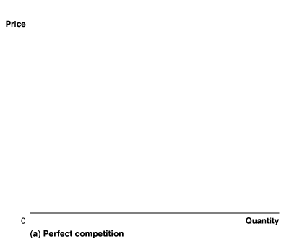
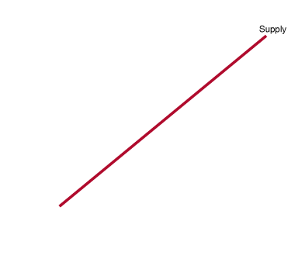
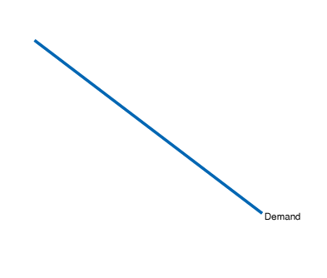
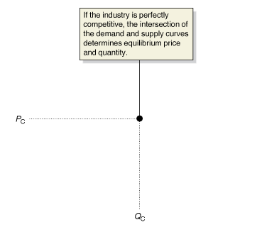
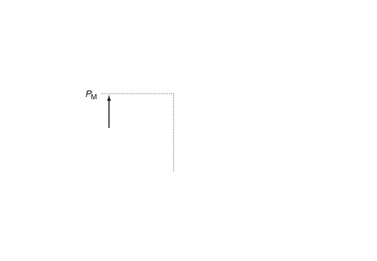
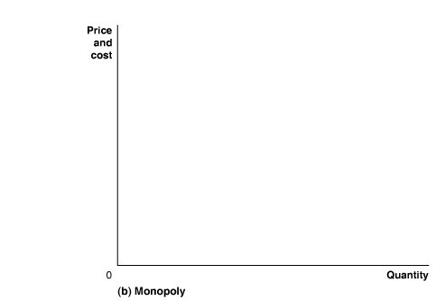
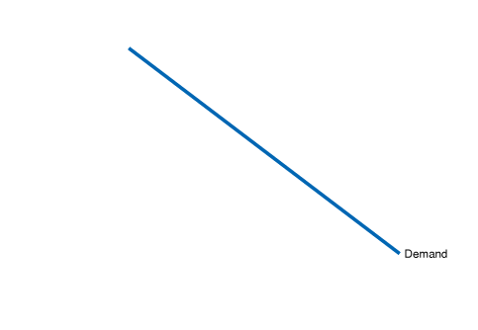
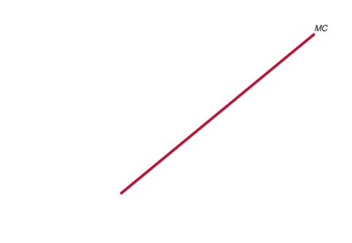
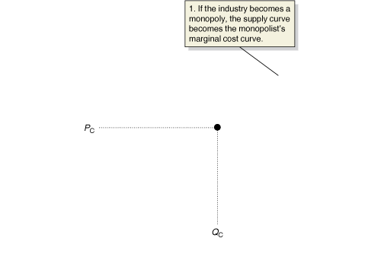
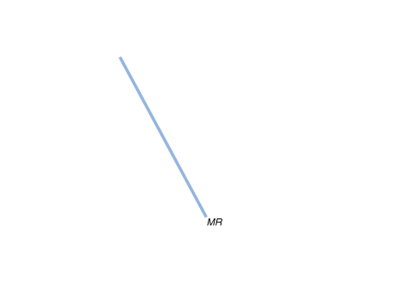
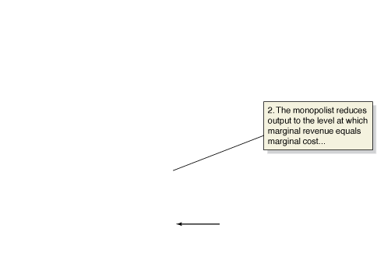
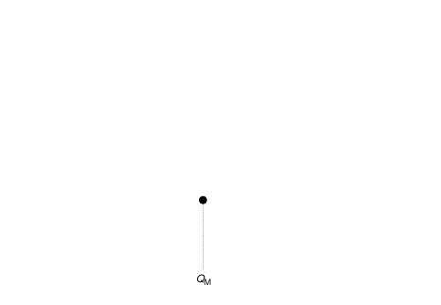
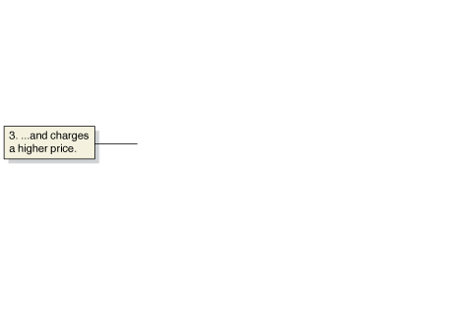
What Happens If a Perfectly Competitive Industry Becomes a Monopoly?
Figure 15.4
In panel (a), the market for tablet computers is perfectly competitive, and price and quantity are determined by the intersection of the demand and supply curves.
In panel (b), the perfectly competitive tablet computer industry becomes a monopoly.
As a result:
1. The industry supply curve becomes the monopolist’s marginal cost curve.
2. The monopolist reduces output to where marginal revenue equals marginal cost, Q_{M}.
3. The monopolist raises the price from P_{C} to P_{M}.

Slide 19
Measuring the Efficiency Losses from Monopoly
衡量因獨占的效率損失
Recall that consumer surplus measures the net benefit received by consumers from purchasing a good or service, and that producer surplus measures the net benefit to producers from selling a good or service.
The sum of consumer surplus plus producer surplus equals economic surplus,
a reduction in which is called deadweight loss and represents the loss of economic efficiency.
We can summarize the effects of monopoly as follows:
1. Monopoly causes a reduction in consumer surplus.
2. Monopoly causes an increase in producer surplus.
3. Monopoly causes a deadweight loss, which represents a reduction in economic efficiency.

Slide 20
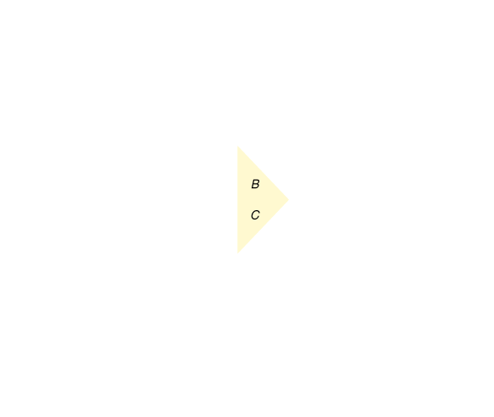
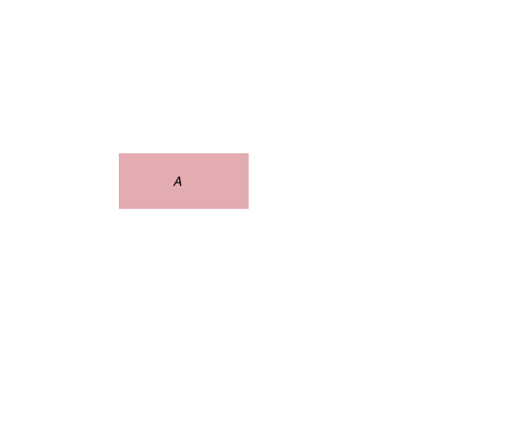
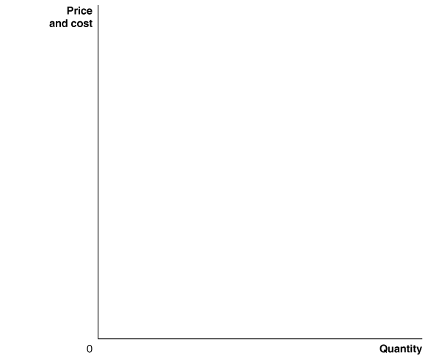
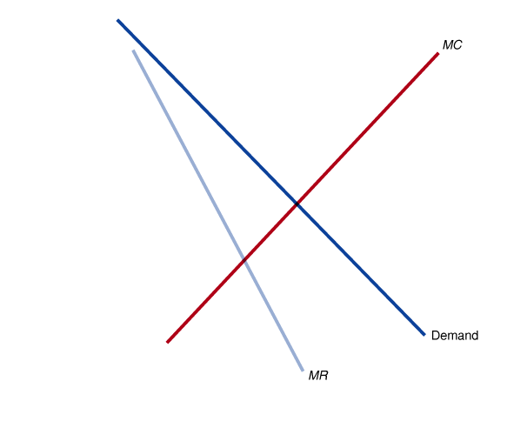
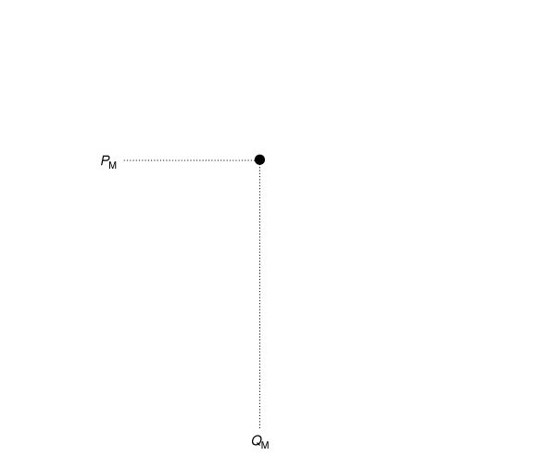
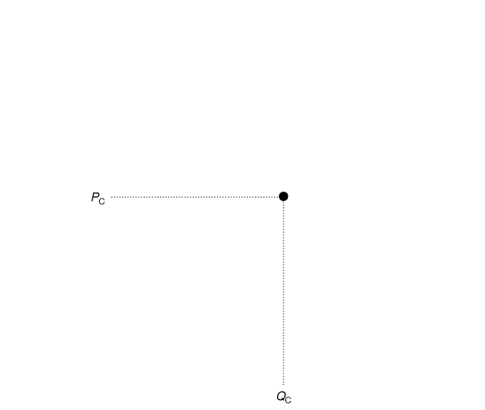
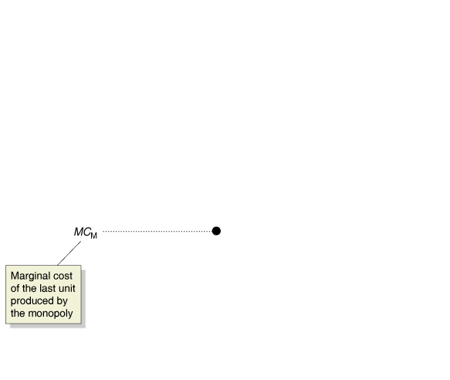
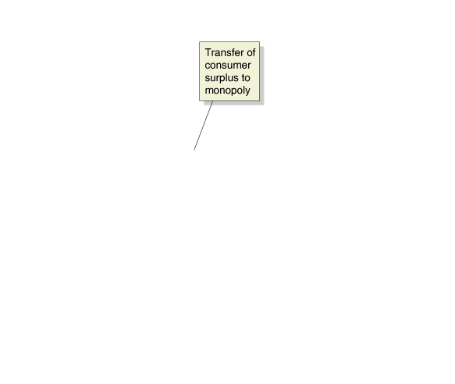
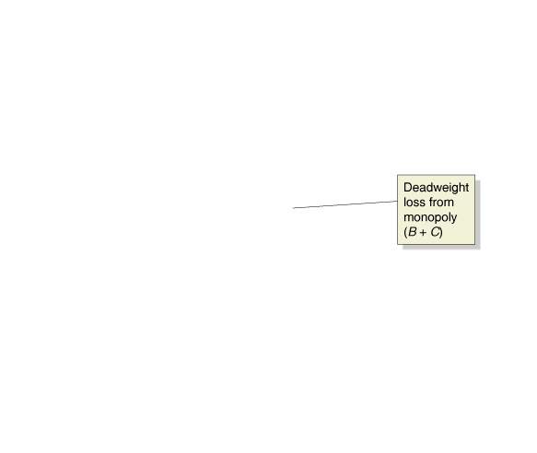
Figure 15.5
The Inefficiency of Monopoly
A monopoly charges a higher price, P_{M},
and produces a smaller quantity, Q_{M},
than a perfectly competitive industry,
which charges price P_{C} and produces Q_{C}.
The higher price reduces consumer surplus by the area equal to the rectangle A and the triangle B.
Some of the reduction in consumer surplus is captured by the monopoly as producer surplus,
and some becomes deadweight loss,
which is the area equal to triangles B and C.

Slide 21
How Large Are the Efficiency Losses Due to Monopoly?
Market power (市場力量) The ability of a firm to charge a price greater than marginal cost.
The only firms that do not have market power are firms in perfectly competitive markets, which must charge a price equal to marginal cost.
Because few markets are perfectly competitive, some loss of economic efficiency occurs in the market for nearly every good or service, yet this loss is small since true monopolies are rare.
Competition keeps price much closer to marginal cost in most industries.
The closer price is to marginal cost, the smaller the size of the deadweight loss.
Market Power and Technological Change
Firms are often forced to rely on their profits to finance the research and development needed for new products, but smaller firms develop a number of new products themselves as well.
Government policymakers continue to struggle with the issue of whether, on balance, large firms with market power are good or bad for the economy.

Slide 22
Government Policy toward Monopoly
15.5 LEARNING OBJECTIVE
Discuss government policies toward monopoly.

Slide 23
Collusion (勾結) An agreement among firms to charge the same price or otherwise not to compete.
In the United States, antitrust laws are designed to prevent monopolies and collusion.
Antitrust Laws and Antitrust Enforcement
Congress passed the Sherman Act in 1890 to promote competition and prevent the formation of monopolies.
The act targeted firms in several industries that had combined together to form “trusts,” the most notorious of which was the Standard Oil Trust, organized by John D. Rockefeller.
In a trust, the firms were operated independently but gave voting control to a board of trustees, which enforced collusive agreements for the firms to charge the same price and not to compete for each other’s customers.
Antitrust laws (反壟斷法) Laws aimed at eliminating collusion and promoting competition among firms.

Slide 24
To address several loopholes in the Sherman Act, Congress passed the Clayton Act, under which a merger was illegal if its effect was “substantially to lessen competition, or to tend to create a monopoly,” and the Federal Trade Commission Act, which set up the Federal Trade Commission (FTC) to police unfair business practices.
Currently, both the Antitrust Division of the U.S. Department of Justice and the FTC are responsible for merger policy.
Table 15.1
Important U.S. Antitrust Laws
Law | Date Enacted | Purpose
Sherman Act | 1890 | Prohibited “restraint of trade,” including price fixing and collusion. Also outlawed monopolization.
Clayton Act | 1914 | Prohibited firms from buying stock in competitors and from having directors serve on the boards of competing firms.
Federal Trade Commission Act | 1914 | Established the Federal Trade Commission (FTC) to help administer antitrust laws.
Robinson-Patman Act | 1936 | Prohibited firms from charging buyers different prices if the result would reduce competition.
Cellar-Kefauver Act | 1950 | Toughened restrictions on mergers by prohibiting any mergers that would reduce competition.

Slide 25
Mergers: The Trade-off between Market Power and Efficiency
Horizontal merger (水平合併) A merger between firms in the same industry.
Vertical merger (垂直合併) A merger between firms at different stages of production of a good.
Two factors can complicate regulating horizontal mergers:
The “market” that firms are in is not always clear.
There is the possibility that the newly merged firm might be more efficient than the merging firms were individually.
In practice, the government defines the relevant market on the basis of whether there are close substitutes for the products being made by the merging firms.
Even if a merged firm is more efficient and has lower costs, that may not offset the increased market power of the firm enough to increase consumer surplus and economic efficiency.

Slide 26
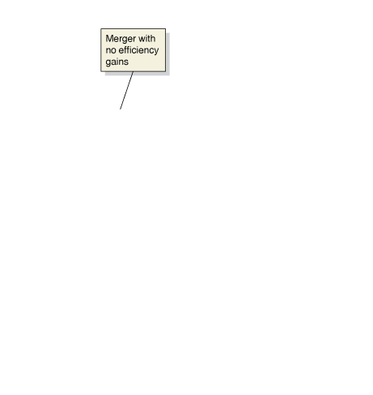
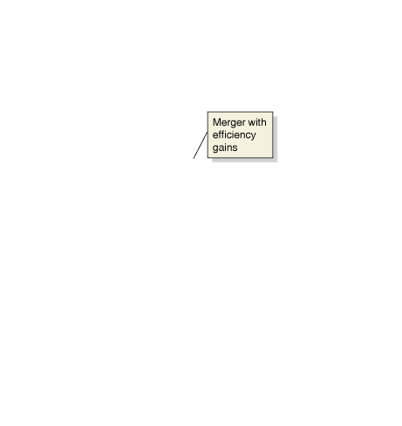
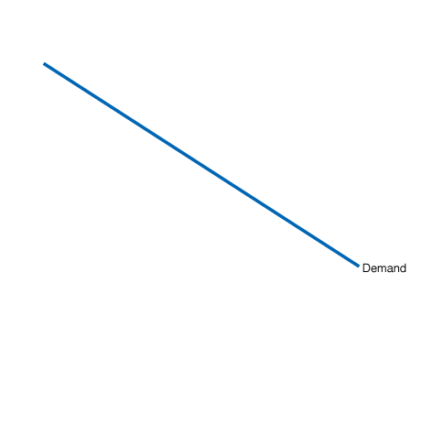
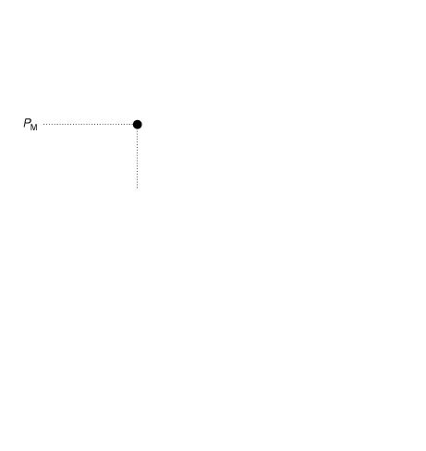









Figure 15.6
A Merger That Makes Consumers Better Off
The figure shows the result of all the firms in a perfectly competitive industry merging to form a monopoly.
If costs are unaffected by the merger,
the result is the same as in Figure 15.5:
Price rises from P_{C} to P_{M}, quantity falls from Q_{C} to Q_{M}, consumer surplus declines, and a loss of economic efficiency results.
If, however, the monopoly has lower costs than the perfectly competitive firms, as shown by the marginal cost curve shifting to MC after the merger,
it is possible that the price will actually decline from P_{C} to P_{Merge} and that output will increase from Q_{C} to Q_{Merge} following the merger.
Although the newly merged firm has a great deal of market power, because it is more efficient, consumers are better off and economic efficiency is improved.

Slide 27
The Department of Justice and FTC Merger Guidelines
Economic analysis shaped antitrust policy after Donald Turner became the first Ph.D. economist to head the Antitrust Division of the Department of Justice in 1965 and the Economics Section of the Antitrust Division was established in 1973.
By 1982, economists played a major role in the development of merger guidelines by the Department of Justice and the FTC.
Modified in 2010, the guidelines have three main parts:
1. Market definition
2. Measure of concentration
3. Merger standards

Slide 28
Market Definition (市場定義) A market consists of all firms making products that consumers view as close substitutes, which can be identified by looking at the effect of a price increase.
Beginning with a narrow definition of the industry, we identify the relevant market involved in a proposed merger if profits increase after a price increase.
If profits decrease, we consider a broader definition, continuing the process until a market has been identified.
Measure of Concentration (衡量集中度) A market is concentrated if a relatively small number of firms have a large share of total sales in the market.
The higher a market’s concentration, the likelier a merger between firms in the industry will increase market power.
The Herfindahl-Hirschman Index (HHI) of concentration squares the market shares of each firm in the industry and adds up their values.

Slide 29
The following are some examples of calculating HHI:
• 1 firm, with 100 percent market share (a monopoly):
HHI = 100² = 10,000
• 2 firms, each with a 50 percent market share:
HHI = 50² + 50² = 5,000
• 4 firms, with market shares of 30 percent, 30 percent, 20 percent, and 20 percent:
HHI = 30² + 30² + 20² + 20² = 2,600
• 10 firms, each with market shares of 10 percent:
HHI = 10 × (10²) = 1,000

Slide 30
Merger Standards (合併標準) The Department of Justice and the FTC use the HHI calculation for a market to evaluate proposed horizontal mergers according to these standards:
• Postmerger HHI below 1,500. These markets are not concentrated,
so mergers in them are not challenged.
• Postmerger HHI between 1,500 and 2,500. These markets are moderately concentrated. Mergers that raise the HHI by less than 100 probably will not be challenged. Mergers that raise the HHI by more than 100 may be challenged.
• Postmerger HHI above 2,500. These markets are highly concentrated.
Mergers that increase the HHI by less than 100 points will not be challenged.
Mergers that increase the HHI by 100 to 200 points may be challenged.
Mergers that increase the HHI by more than 200 points will likely be challenged.
Increases in economic efficiency will be taken into account and can lead to approval of a merger that otherwise would be opposed, but the burden of showing that the efficiencies exist lies with the merging firms.

Slide 31









Figure 15.7
Regulating a Natural Monopoly
A natural monopoly that is not subject to government regulation will charge a price equal to P_{M} and produce Q_{M}.
If government regulators want to achieve economic efficiency,
they will set the regulated price equal to P_{E},
and the monopoly will produce Q_{E}.
Unfortunately, P_{E} is below average cost,
and the monopoly will suffer a loss,
shown by the shaded rectangle.
Because the monopoly will not continue to produce in the long run if it suffers a loss,
government regulators set a price equal to average cost, which is P_{R} in the figure.
The resulting production, Q_{R}, will be below the efficient level.
Local or state regulatory commissions usually set the prices for natural monopolies.

