Slide 1

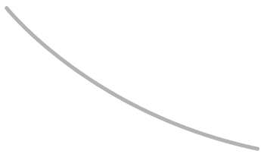
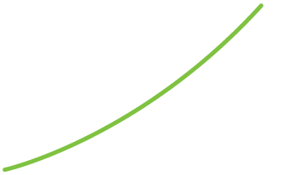
R. GLENN HUBBARD
ANTHONY PATRICK O’BRIEN
Economics
FOURTH EDITION

Slide 2

Economics: Foundations and Models
1
CHAPTER
Chapter Outline and
Learning Objectives
1.1 | Three Key Economic Ideas
1.2 | The Economic Problem That Every Society Must Solve
1.3 | Economic Models
1.4 | Microeconomics and Macroeconomics
APPENDIX: Using Graphs and Formulas

Slide 3
新聞時事-歐債危機的影響
歐債危機四國流失資金3260億 存款部分轉移德國
[2012/09/20中國新聞網]
出於對歐元生存狀況的擔憂，部分歐債危機國的銀行存款正源源不斷流失到其他國家，德法兩國成為資金轉移的主要目標。《世界報》20日報道，到今年7月為止的一年時間裏，西班牙、葡萄牙、愛爾蘭和希臘的銀行共有3260億歐元的存款被提取。在同一時間之內，歐洲有7個國家的銀行存款大量增加，其中德、法兩國增加最快，約有3000億歐元。存款大量外流的情況迫使流失國銀行提高存款利息以挽留客戶。銀行為存款支付的利息越多，銀行界的利潤就越少。例如西班牙銀行在為存款支付4%利息的同時，受歐洲主導利息影響，在私人貸款中只能收取2.5%的利息，由此帶來相當大的損失。
存款從一國轉移到另一國的現象還造成歐元區銀行的分裂，消弱歐洲央行的一系列貨幣政策，併為恢復經濟帶來困難。

Slide 4
新聞時事-歐債危機的影響
歐債禍及北歐 多國經濟不振 [2012/09/07經濟日報]
歐債危機已禍及北歐，導致區內多國經濟不振。瑞典克朗強勢令出口疲弱，央行意外減息四分一厘至1.25厘；芬蘭出現3年來最大經濟收縮，或需進一步削減開支；惠譽則指丹麥央行實施存款負利率，恐削弱當地銀行業。
瑞典克朗兌歐元上月升至12年高位8.1821兌1歐元，引起商界及企業憂慮，增加央行減息的壓力。
連非歐元國亦不能倖免，歐元區的芬蘭自然更受影響。芬蘭出口及投資受進一步打擊，上季國內生產總值（GDP）按季下降1.1%，按年跌0.1%，為2009年第四季以來最差表現。鄰國的瑞典及挪威，同期反而錄得1.4%及1%增長。2008年金融海嘯爆發，曾令芬蘭09年經濟嚴重萎縮8.4%，至近年才好轉。
北歐聯合銀行集團首席經濟師Roger Wessman預期，芬蘭第三季經濟將再次收縮，陷入技術性衰退，直至年底或歐債危機緩和時，才會重回溫和增長。芬蘭很可能已步入衰退，政府需要就平衡公共財政採取新措施，意味其需加強削支力度，或影響國民對援助「歐豬國」意願。

Slide 5
新聞時事-歐債危機的影響
歐債拖累 南韓工業生產連2降 [2012/08/31中央社]
南韓7月工業生產連續第2個月下滑，主因全球經濟趨緩衝擊南韓這個亞洲第4大經濟體的成長。南韓統計局今天指出，7月工業生產較上月下滑1.6%，彭博訪查12名經濟家原估將衰退0.9%，相對6月跌幅為0.6%。7月工業生產較上年同月則成長0.3%。
歐洲各國厲行撙節，加上中國大陸景氣降溫衝擊出口，南韓製造業信心目前接近金融危機席捲全球以來最低水準。
匯豐駐香港分析師曼恩（Ronald Man）在數據出爐前指出：「出口成長萎縮恐衝擊南韓製造產業，導致工業生產進一步滑降。不過，南韓經濟有望在第3季觸底反彈。」

Slide 6
Scarcity (稀少) A situation in which unlimited wants exceed the limited resources available to fulfill those wants.
Economics (經濟學) The study of the choices people make to attain their goals, given their scarce resources.
Economic model (經濟模型) A simplified version of reality used to analyze real-world economic situations.

Slide 7
Three Key Economic Ideas
1.1 LEARNING OBJECTIVE
Explain these three key economic ideas: People are rational, people respond to incentives, and optimal decisions are made at the margin.

Slide 8
Market (市場) A group of buyers and sellers of a good or service and the institution or arrangement by which they come together to trade.
As we study how people make choices and interact in markets, we will return to three important ideas:
1. People are rational. (人是理性的) Economists assume that consumers and firms use all available information as they act to achieve their goals, weighing the benefits and costs of each action, and choosing an action only if the benefits outweigh the costs—even if it is not always the “best” decision.
2. People respond to economic incentives. (人會對經濟誘因做出反應) The economic incentive to banks, for instance, is clearer to economists than to FBI agents: It is less costly to put up with bank robberies than to take additional security measures.
3. Optimal decisions are made at the margin. (在邊際上做出最適選擇) Most decisions in life involve doing a little more or a little less. Economists reason that the optimal decision is to continue any activity up to the point where the marginal benefit equals the marginal cost—in symbols, where MB = MC.
Marginal analysis (邊際分析) Analysis that involves comparing marginal benefits and marginal costs.

Slide 9
The Economic Problem That Every Society Must Solve
1.2 LEARNING OBJECTIVE
Discuss how an economy answers these questions: What goods and services will be produced? How will the goods and services be produced? Who will receive the goods and services produced?

Slide 10
Trade-off (抵換關係) The idea that because of scarcity, producing more of one good or service means producing less of another good or service.
Opportunity cost (機會成本) The highest-valued alternative that must be given up to engage in an activity.
Trade-offs force society to make choices when answering the following three fundamental questions:
1. What goods and services will be produced? Consumers, firms, and the government face the problem of scarcity by trading off one good or service for another. Each choice made comes with an opportunity cost, measured by the value of the best alternative given up.
2. How will the goods and services be produced? Firms choose how to produce the goods and services they sell, often facing a trade-off between using more workers or using more machines.
3. Who will receive the goods and services produced? In the United States, who receives the goods and services produced depends largely on how income is distributed. There is disagreement over whether the current attempts to redistribute income are sufficient or whether there should be more or less redistribution.

Slide 11
Centrally Planned Economies versus Market Economies
Centrally planned economy (中央規劃經濟) An economy in which the government decides how economic resources will be allocated.
Market economy (市場經濟) An economy in which the decisions of households and firms interacting in markets allocate economic resources.
The Modern “Mixed” Economy
Some economists argue that the extent government intervention has expanded since the Great Depression of the 1930s makes it no longer accurate to refer to the U.S., Canadian, Japanese, and Western European economies as pure market economies.
Mixed economy (混合經濟) An economy in which most economic decisions result from the interaction of buyers and sellers in markets but in which the government plays a significant role in the allocation of resources.

Slide 12
Efficiency and Equity
Productive efficiency (生產效率) A situation in which a good or service is produced at the lowest possible cost.
Allocative efficiency (配置效率) A state of the economy in which production is in accordance with consumer preferences; in particular, every good or service is produced up to the point where the last unit provides a marginal benefit to society equal to the marginal cost of producing it.
Voluntary exchange (自願交換) A situation that occurs in markets when both the buyer and seller of a product are made better off by the transaction.
Equity (公平) The fair distribution of economic benefits.
There is often a trade-off between efficiency and equity.

Slide 13
Economic Models
1.3 LEARNING OBJECTIVE
Understand the role of models in economic analysis.

Slide 14
To develop a model, economists generally follow these steps:
Decide on the assumptions to use in developing the model.
Formulate a testable hypothesis.
Use economic data to test the hypothesis.
Revise the model if it fails to explain the economic data well.
Retain the revised model to help answer similar economic questions in the future.
The Role of Assumptions in Economic Models經濟模型假設的作用
Economic models make behavioral assumptions about the motives of consumers and firms.
Forming and Testing Hypotheses in Economic Models
經濟模型的設定與假設檢定
Economic variable (經濟變數) Something measurable that can have different values, such as the incomes of doctors.
The process of developing models, testing hypotheses, and revising models is often referred to as the scientific method, which economics applies to the study of the interactions among individuals.

Slide 15
Normative and Positive Analysis
Positive analysis (實是分析) Analysis concerned with what is.
Normative analysis (規範分析) Analysis concerned with what ought to be.
Economics is about positive analysis, which measures the costs and benefits of different courses of action.
Economics as a Social Science 經濟學是一門社會科學
Because economics studies the actions of individuals, it is a social science. Economics is therefore similar to other social science disciplines, such as psychology, political science, and sociology. As a social science, economics considers human behavior—particularly decision-making behavior—in every context, not just in the context of business.
Don’t Let This Happen to You
Don’t Confuse Positive Analysis with Normative Analysis
Positive economic analysis can show the consequences of a particular policy, but it cannot tell us whether the policy is “good” or “bad.”
MyEconLab
Your Turn: Test your understanding by doing related problem 3.9 at the end of this chapter.

Slide 16
Microeconomics and Macroeconomics
1.4 LEARNING OBJECTIVE
Distinguish between microeconomics and macroeconomics.

Slide 17
Microeconomics (個體經濟學) The study of how households and firms make choices, how they interact in markets, and how the government attempts to influence their choices.
Macroeconomics (總體經濟學) The study of the economy as a whole, including topics such as inflation, unemployment, and economic growth.

Slide 18
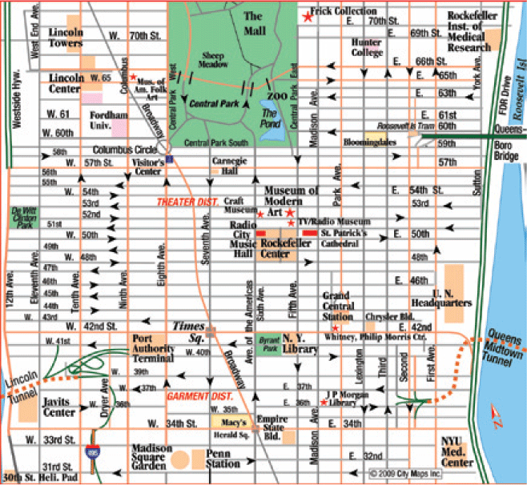
Appendix
Using Graphs and Formulas
LEARNING OBJECTIVE
Review the use of graphs and formulas.
A graph is like a street map—it is a simplified version of reality.

Slide 19
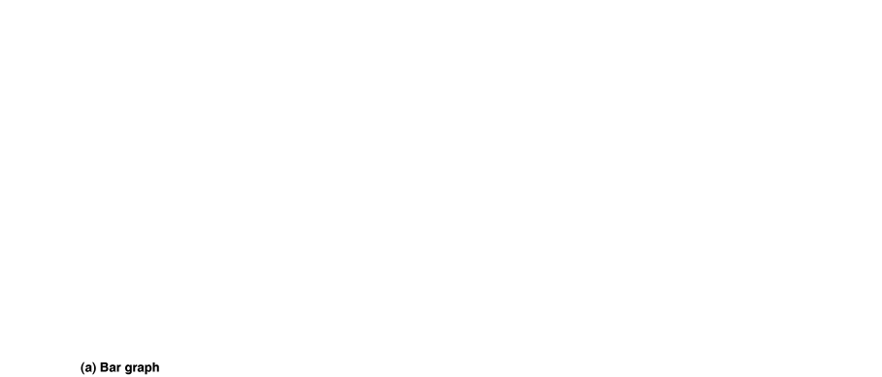
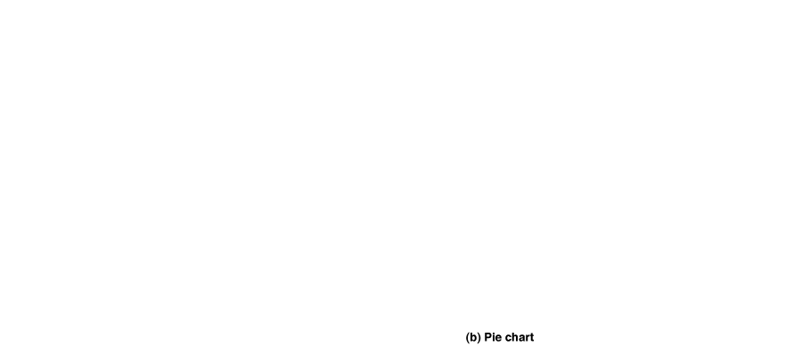
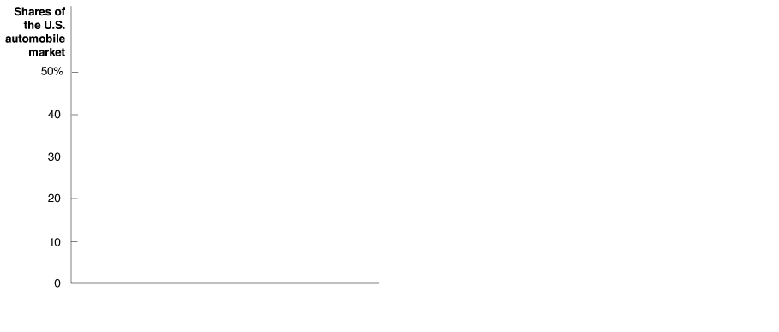
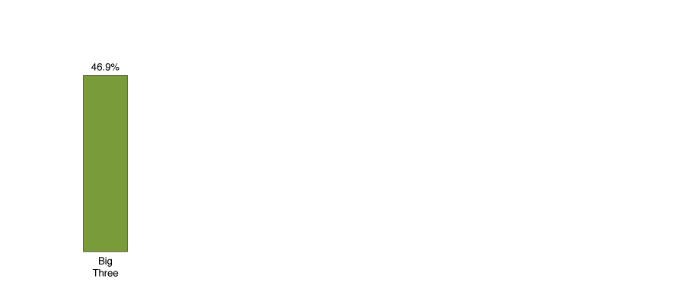
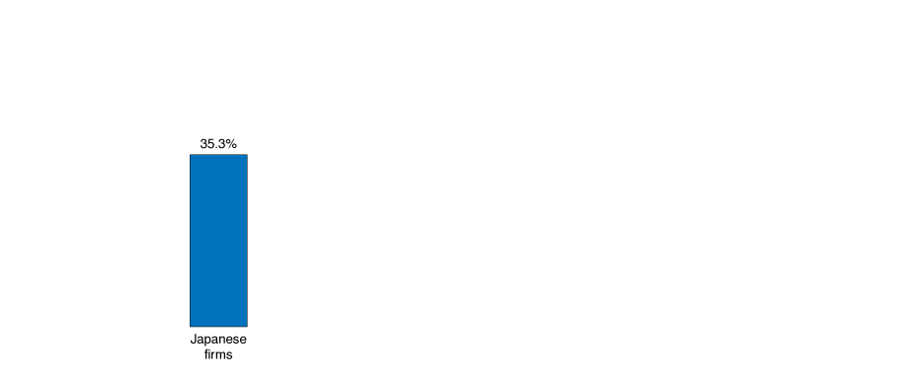
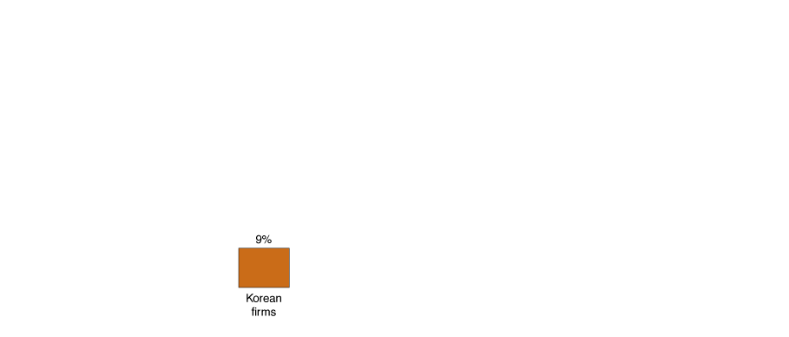
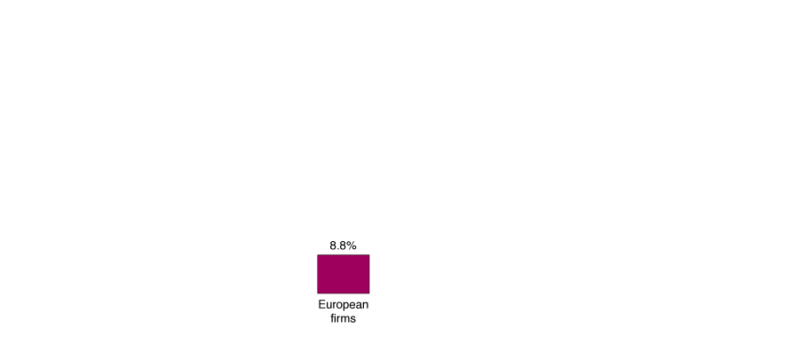
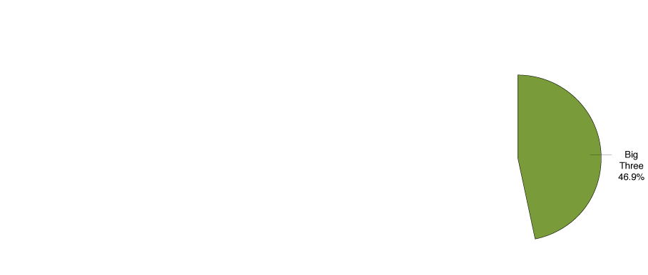
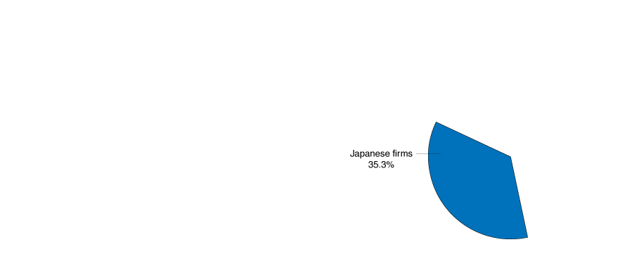
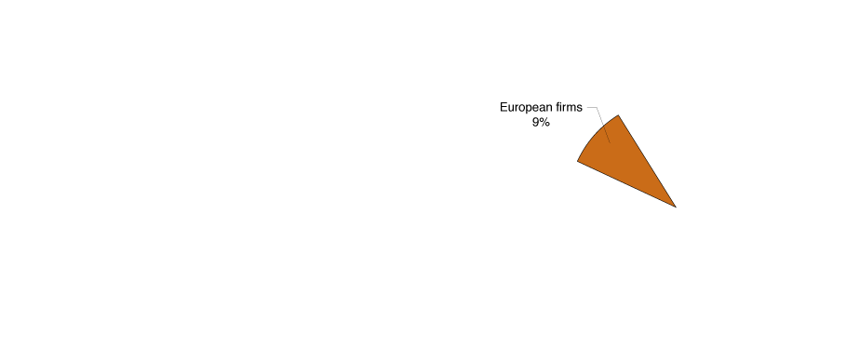
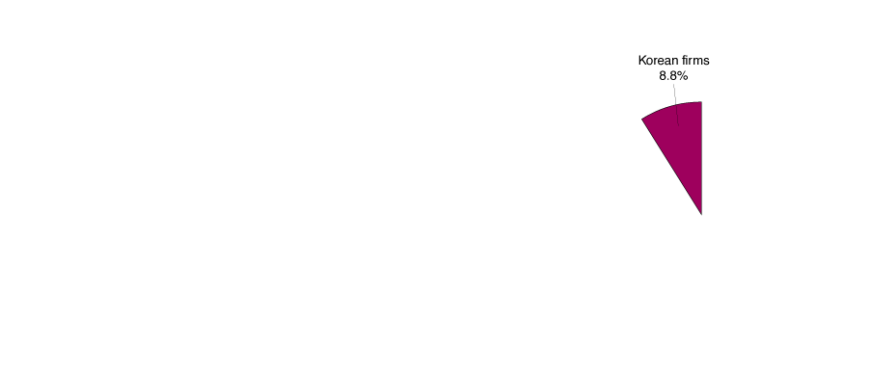
Graphs of One Variable
Figure 1A.1
Bar Graphs and Pie Charts
Values for an economic variable are often displayed as a bar graph or as a pie chart.
In this case, panel (a) shows market share data for the U.S. automobile industry as a bar graph, where the market share of each group of firms is represented by the height of its bar.
Panel (b) displays the same information as a pie chart, with the market share of each group of firms represented by the size of its slice of the pie.

Slide 20
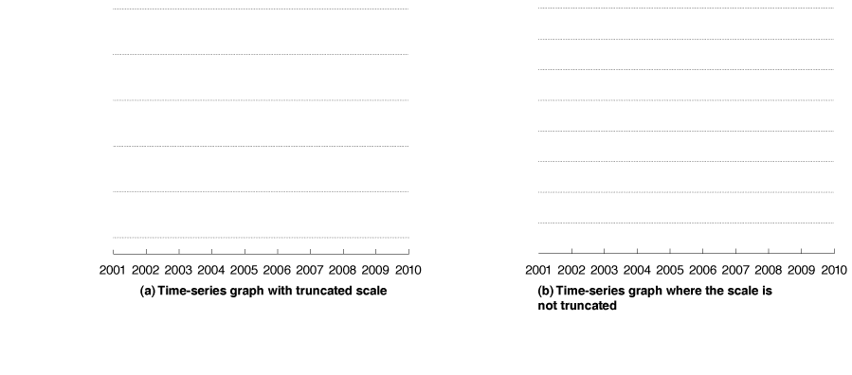
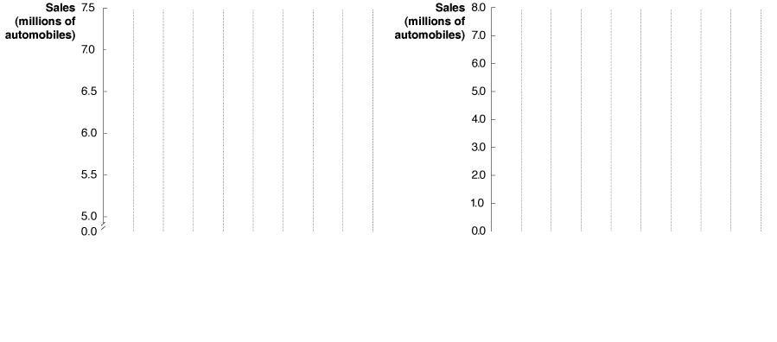
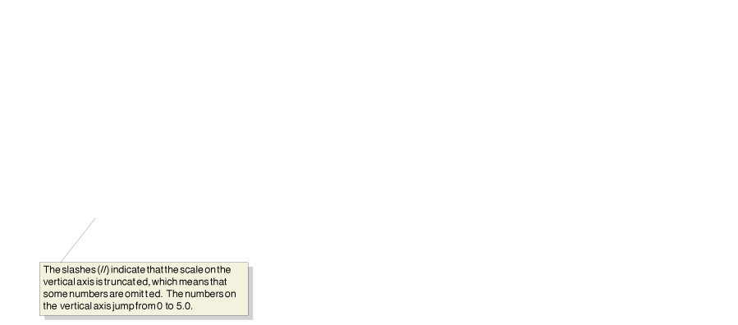
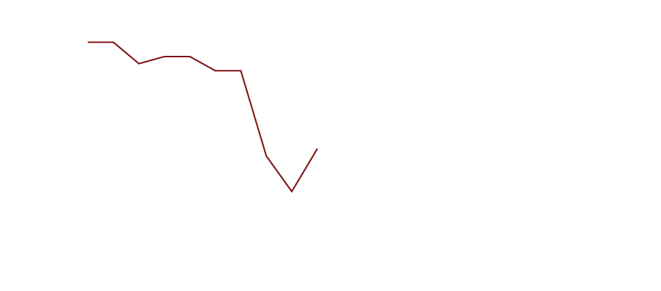
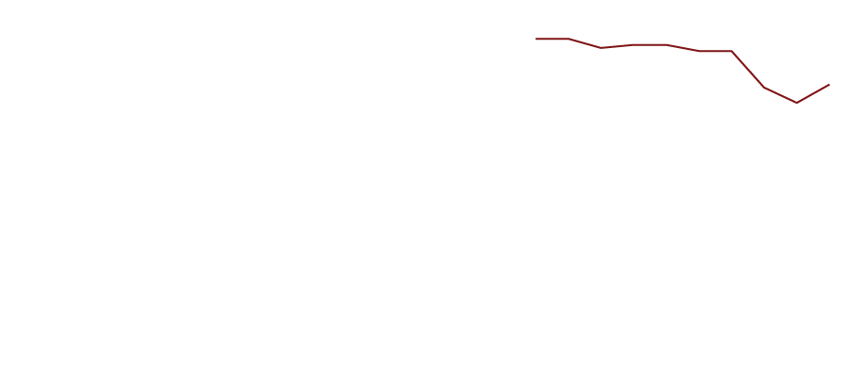
Figure 1A.2
Time-Series Graphs
Both panels present time-series graphs of Ford Motor Company’s worldwide sales during each year from 2001 to 2010.
Panel (a) has a truncated scale on the vertical axis, and panel (b) does not.
As a result, the fluctuations in Ford’s sales appear smaller in panel (b) than in panel (a).

Slide 21
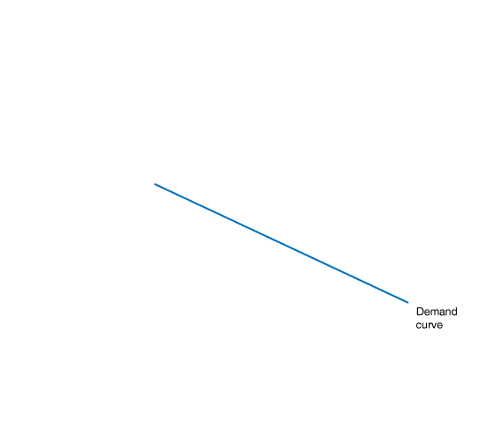
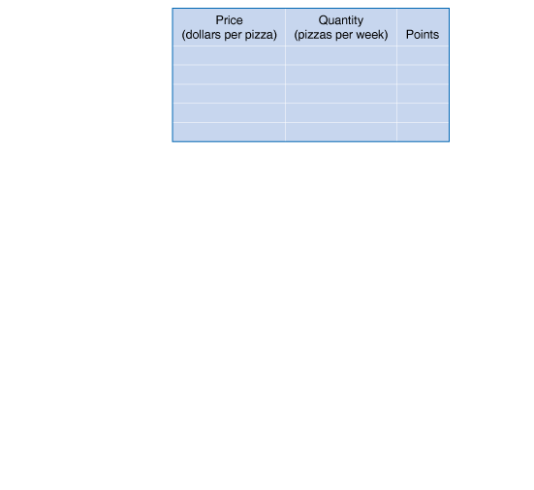
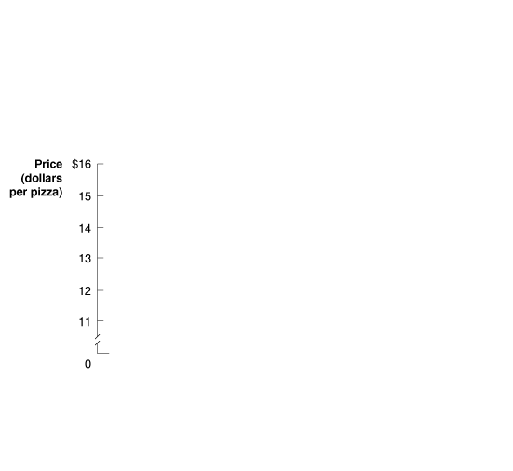
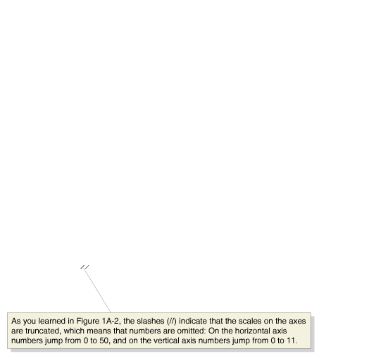
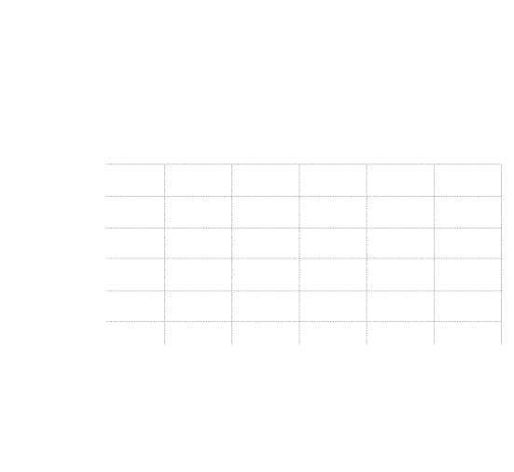
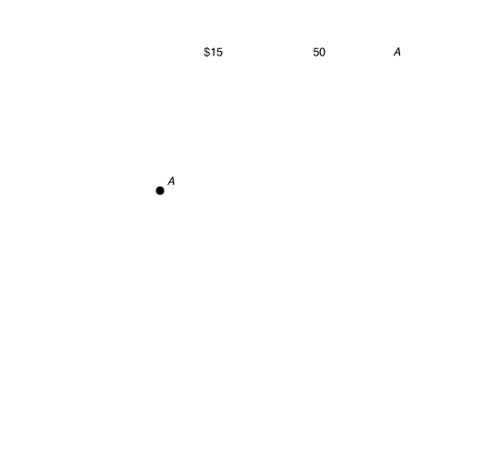
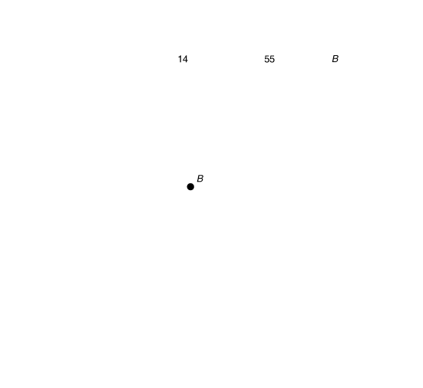
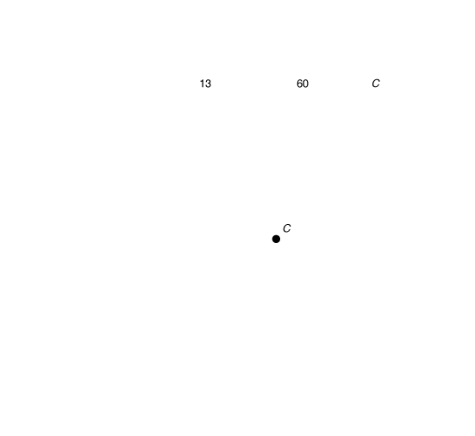
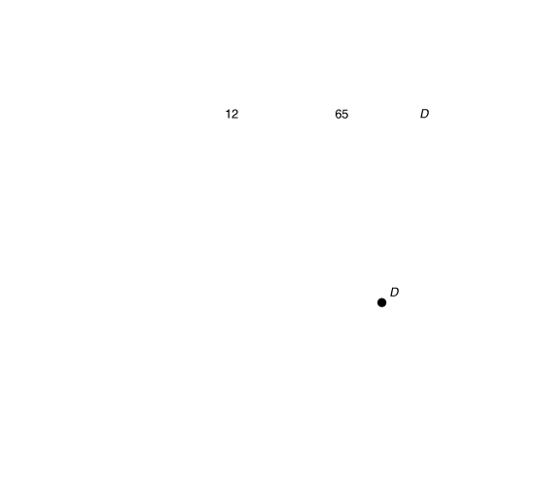
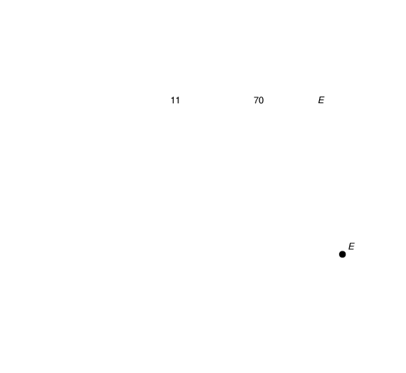
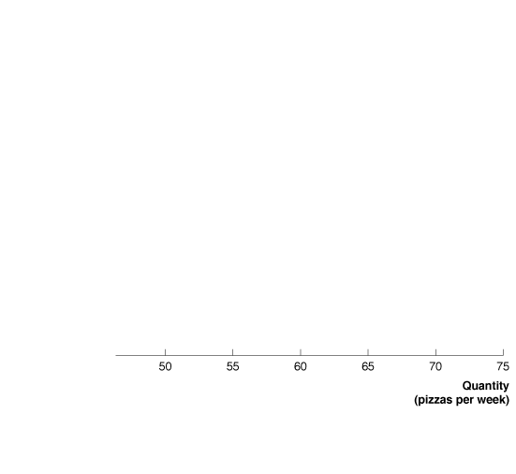
Graphs of Two Variables
Figure 1A.3
Plotting Price and Quantity Points in a Graph
The figure shows a two-dimensional grid on which we measure the price of pizza along the vertical axis (or y-axis) and the quantity of pizza sold per week along the horizontal axis (or x-axis).
Each point on the grid represents one of the price and quantity combinations listed in the table.
By connecting the points with a line, we can better illustrate the relationship between the two variables.

Slide 22
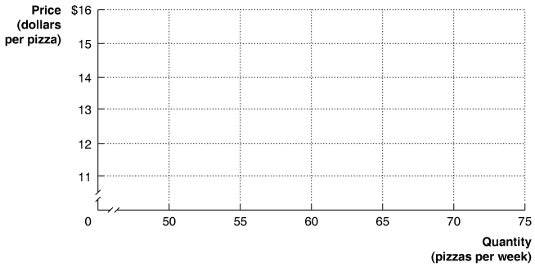
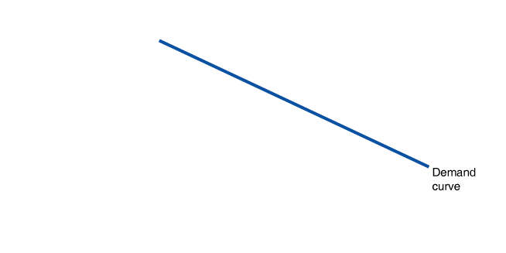
Slopes of Lines
Figure 1A.4
Calculating the Slope of a Line
We can calculate the slope of a line as the change in the value of the variable on the y-axis divided by the change in the value of the variable on the x-axis.
Because the slope of a straight line is constant, we can use any two points in the figure to calculate the slope of the line.

Slide 23
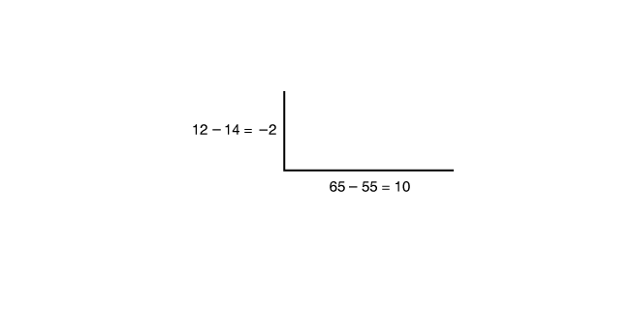
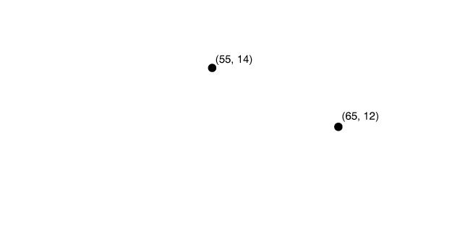
Slopes of Lines
Figure 1A.4
Calculating the Slope of a Line
For example, when the price of pizza decreases from $14 to $12, the quantity of pizza demanded increases from 55 per week to 65 per week.
So, the slope of this line equals –2 divided by 10, or –0.2.

Slide 24
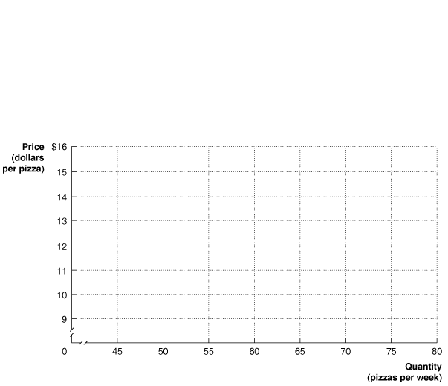
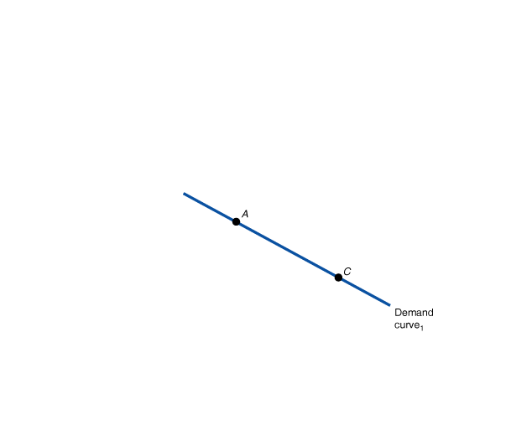
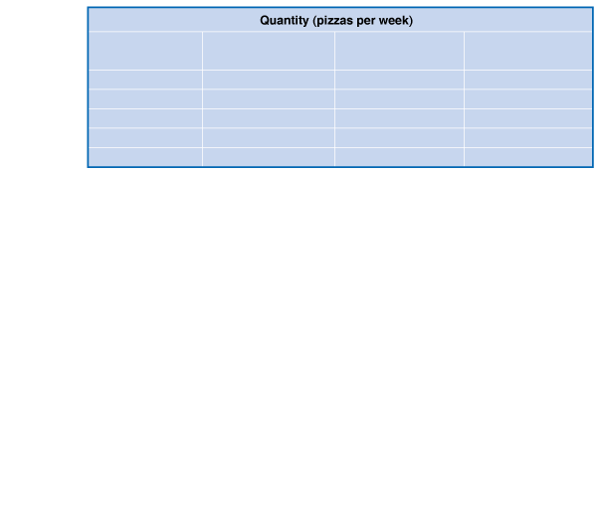
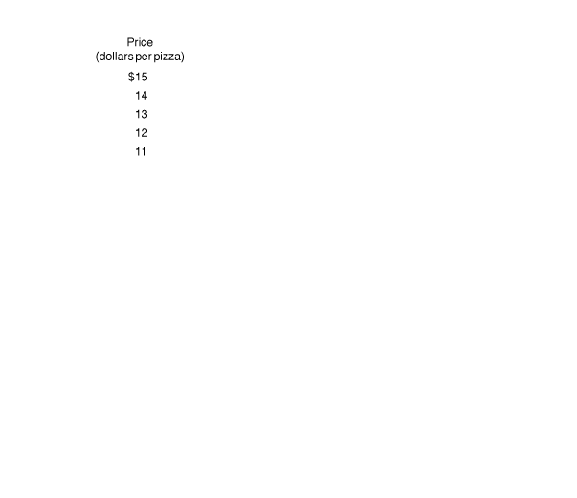
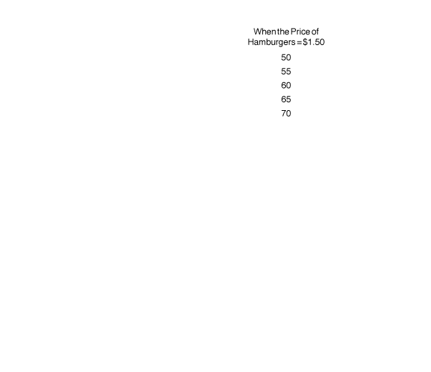
Taking into Account More than Two Variables on a Graph
Figure 1A.5
Showing Three Variables on a Graph
The demand curve for pizza shows the relationship between the price of pizzas and the quantity of pizzas demanded, holding constant other factors that might affect the willingness of consumers to buy pizza.

Slide 25
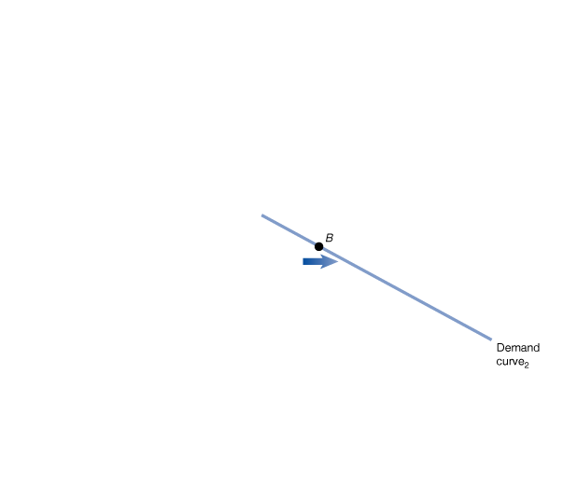
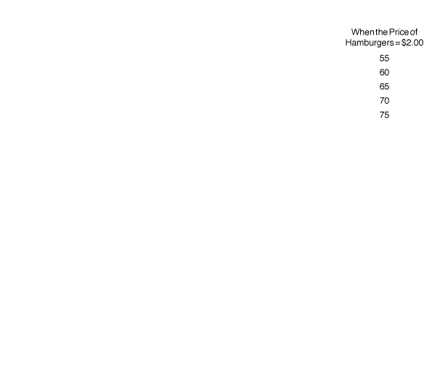
Taking into Account More than Two Variables on a Graph
Figure 1A.5
Showing Three Variables on a Graph
If the price of pizza is $14 (point A), an increase in the price of hamburgers from $1.50 to $2.00 increases the quantity of pizzas demanded from 55 to 60 per week (point B) and shifts us to Demand curve₂.

Slide 26

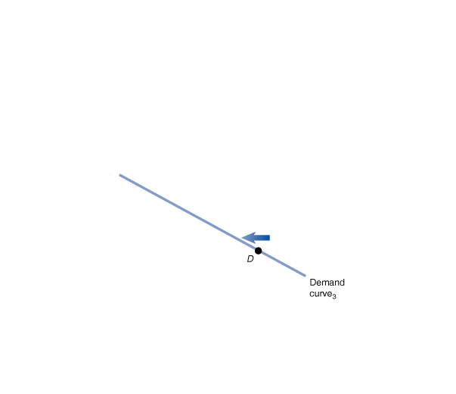
Taking into Account More than Two Variables on a Graph
Figure 1A.5
Showing Three Variables on a Graph
Or, if we start on Demand curve₁ and the price of pizza is $12 (point C), a decrease in the price of hamburgers from $1.50 to $1.00 decreases the quantity of pizza demanded from 65 to 60 per week (point D) and shifts us to Demand curve₃.

Slide 27
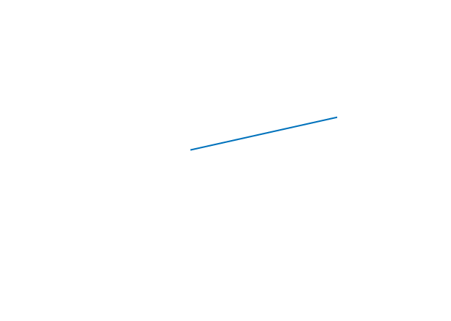
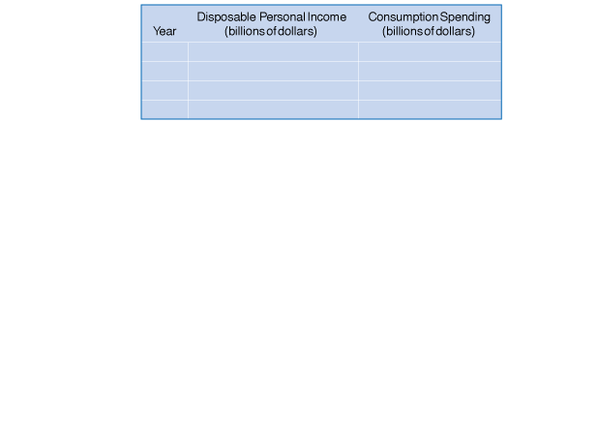
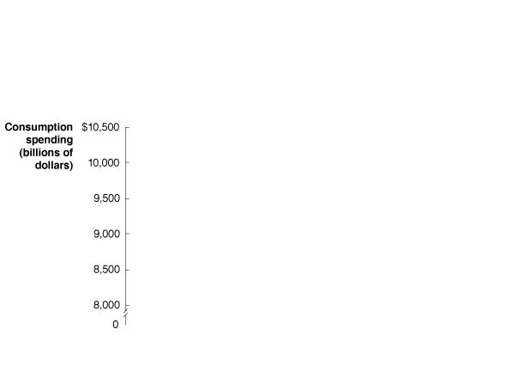
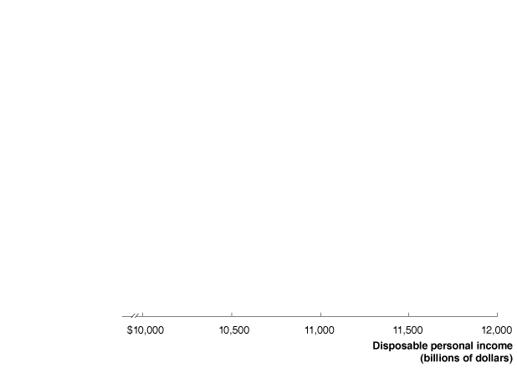
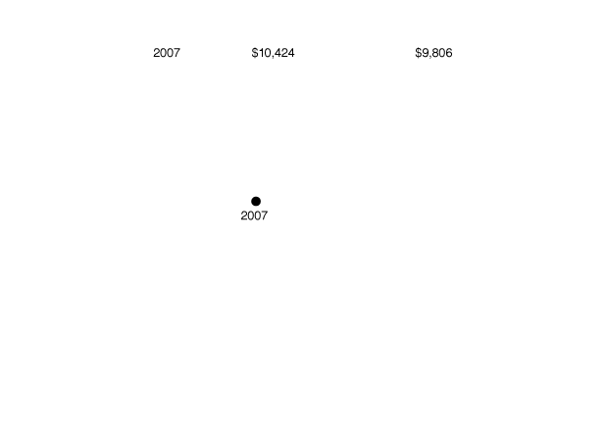
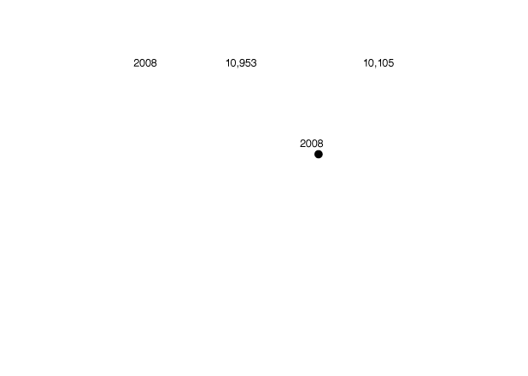
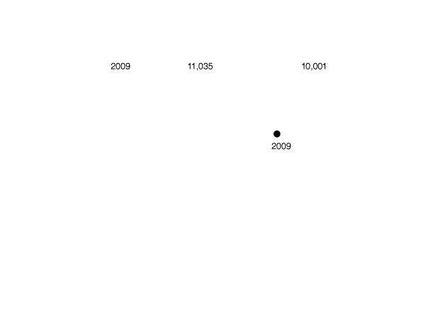
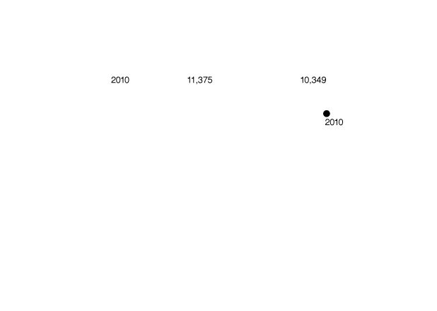
Positive and Negative Relationships
Figure 1A.6
Graphing the Positive Relationship between Income and Consumption
In a positive relationship between two economic variables, as one variable increases, the other variable also increases.
This figure shows the positive relationship between disposable personal income and consumption spending.
As disposable personal income in the United States has increased, so has consumption spending.

Slide 28




Figure 1A.7
Determining Cause and Effect
Using graphs to draw conclusions about cause and effect can be hazardous. In panel (a), we see that there are fewer leaves on the trees in a neighborhood when many homes have fires burning in their fire places.
We cannot draw the conclusion that the fires cause the leaves to fall because we have an omitted variable—the season of the year.
In panel (b), we see that more lawn mowers are used in a neighborhood during times when the grass grows rapidly and fewer lawn mowers are used when the grass grows slowly.
Concluding that using lawn mowers causes the grass to grow faster would be making the error of reverse causality.

Slide 29
Are Graphs of Economic Relationships Always Straight Lines?
The relationship between two variables is linear when it can be represented by a straight line.
Few economic relationships are actually linear. If we carefully plot data on the price of a product and the quantity demanded at each price, holding constant other variables that affect the quantity demanded, we will usually find a curved—or nonlinear—relationship.
In practice, it is often useful to approximate a nonlinear relationship with a linear relationship. If the relationship is reasonably close to being linear, the analysis is not significantly affected.

Slide 30













Figure 1A.8a
The Slope of a Nonlinear Curve
The relationship between the quantity of iPhones produced and the total cost of production is curved rather than linear.
In moving from point A to point B, the quantity produced increases by 1 million iPhones, while the total cost of production increases by $50 million.
Farther up the curve, as we move from point C to point D, the change in quantity is the same—1 million iPhones—but the change in the total cost of production is now much larger: $250 million.
Because the change in the y variable has increased, while the change in the x variable has remained the same, we know that the slope has increased.

Slide 31














Figure 1A.8b
The Slope of a Nonlinear Curve
Here we measure the slope of the curve at a particular point by the slope of the tangent line.
The slope of the tangent line at point B is 75,
and the slope of the tangent line at point C is 150.

Slide 32
Formulas
Formula for a Percentage Change
One important formula is the percentage change, which is the change in some economic variable, usually from one period to the next, expressed as a percentage.

Slide 33




Formulas for the Areas of a Rectangle and a Triangle
Figure 1A.9
Showing a Firm’s Total Revenue on a Graph
The area of a rectangle is equal to its base multiplied by its height.
Total revenue is equal to quantity multiplied by price.
Here, total revenue is equal to the quantity of 125,000 bottles times the price of $2.00 per bottle, or $250,000.
The area of the green-shaded rectangle shows the firm’s total revenue.

Slide 34




Figure 1A.10
The Area of a Triangle
The area of a triangle is equal to 1⁄2 multiplied by its base multiplied by its height.
The area of the blue-shaded triangle has a base equal to 150,000 – 125,000, or 25,000, and a height equal to $2.00 – $1.50, or $0.50.
Therefore, its area equals 1/2 × 25,000 × $0.50, or $6,250.

Slide 35
Summary of Using Formulas
Whenever you must use a formula, you should follow these steps:
1. Make sure you understand the economic concept the formula represents.
2. Make sure you are using the correct formula for the problem you are solving.
3. Make sure the number you calculate using the formula is economically reasonable. For example, if you are using a formula to calculate a firm’s revenue and your answer is a negative number, you know you made a mistake somewhere.

