Slide 1

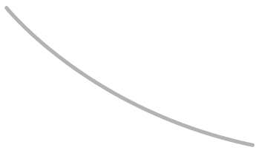

R. GLENN HUBBARD
ANTHONY PATRICK O’BRIEN
Economics
FOURTH EDITION

Slide 2

3
Where Prices Come From:
CHAPTER
The Interaction of Demand and Supply
Chapter Outline and
Learning Objectives
3.1 | The Demand Side of the Market
3.2 | The Supply Side of the Market
3.3 | Market Equilibrium: Putting Demand and Supply Together
3.4 | The Effect of Demand and Supply Shifts on Equilibrium

Slide 3
新聞時事
菜價漲不停 批發價逼近40元 [卡優新聞網2012/08/03]
因蘇拉颱風導致蔬菜採收困難，使得今日台北果菜批發市場蔬菜到貨量僅有650公噸，由於到貨量大減，菜價應聲大漲，平均每公斤批發價逼近40元大關，短期葉菜類價格全面上揚。
台北市蔬菜到貨量約650公噸，比前一天少了將近600公噸，大減近一半，是因為颱風期間風強雨大，農民採收不易，加上採收數量少，集貨運送成本就增加，且部分地區交通受阻，影響蔬菜送到台北果菜市場來的數量。6月豪雨過後，價格就居高不下的蕃茄及青蔥，漲得又更兇。蕃茄漲到200元，是6月豪雨後的2倍價；青蔥批發價漲到180元，也是6月豪雨後的2倍價。台北農產運銷公司解釋，就是因為產量少，價格才會漲成這樣。而農委會則指出，各界關切青蔥的供應，目前已有農民團體規劃自越南進口5貨櫃，預估9天後可供應市場需求。

Slide 4
新聞時事
油價破100美元 5月來首次 [中央社2012/9/14]
紐約油價今天衝破每桶100美元關卡，是今年5月以來首次，主因聯邦準備理事會（Fed）保證採取進一步經濟振興措施，且中東地區和北非地區的騷亂也引發石油供給可能受到威脅的憂慮。
最近一次盤中油價突破100美元是今年5月4日。聯準會昨天在第3輪的所謂量化寬鬆政策中宣布，將進一步購買房貸債務。這項經濟振興計畫和中東緊張情勢是促成油價上漲的原因。現在將錢投入石油市場是很好的時機。
台北時間晚間7時31分，紐約商品交易所10月交割的期油每桶上漲1.77美元或1.80%，報100.08美元。今年最近月油價上漲1.2%。

Slide 5
新聞時事
開源節流 搶救失落的一代 [中央網路報2012/09/30]
根據主計處調查顯示，台灣2011年30歲以下受僱就業者約207萬9千人，其中月薪不到3萬元者高達6成3的比例，而大學學歷的初任人員平均月薪26,577元，僅較5年前調漲了62元，研究所以上的初任人員平均月薪32,321元，亦僅較5年前調漲了1,059元，顯示國內青年薪情低已為常態。
另有新近調查發現，僅有電腦消費性電子製造業、半導體、光電光學、文教、金融投顧保險、醫療保健、法律會計7大產業會優先僱用碩士，具備研究所學歷不再是進入職場的敲門磚，高學歷已非就業的保證，淪為防衛性投資。國內高等教育的急遽擴張固然被視為高學歷青年失業的主因之一，但現今高等教育普及化已是既定的事實，不可能走回頭路。
教育主管機關除了就高等教育「量」的控管之外，「質」的提升亦同等重要。為了提升台灣產業發展競爭力，政府擬定了多項產業發展計畫，朝向新興產業及既有產業高值化發展，然令人擔憂的是，這些所謂的新興產業是否真能符合國家發展所需、創造多元的就業機會，另據主計處統計，去(100)年工業及服務受僱員工空缺人數19萬1千人，空缺率2.7%，各職類短缺則以技藝有關工作人員、機械設備操作人員空缺率最高，對照於同期失業率有4.45%，其中反差如何調合，使供需差距拉近的確值得政府深思。

Slide 6
The Demand Side of the Market
3.1 LEARNING OBJECTIVE
Discuss the variables that influence demand.

Slide 7
Demand Schedules(需求表)and Demand Curves(需求曲線)
Demand schedule (需求表) A table that shows the relationship between the price of a product and the quantity of the product demanded.
Quantity demanded (需求量)The amount of a good or service that a consumer is willing and able to purchase at a given price.
Demand curve (需求曲線) A curve that shows the relationship between the price of a product and the quantity of the product demanded.
Market demand (市場需求)The demand by all the consumers of a given good or service.

Slide 8
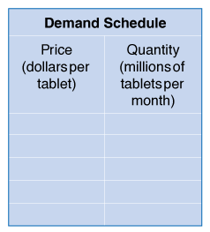
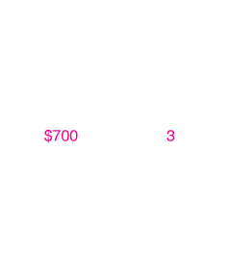
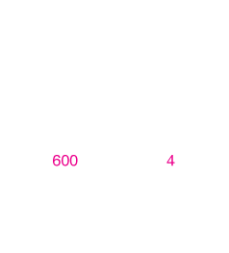
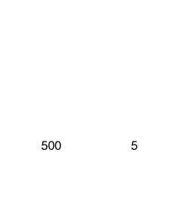
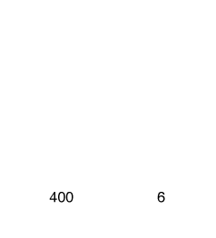

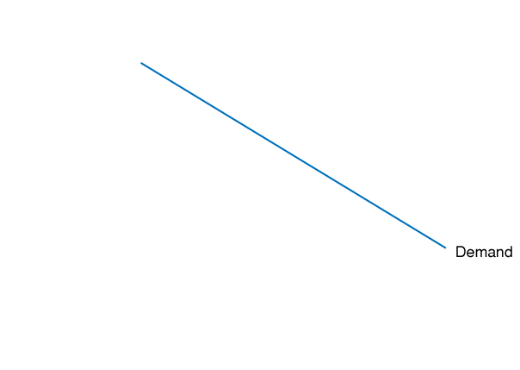
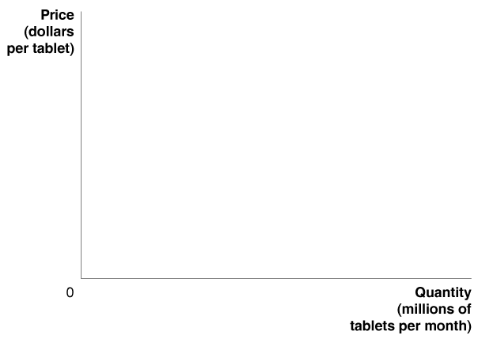
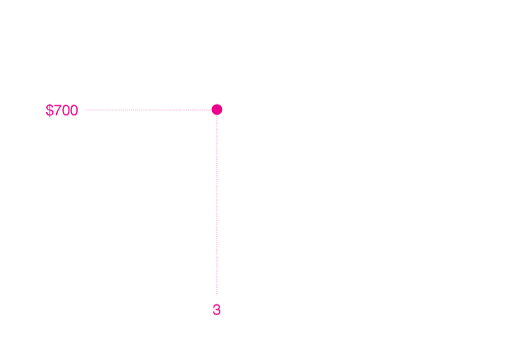
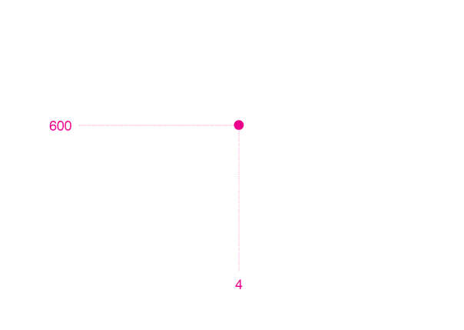
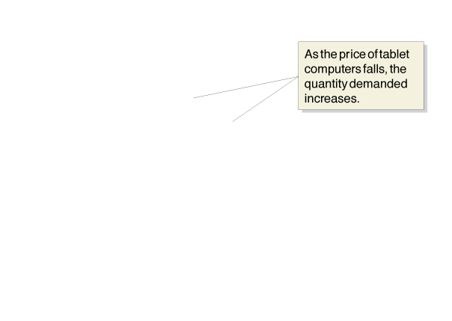
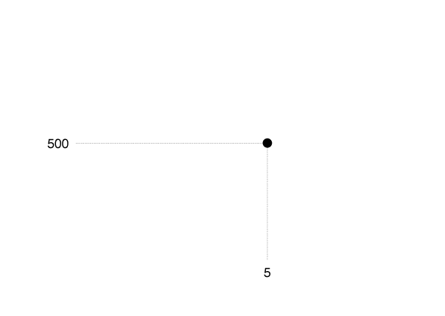
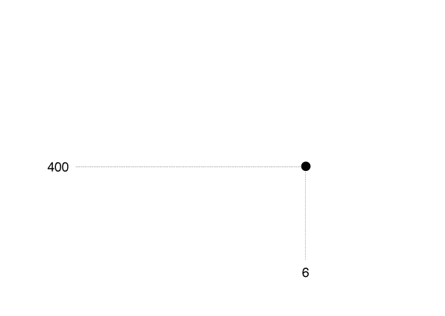
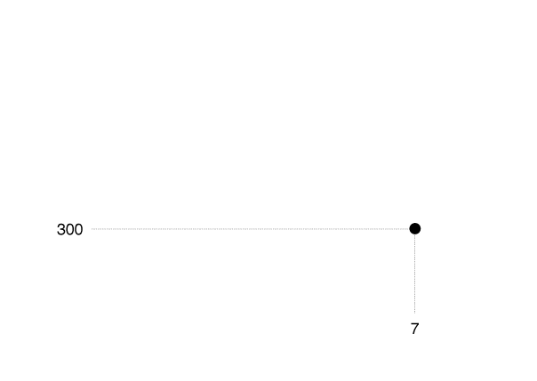
Figure 3.1
A Demand Schedule and Demand Curve
As the price changes, consumers change the quantity of tablet computers they are willing to buy.
We can show this as a demand schedule in a table or as a demand curve on a graph.
The table and graph both show that as the price of tablet computers falls, the quantity demanded increases.
When the price of tablet computers is $700, consumers buy 3 million tablets per month.
When the price drops to $600, consumers buy 4 million tablets.
Therefore, the demand curve for tablet computers is downward sloping.

Slide 9
Law of demand (需求法則) The rule that, holding everything else constant, when the price of a product falls, the quantity demanded of the product will increase, and when the price of a product rises, the quantity demanded of the product will decrease.
What Explains the Law of Demand?
Substitution effect (替代效果) The change in the quantity demanded of a good that results from a change in price, making the good more or less expensive relative to other goods that are substitutes.
Income effect (所得效果) The change in the quantity demanded of a good that results from the effect of a change in the good’s price on consumers’ purchasing power.

Slide 10
Holding Everything Else Constant: The Ceteris Paribus Condition
Ceteris paribus (“all else equal”) condition (在其他條件不變的情況下) The requirement that when analyzing the relationship between two variables—such as price and quantity demanded—other variables must be held constant.
A shift of a demand curve is an increase or a decrease in demand. A movement along a demand curve is an increase or a decrease in the quantity demanded.

Slide 11
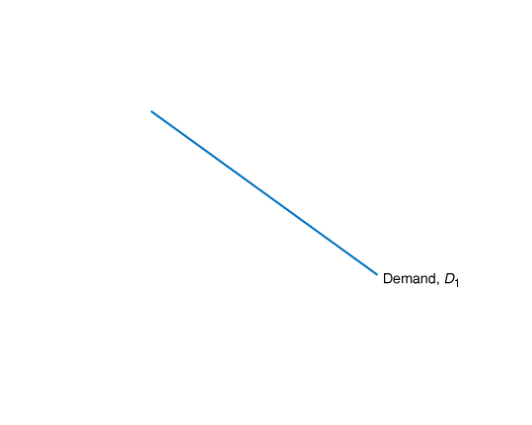
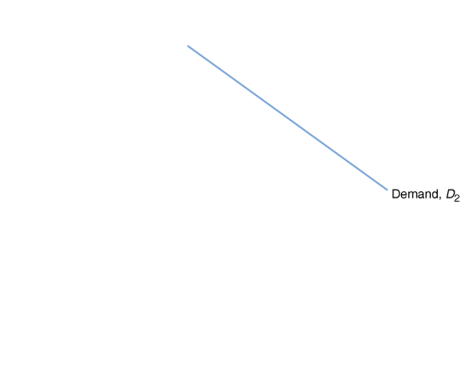
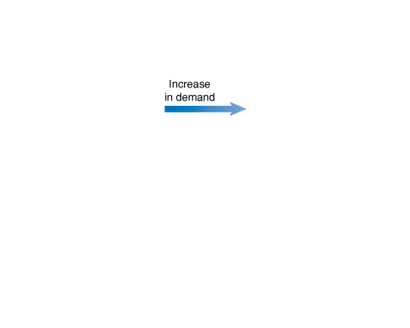
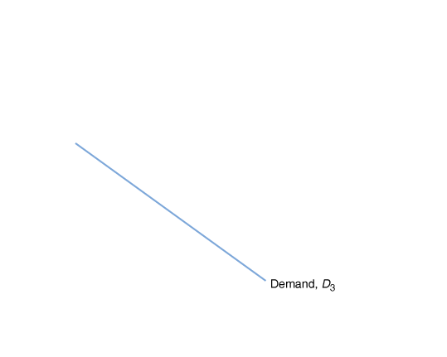
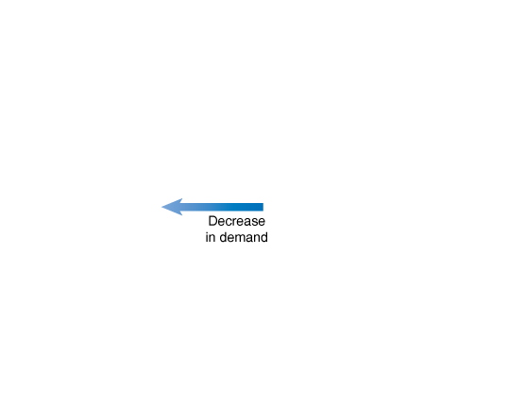
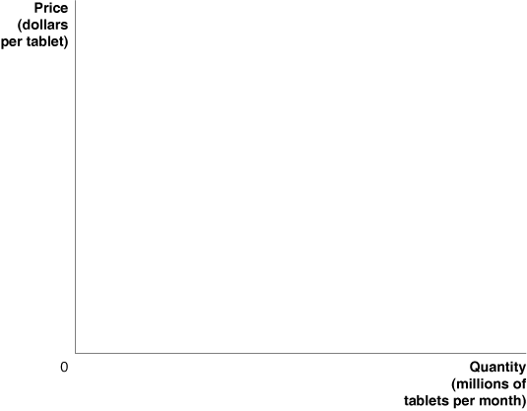
Figure 3.2
Shifting the Demand Curve
When consumers increase the quantity of a product they want to buy at a given price, the market demand curve shifts to the right, from D₁ to D₂.
When consumers decrease the quantity of a product they want to buy at a given price, the demand curve shifts to the left, from D₁ to D₃.

Slide 12
Variables That Shift Market Demand (改變市場需求的變數)
Many variables other than price can influence market demand. We will discuss the five most important:
Income
Normal good (正常財) A good for which the demand increases as income rises and decreases as income falls.
Inferior good (劣等財) A good for which the demand increases as income falls and decreases as income rises.

Slide 13
Prices of Related Goods
Substitutes (替代品) Goods and services that can be used for the same purpose.
Complements (互補品) Goods and services that are used together.
Tastes (品味) Subjective elements, such as ad campaigns or trends, can enter into a consumer’s decision to buy a product.
Population and Demographics
Demographics (人口統計) The characteristics of a population with respect to age, race, and gender.
Expected Future Prices (預期價格) Consumers choose not only which products to buy but also when to buy them.

Slide 14

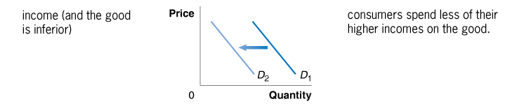

Table 3.1
Variables That Shift Market Demand Curves
An increase in… shifts the demand curve… because…

Slide 15


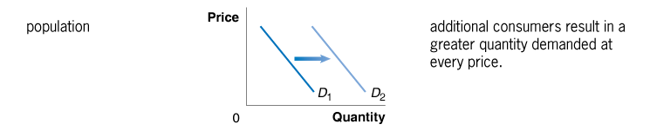
Table 3.1
Variables That Shift Market Demand Curves
An increase in… shifts the demand curve… because…

Slide 16

Table 3.1
Variables That Shift Market Demand Curves
An increase in… shifts the demand curve… because…

Slide 17
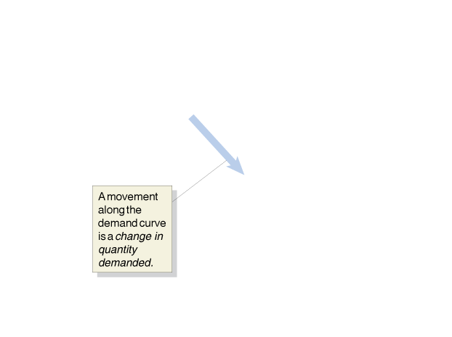
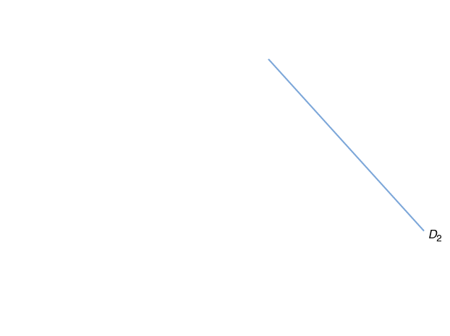
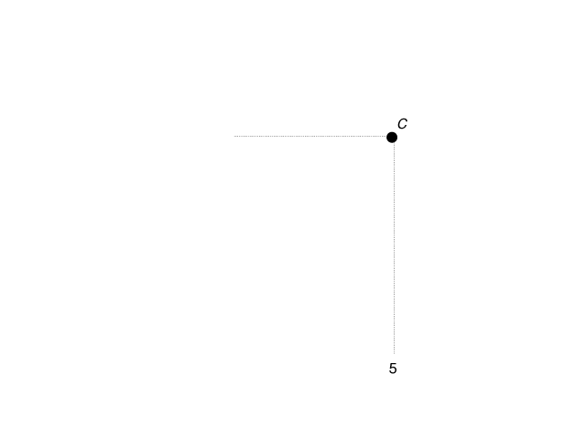
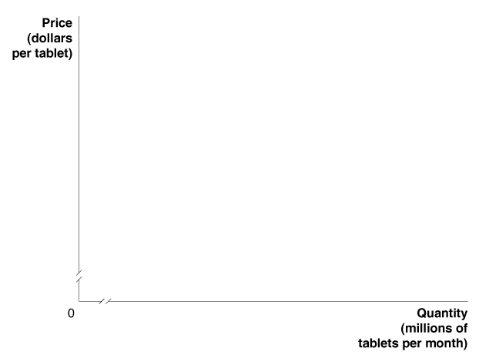
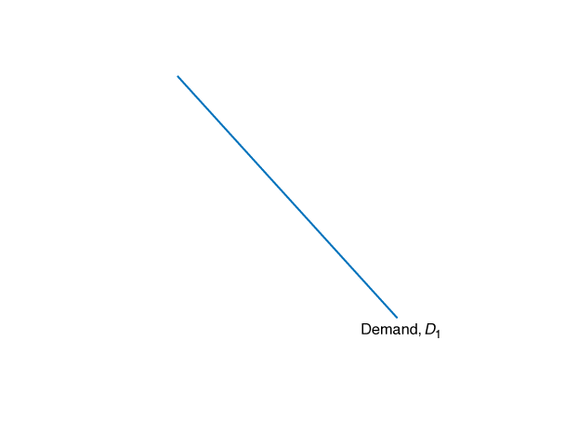
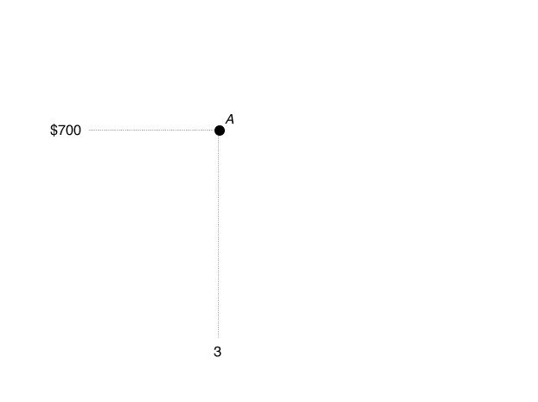
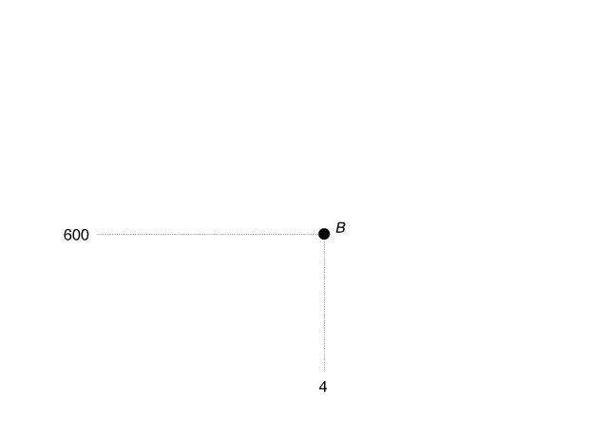
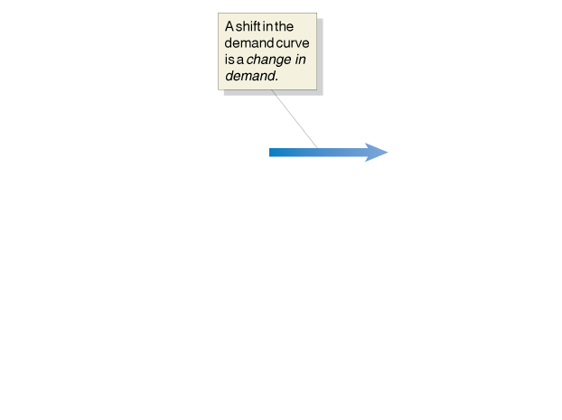
A Change in Demand (需求變動) versus a Change in Quantity Demanded (需求量變動)
Figure 3.3
If the price of tablet computers falls from $700 to $600, the result will be a movement along the demand curve from point A to point B—an increase in quantity demanded from 3 million tablets to 4 million tablets.
If consumers’ incomes increase, or if another factor changes that makes consumers want more of the product at every price, the demand curve will shift to the right—an increase in demand.
In this case, the increase in demand from D₁ to D₂ causes the quantity of tablet computers demanded at a price of $700 to increase from 3 million tablets at point A to 5 million tablets at point C.

Slide 18
The Supply Side of the Market
3.2 LEARNING OBJECTIVE
Discuss the variables that influence supply.

Slide 19
Quantity supplied (供給量) The amount of a good or service that a firm is willing and able to supply at a given price.
Supply Schedules and Supply Curves
Supply schedule (供給表) A table that shows the relationship between the price of a product and the quantity of the product supplied.
Supply curve (供給曲線) A curve that shows the relationship between the price of a product and the quantity of the product supplied.

Slide 20
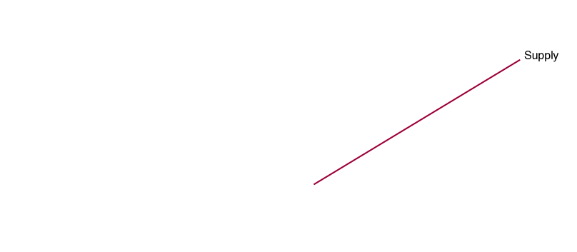
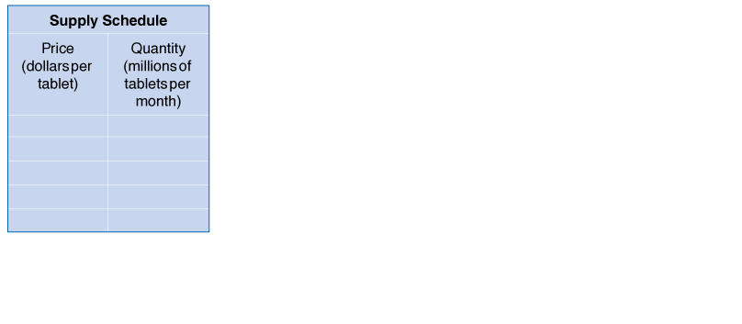
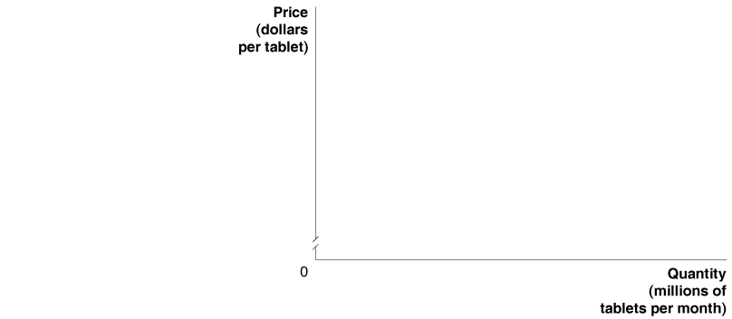
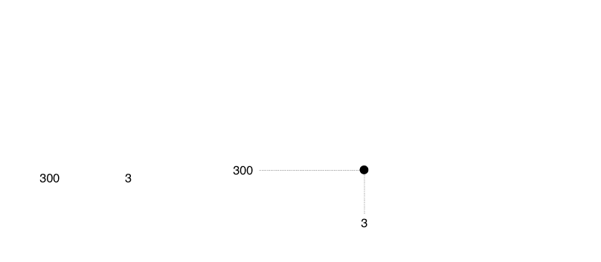
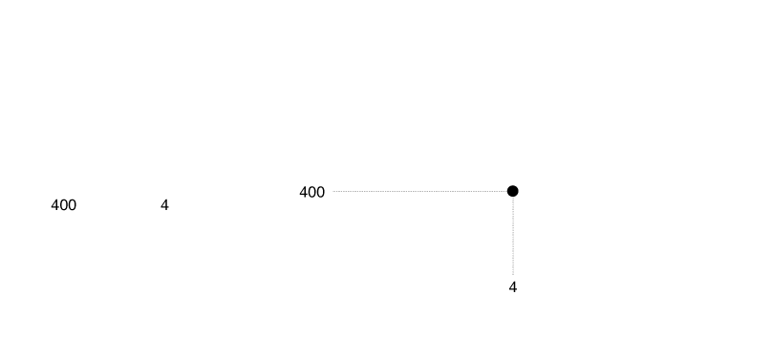
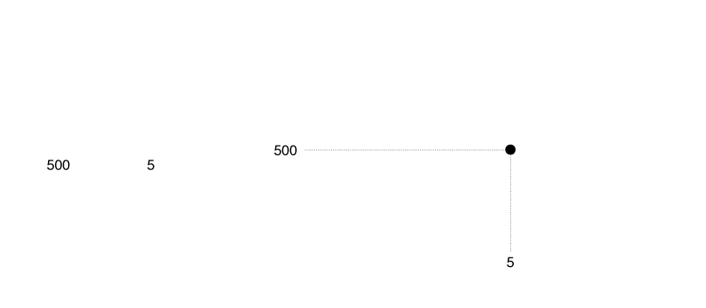
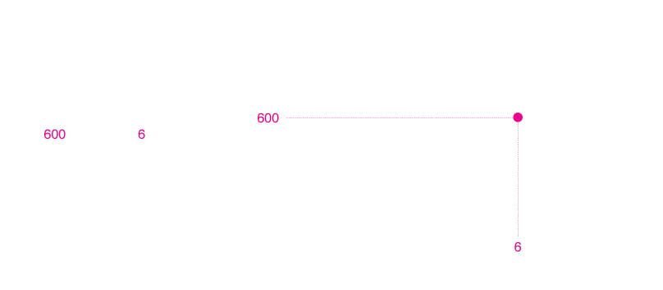
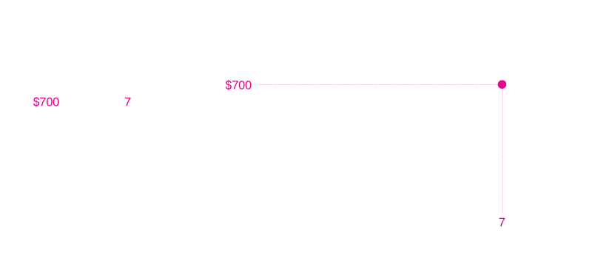
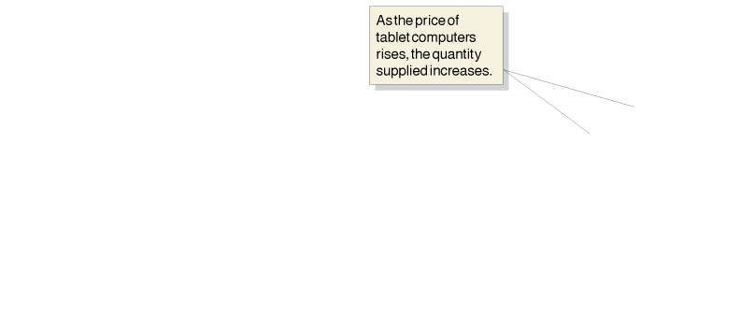
Figure 3.4
A Supply Schedule and Supply Curve
As the price changes, Apple, Toshiba, Samsung, LG, and other firms producing tablet computers change the quantity they are willing to supply.
We can show this as a supply schedule in a table or as a supply curve on a graph.
The supply schedule and supply curve both show that as the price of tablet computers rises, firms will increase the quantity they supply.
At a price of $600 per tablet, firms will supply 6 million tablets.
At a price of $700, firms will supply 7 million tablets.

Slide 21
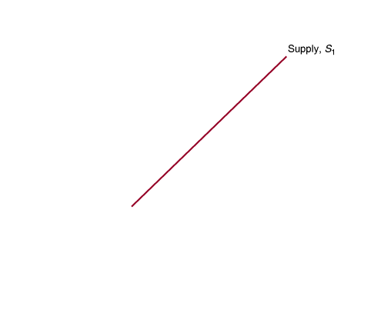
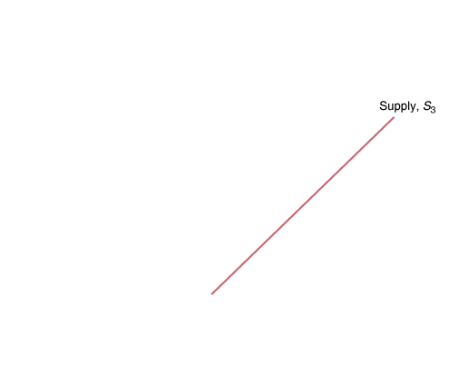
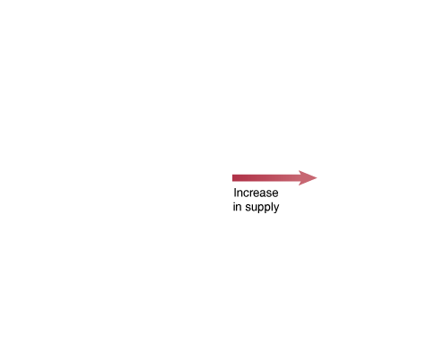
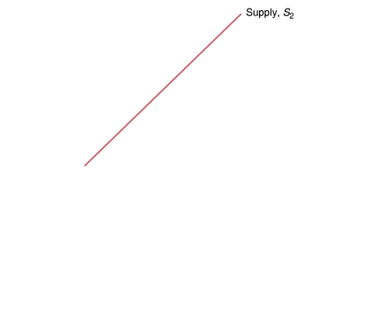
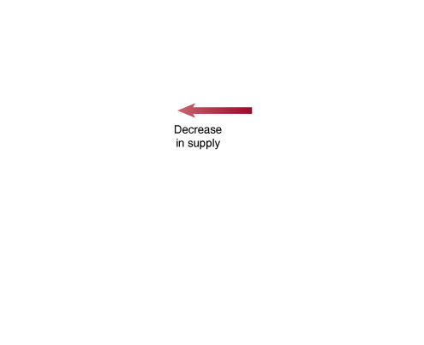
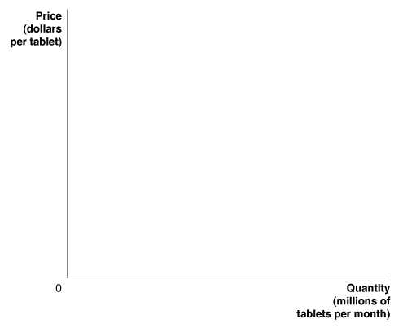
Law of supply (供給法則) The rule that, holding everything else constant, increases in price cause increases in the quantity supplied, and decreases in price cause decreases in the quantity supplied.
Figure 3.5
Shifting the Supply Curve
When firms increase the quantity of a product they want to sell at a given price, the supply curve shifts to the right.
The shift from S₁ to S₃ represents an increase in supply.
When firms decrease the quantity of a product they want to sell at a given price, the supply curve shifts to the left.
The shift from S₁ to S₂ represents a decrease in supply.

Slide 22
Variables That Shift Market Supply (影響市場供給的變數)
The following are the most important variables that shift market supply:
• Prices of Inputs (投入價格) A change in the price of an input—anything used in the production of a good or service—is the most likely factor to cause the supply curve for a product to shift.
• Technological Change
Technological change (技術改變) A positive or negative change in the ability of a firm to produce a given level of output with a given quantity of inputs.
Prices of Substitutes in Production (替代產品的價格) Alternative products that a firm could produce are called substitutes in production.
Number of Firms in the Market (市場內廠商數量) A change in the number of firms in the market will change supply.
Expected Future Prices (預期價格) If a firm expects that the price of its product will be higher in the future than it is today, it has an incentive to decrease supply now and increase it in the future.

Slide 23
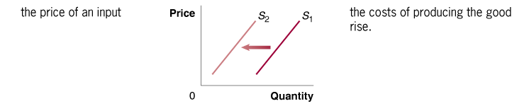

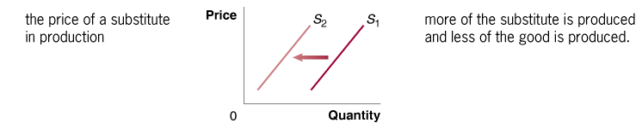
Table 3.2
Variables That Shift Market Supply Curves
An increase in… shifts the supply curve… because…

Slide 24
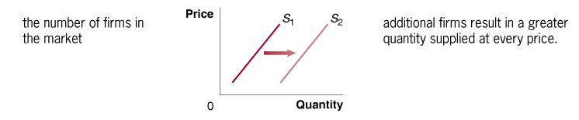

Table 3.2
Variables That Shift Market Supply Curves
An increase in… shifts the supply curve… because…

Slide 25
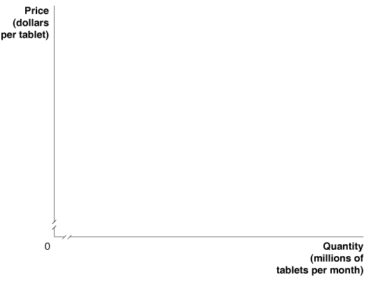
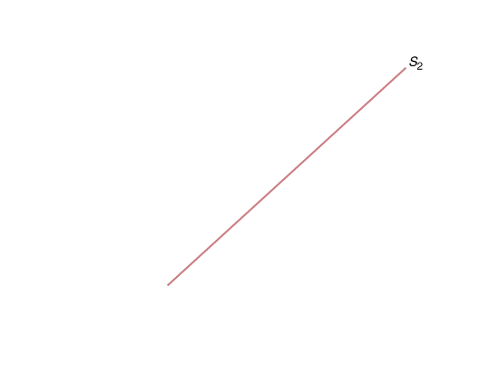






A Change in Supply (供給變動) versus a Change in Quantity Supplied (供給量變動)
Figure 3.6
If the price of tablet computers rises from $500 to $600 per tablet, the result will be a movement up the supply curve from point A to point B—an increase in quantity supplied by Apple, Toshiba, Samsung, and the other firms from 5 million to 6 million tablets.
If the price of an input decreases or another factor changes that causes sellers to supply more of the product at every price, the supply curve will shift to the right—an increase in supply.
In this case, the increase in supply from S₁ to S₂ causes the quantity of tablet computers supplied at a price of $600 to increase from 6 million at point B to 8 million at point C.

Slide 26
Market Equilibrium: Putting Demand and Supply Together
3.3 LEARNING OBJECTIVE
Use a graph to illustrate market equilibrium.

Slide 27





Figure 3.7
Market Equilibrium
Where the demand curve crosses the supply curve determines market equilibrium.
In this case, the demand curve for tablet computers crosses the supply curve at a price of $500 and a quantity of 5 million tablets.
Only at this point is the quantity of tablet computers consumers are willing to buy equal to the quantity that Apple, Amazon, Samsung, and the other firms are willing to sell:
The quantity demanded is equal to the quantity supplied.

Slide 28
Market equilibrium (市場均衡) A situation in which quantity demanded equals quantity supplied.
Competitive market equilibrium (完全競爭市場均衡) A market equilibrium with many buyers and many sellers.
How Markets Eliminate Surpluses and Shortages
Surplus (剩餘) A situation in which the quantity supplied is greater than the quantity demanded.
Shortage (短缺) A situation in which the quantity demanded is greater than the quantity supplied.

Slide 29







Figure 3.8
The Effect of Surpluses and Shortages on the Market Price
When the market price is above equilibrium, there will be a surplus.
In the figure, a price of $600 for tablet computers results in 6 million tablets being supplied but only 4 million tablets being demanded, or a surplus of 2 million.
As Apple, Toshiba, Dell, and other firms cut the price to dispose of the surplus, the price will fall to the equilibrium of $500.
When the market price is below equilibrium, there will be a shortage.
A price of $300 results in 7 million tablets being demanded but only 3 million tablets being supplied, or a shortage of 4 million tablets.
As firms find that consumers who are unable to find tablet computers available for sale are willing to pay higher prices to get them, the price will rise to the equilibrium of $500.

Slide 30
Demand and Supply Both Count
Keep in mind that the interaction of demand and supply determines the equilibrium price.
Neither consumers nor firms can dictate what the equilibrium price will be.
No firm can sell anything at any price unless it can find a willing buyer, and no consumer can buy anything at any price without finding a willing seller.

Slide 31
The Effect of Demand and Supply Shifts on Equilibrium
3.4 LEARNING OBJECTIVE
Use demand and supply graphs to predict changes in prices and quantities.

Slide 32









The Effect of Shifts in Supply on Equilibrium
Figure 3.9
The Effect of an Increase in Supply on Equilibrium
If a firm enters a market, as Toshiba entered the market for tablet computers when it introduced the Thrive, the equilibrium price will fall, and the equilibrium quantity will rise:
1. As Toshiba enters the market for tablet computers, a larger quantity of tablets will be supplied at every price, so the market supply curve shifts to the right, from S₁ to S₂, which causes a surplus of tablets at the original price, P₁.
2. The equilibrium price falls from P₁ to P₂.
3. The equilibrium quantity rises from Q₁ to Q₂.

Slide 33









The Effect of Shifts in Demand on Equilibrium
Figure 3.10
The Effect of an Increase in Demand on Equilibrium
Increases in income will cause the equilibrium price and quantity to rise:
1. Because tablet computers are a normal good, as income grows, the quantity demanded increases at every price, and the market demand curve shifts to the right, from D₁ to D₂, which causes a shortage of tablet computers at the original price, P₁.
2. The equilibrium price rises from P₁ to P₂.
3. The equilibrium quantity rises from Q₁ to Q₂.

Slide 34





















The Effect of Shifts in Demand and Supply over Time
Figure 3.11
Shifts in Demand and Supply over Time
Whether the price of a product rises or falls over time depends on whether demand shifts to the right more than supply.
In panel (a), demand shifts to the right more than supply, and the equilibrium price rises:
In panel (b), supply shifts to the right more than demand, and the equilibrium price falls:
1. Demand shifts to the right more than supply.
2. Equilibrium price rises from P₁ to P₂.
1. Supply shifts to the right more than demand.
2. Equilibrium price falls from P₁ to P₂.

Slide 35
Table 3.3
How Shifts in Demand and Supply Affect Equilibrium Price (P) and Quantity (Q)
 | Supply Curve Unchanged | Supply Curve Shifts to the Right | Supply Curve Shifts to the Left
Demand Curve Unchanged | Q unchanged P unchanged | Q increases P decreases | Q decreases P increases
Demand Curve Shifts to the Right | Q increases P increases | Q increases P increases or decreases | Q increases or decreases P increases
Demand Curve Shifts to the Left | Q decreases P decreases | Q increases or decreases P decreases | Q decreases P increases or decreases

