Slide 1



R. GLENN HUBBARD
ANTHONY PATRICK O’BRIEN
Economics
FOURTH EDITION

Slide 2

10
Consumer Choice and Behavioral Economics
CHAPTER
Chapter Outline and
Learning Objectives
10.1 | Utility and Consumer Decision Making
10.2 | Where Demand Curves Come From
10.3 | Social Influences on Decision Making
10.4 | Behavioral Economics: Do People Make Their Choices Rationally?
Appendix: Using Indifference Curves and Budget Lines to Understand Consumer Behavior

Slide 3

新聞時事
江蕙連莊金門酒廠代言 [2012年11月08日蘋果日報]
江蕙去年替金門酒廠代言限量2千套的60周年紀念酒組，2小時完售紀錄與創下5960萬元驚人銷售佳績，1組原價2萬9800元，網路一度被炒到10萬元，今年2度獲邀代言，2年代言費逾千萬元，網路上還有旅居紐約、歐洲等地僑胞歌迷，買了她代言紀念酒款，讚嘆江蕙歌聲如金門醇酒，一解鄉愁。

Slide 4

新聞時事
藝人吳建豪 代言中型房車 [華視2012/09/17]
吳建豪在台上勁歌熱舞，炒熱現場氣氛，車商業者找來吳建豪代言新車款，希望可以藉著他的國際形象與魅力，衝高銷售量。新車款擁有流線車身造型、豪華科技質感與更豐富的配備，鎖定35歲以下的目標客群，車商有信心可以達到月銷1000輛的目標。

Slide 5
Economics in Your Life
Do You Make Rational Decisions?(你做理性選擇嗎?)
Economists generally assume that people make decisions in a rational, consistent way. But are people actually as rational as economists assume?
See if you can answer these questions by the end of the chapter:
Consider the following situation:
You bought a concert ticket for $75, which is the most you were willing to pay. While you are in line to enter the concert hall, someone offers you $90 for the ticket.
Would you sell the ticket?
Would an economist think it is rational to sell the ticket?

Slide 6
Utility and Consumer Decision Making
10.1 LEARNING OBJECTIVE
Define utility and explain how consumers choose goods and services to maximize their utility.

Slide 7
The Economic Model of Consumer Behavior in a Nutshell 概括消費行為的經濟模型
The economic model of consumer behavior predicts that consumers will choose to buy the combination of goods and services that makes them as well off as possible from among all the combinations that their budgets allow them to buy.
Utility (效用) The enjoyment or satisfaction people receive from consuming goods and services.
The Principle of Diminishing Marginal Utility 邊際效用遞減原則
Marginal utility (MU) (邊際效用) The change in total utility a person receives from consuming one additional unit of a good or service.
Law of diminishing marginal utility (邊際效用遞減法則) The principle that consumers experience diminishing additional satisfaction as they consume more of a good or service during a given period of time.

Slide 8
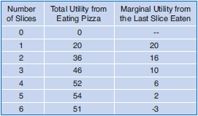
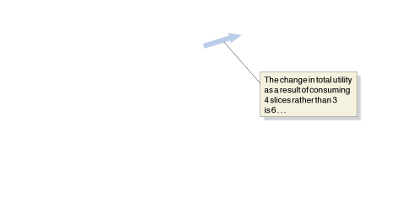


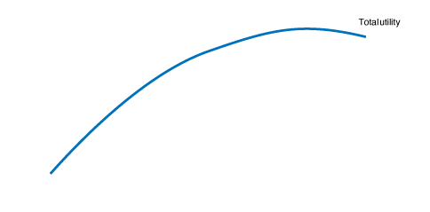
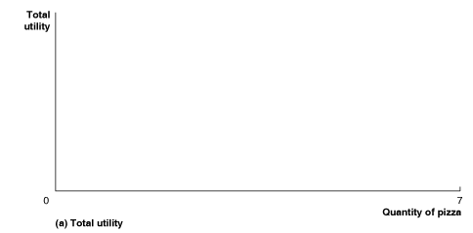


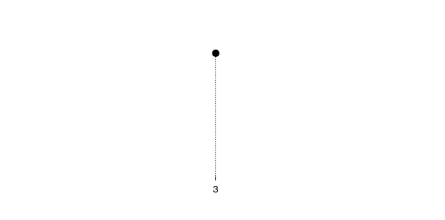
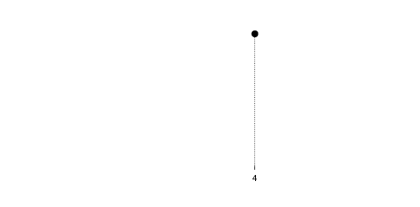


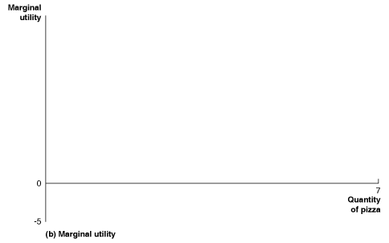
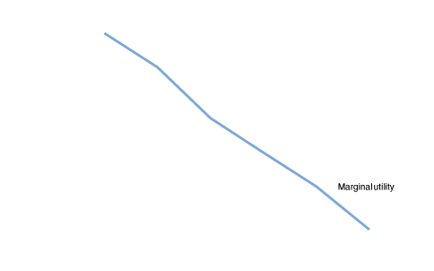
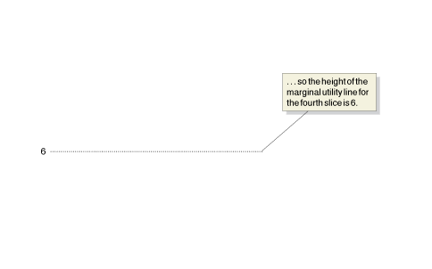



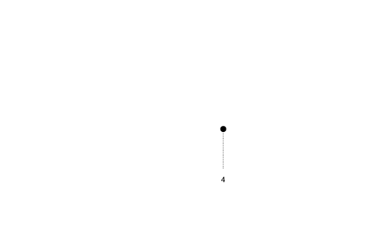



Figure 10.1
Total and Marginal Utility from Eating Pizza on Super Bowl Sunday
The table shows that for the first 5 slices of pizza, the more you eat, the more your total satisfaction, or utility, increases.
If you eat a sixth slice, you start to feel ill from eating too much pizza, and your total utility falls.
Each additional slice increases your utility by less than the previous slice, so your marginal utility from each slice is less than the one before.
Panel (a) shows your total utility rising as you eat the first 5 slices and falling with the sixth slice.
Panel (b) shows your marginal utility falling with each additional slice you eat and becoming negative with the sixth slice.
The height of the marginal utility line at any quantity of pizza in panel (b) represents the change in utility as a result of consuming that additional slice.
For example, the change in utility as a result of consuming 4 slices instead of 3 is 6 utils, so the height of the marginal utility line in panel (b) for the fourth slice is 6 utils.

Slide 9
The Rule of Equal Marginal Utility per Dollar Spent 每一元花費邊際效用均等法則
Budget constraint (預算限制) The limited amount of income available to consumers to spend on goods and services.
Table 10.1
Total Utility and Marginal Utility from Eating Pizza and Drinking Coke
Number of Slices of Pizza | Total Utility from Eating Pizza | Marginal Utility from the Last Slice | Number of Cups of Coke | Total Utility from Drinking Coke | Marginal Utility from the Last Cup
0 | 0 | — | 0 | 0 | —
1 | 20 | 20 | 1 | 20 | 20
2 | 36 | 16 | 2 | 35 | 15
3 | 46 | 10 | 3 | 45 | 10
4 | 52 | 6 | 4 | 50 | 5
5 | 54 | 2 | 5 | 53 | 3
6 | 51 | −3 | 6 | 52 | −1
Remember: Optimal decisions are made at the margin. The key to making the best consumption decision is to maximize utility by following the rule of equal marginal utility per dollar spent.

Slide 10
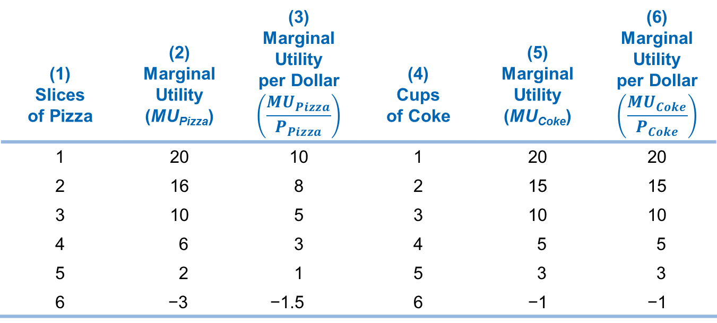
Table 10.2
Converting Marginal Utility to Marginal Utility per Dollar
(1) Slices of Pizza | (2) Marginal Utility (MU_{Pizza}) |  | (4) Cups of Coke | (5) Marginal Utility (MU_{Coke})
1 | 20 | 10 | 1 | 20 | 20
2 | 16 | 8 | 2 | 15 | 15
3 | 10 | 5 | 3 | 10 | 10
4 | 6 | 3 | 4 | 5 | 5
5 | 2 | 1 | 5 | 3 | 3
6 | −3 | −1.5 | 6 | −1 | −1

Slide 11
Table 10.3
Equalizing Marginal Utility per Dollar Spent
Combinations of Pizza and Coke with Equal Marginal Utilities per Dollar | Marginal Utility Per Dollar (MU/P) | Total Spending | Total Utility
1 slice of pizza and 3 cups of Coke | 10 | $2 + $3 = $5 | 20 + 45 = 65
3 slices of pizza and 4 cups of Coke | 5 | $6 + $4 = $10 | 46 + 50 = 96
4 slices of pizza and 5 cups of Coke | 3 | $8 + $5 = $13 | 52 + 53 = 105
We can summarize the two conditions for maximizing utility:
1.
2. Spending on pizza + Spending on Coke = Amount available to be spent

Slide 12
Appendix
Using Indifference Curves and Budget Lines to Understand Consumer Behavior
LEARNING OBJECTIVE
Use indifference curves and budget lines to understand consumer behavior.
Consumer Preferences
Suppose that a consumer is presented with the following alternatives, or consumption bundles:
Consumption Bundle A | Consumption Bundle B
2 slices of pizza and 1 can of Coke | 1 slice of pizza and 2 cans of Coke
We assume that the consumer will always be able to decide which of the following is true:
• The consumer prefers bundle A to bundle B.
• The consumer prefers bundle B to bundle A.
• The consumer is indifferent between bundle A and bundle B. That is, the consumer would be equally happy to receive either bundle, so we can say the consumer receives equal utility from the two bundles.
For consistency, we also assume that the consumer’s preferences are transitive.

Slide 13
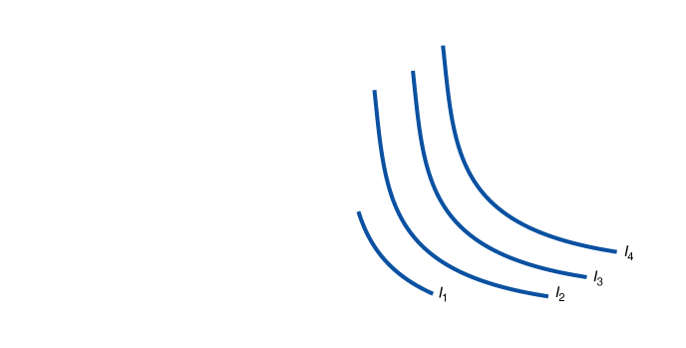
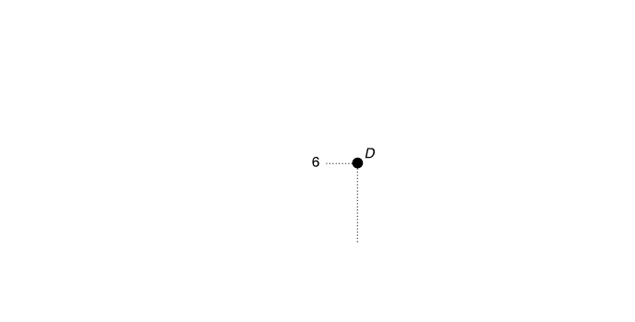
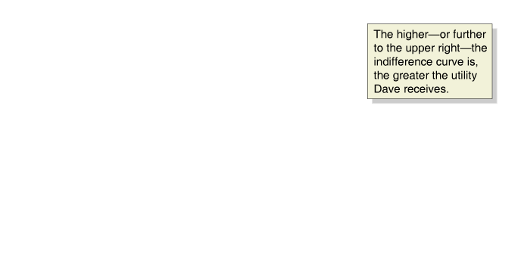
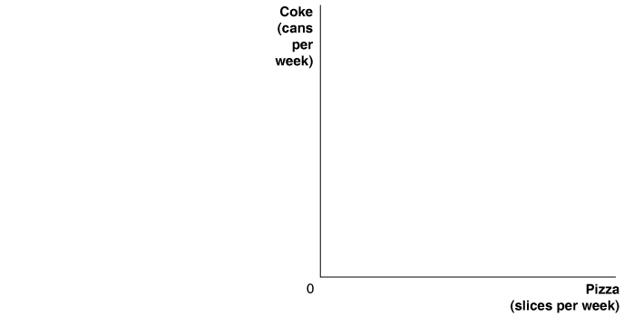
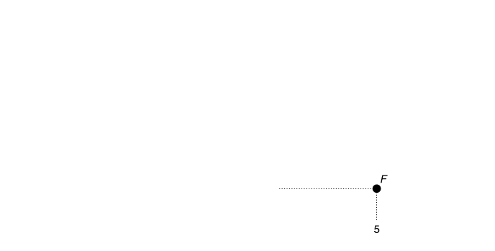
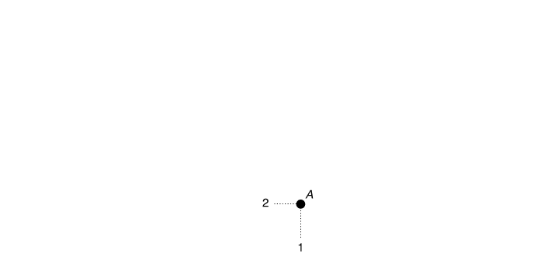
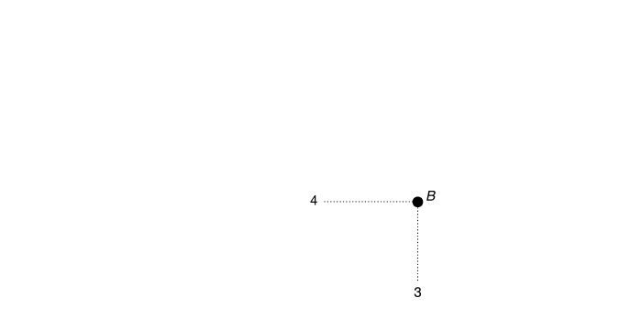
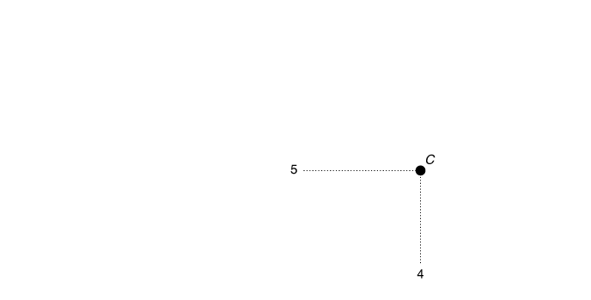
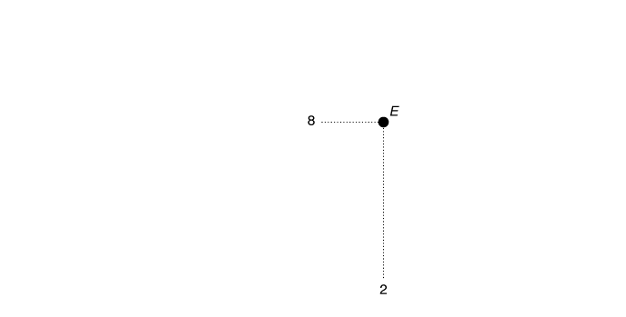
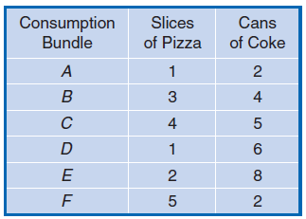
Indifference curve (無異曲線) A curve that shows the combinations of consumption bundles that give the consumer the same utility.
Figure 10A.1
Plotting Dave’s Preferences for Pizza and Coke
Every possible combination of pizza and Coke will have an indifference curve passing through it, although in the graph we show just four of Dave’s indifference curves.
Dave is indifferent among all the consumption bundles that are on the same indifference curve.
So, he is indifferent among bundles E, B, and F because they all lie on indifference curve I₃.
Moving to the upper right in the graph increases the quantities of both goods available for Dave to consume.
Therefore, the further to the upper right the indifference curve is, the greater the utility Dave receives.

Slide 14
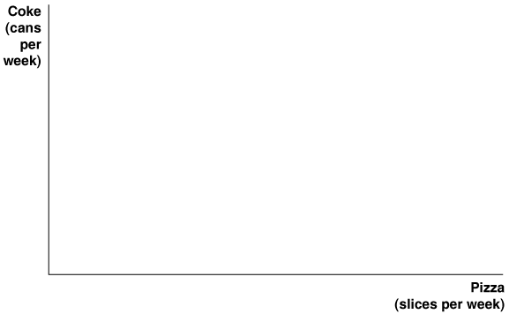
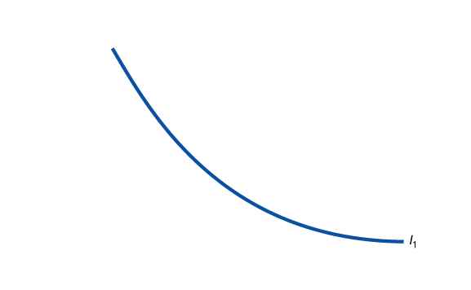
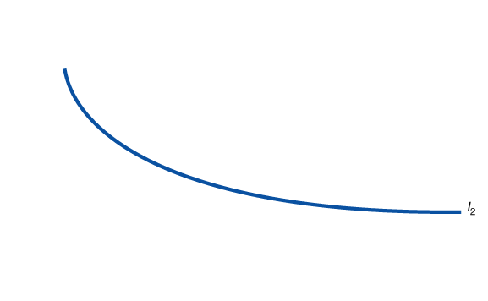



The Slope of an Indifference Curve 無異曲線的斜率
Marginal rate of substitution (MRS) (邊際替代率) The rate at which a consumer would be willing to trade off one good for another.
Can Indifference Curves Ever Cross?
Figure 10A.2
Indifference Curves Cannot Cross
Because bundle X and bundle Z are both on indifference curve I₁, Dave must be indifferent between them.
Similarly, because bundle X and bundle Y are on indifference curve I₂, Dave must be indifferent between them.
The assumption of transitivity means that Dave should also be indifferent between bundle Z and bundle Y.
We know that this is not true, however, because bundle Y contains more pizza and more Coke than bundle Z.
So Dave will definitely prefer bundle Y to bundle Z, which violates the assumption of transitivity.
Therefore, none of Dave’s indifference curves can cross.

Slide 15

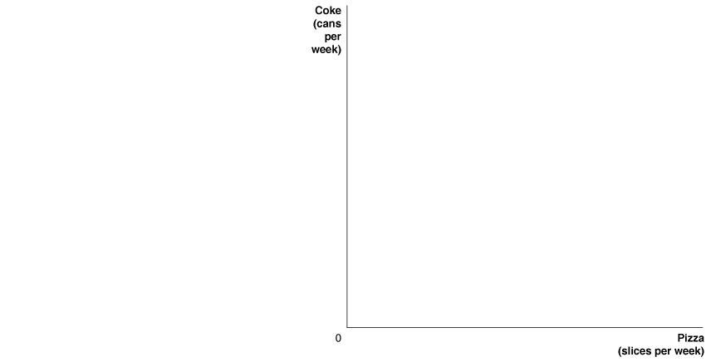
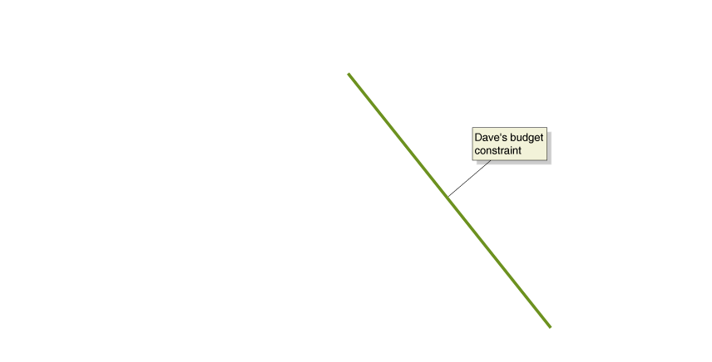

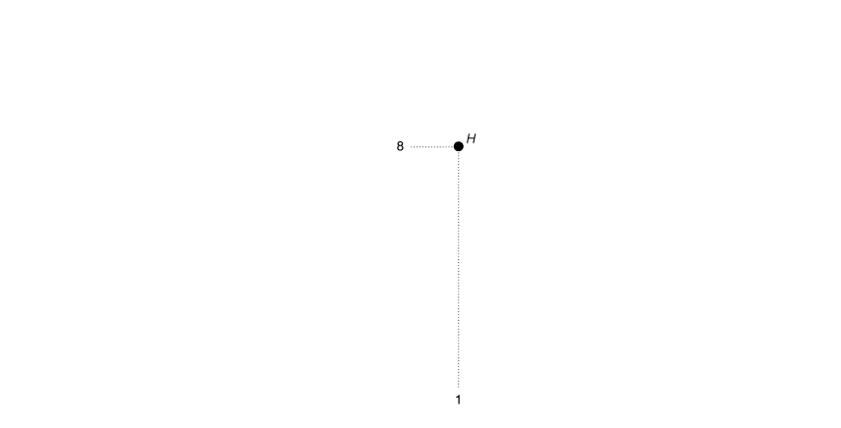
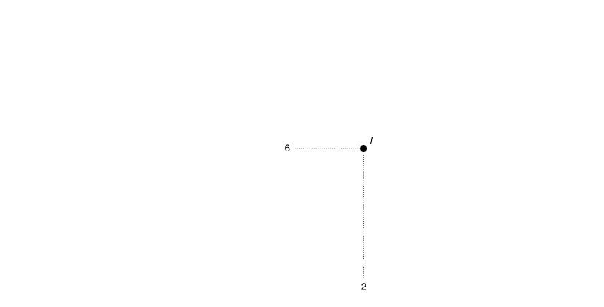
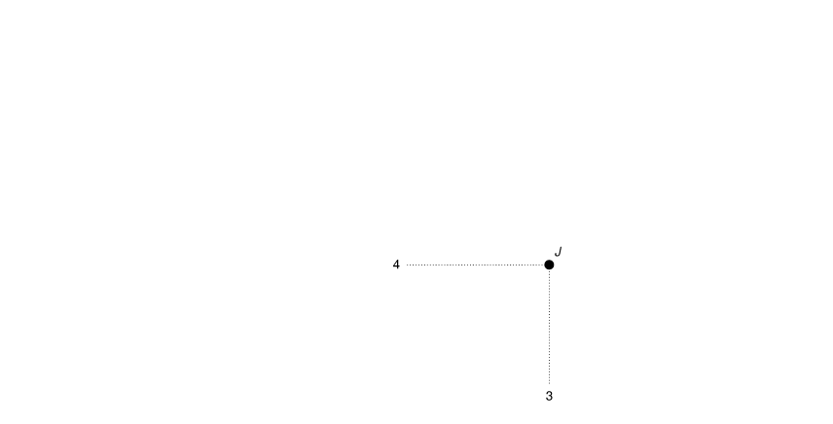
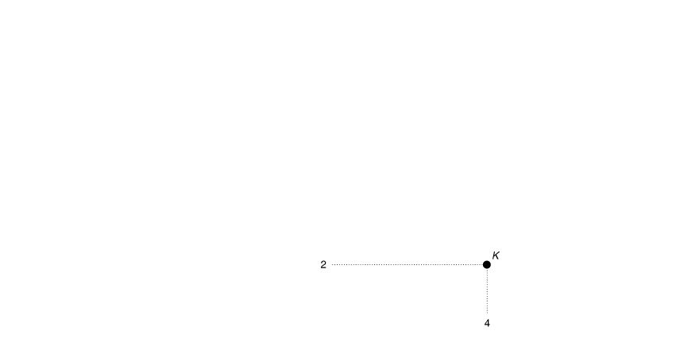
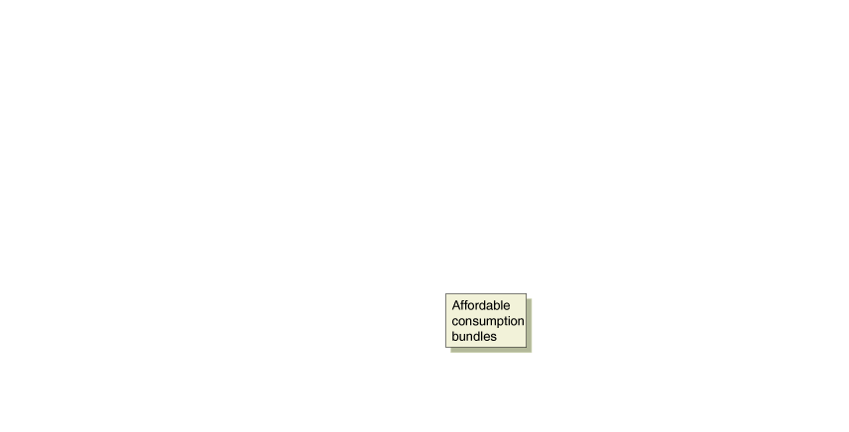


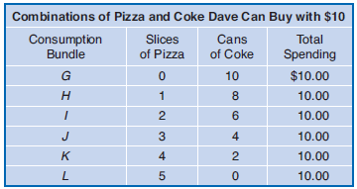
The Budget Constraint
Remember that a consumer’s budget constraint is the amount of income he or she has available to spend on goods and services.
Figure 10A.3
Dave’s Budget Constraint
Dave’s budget constraint shows the combinations of slices of pizza and cans of Coke he can buy with $10.
The price of Coke is $1 per can, so if he spends all of his $10 on Coke, he can buy 10 cans (bundle G).
The price of pizza is $2 per slice, so if he spends all of his $10 on pizza, he can buy 5 slices (bundle L).
As he moves down his budget constraint from bundle G, he gives up 2 cans of Coke for every slice of pizza he buys.
Any consumption bundles along the line or inside the line are affordable.
Any bundles that lie outside the line are unaffordable.
The slope of the budget constraint is equal to the ratio of the price of the good on the horizontal axis divided by the price of the good on the vertical axis multiplied by −1.

Slide 16
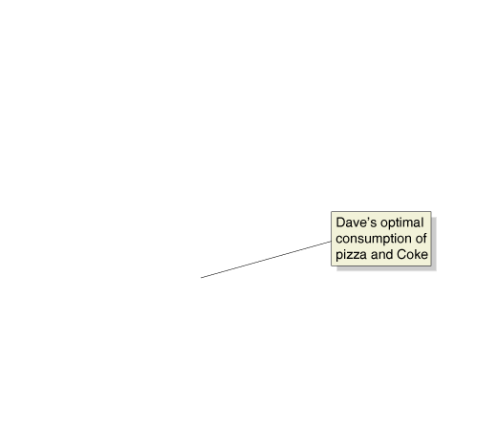
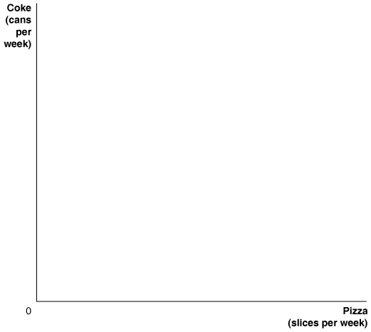
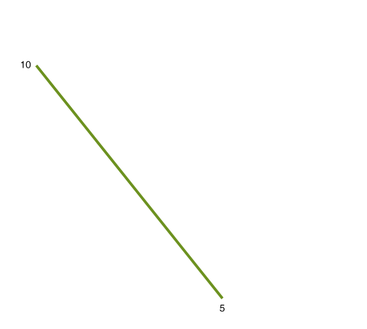
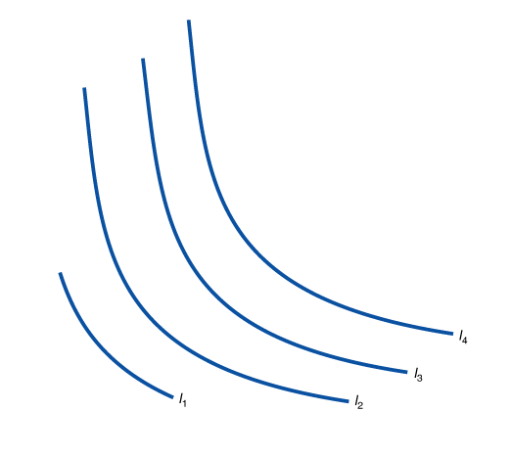
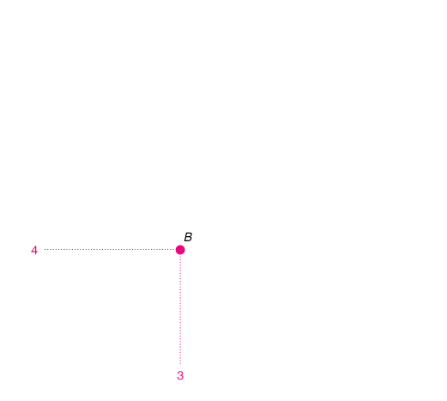
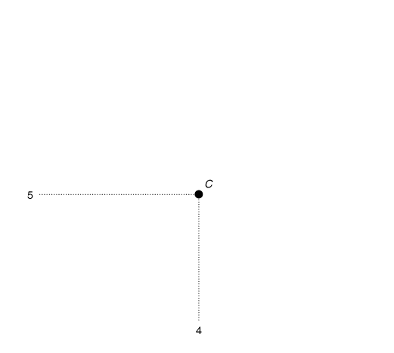
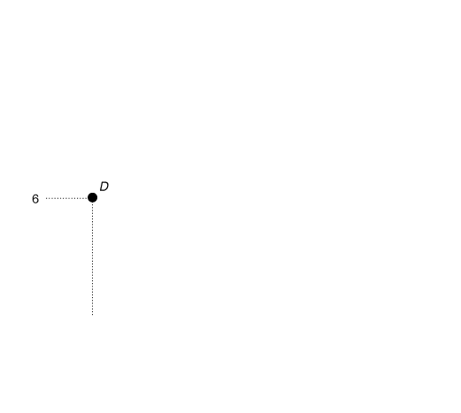
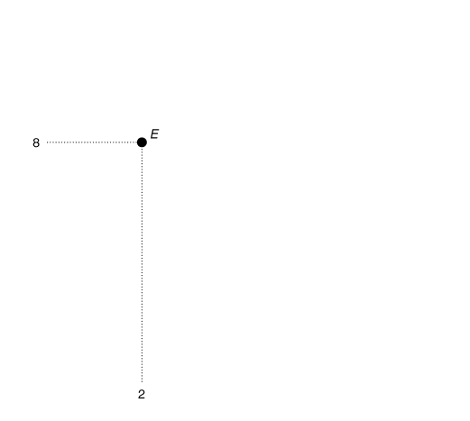
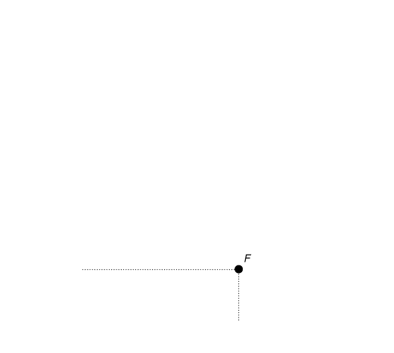
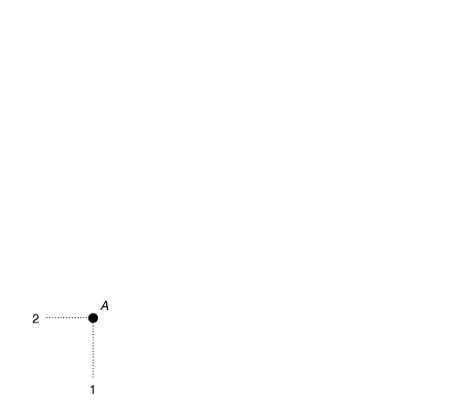
Choosing the Optimal Consumption of Pizza and Coke
Figure 10A.4
Finding Optimal Consumption
Dave would like to be on the highest possible indifference curve, but he cannot reach indifference curves such as I₄ that are outside his budget constraint.
Dave’s optimal combination of slices of pizza and cans of Coke is at point B, where his budget constraint just touches—or is tangent to—the highest indifference curve he can reach.
At point B, he buys 3 slices of pizza and 4 cans of Coke.
To maximize utility, a consumer needs to be on the highest indifference curve, given his budget constraint.

Slide 17
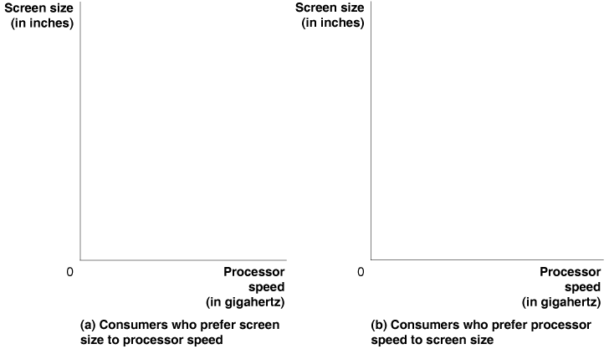


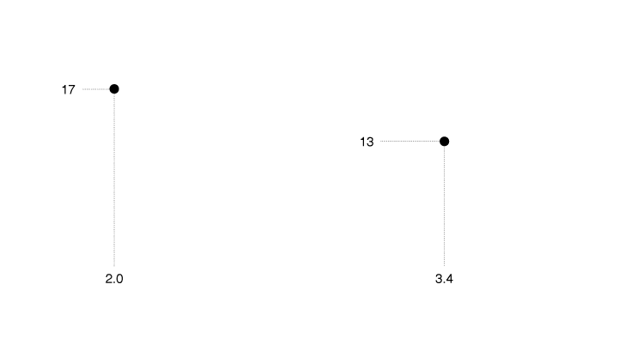
Making the Connection
Dell Determines the Optimal Mix of Products
We can use the model of consumer choice to analyze a simplified version of the situation Dell faces in deciding which features to offer consumers.
Each point of tangency between a typical consumer’s indifference curve and the budget constraint shows an optimal processor speed and screen size choice, which is useful information for Dell in determining the mix of components to offer consumers.
MyEconLab
Your Turn: Test your understanding by doing related problem 10A.8 at the end of this appendix.

Slide 18
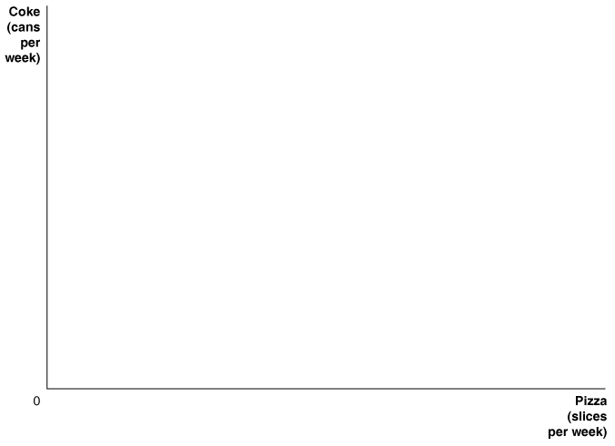
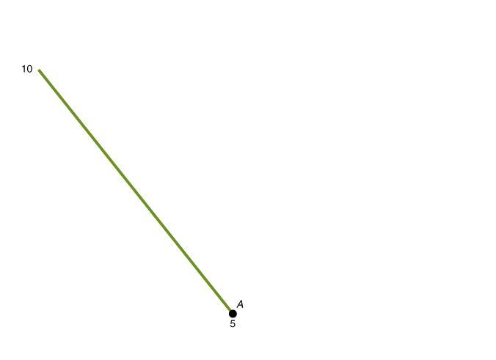
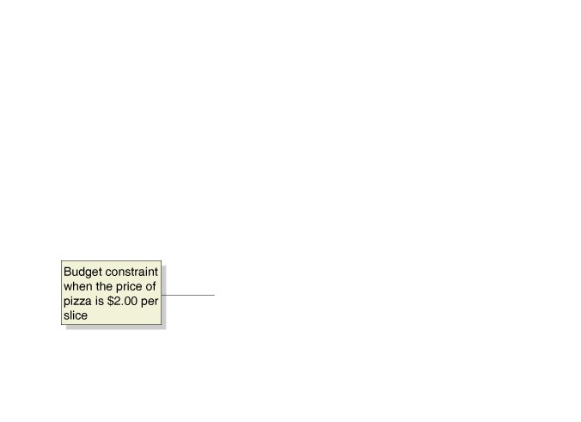
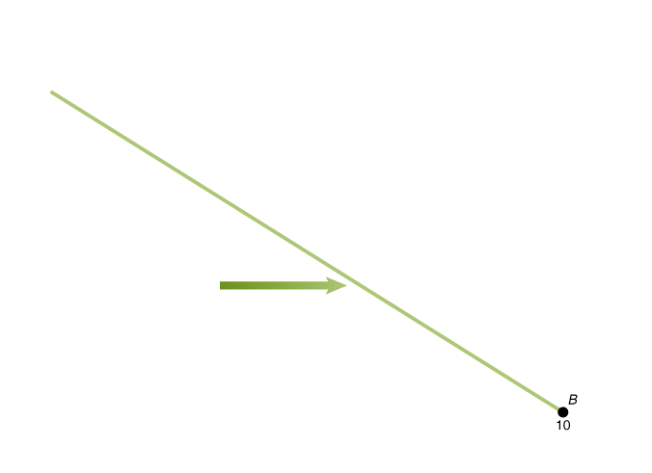
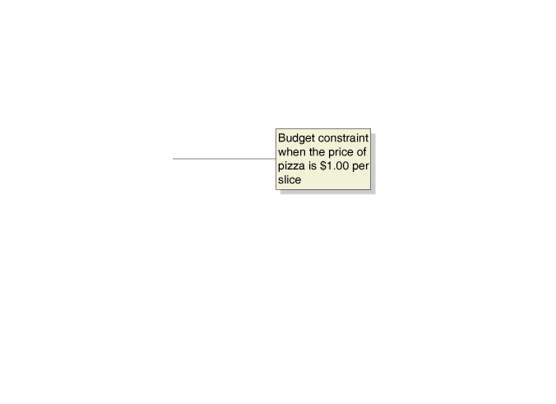
Deriving the Demand Curve 推導需求曲線
Figure 10A.5
How a Price Decrease Affects the Budget Constraint
A fall in the price of pizza from $2 per slice to $1 per slice increases the maximum number of slices Dave can buy with $10 from 5 to 10.
The budget constraint rotates outward from point A to point B to show the effect of the price decrease.

Slide 19

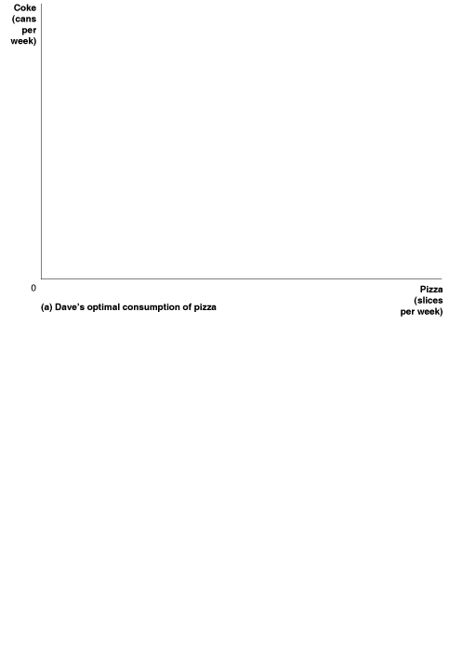










Figure 10A.6
How a Price Change Affects Optimal Consumption
In panel (a), a fall in the price of pizza results in Dave’s consuming less Coke and more pizza.
1. A fall in the price of pizza rotates the budget constraint outward because Dave can now buy more pizza with his $10.
2. In the new optimum on indifference curve I₂, Dave changes the quantities he consumes of both goods.
His consumption of Coke falls from 4 cans to 3 cans.
3. In the new optimum, Dave’s consumption of pizza increases from 3 slices to 7 slices.
In panel (b), Dave responds optimally to the fall in the price of pizza from $2 per slice to $1 by increasing the quantity of slices he consumes from 3 slices to 7 slices.
When we graph this result, we have Dave’s demand curve for pizza.

Slide 20










Income and Substitution Effects of a Price Change
Figure 10A.7
Following a decline in the price of pizza, Dave’s optimal consumption of pizza increases from 3 slices (point A) per week to 7 slices per week (point C).
We can think of this movement from point A to point C as taking place in two steps:
The movement from point A to point B along indifference curve I₁ represents the substitution effect, and
the movement from point B to point C represents the income effect.
Dave increases his consumption of pizza from 3 slices per week to 5 slices per week because of the substitution effect of a fall in the price of pizza and from 5 slices per week to 7 slices per week because of the income effect.

Slide 21





Figure 10A.8
How a Change in Income Affects the Budget Constraint
When the income Dave has to spend on pizza and Coke increases from $10 to $20, his budget constraint shifts outward.
With $10, Dave could buy a maximum of 5 slices of pizza or 10 cans of Coke.
With $20, he can buy a maximum of 10 slices of pizza or 20 cans of Coke.

Slide 22








Figure 10A.9
How a Change in Income Affects Optimal Consumption
An increase in income leads Dave to consume more Coke and more pizza.
1. An increase in income shifts Dave’s budget constraint outward because he can now buy more of both goods.
2. In the new optimum on indifference curve I₂, Dave changes the quantities he consumes of both goods.
His consumption of Coke increases from 4 cans to 6 cans.
3. In the new optimum, Dave’s consumption of pizza increases from 3 slices to 7 slices.

Slide 23





The Slope of the Indifference Curve, the Slope of the Budget Line, and the Rule of Equal Marginal Utility per Dollar Spent
Figure 10A.10
At the Optimum Point, the Slopes of the Indifference Curve and Budget Constraint Are the Same
At the point of optimal consumption, the marginal rate of substitution is equal to the ratio of the price of the product on the horizontal axis to the price of the product on the vertical axis.
At the point of optimal consumption, the marginal rate of substitution (MRS) is equal to the ratio of the price of the product on the horizontal axis to the price of the product on the vertical axis.

Slide 24

The Rule of Equal Marginal Utility per Dollar Spent Revisited
The rule of equal marginal utility per dollar states that to maximize utility, consumers should spend their income so that the last dollar spent on each product gives them the same marginal utility.
When Dave consumes less Coke but more pizza, his total utility remains the same along an indifference curve. Therefore, we can write:
If we rearrange terms, we have:
Because the first expression is the slope of the indifference curve, it is equal to the marginal rate of substitution (multiplied by negative 1). So, we can write:

Slide 25
The slope of Dave’s budget constraint equals the price of pizza divided by the price of Coke (multiplied by negative 1).
We saw earlier in this appendix that at the point of optimal consumption, the MRS equals the ratio of the prices of the two goods. Therefore:
We can rewrite this to show that at the point of optimal consumption:
This last expression is the rule of equal marginal utility per dollar that we first developed in this chapter.
So we have shown how this rule follows from the indifference curve and budget constraint approach to analyzing consumer choice.

Slide 26
What if the Rule of Equal Marginal Utility per Dollar Does Not Hold?
The idea of getting the maximum utility by equalizing the ratio of marginal utility to price for the goods you are buying can be difficult to grasp, so it is worth thinking about in another way.
From the information in Table 10.1, we can list the additional utility per dollar you are getting from the last slice and the last cup and the total utility from consuming 4 slices and 2 cups:
Marginal utility per dollar for the fourth slice of pizza = 3 utils per dollar
Marginal utility per dollar for the second cup of Coke = 15 utils per dollar
Total utility from 4 slices of pizza and 2 cups of Coke = 87 utils
The marginal utilities per dollar are not equal. You could raise your total utility by buying less pizza and more Coke.

Slide 27
The Income Effect and Substitution Effect of a Price Change 一單位價格改變的所得效果與替代效果
Income effect (所得效果) The change in the quantity demanded of a good that results from the effect of a change in price on consumer purchasing power, holding all other factors constant.
Substitution effect (替代效果) The change in the quantity demanded of a good that results from a change in price making the good more or less expensive relative to other goods, holding constant the effect of the price change on consumer purchasing power.
Table 10.4
Income Effect and Substitution Effect of a Price Change
When price . . . | consumer purchasing power . . . | The income effect causes quantity demanded to . . . | The substitution effect causes the opportunity cost of consuming a good to . . .
decreases, | increases. | increase, if a normal good, and decrease, if an inferior good. | decrease when the price decreases, which causes the quantity of the good demanded to increase.
increases, | decreases. | decrease, if a normal good, and increase, if an inferior good. | increase when the price increases, which causes the quantity of the good demanded to decrease.

Slide 28

Table 10.5
Adjusting Optimal Consumption to a Lower Price of Pizza
Number of Slices of Pizza | Marginal Utility from Last Slice (Mu_{pizza}) |  | Number of Cups of Coke | Marginal Utility from Last Cup (Mu_{coke})
1 | 20 | 13.33 | 1 | 20 | 20
2 | 16 | 10.67 | 2 | 15 | 15
3 | 10 | 6.67 | 3 | 10 | 10
4 | 6 | 4 | 4 | 5 | 5
5 | 2 | 1.33 | 5 | 3 | 3
6 | −3 | — | 6 | −1 | —

Slide 29
Where Demand Curves Come From
10.2 LEARNING OBJECTIVE
Use the concept of utility to explain the law of demand.

Slide 30







Figure 10.2
Deriving the Demand Curve for Pizza
A consumer responds optimally to a fall in the price of a product by consuming more of that product.
In panel (a), the price of pizza falls from $2 per slice to $1.50, and the optimal quantity of slices consumed rises from 3 to 4.
When we graph this result in panel (b), we have the consumer’s demand curve.

Slide 31


















Figure 10.3
Deriving the Market Demand Curve from Individual Demand Curves
The table shows that the total quantity demanded in a market is the sum of the quantities demanded by each buyer. We can find the market demand curve by adding horizontally the individual demand curves in panels (a), (b), and (c).
For instance, at a price of $1.50, your quantity demanded is 4 slices, David’s quantity demanded is 6 slices, and Lori’s quantity demanded is 5 slices. Therefore, panel (d) shows that a price of $1.50 and a quantity demanded of 15 is a point on the market demand curve.

Slide 32

Making the Connection
Are There Any Upward-Sloping Demand Curves in the Real World?真實世界裡有任何向上傾斜的需求曲線嗎?
For a demand curve to be upward sloping, the good would have to be an inferior good making up a very large portion of consumers’ budgets with a greater income effect than substitution effect.
Finding goods with upward-sloping demand curves, referred to as Giffen goods, proved impossible for more than a century until finally in 2006, Robert Jensen of Brown University and Nolan Miller of Harvard conducted a study revealing both rice and wheat as two examples.
Rice is a Giffen good in poor parts of China.
MyEconLab
Your Turn: Test your understanding by doing related problem 2.9 at the end of this chapter.

Slide 33
Social Influences on Decision Making
10.3 LEARNING OBJECTIVE
Explain how social influences can affect consumption choices.

Slide 34
Sociologists and anthropologists have argued that social factors such as culture, customs, and religion are very important in explaining the choices consumers make.
Economists have traditionally seen such factors as being relatively unimportant, if they take them into consideration at all.
Recently, however, some economists have begun to study how social factors influence consumer choice.
The Effects of Celebrity Endorsements 名人代言的影響
In many cases, it is not just the number of people who use a product that makes it desirable but the types of people who use it.
If consumers believe that media stars or professional athletes use a product, demand for the product will often increase.

Slide 35

Making the Connection
Why Do Firms Pay Tom Brady to Endorse Their Products?為何廠商支付Tom Brady 去認同他們的產品?
The NFL is by far the most popular sports league in the United States, so it may not be surprising that companies have lined up to have NFL quarterback Tom Brady endorse their products.
Under Armour was so eager to have Brady endorse their sportswear that they gave him part ownership of the company in exchange for his endorsement.
The average football fan might believe that sportswear endorsed by Brady may be better.
But it seems more likely that people buy products associated with Tom Brady or other celebrities because using these products makes them feel closer to the celebrity endorser or because it makes them appear to be fashionable.
Are you more likely to purchase a product based on Tom Brady’s endorsement?
MyEconLab
Your Turn: Test your understanding by doing related problem 3.10 at the end of this chapter.

Slide 36
Network externality (網路外部性) A situation in which the usefulness of a product increases with the number of consumers who use it.
Network externalities sometimes result in market failures, partly due to significant switching costs they can create related to changing products, the selection of which may be path dependent.
Does Fairness Matter? 是否與公平性有關?
If people were only interested in making themselves as well off as possible in a material sense, they would not be concerned with fairness.
There is a great deal of evidence, however, that people like to be treated fairly and that they usually attempt to treat others fairly, even if doing so makes them worse off financially.

Slide 37
A Test of Fairness in the Economic Laboratory: The Ultimatum Game Experiment (最後通牒賽局試驗)Experimental economics has been widely used during the past two decades, and a number of experimental economics laboratories exist in the United States and Europe.
The ultimatum game, first popularized by Werner Güth of the Max Planck Institute of Economics, is an experiment that tests whether fairness is important in consumer decision making.
Are the Results of Economic Experiments Reliable? 經濟試驗的結果可靠嗎? The experimental situation is artificial, so results obtained from experiments may not hold up in the real world.
Business Implications of Fairness (商業公平性的影響 ) If consumers value fairness, how does this affect firms?
One consequence is that firms will sometimes not raise prices of goods and services, even when there is a large increase in demand, because they are afraid their customers will consider the price increases unfair and may buy elsewhere.
Sometimes firms will give up some profits in the short run to keep their customers happy and increase their profits in the long run.

Slide 38







Making the Connection
What’s Up with “Fuel Surcharges”? 什麼使燃油附加費用增加?
As oil prices began to rise in 2008, a number of companies began adding a line for “fuel surcharge” to their bills because they knew that doing so would make consumers believe that the price increases were fair.
As oil prices declined in mid-2011, the price of most airline tickets did not decline and in fact, actually increased slightly on some airline routes.
MyEconLab
Your Turn: Test your understanding by doing related problems 3.12 and 3.13 at the end of this chapter.

Slide 39
Behavioral Economics: Do People Make Their Choices Rationally?
10.4 LEARNING OBJECTIVE
Describe the behavioral economics approach to understanding decision making.
Behavioral economics (行為經濟學) The study of situations in which people make choices that do not appear to be economically rational.

Slide 40
Consumers commonly commit the following three mistakes when making decisions:
They take into account monetary costs but ignore nonmonetary opportunity costs.
They fail to ignore sunk costs.
They are unrealistic about their future behavior.
Ignoring Nonmonetary Opportunity Costs 忽視非貨幣的機會成本
Opportunity cost (機會成本) The highest-valued alternative that must be given up to engage in an activity.
Endowment effect (稟賦效應) The tendency of people to be unwilling to sell a good they already own even if they are offered a price that is greater than the price they would be willing to pay to buy the good if they didn’t already own it.
Nonmonetary opportunity costs are just as real as monetary costs and should be taken into account when making decisions.

Slide 41
Failing to Ignore Sunk Costs 未忽略沉沒成本
Sunk cost (沉沒成本) A cost that has already been paid and cannot be recovered.
Once you have paid money and can’t get it back, you should ignore that money in any later decisions you make.
Being Unrealistic about Future Behavior 對未來作出不切實際的行為
Many people have preferences that are not consistent over time.
If you are unrealistic about your future behavior, you underestimate the costs of choices that you make today.
Taking into account nonmonetary opportunity costs, ignoring sunk costs, and being more realistic about future behavior are three ways in which consumers are able to improve the decisions they make.

Slide 42

Making the Connection
A Blogger Who Understands the Importance of Ignoring Sunk Costs 一個了解忽略沉沒成本重要性的部落客
Arnold Kim began blogging about Apple products in 2000, during his fourth year of medical school.
By 2008, he was earning more than $100,000 per year from paid advertising.
The time, energy, and nearly $200,000 he had invested in medical school were sunk costs he needed to ignore in order to make a rational decision about whether to continue in medicine or to become a full-time blogger.
After weighing all his options, Kim chose to blog full time and by mid-2011, his income had risen above what he would have made as a doctor.
Knowing that it is rational to ignore sunk costs can be important in making key decisions in life.
Would you give up being a surgeon to start your own blog?
MyEconLab
Your Turn: Test your understanding by doing related problems 4.7, 4.8, and 4.9 at the end of this chapter.

Slide 43

Making the Connection
Why Don’t Students Study More?
Government statistics show that students who do well in college earn at least $10,000 more per year than students who fail to graduate or who graduate with low grades.
Most colleges advise that students study at least two hours outside class for every hour they spend in class, but surveys show that students often ignore this advice.
On any given night, a student has to choose between studying and other activities that may seem to provide higher utility in the short run.
If students were more realistic about their future behavior, they would not make the mistake of overvaluing the utility from activities such as watching television or partying because they would realize that those activities can endanger their long-run goal of graduating with honors.
If the payoff to studying is so high, why don’t students study more?
MyEconLab
Your Turn: Test your understanding by doing related problems 4.10 and 4.11 at the end of this chapter.

Slide 44
Economics in Your Life
Do You Make Rational Decisions?
At the beginning of the chapter, we asked you to consider a situation in which you had paid $75 for a concert ticket, which is the most you would be willing to pay. Just before you enter the concert hall, someone offers you $90 for the ticket. We posed two questions:
Would you sell the ticket? and
Would an economist think it is rational to sell the ticket?
If you answered that you would sell, then your answer is rational in the sense in which economists use the term. The cost of going to see the concert is what you have to give up for the ticket. Initially, the cost was just $75—the dollar price of the ticket and the most you were willing to pay. However, once someone offers you $90 for the ticket, the cost of seeing the concert rises to $90 because once you turn down the offer, you have incurred a nonmonetary opportunity cost of $90 if you use the ticket yourself.
The endowment effect explains why some people would not sell the ticket. People seem to value things that they have more than things that they do not have. Behavioral economists study situations where people’s choices do not appear to be economically rational.

