Slide 1



R. GLENN HUBBARD
ANTHONY PATRICK O’BRIEN
Economics
FOURTH EDITION

Slide 2

11
Technology, Production, and Costs
CHAPTER
Chapter Outline and
Learning Objectives
11.1 | Technology: An Economic Definition
11.2 | The Short Run and the Long Run in Economics
11.3 | The Marginal Product of Labor and the Average Product of Labor
11.4 | The Relationship between Short-Run Production and Short-Run Cost
11.5 | Graphing Cost Curves
11.6 | Costs in the Long Run
Appendix: Using Isoquants and Isocost Lines to Understand Production and Cost

Slide 3
新聞時事
廠商籲 緩漲園區租金 [工商時報 2012/11/23]
102年竹科、中科，及南科等三大園區的土地租金，可能因明年公告地價調漲，或因公共設施建設費分擔費用大幅提高，而被迫大幅調漲。其中，才開發幾年的中科后里園區，明年土地租金，因要分攤園區公共設施建設費，恐比3年前，調漲183％，令廠商大喊吃不消。
因目前科技業景氣不好，會員包括竹科、中科及南科廠商的台灣科學工業園區科學工業同業公會，剛建議國科會，暫緩明年調漲科學園區的土地租金，甚至要求調降園區的管理費。
沈國榮說，景氣不好，且目前科學園區廠商經營也不好，該公會才建議國科會，暫緩102年三大園區的土地租金調整案，並建議將公共設施建設費的分攤年限，由原20年，再延長至25或30年，進而減少廠商每月土地租金負擔。
另外，公會也分別向台中市政府及雲林縣政府等單位反映上述的難題，目前上述縣市政府已表達重視此問題，會在調整明年公告地價的會議上，慎重深入考量。

Slide 4
新聞時事
因應加薪潮 企業須降成本 [經濟日報 2012/11/30]
企業如何因應全球金融危機轉型升級？台資新麥機械有限公司總經理呂國宏認為，關鍵是企業要做好內部管理，核心是降低成本，以新麥為例是推動產品與生產製程自動化，薪資採按件計酬制，跨領域經營則要以核心技術為本。
打造機器需要熟練工人，銷售人員也必須熟悉機器知識，人員穩定對麵包機製造業十分重要，然沒有好的薪資、留不住人才，但提高薪資又增加成本，企業內部管理如何降低成本變得更加重要。呂國宏以新麥機械的經驗為例指出，首先是推動產品的自動化，讓客戶在使用時也能降低成本，其次是製程引進自動化設備，目前工廠的噴漆、焊接、板材加工、裁切等都已自動化，透過自動化取代部分勞力。
最後是薪資管理，呂國宏採取大陸海爾集團的「按件計酬」制，這類似承包制，目的是刺激員工的積極性、多做多得，而實施結果也顯示，真正提高的製造成本並不多，但員工的流動率大幅降低。

Slide 5
新聞時事
台南／肉鴨減成本增 周氏滷味不漲價 [聯合報2012/11/22] 在全台有10多家分店的周氏滷味，每次出貨上千斤滷味，連香港、大陸都有盤商專程來台掃貨。現肉鴨減產，縱使營運成本提高2成，周文俊堅持賣小吃就是不能漲價。
周文俊說，10多年前經營家電行，因生意不佳轉行，與老婆「多吃、多看、多比較」自學廚藝，研發出突破傳統的冰鎮滷味，加入數十種中藥材滷製，吃來爽口深受饕客喜愛，連大陸、香港都有盤商來台下訂單。
周文俊說，近幾個月肉鴨減產，加上原物料及油電上漲，營運成本至少增加2成。鴨舌平均成本從原本的1支6元漲到10元，鴨翅從8元漲到13元，但他堅持不漲價，苦撐也要自行吸收成本，「讓更多人品嘗台南好滋味，和民眾共體時艱」。

Slide 6
Technology: An Economic Definition
11.1 LEARNING OBJECTIVE
Define technology and give examples of technological change.

Slide 7
The basic activity of a firm is to use inputs, such as workers, machines, and natural resources, to produce outputs of goods and services.
Technology (技術) The processes a firm uses to turn inputs into outputs of goods and services.
Technological change (技術改變) A change in the ability of a firm to produce a given level of output with a given quantity of inputs.

Slide 8
The Short Run and the Long Run in Economics
11.2 LEARNING OBJECTIVE
Distinguish between the economic short run and the economic long run.

Slide 9
Short run (短期) The period of time during which at least one of a firm’s inputs is fixed.
Long run (長期) The period of time in which a firm can vary all its inputs, adopt new technology, and increase or decrease the size of its physical plant.
The Difference between Fixed Costs and Variable Costs
(固定成本與變動成本的差異)
Total cost (總成本) The cost of all the inputs a firm uses in production.
Variable costs (變動成本) Costs that change as output changes.
Fixed costs (固定成本) Costs that remain constant as output changes.
All of a firm’s costs are either fixed or variable, so we can state the following:
Total cost = Fixed cost + Variable cost
or, using symbols:
TC = FC + VC

Slide 10
Implicit Costs (隱藏成本) versus Explicit Costs (外顯成本)
Opportunity cost (機會成本) The highest-valued alternative that must be given up to engage in an activity.
Explicit cost (外顯成本) A cost that involves spending money.
Implicit cost (隱藏成本) A nonmonetary opportunity cost.
Economic depreciation is the difference between the amount paid for capital at the beginning of the year and the amount it could be sold for at the end of the year.
Explicit costs are sometimes called accounting costs.
Economic costs include both accounting costs and implicit costs.

Slide 11
Table 11.1
Jill Johnson’s Costs per Year
Pizza dough, tomato sauce, and other ingredients | $20,000
Wages | 48,000
Interest payments on loan to buy pizza ovens | 10,000
Electricity | 6,000
Lease payment for store | 24,000
Foregone salary | 30,000
Foregone interest | 3,000
Economic depreciation | 10,000
Total | $151,000
The entries in red are explicit costs, and the entries in blue are implicit costs.

Slide 12
Production function (生產函數) The relationship between the inputs employed by a firm and the maximum output it can produce with those inputs.
Table 11.2
Short-Run Production and Cost at Jill Johnson’s Restaurant
Quantity of Workers | Quantity of Pizza Ovens | Quantity of Pizzas per Week | Cost of Pizza Ovens (Fixed Cost) | Cost of Workers (Variable Cost) | Total Cost of Pizzas per Week | Cost per Pizza (Average Total Cost)
0 | 2 | 0 | $800 | $0 | $800 | —
1 | 2 | 200 | 800 | 650 | 1,450 | $7.25
2 | 2 | 450 | 800 | 1,300 | 2,100 | 4.67
3 | 2 | 550 | 800 | 1,950 | 2,750 | 5.00
4 | 2 | 600 | 800 | 2,600 | 3,400 | 5.67
5 | 2 | 625 | 800 | 3,250 | 4,050 | 6.48
6 | 2 | 640 | 800 | 3,900 | 4,700 | 7.34

Slide 13
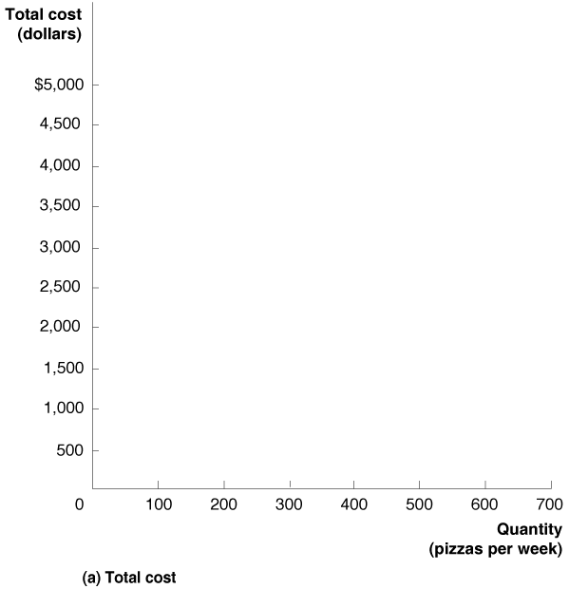
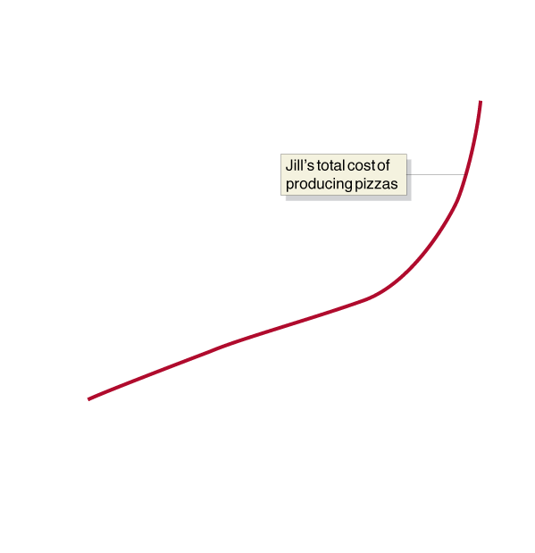
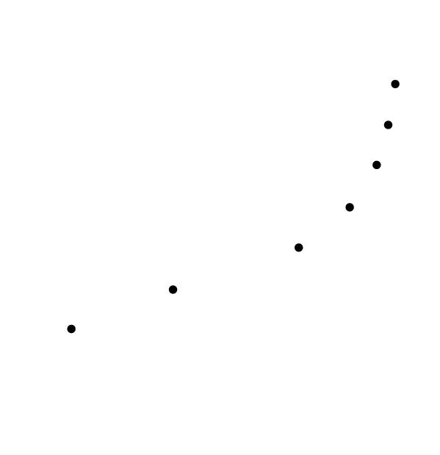
A First Look at the Relationship between Production and Cost
Figure 11.1a
Graphing Total Cost and Average Total Cost at Jill Johnson’s Restaurant
We can use the information from Table 11.2 to graph the relationship between the quantity of pizzas Jill produces and her total cost and average total cost.
Panel (a) shows that total cost increases as the level of production increases.

Slide 14


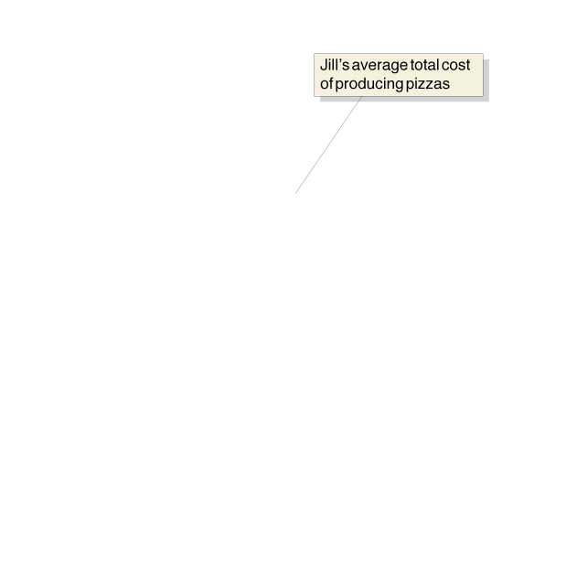
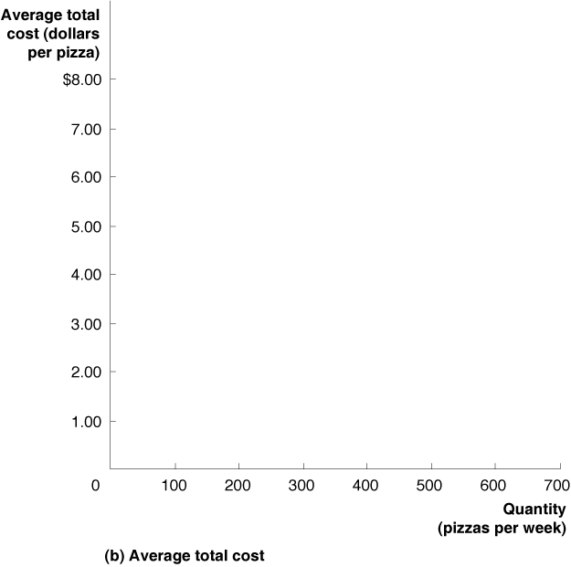
Average total cost (平均總成本) Total cost divided by the quantity of output produced.
Figure 11.1b
Graphing Total Cost and Average Total Cost at Jill Johnson’s Restaurant
Here we see that the average total cost is roughly U shaped:
As production increases from low levels, average total cost falls before rising at higher levels of production.
To understand why average total cost has this shape, we must look more closely at the technology of producing pizzas, as shown by the production function.

Slide 15
The Marginal Product of Labor and the Average Product of Labor
11.3 LEARNING OBJECTIVE
Understand the relationship between the marginal product of labor and the average product of labor.

Slide 16
Marginal product of labor (勞動邊際產出) The additional output a firm produces as a result of hiring one more worker.
Table 11.3
The Marginal Product of Labor at Jill Johnson’s Restaurant
Quantity of Workers | Quantity of Pizza Ovens | Quantity of Pizzas | Marginal Product of Labor
0 | 2 | 0 | —
1 | 2 | 200 | 200
2 | 2 | 450 | 250
3 | 2 | 550 | 100
4 | 2 | 600 | 50
5 | 2 | 625 | 25
6 | 2 | 640 | 15
An increase in the marginal product can result from the division of labor and from specialization.
Law of diminishing returns (報酬遞減法則) The principle that, at some point, adding more of a variable input, such as labor, to the same amount of a fixed input, such as capital, will cause the marginal product of the variable input to decline.

Slide 17
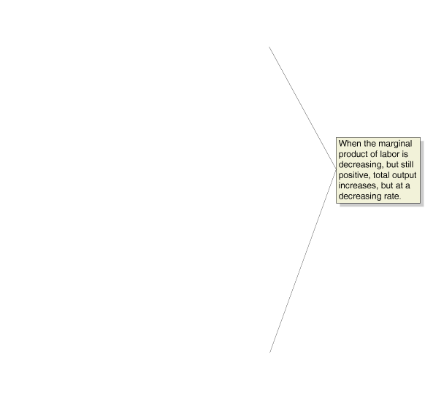
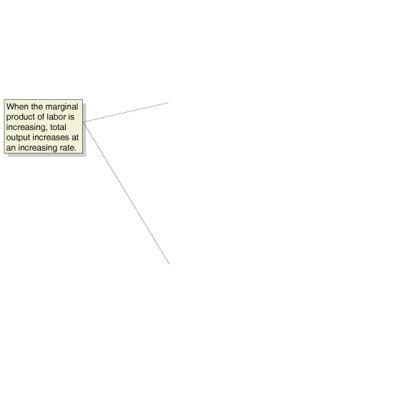





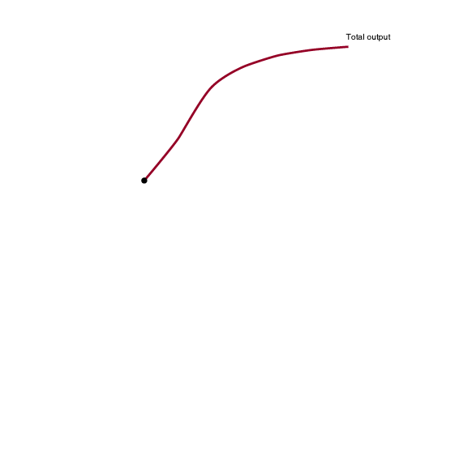
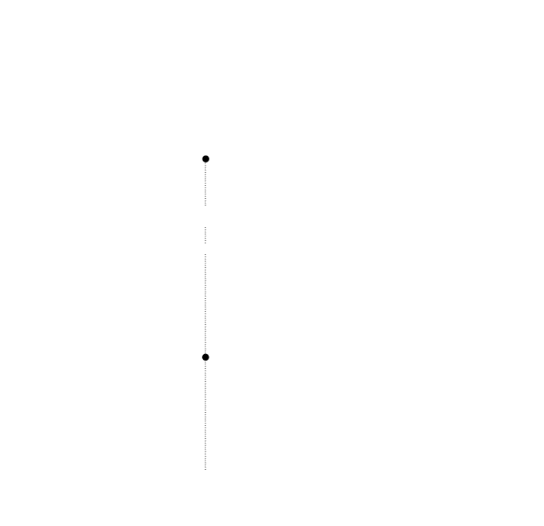
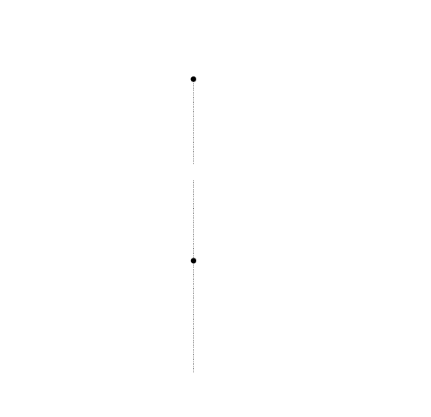
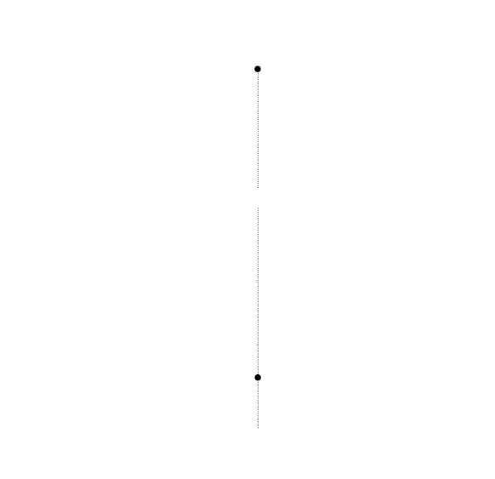
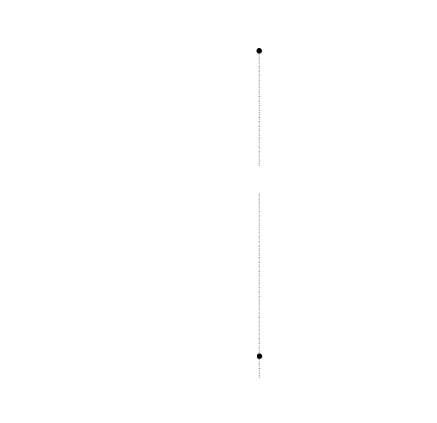
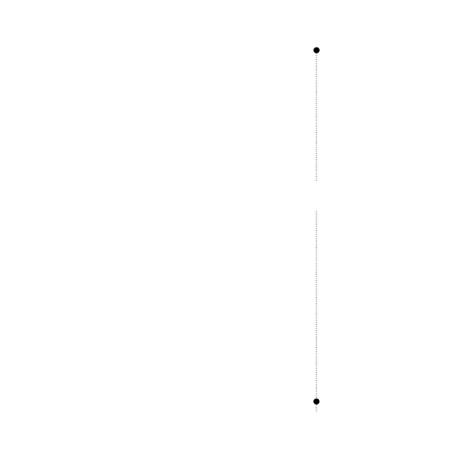
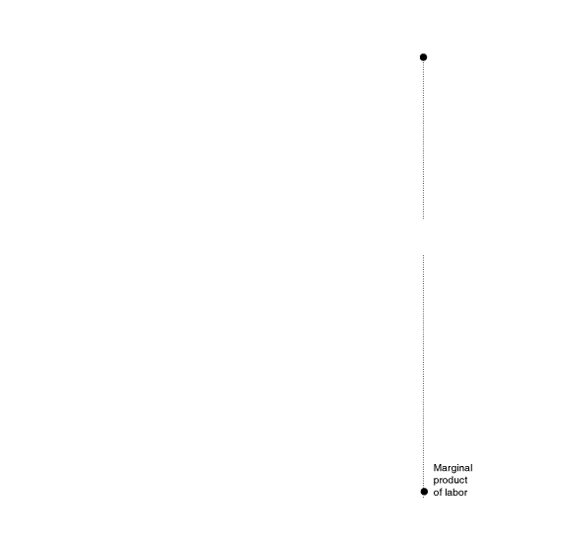
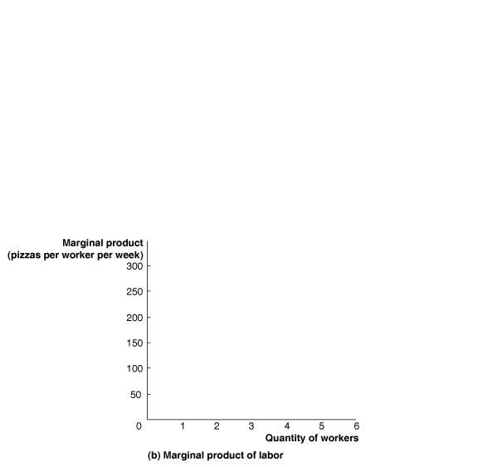
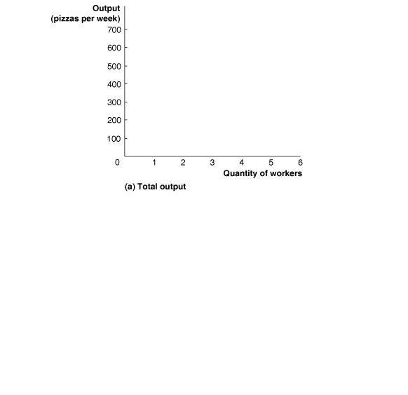
Graphing Production
Figure 11.2
Total Output and the Marginal Product of Labor
In panel (a), output increases as more workers are hired, but the increase in output does not occur at a constant rate.
Because of specialization and the division of labor, output at first increases at an increasing rate, with each additional worker hired causing production to increase by a greater amount than did the hiring of the previous worker.
After the third worker has been hired, hiring more workers while keeping the number of pizza ovens constant results in diminishing returns.
When the point of diminishing returns is reached, production increases at a decreasing rate.
Each additional worker hired after the third worker causes production to increase by a smaller amount than did the hiring of the previous worker.
In panel (b), the marginal product of labor is the additional output produced as a result of hiring one more worker.
The marginal product of labor rises initially because of the effects of specialization and division of labor,
and then it falls due to the effects of diminishing returns.

Slide 18
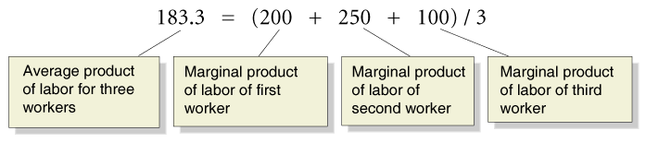
The Relationship between Marginal Product and Average Product 邊際產出與平均產出的關係
Average product of labor (勞動平均產出) The total output produced by a firm divided by the quantity of workers.
The average product of labor is the average of the marginal products of labor.
Using the numbers from Table 11.3, we can find the average product of labor for three workers:

Slide 19
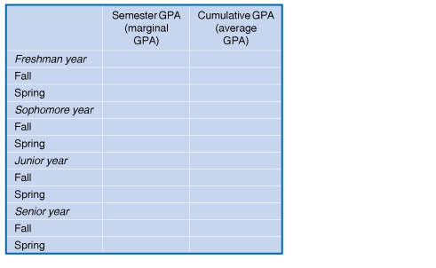

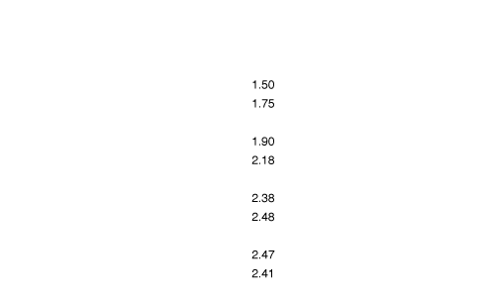
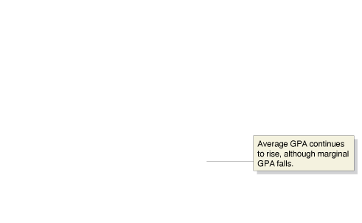
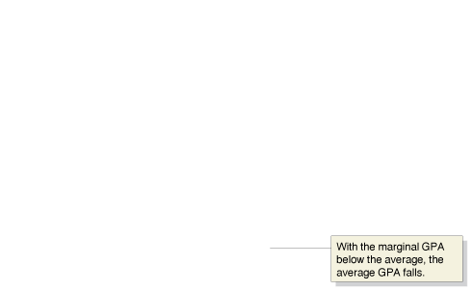
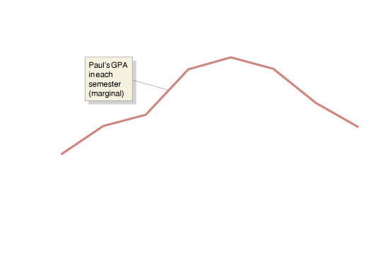
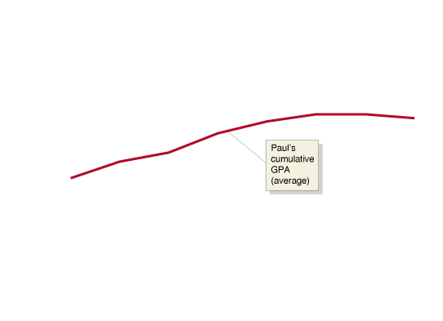
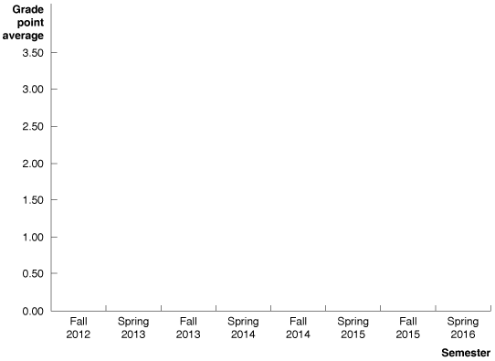


An Example of Marginal and Average Values: College Grades
Figure 11.3
Marginal and Average GPAs
The relationship between marginal and average values for a variable can be illustrated using GPAs.
We can calculate the GPA Paul earns in a particular semester (his “marginal GPA”),
and we can calculate his cumulative GPA for all the semesters he has completed so far (his “average GPA”).
Paul’s GPA is only 1.50 in the fall semester of his first year.
In each following semester through the fall of his junior year, his GPA for the semester increases—raising his cumulative GPA.
In Paul’s junior year, even though his semester GPA declines from fall to spring, his cumulative GPA rises.
Only in the fall of his senior year, when his semester GPA drops below his cumulative GPA, does his cumulative GPA decline.

Slide 20
The Relationship between Short-Run Production and Short-Run Cost
11.4 LEARNING OBJECTIVE
Explain and illustrate the relationship between marginal cost and average total cost.
Marginal cost (邊際成本) The change in a firm’s total cost from producing one more unit of a good or service.

Slide 21
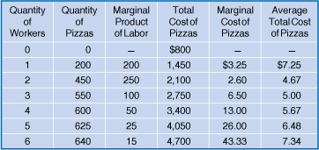
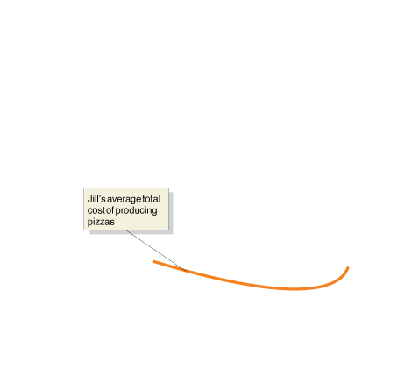
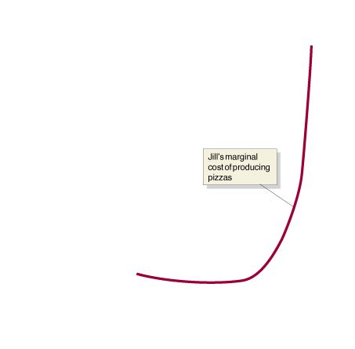
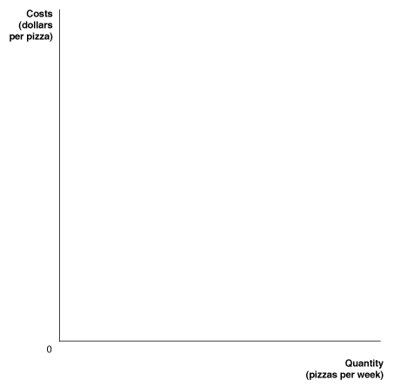
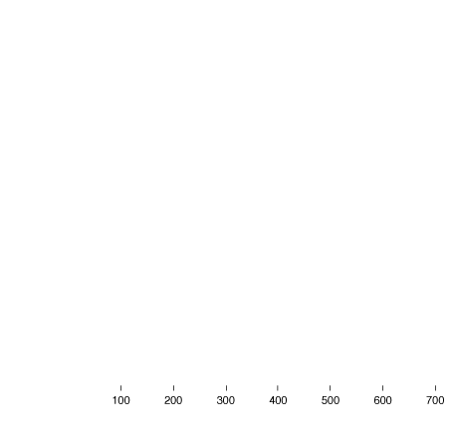
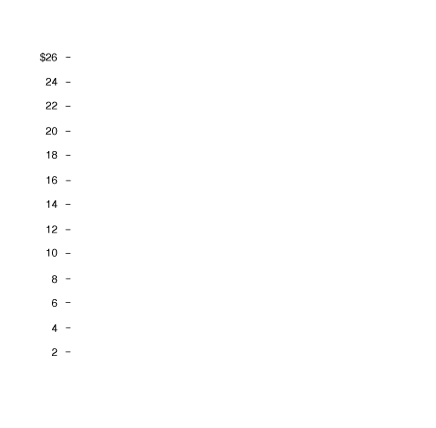


Jill Johnson’s Marginal Cost and Average Total Cost of Producing Pizzas
Figure 11.4
We can use the information in the table to calculate Jill’s marginal cost and average total cost of producing pizzas.
For the first two workers hired, the marginal product of labor is increasing, which causes the marginal cost of production to fall.
For the last four workers hired, the marginal product of labor is falling, which causes the marginal cost of production to increase.
So, the marginal cost curve falls and then rises—that is, has a U shape—because the marginal product of labor rises and then falls.
As long as marginal cost is below average total cost, average total cost will be falling.
When marginal cost is above average total cost, average total cost will be rising.
The relationship between marginal cost and average total cost explains why the average total cost curve also has a U shape.

Slide 22
Why Are the Marginal and Average Cost Curves U Shaped? 為何邊際與平均成本曲線為U型?
When the marginal product of labor is rising, the marginal cost of output is falling.
When the marginal product of labor is falling, the marginal cost of production is rising.
We can conclude that the marginal cost of production falls and then rises—forming a U shape—because the marginal product of labor rises and then falls.

Slide 23
Graphing Cost Curves
11.5 LEARNING OBJECTIVE
Graph average total cost, average variable cost, average fixed cost, and marginal cost.

Slide 24
Average fixed cost (平均固定成本) Fixed cost divided by the quantity of output produced.
Average variable cost (平均變動成本) Variable cost divided by the quantity of output produced.
With Q being the level of output, we have:
Notice that average total cost is the sum of average fixed cost plus average variable cost:
ATC = AFC + AVC

Slide 25
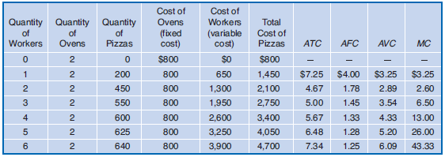
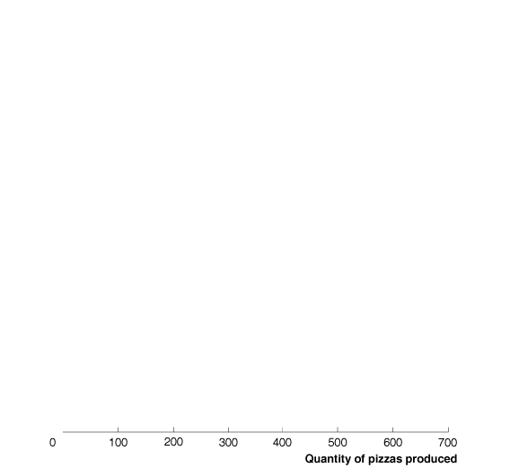
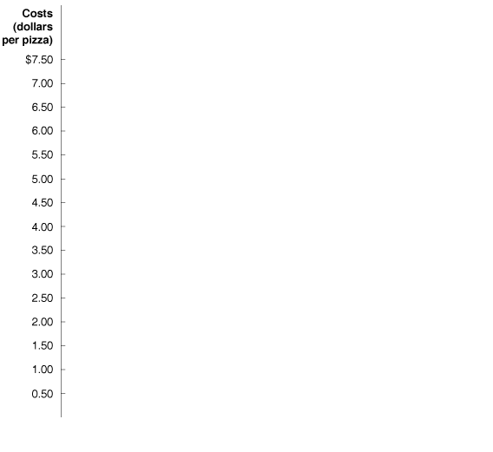
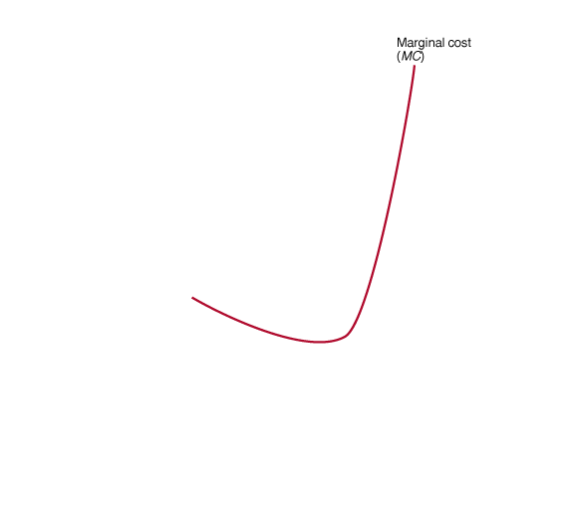
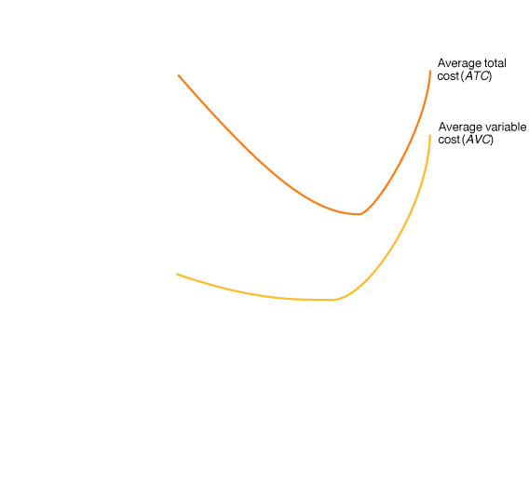
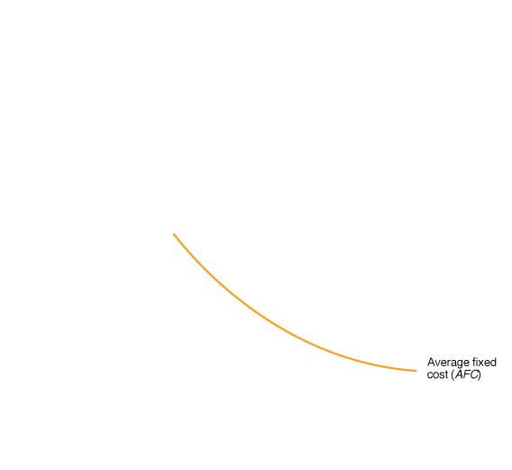

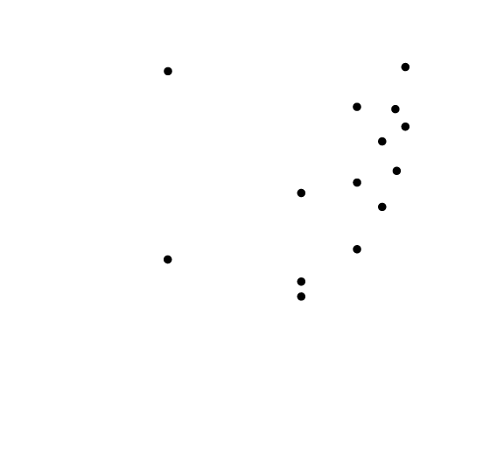
Figure 11.5
Costs at Jill Johnson’s Restaurant
Jill’s costs of making pizzas are shown in the table and plotted in the graph.
Notice three important facts about the graph:
The marginal cost (MC), average total cost (ATC), and average variable cost (AVC) curves are all U shaped, and
the marginal cost curve intersects both the average variable cost curve and average total cost curve at their minimum points.
(2) As output increases, average fixed cost (AFC) gets smaller and smaller.
(3) As output increases, the difference between average total cost and average variable cost decreases.

Slide 26
Understand the following three key facts about Figure 11.5:
When marginal cost is less than average variable cost or average total cost, it causes them to decrease. When it is greater, it causes them to increase.
Therefore, when they are equal, they must be at their minimum points where the marginal cost curve intersects. All three of these curves are U shaped.
Average fixed cost gets smaller and smaller as output increases because in calculating average fixed cost, we are dividing something that gets larger and larger—output—into something that remains constant—fixed cost.
Firms often refer to this process of lowering average fixed cost by selling more output as “spreading the overhead” (where “overhead” refers to fixed costs).
The difference decreases between average total cost and average variable cost because it is representing average fixed cost, which gets smaller as output increases.

Slide 27
Costs in the Long Run
11.6 LEARNING OBJECTIVE
Understand how firms use the long-run average cost curve in their planning.

Slide 28
In the long run, all costs are variable. There are no fixed costs in the long run.
Economies of Scale (規模經濟)
Long-run average cost curve (長期平均成本線) A curve that shows the lowest cost at which a firm is able to produce a given quantity of output in the long run, when no inputs are fixed.
Economies of scale The situation when a firm’s long-run average costs fall as it increases the quantity of output it produces.

Slide 29
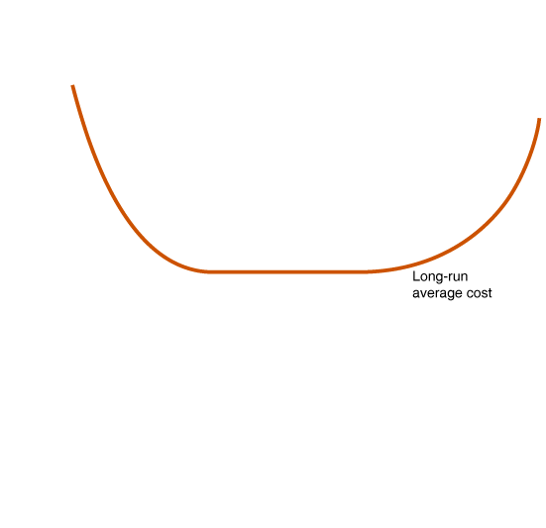
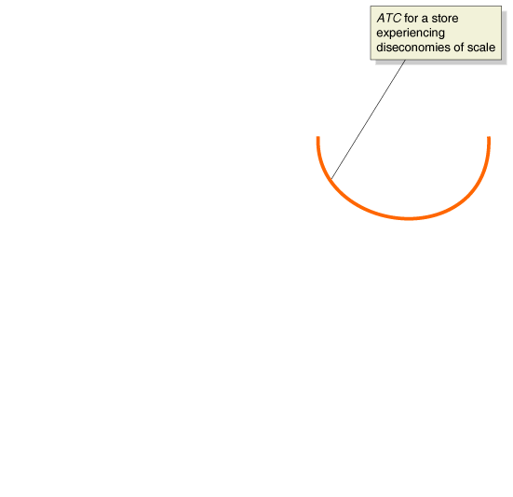


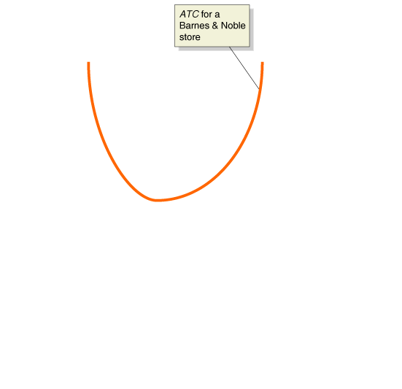
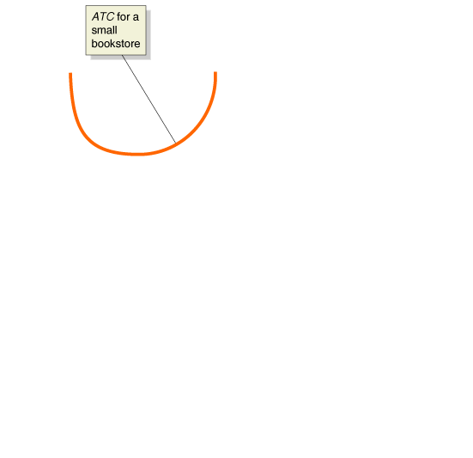
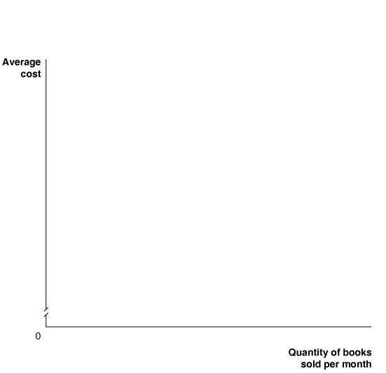
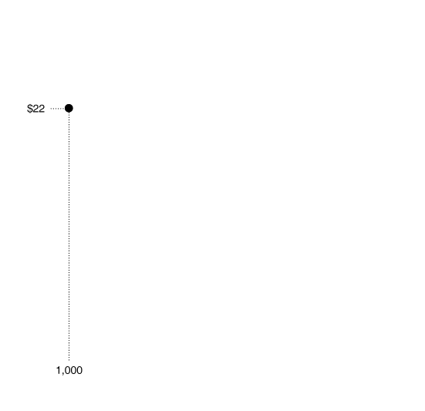
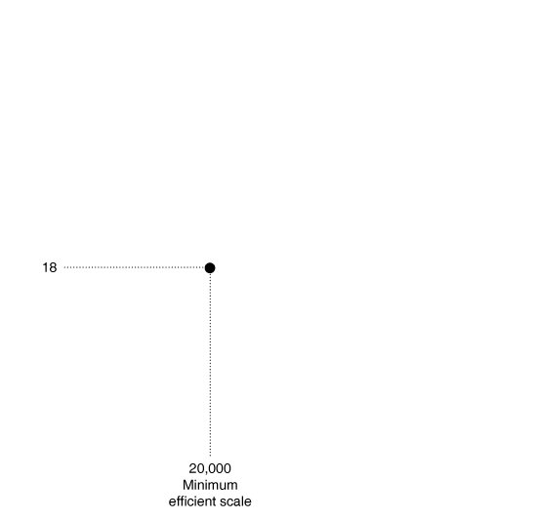
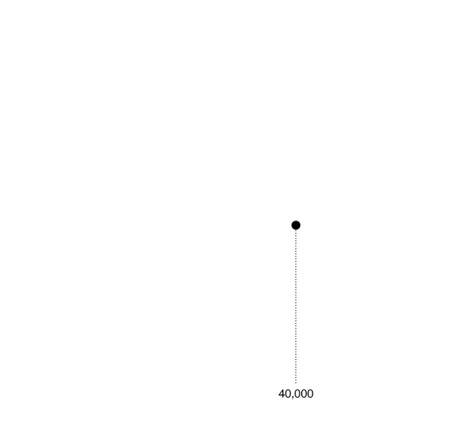
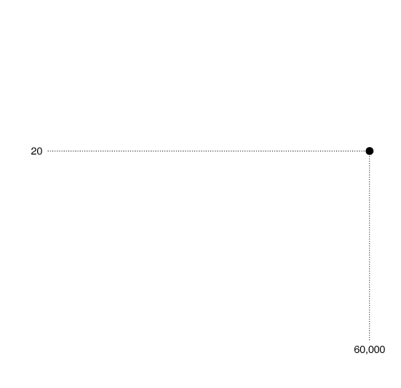
Figure 11.6
The Relationship between Short-Run Average Cost and Long-Run Average Cost
If a small bookstore expects to sell only 1,000 books per month, it will be able to sell that quantity at the lowest average cost of $22 per book.
A larger bookstore will be able to sell 20,000 books per month at a lower cost of $18 per book.
A bookstore selling 20,000 books per month and a bookstore selling 40,000 books per month will experience constant returns to scale and have the same average cost.
The bookstore selling 20,000 books per month will have reached minimum efficient scale.
Very large bookstores will experience diseconomies of scale, and their average costs will rise as sales increase beyond 40,000 books per month.

Slide 30
Long-Run Average Total Cost Curves for Bookstores
Constant returns to scale (規模報酬不變) The situation in which a firm’s long-run average costs remain unchanged as it increases output.
Minimum efficient scale (最小效率規模) The level of output at which all economies of scale are exhausted.
Diseconomies of scale (規模不經濟) The situation in which a firm’s long-run average costs rise as the firm increases output.

Slide 31
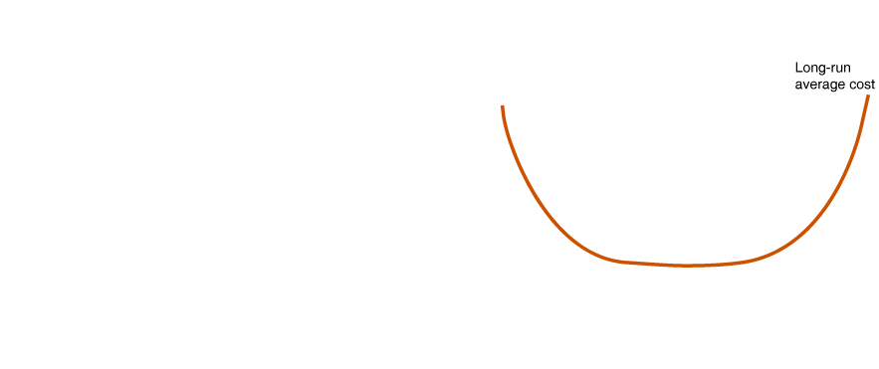
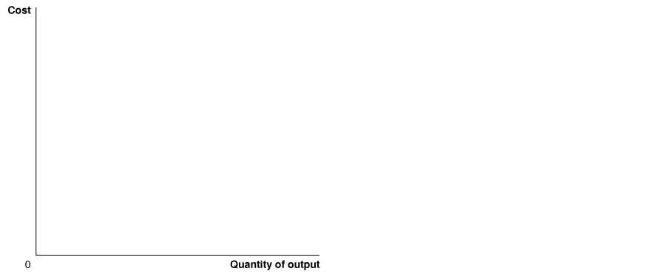

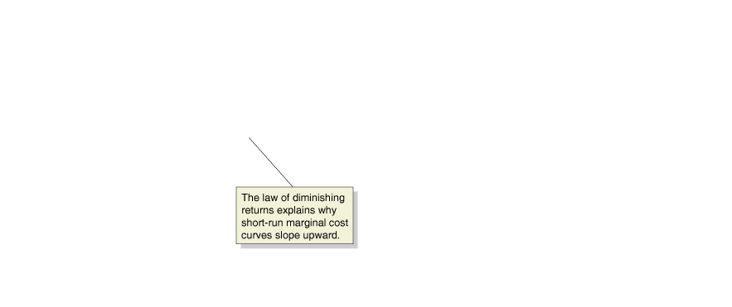
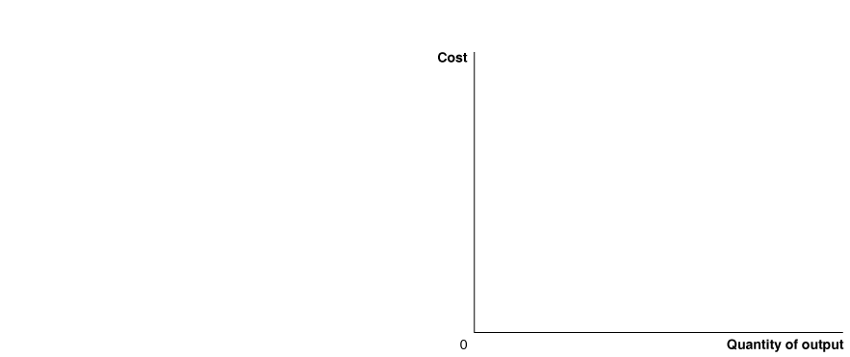




Don’t Let This Happen to You
Don’t Confuse Diminishing Returns with Diseconomies of Scale
Diminishing returns applies only to the short run, when at least one of the firm’s inputs, such as the quantity of machinery it uses, is fixed.
Diseconomies of scale apply only in the long run, when the firm is free to vary all its inputs, can adopt new technology, and can vary the amount of machinery it uses and the size of its facility.
MyEconLab
Your Turn: Test your understanding by doing related problem 6.14 at the end of this chapter.

Slide 32

Table 11.4
A Summary of Definitions of Cost
Term | Definition | Symbols and Equations
Total cost | The cost of all the inputs used by a firm, or fixed cost plus variable cost | TC
Fixed costs | Costs that remain constant as a firm’s level of output changes | FC
Variable costs | Costs that change as the firm’s level of output changes | VC
Marginal cost | Increase in total cost resulting from producing another unit of output
Average total cost | Total cost divided by the quantity of output produced
Average fixed cost | Fixed cost divided by the quantity of output produced
Average variable cost | Variable cost divided by the quantity of output produced
Implicit cost | A nonmonetary opportunity cost | ―
Explicit cost | A cost that involves spending money | ―

Slide 33
Appendix
Using Isoquants and Isocost Lines to Understand Production and Cost
LEARNING OBJECTIVE
Use isoquants and isocost lines to understand production and cost.
Isoquants
Firms search for the cost-minimizing combination of inputs that will allow them to produce a given level of output. This combination depends on two factors:
1. Technology—which determines how much output a firm receives from employing a given quantity of inputs.
2. Input prices—which determine the total cost of each combination of inputs.
An Isoquant Graph
Isoquant (等量曲線) A curve that shows all the combinations of two inputs, such as capital and labor, that will produce the same level of output.

Slide 34







Figure 11A.1
Isoquants
Isoquants show all the combinations of two inputs, in this case capital and labor, that will produce the same level of output.
For example, the isoquant labeled Q = 5,000 shows all the combinations of ovens and workers that enable Jill to produce that quantity of pizzas per week.
At point A, she produces 5,000 pizzas using 3 ovens and 6 workers,
and at point B, she produces the same output using 2 ovens and 10 workers.
With more ovens and workers, she can move to a higher isoquant.
For example, with 4 ovens and 12 workers, she can produce at point C on the isoquant Q = 10,000.
With even more ovens and workers, she could move to the isoquant Q = 13,000.

Slide 35
The Slope of an Isoquant
Marginal rate of technical substitution (MRTS) (邊際技術替代率) The rate at which a firm is able to substitute one input for another while keeping the level of output constant.
The MRTS is equal to the change in capital divided by the change in labor, so it will become smaller (in absolute value) as we move down an isoquant.
Isocost Lines
A firm wants to produce a given quantity of output at the lowest possible cost.
We can show the relationship between the quantity of inputs used and the firm’s total cost by using an isocost line.
Isocost line (等成本線) All the combinations of two inputs, such as capital and labor, that have the same total cost.

Slide 36









Graphing the Isocost Line
Figure 11A.2
An Isocost Line
The isocost line shows the combinations of inputs with a total cost of $6,000.
The rental price of ovens is $1,000 per week, so if Jill spends the whole $6,000 on ovens, she can rent 6 ovens (point A).
The wage rate is $500 per week, so if Jill spends the whole $6,000 on workers, she can hire 12 workers.
As she moves down the isocost line, she gives up renting 1 oven for every 2 workers she hires.
Any combinations of inputs along the line or inside the line can be purchased with $6,000.
Any combinations that lie outside the line cannot be purchased with $6,000.

Slide 37




The Slope and Position of the Isocost Line
The slope of the isocost line is equal to the ratio of the price of the input on the horizontal axis divided by the price of the input on the vertical axis multiplied by -1.
Figure 11A.3
The Position of the Isocost Line
The position of the isocost line depends on the level of total cost.
As total cost increases from $3,000 to $6,000 to $9,000 per week, the isocost line shifts outward.
For each isocost line shown, the rental price of ovens is $1,000 per week, and the wage rate is $500 per week.

Slide 38






Choosing the Cost-Minimizing Combination of Capital and Labor
Figure 11A.4
Choosing Capital and Labor to Minimize Total Cost
Jill wants to produce 5,000 pizzas per week at the lowest total cost.
Point B is the lowest-cost combination of inputs shown in the graph, but this combination of 1 oven and 4 workers will produce fewer than the 5,000 pizzas needed.
Points C and D are combinations of ovens and workers that will produce 5,000 pizzas, but their total cost is $9,000.
The combination of 3 ovens and 6 workers at point A produces 5,000 pizzas at the lowest total cost of $6,000.

Slide 39









Different Input Price Ratios Lead to Different Input Choices
Figure 11A.5
Changing Input Prices Affect the Cost-Minimizing Input Choice
As the graph shows, the input combination at point A, which was optimal for Jill, is not optimal for a businessperson in China.
Using the input combination at point A would cost businesspeople in China more than $6,000.
Instead, the Chinese isocost line is tangent to the isoquant at point B, where the input combination is 2 ovens and 10 workers.
Because ovens cost more in China but workers cost less, a Chinese firm will use fewer ovens and more workers than a U.S. firm, even if it has the same technology as the U.S. firm.

Slide 40
Another Look at Cost Minimization
At the point of cost minimization, the isoquant and isocost lines are tangent, so they have the same slope.
Therefore, at the point of cost minimization, the marginal rate of technical substitution (MRTS) is equal to the wage rate divided by the rental price of capital.
The slope of the isoquant tells us the rate at which a firm is able to substitute labor for capital, given existing technology.
The slope of the isocost line tells us the rate at which a firm is able to substitute labor for capital, given current input prices.
Only at the point of cost minimization are these two rates the same.
In this chapter, we defined the marginal product of labor (MP_{L}) as the additional output produced by a firm as a result of hiring one more worker.
Similarly, we can define the marginal product of capital (MP_{K}) as the additional output produced by a firm as a result of using one more machine.

Slide 41


When Jill uses fewer ovens but more workers, the gain in output from the additional workers is equal to the loss from the smaller quantity of ovens because total output remains the same along an isoquant. Therefore:
−Change in the quantity of ovens × MP_{K} = Change in the quantity of workers × MP_{L}
If we rearrange terms, we have the following:
Because the first expression is the slope of the isoquant, it is equal to the marginal rate of technical substitution (multiplied by negative 1).
So, we can write:

Slide 42
The slope of the isocost line equals the wage rate (w) divided by the rental price of capital (r).
We saw earlier in this appendix that at the point of cost minimization, the MRTS equals the ratio of the prices of the two inputs. Therefore:
We can rewrite this to show that at the point of cost minimization:
This last expression tells us that to minimize cost for a given level of output, a firm should hire inputs up to the point where the last dollar spent on each input results in the same increase in output.
If this equality did not hold, a firm could lower its costs by using more of one input and less of the other.

Slide 43













Expansion path (擴張路徑) A curve that shows a firm’s cost-minimizing combination of inputs for every level of output.
Figure 11A.6
The Expansion Path
The tangency points A, B, and C lie along the firm’s expansion path,
which is a curve that shows the cost-minimizing combination of inputs for every level of output.
In the short run, when the quantity of machines is fixed, the firm can expand output from 75 bookcases per day to 100 bookcases per day at the lowest cost only by moving from point B to point D and increasing the number of workers from 60 to 110.
0
In the long run, when it can increase the quantity of machines it uses, the firm can move from point D to point C, thereby reducing its total costs of producing 100 bookcases per day from $4,250 to $4,000.
The expansion path represents the least-cost combination of inputs to produce a given level of output in the long run, when the firm is able to vary the levels of all of its inputs.

