Slide 1

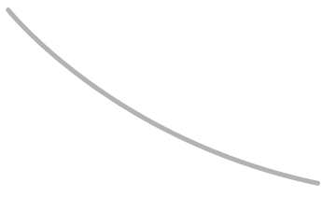

R. GLENN HUBBARD
ANTHONY PATRICK O’BRIEN
Economics
FOURTH EDITION

Slide 2

12
Firms in Perfectly Competitive Markets
CHAPTER
Chapter Outline and
Learning Objectives
12.1 | Perfectly Competitive Markets
12.2 | How a Firm Maximizes Profit in a Perfectly Competitive Market
12.3 | Illustrating Profit or Loss on the Cost Curve Graph
12.4 | Deciding Whether to Produce or to Shut Down in the Short Run
12.5 | “If Everyone Can Do It, You Can’t Make Money at It”: The Entry and Exit of Firms in the Long Run
12.6 | Perfect Competition and Efficiency

Slide 3
新聞時事
超商早餐大戰 附咖啡50有找 【中國時報 2009.03.25】
早餐外食市場再興戰火，統一超商7-ELEVEn推出早餐組合，以廿八元最低起價，卯上超商同業，也想挑戰連鎖早餐業者。全家便利商店提前反應，推出早午三時段餐餐八五折及飲料第三件一元的方案因應；連鎖速食業者也備好新品，準備四月開打。
信心滿滿的7-ELEVEn表示，廿八元早餐只是序曲，未來還有一波波組合早餐上檔。
台灣外食市場約二千億元規模，早餐就占一半左右，去年到統一超商吃早餐人數已超過五億人次。統一超商表示，這波促銷採業界首見的「限時段優惠」及「組合餐」，價位較其他早餐或速食店便宜四成到六成不等，藉此擴大來客數，業績以衝上一成為目標。
全家便利商店昨日起推出三時段優惠，早上七到九點是麵包搭配牛奶，十一點至下午一點午餐時段便當配瓶裝茶飲料，下午三點至五點下午茶時段有銅鑼燒配拿鐵咖啡組合，三個時段都打八五折，早餐最多可便宜七、八元，午餐可省十四元。還有飲料超值選，每天指定飲料第三件一元優惠。
萊爾富推出均一價超值營養餐，有二十二元至三十二元不等的三角飯糰、手捲、壽司及三明治，搭配一瓶鮮乳都賣四十二元，換算最高折扣達七四折。四月還會推出跨品類促銷，折扣也在八折上下，麵包、飯糰、三明治等早餐類也可混搭購買。
Dunkin' Donuts推出甜甜圈加一杯美式咖啡三十九元早餐促銷價，已帶動二至三成

Slide 4
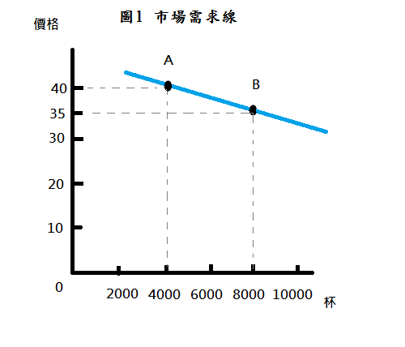
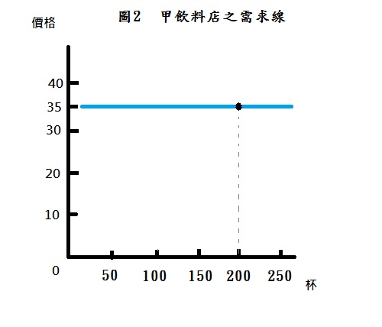
新聞時事
清大夜市商圈的飲料店高達二十多家，幾乎每一家都有賣珍珠奶茶，大杯價格大多為35元，以下圖1是清大夜市珍珠奶茶的市場需求線，假設珍珠奶茶價格是35元，市場需求量是8000杯，如圖1中B點所示。
圖2是甲飲料店的需求線，為水平，若提高價格為40，消費者會向別家購買，甲飲料店的需求量會變成0。
店家 | Comebuy | COCO | C.up c+ | 有茶氏 | 歇腳亭 | 甘喜茶
價格 | 35 | 35 | 35 | 35 | 35 | 35

Slide 5
Firms in perfectly competitive industries are unable to control the prices of the products they sell and are unable to earn an economic profit in the long run because:
firms in these industries sell identical products, and
(2) it is easy for new firms to enter these industries.
Studying how perfectly competitive industries operate is the best way to understand how markets answer the fundamental economic questions discussed in Chapter 1:
What goods and services will be produced?
How will the goods and services be produced?
Who will receive the goods and services produced?

Slide 6
Most industries, though, are not perfectly competitive.
In particular, any industry has three key characteristics, which economists use to classify into four market structures:
1. The number of firms in the industry
2. The similarity of the good or service produced by the firms in the industry
3. The ease with which new firms can enter the industry
Table 12.1
The Four Market Structures
 | Market Structure
Characteristic | Perfect Competition | Monopolistic Competition | Oligopoly | Monopoly
Number of firms | Many | Many | Few | One
Type of product | Identical | Differentiated | Identical or differentiated | Unique
Ease of entry | High | High | Low | Entry blocked
Examples of industries | • Growing wheat • Growing apples | • Clothing stores • Restaurants | • Manufacturing computers • Manufacturing automobiles | • First-class mail delivery • Tap water

Slide 7
Perfectly Competitive Markets
12.1 LEARNING OBJECTIVE
Explain what a perfectly competitive market is and why a perfect competitor faces a horizontal demand curve.

Slide 8
Perfectly competitive market (完全競爭市場) A market that meets the conditions of (1) many buyers and sellers, (2) all firms selling identical products, and (3) no barriers to new firms entering the market.
A Perfectly Competitive Firm Cannot Affect the Market Price完全競爭市場廠商無法影響市場價格
Price taker (價格接受者) A buyer or seller that is unable to affect the market price.
If any one wheat farmer has the best crop the farmer has ever had, or if any one wheat farmer stops growing wheat altogether, the market price of wheat will not be affected because the market supply curve for wheat will not shift by enough to change the equilibrium price by even 1 cent.

Slide 9
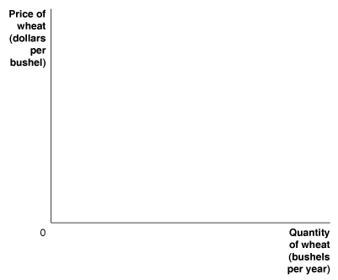
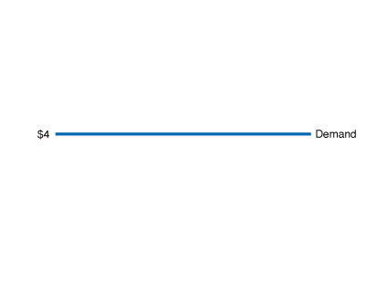
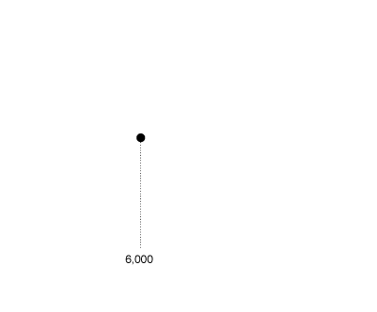
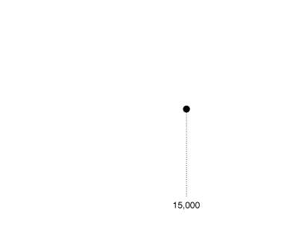
The Demand Curve for the Output of a Perfectly Competitive Firm 在完全競爭市場的廠商產出面對的需求曲線
Figure 12.1
A Perfectly Competitive Firm Faces a Horizontal Demand Curve
A firm in a perfectly competitive market is selling exactly the same product as many other firms.
Therefore, it can sell as much as it wants at the current market price,
but it cannot sell anything at all if it raises the price by even 1 cent.
As a result, the demand curve for a perfectly competitive firm’s output is a horizontal line.
In the figure, whether a wheat farmer such as Bill Parker sells 6,000 bushels per year
or 15,000 bushels has no effect on the market price of $4.

Slide 10
Farmer Parker is a price taker because he is selling wheat in a perfectly competitive market.
With a horizontal demand curve for his wheat, he must accept the market price.
Don’t Let This Happen to You
Don’t Confuse the Demand Curve for Farmer Parker’s Wheat with the Market Demand Curve for Wheat
The market demand curve for wheat has the normal downward-sloping shape, but the demand curve for the output of a single wheat farmer and any firm in a perfectly competitive market is a horizontal line.
MyEconLab
Your Turn: Test your understanding by doing related problem 1.6 at the end of this chapter.

Slide 11
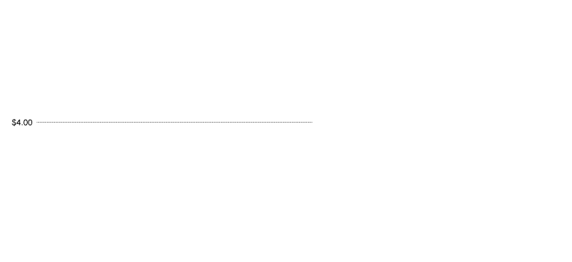
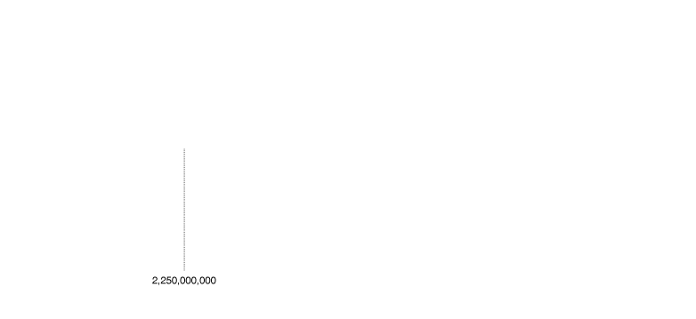
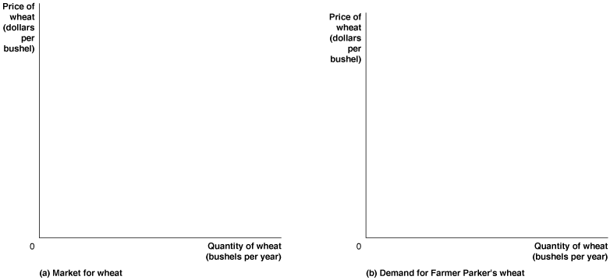
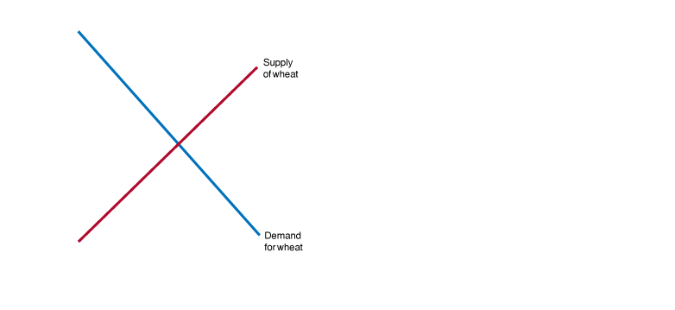
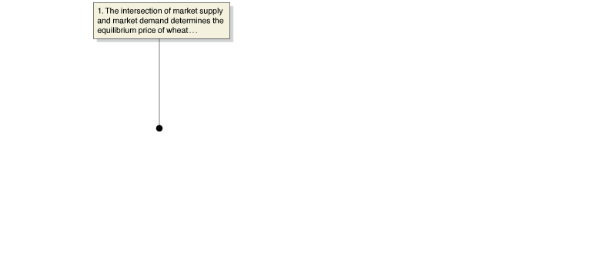
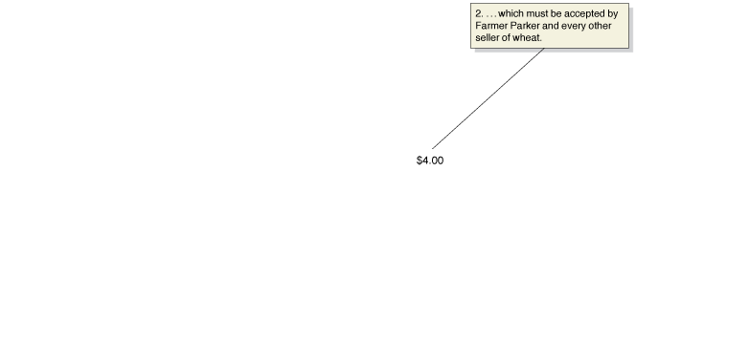
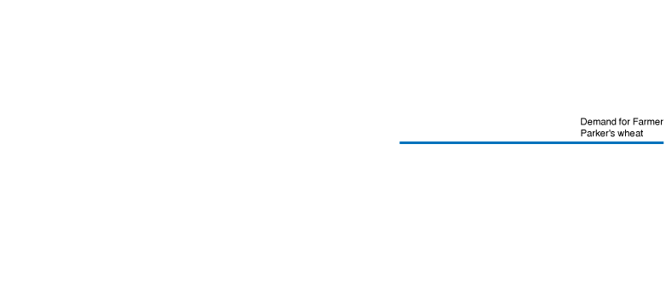
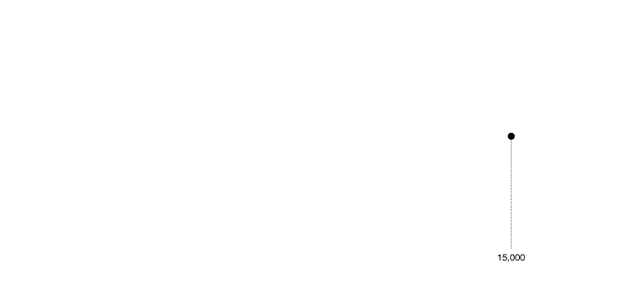
Figure 12.2
The Market Demand for Wheat versus the Demand for One Farmer’s Wheat
In a perfectly competitive market, price is determined by the intersection of market demand and market supply.
In panel (a), the demand and supply curves for wheat intersect at a price of $4 per bushel.
An individual wheat farmer like Farmer Parker cannot affect the market price for wheat.
Therefore, as panel (b) shows, the demand curve for Farmer Parker’s wheat is a horizontal line.
To understand this figure, it is important to notice that the scales on the horizontal axes in the two panels are very different.
In panel (a), the equilibrium quantity of wheat is 2.25 billion bushels,
and in panel (b), Farmer Parker is producing only 15,000 bushels of wheat.

Slide 12
How a Firm Maximizes Profit in a Perfectly Competitive Market
12.2 LEARNING OBJECTIVE
Explain how a firm maximizes profit in a perfectly competitive market.

Slide 13
Profit (利潤) Total revenue minus total cost.
Revenue for a Firm in a Perfectly Competitive Market
Average revenue (AR) (平均收益) Total revenue divided by the quantity of the product sold.
For any level of output, a firm’s average revenue is always equal to the market price. This equality holds because total revenue equals price times quantity:
(TR = P × Q)
and average revenue equals total revenue divided by quantity:
(AR = TR/Q)
So, AR = TR/Q = (P × Q)/Q = P
Marginal revenue (MR) (邊際收益) The change in total revenue from selling one more unit of a product.

Slide 14
Table 12.2
Farmer Parker’s Revenue from Wheat Farming
Number of Bushels (Q) | Market Price (per bushel) (P) | Total Revenue (TR) | Average Revenue (AR) | Marginal Revenue (MR)
0 1 2 3 4 5 6 7 8 9 10 | $4 4 4 4 4 4 4 4 4 4 4 | $0 4 8 12 16 20 24 28 32 36 40 | — $4 4 4 4 4 4 4 4 4 4 | — $4 4 4 4 4 4 4 4 4 4
For a firm in a perfectly competitive market, price is equal to both average revenue and marginal revenue.

Slide 15
Determining the Profit-Maximizing Level of Output
Table 12.3
Farmer Parker’s Profits from Wheat Farming
Quantity (bushels) (Q) | Total Revenue (TR) | Total Cost (TC) | Profit (TR−TC) | Marginal Revenue (MR) | Marginal Cost (MC)
0 1 2 3 4 5 6 7 8 9 10 | $0.00 4.00 8.00 12.00 16.00 20.00 24.00 28.00 32.00 36.00 40.00 | $2.00 5.00 7.00 8.50 10.50 13.00 16.50 21.50 28.50 38.00 50.50 | −$2.00 −1.00 1.00 3.50 5.50 7.00 7.50 6.50 3.50 −2.00 −10.50 | — $4.00 4.00 4.00 4.00 4.00 4.00 4.00 4.00 4.00 4.00 | — $3.00 2.00 1.50 2.00 2.50 3.50 5.00 7.00 9.50 12.50

Slide 16

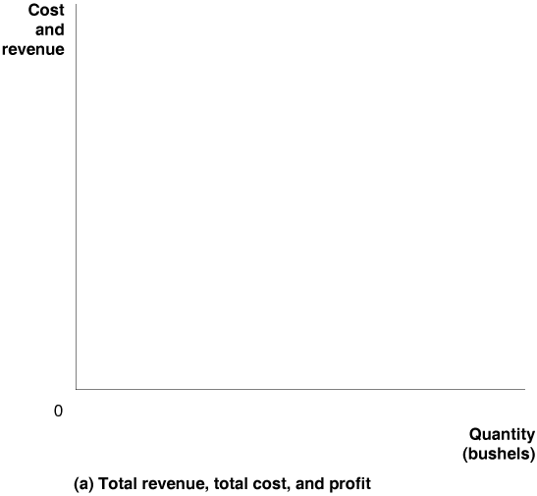

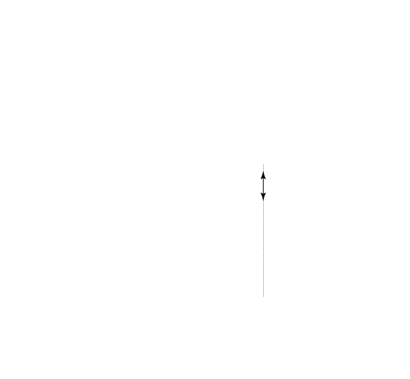
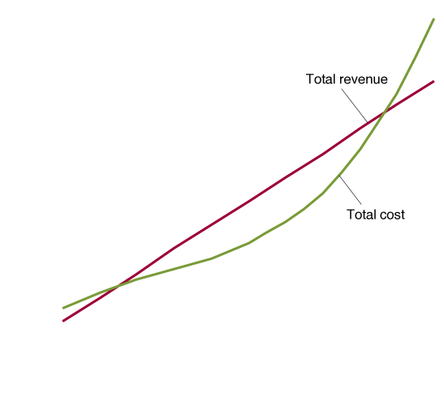
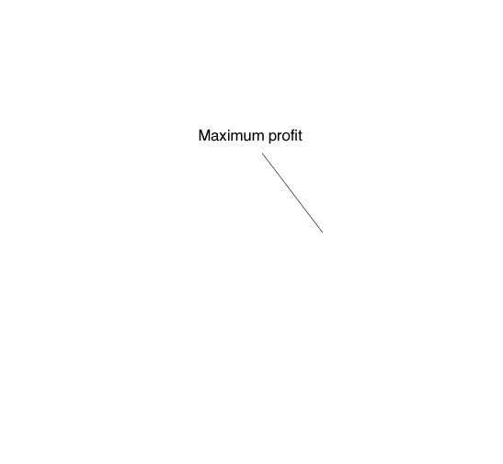
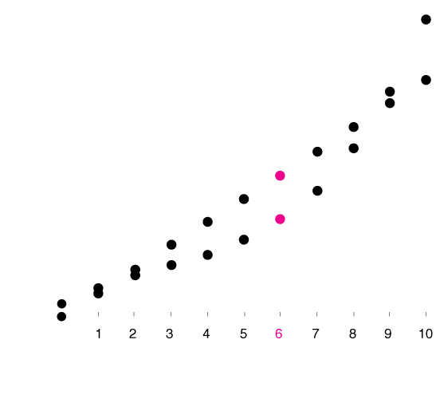
Figure 12.3a
The Profit-Maximizing Level of Output
Farmer Parker maximizes his profit where the vertical distance between total revenue and total cost is the largest.
This happens at an output of 6 bushels.
This is one way of thinking about how Farmer Parker can determine the profit-maximizing quantity of wheat to produce.

Slide 17


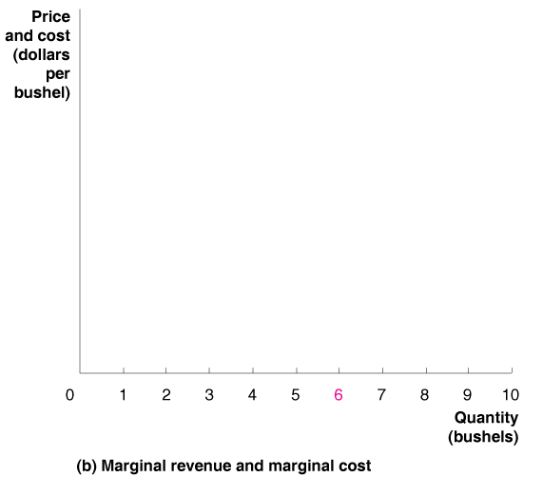
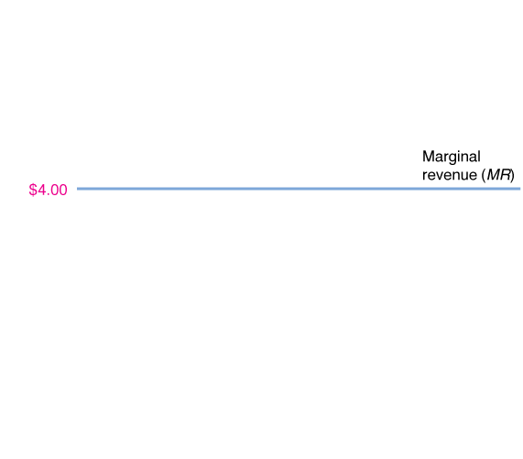
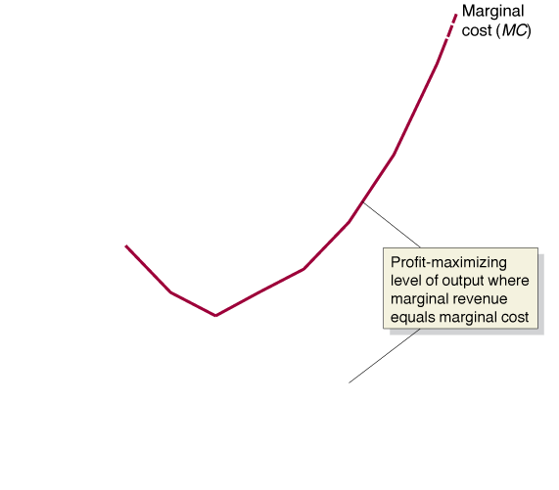
Figure 12.3b
The Profit-Maximizing Level of Output
Notice that Farmer Parker’s marginal revenue (MR) is equal to a constant $4 per bushel.
Farmer Parker maximizes profits by producing wheat up to the point where the marginal revenue of the last bushel produced is equal to its marginal cost, or MR = MC.
In this case, at no level of output does marginal revenue exactly equal marginal cost.
The closest Farmer Parker can come is to produce 6 bushels of wheat.
He will not want to continue to produce once marginal cost is greater than marginal revenue because that would reduce his profits.
This is another way of thinking about how Farmer Parker can determine the profit-maximizing quantity of wheat to produce.
The marginal revenue curve for a perfectly competitive firm is the same as its demand curve.

Slide 18
From the information in Table 12.3 and Figure 12.3, we can draw the following conclusions:
The profit-maximizing level of output is where the difference between total revenue and total cost is the greatest.
The profit-maximizing level of output is also where marginal revenue equals marginal cost, or MR = MC.
Both of these conclusions are true for any firm, whether or not it is in a perfectly competitive industry.
We can draw one other conclusion about profit maximization that is true only of firms in perfectly competitive industries:
For a firm in a perfectly competitive industry, price is equal to marginal revenue, or P = MR.
So, we can restate the MR = MC condition as P = MC.

Slide 19
Illustrating Profit or Loss on the Cost Curve Graph
12.3 LEARNING OBJECTIVE
Use graphs to show a firm’s profit or loss.

Slide 20
We can express profit in terms of average total cost (ATC). Because profit is equal to total revenue minus total cost (TC) and total revenue is price times quantity, we can write the following:
If we divide both sides of this equation by Q, we have
or
because TC/Q equals ATC.
This equation tells us that profit per unit (or average profit) equals price minus average total cost. Finally, we obtain the equation for the relationship between total profit and average total cost by multiplying again by Q:
This equation tells us that a firm’s total profit is equal to the quantity produced multiplied by the difference between price and average total cost.

Slide 21

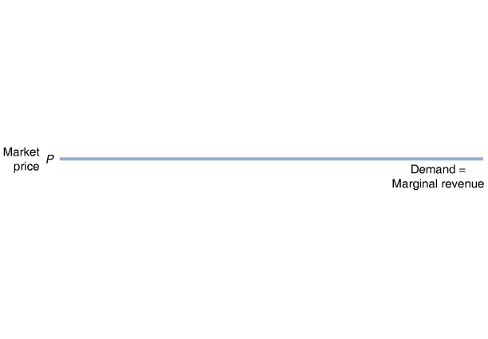
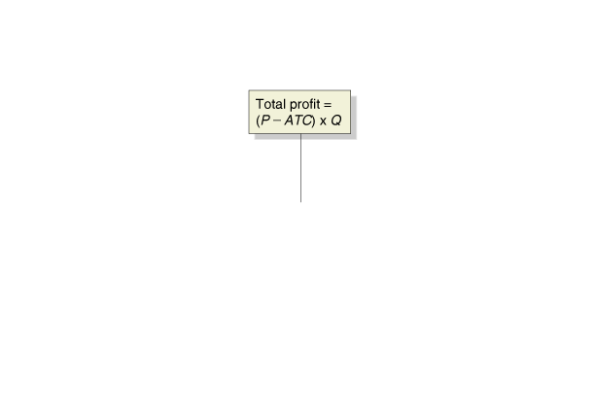
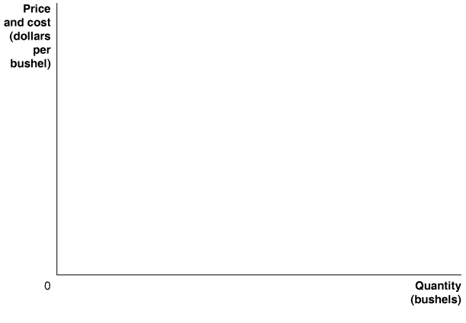
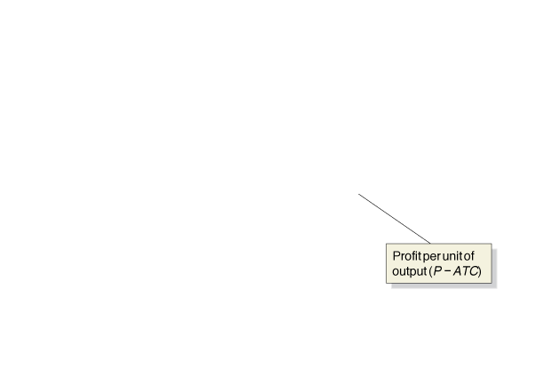
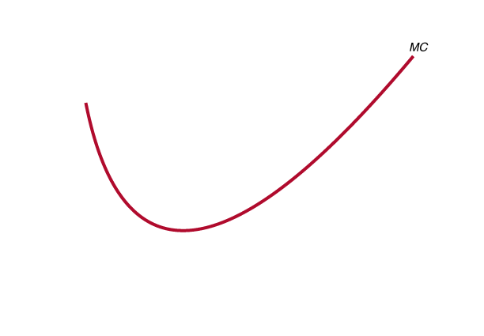

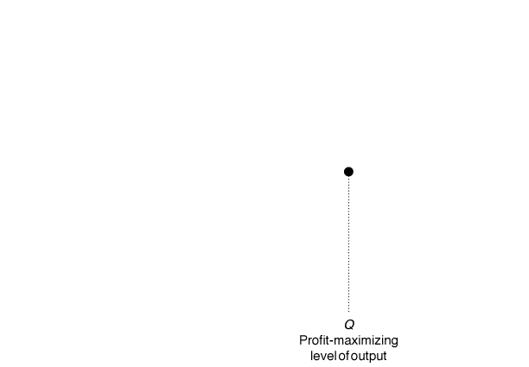
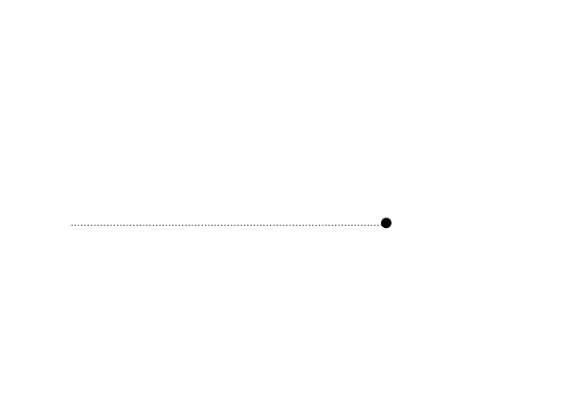
Showing a Profit on the Graph
Figure 12.4
The Area of Maximum Profit
A firm maximizes profit at the level of output at which marginal revenue equals marginal cost.
The difference between price and average total cost equals profit per unit of output.
Total profit equals profit per unit multiplied by the number of units produced.
Total profit is represented by the area of the green-shaded rectangle, which has a height equal to (P − ATC) and a width equal to Q.

Slide 22
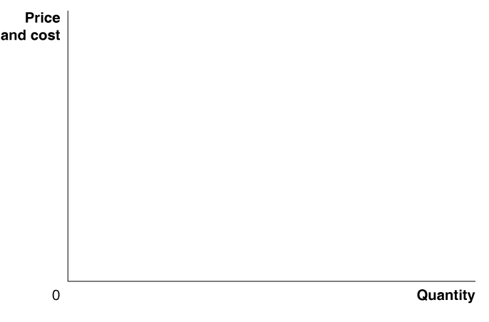
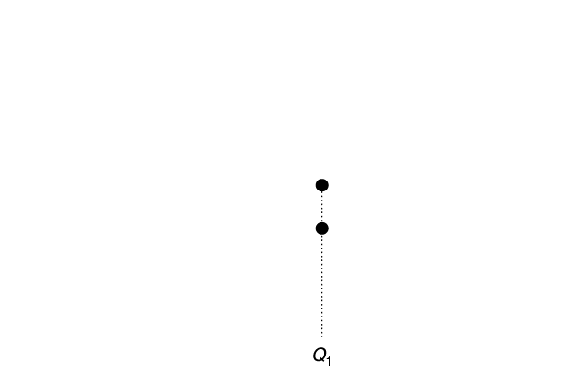
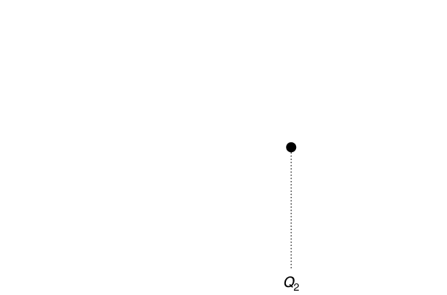
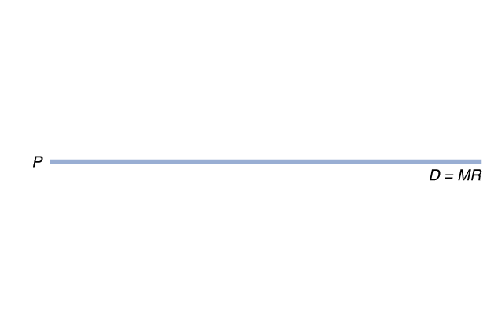
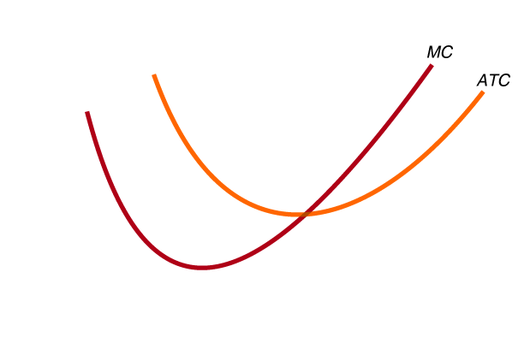
Don’t Let This Happen to You
Remember That Firms Maximize Their Total Profit, Not Their Profit per Unit
Only when the firm has expanded production to Q₂ will it have produced every unit for which marginal revenue is greater than marginal cost.
At that point, it will have maximized profit.
MyEconLab
Your Turn: Test your understanding by doing related problem 3.5 at the end of this chapter.

Slide 23
Illustrating When a Firm Is Breaking Even or Operating at a Loss廠商收支平衡或經營虧損的狀況
Whether a firm actually makes a profit at the level of output where marginal revenue equals marginal cost depends on the relationship of price to average total cost.
There are three possibilities:
1. P > ATC, which means the firm makes a profit
2. P = ATC, which means the firm breaks even (its total cost equals its total revenue)
3. P < ATC, which means the firm experiences a loss

Slide 24
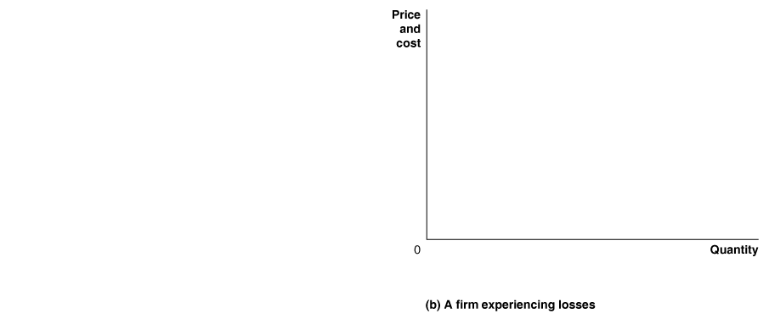
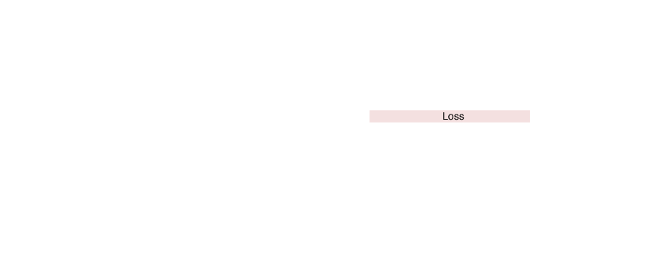
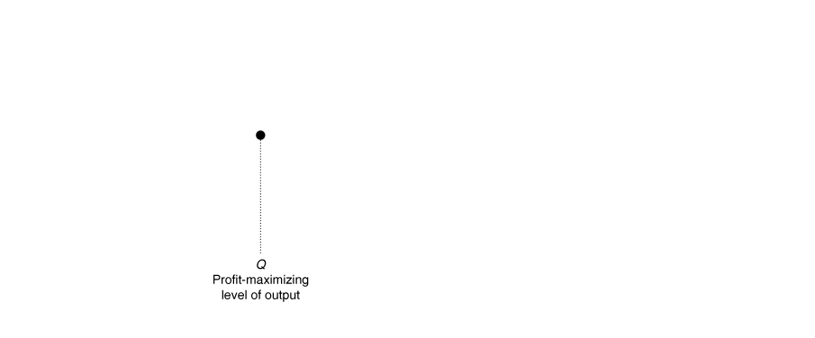
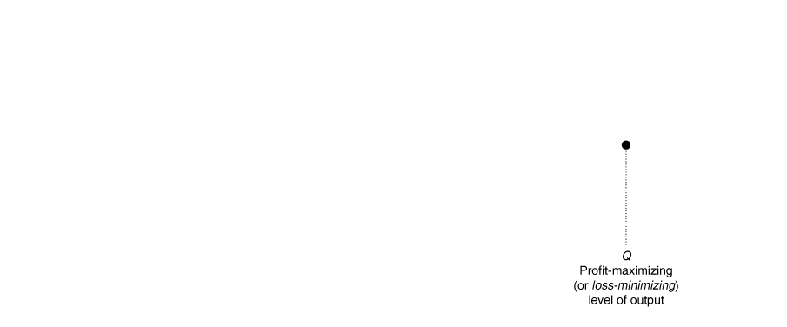
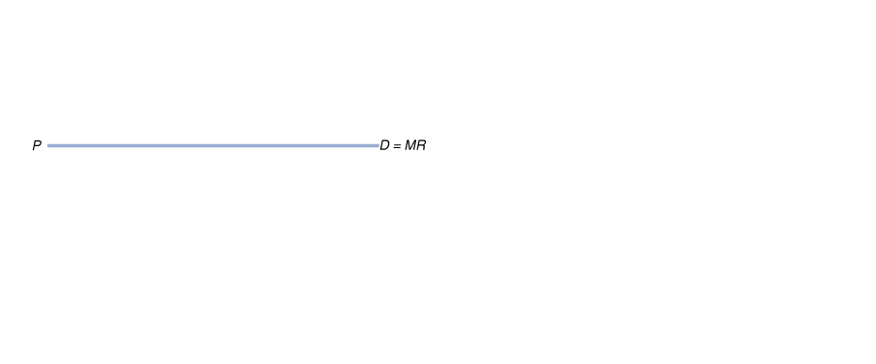

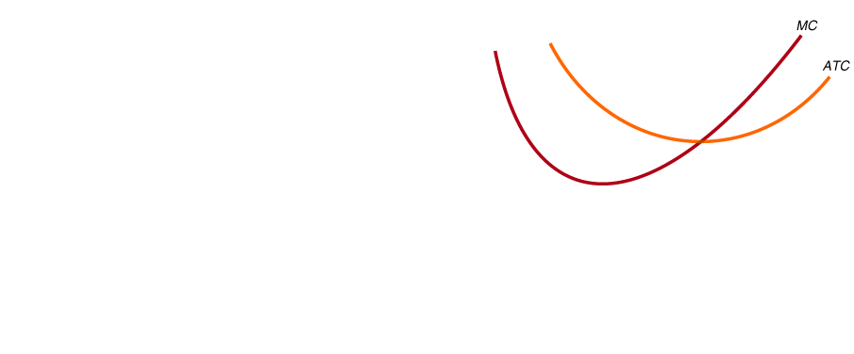
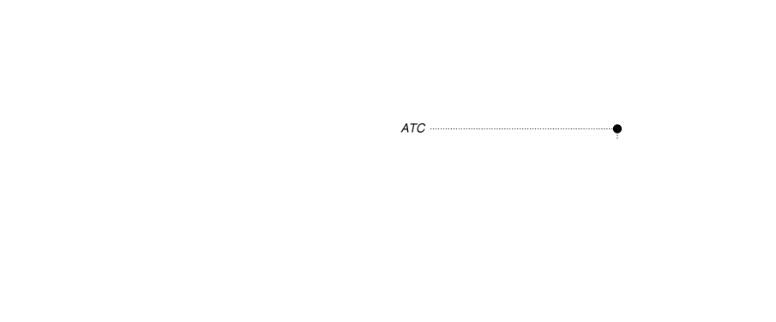
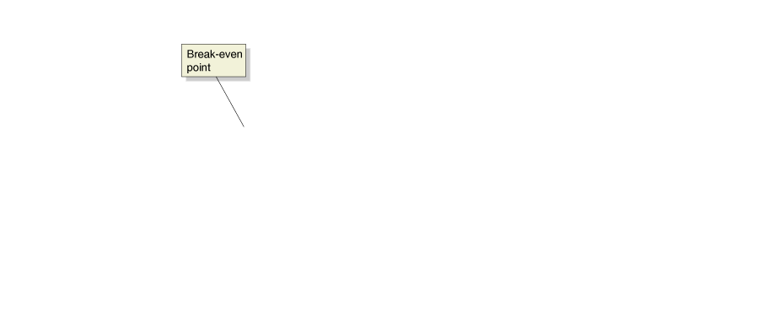
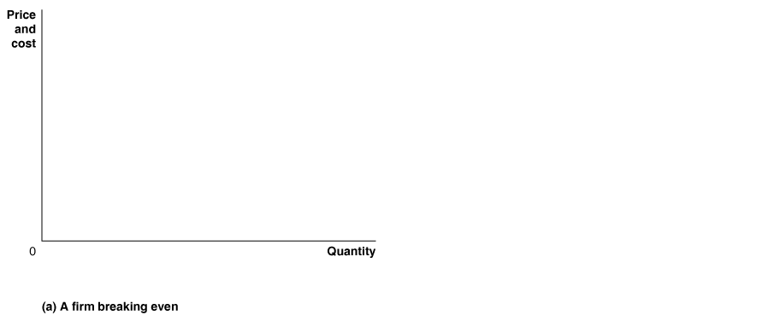
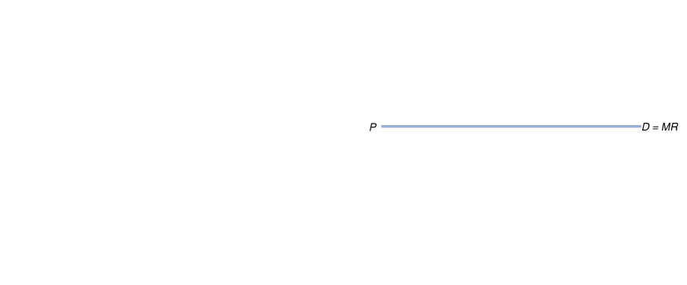
Figure 12.5
A Firm Breaking Even and a Firm Experiencing Losses
In panel (a), price equals average total cost, and the firm breaks even because its total revenue will be equal to its total cost.
In this situation, the firm makes zero economic profit.
In panel (b), price is below average total cost, and the firm experiences a loss.
The loss is represented by the area of the red-shaded rectangle, which has a height equal to (ATC − P) and a width equal to Q.
Maximizing profit in some cases amounts to minimizing loss.

Slide 25
Deciding Whether to Produce or to Shut Down in the Short Run
12.4 LEARNING OBJECTIVE
Explain why firms may shut down temporarily.

Slide 26
In the short run, a firm experiencing a loss has two choices:
Continue to produce
Stop production by shutting down temporarily
Sunk cost (沉隱成本) A cost that has already been paid and cannot be recovered.
If a farmer has taken out a loan to buy land, the farmer is legally required to make the monthly loan payment whether he or she grows any wheat that season or not.
The farmer has to spend those funds and cannot get them back, so the farmer should treat his or her sunk costs as irrelevant to his or her decision making.
For any firm, whether total revenue is greater or less than variable costs is the key to deciding whether to shut down.

Slide 27
The Supply Curve of a Firm in the Short Run
廠商的短期供給曲線
A perfectly competitive firm’s marginal cost curve also is its supply curve.
If a firm is experiencing a loss, it will shut down if its total revenue is less than its variable cost:
or, in symbols:
If we divide both sides by Q, we have the result that the firm will shut down if:
The firm’s marginal cost curve is its supply curve only for prices at or above average variable cost.
Shutdown point (歇業點) The minimum point on a firm’s average variable cost curve; if the price falls below this point, the firm shuts down production in the short run.

Slide 28
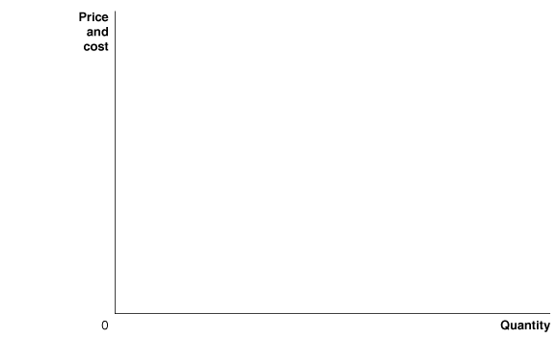
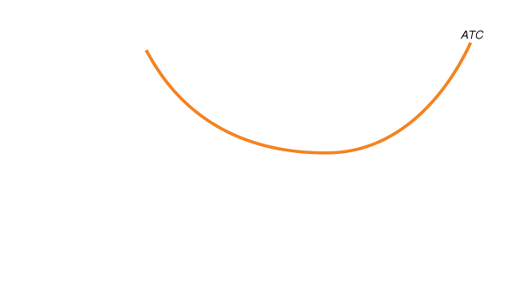

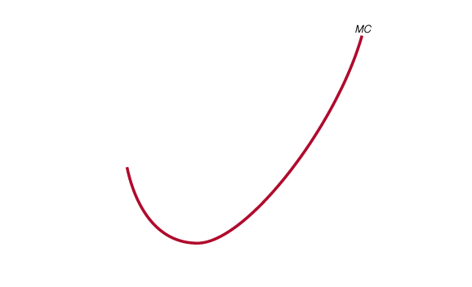
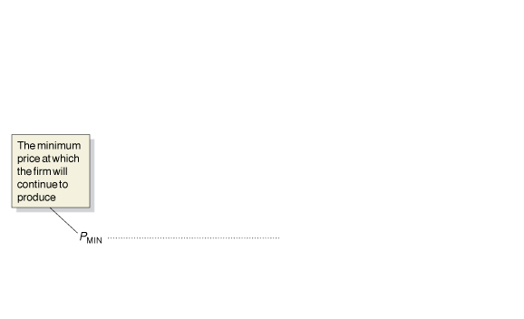
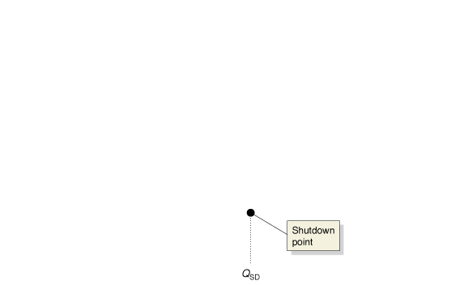



Figure 12.6
The Firm’s Short-Run Supply Curve
The firm will produce at the level of output at which MR = MC.
Because price equals marginal revenue for a firm in a perfectly competitive market, the firm will produce where P = MC.
For any given price, we can determine the quantity of output the firm will supply from the marginal cost curve.
In other words, the marginal cost curve is the firm’s supply curve.
The firm will shut down if the price falls below average variable cost.
The marginal cost curve crosses the average variable cost at the firm’s shutdown point.
This point occurs at output level Q_{SD}.
For prices below P_{MIN}, the supply curve is a vertical line along the price axis, which shows that the firm will supply zero output at those prices.
The red line in the figure is the firm’s short-run supply curve.

Slide 29




The Market Supply Curve in a Perfectly Competitive Industry
Figure 12.7
Firm Supply and Market Supply
We can derive the market supply curve by adding up the quantity that each firm in the market is willing to supply at each price.
In panel (a), one wheat farmer is willing to supply 15,000 bushels of wheat at a price of $4 per bushel.

Slide 30




The Market Supply Curve in a Perfectly Competitive Industry
Figure 12.7
Firm Supply and Market Supply
(Continued)
If every wheat farmer supplies the same amount of wheat at this price and if there are 150,000 wheat farmers, the total amount of wheat supplied at a price of $4 will equal 15,000 bushels per farmer × 150,000 farmers = 2.25 billion bushels of wheat.
This is one point on the market supply curve for wheat shown in panel (b).
We can find the other points on the market supply curve by determining how much wheat each farmer is willing to supply at each price.

Slide 31
“If Everyone Can Do It, You Can’t Make Money at It”: The Entry and Exit of Firms in the Long Run
12.5 LEARNING OBJECTIVE
Explain how entry and exit ensure that perfectly competitive firms earn zero economic profit in the long run.

Slide 32
Economic Profit and the Entry or Exit Decision
經濟利潤與進入或退出的決定
Table 12. 4
Farmer Gillette’s Costs per Year
Explicit Costs
Water Wages Fertilizer Electricity Payment on bank loan | $10,000 $15,000 $10,000 $5,000 $45,000
Implicit Costs
Forgone salary Opportunity cost of the $100,000 she has invested in her farm | $30,000 $10,000
Total cost | $125,000
Economic profit A firm’s revenues minus all its costs, implicit and explicit.

Slide 33










Economic Profit Leads to Entry of New Firms
Figure 12.8
The Effect of Entry on Economic Profits
We assume that Farmer Gillette’s costs are the same as the costs of other carrot farmers.
Initially, she and other farmers selling carrots in farmers’ markets are able to charge $15 per box and earn an economic profit.
Farmer Gillette’s economic profit is represented by the area of the green box.
Panel (a) shows that as other farmers begin to sell carrots in farmers’ markets, the market supply curve shifts to the right, from S₁ to S₂, and the market price drops to $10 per box.

Slide 34


Economic Profit Leads to Entry of New Firms
Figure 12.8
The Effect of Entry on Economic Profits
(Continued)
Panel (b) shows that the falling price causes Farmer Gillette’s demand curve to shift down from D₁ to D₂, and she reduces her output from 10,000 boxes to 8,000.
At the new market price of $10 per box, carrot growers are just breaking even:
Their total revenue is equal to their total cost, and their economic profit is zero.
Notice the difference in scale between the graph in panel (a) and the graph in panel (b).

Slide 35












Economic Losses Lead to Exit of Firms
Figure 12.9a-b
The Effect of Exit on Economic Losses
When the price of carrots is $10 per box, Farmer Gillette and other farmers are breaking even.
A total quantity of 310,000 boxes is sold in the market. Farmer Gillette sells 8,000 boxes.
Panel (a) shows a decline in the demand for carrots sold in farmers’ markets from D₁ to D₂ that reduces the market price to $7 per box.
Panel (b) shows that the falling price causes Farmer Gillette’s demand curve to shift down from D₁ to D₂ and her output to fall from 8,000 to 5,000 boxes.
At a market price of $7 per box, farmers have economic losses, represented by the area of the red box.
As a result, some farmers will exit the market, which shifts the market supply curve to the left.

Slide 36











Figure 12.9c-d
The Effect of Exit on Economic Losses
Panel (c) shows that exit continues until the supply curve has shifted from S₁ to S₂ and the market price has risen from $7 back to $10.
Panel (d) shows that with the price back at $10, Farmer Gillette will break even.
In the new market equilibrium in panel (c), total sales of carrots in farmers’ markets have fallen from 310,000 to 270,000 boxes.
Economic loss (經濟損失) The situation in which a firm’s total revenue is less than its total cost, including all implicit costs.

Slide 37
Long-Run Equilibrium in a Perfectly Competitive Market
Long-run competitive equilibrium (競爭市場長期均衡) The situation in which the entry and exit of firms has resulted in the typical firm breaking even.
The long-run average cost curve shows the lowest cost at which a firm is able to produce a given quantity of output in the long run.
So, we would expect that in the long run, competition drives the market price to the minimum point on the typical firm’s long-run average cost curve.

Slide 38













FIGURE 12.10
The Long-Run Supply Curve in a Perfectly Competitive Industry
Panel (a) shows that an increase in demand for carrots sold in farmers’ markets will lead to a temporary increase in price from $10 to $15 per box, as the market demand curve shifts to the right, from D₁ to D₂.
The entry of new firms shifts the market supply curve to the right, from S₁ to S₂, which will cause the price to fall back to its long-run level of $10.
Panel (b) shows that a decrease in demand will lead to a temporary decrease in price from $10 to $7 per box, as the market demand curve shifts to the left, from D₁ to D₂.
The exit of firms shifts the market supply curve to the left, from S₁ to S₂, which causes the price to rise back to its long-run level of $10. The long-run supply curve (S_{LR}) shows the relationship between market price and the quantity supplied in the long run. In this case, the long-run supply curve is a horizontal line.

Slide 39
Long-run supply curve (長期供給曲線) A curve that shows the relationship in the long run between market price and the quantity supplied.
In the long run, a perfectly competitive market will supply whatever amount
of a good consumers demand at a price determined by the minimum point on the typical firm’s average total cost curve.
Increasing-Cost and Decreasing-Cost Industries
Industries with horizontal long-run supply curves are called constant-cost industries.
Industries with upward-sloping long-run supply curves are called increasing-cost industries.
Industries with downward-sloping long-run supply curves are called decreasing-cost industries.

Slide 40
Perfect Competition and Efficiency
12.6 LEARNING OBJECTIVE
Explain how perfect competition leads to economic efficiency.

Slide 41
Productive Efficiency 生產效率
The forces of competition will drive the market price to the minimum average cost of the typical firm.
Productive efficiency The situation in which a good or service is produced at the lowest possible cost.
As we have seen, perfect competition results in productive efficiency.
Managers of firms strive to earn an economic profit by reducing costs, but in a perfectly competitive market, other firms quickly copy ways of reducing costs.
Therefore, in the long run, only the consumer benefits from cost reductions.

Slide 42
Allocative Efficiency 配置效率
We know firms will supply all those goods that provide consumers with a marginal benefit at least as great as the marginal cost of producing them because:
The price of a good represents the marginal benefit consumers receive from consuming the last unit of the good sold.
Perfectly competitive firms produce up to the point where the price of the good equals the marginal cost of producing the last unit.
Therefore, firms produce up to the point where the last unit provides a marginal benefit to consumers equal to the marginal cost of producing it.
Allocative efficiency A state of the economy in which production represents consumer preferences; in particular, every good or service is produced up to the point where the last unit provides a marginal benefit to consumers equal to the marginal cost of producing it.

