Slide 1

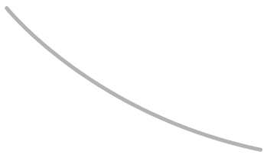

R. GLENN
HUBBARD
ANTHONY PATRICK
O’BRIEN
Economics
FOURTH EDITION

Slide 2
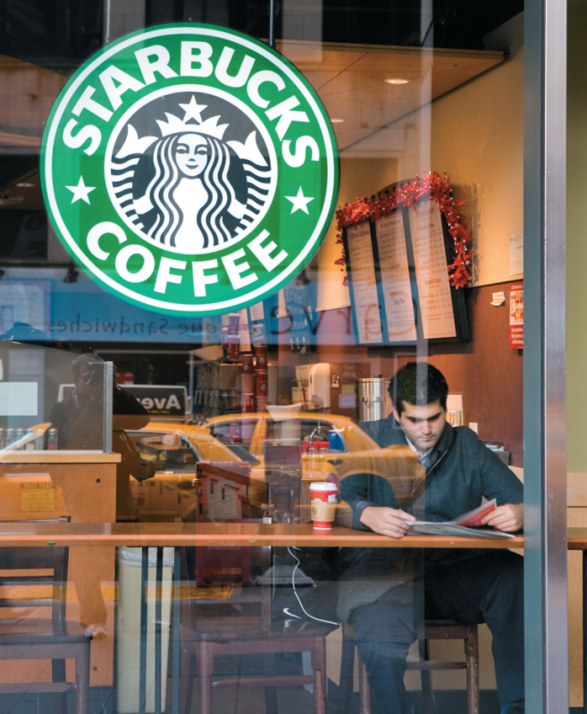
13
Monopolistic Competition:
CHAPTER
The Competitive Model
in a More Realistic Setting
Chapter Outline and
Learning Objectives
13.1 | Demand and Marginal Revenue for a Firm in a Monopolistically Competitive Market
13.2 | How a Monopolistically Competitive Firm Maximizes Profit in the Short Run
13.3 | What Happens to Profits in the Long Run?
13.4 | Comparing Monopolistic Competition and Perfect Competition
13.5 | How Marketing Differentiates Products
13.6 | What Makes a Firm Successful?

Slide 3
新聞時事
台灣知名咖啡店價錢比較
品牌 | 美式咖啡 | 卡布奇諾 | 拿鐵
星巴克 | 115 | 135 | 135
丹堤 | 70 | 90 | 90
客喜康 | 100 | 130 | 130
怡客 | 65 | 80 | 90

Slide 4
Monopolistic competition (獨占性競爭) A market structure in which barriers to entry are low and many firms compete by selling similar, but not identical, products.

Slide 5
Demand and Marginal Revenue for a Firm in a Monopolistically Competitive Market
13.1 LEARNING OBJECTIVE
Explain why a monopolistically competitive firm has downward-sloping demand
and marginal revenue curves.

Slide 6
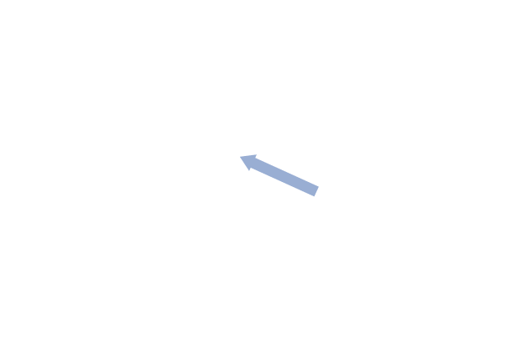
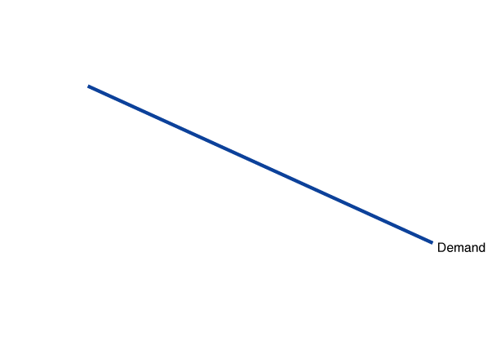
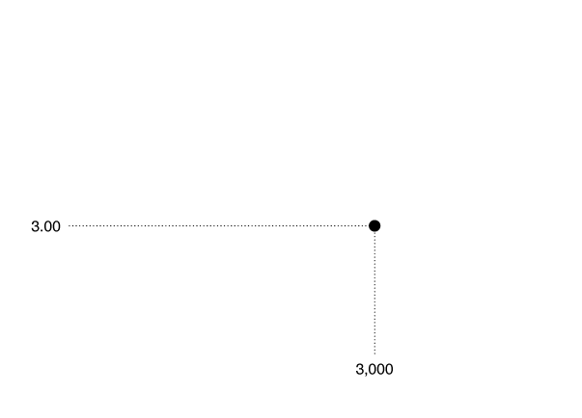
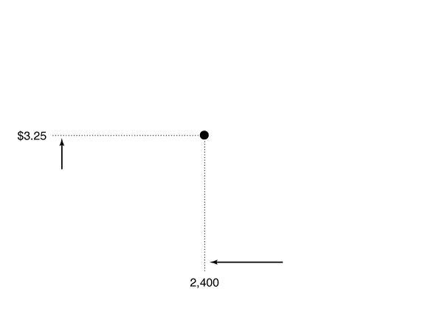
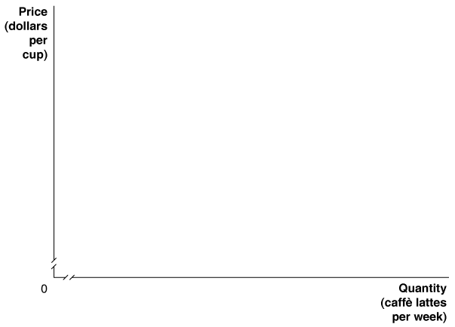
The Demand Curve for a Monopolistically Competitive Firm
Figure 13.1
The Downward-Sloping Demand for Caffè Lattes at a Starbucks
If a Starbucks increases the price of caffè lattes, it will lose some, but not all, of its customers.
In this case, raising the price from $3.00 to $3.25 reduces the quantity of caffè lattes sold from 3,000 to 2,400.
Therefore, unlike a perfect competitor, a Starbucks store faces a downward-sloping demand curve.

Slide 7
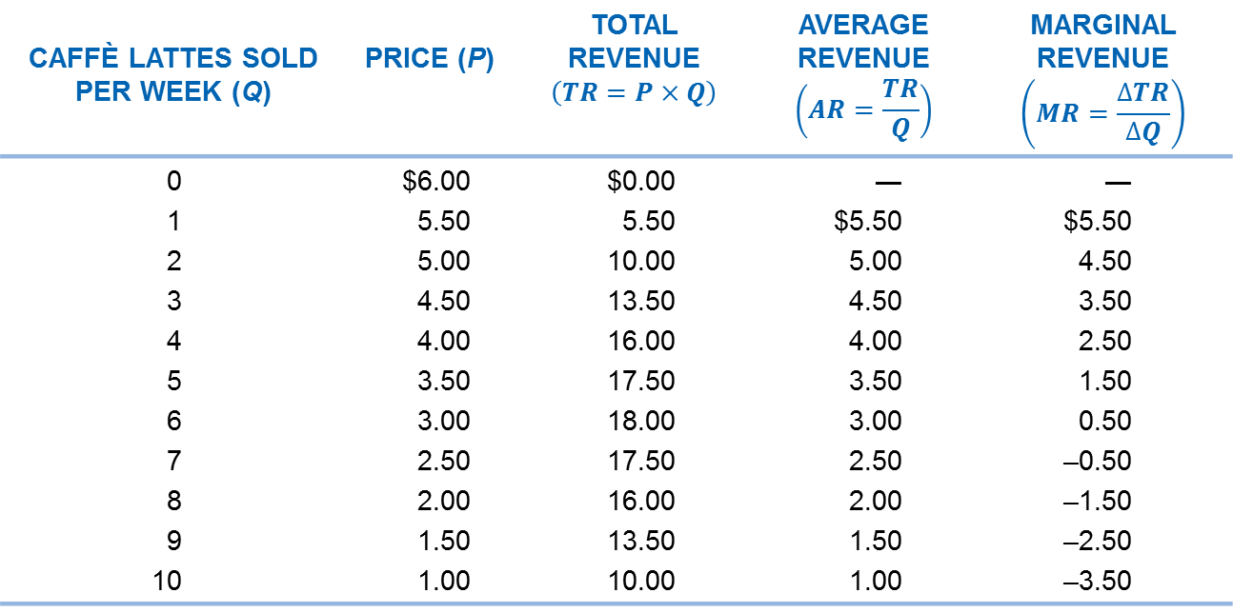
Marginal Revenue for a Firm with a Downward-Sloping Demand Curve
Table 13.1
Demand and Marginal Revenue at a Starbucks
CAFFÈ LATTES SOLD PER WEEK (Q) |  | PRICE (P)
0 1 2 3 4 5 6 7 8 9 10 | $6.00 5.50 5.00 4.50 4.00 3.50 3.00 2.50 2.00 1.50 1.00 |  | $0.00 5.50 10.00 13.50 16.00 17.50 18.00 17.50 16.00 13.50 10.00 | ― $5.50 5.00 4.50 4.00 3.50 3.00 2.50 2.00 1.50 1.00 | ― $5.50 4.50 3.50 2.50 1.50 0.50 –0.50 –1.50 –2.50 –3.50
The fourth column shows the firm’s revenue per unit, or its average revenue. Average revenue is equal to total revenue divided by quantity. Because total revenue equals price multiplied by quantity, dividing by quantity leaves just price. Therefore, average revenue is always equal to price.

Slide 8
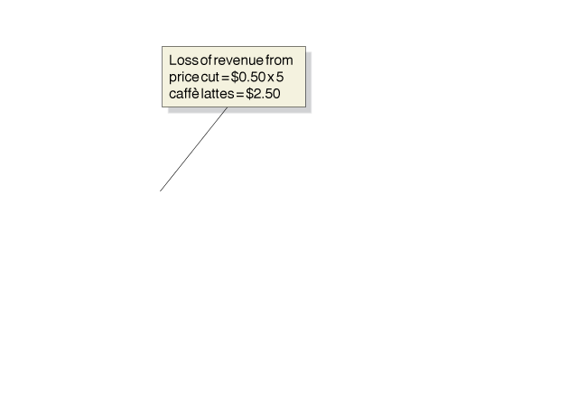


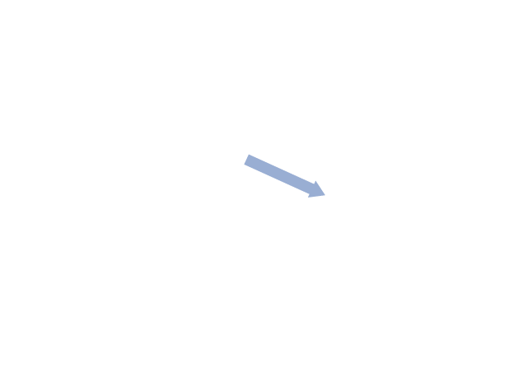
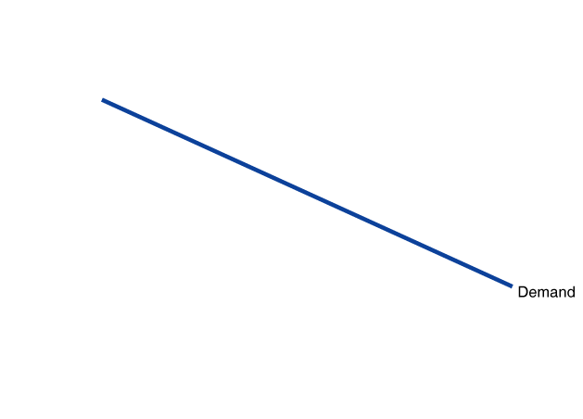
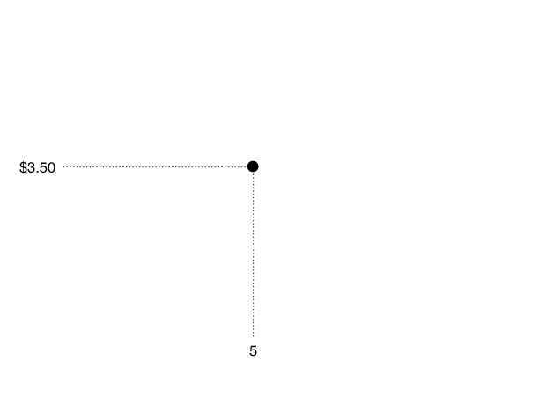
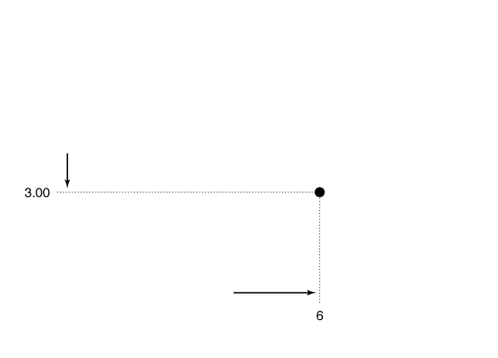
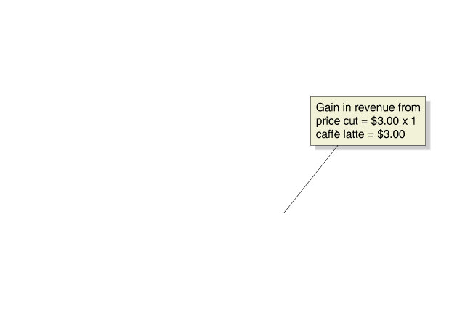
When the firm cuts the price by $0.50, one good thing and one bad thing happen:
• The good thing. (好事情)It sells 1 more caffè latte; we can call this the output effect.
• The bad thing.(壞事情)It receives $0.50 less for each caffè latte that it could have sold at the higher price; we can call this the price effect.
Figure 13.2
How a Price Cut Affects a Firm’s Revenue
If the local Starbucks reduces the price of a caffè latte from $3.50 to $3.00, the number of caffè lattes it sells per week will increase from 5 to 6.
Its marginal revenue from selling the sixth caffè latte will be $0.50, which is equal to the $3.00 additional revenue from selling 1 more caffè latte (the area of the green box)
minus the $2.50 loss in revenue from selling the first 5 caffè lattes for $0.50 less each (the area of the red box).

Slide 9
There is an important general point: Every firm that has the ability to affect the price of the good or service it sells will have a marginal revenue curve that is below its demand curve.
Only firms in perfectly competitive markets, which can sell as many units as they want at the market price, have marginal revenue curves that are the same as their demand curves.

Slide 10
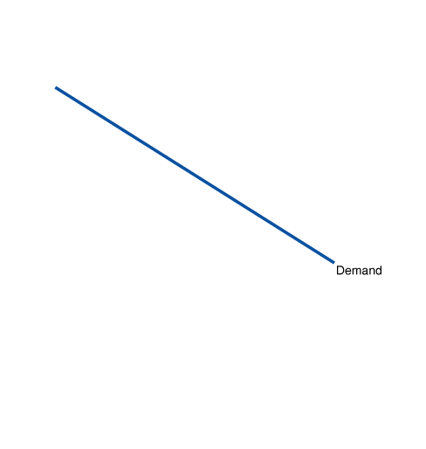
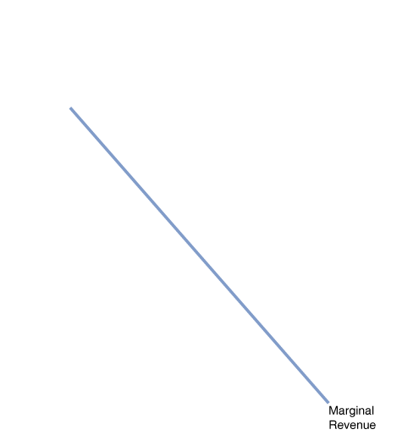
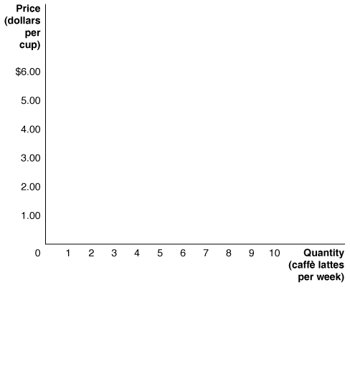
Figure 13.3
The Demand and Marginal Revenue Curves for a Monopolistically Competitive Firm
Any firm that has the ability to affect the price of the product it sells will have a marginal revenue curve that is below its demand curve.
We plot the data from Table 13.1 to create the demand and marginal revenue curves.
After the sixth caffè latte, marginal revenue becomes negative because the additional revenue received from selling 1 more caffè latte is smaller than the revenue lost from receiving a lower price on the caffè lattes that could have been sold at the original price.

Slide 11
How a Monopolistically Competitive Firm Maximizes Profit in the Short Run
13.2 LEARNING OBJECTIVE
Explain how a monopolistically competitive firm maximizes profit in the short run.

Slide 12
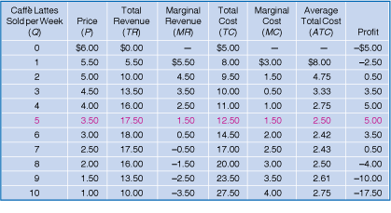

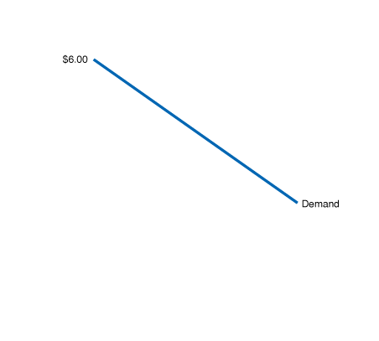
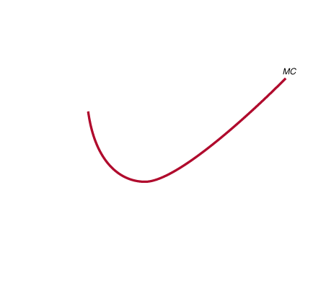
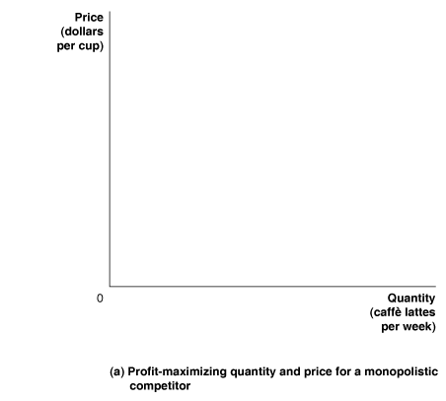
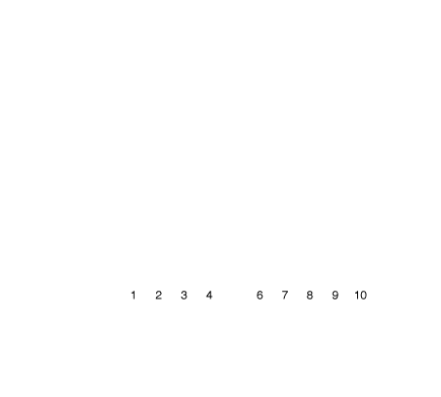
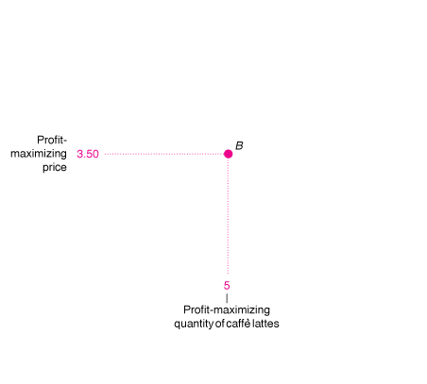
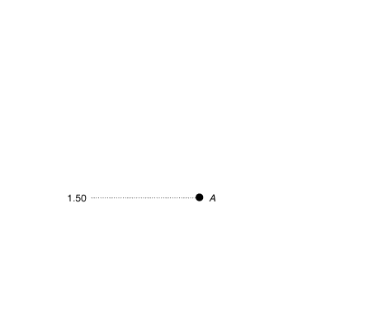
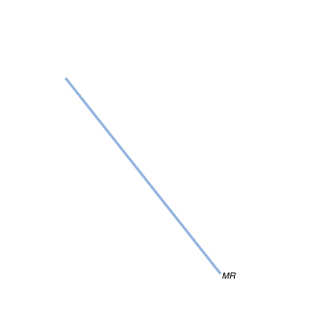

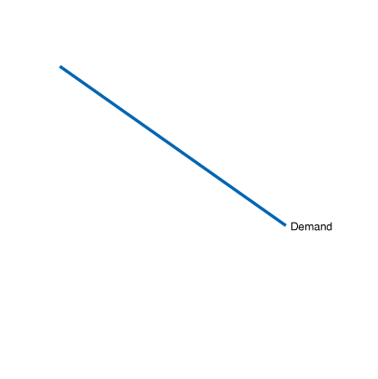
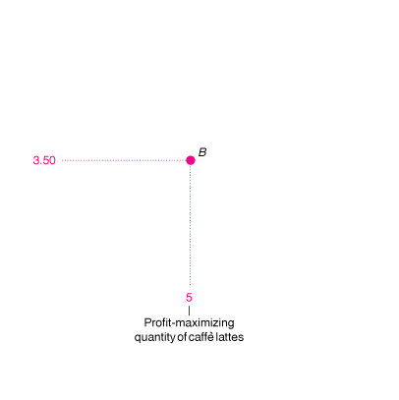
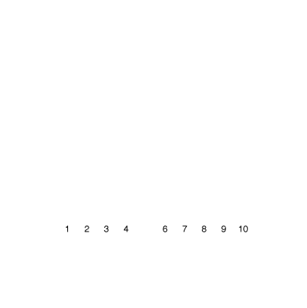
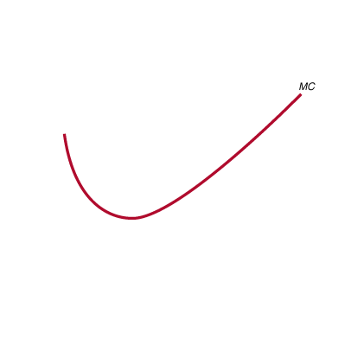
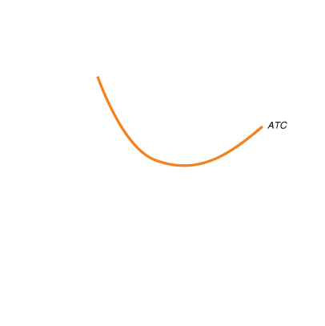
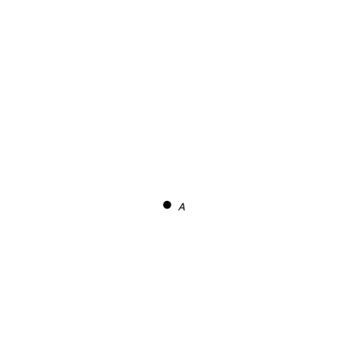
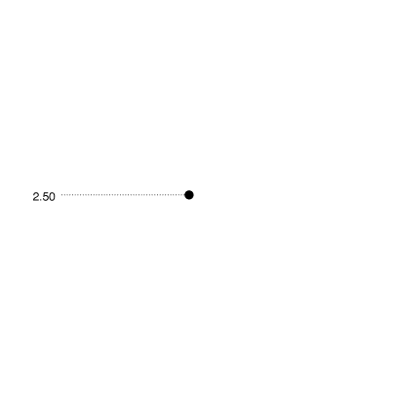
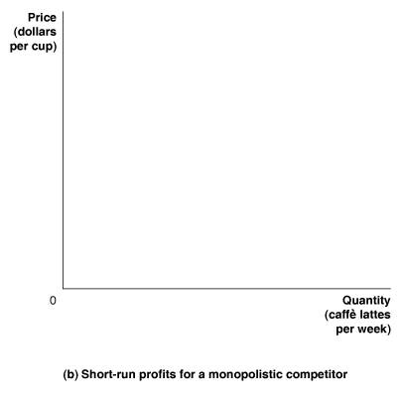
Figure 13.4
Maximizing Profit in a
Monopolistically Competitive Market
To maximize profit, a Starbucks coffeehouse wants to sell caffè lattes up to the point where the marginal revenue from selling the last caffè latte is just equal to the marginal cost. As the table shows, this happens with the fifth caffè latte—point A in panel (a)—which adds $1.50 to the firm’s costs and $1.50 to its revenues. The firm then uses the demand curve to find the price that will lead consumers to buy this quantity of caffè lattes (point B). In panel (b), the green box represents the firm’s profits. The box has a height equal to $1.00, which is the $3.50 price minus the average total cost of $2.50, and it has a base equal to the quantity of 5 caffè lattes. So, this Starbucks’s profit equals $1 × 5 = $5.00.

Slide 13
What Happens to Profits in the Long Run?
13.3 LEARNING OBJECTIVE
Analyze the situation of a monopolistically competitive firm in the long run.

Slide 14

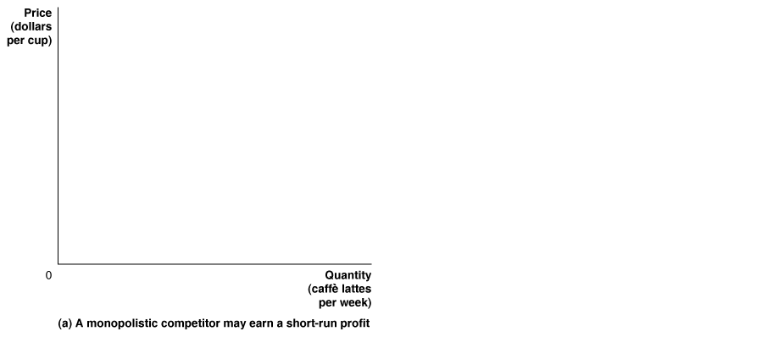
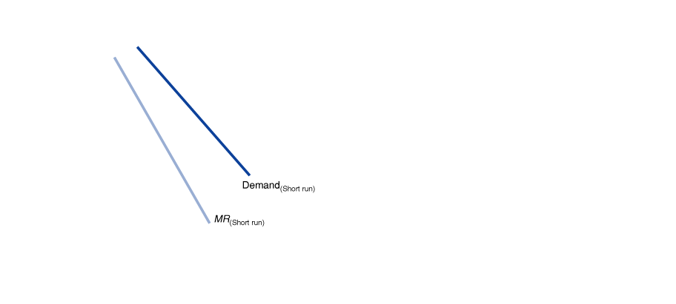
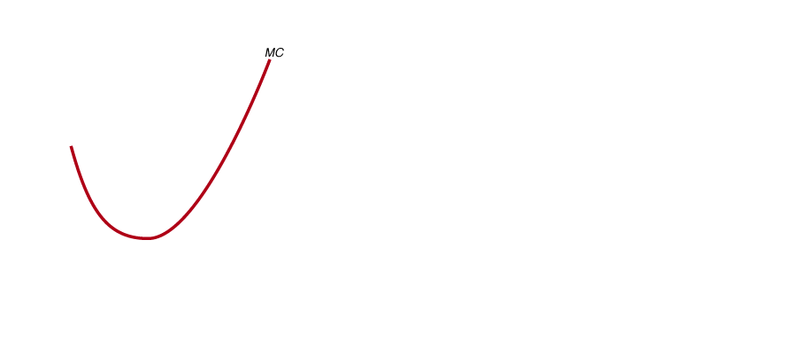

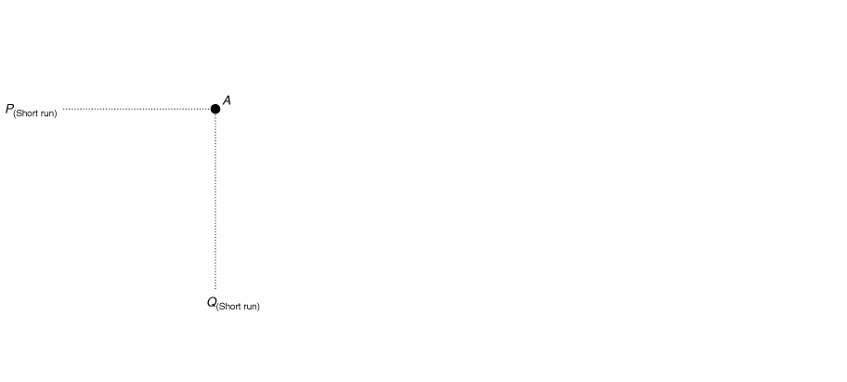
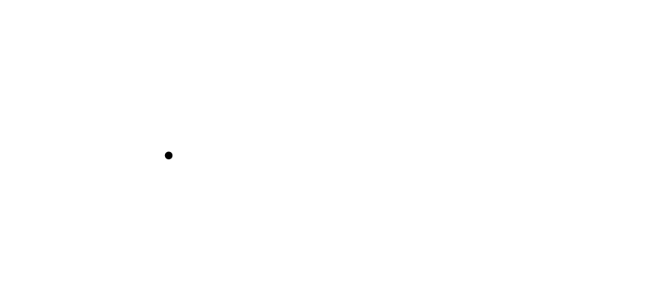
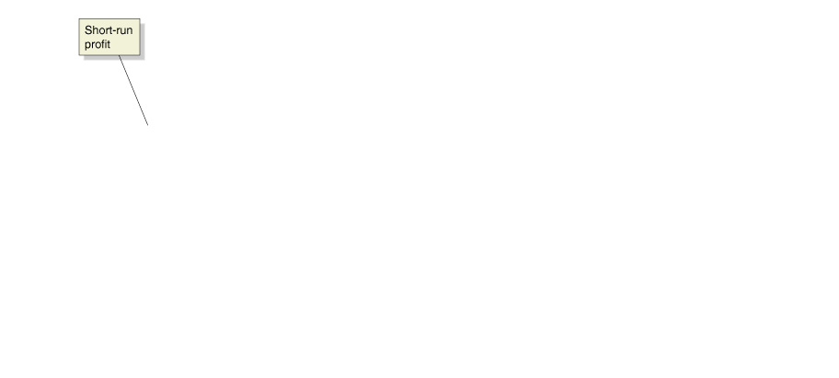
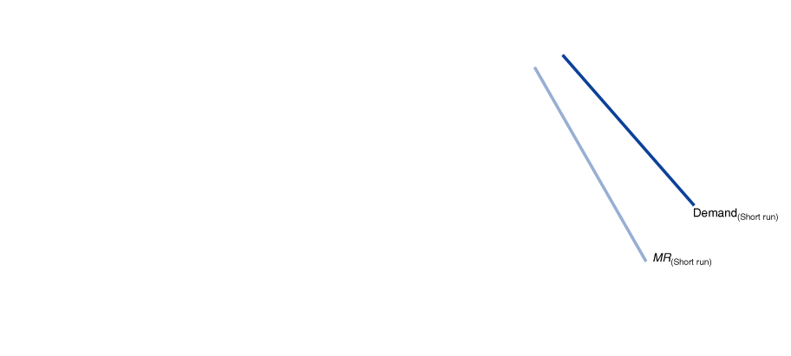
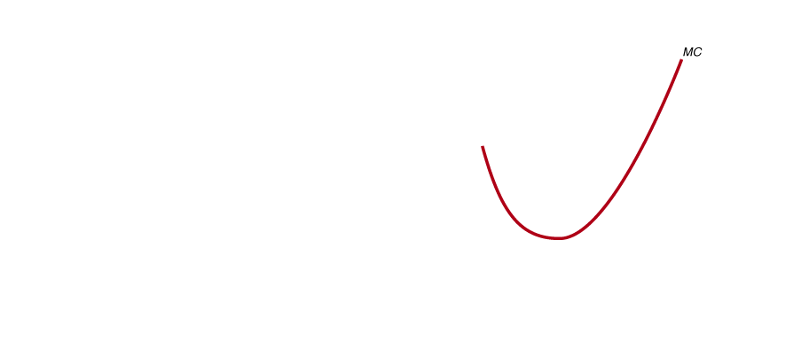
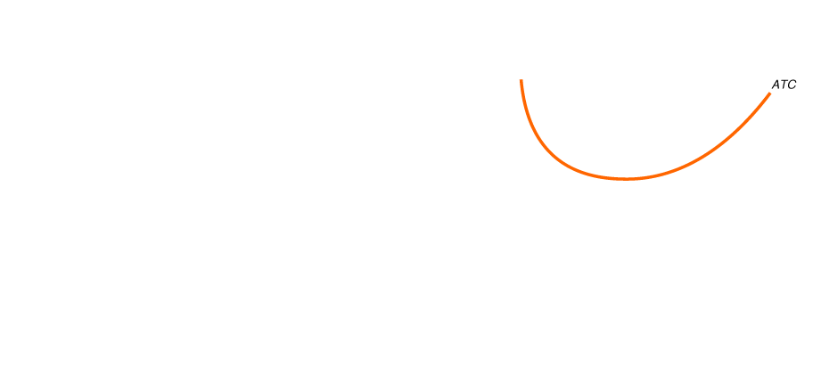
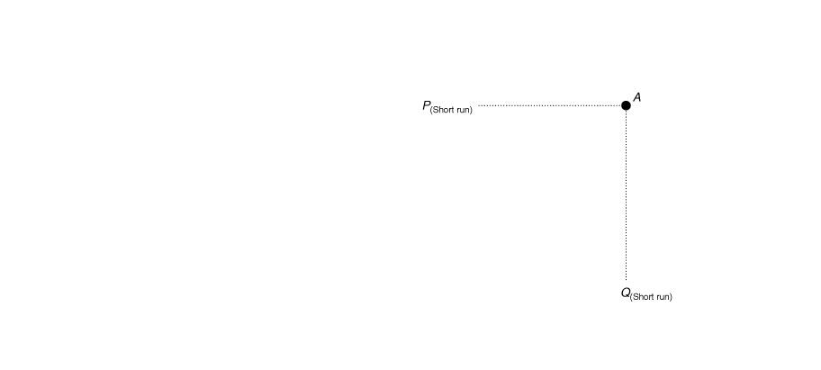
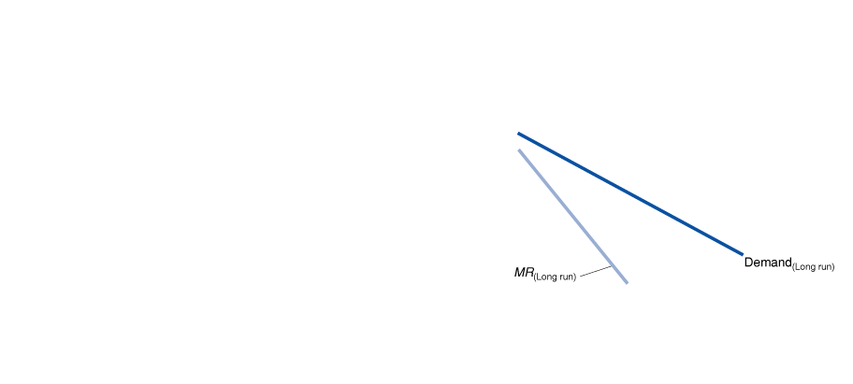
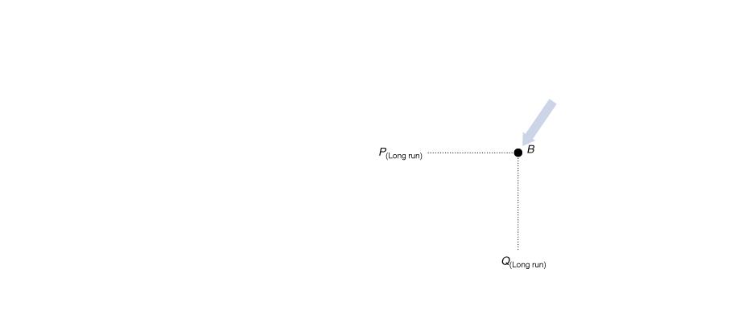
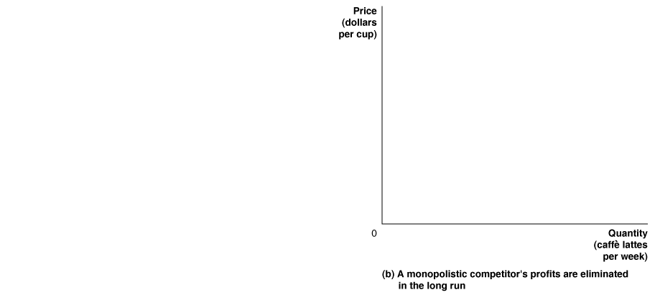
How Does the Entry of New Firms Affect the Profits of Existing Firms?
Figure 13.5
How Entry of New Firms Eliminates Profits
Panel (a) shows that in the short run, the local Starbucks faces the demand and marginal revenue curves labeled “Short run.” With this demand curve, Starbucks can charge a price above average total cost (point A) and make a profit, shown by the green rectangle.
But this profit attracts new firms to enter the market, which shifts the demand and marginal revenue curves to the curves labeled “Long run” in panel (b). Because price is now equal to average total cost (point B), Starbucks breaks even and no longer earns an economic profit.

Slide 15
Is Zero Economic Profit Inevitable in the Long Run?
If a firm introduces new technology that allows it to sell a good or service at a lower cost, competing firms will eventually be able to duplicate that technology and eliminate the firm’s profits. But this result holds only if the firm stands still and fails to find new ways of differentiating its product or fails to find new ways of lowering the cost of producing its product.
To stay one step ahead of its competitors, a firm has to offer consumers goods or services that they perceive to have greater value than those competing firms offer. Value can take the form of product differentiation, or it can take the form of a lower price.
Don’t Let This Happen to You
Don’t Confuse Zero Economic Profit with Zero Accounting Profit
Remember that economists count the opportunity cost of the owner’s investment in a firm as a cost.
Original investment = $200,000
Return on similar investment = 10 percent.
Annual opportunity cost of investing the funds = $200,000 x 10% = $20,000.
In an economic sense, the $20,000 is a cost. In long-run equilibrium, we would expect that entry of new firms would keep you from earning more than 10 percent on your investment. So, you would end up breaking even and earning zero economic profit, even though you were earning an accounting profit of $20,000.
MyEconLab
  Your Turn: Test your understanding by doing related problem 3.6 at the end of this chapter.

Slide 16
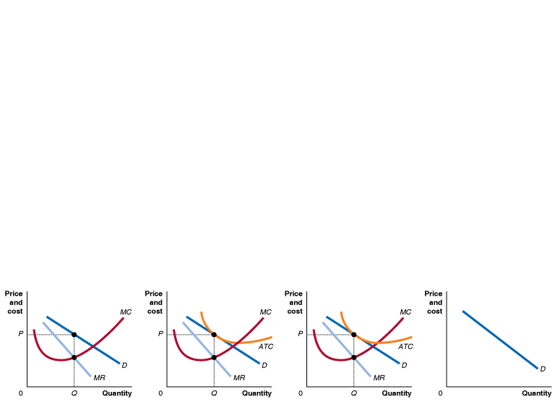
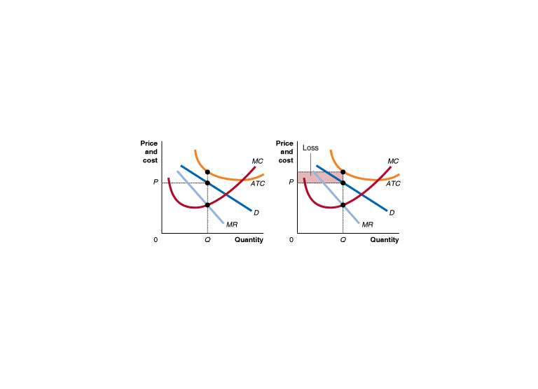
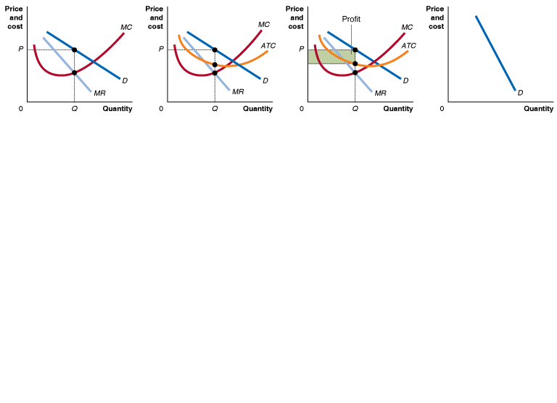
Table 13.2
The Short Run and the Long Run for a Monopolistically Competitive Firm
Relationship between Price
and Marginal Cost
Relationship between Price
and Average Total Cost
Profit and Loss
Elasticity of Demand Curve
Short Run
P > MC
Short Run
P > ATC
Short Run
Economic profit
Short Run
Less elastic demand curve
or P < ATC
or Economic loss
Long Run
P > MC
Long Run
P = ATC
Long Run
Zero economic profit
Long Run
More elastic demand curve

Slide 17
Comparing Perfect Competition
and Monopolistic Competition
13.4 LEARNING OBJECTIVE
Compare the efficiency of monopolistic competition and perfect competition.

Slide 18
Monopolistic competition and perfect competition share the characteristic that in long-run equilibrium, firms earn zero economic profits.
However, there are two important differences between long-run equilibrium in the two markets:
• Monopolistically competitive firms charge a price greater than marginal cost.
• Monopolistically competitive firms do not produce at minimum average total cost.

Slide 19
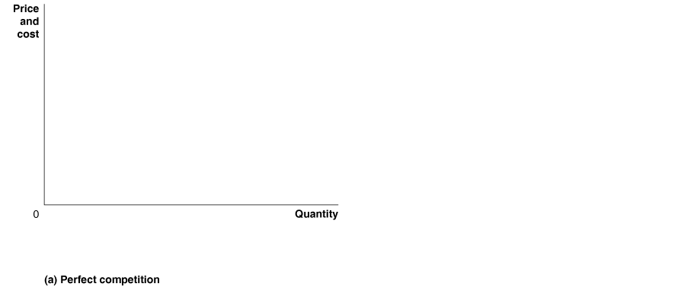



Excess Capacity under Monopolistic Competition
Figure 13.6 (1 of 2)
Comparing Long-Run Equilibrium under Perfect Competition and Monopolistic Competition
In panel (a), a perfectly competitive firm in long-run equilibrium produces at Q_{PC}, where price equals marginal cost, and average total cost is at a minimum. The perfectly competitive firm is both allocatively efficient and productively efficient.

Slide 20






Excess Capacity under Monopolistic Competition
Figure 13.6 (2 of 2)
Comparing Long-Run Equilibrium under Perfect Competition and Monopolistic Competition
In panel (b), a monopolistically competitive firm produces at Q_{MC}, where price is greater than marginal cost, and average total cost is not at a minimum. As a result, the monopolistically competitive firm is neither allocatively efficient nor productively efficient. The monopolistically competitive firm has excess capacity equal to the difference between its profit-maximizing level of output and the productively efficient level of output.

Slide 21
Is Monopolistic Competition Inefficient?
獨占性競爭是不效率的嗎?
In Chapter 12, we discussed productive efficiency and allocative efficiency. Productive efficiency refers to the situation where a good is produced at the lowest possible cost. Allocative efficiency refers to the situation where every good or service is produced up to the point where the last unit provides a marginal benefit to consumers equal to the marginal cost of producing it.
Economists have debated whether monopolistically competitive markets being neither productively nor allocatively efficient results in a significant loss of well-being to society in these markets compared with perfectly competitive markets.
How Consumers Benefit from Monopolistic Competition
The perfectly competitive firm is selling a good or service identical to those being sold by its competitors. A key point to remember is that firms differentiate their products to appeal to consumers.
The success of these product differentiation strategies indicates that some consumers find these products preferable to the alternatives. Consumers, therefore, are better off than they would have been had these companies not differentiated their products.

Slide 22
How Marketing Differentiates Products
13.5 LEARNING OBJECTIVE
Define marketing and explain how firms use marketing to differentiate their products.

Slide 23
Marketing (行銷) All the activities necessary for a firm to sell a product to a consumer.
Brand management (品牌管理) The actions of a firm intended to maintain the differentiation of a product over time.
Advertising (廣告)
If the increase in revenue that results from advertising is greater than the increase in costs, the firm’s profits will rise.
Defending a Brand Name (保護品牌)
A firm can apply for a trademark, which grants legal protection against other firms using its product’s name.
Legally enforcing trademarks can be difficult. U.S. firms often find it difficult to enforce their trademarks in the courts of some foreign countries,

Slide 24
What Makes a Firm Successful?
13.6 LEARNING OBJECTIVE
Identify the key factors that determine a firm’s success.

Slide 25

A firm’s ability to differentiate its product and to produce it at a lower average cost than competing firms creates value for its customers.
Some factors that affect a firm’s profitability are not directly under the firm’s control. Certain factors will affect all the firms in a market.
Figure 13.7
What Makes a Firm Successful?
The factors under a firm’s control—the ability to differentiate its product and the ability to produce it at lower cost—combine with the factors beyond its control to determine the firm’s profitability.

