Slide 1



R. GLENN
HUBBARD
ANTHONY PATRICK
O’BRIEN
Economics
FOURTH EDITION

Slide 2
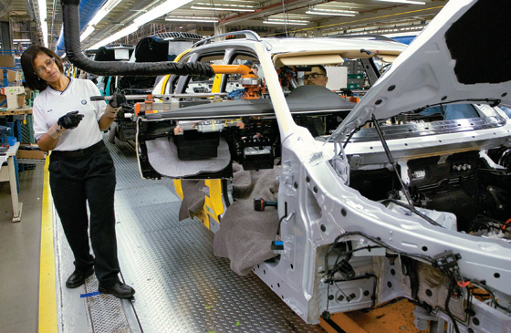
2
Trade-offs, Comparative Advantage, and the Market System
CHAPTER
Chapter Outline and
Learning Objectives
2.1 | Production Possibilities Frontiers and Opportunity Costs
2.2 | Comparative Advantage and Trade
2.3 | The Market System

Slide 3
新聞時事
亞洲補教產值高 直逼政府教育經費 [TVBS2012/7/5]
亞洲父母為孩子在補教上的花費，甚至直逼政府的教育經費，而且還有逐年成長的趨勢！並且不只富國，像是日本與新加坡的家長，甚至較窮困的巴基斯坦，也熱衷把孩子送去補習，反映出亞洲父母不願孩子輸在起跑點的心態。
抓準家長心態，做到美國上市、市值約台幣247億，預計到2016年，中國大陸中小學補教市場將達到人民幣6000億、約新台幣2.8兆的規模，補教市場驚人，絕非大陸特有現象。
南韓家長對教育成本的投資，約是政府對國民基本教育經費的8成之多，日本家庭2010年課外教育費用更達120億美元、合約台幣3600億。不只亞洲富國為補習砸錢不手軟，新加坡家庭2008年，花費6.8億美元、204億台幣，連窮國也不想輸在起跑點，巴基斯坦6成人口每天靠不到2美元過活，但2011年平均每名學童每月補教費用竟有3.4美元，瘋狂補習，追本溯源，還是跟考試制度有關。

Slide 4
Making
the
Connection
Subsidies for Education at Taiwan
教育部各年度補助經費 (單位:千元) | 高等教育 | 非高等教育
2010 | 72,195,036 | 940,376
2011 | 80,604,927 | 703,663
2012 | 78,459,641 | 778,563

Slide 5
Production Possibilities Frontiers and Opportunity Costs
2.1 LEARNING OBJECTIVE
Use a production possibilities frontier to analyze opportunity costs and trade-offs.
Production possibilities frontier (PPF生產可能曲線) A curve showing the maximum attainable combinations of two products that may be produced with available resources and current technology.

Slide 6
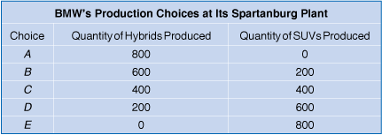
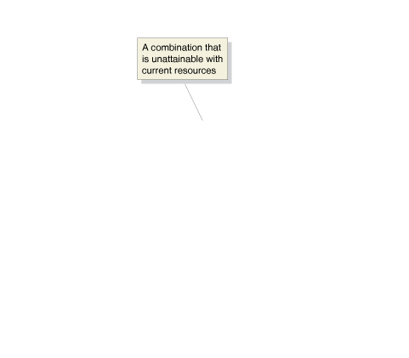
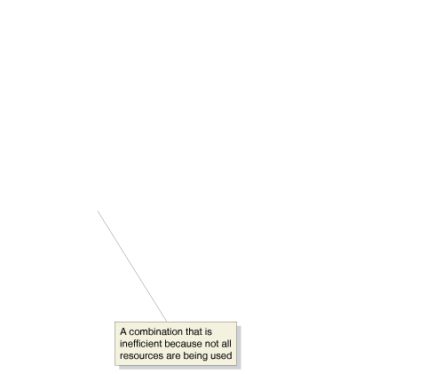
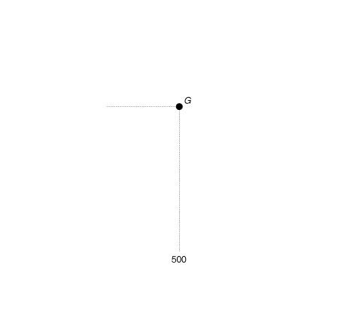
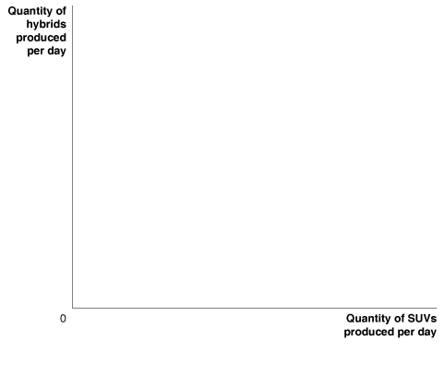



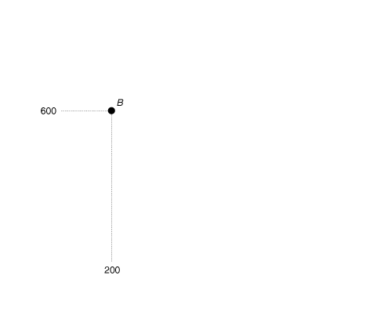
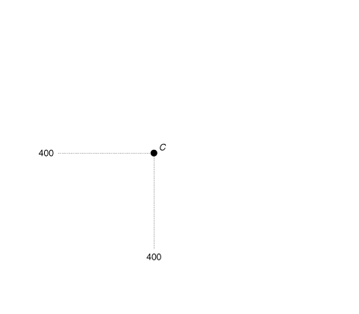
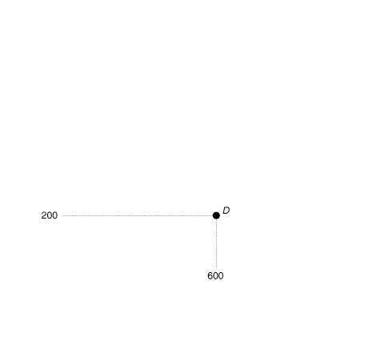
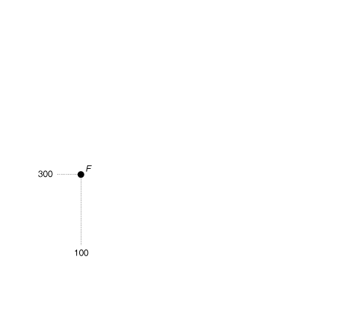
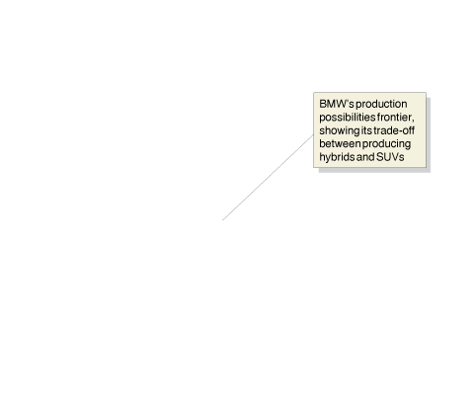
Graphing the Production Possibilities Frontier (生產可能曲線)
Figure 2.1
BMW’s Production Possibilities Frontier
BMW faces a trade-off: To build one more hybrid, it must build one less SUV.
The production possibilities frontier illustrates the trade-off BMW faces.
Combinations on the production possibilities frontier—like points A, B, C, D, and E—are technically efficient because the maximum output is being obtained from the available resources.
Combinations inside the frontier— like point F—are inefficient because some resources are not being used.
Combinations outside the frontier—like point G—are unattainable with current resources.
Opportunity cost (機會成本) The highest-valued alternative that must be given up to engage in an activity.

Slide 7
Making
the
Connection
Family Spending in Health Caring at Taiwan--Facing Trade-offs
年 別 | 合 計 | 食品、飲料及菸草 | 衣著、鞋襪類 | 住宅服務、水電瓦斯及燃料 | 家具設備及家務服務 | 醫療保 健 | 運輸交通及通訊 | 休閒、文化及教育消費 | 餐廳及旅館 | 什 項消 費
2007 | 100 | 16.5 | 3.3 | 23.9 | 2.5 | 14.1 | 12.9 | 11.2 | 9.7 | 6
2008 | 100 | 16.4 | 3.2 | 24.2 | 2.5 | 14.4 | 12.4 | 11.3 | 10.1 | 5.6
2009 | 100 | 16.7 | 3.2 | 24.3 | 2.5 | 14.5 | 12.7 | 11 | 9.4 | 5.7
2010 | 100 | 16.6 | 3.2 | 24.6 | 2.5 | 14.4 | 12.5 | 11 | 9.7 | 5.4
2011 | 100 | 16.2 | 3.1 | 24.4 | 2.5 | 14.6 | 13 | 10.4 | 10.2 | 5.6

Slide 8
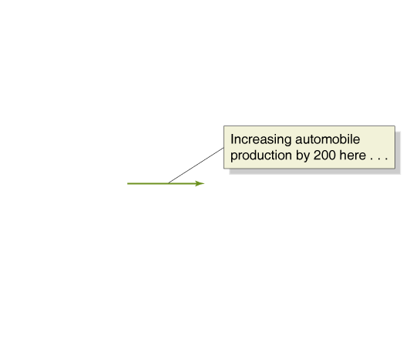
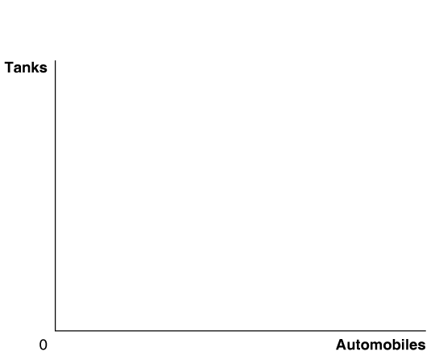
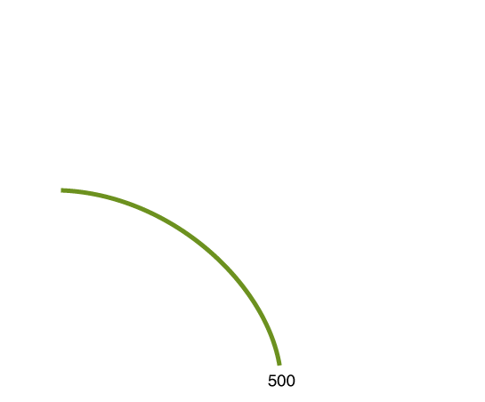
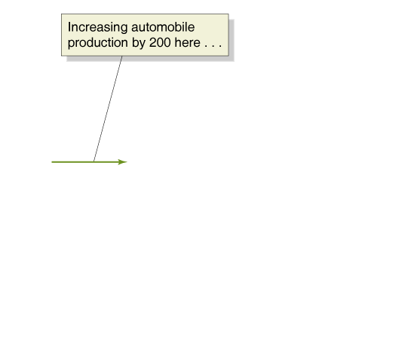

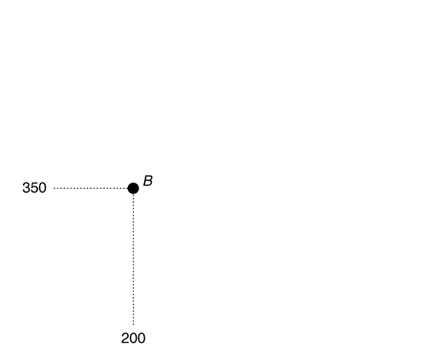
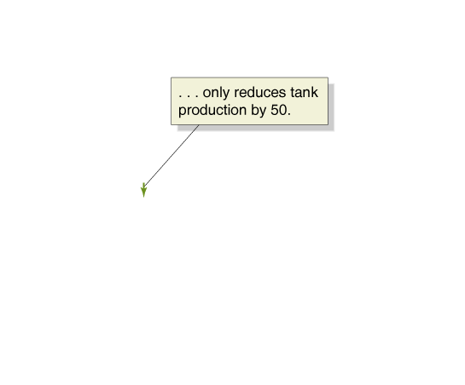
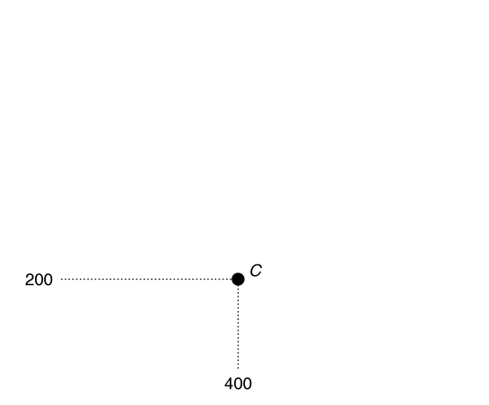
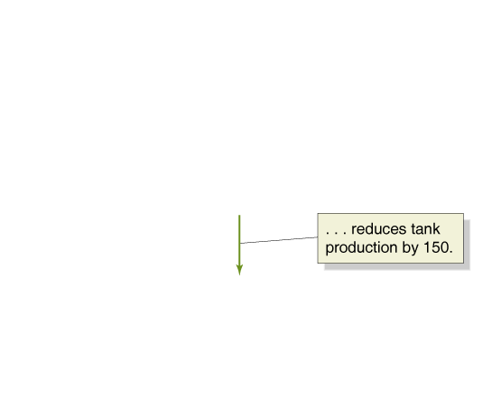
Figure 2.2
Increasing Marginal Opportunity Costs
As the economy moves down the production possibilities frontier, it experiences increasing marginal opportunity costs because increasing automobile production by a given quantity requires larger and larger decreases in tank production.
For example, to increase automobile production from 0 to 200—moving from point A to point B—the economy has to give up only 50 tanks.
But to increase automobile production by another 200 vehicles—moving from point B to point C—the economy has to give up 150 tanks.
The more resources already devoted to an activity, the smaller the payoff to devoting additional resources to that activity.

Slide 9
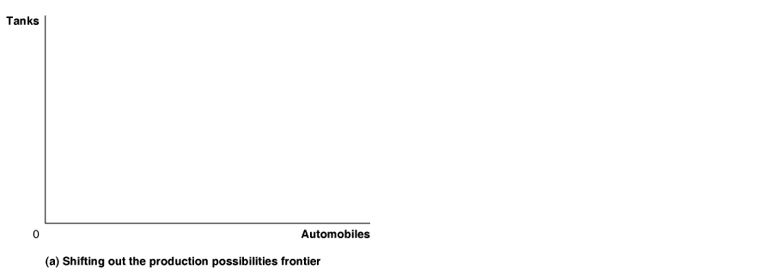
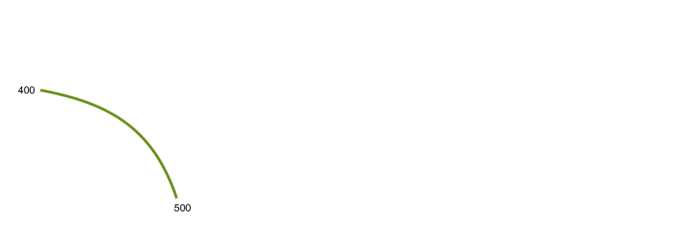
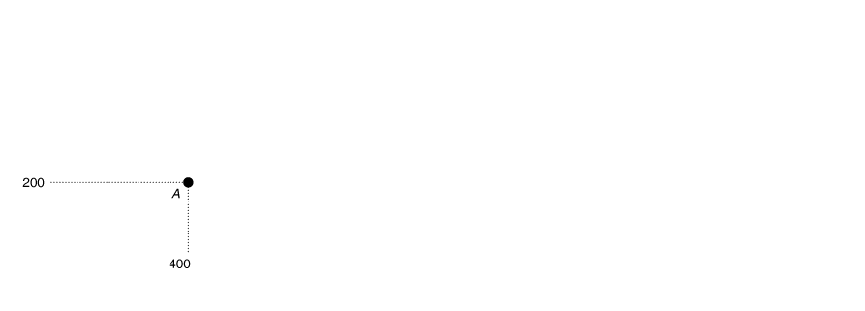
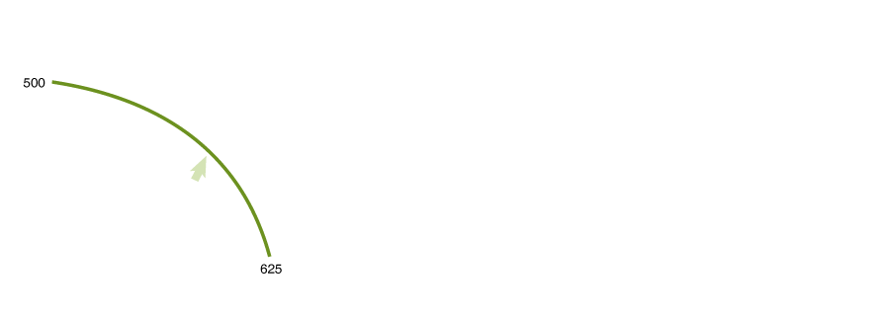

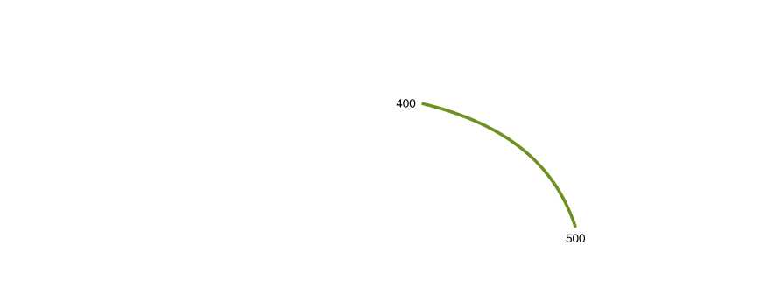
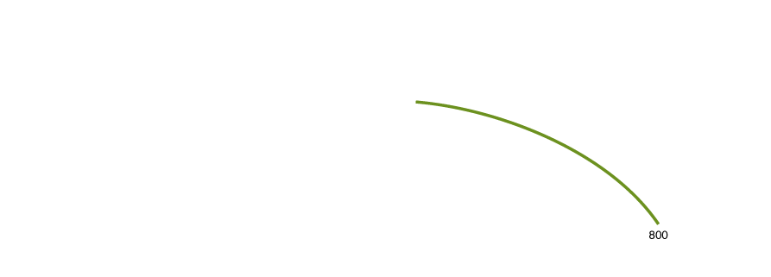
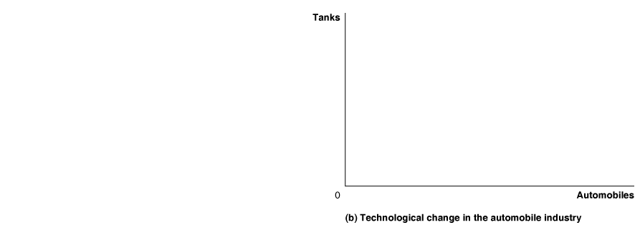
Economic growth (經濟成長) The ability of the economy to increase the production of goods and services.
Figure 2.3
Economic Growth
Panel (a) shows that as more economic resources become available and technological change occurs, the economy can move from point A to point B, producing more tanks and more automobiles.
Panel (b) shows the results of technological change in the automobile industry that increases the quantity of vehicles workers can produce per year while leaving unchanged the maximum quantity of tanks that can be produced.
Shifts in the production possibilities frontier represent economic growth.

Slide 10
Comparative Advantage and Trade
2.2 LEARNING OBJECTIVE
Understand comparative advantage and explain how it is the basis for trade.

Slide 11
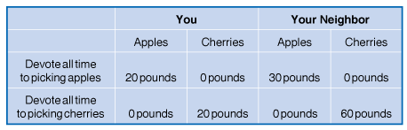
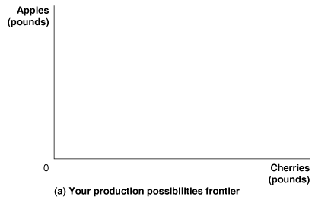
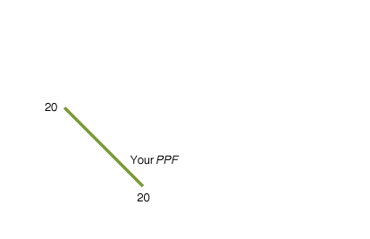
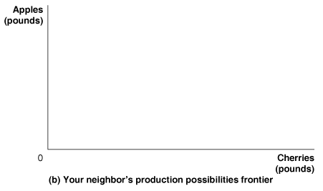
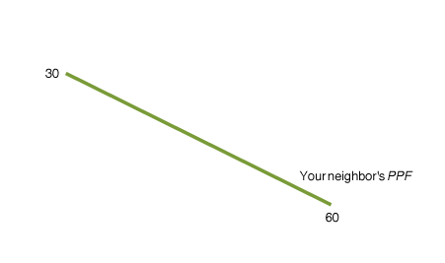
Specialization (專業化) and Gains from Trade (交易利得)
Figure 2.4
Production Possibilities for You and Your Neighbor, without Trade
The table shows how many pounds of apples and how many pounds of cherries you and your neighbor can each pick in one week.
Panel (a) shows your PPF. If you devote all your time to picking apples and none of your time to picking cherries, you can pick 20 pounds. If you devote all your time to picking cherries, you can pick 20 pounds.
Panel (b) shows that if your neighbor devotes all her time to picking apples, she can pick 30 pounds. If she devotes all her time to picking cherries, she can pick 60 pounds.

Slide 12
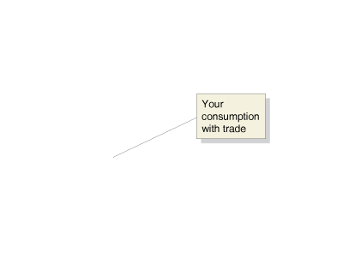
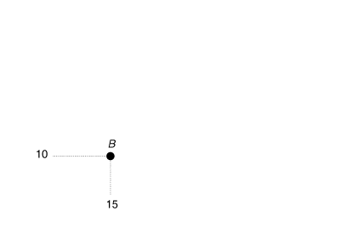
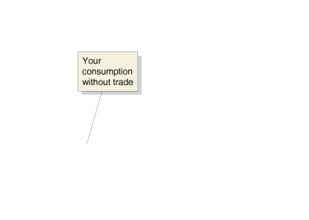
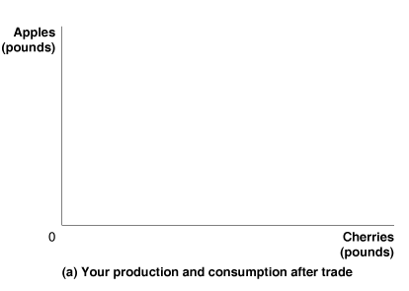
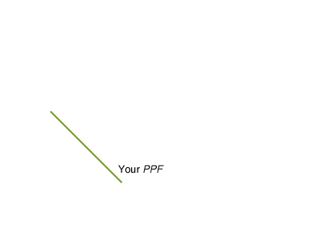
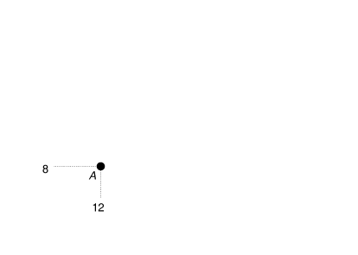
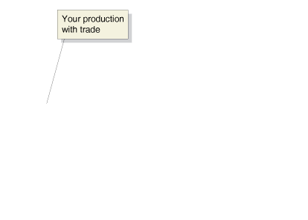
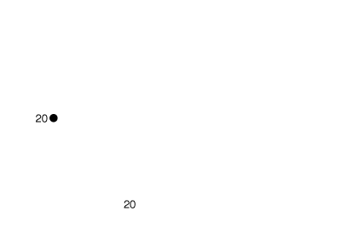
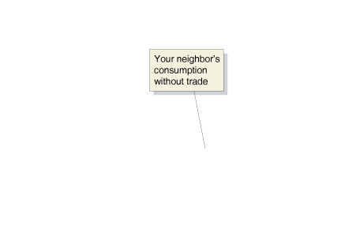

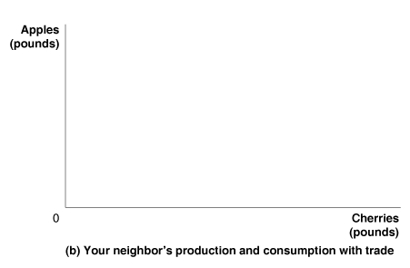
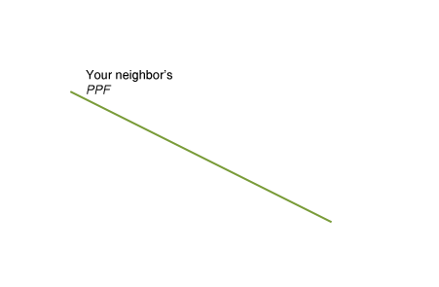
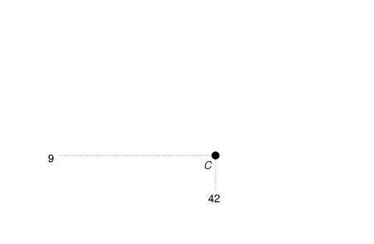
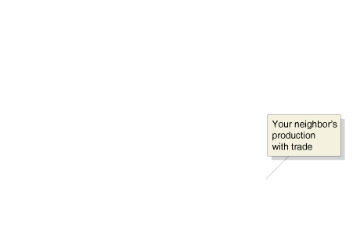
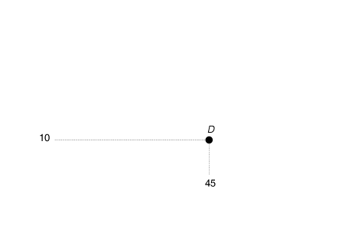

Trade (交易) The act of buying and selling.
Figure 2.5
Gains from Trade
When you don’t trade with your neighbor, you pick and consume 8 pounds of apples and 12 pounds of cherries per week—point A in panel (a).
When your neighbor doesn’t trade with you, she picks and consumes 9 pounds of apples and 42 pounds of cherries per week—point C in panel (b).
If you specialize in picking apples, you can pick 20 pounds. If your neighbor specializes in picking cherries, she can pick 60 pounds.
If you trade 10 pounds of your apples for 15 pounds of your neighbor’s cherries, you will be able to consume 10 pounds of apples and 15 pounds of cherries— point B in panel (a).
Your neighbor can now consume 10 pounds of apples and 45 pounds of cherries—point D in panel (b). You and your neighbor are both better off as a result of trade.

Slide 13
Table 2.1
A Summary of the Gains from Trade
 | You |  | Your Neighbor
 | Apples (in pounds) | Cherries (in pounds) | Apples (in pounds) | Cherries (in pounds)
Production and consumption without trade | 8 | 12 | 9 | 42
Production with trade | 20 | 0 | 0 | 60
Consumption with trade | 10 | 15 | 10 | 45
Gains from trade (increased consumption) | 2 | 3 | 1 | 3

Slide 14
Absolute Advantage(絕對利益) versus Comparative Advantage(比較利益)
Absolute advantage The ability of an individual, a firm, or a country to produce more of a good or service than competitors, using the same amount of resources.
Table 2.2
Opportunity Costs of Picking Apples and Cherries
 | Opportunity Cost of Picking 1 Pound of Apples | Opportunity Cost of Picking 1 Pound of Cherries
You | 1 pound of cherries | 1 pound of apples
Your Neighbor | 2 pounds of cherries | 0.5 pound of apples
Comparative advantage The ability of an individual, a firm, or a country to produce a good or service at a lower opportunity cost than competitors.
Don’t Let This Happen to You
Don’t Confuse Absolute Advantage and Comparative Advantage
Make sure you know the definitions.
Keep in mind it is possible to have one without the other.
MyEconLab
  Your Turn: Test your understanding by doing related problem 2.5 at the end of this chapter.

Slide 15
Comparative Advantage (比較利益)and the Gains from Trade(交換利得)
The basis for trade is comparative advantage, not absolute advantage.
Individuals, firms, and countries are better off if they specialize in producing goods and services for which they have a comparative advantage and obtain the other goods and services they need by trading.

Slide 16
The Market System
2.3 LEARNING OBJECTIVE
Explain the basic idea of how a market system works.

Slide 17
Market (市場) A group of buyers and sellers of a good or service and the institution or arrangement by which they come together to trade.
Product market (產品市場) A market for goods—such as computers—or services—such as medical treatment.
Factor market (要素市場) A market for the factors of production, such as labor, capital, natural resources, and entrepreneurial ability.
Factors of production (生產要素) The inputs used to make goods and services.

Slide 18
Factors of production are divided into four broad categories:
Labor includes all types of work, from the part-time labor of teenagers working at McDonald’s to the work of senior managers in large corporations.
Capital refers to physical capital, such as computers and machine tools, that is used to produce other goods.
Natural resources include land, water, oil, iron ore, and other raw materials (or “gifts of nature”) that are used in producing goods.
An entrepreneur is someone who operates a business. Entrepreneurial ability is the ability to bring together the other factors of production to successfully produce and sell goods and services.

Slide 19
The Circular Flow of Income (所得循環流動)
Two key groups participate in markets:
• A household consists of all the individuals in a home.
Firms are suppliers of goods and services.
Circular-flow diagram (循環流動圖表) A model that illustrates how participants in markets are linked.

Slide 20
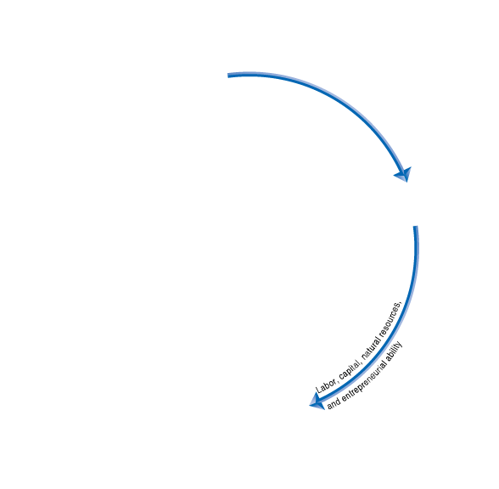
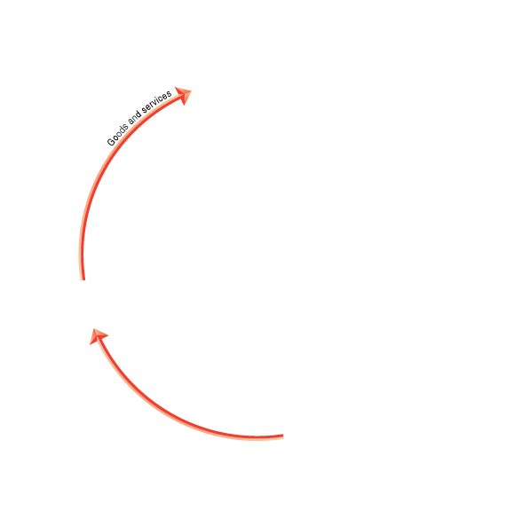
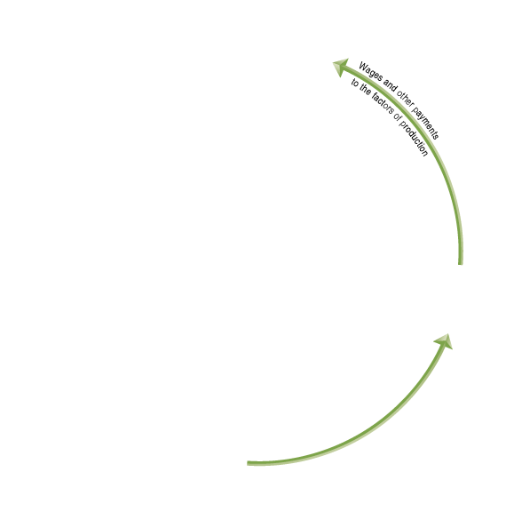
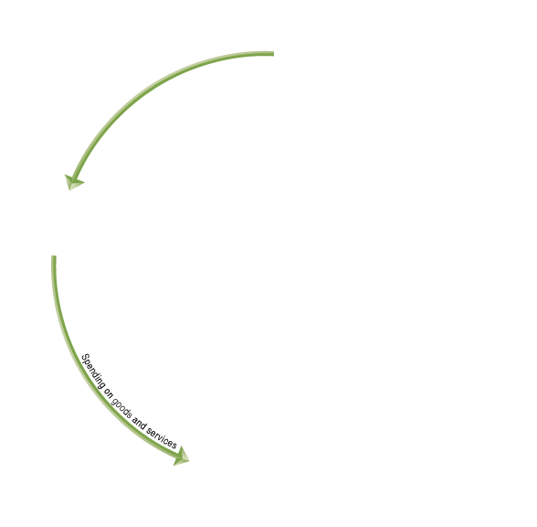


Figure 2.6
The Circular-Flow Diagram
Households and firms are linked together
in a circular flow of production, income,
and spending.
The blue arrows show the flow of
the factors of production.
In factor markets, households
supply labor, entrepreneurial
ability, and other factors of
production to firms.
Firms use these factors of
production to make goods and
services that they supply to
households in product markets.
The red arrows show the flow of goods
and services from firms to households.
The green arrows show the flow of funds.
In factor markets, households receive wages
and other payments from firms in exchange for
supplying the factors of production.
Households use these wages and other payments to purchase goods and services from firms in product markets. Firms sell goods and services to households in product markets, and they use the funds to purchase the factors of production from households in factor markets.

Slide 21
The Gains from Free Markets
Free market A market with few government restrictions on how a good or service can be produced or sold or on how a factor of production can be employed.
Countries that come closest to the free market benchmark have been more successful than those with centrally planned economies in providing their people with rising living standards, as Adam Smith argued in 1776.
The Market Mechanism
Individuals usually act in a rational, self-interested way. In analyzing people in the act of buying and selling, the motivation of financial reward usually provides the best explanation for the actions people take.
For the market mechanism to work in responding to changes in consumers’ wants, prices must be flexible. In a famous phrase, Smith said that firms would be led by the “invisible hand” of the market to provide consumers with what they want.
Firms respond individually to changes in relative prices by making decisions that collectively end up satisfying the wants of consumers.

Slide 22
The Legal Basis of a Successful Market System
Protection of Private Property
Property rights The rights individuals or firms have to the exclusive use of their property, including the right to buy or sell it.
Patents and copyrights protect intellectual property rights for inventors of ideas for new products or production methods and for creators of books, films, and software.
Enforcement of Contracts and Property Rights If property rights are not well enforced, fewer goods and services will be produced. This reduces economic efficiency, leaving the economy inside its production possibilities frontier.

