Slide 1
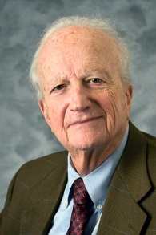
Gary S. Becker (December 2, 1930 – May 3, 2014)
Institution:
University of Chicago(1968–2014)
Field:
Social economics
Contributions:
Analysis of human capital , Rotten kid theorem(social interaction)
Awards:
1967 - John Bates Clark Medal
1992 - Nobel Memorial Prize in Economic Sciences
1997 - Pontifical Academy of Sciences
2000 - National Medal of Science
2004 - John von Neumann Award
2007 - Presidential Medal of Freedom

Slide 2
Gary S. Becker - Contributions
Human Capital
Individuals make choices of investing in human capital based on rational benefits and cost that include a return on investment as well as a cultural aspect.
Research:
impact of positive and negative habits such as punctuality and alcoholism on human capital.
the different rates of return for different people and the resulting macroeconomic implications.
distinguished between general to specific education and their influence on job-lock and promotions.
Publications:《Human Capital: A Theoretical and Empirical Analysis, with special reference to education 》
Rotten kid theorem
Family members, even if they are selfish, will act to help one another if their financial incentives are properly linked
Publications: 《A Treatise on the Family 》

Slide 3
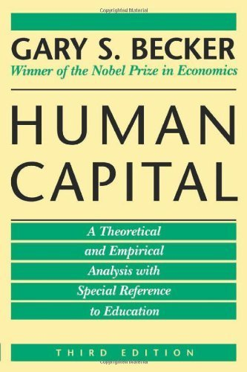

Gary S. Becker - Publications
《Human Capital: A Theoretical and Empirical Analysis , with special reference to education》(1994)
《A Treatise on the Family》(1993)

Slide 4
HUMAN CAPITAL: EDUCATION AND EARNINGS
Hwei-Lin Chuang, Ph.D.
2014/04/21

Slide 5
EDUCATION: STYLIZED FACTS
Education is strongly correlated with:
Labor force participation rates
Unemployment rates
Earnings

Slide 6
1. EDUCATION IN THE LABOR MARKET: SOME STYLIZED FACTS
表一 勞動參與率與教育程度
單位：%
教育程度 | 80年 | 85年 | 90年 | 95年 | 96年 | 97年 | 98年 | 99年 | 100年 | 101年 | 102年
國中及以下 | 56.22 | 52.69 | 48.51 | 44.34 | 43.88 | 42.87 | 41.67 | 41.62 | 41.18 | 41.25 | 41.50
高中（職） | 60.65 | 61.12 | 61.38 | 63.52 | 63.95 | 63.64 | 62.61 | 62.25 | 62.36 | 62.30 | 61.82
大專及以上 | 66.80 | 68.27 | 66.40 | 67.38 | 67.63 | 68.18 | 68.40 | 68.43 | 68.23 | 68.00 | 67.77
表二 就業者與教育程度
單位：%
教育程度 | 80年 | 85年 | 90年 | 95年 | 96年 | 97年 | 98年 | 99年 | 100年 | 101年 | 102年
國中及以下 | 54.26 | 43.60 | 35.36 | 27.40 | 26.13 | 24.61 | 23.27 | 22.50 | 21.59 | 20.88 | 20.30
高中（職） | 29.89 | 34.14 | 35.93 | 35.91 | 35.75 | 35.25 | 34.55 | 34.15 | 34.04 | 33.83 | 33.38
大專及以上 | 15.85 | 22.27 | 28.71 | 36.70 | 38.13 | 40.14 | 42.18 | 43.36 | 44.37 | 45.28 | 46.32

Slide 7
表三 失業率與教育程度
單位：%
教育程度 | 80年 | 85年 | 90年 | 95年 | 96年 | 97年 | 98年 | 99年 | 100年 | 101年 | 102年
國中及以下 | 0.97 | 2.02 | 4.71 | 3.21 | 3.22 | 3.76 | 5.84 | 4.83 | 3.69 | 3.52 | 3.53
高中（職） | 2.16 | 3.00 | 5.12 | 4.36 | 4.31 | 4.34 | 6.19 | 5.58 | 4.66 | 4.22 | 4.11
大專及以上 | 2.04 | 3.13 | 3.72 | 3.98 | 4.00 | 4.21 | 5.57 | 5.12 | 4.51 | 4.58 | 4.50
表四 薪資與教育程度
教育程度 | 91年 | 92年 | 93年 | 94年 | 95年 | 96年 | 97年 | 98年 | 99年 | 100年 | 101年 | 102年
國中及以下 | 26,720 | 26,052 | 26,646 | 27,247 | 27,294 | 27,725 | 28,180 | 25,698 | 26,358 | 26,840 | 27,519 | 27,713
高中（職） | 29,782 | 29,507 | 29,658 | 30,183 | 30,123 | 30,308 | 30,256 | 29,065 | 29,509 | 29,916 | 30,264 | 30,370
專科 | 36,115 | 35,828 | 36,389 | 36,688 | 36,409 | 36,496 | 37,296 | 36,114 | 36,976 | 37,669 | 37,640 | 37,890
大學及以上 | 49,274 | 48,853 | 47,363 | 46,362 | 45,806 | 44,972 | 44,239 | 42,388 | 42,550 | 42,870 | 41,032 | 41,069

Slide 8
102年大專及以上各項人力指標
表五 薪資與教育程度
大專及以上 | 專科 | 大學以上 | 計
勞動參與率 | 74.92 | 64.44 | 67.77
就業者 | 16.48 | 29.84 | 45.60
失業率 | 3.11 | 5.26 | 4.50
薪資 | 37,890 | 41,069 | 35,551
註：大學及研究所合併為大學及以上。

Slide 9
台灣2000大企業最愛大學生調查
2014年2月 Cheers雜誌
長期作為企業與人才之間的橋梁 ，《Cheers》雜誌16年來執行「3000大企業人才策略與最愛大學生」調查 ﹕
調查對象﹕ 2013 年《天下》雜誌 2000 大企業人資主管
有效樣本﹕寄出2,102份問卷，回收812份，回收率38.6％
調查期間﹕2013年12月2日~2013年12月27日
調查執行：《天下》雜誌調查中心 、《Cheers》雜誌編輯部

Slide 10
表1﹕2000大企業最愛大學生總排名
2014年排名 | 學校 | 2013年排名
1 | 成功大學 | 2
2 | 台灣大學 | 1
3 | 交通大學 | 3
4 | 清華大學 | 4
5 | 台灣科大 | 6
6 | 政治大學 | 5
7 | 台北科大 | 8
8 | 淡江大學 | 7
9 | 逢甲大學 | 11
10 | 中山大學 | 9
2014年排名 | 學校 | 2013年排名
11 | 中央大學 | 10
12 | 中原大學 | 13
13 | 輔仁大學 | 12
14 | 中興大學 | 17
15 | 中正大學 | 18
16 | 高雄應用 | 14
17 | 元智大學 | 20
18 | 銘傳大學 | 16
19 | 東吳大學 | 15
20 | 雲林科大 | 23

Slide 11
表2﹕2000大企業最愛私校與技職排名
私校排名 | 整體排名 | 學校名稱
1 | 8 | 淡江大學
2 | 9 | 逢甲大學
3 | 12 | 中原大學
4 | 13 | 輔仁大學
5 | 17 | 元智大學
6 | 18 | 銘傳大學
7 | 19 | 東吳大學
8 | 21 | 文化大學
9 | 23 | 東海大學
10 | 25 | 南台科大
技職排名 | 總排名 | 學校
1 | 5 | 台灣科大
2 | 7 | 台北科大
3 | 16 | 高雄應用
4 | 20 | 雲林科大
5 | 24 | 高雄第一
6 | 25 | 南台科大
7 | 26 | 虎尾科大
8 | 28 | 勤益科大
9 | 29 | 屏東科大
10 | 30 | 高雄餐旅

Slide 12
2014 年「企業最愛大學生」調查 : 態度積極主動，是企業用新人最大關鍵
表3: 6 成 2 企業敘薪因人而異，
而非看畢業學校
表4: 企業看新人，態度是關鍵
問題：公司在新鮮人敘薪上， 是否會以「學校」不同，區分等級敘薪？
沒有將大學區分等級敘薪，完全因人而異 | 62%
將大學區分數個不同等級敘薪，但也會考量因人而異 | 25.7%
將大學區分數個不同等級，做為統一的敘薪標準 | 12.3%
公司在新人試用期間，會以哪些態度指標來評估是否合用？（可複選 3 項）
態度積極主動 | 75.5%
有學習意願 | 49.1%
有抗壓、耐挫的能力 | 39.0%
遵守工作紀律 | 33.0%
具有解決問題能力 | 24.9%
能夠獨立作業，完成指派工作 | 24.5%
願意與人合作 | 23.1%
必要時配合加班、輪班 | 15.5%
能夠承擔責任 | 10.9%
遵守職業道德 | 7.7%
是否誠實 | 6.8%
懂得職場禮儀與穿著規範 | 3.1%
資料來源﹕ http://topic.cheers.com.tw/news/20140211_college.pdf

Slide 13
2014 新世代最嚮往100大企業
2014年3月 Cheers雜誌
《Cheers》雜誌2014年新鮮人最嚮往企業調查﹕
調查對象﹕全台灣148個大學科系應屆畢業生
有效樣本﹕寄出4,885份問卷，回收3,456份 ，回收率70.75%
調查期間﹕2013年12月4日~2014年1月22日
調查方法﹕根據教育部公布101學年度各大專院校的人數與科系分布狀況，採分層比例抽樣法進行郵寄問卷調查
調查執行：《天下》雜誌調查中心
資料來源﹕http://m.cheers.com.tw/article/article.action?id=5056899

Slide 14
王品三連霸！服務業持續升溫、觀光業表現亮眼
服務業持續升溫、觀光業表現亮眼
整體觀察，服務業整體名次逐年向前推進，科技業排名反而集體退潮
「鐵飯碗」光環褪色、國營事業排名倒退
台灣中油、台鐵、台灣菸酒、台灣糖業、中華郵政等過去極為搶手的國營事業，今年排名全數大幅倒退，顯示公職退燒趨勢
新鮮人自信不足
近4成的新鮮人面對職場時，擔心自己「能力不足」，其中又以自認缺乏「國際觀與外語能力」的占最多數
以「知名度」和「廣告」來判斷企業好壞、對企業了解不足

Slide 15
2014年「新世代最嚮往企業Top20」
2014排名 | 企業名稱 | 產業別 | 2013排名
1 | 王品餐飲 | 服務業 | 1
2 | Google | 服務業 | 5
3 | 台灣積體電路 | 製造業 | 7
4 | 長榮航空 | 服務業 | 8
5 | 誠品 | 服務業 | 3
6 | 中華航空 | 服務業 | 10
7 | 統一企業 | 製造業 | 2
8 | 台灣無印良品 | 服務業 | 9
9 | 統一星巴克 | 服務業 | 6
10 | 台灣銀行 | 金融業 | 11
2014排名 | 企業名稱 | 產業別 | 2013排名
11 | 中華電信 | 服務業 | 4
12 | 宜家家居（IKEA） | 服務業 | 15
13 | W飯店 | 服務業 | -
14 | 中國鋼鐵 | 製造業 | 12
15 | 台灣微軟 | 服務業 | 21
16 | 台灣高速鐵路 | 服務業 | 14
17 | 鴻海精密 | 製造業 | 13
18 | 天下雜誌 | 服務業 | 16
18 | 華碩電腦 | 服務業 | 18
20 | 雄獅旅行社 | 服務業 | 19

Slide 16
Introduction
People bring into the labor market a unique set of abilities and acquired skills known as human capital.
Workers add to their stock of human capital throughout their lives, especially via job experience and education.

Slide 17
Human Capital: Education and Earnings
Wages will vary among workers because workers are different. We each bring into the labor market a unique set of abilities and acquired skills, or human capital.
We begin our study of human capital by focusing on the decision to acquire formal education. The skills we acquire in school make up an increasingly important component of our stock of knowledge.

Slide 18
2. The Schooling Model
What factors motivates some workers to remain in school while other workers dropout before they finish high school? We assume that workers acquire the skill level that maximizes the present value of lifetime earnings.

Slide 19
2. The Schooling Model
Real earnings (earnings adjusted for inflation).
Age-earnings profile: the wage profile over a worker’s lifespan.
The higher the discount rate, the less likely someone will invest in education (since they are less future oriented).
The discount rate depends on:
the market rate of interest.
time preferences: how a person feels about giving up today’s consumption in return for future rewards.

Slide 20
(1) PRESENT VALUE CALCULATIONS
Present value allows comparison of dollar amounts spent and received in different time periods. (An idea from finance.)
Present Value = PV = y/(1+r)^{t}
r is the per-period discount rate.
y is the future value.
t is the number of time periods.

Slide 21
The present value of the earnings stream if the worker only gets a high school education is:
(1)
The parameter r is the worker’s rate of discount. There are 47 terms in this sum, one for each year that elapses between the ages of 18 and 64.

Slide 22
The present value of the earnings stream if the worker gets a college diploma is:
Direct Costs of Attending College
Post-College Earnings Stream
(2)
The first four terms in this sum give the present value of the direct costs of a college education, while the remaining 43 terms give the present value of lifetime earnings in the post-college period.

Slide 23
We assume that a person’s schooling decision maximizes the present value of lifetime earnings. Therefore, the worker attends college if the present value of lifetime earnings when he gets a college education exceeds the present value of lifetime earnings when he gets only a high school diploma, or:
Dollars
(3)
w_{COL}
Goes to College
w_{HS}
Quits after High School
Age
18
22
65
-H
FIGURE 1 Earning Streams Faced by a High School Graduate

Slide 24
(2) The Wage-Schooling Locus
The salaries firms are willing to pay workers depends on the level of schooling.
Properties of the wage-schooling locus.
The wage-schooling locus is upward sloping.
The slope of the wage-schooling locus indicates the increase in earnings associated with an additional year of education.
The wage-schooling locus is concave, reflecting diminishing returns to schooling.

Slide 25
(2) The Wage-Schooling Locus
The wage-schooling locus gives the salary that a particular worker would earn if he completed a particular level of schooling. If the worker graduates from high school, he earns $20,000 annually. If he goes to college for 1 year, he earns $23,000. And so on.
Dollars
30,000
25,000
23,000
20,000
0
12
13
14
18
Years of Schooling

Slide 26
Defn. The Marginal Rate of Return to Schooling
The percentage change in earnings resulting from one more year of school is defined to be the marginal rate of return to schooling.

Slide 27
(3) The Stopping Rule, or When Should I Quit School?
Suppose that the worker has a rate of discount r that is constant; that is, it is independent of how much schooling the worker gets. The stopping rule that maximizes the worker’s present value of earnings over the life cycle is given by:
Quit school when the marginal rate of return to schooling = r

Slide 28
This stopping rule maximizes the worker’s present value of earnings over the life cycle.
Rate of interest
r’
r
MRR
s’
s*
Years of Schooling
FIGURE 3 The Schooling Decision

Slide 29
Schooling and Earnings When Workers Have Different Rates of Discount
Rate of Interest
Dollars
w_{HS}
P_{BO}
r_{AL}
w_{DROP}
P_{AL}
r_{BO}
MRR
11
12
Years of Schooling
11
12
Years of Schooling

Slide 30
Schooling and Earnings When Workers Have Different Abilities
Rate of Interest
Dollars
Z
w_{HS}
Bob
w_{ACE}
Ace
w_{DROP}
P_{ACE}
r
MRR_{BOB}
MRR_{ACE}
11
12
Years of Schooling
11
12
Years of Schooling
Ace and Bob have the same discount rate (r) but each worker faces a different wage-schooling locus. Ace drops out of high school and Bob gets a high school diploma. The wage differential between Bob and Ace (w_{HS} - w_{DROP}) arises both because Bob goes to school for one more year and because Bob is more able. As a result, this wage differential does not tells us by how much Ace’s earnings would increase if he were to complete high school (w_{ACE} - w_{DROP}).

Slide 31
3. Is Education a Good Investment?
(1) Is Education a Good Investment for Individuals?
The rate of return typically estimated for the U.S. generally fall in the range of 5-15 percent.
At first glance, an investment in education is about as good as an investment in stocks, bonds, or real estate.

Slide 32
EDUCATION AND THE WAGE GAP
Observed data on earnings and schooling does not allow us to estimate returns to schooling.
In theory, a more able person gets more from an additional year of education.
Ability bias: The extent to which unobserved ability differences exist affects estimates on returns to schooling, since the ability difference may be the true source of the wage differential.

Slide 33
Estimating the Rate of Return to Schooling
A typical empirical study estimates a regression of the form:
Log(w) = a·s + other variables
w is the wage rate
s is the years of schooling
a is the coefficient that estimates the rate of return to an additional year of schooling

Slide 34
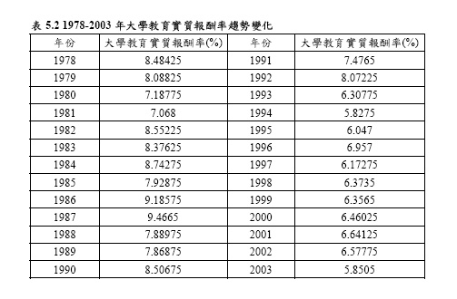
資料來源：中央產經論文-台灣地區大學教育報酬率時間變化之分析 (邱麗芳)

Slide 35
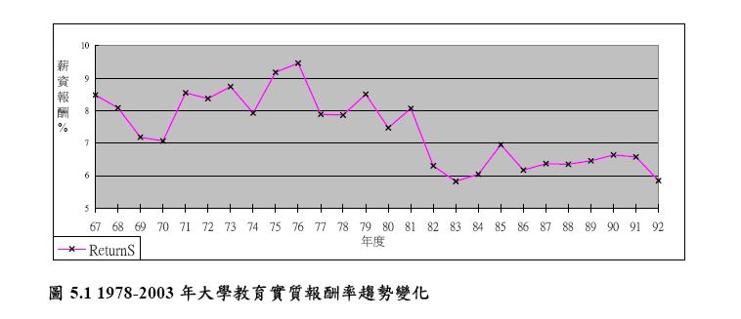
資料來源：中央產經論文-台灣地區大學教育報酬率時間變化之分析 (邱麗芳)

Slide 36
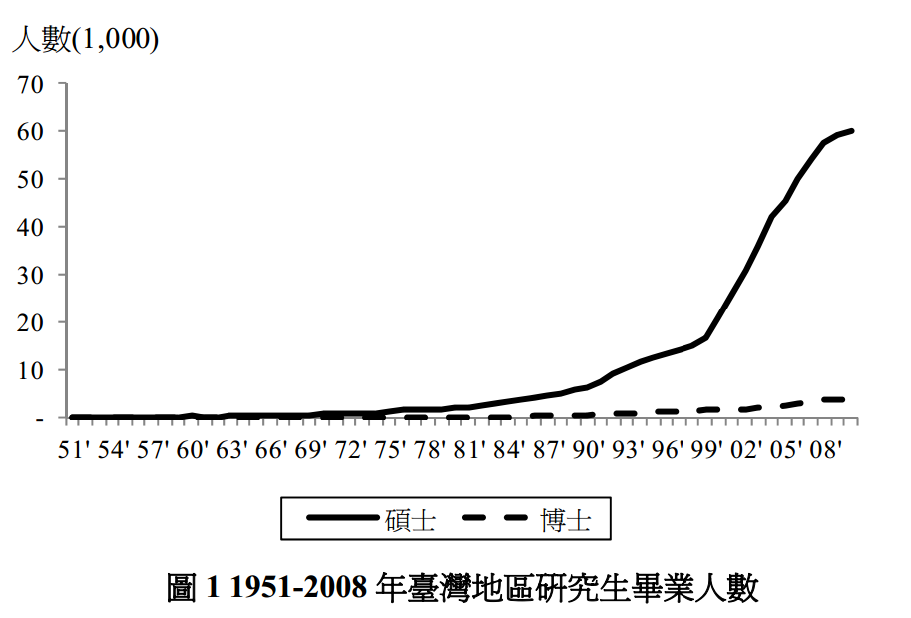
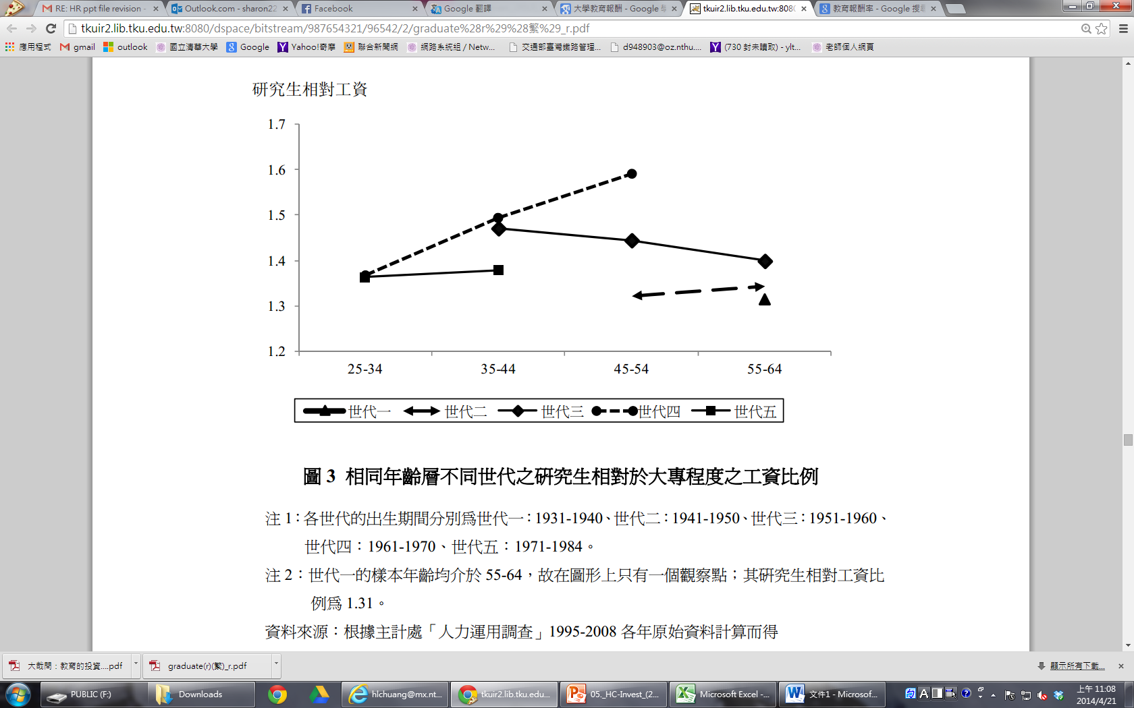
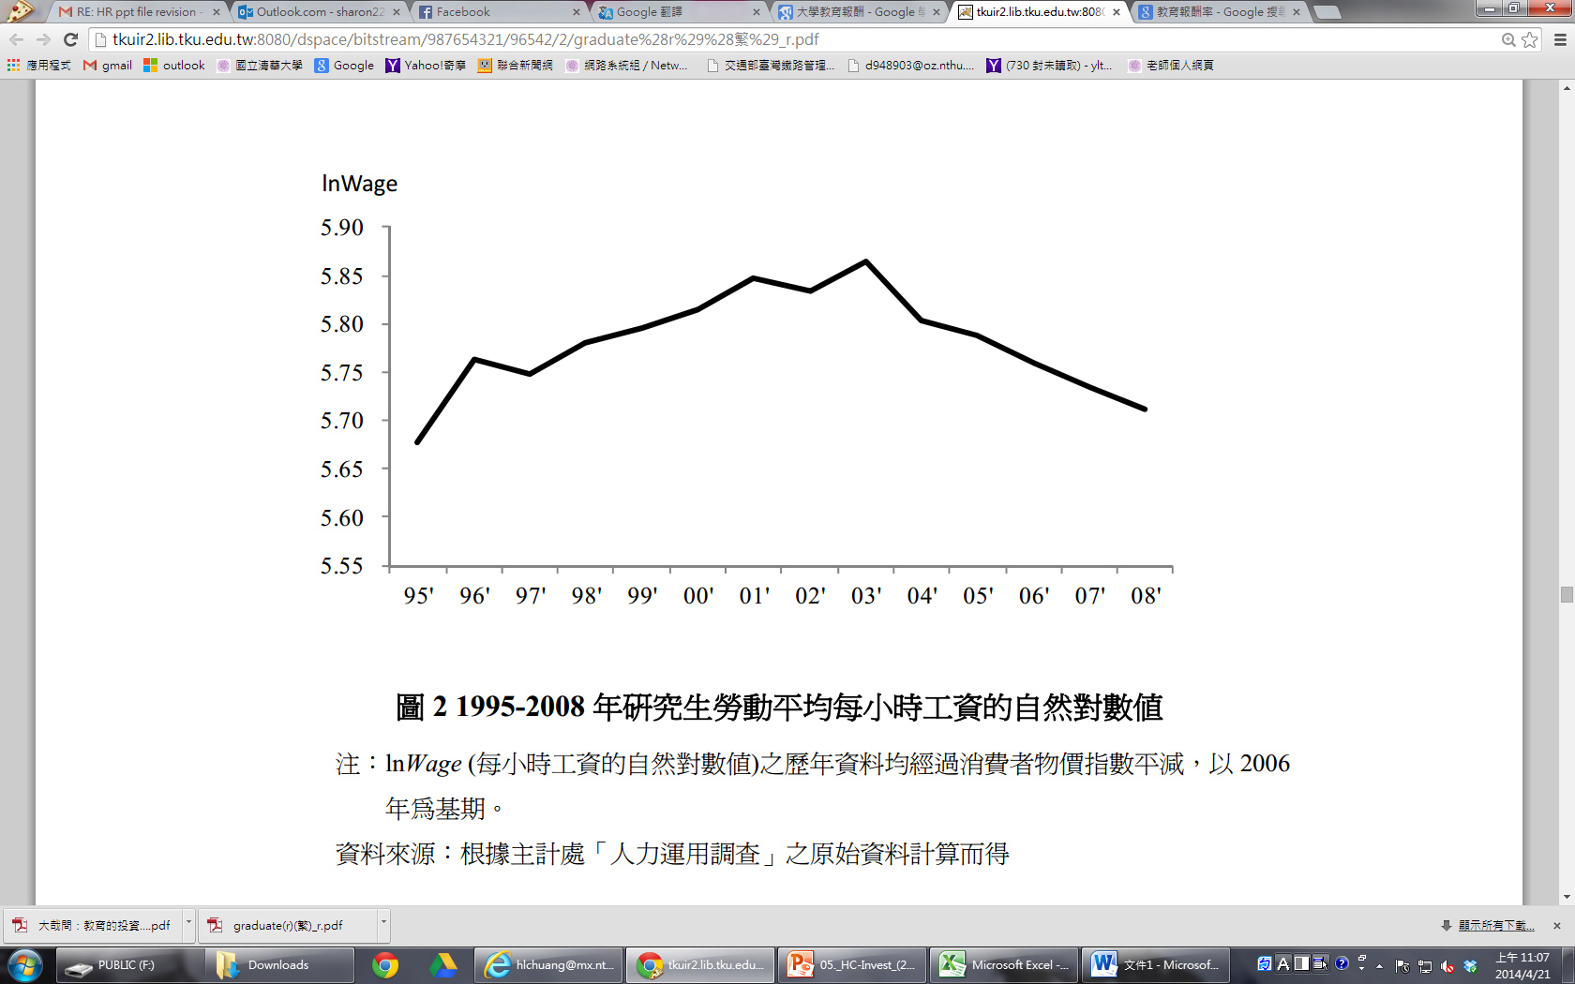
資料來源：研究所的教育擴張、教育報酬與薪資不均度:臺灣的實證研究(陳文怡、江莉莉)

Slide 37
A. The Upward Bias
The typical estimates of the rate of return on further schooling overstate the gain an individual student could obtain by investing in education because they are unable to separate the contribution that ability makes to higher earnings from the contribution made by schooling.
i.e., Some of the added earnings college graduates typically receive would probably be received by an equally able high school graduates who did not attend college.

Slide 38
Methods to correct this bias:
Separating effects of ability and schooling by including the aptitude-test scores such as IQ.
Controlling for all the unmeasured aspects of ability by using data on twins.
Part of earnings differentials associated with higher levels of schooling are due to inherently abler persons obtaining more schooling.

Slide 39
B. The Downward Bias
Some benefits of college attendance are not necessarily reflected in higher productivity.
Most rate-of-return studies fail to include fringe benefits.
Fringe benefits, usually as a fraction of total compensation, tend to rise as money earnings rise.
Some of the job-related rewards of college are captured in the form of psychic or nonmonetary benefits.

Slide 40
C. Selection Bias
The measured rate of return on a college education may understate the actual return for those who choose to attend college. Likewise, the measured rate of return may overstate the return that would have been received by those terminating schooling with higher school had they instead chosen to attend college.

Slide 41
Measured benefit B_{t}:
: the earnings in a college-level job of those who
choose to go to college.
: the earning in a high school-level job of those who
choose not to go to college.
Let : the earnings in a high school-level job of those
who choose to attend college terminating
schooling at high school.
is perhaps less than

Slide 42
:the earnings in a college-level job of those
who choose not to attend college were to
alter their decisions.
is perhaps less than
→When abilities are diverse, the principle of comparative
advantage is an important factor in making choices
about schooling and occupations.

Slide 43
SCHOOL QUALITY AND THE RATE OF RETURN TO SCHOOLING
Source: David Card and Alan B. Krueger, “Does School Quality Matter? Returns to Education and the Characteristics of Public Schools in the United States,” Journal of Political Economy 100 (February 1992), Tables 1 and 2. The data in the graphs refer to the rate of return to school and the school quality variables for the cohort of persons born in 1920-1929.

Slide 44
女性商學大學畢業生金融證照持有與初期職涯表現之關係
台灣高等教育資料庫「94 學年度大專畢業生問卷調查」與「94 學年度大專畢業後一年問卷調查」資料顯示：
1.私立大學畢業生在金融證照持有的「量」與「種類」上都最多；但在至少持有1 張金融證照的機率上，公立大學畢業生則有顯著較高的機率；
（註：畢業一年後的狀態稱為「初期職涯狀態」）
資料來源：女性商學大學畢業生金融證照持有與初期職涯表現之關係（陶宏麟、蕭富方）

Slide 45
女性商學大學畢業生金融證照持有與初期職涯表現之關係
2.商學大學畢業生金融證照持有數量越多，失業機率越低，全職就業機率越高，但並未對應較低的升學機率。以持有的種類看，持有銀行或保險類證照，才對應低失業率與高全職就業率；
3.在對薪資的影響上，金融證照持有的量對薪資無顯著關聯，但若在金融保險業服務則有顯著正向關聯；在持有的種類上，銀行或保險類證照才與金融保險業服務的薪資有顯著正向關聯。
資料來源：女性商學大學畢業生金融證照持有與初期職涯表現之關係（陶宏麟、蕭富方）

Slide 46
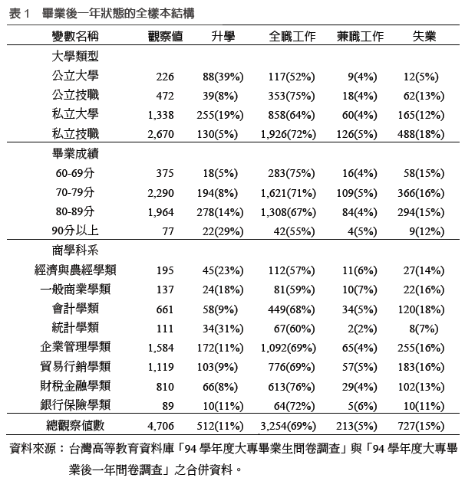
女性商學畢業生金融證照與初期職涯表現 －樣本結構(一)
資料來源：女性商學大學畢業生金融證照持有與初期職涯表現之關係（陶宏麟、蕭富方）

Slide 47
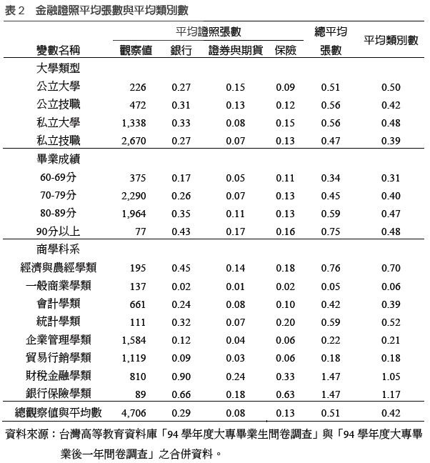
女性商學畢業生金融證照與初期職涯表現 －樣本結構(二)
資料來源：女性商學大學畢業生金融證照持有與初期職涯表現之關係（陶宏麟、蕭富方）

Slide 48
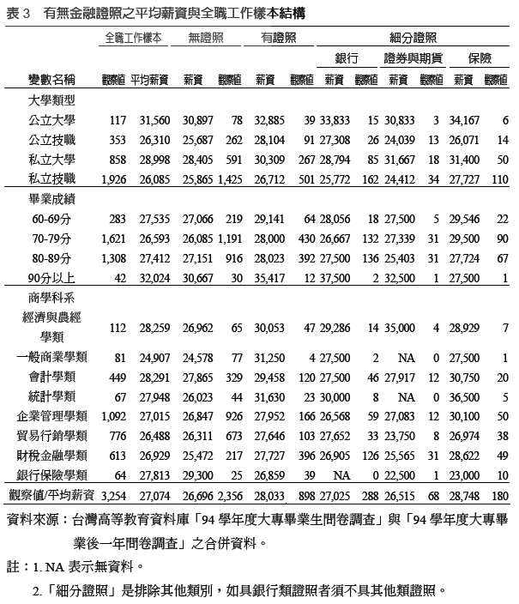
女性商學畢業生金融證照與初期職涯表現 －樣本結構(三)
資料來源：女性商學大學畢業生金融證照持有與初期職涯表現之關係（陶宏麟、蕭富方）

Slide 49
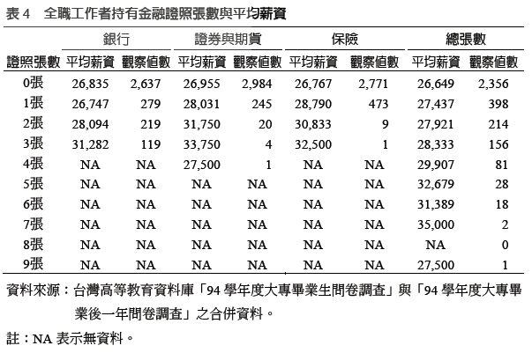
女性商學畢業生金融證照與初期職涯表現 －樣本結構(四)
資料來源：女性商學大學畢業生金融證照持有與初期職涯表現之關係（陶宏麟、蕭富方）

Slide 50
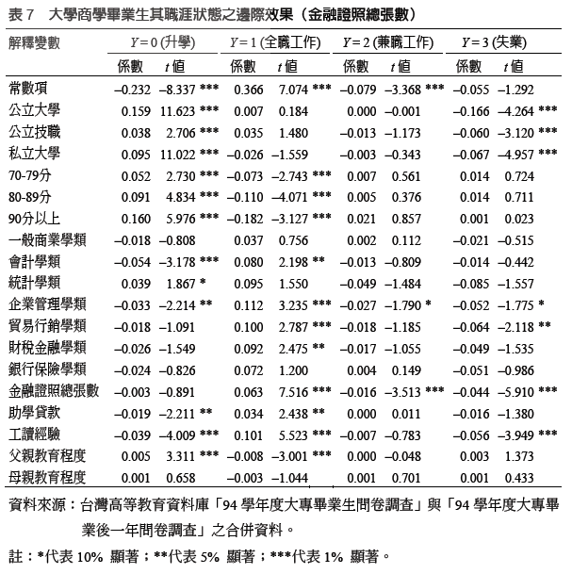
金融證照與初期職涯狀態的關聯(實證I)
資料來源：女性商學大學畢業生金融證照持有與初期職涯表現之關係（陶宏麟、蕭富方）

Slide 51

金融證照與初期職涯狀態的關聯(實證I)

Slide 52
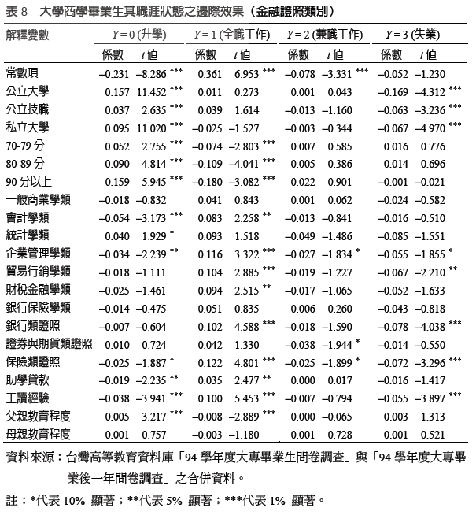
金融證照與初期職涯狀態的關聯(實證II)
資料來源：女性商學大學畢業生金融證照持有與初期職涯表現之關係（陶宏麟、蕭富方）

Slide 53

金融證照與初期職涯狀態的關聯(實證II)

Slide 54
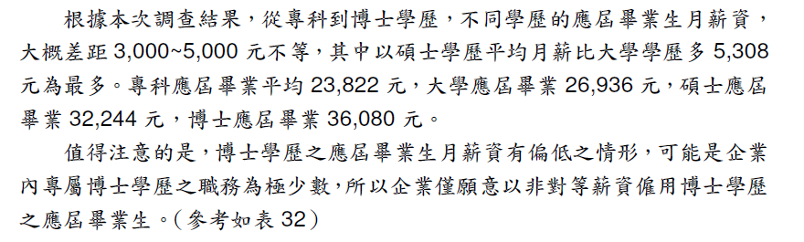
98年大專應屆畢業青年平均薪資
資料來源：行政院青年輔導委員會-98年大專青年就業力現況調查報告

Slide 55
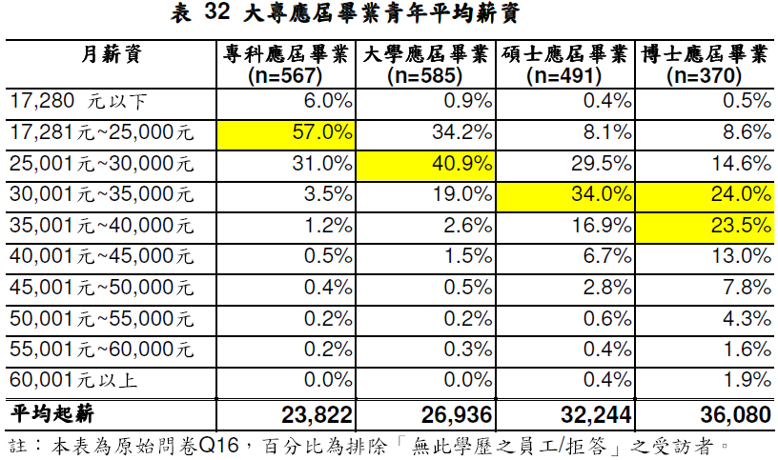
98年大專應屆畢業青年平均薪資
資料來源：行政院青年輔導委員會-98年大專青年就業力現況調查報告

Slide 56
當前青年就業－就／失業情形
依據行政院主計處人力資源統計，將青年就業及失業等數據分析如下：
（一） 青年勞動力參與率偏低
（二）青年就業者以大專及以上教育程度者為最多98年青年就業者為224萬4千人
（三）青年就業者以行職業及從業身分區分，以服務業、生產有關工人機械設備操作工及體力工、受僱者為主
（四）青年失業率較全體平均失業率偏高
（五）青年失業者以大專及以上程度者為最多
（六）青年失業原因以非初次尋職者較多，但失業週數較全體平均週數為少
（七）青年長期失業者亦以大專以上程度者為主
資料來源：協助青年就業接軌方案（行政院青年輔導委員會）

Slide 57
當前青年就業－原因分析
青年失業率高於全體平均失業率，大專及以上平均失業率亦高於全體平均失業率，青年就業顯得更不容易，其主要原因如下：
（一）大學學歷青年人力供給量增加
（二）青年人力供給與產業人力需求之間有落差
（三）青年對自己的職涯規劃可更加積極，公立就業服務機構及學校職涯輔導等資源尚待加強運用
（四）長期失業青年的自信心喪失更難找到工作
資料來源：協助青年就業接軌方案（行政院青年輔導委員會）

Slide 58
現行促進青年就業政策－具體方案
（一）「在學校教育中提升青年就業力」面向，將「就業力」列為大學培育人才的使命之一：職涯探索、講座， RICH職場體驗資訊網及辦理暑期社區工讀
（二）「協助初入職場青年順利與職場接軌，並提供有利的學習與發展環璄」面向：青年職場體驗計畫，「高中職創業體驗營」
（三）「協助有高度就業困難青年積極就業」面向，有「 97-98年國中畢業未升學未就業青少年職能培訓輔導試辦計畫」
（四）「促進青年公平就業機會」面向 ：女性、身障者、原住民
資料來源：協助青年就業接軌方案（行政院青年輔導委員會）

Slide 59
現行促進青年就業政策－成效
從以上四大面向執行成效來看，該方案已具初步成效，惟其中量化指標「2009年達成15至24歲青年平均失業率減少為10%以內；2015年內達成15至24歲青年平均失業率在全體平均失業率2倍以內」經三年來各相關部會努力執行下，因於97年下半年至98年上半年之間遇上全球金融海嘯，經濟景氣低迷，全體平均失業率96年為3.91%、97年為4.14%、98年卻飆升為5.85%。其中15至24歲青年失業率分別為10.65%、10 、11.81%及14.49%，未能達成減少至10%之目標值；但從15至24歲青年失業率與全體平均失業率之倍數計算，近三年來分別為2.72倍、2.85倍及2.48倍，尤其是98年倍數尤低，其原因為中高年齡失業更趨嚴重，相對地青年失業有減緩趨勢。
資料來源：協助青年就業接軌方案（行政院青年輔導委員會）

Slide 60
現行促進青年就業政策－檢討
（一）提供青年各種職場體驗的方案受限於預算及相關單位的配合意願，受惠人數有限，未來如能配套研擬獎勵企業措施，提高企業提供實務學習機會的意願，並透過教育體系向下扎根全面推動，將更有助於青年與職場接軌。
（二）目前推動各大學校院全面建置「系科職涯進路與課程學習地圖」及「生涯歷程檔案」係以補助方式鼓勵辦理，致仍有部分大專校院尚未建置，建議納入評鑑指標，要求分年建置完成，以改善學用不相符現象。
（三）「國軍屆退官兵就業服務」辦理多年，對於提供官兵就業機會資訊，轉銜進入職場具相當成效；惟目前服役期間已調整，國軍編制亦精簡，故本計畫未來應配合募兵制調整轉型。
（四）「97-98年國中畢業未升學未就業青少年職能培訓輔導試辦計畫」由公部門與非營利組織合作，積極建立對於未升學未就業青少年輔導機制。由於培訓期間較長，故個人平均成本高，較難擴大規模辦理。本計畫對於協助青少年有實質成效，未來應持續編列公務預算執行。
資料來源：協助青年就業接軌方案（行政院青年輔導委員會）

Slide 61
(2) Is Education a Good Social Investment?
Some critics have suggested that to a large degree, education acts merely as a “sorting device”.
→Schooling does nothing to alter productive characteristics. The education is simply as a filter that has the effect of “signaling” which people are likely to be most productive.
Note: Even if schooling were only a screening device, it could have social value. Employers need a reliable method by which to select employees. Investment in schooling sends a signal to the labor market that one has a certain level of ability.

Slide 62
→School would have net social value if the decision to attend and the success one attained in school sent accurate signals about productive characteristics to employers in the least costly way.
Either education does enhance worker productivity or it is a cheaper screening tool than any other that firms could use. In either case, the fact that employers are willing to pay a high price for an educated work force seems to suggest that education produces social benefits.

Slide 63
Schooling as a Signal
Education reveals a level of attainment which signals a worker’s qualifications or innate ability to potential employers.
Information that is used to allocate workers in the labor market is called a signal.
There could be a “separating equilibrium.”
Low-productivity workers choose not to obtain X years of education, voluntarily signaling their low productivity.
High-productivity workers choose to get at least X years of schooling and separate themselves from the pack.

Slide 64
Education as a Signal
Dollars
Dollars
Costs
300,000
300,000
Costs
250,001 y⁻
200,000
Slope = 25,000
200,000
20,000 y⁻
Slope = 20,000
0
y⁻
Years of Schooling
0
y⁻
Years of Schooling
(a) Low-Productivity Workers
(b) High-Productivity Workers
Workers get paid $200,000 if they get less than y⁻ years of college, and $300,000 if they get at least y⁻ years. Low-productivity workers find it expensive to invest in college, and will not get y⁻ years. High-productivity workers do obtain y⁻ years. As a result, the worker’s education signals if he is a low-productivity or a high-productivity worker.

Slide 65
EDUCATION AS A SIGNAL
The low-productivity worker will not attend college if
(6-16)
Solving for implies that
(6-17)
The high-productivity workers get years of college whenever
(6-18)
Solving for yields
(6-19)

Slide 66
Implications of Schooling as a Signal
Education is more than a signal, it alters the stock of human capital.
Social return to schooling (percentage increase in national income) is likely to be positive even if a particular worker’s human capital is not increased.

Slide 67
4. Post-School Human Capital Investments
Some important properties of age-earnings profiles:
Highly educated workers earn more than less educated workers.
Earnings rise over time at a decreasing rate.
The age-earnings profiles of different education cohorts diverge over time (they “fan outwards”).
Earnings increase faster for more educated workers.

Slide 68
Age-Earnings Profiles

Slide 69
Age-Earnings Profiles

Slide 70
On-The-Job Training
Most workers augment their human capital stock through on-the-job training (OJT) after completing education investments.
Two types of OJT:
General: training that is useful at all firms once it is acquired.
Specific: training that is useful only at the firm where it is acquired.

Slide 71
Implications
Firms only provide general training if they do not pay the costs.
In order for the firm to willingly pay some of the costs of specific training, the firm must share in the returns to specific training. Engaging in specific training eliminates the possibility of the worker separating from the job in the post-training period.

Slide 72
The Acquisition of Human Capital Over the Life Cycle
The marginal revenue of an efficiency unit of human capital declines as the worker ages (so that MR₂₀, the marginal revenue of a unit acquired at age 20, lies above MR₃₀). At each age, the worker equates the marginal revenue with the marginal cost, so that more units are acquired when the worker is younger.
Dollars
MC
MR₂₀
MR₃₀
0
Q₃₀
Q₂₀
Efficiency Units

Slide 73
AGE-EARNINGS PROFILES AND OJT
Human capital investments are more profitable the earlier they are taken.
The Mincer earnings function:
Log(w) = a·s + b·t – c·t² + other variables.
The “overtaking age” is t* and indicates the time when the worker slows down acquisition of human capital to collect the return on prior investments so as to “overtake” earnings of those that did not undertake similar investments.

Slide 74
THE AGE-EARNINGS PROFILE IMPLIED BY HUMAN CAPITAL THEORY
The age-earnings profile is upward-sloping and concave. Older workers earn more because they invest less in human capital and because they are collecting the returns from earlier investments. The rate of growth of earnings slows down over time because workers accumulate less human capital as they get older.
Dollars
Age-Earnings Profile
Age

