Slide 1
04
OTHERS

Slide 2
TIMELINE OF THE OBJECTS
Wizard Chess
Invisibility Cloak
Revealer
Sorting Hat
1
2
3
4

Slide 3
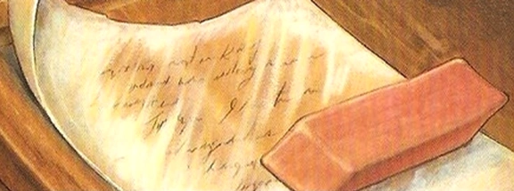
Revealer

Slide 4
Revealer
Its use
History
A magical device used to render invisible writing visible.
Hermione once brought a revealer in the diagon alley to inspect the information in Tom Riddle’s diary.

Slide 5
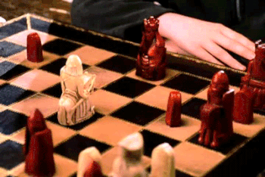
Wizard Chess

Slide 6
Wizard Chess
Its use
History
Exactly the muggle chess except all the characters are alive.
Act as a security for the philosopher’s stone.

Slide 7
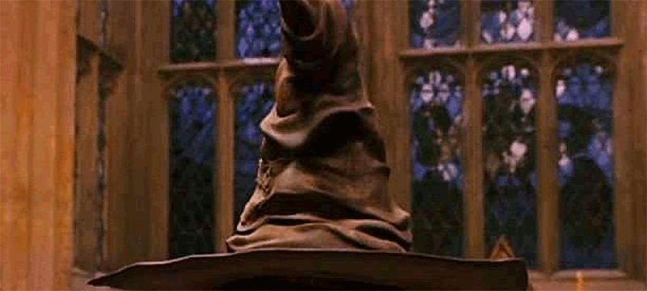
Sorting Hat

Slide 8
Sorting Hat
Its use
History
A sentient hat at Hogwarts that determines which of the four Houses each new student belongs most to.
Originally belongs to Godric Gryffindor.

Slide 9

Invisibility Cloak

Slide 10
Invisibility Cloak
Its use
History
magical garment which renders whomever or whatever it covers invisible.
One of the Deathly Hallows.

Slide 11
THANKS!!!

