Slide 1
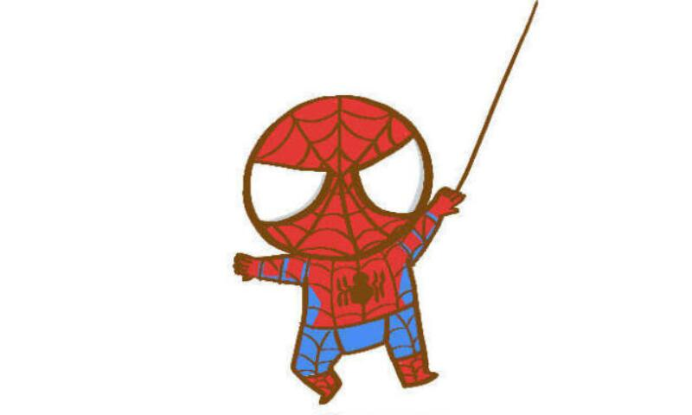

Spider report by Linda

Slide 2
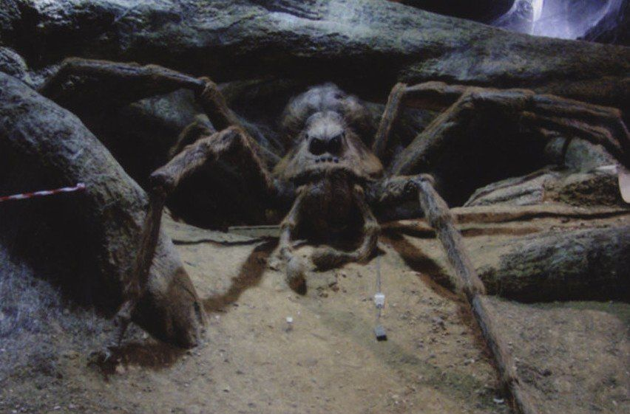
spider in Harry Potter
Aragog

Slide 3
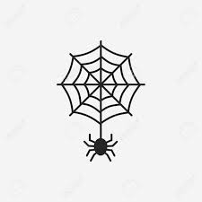
symbol of spider
creativity
aggressive
center of the world

Slide 4
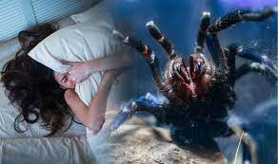
Spider in dreams
fear
lock
need to take some time out for cleaning

Slide 5

In Hopi mythology
Spider Grandmother
A folklore of Native Southwestern American
It’s the biggest planet of them all
shape of common woman or a spider
help people in human shape
spider Grandmother is seen as a leader a wise individual who represents good things.
VENUS

Slide 6
thank you for your listening ~

