Slide 1
Nonlinear Optics
What are nonlinear-optical effects and why do they occur?
Maxwell's equations in a medium
Nonlinear-optical media
Second-harmonic generation
Sum- and difference frequency generation
Conservation laws for photons (Phase-matching)
Induced gratings
Phase conjugation and aberration cancellation
Holography
Self-phase modulation
Thanks to Prof. Rick Trebino
Notes:
www.physics.gatech.edu/frog/lectures

Slide 2
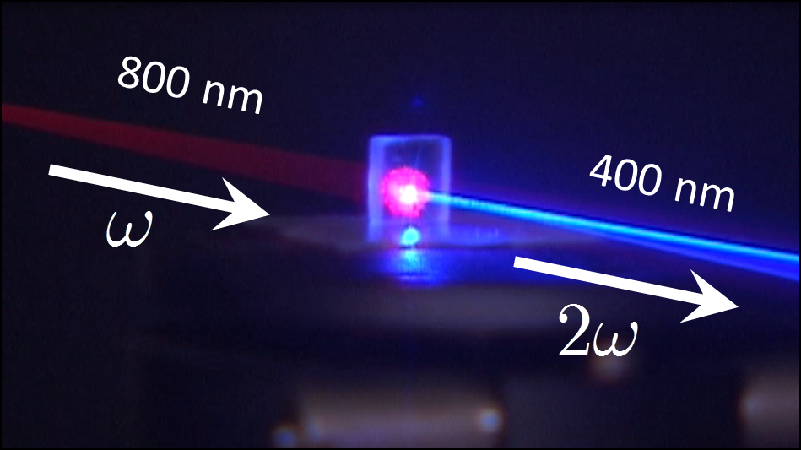
Nonlinear optics is responsible for many exotic effects.
Sending infrared light into a crystal yielded this display of blue light:
Nonlinear optics allows us to change the color of a light beam, to change its shape in space and time, to switch telecommunications systems, and to create the shortest events ever made by Man.
http://www.vincentkemlin.website/?page_id=140
Notes:
Photo taken by Rick Trebino.

Slide 3
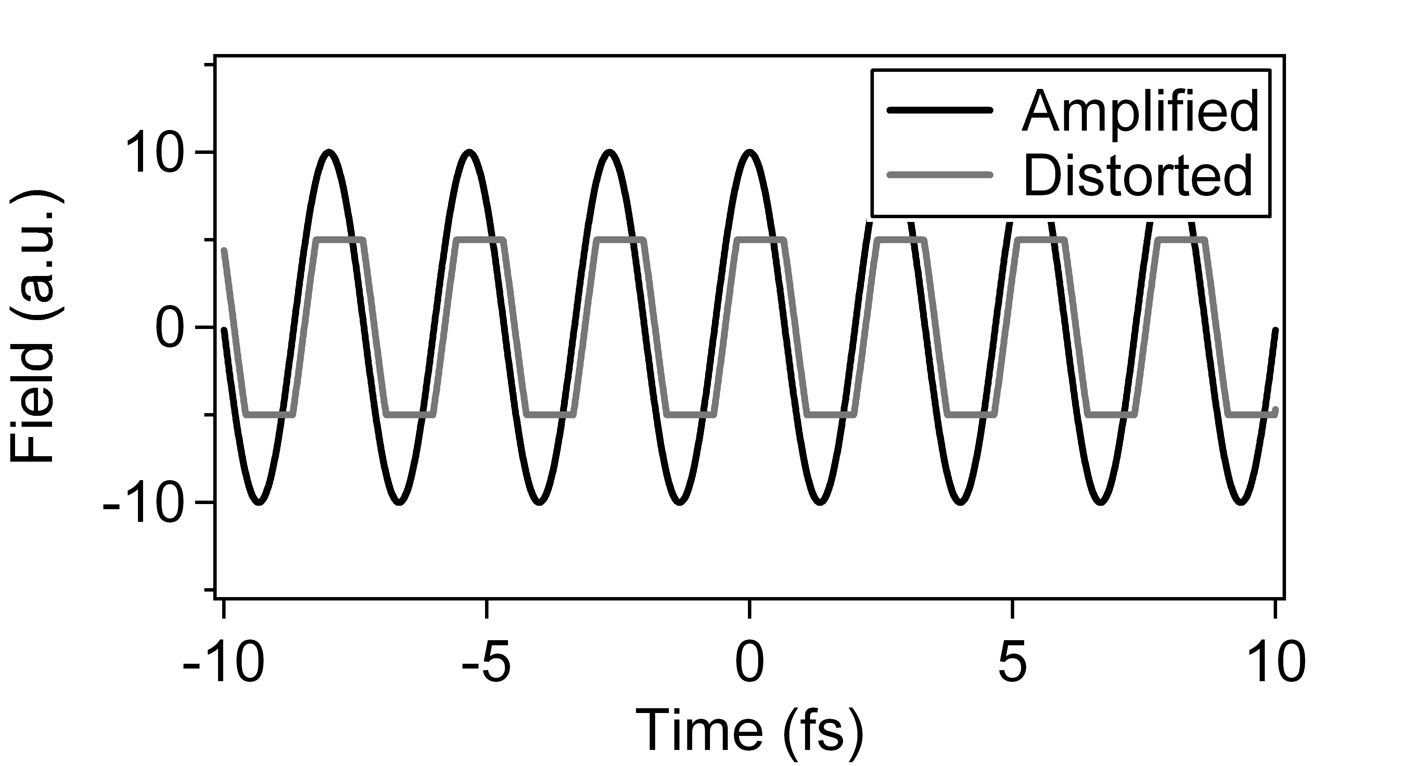
Why do nonlinear effects occur, in general?
Imagine playing music through a cheap amplifier that just can’t quite put out the power necessary to hit the loud notes.
The sharp edges correspond to higher frequencies—harmonics!
Notes:
R. Trebino, FROG book.

Slide 4
Nonlinear Effects in Atoms and Molecules
Potential due to nucleus
Energy
The potential gets very flat out at infinity, so the electron’s motion can easily go nonlinear!
Nucleus
Position
So an electron’s motion will also depart from a sine wave.

Slide 5
The first Nonlinear Optics
Second Harmonic Generation
  P.A. Franken et al, PRL 7, 118 (1961); Armstrong et al., PRA 127, 1918 (1962)
Ruby laser
347nm
Lens
694nm
Quartz crystal
Prism
Photographic plate
E_{Pump}(t)
d(t) electric dipole moment
E_{P}(ω)=E₀^{iωt}
d(ω)=a₁e^{iωt} + a₂e^{i2ωt} +…
Log intensity
t
Frequency
Notes:
We generate EUV light by focusing a femtosecond laser beam into a a gas that is contained either in a gas jet or inside a hollow fiber. the nonlinear interaction between the light field and the atoms in the gas is so strong that very high harmonics of the fundamental laser are observed. These harmonics extend well into the XUV region the spectrum and if you do things right, they are emitted as a coherent, low divergence x-ray beam. The process is very similar to what is happening in this laser pointer…..

Slide 6
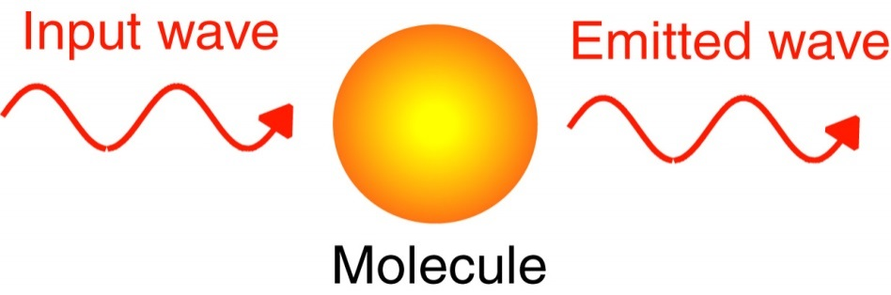
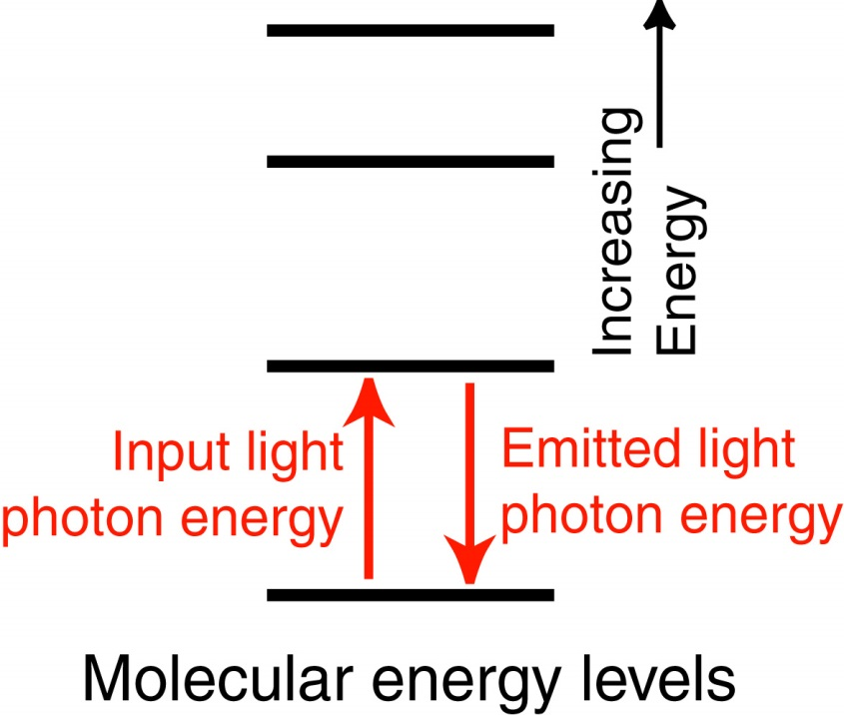
Why do nonlinear-optical effects occur?
Recall that, in normal linear optics, a light wave acts on a molecule, which vibrates and then emits its own light wave that interferes with the original light wave.
We can also imagine this
process in terms of the
molecular energy levels,
using arrows for the
photon energies:

Slide 7
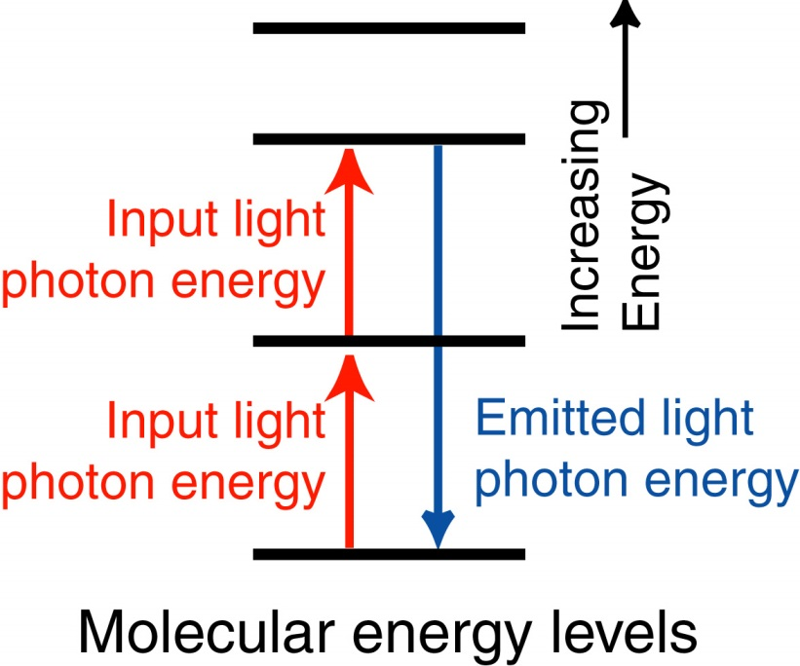
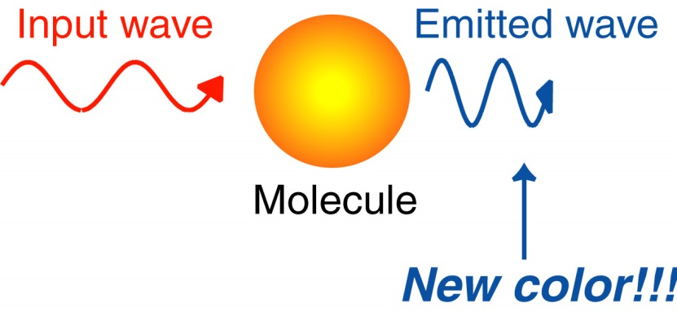
Why do nonlinear-optical effects occur?
Now, suppose the irradiance is high enough that many molecules are excited to the higher-energy state. This state can then act as the lower level for additional excitation. This yields vibrations at all frequencies corresponding to all energy differences between populated states.

Slide 8
Maxwell's Equations in a Medium
The induced polarization, P , contains the effect of the medium:
The polarization is proportional to the field:
This has the effect of simply changing the dielectric constant:

Slide 9
The effect of an induced polarization on a wave requires solving Maxwell’s Equations.
The induced polarization in Maxwell’s Equations yields another term in the wave equation:
As we’ve learned, this is the Inhomogeneous Wave Equation.
The polarization is the driving term for a new solution to this equation.

Slide 10
Maxwell's Equations in a Nonlinear Medium
Nonlinear optics is what happens when the polarization is the result
of higher-order (nonlinear!) terms in the field:
What are the effects of such nonlinear terms?
Consider the second-order term:
2ω = 2nd harmonic!
Harmonic generation is one of many exotic effects that can arise!
Notes:
Photo by Rick Trebino

Slide 11
Sum- and Difference-Frequency Generation
Suppose there are two different-color beams present:
So:
2nd-harmonic gen
2nd-harmonic gen
Sum-freq gen
Diff-freq gen
dc rectification
Note also that, when ω_{i} is negative inside the exp, the E in front has a *.

Slide 12
Complicated nonlinear-optical effects can occur.
Nonlinear-optical processes are often referred to as:
N-wave-mixing processes
where N is the number of photons involved (including the emitted one). This is a six-wave-mixing process.
ω₃
ω₄
ω₅
ω₂
ω₁
ω_{sig}
Emitted-light
frequency
Dashed lines are “virtual levels.”
Arrows pointing upward correspond to absorbed photons and contribute a factor of their field, E_{i}. Arrows pointing downward correspond to emitted photons and contribute a factor the complex conjugate of their field:

Slide 13
Conservation of Energy for Photons in Nonlinear Optics
Adding the frequencies:
ω₃
ω₄
ω₅
ω₂
If we multiply both sides by ħ:
ω₁
ω_{sig}
It’s the same as energy conservation for photons.

Slide 14
Conservation of Momentum for Photons in Nonlinear Optics
Recall that a light wave propagates in
space and so has a spatial dependence also:
So we must also add the k’s:
y
which is the same as momentum conser-vation if we multiply both sides by ħ:
x
Conserving both energy and momentum is called phase-matching.

Slide 15


Slide 16
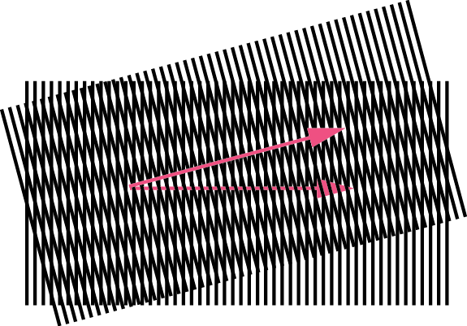

Slide 17
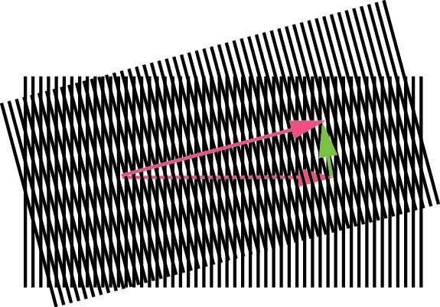

Slide 18
Conservation Laws for Photons in SHG
Energy must be conserved:
ω₁
ω_{sig}
Energy
ω₁
Momentum must also be conserved:
where:
To simultaneously conserve energy and momentum:
The phase-matching condition for SHG.

Slide 19
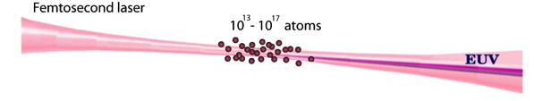
The macroscopic phase-matching problem
10¹³–10¹⁷ atoms
Driving laser field
Harmonics
V_{Laser}=V_{X-ray}= c

Slide 20
The macroscopic phase-matching problem
10¹³–10¹⁷ atoms
Driving laser field
V_{Laser} > C
Harmonics
V_{X-ray} = C

Slide 21
Phase-Matching Second-Harmonic Generation
The phase-matching condition for SHG:
Unfortunately, dispersion (the property of materials to have a refractive index that varies with frequency) prevents this from ever happening.
Refractive
index
Frequency

Slide 22
First Demonstration of Second-Harmonic Generation
P.A. Franken, et al, Physical Review Letters 7, p. 118 (1961)
The second-harmonic beam was very weak because the process wasn’t phase-matched.
Notes:
Figure borrowed from Margaret Murnane’s HHG talk.

Slide 23
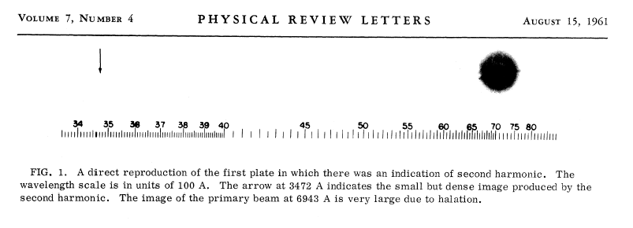
First Demonstration of SHG: The Data
The actual published result…
The second harmonic
Input beam
Note that the very weak spot due to the second harmonic is missing. It was removed by an overzealous Physical Review Letters editor, who thought it was a speck of dirt.
Notes:
http://www.physik.unibe.ch/content/e4897/e4910/e4913/e6210/e6216/e6256/1961-GenerationofOpticalHarmonics_ger.pdf

Slide 24
Phase-Matching SHG Using Birefringence
Birefringent materials have different refractive indices for different
polarizations. Ordinary and extraordinary refractive indices
can be different by up to ~0.1 for SHG crystals.
We can now satisfy the
phase-matching condition.
Use the extraordinary polarization for ω and the ordinary for 2ω.
n_{e} depends on the propagation angle, so we can tune for a given ω.
Refractive index
n₀(2ω) = n_{e}(ω)
Frequency
Some crystals have n_{e} < n_{o}, so the opposite polarizations work.

Slide 25
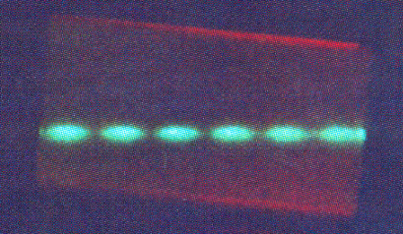
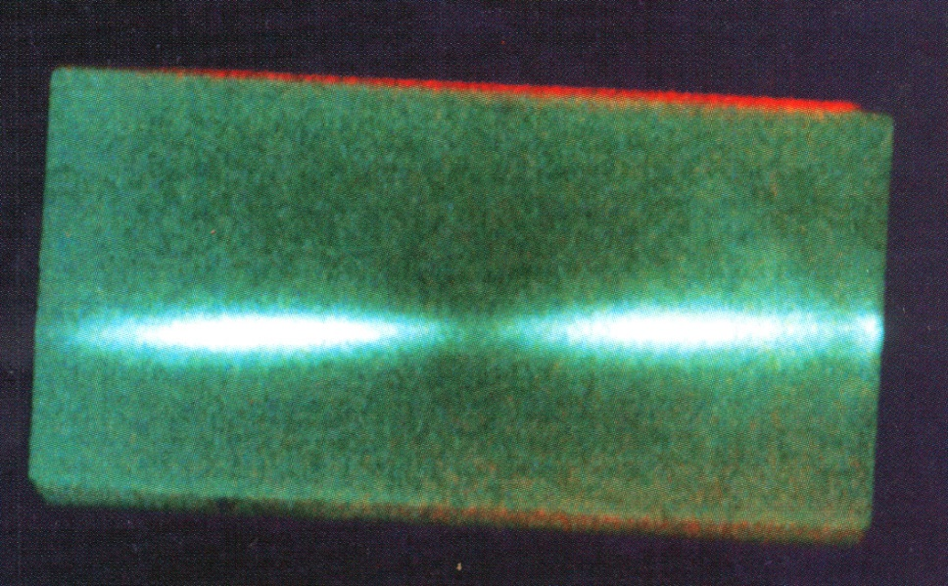
Light Created in Real Crystals
Far from
phase-matching:
SHG crystal
Output beam
Input beam
Closer to
phase-matching:
SHG crystal
Input beam
Output beam
Note that SH beam is brighter as phase-matching is achieved.
Notes:
SHG Crystal [http://www.ifsc.usp.br/~fotonica/research/shg-crystal-p.jpg]

Slide 26
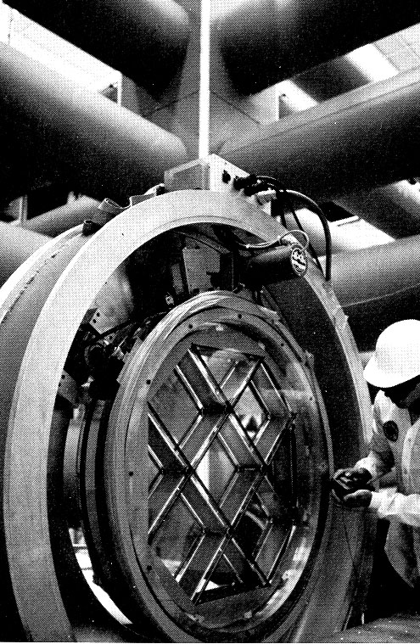
Second-Harmonic Generation
SHG KDP crystals at Lawrence Livermore National Laboratory
These crystals convert as much as 80% of the input light to its second harmonic. Then additional crystals produce the third harmonic with similar efficiency!
Notes:
Lawrence Livermore National Labs report.

Slide 27
Difference-Frequency Generation: Optical Parametric Generation, Amplification, Oscillation
Difference-frequency generation takes many useful forms.
ω₁
ω₁
ω₁
ω₂ = ω₃ − ω₁
ω₃
ω₃
ω₂
Parametric Down-Conversion
(Difference-frequency generation)
Optical Parametric Amplification (OPA)
ω₁
ω₁
"signal"
ω₃
ω₃
ω₂
ω₂
"idler"
mirror
mirror
Optical Parametric Generation (OPG)
By convention:
ω_{signal} > ω_{idler}
Optical Parametric Oscillation (OPO)

Slide 28
Another 2nd-Order Process: Electro-Optics
Applying a voltage to a crystal changes its refractive indices and introduces birefringence. In a sense, this is sum-frequency generation with a beam of zero frequency (but not zero field!).
A few kV can turn a crystal into a half- or quarter-wave plate.
V
Polarizer
If V = 0, the pulse polarization doesn’t change.
Pockels cell
(voltage may be transverse or longitudinal)
If V = V_{π} , the pulse polarization switches to its orthogonal state.
Abruptly switching a Pockels cell allows us to switch a pulse into or out of a laser.

Slide 29
Nonlinear Refractive Index
Recall:
The usual refractive index (which we’ll call n₀) is:
But the refractive index in the presence
of linear and nonlinear polarization:
So:
Assume that the nonlinear term << n₀² :
So:
Usually, we define a nonlinear refractive index:

Slide 30
Self-Phase Modulation & Continuum Generation
As a pulse propagates through a medium, it becomes phase delayed:
But n = n₀ + n₂ I(t)
So the pulse develops a φ(t) proportional to the pulse I(t).
Pulse intensity
vs. time
That is:
The farther the pulse travels, the more phase distortion occurs.
If the pulse begins with a flat phase, then SPM broadens the spectrum.
This is not a small effect! A total phase variation of hundreds can occur! A broad spectrum generated in this manner is called Continuum.

Slide 31
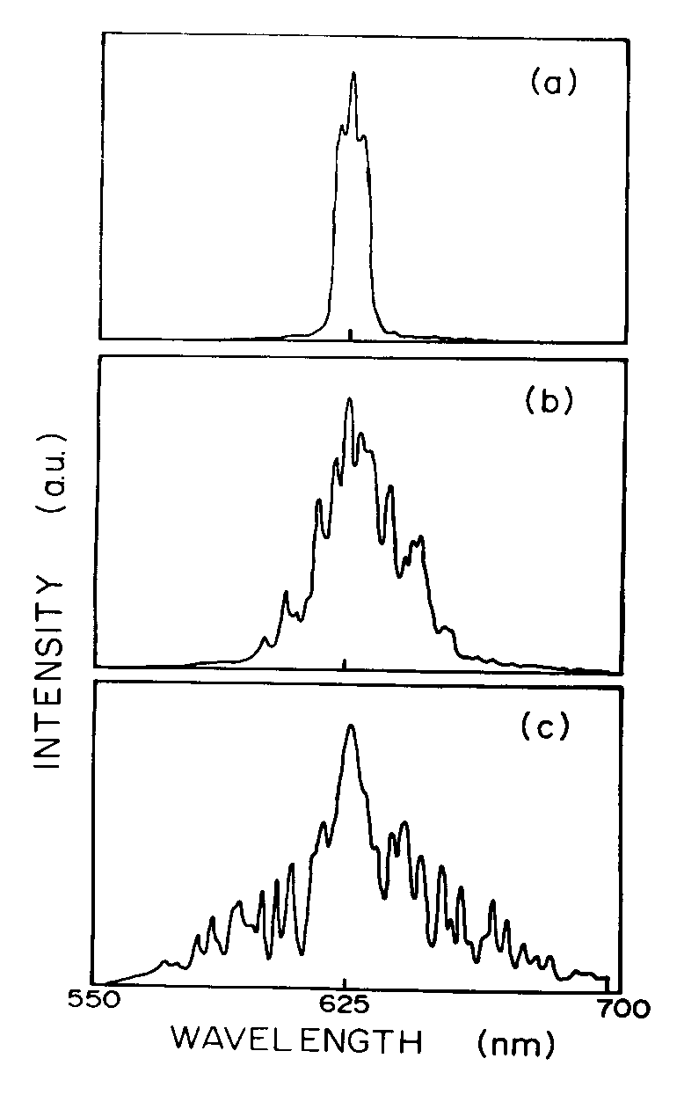
Experimental Continuum
Spectrum in a Fiber
Low
Energy
Medium
Energy
High
Energy
Continua created by propagating 500-fs 625-nm pulses through 30 cm of single-mode fiber.
The broadest spectrum occurs for highest energy.
The Supercontinuum Laser Source, Alfano, ed.
Notes:
The Supercontinuum Laser Source, Alfano, ed.

Slide 32
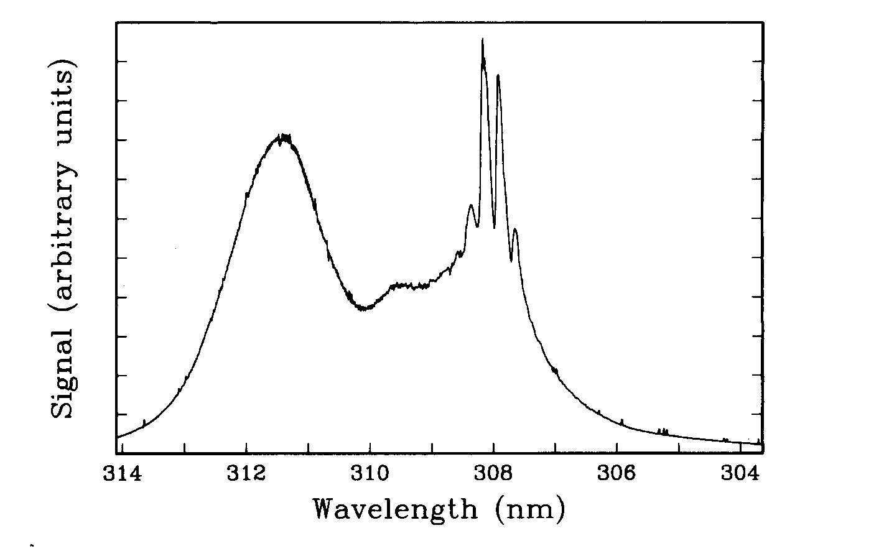
UV Continuum in Air!
308 nm input pulse; weak focusing with a 1-m lens.
The Supercontinuum
Laser Source, Alfano, ed.
Notes:
The Supercontinuum
Laser Source, Alfano, ed.

Slide 33
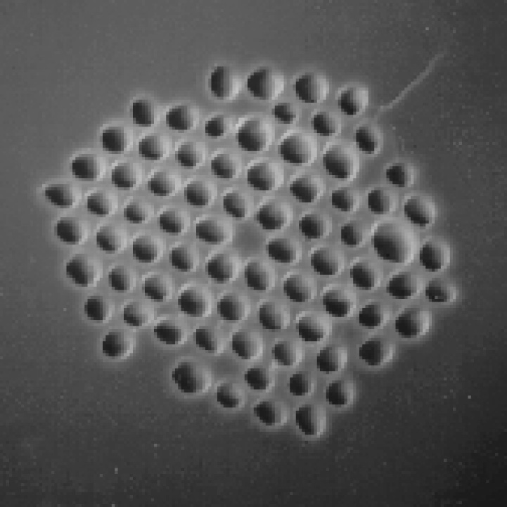
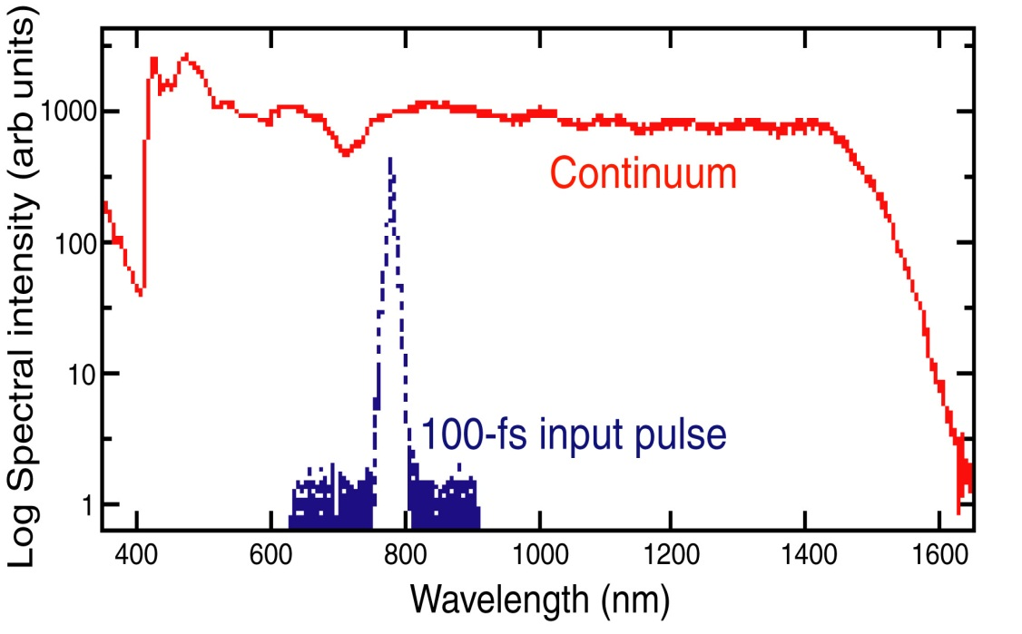
The continuum from microstructure optical fiber is ultrabroadband.
Cross section of the microstructure fiber.
Continuum
The spectrum extends from ~400 to ~1500 nm and is relatively flat (when averaged over time).
100fs input pulse
This continuum was created using unamplified Ti:Sapphire pulses.
J.K. Ranka, R.S. Windeler, and A.J. Stentz, Opt. Lett. Vol. 25, pp. 25-27, 2000
Notes:
Image and plot from Jinendra Ranka.

Slide 34
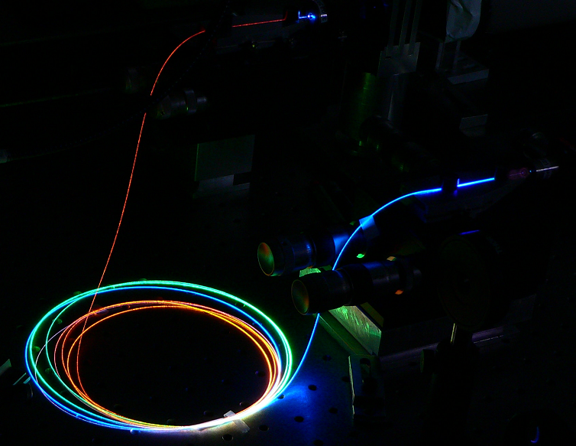
Continuum is quite beautiful!
Notes:
http://en.wikipedia.org/wiki/Supercontinuum

Slide 35
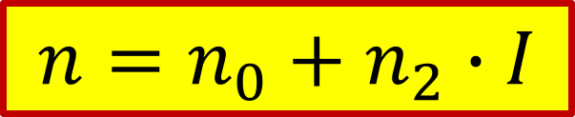
Self phase modulation (SPM)
Refraction index :
$$n=n_{0}+n_{2}∙I$$
Low laser intensity
High laser intensity

Slide 36
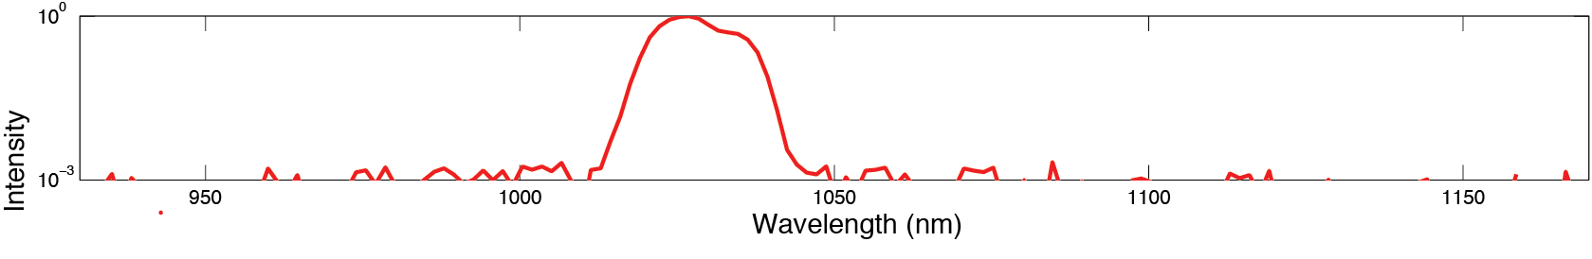
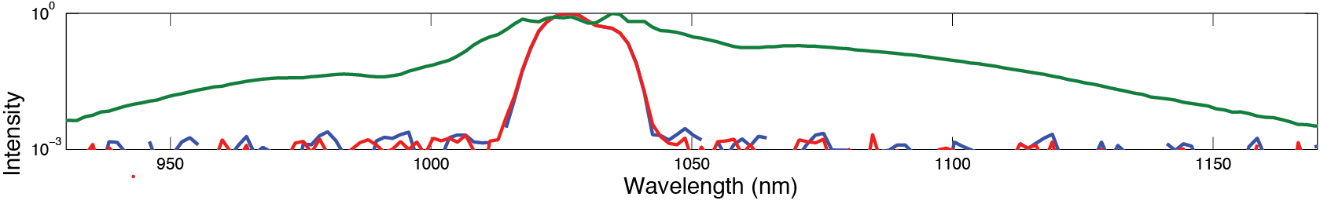
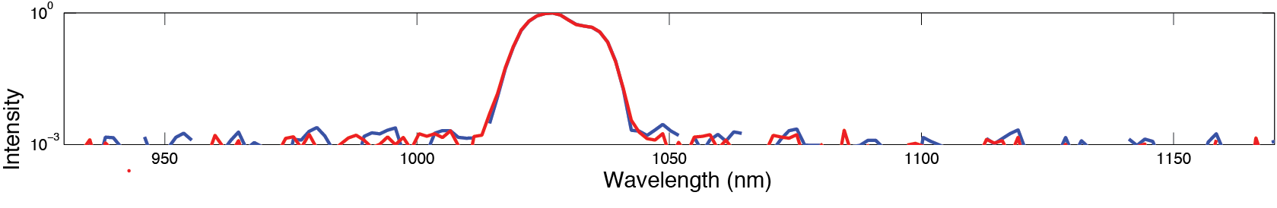
Self phase modulation (SPM)
Low laser intensity
High laser intensity

Slide 37



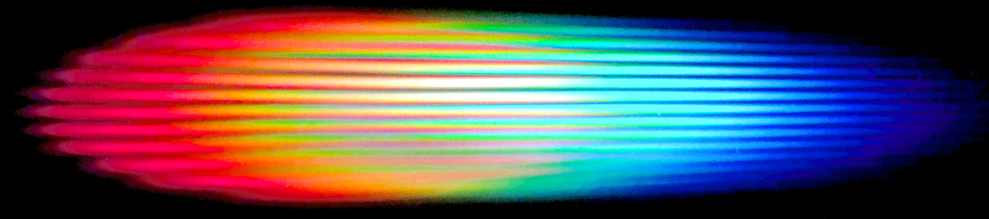
The concept of MPContinuum
10 - 300 μJ
Bomb

Slide 38
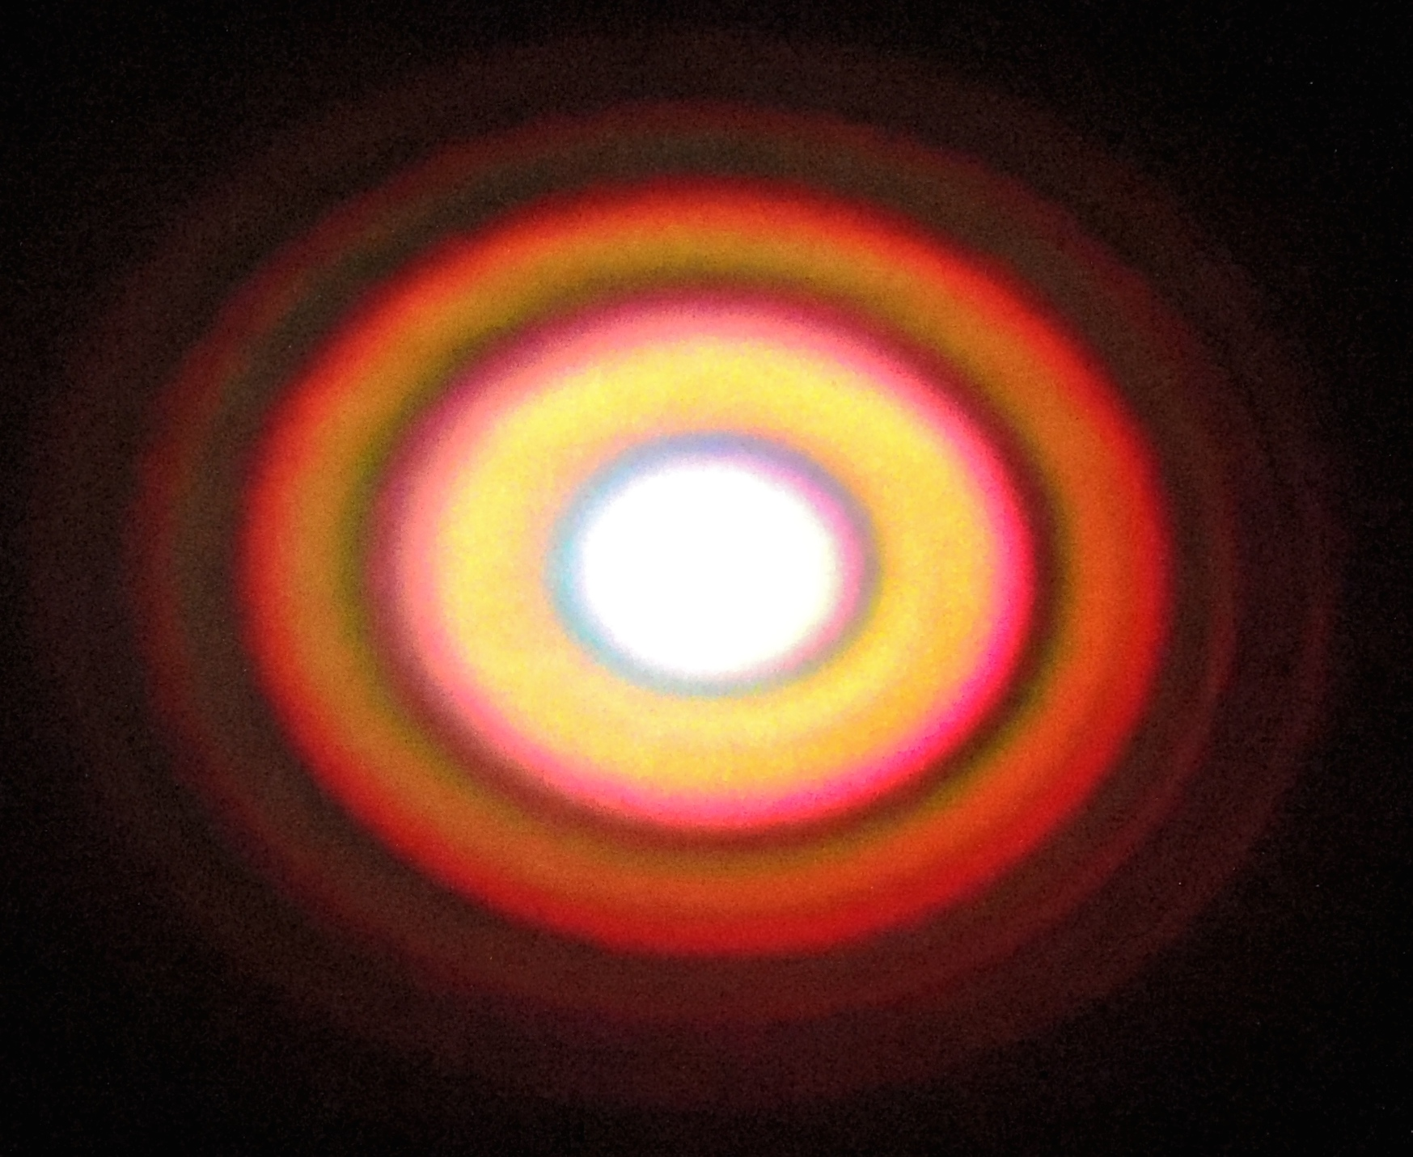




The concept of MPContinuum
Experimental Spectrum
140 μJ, 30fs
132 μJ
125 μJ
114 μJ
190 μJ
109 μJ

Slide 39
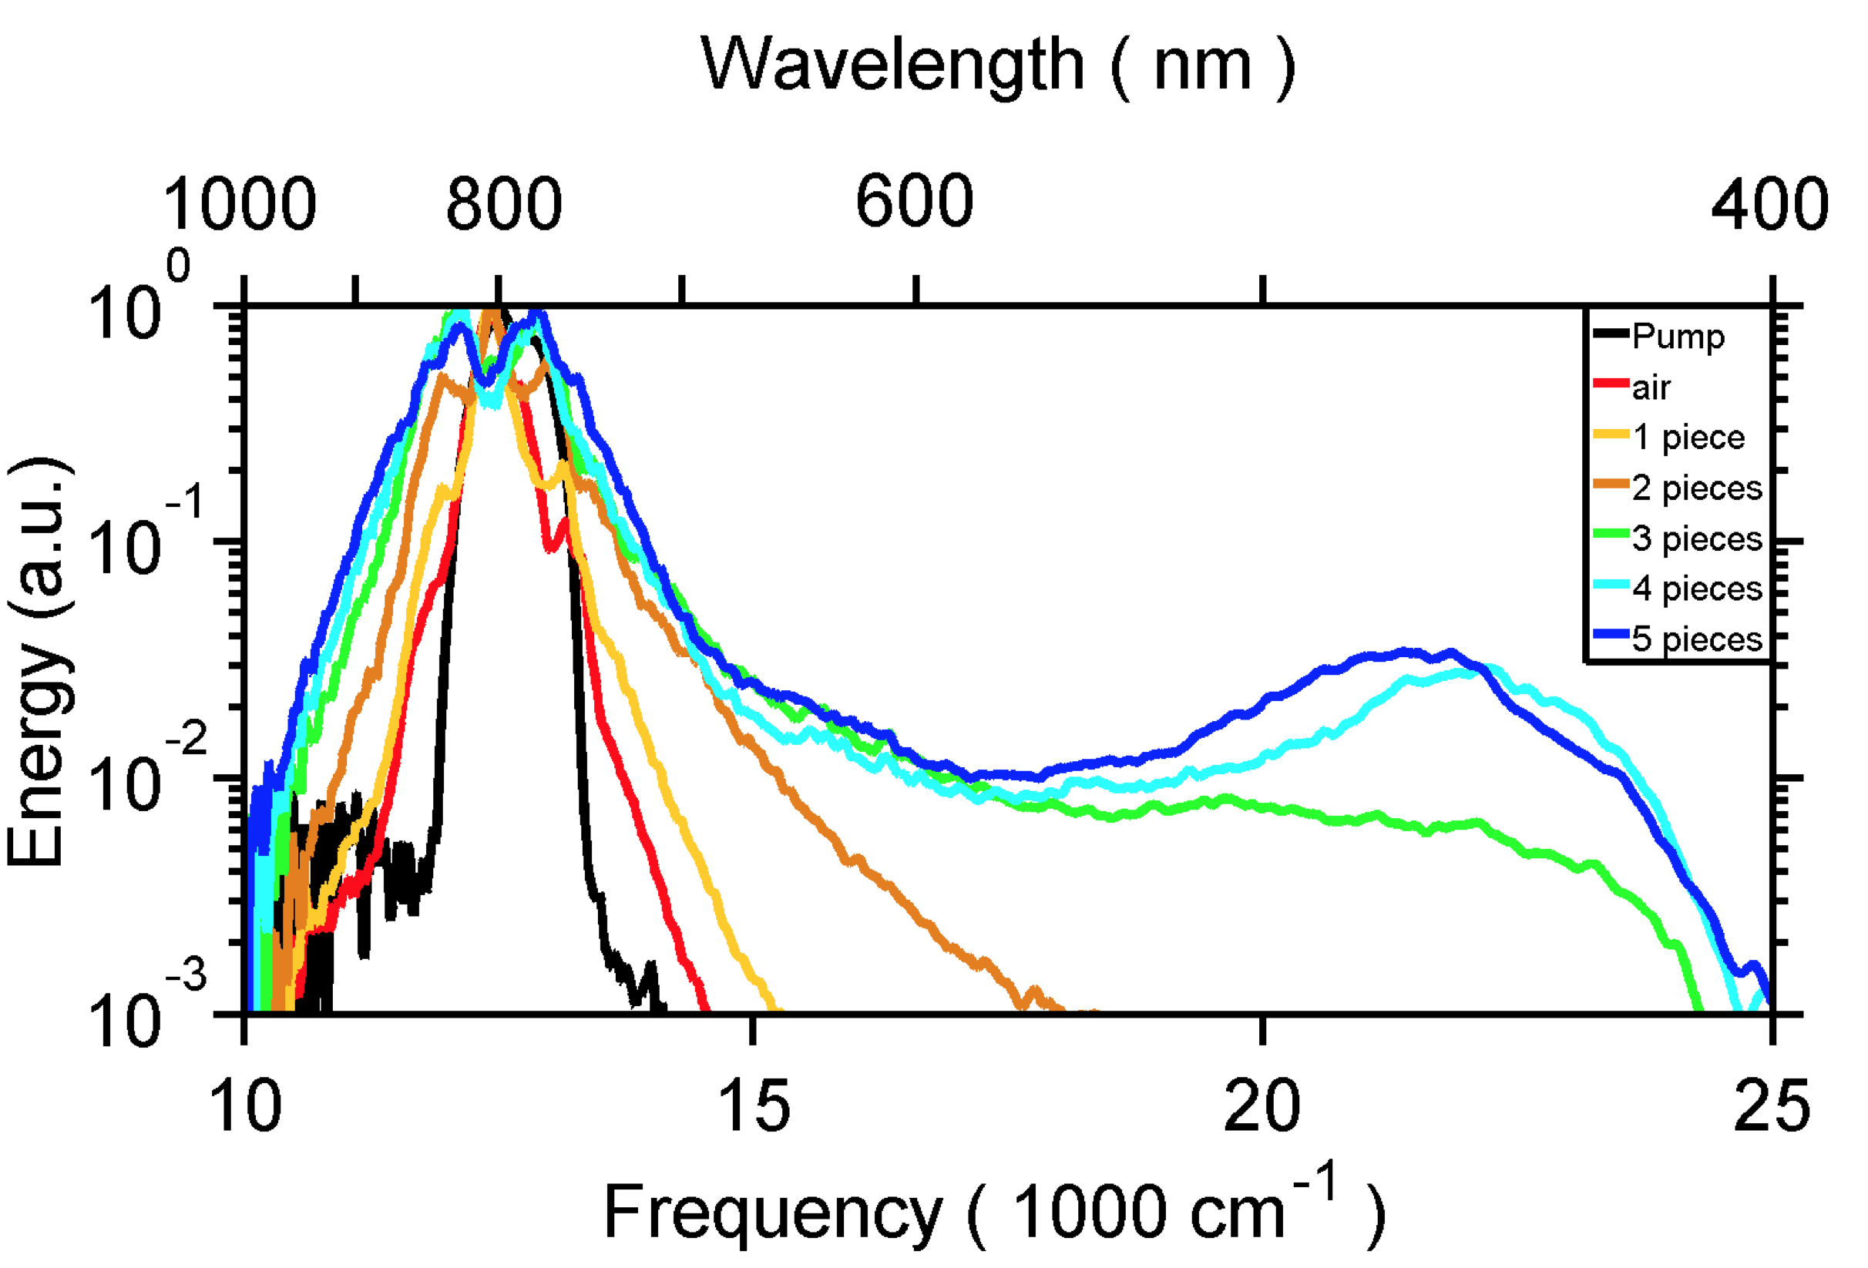
Broadband spectrum generation with different number of thin plates of crystal
Optica 1, 400-406 (2014).

Slide 40
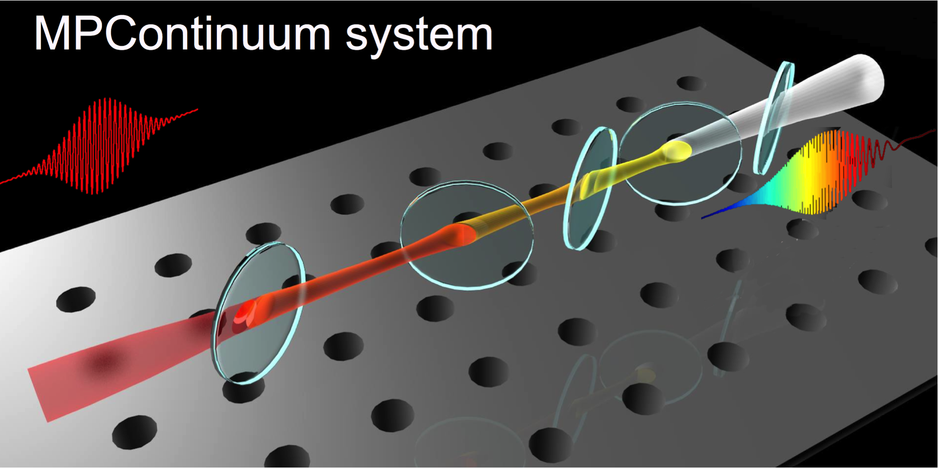
The Configuration of MPContinuum
30 fs, 2.8×10¹³ W/cm²
Notes:
2.8 MW >1000 times
2.4 GW

Slide 41
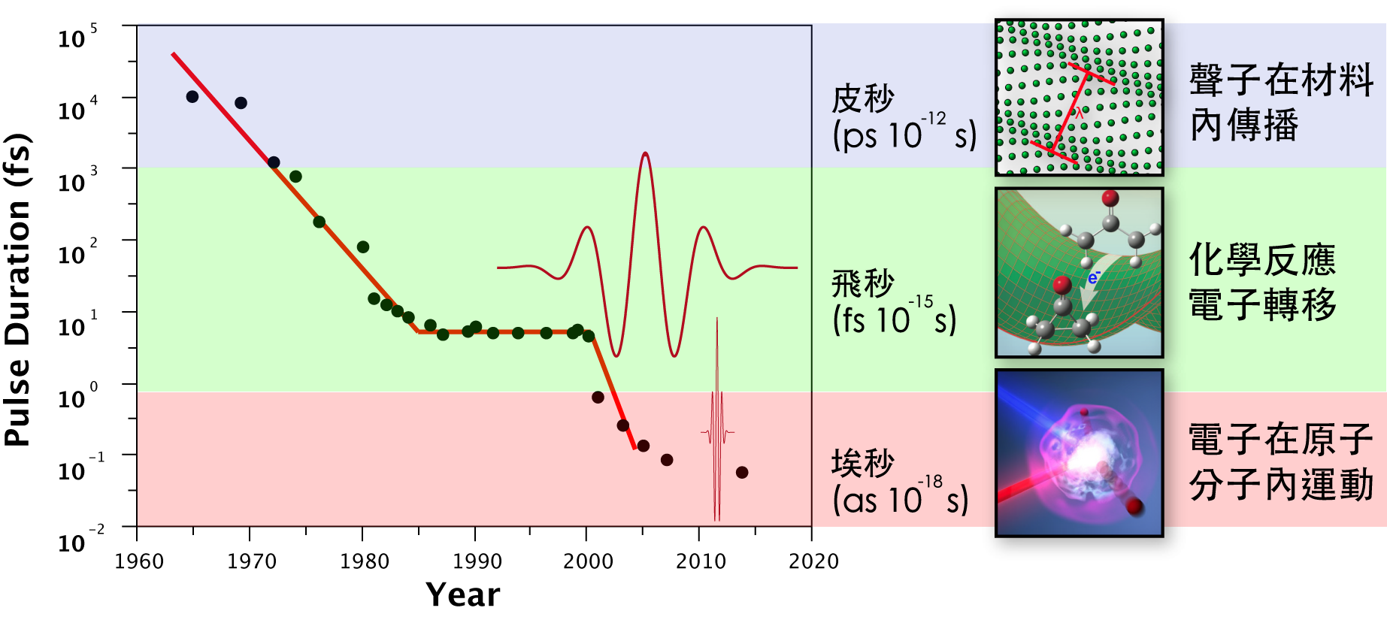
How can we shorten pulses further?
Our stories happen here

