Slide 1
Device to device communications with WiFi Direct: overview and experimentation
D. Camps-Mur is with NEC Network Laboratories in Heidelberg,
Germany.
A. Garcia-Saavedra and Pablo Serrano are with Univ. Carlos III de
Madrid, Spain.

Slide 2
Outline
Introduction
Related work
Wi-Fi Direct Overview
Experimental Evaluation
Conclusions

Slide 3
Introduction
Wi-Fi Direct is a new technology defined by the Wi-Fi Alliance.
A natural way for the technology to progress is to target device to device connectivity.
Without requiring the presence of an Access Point(AP).
Wi-Fi Direct builds upon the successful IEEE 802.11 infrastructure mode.

Slide 4
Introduction cont.
Implement a novel power saving protocol the “Notice of Absence” and “Opportunistic Power Save”.

Slide 5
Related work
ad-hoc mode
802.11z known as “Tunneled Direct Link Setup” (TDLS)

Slide 6
Wi-Fi Direct Overview
Wi-Fi Direct devices, formally known as P2P Devices, communicate by establishing P2P Groups.
The device implementing AP-like functionality in the P2P Group is the P2P Group Owner (P2P GO).
Once the P2P Group is established, other P2P Clients can join the group as in a traditional Wi-Fi network.

Slide 7
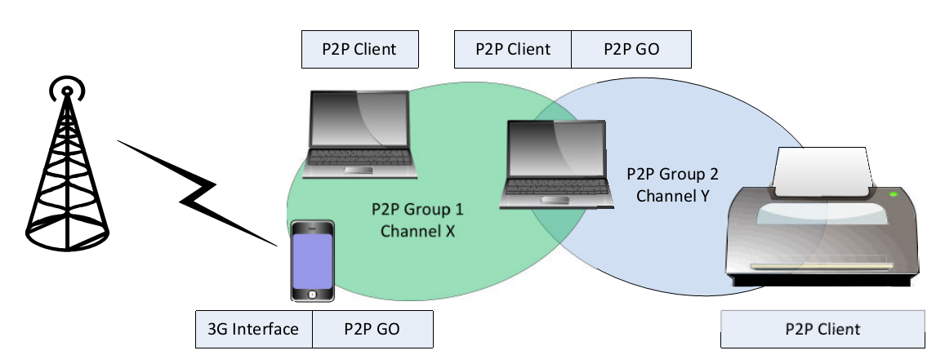
Wi-Fi Direct Overview
Notes:
In order to act both as P2P Client and as P2P GO the laptop will typically alternate between the two roles by time-sharing the Wi-Fi interface;

Slide 8
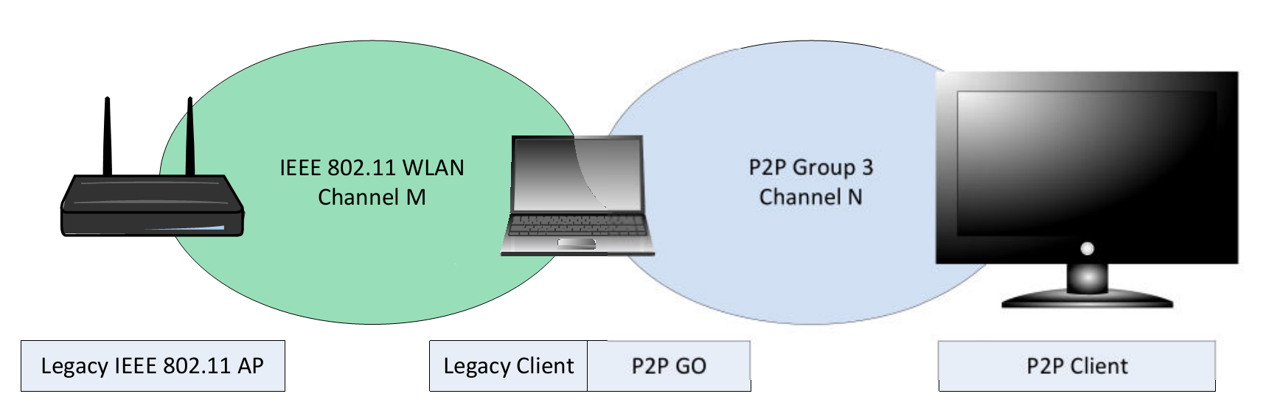
Wi-Fi Direct Overview

Slide 9
Wi-Fi Direct Overview
Like a traditional AP, a P2P GO announces itself through beacons.
P2P GO has to support power saving services for its associated clients.
The P2P GO is required to run a Dynamic Host Configuration Protocol (DHCP) server to provide P2P Clients with IP addresses.
Only the P2P GO is allowed to cross-connect the devices in its P2P Group to an external network
If the P2P GO leaves the P2P Group then the group is torn down.

Slide 10
Group Formation
Three Group Formation cases
Standard
Autonomous
Persistent
Notes:
1.標準模式
2.獨立模式
3.已經建立過連線

Slide 11
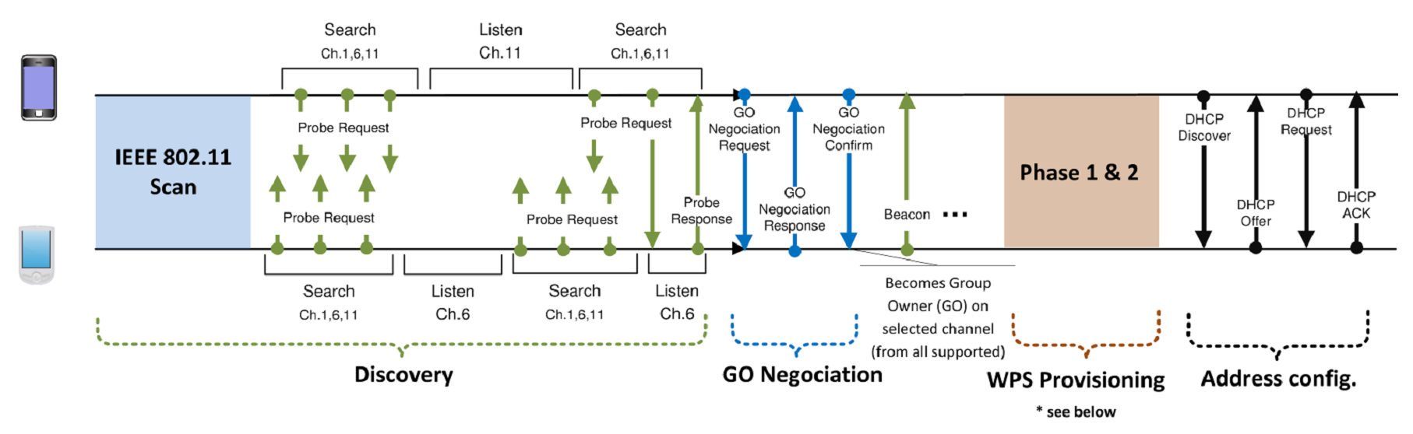
P2P Standard Group Formation
Notes:
GO Negotiation phase. This is implemented using a three-way handshake,

Slide 12
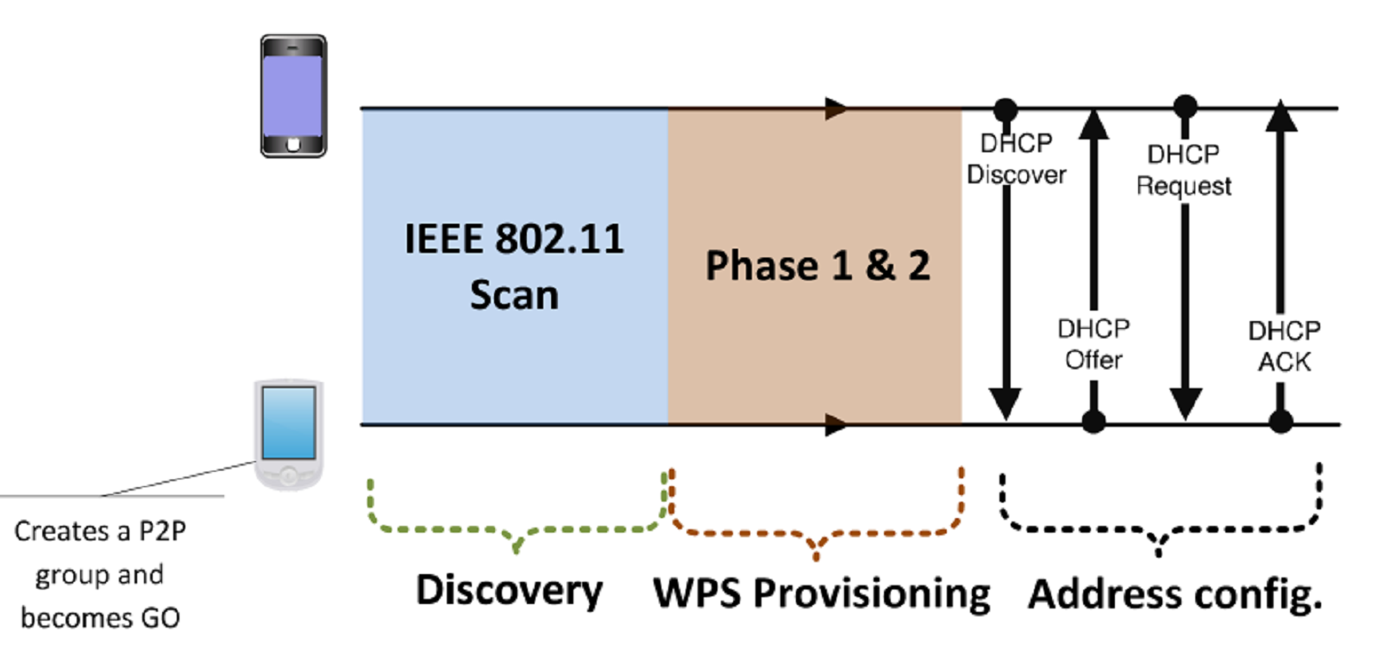
P2P Autonomous Group Formation

Slide 13
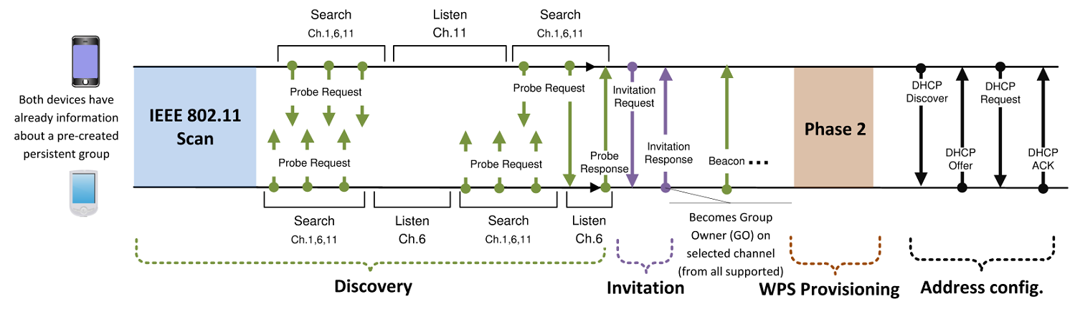
P2P Persistent Group Formation
Notes:
Invitation Procedure (a two-way handshake)

Slide 14
Security
Wi-Fi Direct devices are required to implement Wi-Fi Protected Setup (WPS)
WPS allows to establish a secure connection by, e.g., introducing a PIN in the P2P Client, or pushing a button in the two P2P Devices.
WPS is based on WPA-2 security.

Slide 15
Security
Phase 1
Security keys, to the Enrollee.
Randomly generated Pre-Shared Key (PSK) for mutual authentication.
Phase 2
The Enrollee (P2PClient) disassociates and reconnects using its new authenti-cation credentials.
Notes:
如果是persistent group就可以直接跳過phase1。

Slide 16
Power Saving
Current Wi-Fi networks are not defined for APs but only for clients.
P2P Client can benefit from the existing Wi-Fi power saving protocols.

Slide 17
Power Saving
Two new power saving mechanisms:.
The Opportunistic Power Save
The Notice of Absence (NoA) protocol
The Notice of Absence (NoA) protocol allows a P2P GO to announce time intervals.
Notes:
CTWindow Client Traffic Window

Slide 18
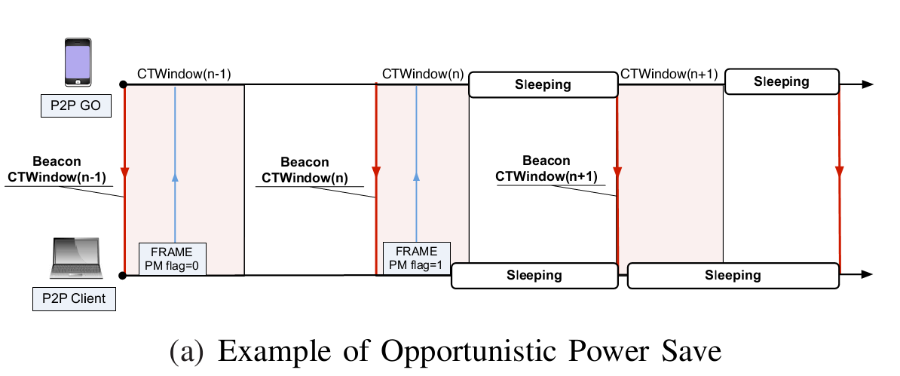
Opportunistic Power Save

Slide 19
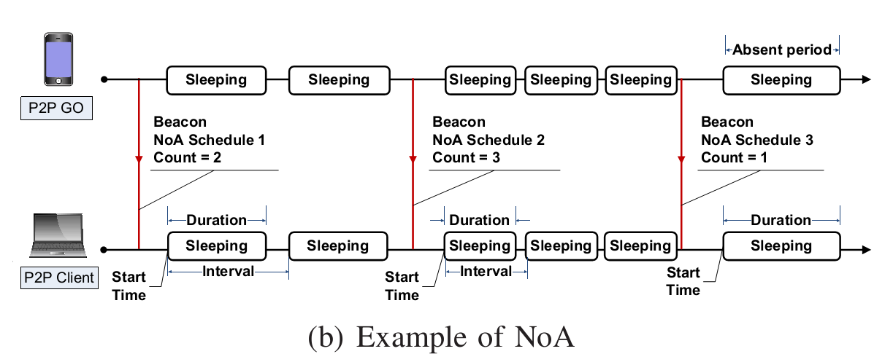
Notice of Absence

Slide 20
Group Formation Delays
Discovery delay, this being the time required for the two P2P devices to find each other.
Formation delay, this being the time required to agree on the roles, establish a secure communication and perform the DHCP exchange.

Slide 21
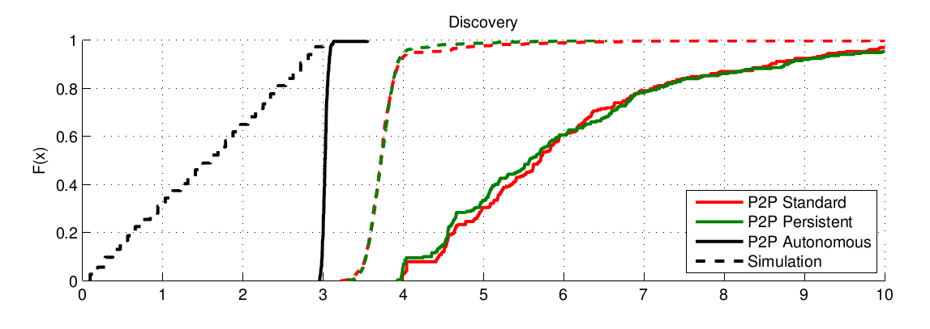
Group Formation Delays

Slide 22
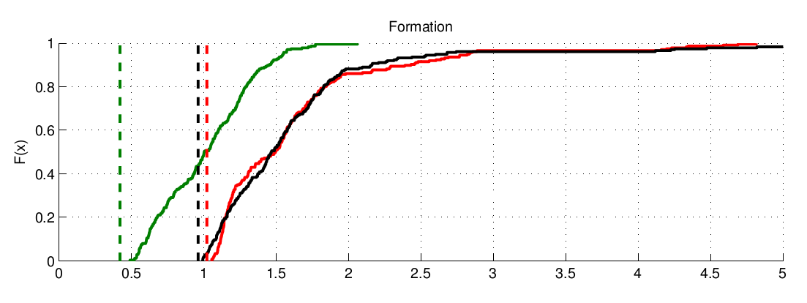
Group Formation Delays

Slide 23
Conclusions
In this paper we presented a thorough overview of the novel technical features specified in Wi-Fi Direct, following by an experimental evaluation that quantifies the group formation delays to be expected in real-life scenarios.
This is the first paper in the state of the art that provides a wide overview and experimental evaluation of Wi-Fi Direct.

