Slide 1

Evolution and Sustainability of a Wildlife Monitoring Sensor Network
Vladimir Dyo, Stephen A. Ellwood†, David W. Macdonald†, Andrew Markham‡
Cecilia Mascolo§, Bence P´asztor§, Salvatore Scellato§, Niki Trigoni‡, Ricklef Wohlers‡, Kharsim Yousef§
Dept. of Computer Science and Technology, University of Bedfordshire, UK §Computer Lab, University of Cambridge, UK
†Wildlife Conservation Research Unit, Dept. of Zoology and ‡Computing Laboratory, University of Oxford, UK

Slide 2
Outline
Wildlife Monitoring Application
Initial System Design
Evolution Stage 1: Improving Sensing and Data Collection
Evolution Stage 2: Hardware Improvements
Network Maintenance Costs
Conclusions and Lessons Learned

Slide 3
Outline
Wildlife Monitoring Application
Initial System Design
Evolution Stage 1: Improving Sensing and Data Collection
Evolution Stage 2: Hardware Improvements
Network Maintenance Costs
Conclusions and Lessons Learned

Slide 4
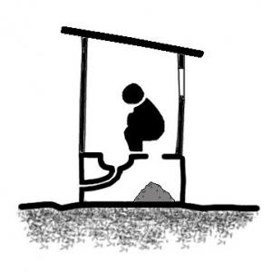

Wildlife Monitoring Application
Badger(獾)
Nocturnal mammal
Living in multi-entrance burrow system
Also visiting specific places, “latrines”

Slide 5

Badgers Monitoring
Source: http://www.albinoblacksheep.com/flash/960/badgers.jpg

Slide 6
Outline
Wildlife Monitoring Application
Initial System Design
Evolution Stage 1: Improving Sensing and Data Collection
Evolution Stage 2: Hardware Improvements
Network Maintenance Costs
Conclusions and Lessons Learned

Slide 7
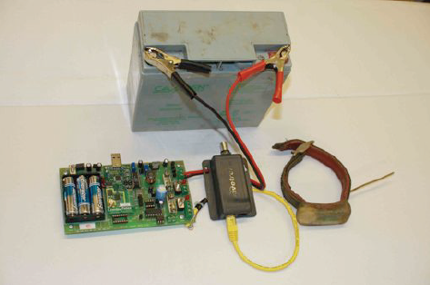
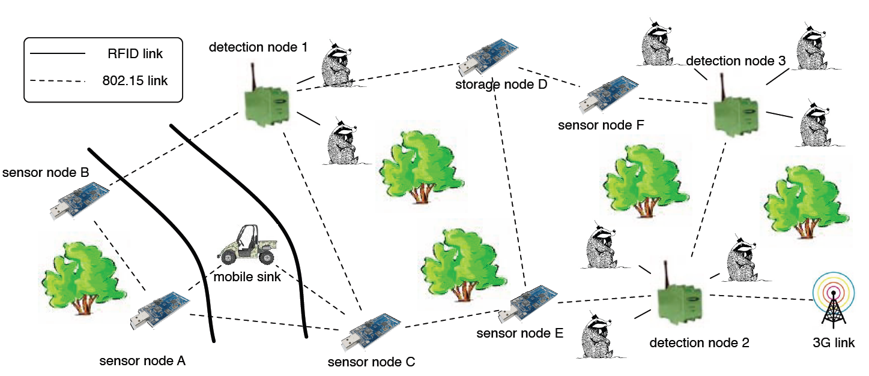
Initial System Design: Sensing
Tmote Sky Node with two sensor
微氣候監測
溫度: 放置在地下30公分
濕度: 放置在一公尺高
Low energy consumption: 30μA
Badger
Detection Node (Left) & RFID Tag (Right)
Sensor nodes and detection nodes were all connected through the same network
It were placed in key location throughout the woods
Only a single solar powered gateway with cellular connectivity

Slide 8
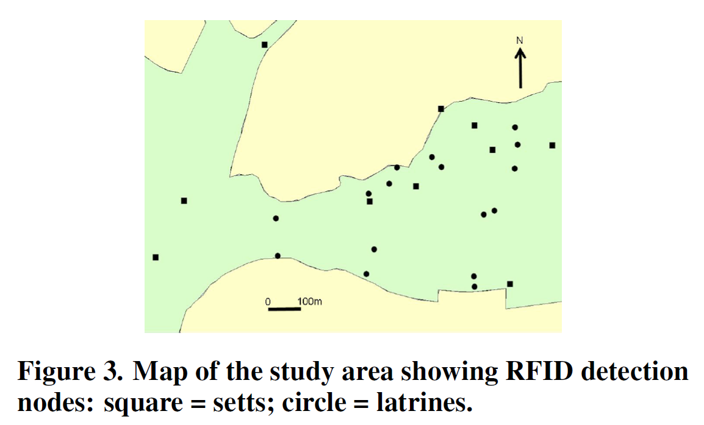
Initial System Design: Sensing

Slide 9
Initial System Design: Data Collection
Compression and Local Storage
In essence, we simply encode the difference between a base RFID observation and subsequent readings.
Each raw reading, which consists of a timestamp, tag age and received signal strength occupies 10 bytes in its uncompressed form.
The difference between an observation and the base record can be stored using only 3 bytes of information.
Using this simple scheme, raw data is typically compressed by an average factor of 2.7x.

Slide 10
Initial System Design: Data Collection
Routing
Low-volume data (such as network status messages) are forwarded to the fixed 3G gateway node using a proactive shortest path routing algorithm.
Every node maintains a routing table containing its distance to the gateway node.
The distance from a node to the gateway is evaluated taking into account the link qualities along the route.
The expected transmissions etx per message from the current node to a neighbor node N is computed as follows
etx(N)=attemptedtx(N)/successfultx(N)
?

Slide 11
Initial System Design: Data Collection
Routing
Every node broadcasts its distance to the gateway every 30 minutes.
Upon receiving an advertisement from a neighbor N, a node compares the advertised distance (advDist) to the distance in its local routing table (rtDist).
If advDist + etx(N) < rtDist then it sets rtDist = advDist +etx(N) and sets neighbor N as its next hop.
If the route quality deteriorates significantly, a node will simply select the next best available route.

Slide 12
Outline
Wildlife Monitoring Application
Initial System Design
Evolution Stage 1: Improving Sensing and Data Collection
Evolution Stage 2: Hardware Improvements
Network Maintenance Costs
Conclusions and Lessons Learned

Slide 13
Evolution Stage 1: Improving Sensing and Data Collection
The main weaknesses of our initial design were the high energy consumption of the badger detection nodes (RFID readers), and the heavy communication load around the fixed gateway.

Slide 14
Evolution Stage 1: Improving Sensing and Data Collection
Adaptive Sensing
  RFID readers are the major source of power consumption on detection nodes.
An obvious way to save energy is to duty cycle the RFID reader by periodically turning it on for a fixed duration of seconds every seconds.
Nevertheless, setting optimal parameters is not straightforward: a high frequency sampling may be too wasteful, whereas low frequency sampling may lose important contacts.
The approach is composed of two main components:
  Short-term adaptation
  Long-term adaptation

Slide 15
Evolution Stage 1: Improving Sensing and Data Collection
Short-term adaptation extends the awake time of the reader by a fixed short period of seconds each time badger activity is detected (i.e., a tag is in range).
The drawback of the periodic sampling technique, even in the presence of short-term adaptation, is that it assumes uniform badger activity throughout the day.

Slide 16
Evolution Stage 1: Improving Sensing and Data Collection
Short-term adaptation extends the awake time of the reader by a fixed short period of seconds each time badger activity is detected (i.e., a tag is in range).
The drawback of the periodic sampling technique, even in the presence of short-term adaptation, is that it assumes uniform badger activity throughout the day.

Slide 17
Evolution Stage 1: Improving Sensing and Data Collection
The Long-term adaptation component learns daily patterns of badger activity and adapts the interval accordingly.

Slide 18
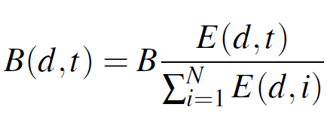
Evolution Stage 1: Improving Sensing and Data Collection
We define a target daily budget B as the amount of seconds that a badger detection node should spend in active state per day. Each day is divided in N equal time slots. Then, each node computes the expected number of sightings E(d, t) during a day d for timeslot t and assigns a budget B(d, t), proportional to E(d, t), to each timeslot:

Slide 19


Evolution Stage 1: Improving Sensing and Data Collection
Each day is divided in N equal time slots, and the length of a slot time is T.
Since in a timeslot of length T the reader is to be active only for B(d, t) seconds, we have that
or
……
……
T
Time line
B(d, t)

Slide 20
Evolution Stage 1: Improving Sensing and Data Collection
Then, the expected number of sightings E(d, t) in timeslot t of a particular day d is evaluated as follows:
where O(d-1, t) is the actual number of sightings that were observed in the same timeslot on the previous day and a is a weight in the range [0,1].

Slide 21
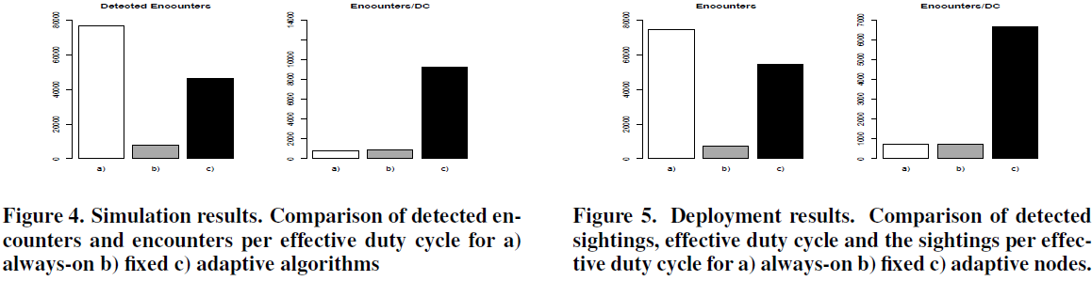
Evolution Stage 1: Improving Sensing and Data Collection

Slide 22
Evolution Stage 1: Improving Sensing and Data Collection
Data priorities:
  Priority class 1: Maximum of a few hours delay
  Priority class 2: Maximum of a few days delay
  Priority class 3: Delays of weeks are acceptable
Node priorities:
  Each node is assigned a priority class PN based on the frequency it is expected to be visited by mobile sinks for data collection.
  The more frequently visited a node is, the lower the expected data delivery time, and the lower the assigned node priority class.

Slide 23
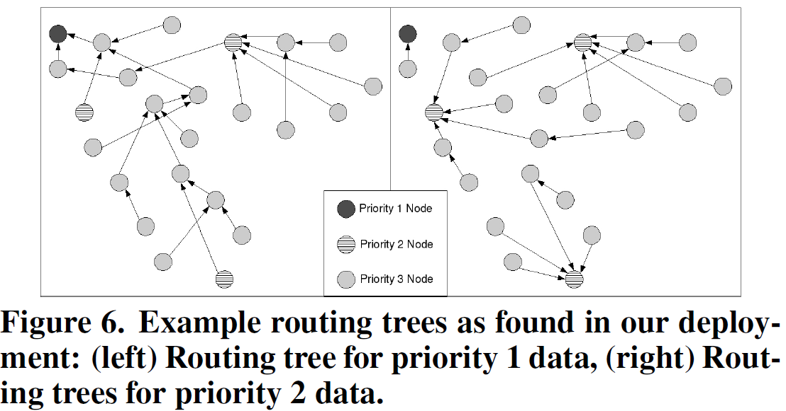
Evolution Stage 1: Improving Sensing and Data Collection

Slide 24
Outline
Wildlife Monitoring Application
Initial System Design
Evolution Stage 1: Improving Sensing and Data Collection
Evolution Stage 2: Hardware Improvements
Network Maintenance Costs
Conclusions and Lessons Learned

Slide 25
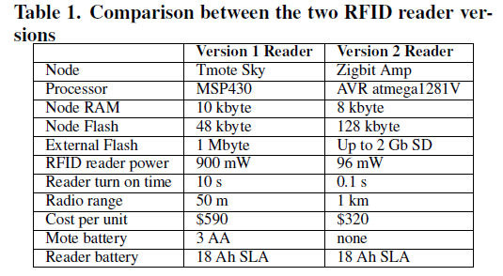
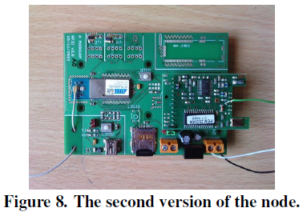
Evolution Stage 2: Hardware Improvements

Slide 26
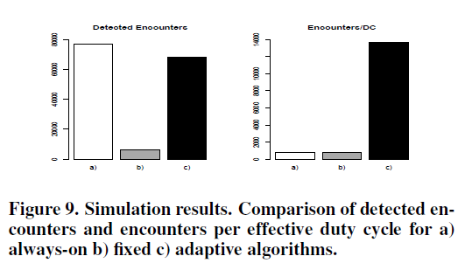
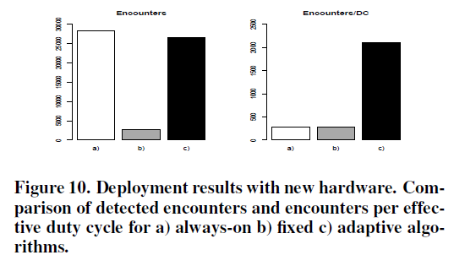
Evolution Stage 2: Hardware Improvements
The original Tinterval was set to 330s, with a duty cycle of 9%.
It had the drawback of not being able to react to the presence of animals outside of the normal predicted times.
we modified Ton to be 1s, with Tinterval to be 11s.

Slide 27
Evolution Stage 2: Hardware Improvements
In summary
  the detection node has dropped the power consumption by nearly an order of magnitude.
  The storage space has been increased to such an extent that it allows for 40 years of storage.
  The communication range has also been increased greatly.
The hardware improvements introduced in Stage 2 had a dual effect on the data collection process.

Slide 28
Evolution Stage 2: Hardware Improvements
Recall that the hardware optimizations introduced in the second stage dramatically increased the communication range of sensor and badger detection nodes from 50m to 1km.
As a result, all nodes now have one-hop connectivity to the fixed 3G gateway, and no longer need to make use of mobile sinks.

Slide 29
Evolution Stage 2: Hardware Improvements
Hence, in the second evolution stage, the hierarchy of nodes (based on priorities) collapsed and the use of mobile sinks to collect data efficiently and relieve the fixed network, became less relevant.
However, we expect it to become relevant again in the near future, when we proceed to the third evolution stage of the system.

Slide 30
Outline
Wildlife Monitoring Application
Initial System Design
Evolution Stage 1: Improving Sensing and Data Collection
Evolution Stage 2: Hardware Improvements
Network Maintenance Costs
Conclusions and Lessons Learned

Slide 31
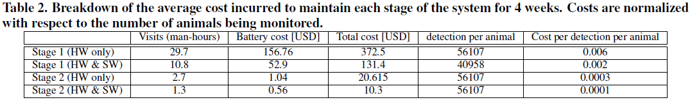
Network Maintenance Costs
There are several other methods of animal tracking, such as the GPS and ARGOS satellite-based systems that we do not include in the direct comparison.
  Inferior spatial resolution (ARGOS)
  Reliability (GPS performs poorly in woodland).

Slide 32
Outline
Wildlife Monitoring Application
Initial System Design
Evolution Stage 1: Improving Sensing and Data Collection
Evolution Stage 2: Hardware Improvements
Network Maintenance Costs
Conclusions and Lessons Learned

Slide 33
Conclusions and Lessons Learned
Network maintenance should not be an afterthought, but a key consideration in the original design of the system.
Before delving into algorithmic improvements and strenuous testing of new software, it is important to carefully consider hardware limitations.

Slide 34
Conclusions and Lessons Learned
An algorithmic improvement that yields significant benefits on one platform may be less efficient or even inapplicable to another.
These changes must be performed in a controlled manner so that they do not disrupt the data collection process.

Slide 35
Thanks for your attention!

