Slide 1
Telos: Enabling Ultra-Low Power Wireless Research
Joseph Polastre, Robert Szewczyk, and David Culler
Computer Science Department
University of California, Berkeley
Berkeley, CA 94720
{polastre,szewczyk,culler}@cs.berkeley.edu
In IPSN '05
第一組 :林孝先 黃彥碩

Slide 2
Outline
INTRODUCTION
RELATEDWORK
TELOS PLATFORM
  A. Technological Trends
  B. Integrated Design
  C. Analysis
  D. Enabling Research
Conclusion
Notes:
A.技術發展趨勢
C.分析

Slide 3
INTRODUCTION
Wireless sensor networks are ideally suited for long-lived applications deployed at large densities for low cost.
Unfortunately, the current WSN platforms built from commercial off-the-shelf (COTS) components have a lifetime of no more than two years, communicate through non-standard interfaces, are expensive, and are difficult to use for experimentation, development, testing, and deployment.
Notes:
需求
現況

Slide 4
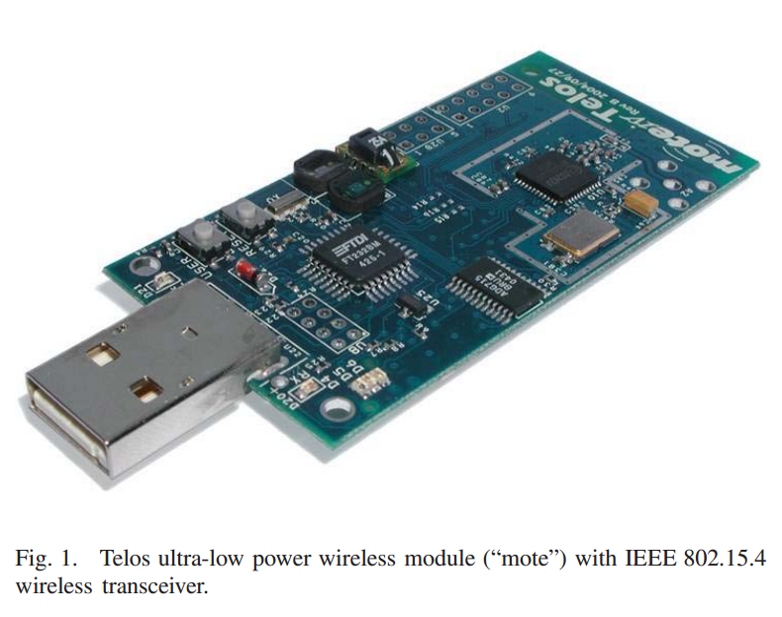
INTRODUCTION
Telos is a new design to further research in sensor networks with three major goals: lower power operation than previous mote generations, easy to use, and robustness for experimentation and deployment.
Notes:
Robustness 穩定性

Slide 5
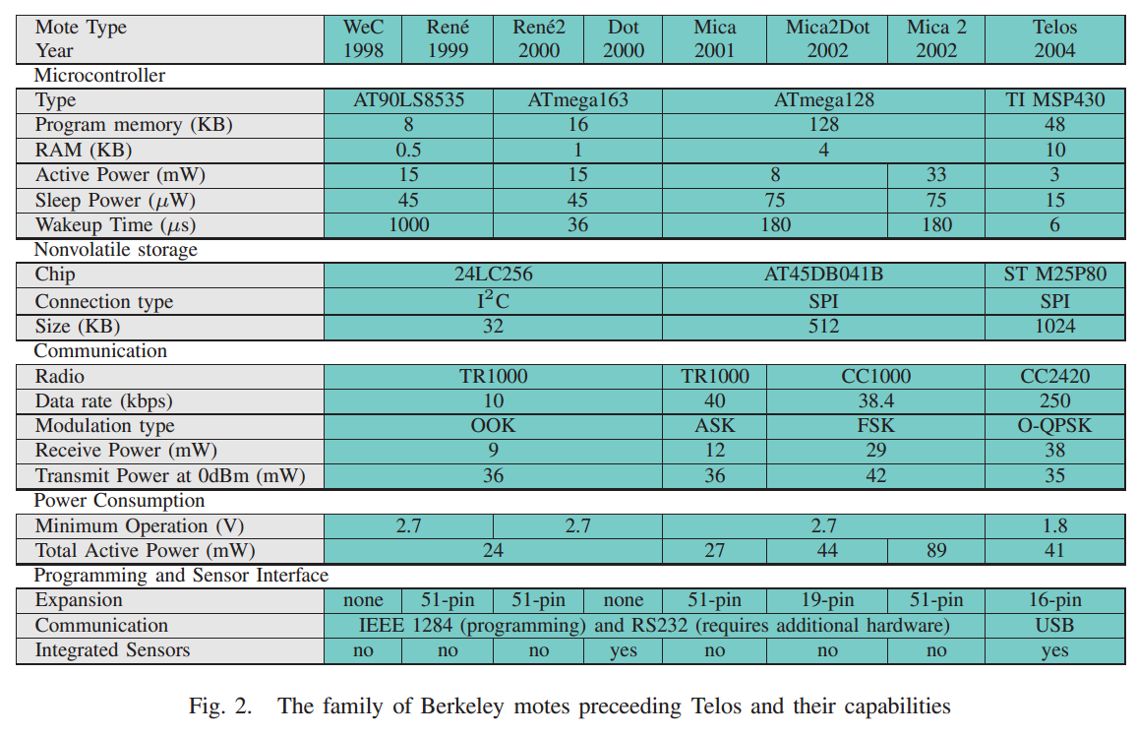
RELATEDWORK
Notes:
(weC [4], and Ren´ e) exposed a custom sensor interface and allowed for the possibility of remote reprogramming.
Mica [5] The radio’s primitive interfaces allowed low power operation and quick turn-on times.但還是有著高耗電量問題值到下一代改善才便成標準的研究平台
(16 of 21 papers in SenSys 2004 used Mica2 for evaluation)

Slide 6
TELOS PLATFORM
Telos is a new design to further research in sensor networks with three major goals: lower power operation than previous mote generations, easy to use, and robustness for experimentation and deployment.
Notes:
Robustness 穩定性

Slide 7
TELOS PLATFORM
A. Technological Trends
B. Integrated Design
C. Analysis
D. Enabling Research

Slide 8
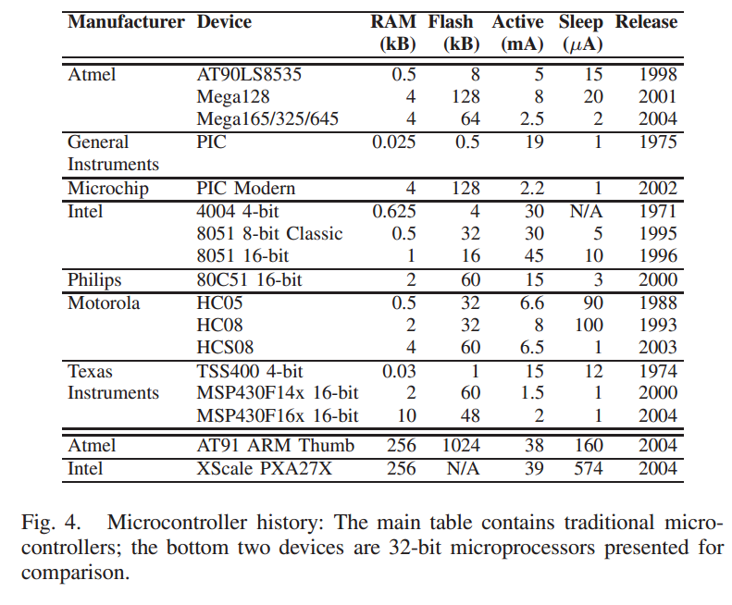
A. Technological Trends - MCU
Our low power principle focuses on reducing the sleep current and wakeup time of our system.
Notes:
Figure 4 shows that the MSP430 has the lowest power consumption in sleep and active modes

Slide 9
A. Technological Trends - RAM
The trend is to keep the RAM and Flash sizes constant (shown in Figure 4) while adding additional hardware accelerator modules.
The MSP430 provides us with the largest on-chip RAM buffer (10kB), useful for on-chip
signal processing.
Notes:
MSP430為我們提供了最大的片上RAM緩衝區（10KB），可用於芯片上信號處理。

Slide 10
A. Technological Trends - bandwidth
There are two distinct types of low power, low data rate radios: narrowband and wideband radios.
Many narrowband radios provide very fast startup times since they are clocked by the MCU but have simple modulation schemes, no spreading codes, and are not robust to noise.
Narrowband radios typically operate at lower frequencies and lower data rates;
Notes:
A. Technological Trends
Narrowband:
但其具有簡單的調變方案，沒有擴頻碼也不能抗雜訊的特性
較低的傳輸速率
Wideband:
必須要等待高速震盪器啟動
但其可以擴頻並具有抗雜抗干擾的訊號穩定性
較高的傳輸速率

Slide 11
A. Technological Trends - bandwidth
Wideband radios must wait for high speed oscillators to start.
Enhanced modulation schemes found in wideband radios, such as spread spectrum (DSSS) and phase shift keying (O-QPSK), provide signal robustness to noise and interference.
Wideband radios typically operate in the 2.4GHz band and provide higher data rates.
Notes:
寬帶無線電必須等待高速振盪器開始。增強寬帶無線電通訊設備，如擴頻（DSSS）和相移鍵控（O-QPSK）調製方案，提供了噪聲和干擾信號的魯棒性。
寬帶無線電的一般工作在2.4GHz頻段，並提供更高的數據傳輸速率。
Wideband:
必須要等待高速震盪器啟動
但其可以擴頻並具有抗雜抗干擾的訊號穩定性
較高的傳輸速率

Slide 12
A. Technological Trends - bandwidth
To pick the most applicable radio, we must evaluate the impact of noise, flexibility available to the end application, ease of communication with other devices, power consumption, startup times, and available data bandwidth.
Instead a radio must be chosen based on application require-ments.
Notes:
Available 可用的
application requirements.

Slide 13
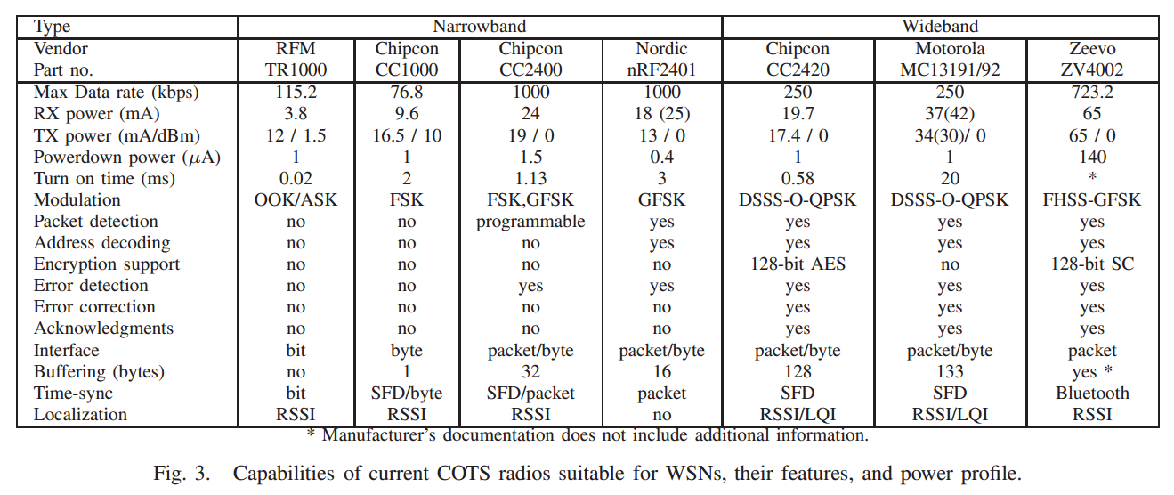
A. Technological Trends

Slide 14
A. Technological Trends
Cc2420 - COMMUNICATE
For Telos, we chose to use the new IEEE 802.15.4 standard. By using a standardized radio, Telos can communicate with any number of devices sharing the same physical layer, including devices from other vendors.

Slide 15
A. Technological Trends
Cc2420 - hARDWARE
Telos uses the Chipcon CC2420 radio in the 2.4GHz band.
  The higher data rate allows shorter active periods further reducing energy consumption.
  The radio crystal used on Telos was carefully chosen to be a low-ESR 16MHz crystal; low resistance is essential for minimizing the startup time of the crystal.
  The accelerators may not be used as general purpose functions.
Notes:
3.例如，一個數據緩衝器可被加密，並存儲在閃存中，但是，因為它不被發送通過無線電，無線電設備的硬件加密模塊不能使用.

Slide 16
TELOS PLATFORM
A. Technological Trends
B. Integrated Design
C. Analysis
D. Enabling Research

Slide 17
B. Integrated Design
Instead of using separate pluggable modules to create a full sensor node, Telos integrates programming, computation, communication, and sensing onto a single device.
Notes:
集成了編程，計算，通信，感測到一個單一的設備。

Slide 18
B. Integrated Design
Instead of using separate pluggable modules to create a full sensor node, Telos integrates programming, computation, communication, and sensing onto a single device. The integrated design provides an easy to use mote with increased robustness.
Notes:
集成了編程，計算，通信，感測到一個單一的設備。

Slide 19
B. Integrated Design - Antenna
Telos uses an internal 2.4GHz Planar Inverted Folded Antenna (PIFA) built into the printed circuit board and tuned to match the radio circuitry.
Integration of the antenna lowers the overall cost of the mote since no expensive external antennae are needed.

Slide 20
B. Integrated Design - usb
Telos is programmed through on-board USB that also provides power.
USB was chosen since it is a standardized protocol that interfaces well with current PCs.

Slide 21
B. Integrated Design - Board
Telos has a user button, reset button, and 16-pin IDC expansion header.
The reset button may be retasked as a non-maskable interrupt allowing it to be used as a power button instead.
By exporting I^2C and UART over the expansion header, I/O bus expanders can be used to attach as many connections as are found on legacy “Mica-style” sensor boards.
Notes:
可重新定義的復位按鈕，允許它被用作一個電源鍵，而不是作為一個非屏蔽中斷。

Slide 22
B. Integrated Design – “sub-circuit”
Each hardware “sub-circuit” is isolated; power to the circuit can be turned on or off independently of the rest of the platform.
This isolation provides a degree of robustness–in the event of a failure, faulty modules can be disabled to minimize their impact on the system.
Notes:
電路的電源可以被打開或關閉的其餘部分獨立的平台。
Failure :故障

Slide 23
TELOS PLATFORM
A. Technological Trends
B. Integrated Design
C. Analysis
D. Enabling Research

Slide 24
C. Analysis
Our analysis of the Telos platform focuses on the platform’s power consumption and the features that further research in sensor networks.
Notes:
電路的電源可以被打開或關閉的其餘部分獨立的平台。
Failure :故障

Slide 25
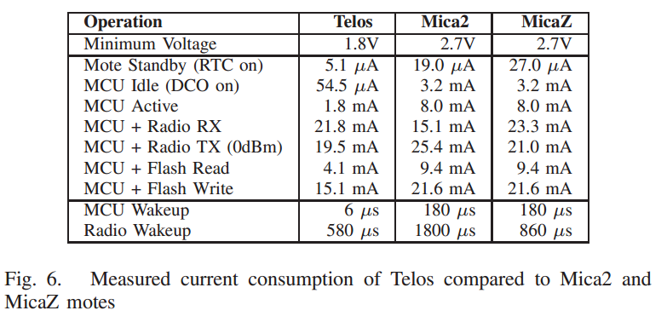
C. Analysis

Slide 26
C. Analysis - lifetime
At a 1% duty cycle, Telos can last for almost 3 years. For comparison, the lifetime of the Mica2 mote is 1.5 years and the MicaZ mote is 1 year.

Slide 27
C. Analysis - Hardware function
Lower power consumption does not imply that Telos has less functionality.
Telos features a DMA controller that operates while the MCU core is sleeping. The DMA permits applications to sample from the ADC, output a voltage on the DAC, or transfer data to and from the radio without interrupting the MCU.

Slide 28
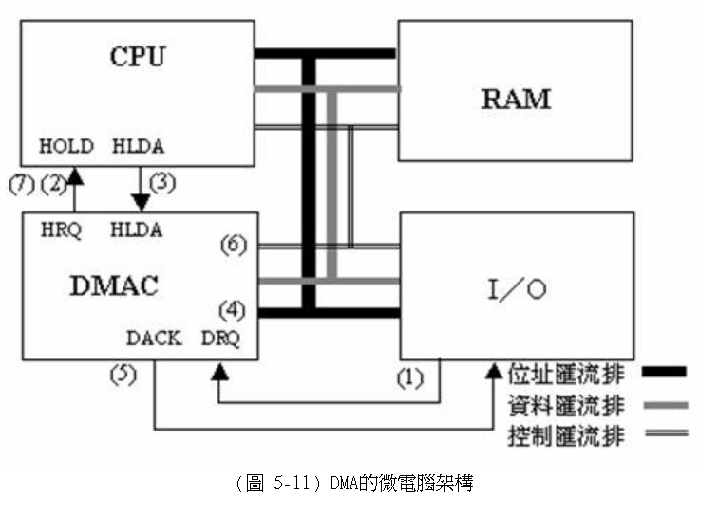
What is DMA?

Slide 29
C. Analysis - Hardware function
The performance enhancements of DMA permit up to 200k samples/sec ADC sampling.
Telos also has built-in brown-out reset, supply voltage supervisor, and interrupt driven sensors to maximize the sleeping time of the mote.
Notes:
（一些功能強大的MCU可以實現高達70K採樣/秒，但沒有中斷為基礎的方法對當前的最大MCU可以實現200ksamples/sec）。
較低採樣率所造成的開銷的上下文切換，由於每個ADC對話後的中斷。
TELOS也有內置的掉電復位，電源電壓監控器，中斷驅動的傳感器，以最大限度地提高睡眠時間的刺。

Slide 30
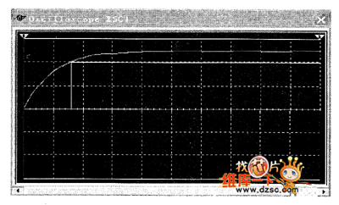
What is built-in brown-out reset

Slide 31
C. Analysis - testing
We tested the effect of distance on received signal strength (RSSI), packet success rate, and link quality (LQI).
We placed 10 receivers at the same location and 1 node transmitting at 0dBm at a distanced, all located 4” above the ground outdoors. We averaged the results over all receivers.
Notes:
我們平均的結果，所有的接收器。

Slide 32
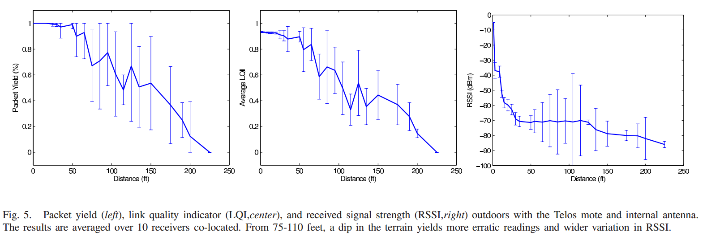
C. Analysis - testing
Notes:
我們平均的結果，所有的接收器。

Slide 33
C. Analysis - testing
The LQI provided by the radio closely maps to the packet success rate as shown in Figure 5. The RSSI follows an exponential decrease while the packet success rate is high.

Slide 34
C. Analysis - higher speed
The consequence of using a higher speed radio is that it may saturate the MCU’s processing capabilities when the channel is fully loaded.
We ran experiments on a 30 node Telos network to measure the effective bandwidth. A single Telos node is able to source approximately 1/2 of the full data bandwidth of the channel, or 125kbps.
Notes:
使用更高的速度的無線電的後果是，它可能飽和MCU的處理能力時，該信道被完全加載。
我們跑了一個30節點的TELOS網絡的實驗測量的有效帶寬。一個單一的TELOS節點的可以來源約1/2的全部數據的通道，或125kbps的帶寬。

Slide 35
TELOS PLATFORM
A. Technological Trends
B. Integrated Design
C. Analysis
D. Enabling Research

Slide 36
D. Enabling Research - button
Since Telos features a “User Button” for external user input, a combination of pressing the reset and user buttons may be required to boot to the golden image.
The user button may serve other user programmable services thereby providing a method for physical input to be received at the mote when radio commands are not an option (such as during physical deployment).
Notes:
TELOS設有一個外部用戶輸入的“用戶”按鈕，按下復位和用戶按鈕的組合，可能需要啟動的金像。
用戶按鈕，可以為其他用戶可編程的服務，從而提供了一種方法，可以在遙控接收的物理輸入無線電指令時，是不是一種選擇（如在物理部署）。

Slide 37
D. Enabling Research - button
The low power profile also makes Telos attractive for rechargeable designs, including solar and vibration harvesting. Since Telos operates down to 1.8V.
Notes:
Attractive :有吸引力
rechargeable:充電
低功率曲線也使得TELOS有吸引力的充電設計，包括太陽能和振動收穫。

Slide 38
D. Enabling Research -
Finally, Telos lowers the barrier of entry for using WSNs.
By using USB on every mote, any Telos may operate as an experimental device on a lab bench, a gateway to a PC or higher functionality device, or as a node in a large testbed.
Notes:
TELOS使用無線傳感器網絡的門檻降低了

Slide 39
CONCLUSION
We showed that Telos is the lowest power mote to date. Telos includes numerous enhancements that enable research in wireless sensor networks while making the devices easier to use and lowering the per-module cost.
Other features, like hardware write protection and radio signal stabil-ity, closely map to current research.
Additional flexibility allows software to configure or disable hardware modules. Telos is a robust module with lower power consumption yet greater performance than existing designs.
Notes:
我們發現，TELOS是最低的功率遙控。 TELOS包括許多增強功能，可在無線傳感器網絡的研究，同時使設備更容易使用，降低了每個模塊的成本。
其他功能，如硬件寫保護和無線電信號的穩定性，緊密地映射到當前的研究。
額外的靈活性，允許軟件配置或禁用硬件模塊的。 TELOS是一個強大的模塊，降低設備功耗，更高的性能比現有的設計。

