Slide 1

Perpetual Environmentally Powered Sensor Networks

Slide 2
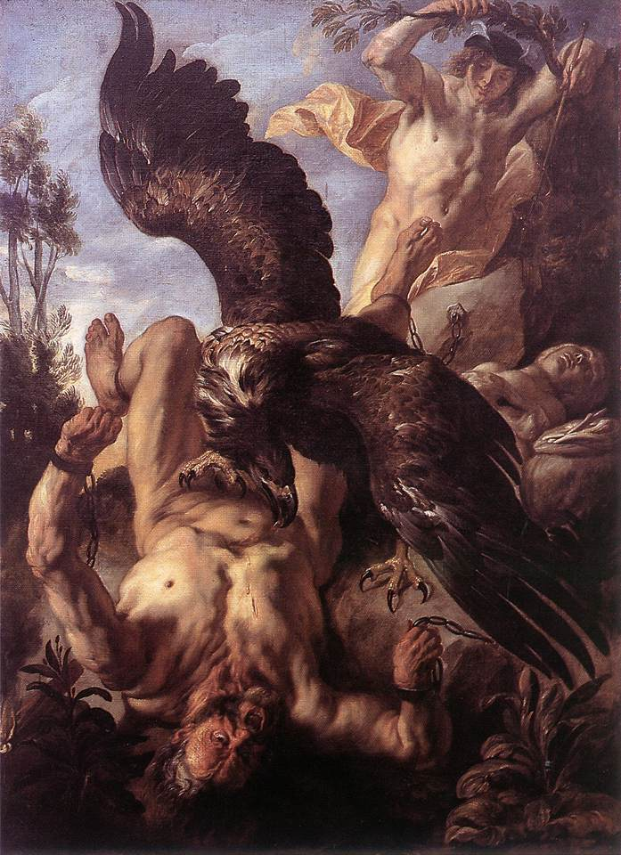

Introduction
Prometheus
[prəˋmiθjəs]
【希神】普羅米修斯

Slide 3
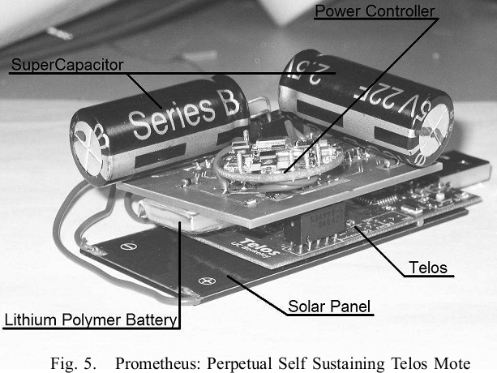
Introduction
Scenario :
Operating at low duty cycles.
Unpredictable environment.
System should adapt to available energy reserve.

Slide 4
Introduction
Problems:
Physical deterioration of the energy storage device.
Ex: Rechargeable batteries have about 300 to 500 recharge cycles.
Challenge:
Reducing the stain on storage element while preserving simple hardware and software architecture.

Slide 5
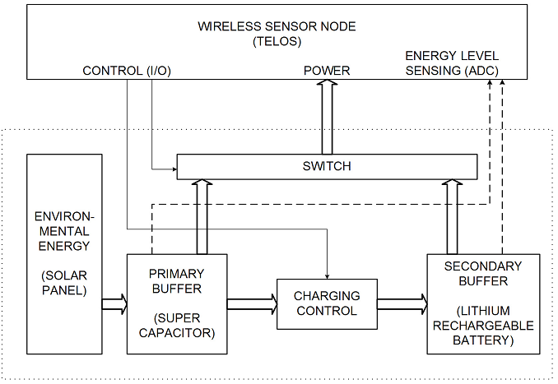
Architecture
Notes:
Primary buffer is super capacitor
Use MCU to do power management

Slide 6

Power Management Policy
The supercapacitor must provide energy to consumer most of the time.
Minimize access to the secondary buffer to prolong its lifetime.

Slide 7
Solar Panel
The size of the solar panel should be determined based on how fast the primary buffer should be replenished.
Larger solar cells only yield quicker charging.

Slide 8
Wireless Sensor Node
The sensor node influences the system’s power consumption by changing its duty cycle.
D is chosen by the application.
if the application knows the energy levels of the two buffers, it can adjust duty cycle intelligently.
Ex: this information can be shared across nodes to make routing decisions.

Slide 9
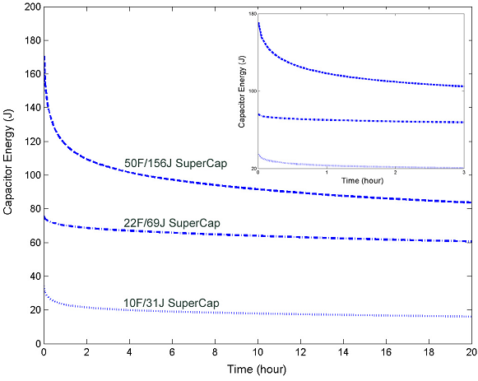
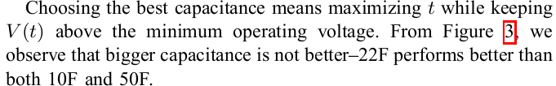
Primary Buffer: Supercapacitor
Advantages:
Virtual infinite charge cycles
Ideal for frequent pulsing application
Volatile input and frequent charge cycles.
Without time deterioration
Drawbacks:
Higher leakage current
Larger size
Cost

Slide 10
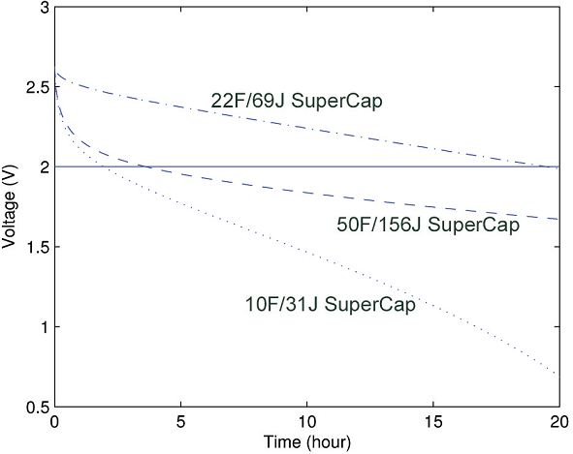
Primary Buffer: Supercapacitor
Primary buffer supercapcitor should be as large as possible to prolong lifetime.
The larger the capacity, the larger the leakage current.

Slide 11


Primary Buffer: Supercapacitor
Configuration to reduce leakage.
Leakage is proportional to energy level.
=>Lower by wiring two supercapacitors:

Slide 12
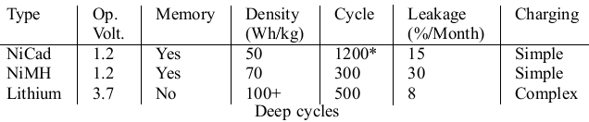
Secondary Buffer: Lithium Battery
When the primary exhausted, the secondary buffer is used.
hold energy for a long period of time.
low leakage but not charged or discharged frequently.

Slide 13
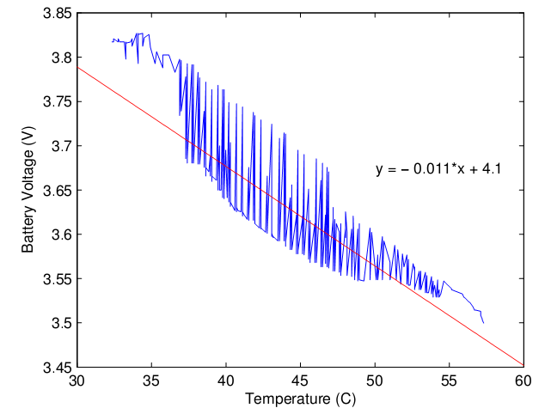

Software compensation
This may trigger a charge when not necessary.
Use software make compensated readings for true battery capacity.

Slide 14

Sensing and Control
Application with an active period at least once an hour is sufficient
Internal reference voltages of Telos are only 2.5V 1.5V => use 1M ohms resistor as divider instead of 1k ohms resistor
Notes:
1M 誤差雖大 但功耗少

Slide 15
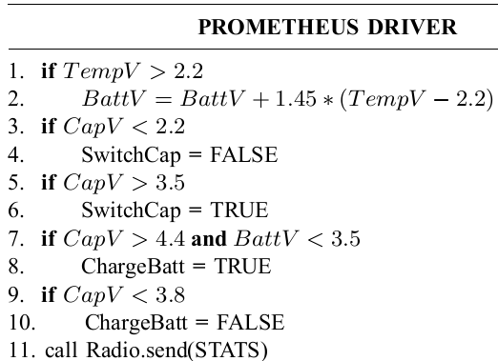
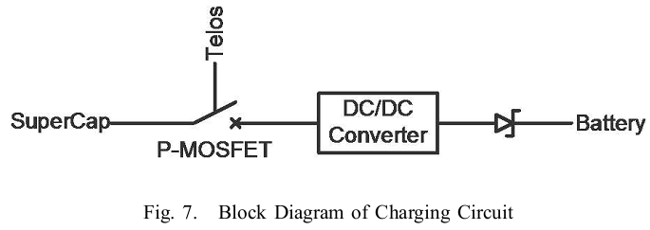
Charging Circuit & Driver
Software control all the power management.
Shallow discharge/charge can extend the battery’s life.
Notes:
充電的方法很多 可以純硬體 也可以軟應配合 也可純軟 選純軟最簡單 省電 又能執行複雜的scheme

Slide 16
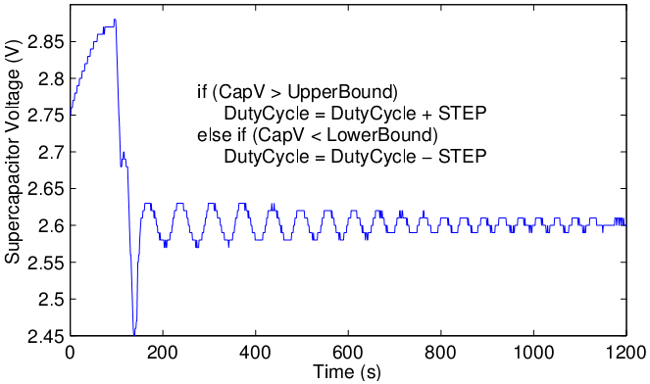
Example: Dynamical Duty Cycle
Dynamically adjust duty cycle based on energy in the primary buffer.

Slide 17
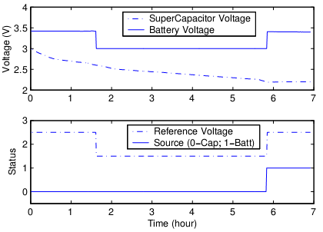
Result & Analysis(Scenario 1)
Conditions:
Reference voltage changing
1% duty cycle
During the night and energy in supercap is low
Reference voltage
2.5v -> 1.5v -> 2.5v

Slide 18
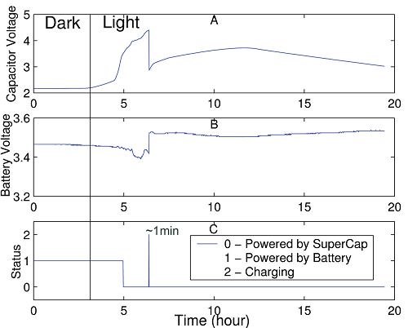
Result & Analysis(Scenario 2)
Charging start
Initiation of charging
1% duty cycle
During sunrise
Start with low battery level

Slide 19


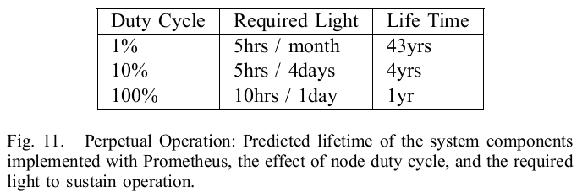
Result & Analysis
No light condition with 200mAh battery:

Slide 20
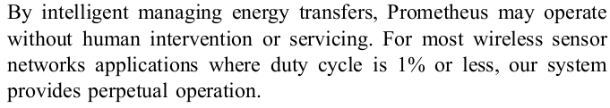

Conclusion

Slide 21
END
Thanks for your attention!

