Slide 1
System Architecture Direction for Networked Sensors
Jason Hill, Robert Szewczyk, Alec Woo,
Seth Hollar, David Culler, Kristofer Pister
Department of Electrical Engineering and Computer Sciences
University of California, Berkeley
Group 4
499415130 601415010 601441045
王維寬 林奕丞 鄭賜福

Slide 2
Outline
Introduction
Network Sensor Characteristics
Example Design Point
Tiny Microthreading Operating System (TinyOS)
Evaluation
Related Work
Architectural Implications

Slide 3
Outline
Introduction
Network Sensor Characteristics
Example Design Point
Tiny Microthreading Operating System (TinyOS)
Evaluation
Related Work
Architectural Implications

Slide 4
What enables the networked sensor?
4 important trends:
Moore’ s law
Systems on a chip
Integrated low-power communication
Integrated low-power transducers

Slide 5
Two issues for the design regime
Concurrency intensive
Several flows of data must be kept moving simultaneously.
Efficient modularity
Hardware specific and application specific components must snap together with little processing and storage overhead.

Slide 6
Following topics
Section 2 :
Design requirement and microthreading approach
Section 3 :
Current-technology hardware design
Section 4 :
Development of TinyOS
Section 5 :
Evaluation of the effectiveness
Section 6 :
Contrast with other embedded operating system
Section 7 :
Implication for the architectural directions

Slide 7
Outline
Introduction
Network Sensor Characteristics
Example Design Point
Tiny Microthreading Operating System (TinyOS)
Evaluation
Related Work
Architectural Implications

Slide 8
Design requirements
Small physical size and low power consumption :
Size and power constrain the processing, storage and interconnect capability.
Concurrency-intensive operation :
The primary mode of operation : Flow information.
Limited physical parallelism and controller hierarchy :
Capabilities and sophistication of the controller are much lower than conventional systems.
Diversity in design and usage :
Networked sensor devices tend to be application specific.
Robust operation :
These devices are unattended and operated in long time.

Slide 9
Outline
Introduction
Network Sensor Characteristics
Example Design Point
Tiny Microthreading Operating System (TinyOS)
Evaluation
Related Work
Architectural Implications

Slide 10
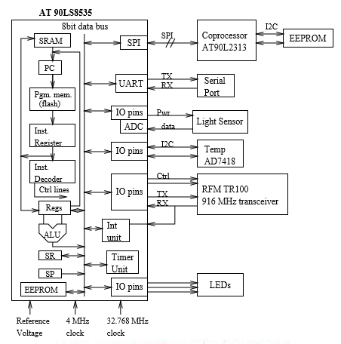
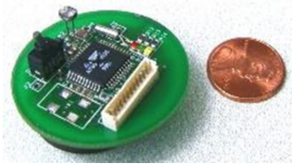
Hardware configuration

Slide 11
Hardware organization
Processor :
Using the MCU - ATMEL AT90LS8535.
8-bit Harvard architecture with 16-bit addresses.
32 8-bit general registers.
Processing at 4 MHz.
Operating voltage 3 V.
8 KB of flash and 512 bytes of SRAM. <-- The memory is very constrained !!
3 sleep modes : idle, power down and power save.
LEDs :
3 LEDs are connected through general I/O ports.
Photo sensor :
Connected through ADC.
Radio :
An RF Monolithics 916.50 MHz transceiver ( TR1000 ) .
Temperature sensor :
Analog devices - AD7428.
Serial port - UART:
Transmit mode : taking a byte of data and shifting it out.
Receive mode : sampling the input pin and shifting in bits.
Coprocessor :
Using the MCU - ATMEL AT90LS2343
Reprogramming the main microcontroller.

Slide 12
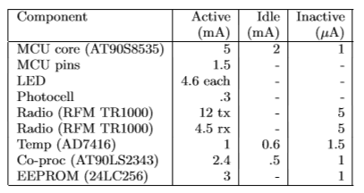
Power characteristics
Table 1 :
Powered by an Energizer CR2450 lithium battery
2 configurations :
Mobile sensor
Temperature and light reading
Limited energy
Stationary sensor
Bridging the radio network
Having power supplied.

Slide 13
Outline
Introduction
Network Sensor Characteristics
Example Design Point
Tiny Microthreading Operating System (TinyOS)
Evaluation
Related Work
Architectural Implications

Slide 14
4 Component parts
A set of fixed-size frame
Event handler
A Bundle of simple task
Command handler

Slide 15
A set of fixed-size frame
It prevents the overhead associated with dynamic allocation.
Execution time savings because variable locations can be statically compiled into the program instead of accessing thread state via pointers.

Slide 16
Event handler
The lowest level components have handlers connected directly to hardware interrupts
An event handler can deposit information into its frame, post tasks, signal higher level events or call lower level commands

Slide 17
Command
A command will deposit request parameters into its frame and conditionally post a task for later execution.
A command must provide feedback to its caller by returning status indicating whether it was successful or not.

Slide 18
Task
Tasks allow us to simulate concurrency within each component, since they execute asynchronously with respect to events.
FIFO scheduler.
Our prototype puts the processor to sleep when the task queue is empty.

Slide 19
Component types
Hardware abstraction
Synthetic hardware
The high level software components

Slide 20
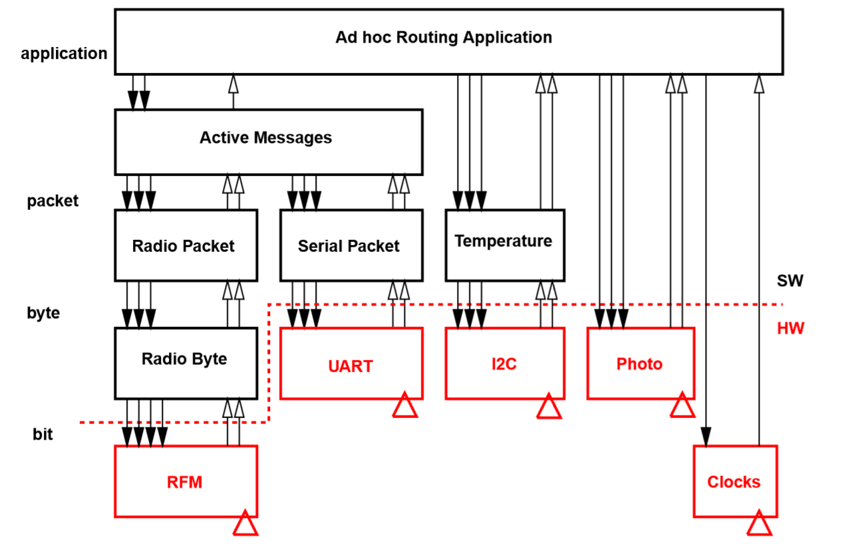

Slide 21
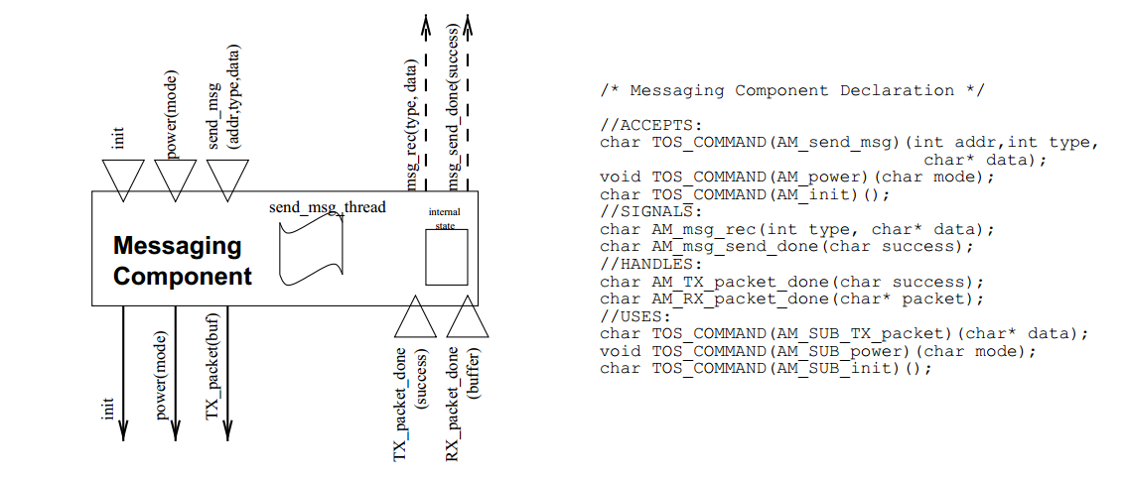
A sample messaging component

Slide 22
Put it together
Each sensor can act as a router for packets traveling from sensors that are out of range of the base station.
Each device must respond to : the arrival if a rout update, the arrival of a message that needs to be forwarded, the collection of new data

Slide 23
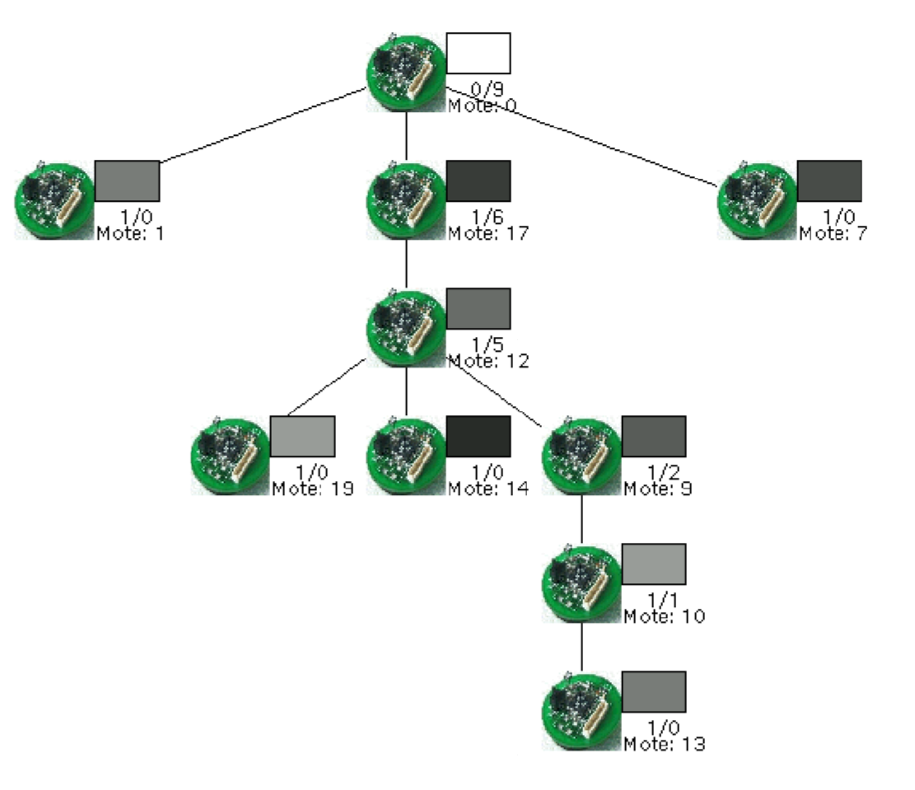

Slide 24
Outline
Introduction
Network Sensor Characteristics
Example Design Point
Tiny Microthreading Operating System (TinyOS)
Evaluation
Related Work
Architectural Implications

Slide 25
Evaluation
Small physical size
Concurrency-intensive operation
Efficient modularity
Limited physical parallelism and controller hierarchy
Diversity in usage and robust operation

Slide 26
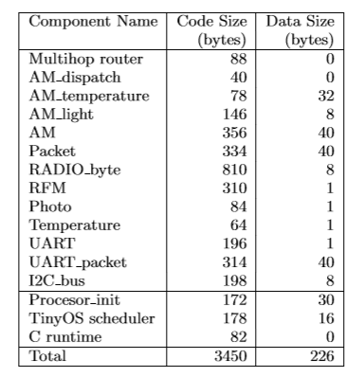
Small physical size:
Table 2 shows the code and data size

Slide 27
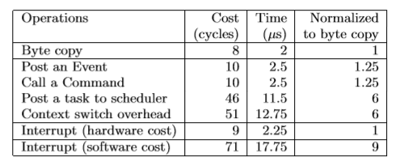
Concurrency-intensive operation:
important baseline characteristic -> context switch speed
Table 3 shows intrinsic hardware cost for moving bytes in memory.

Slide 28
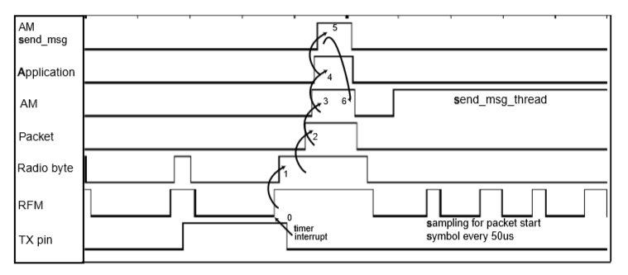
Efficient modularity:
Events and commands can propagate through components quickly.
Step 0 : Starting from the hardware timer interrupt
Step 1 : Events propagate up through the TX_bit_evt into byte-level processing.
Step 2 : Handler issues a command to transmit the final bit and then fires the
TX_byte_ready event to signal the end of the byte.
Step 3 : Trigger TX_packet_done
Step 4 : Signal the application that the send_msg command has finished
Step 5 : Issues another asynchronous send_msg command
Step 6 : Post a task at to send the packet.

Slide 29
Limited physical parallelism and controller hierarchy:
The processor is idle approximately 50% of the time in highly active period and the remaining time used to access other sensors.
Implement bit level functions on a separate microcontroller incur :
(a)can’t realize a performance gain because of the radio
bandwidth limitations.
(b)additional power and time expense in transferring
data between microcontrollers.
Diversity in usage and robust operation
The versatility of the architecture .
Target multiple CPU architectures in C.
When one node failure, routing application automatically reconfigures itself.

Slide 30
Outline
Introduction
Network Sensor Characteristics
Example Design Point
Tiny Microthreading Operating System (TinyOS)
Evaluation
Related Work
Architectural Implications

Slide 31
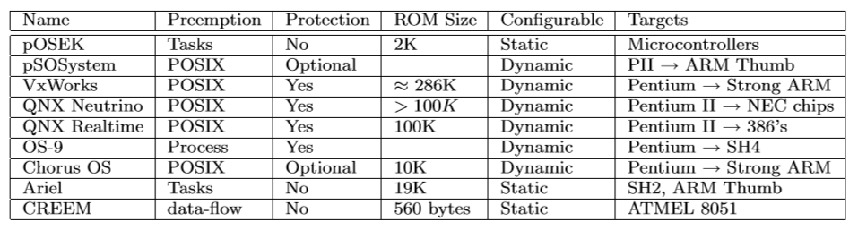
Related Work
Developing microelectromechanical sensors and new communication devices make a strong case for the development of a software platform to support and connect them.
EX: TinyOS
Traditional real time embedded operating systems :

Slide 32
Finite state machine (FSM) description language :
express component designs that are compiled down to software.
Device side :
Cubic millimeter sensor.
Low power hardware.
Efficient software .

Slide 33
Outline
Introduction
Network Sensor Characteristics
Example Design Point
Tiny Microthreading Operating System (TinyOS)
Evaluation
Related Work
Architectural Implications

Slide 34
Major design question
Whether or not individual microcontrollers should be used to manage each I/O device?
The tradeoffs :
Power consumption.
Speed of off chip communication.
Flexibility and functionality.
Using a higher performance ARM Thumb.
Won’t change the architecture.

Slide 35
Impact of changing architecture
The inclusion of hardware support for events would make significant performance impact.
An additional register set for event execution would save about 20 μs per event or 20 % of total CPU load.
The result shows the hardware support for radio collection would save about 690 μ J per bit in processor overhead.
This represents the elimination of bit level processing from the CPU.

Slide 36
Reconfigurable
The traditional system is configured for a particular system niche.
Reconfigurable computing has the potential of making WSN highly versatile.
For example : the Radio Byte
it consumes a significant amount of CPU time and must be radio protocol specific.

Slide 37
End
Thanks for your attentions.

