Slide 1
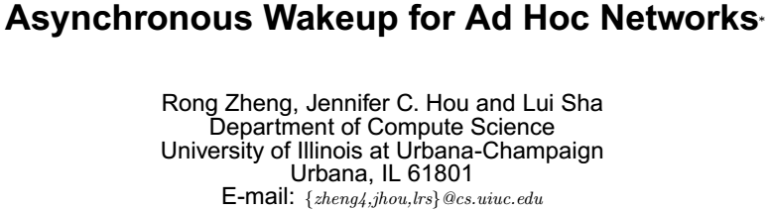

Slide 2
Outline
Introduction
Implement
Evaluation

Slide 3
Introduction: RFID
Out-band signal is used to wake up sleeping node
Asymmetrical, high power base node VS low power tag
Transmission in Mbps speed with lower power three orders of magnitude lower than the typical radio module
Sensitive to the interference over a large range frequencies in un controlled environment

Slide 4
Introduction: out-band control
Separate control channel
Lower-power radio control the operation
Data transmission use another radio band
915Mhz for control
2.4GHz for data transmission
Different frequency bands or different modulation schemes are usually different.

Slide 5
Introduction: Asynchronous wakeup mechanism
Asynchronous wakeup does not require clock synchronization
Each node follows its own wakeup schedule in idle states, as long as the wakeup intervals among neighbors overlap.
Nodes usually have to wakeup more frequently than in the scheduled rendezvous mechanisms.
Asynchronous wakeup is easier to implement and can ensure network connectivity even in highly dynamic networks.

Slide 6
Introduction 802.11
Single-hop
Power saving mode
Scheduled rendezvous mechanism
Distributed clock synchronization is a non-trivial issue in multi-hop ad-hoc networks

Slide 7
Challenge
A key challenge is to derive schedules that have minimum idle state energy consumption with bounded neighbor discovery latency.
  1. Desirable delay for neighbor discovery, what is the minimum percentage of time a node has to be awake?
  2. Does there exist an optimal schedule that can achieve such minimum value?
  3. How to design a wakeup protocol using the optimal schedule?
How can power management be performed with asynchronous wakeup?

Slide 8
Result
We implement our proposed schemes using IEEE 802.11 MAC (without the power management component) .
The proposed wakeup protocol can achieve communication efficiency comparable to the case without power management while saving energy up to 70%.
Using NS2 as the simulation platform.

Slide 9
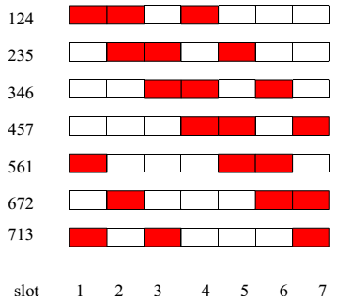
Symmetric WSF(wakeup schedule function)
(7,3,1) design
The slot assignment under the(7,3,1)-design. Each solid rectangle corresponds to an “on”
slot and each hollow rectangle an “off” slot. The rectangles are numbered by their positions. Note that
each schedule repeats every 7 slots and has 3 active slots
(ii) any two schedules overlaps for
at least 1 slot.

Slide 10
Implementation Issues
(I) The slot boundaries are not aligned
(ii) Even the slot boundaries are aligned, the schedules usually have phase shift relative to each other.
→The result of optimal symmetric block ensures that there exist sufficient, overlapping active slots even if two schedules are phase shifts of each other.
Notes:
NP-hard complete problem

Slide 11
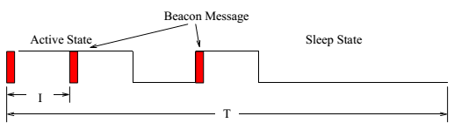
Protocol Implementation: Discovery
Each node divides its time axis into fixed-length frames of T slots. Each slot is in turn of length I.
Every node chooses the same WSF to schedule its own active and sleeping slots, where the WSF is derived from the optimal block design

Slide 12
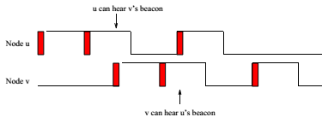
Example that two node discover each other
The WSF schedule ensures a minimum of one overlapping slot=>
  two neighboring nodes can hear each others beacons with probability one.
Transmission of beacons is deferred by a random backoff period when the channel is idle.
The beacon transmission time is at least one order of magnitude smaller than I.

Slide 13
Protocol Implementation: Neighbor List
Each node keeps a neighbor list
Refresh timer maintains the neighbor list
The relative clock in the clock field.
The schedule differences between the node and its neighbor in the schedule field.
The lifespan field in the neighbor list entry keeps the expected wakeup duration of a neighbor

Slide 14
Book keeping of Neighbor Schedules
Beacon messages use broadcast, they are subject to collision
Node to keep track of neighbor schedules and clock shifts in order to infer its neighbors’ wakeup schedules.
The processing and propagation delay on the interface card and the wireless medium may result in inaccuracy in estimating neighbors’ schedules. ➔ Introduce a small amount of slack time at the beginning and end

Slide 15
Difference with 802.11(Book keeping)
In IEEE 802.11, a node can optionally enters the sleep mode if it receives no ATIM frame in an ATIM window.
To ensure the correctness of the protocol, a node has to remain awake throughout the entire active slot.

Slide 16
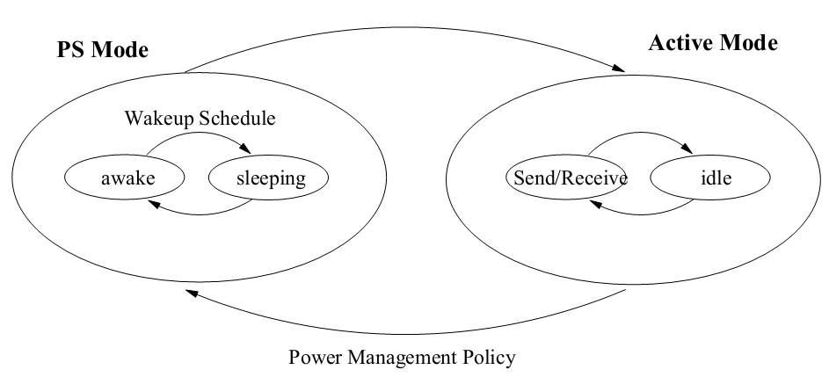
POWER MANAGEMENT USING ASYNCHRONOUS WAKEUP

Slide 17
Power management policy
Slot-based power management
On-demand power management

Slide 18
POWER MANAGEMENT USING ASYNCHRONOUS WAKEUP
If nodes can only communicate during the active slots of the wakeup schedule, the capacity of the network will be greatly reduced and the delay experienced by packets may be prohibitively long
the worst case nT for communication over an n-hop path

Slide 19
Slot-based power management
In the signaling protocol, if the number of buffered packets for an intended receiver exceeds a threshold L, the sender signals the receiver to remain on for the next slot.
A node requested to stay awake sends an acknowledgment to the sender, indicating its willingness to remain awake in the next slot.
If a node is not requested to stay awake by any of its neighbors, it follows its own wakeup schedule

Slide 20
Implement: Slot-based power management
We may employ an IEEE 802.11 like medium access and contention resolution scheme.
A signaling/reservation flag is piggybacked in data/ack messages and rts/cts messages using the has-more-data field in the mac header.

Slide 21
On-demand power management
Power management decisions are driven by data transmission in the network
Connectivity is only maintained between pairs of senders and receivers along the routes of data communication
Transitions from active mode to power saving mode is determined by a soft state timer called the keep-alive timer.
This reduces energy consumption while maintaining effective communication.

Slide 22
Discussion
Slot-based power management
  Finer time granularity
  Per-link state between a pair of neighbors using in-band signaling
On-demand power management
  Establish per-node state whose transitions are triggered by active communication
  Nodal state are more resilient to mobility than other network
  Pitfall: keep a node awake longer than necessary due to the fixed length of the keep-alive timer

Slide 23
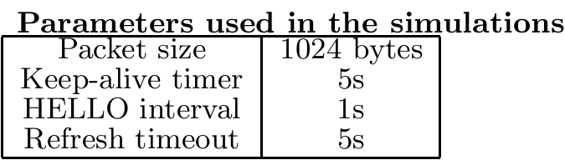
Performance evaluation
Half-duplex wireless radios that conform to 802.11-based WLAN with a bandwidth of 2mbps and a nominal transmission radius of 250m.
Greedy geographical routing protocol that forwards packet to a neighbor that is closest to the destination at each hop.
Performance metrics of interest are
  (i) the amount of power consumed
  (ii) the packet delivery ratio
  (Iii) the capability of adapting to network dynamics.
(T, k, m)-design: (1, 1, 1)== always on (73, 9, 1) (7, 3, 1)

Slide 24
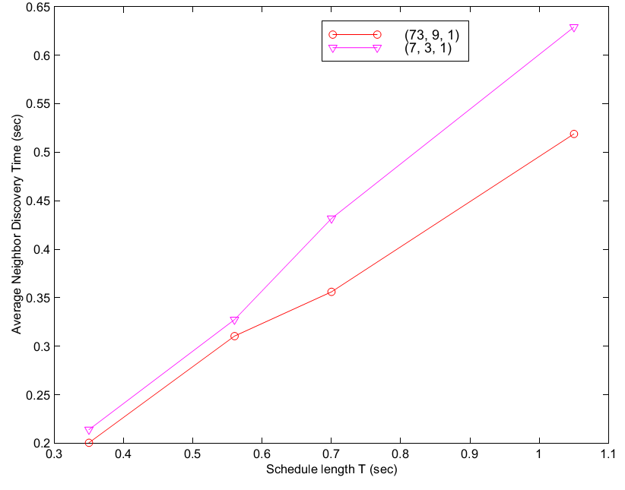
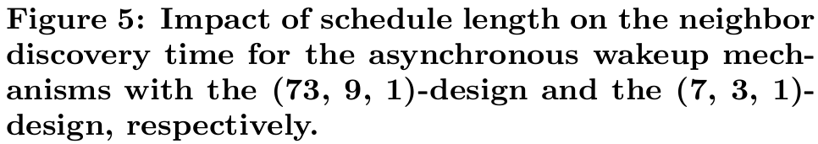
Study of neighbor discovery
50 nodes randomly placed in a
two-dimensional 1500x300 region.
(73, 7, 1) and (7, 3, 1) designs
use a schedule of total length 0.7s.
604 unidirectional links among
50 nodes.

Slide 25
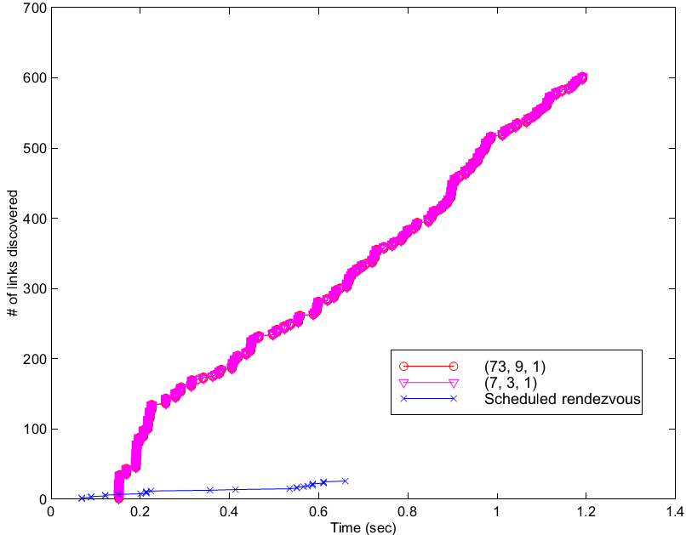
Study of neighbor discovery
The scheduled rendezvous wakeup
mechanism
  It is hypothetical one that similar to IEEE802.11 PSM
  Beacon interval 0.7s
  ATIM window size 0.035s,
  With the exception that the wakeup
  times are not synchronized.
Asynchronous wakeup mechanisms
  All the links are detected in a small
  amount of time
Scheduled rendezvous wakeup
mechanisms
  Only a subset of links can be detected due to
  the lack of time synchronization

Slide 26
Simulation: Static Networks with On-off Traffic Sources
Asynchronous wakeup mechanisms under on-off traffic sources
1500x300 static network with 50 nodes
Each sender is an on-off CBR traffic source with interleaved “on” and “off” periods of length 10s and 50s
The simulation lasts for 900s
Notes:
Constant Bit Rate. (CBR)

Slide 27
Simulation: Static Networks with On-off Traffic Sources
Significant energy saving under the proposed asynchronous wakeup protocol
The packet delivery ratio is comparable to that in the case without power management.
The packet delivery ratio under on-demand power management is higher than that under slot-based power management (note, however, the smallest packet delivery ratio is at least 94%).
Energy consumption under on-demand power management is higher due to the use of fixed-length keep-alive timers.
Slot-based power management, on the other hand, manages the power at a finer time granularity.
A shorter schedule saves less energy but also incurs less packet losses because the duty cycle of a node is higher.
On-demand power management in conjunction with the (73, 9, 1) wakeup schedule can achieve a good balance between energy consumption and packet delivery ratio.

Slide 28
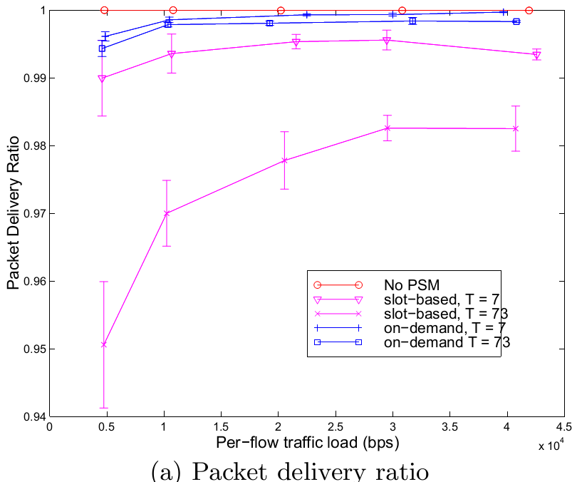
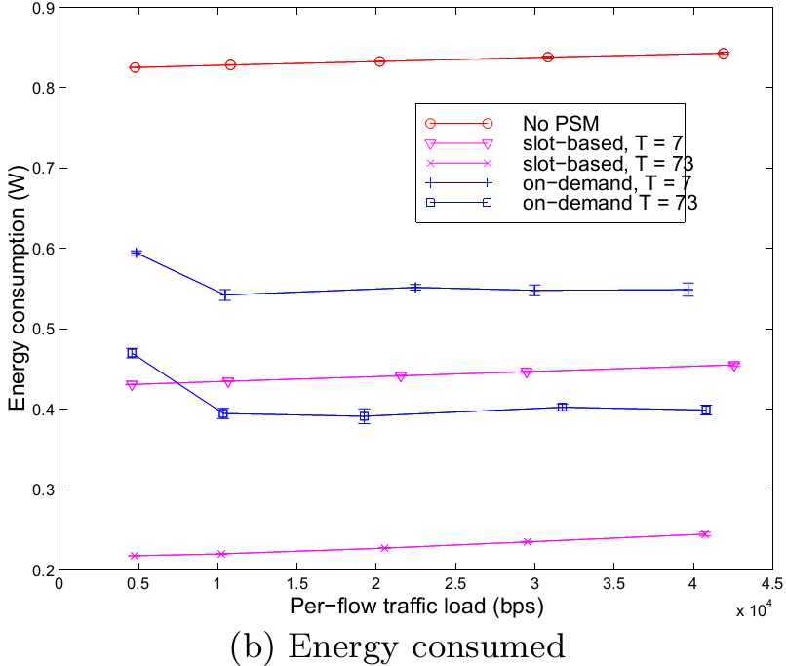
Simulation: Static Networks with On-off Traffic Sources

Slide 29
Simulation: Mobile Networks
10 long-lived CBR connections transmitting at 1kbps in a 50-node 1500mx300m network. All nodes move at 20m/s with pause times varying from 15s to 75s.
The level of power saving as a result of the asynchronous wakeup mechanism is quite significant.
The packet delivery ratio under slot-based power management deteriorates as the mobility becomes high.
Loss rate under the asynchronous wakeup mechanism with on-demand power management is less than that of an always-on network. Because the beacons are sent at higher rate. And the random backoff due to asynchronous wakeup mechanism.

Slide 30
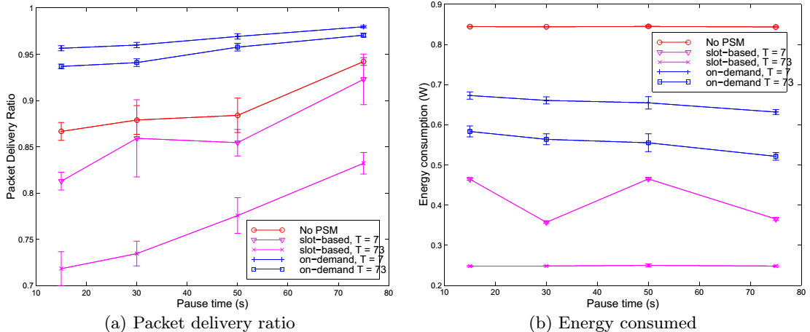
Simulation: Mobile Networks

Slide 31
Conclusion
The (7,3,1)-design is approximately half of that without power management
(73,9,1)-design can achieve much lower reciprocal of power consumption per unit data delivery at the expensive of slightly higher packet loss rate.
On-demand power management in conjunction with the asynchronous wakeup mechanism with the (73,9,1)-design can achieve a good balance between energy consumption and packet delivery ratio.

