Slide 1
能源科技與環境概論 太陽能電池導論
Hsing-Yu Tuan (段興宇）
Department of Chemical Engineering, National Tsing-Hua University

Slide 2
References
太陽電池 solar cells 黃惠良、曾百亨
Optoelectronics and photonics priciples and practices, S.O. Kasap 1999
Handbook of photovoltaic science and engineering Antonio Luque

Slide 3
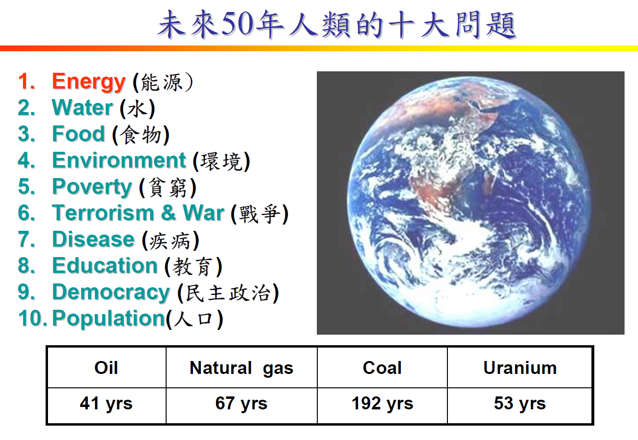

Slide 4


Slide 5
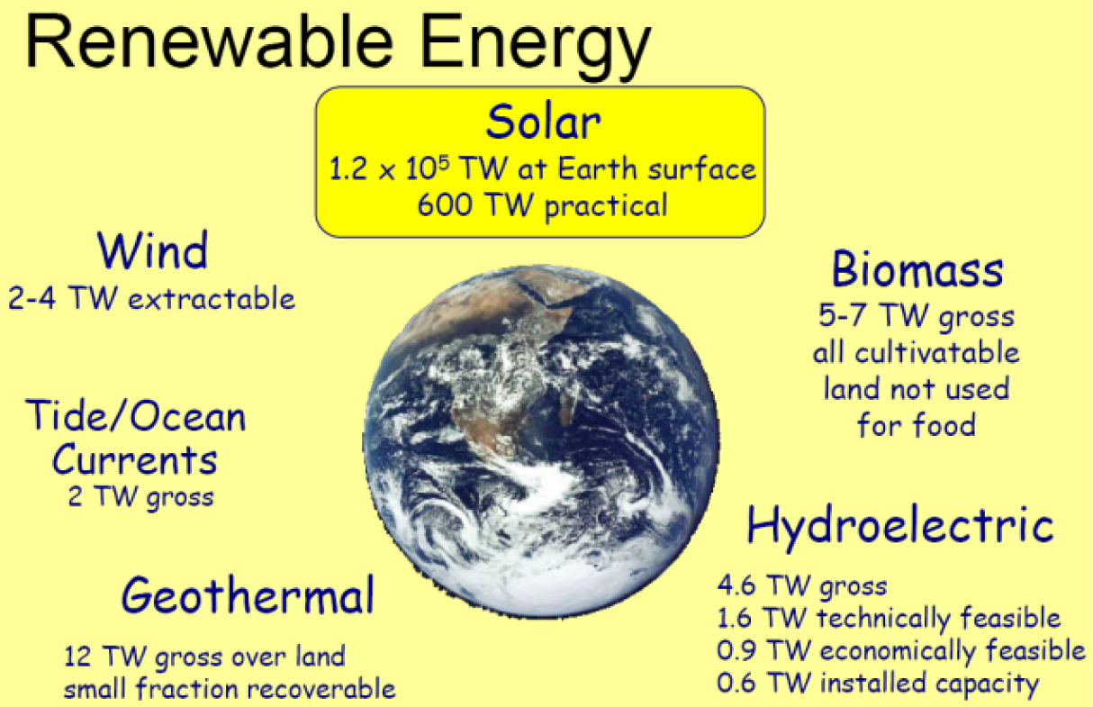

Slide 6
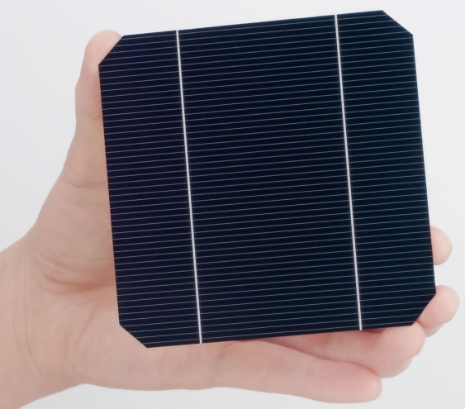
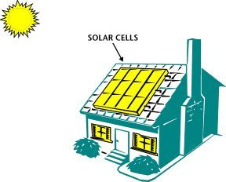
Solar cells
Solar light in
Electricity out

Slide 7
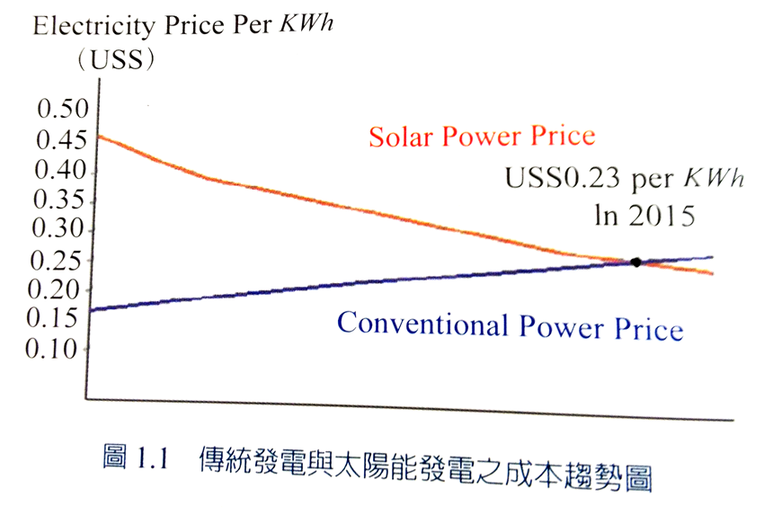
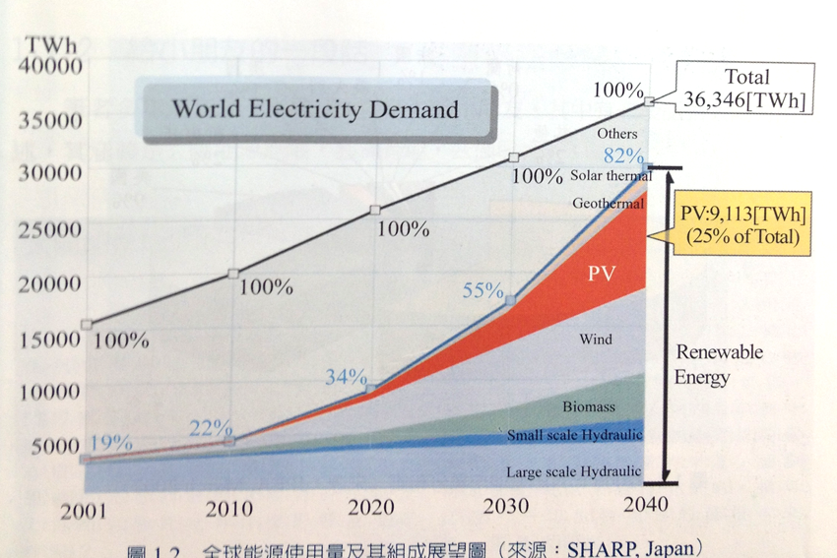
The request for solar energy
人類用電的使用量只會越來越高，而太陽能電池的
需求也會與日劇增
當達到黃金交叉時，太陽能電池
市場會有爆炸性的發展。

Slide 8
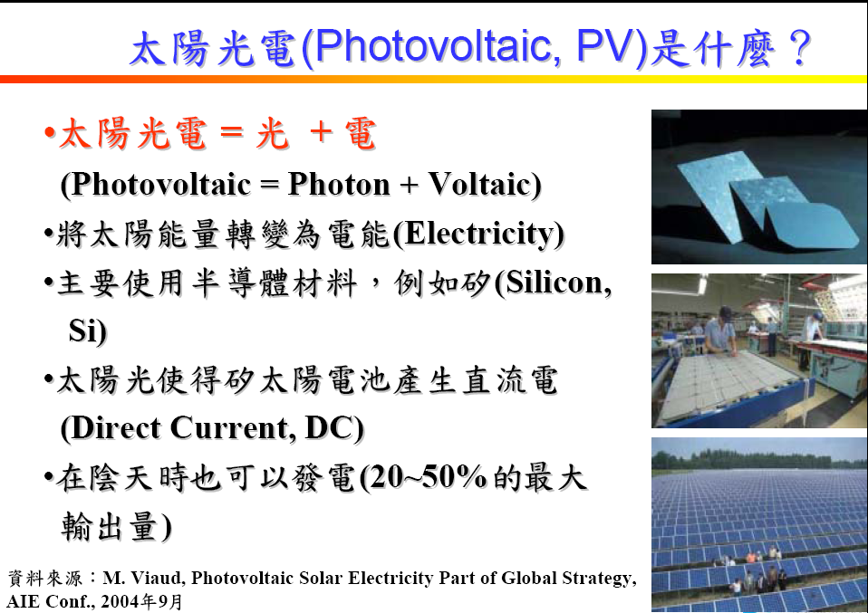

Slide 9
Video

Slide 10
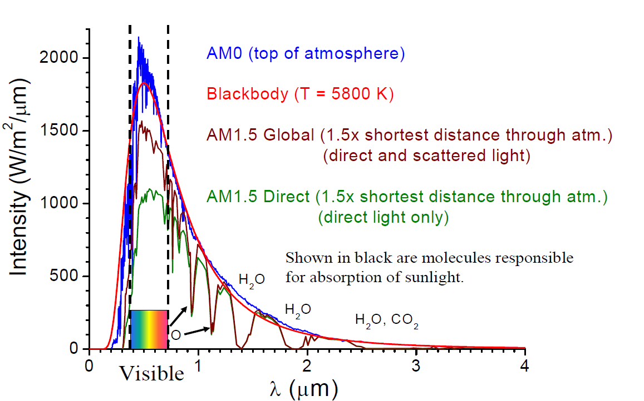
Solar light spectrum

Slide 11

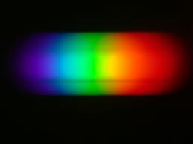
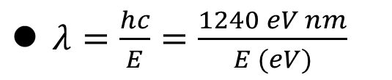
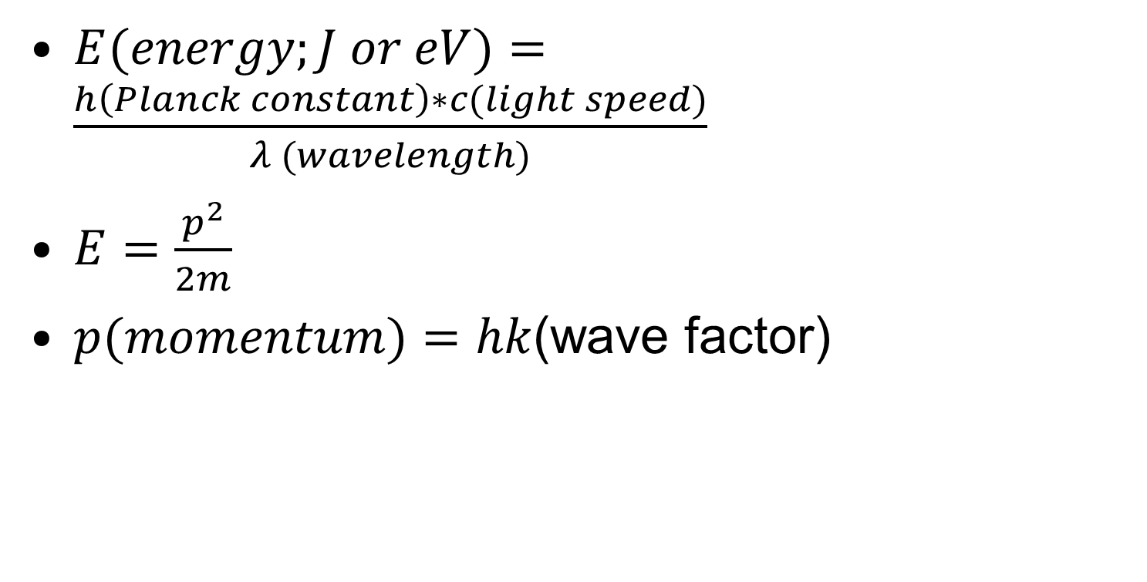
Energy conversion of light
$E(energy;J or eV)=\frac{h\left(Planck constant\right)∗c(light speed)}{λ (wavelength)}$
$E=\frac{p^{2}}{2m}$
$p(momentum)=hk$(wave factor)
$λ=\frac{hc}{E}=\frac{1240 eV nm}{E (eV)}$
A light with a wavelength of 1100 nm corresponds to 1.12 eV

Slide 12
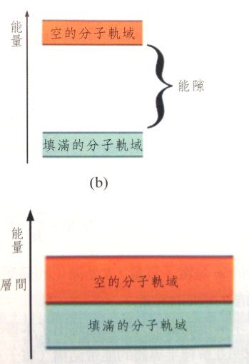
Generate electrons from materials by photons
excited state
Separation of the
electron-hole
pair
electron
Conduction band
or HOMO
Valence band
or LUMO
Conduction band
or HOMO
Valence band
or LUMO
pair
So, materials used for solar cell application need to have discrete energy
gap for photogeneration of electron-hole pair

Slide 13
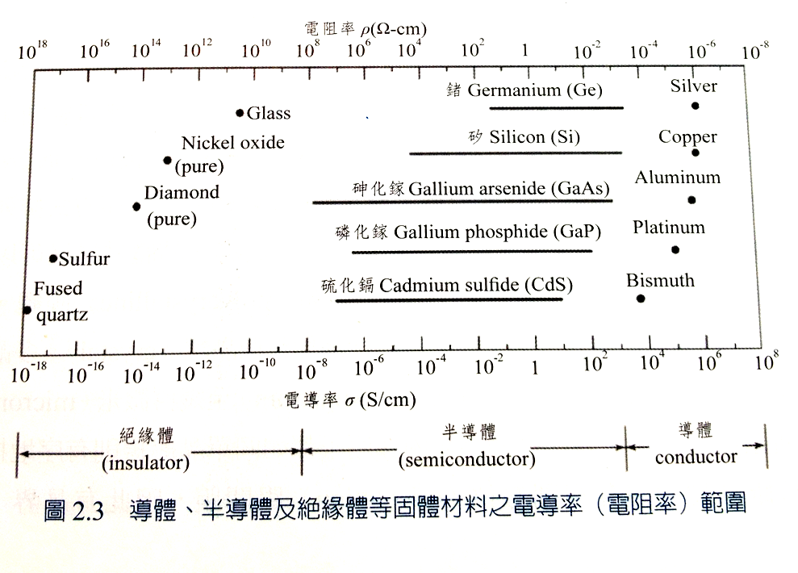

Slide 14
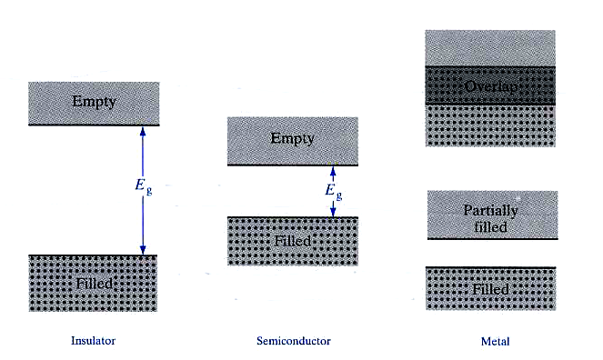
Inorganic materials: Insulator, semiconductor and metal
Insulator Semiconductor Metal
conduction band
> 5 eV
valance band
Streetman p62

Slide 15
Elemental and Compound Semiconductors
I II III IV V VI
 |  | 5 B | 6 C | 7 N | 8 O
 |  | 13 Al | 14 Si | 15 P | 16 S
29 Cu | 30 Zn | 31 Ga | 32 Ge | 33 As | 34 Se
47 Ag | 48 Cd | 49 In | 50 Sn | 51 Sb | 52 Te
15
Notes:
15
You have heard many good things from me about CIGS solar cell. From here, I would like to give a brief introduction of CIGS material and its properties. CIGS is a I-III-VI compound semiconductor derived from II-VI compound. The group II element is replaced by group I and group III elements. Therefore, the I-III-VI compound has the atomic ratio of 1:1:2. Like other compound semiconductors, the elements belongs to the same group can be substituted to form solid solution such as Cu-In-Ga-Se quaternary compound or even Cu-In-Ga-Se-S pentanary compounds.

Slide 16
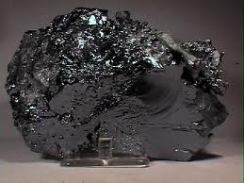
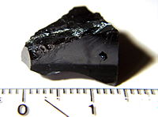
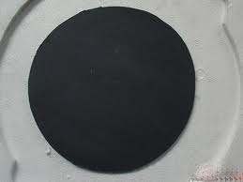
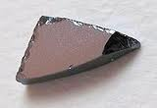
Inorganic Semiconductors
Silicon
CdTe
CIGS
GaAs

Slide 17
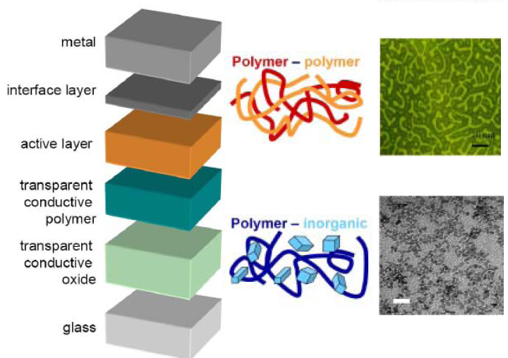
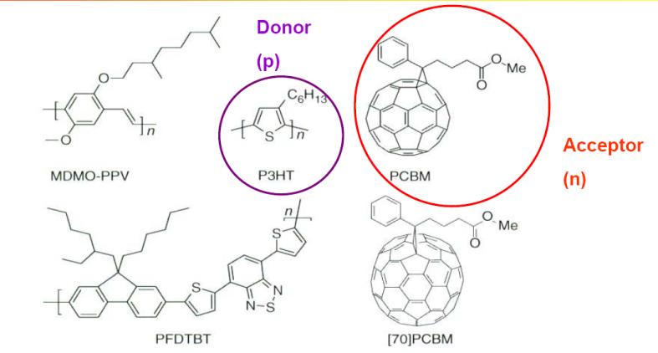
Conducting polymer

Slide 18
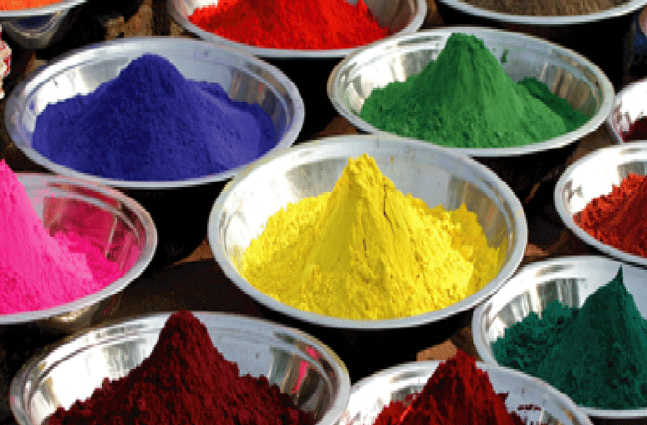

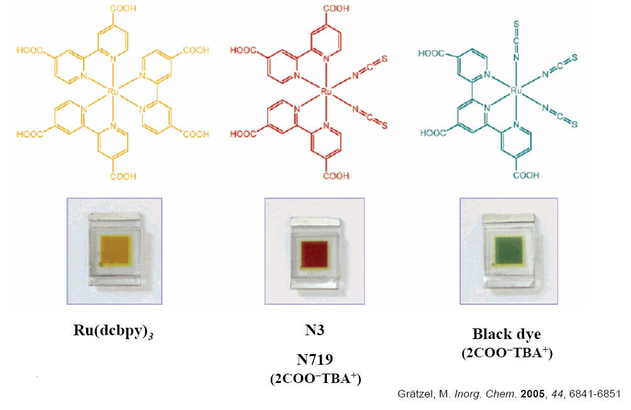
Or dyes

Slide 19
Various types of solar cells
crystalline
single crystalline
silicon
polycrystalline
thin film amorphous
single crystalline
III-V(GaAs)
solar cells
compound
poly crystalline
thin film
CIGS
CdTe
organic
dye sensitized
polymer

Slide 20
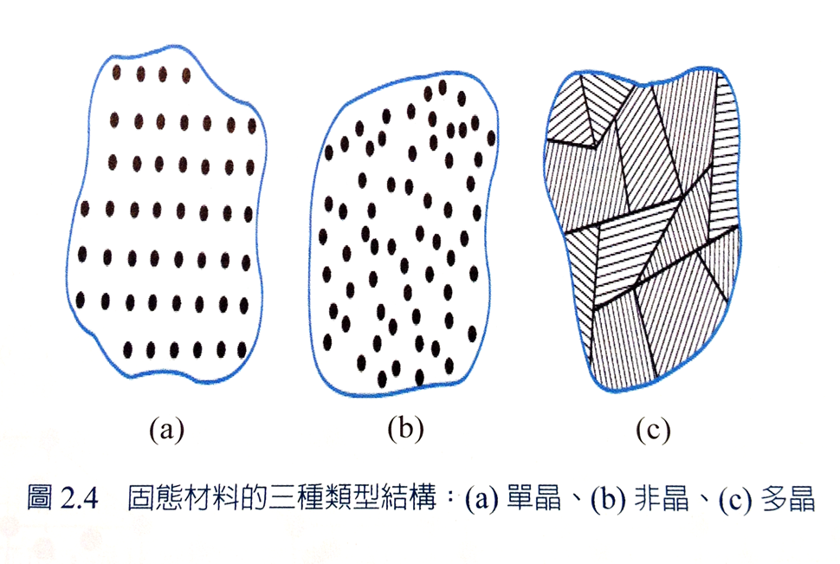
Solid materials : types

Slide 21
Solar cell Efficiencies
太陽電池材料種類 |  |  | 量產電池 轉換效率 | 量產模組 轉換效率 | 我國主要廠商
矽 | 矽晶片型 | 單晶 | ~18% | ~16% | 茂迪、昱晶、新日光、益通等………
 |  | 多晶 | ~16.8% | ~15% | 茂迪、昱晶、新日光、益通等………
 | 薄膜矽 | 非晶、非晶/微晶堆疊 | 8~13% | 7~10% | 聯相、富陽、宇通、旭能等………
化合物半導體 | III-V族 | GaAs 砷化鎵 (晶片、薄膜型) | 18~30% | ~25% | 華宇、禧通、億芳等………
 | II-VI族 | CdTe銻化鎘 (薄膜型) | 12~15% | 10~12% | 我國無廠商投入
 | 多元化 合物 | CIGS銅銦鎵硒 (薄膜型) | 12~14% | 10~11% | 新能、綠陽、台積電等………
有機物 |  | DSSC 染料敏化 | 6~9% | ~6% | 台塑、永光、福盈等………

Slide 23
Pick right materials as absorption layer
- Good absorption coefficient to harvest
light
- Suitable band gap

Slide 24
Direct band gap and indirect band gap structure
-We prefer direct semiconductor materials
since they can absorb light more efficiently

Slide 25
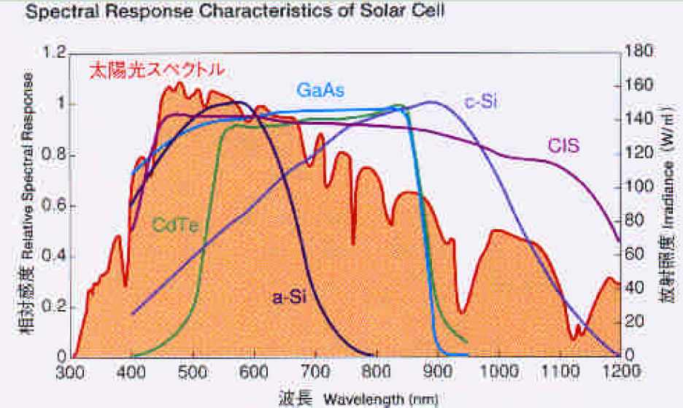
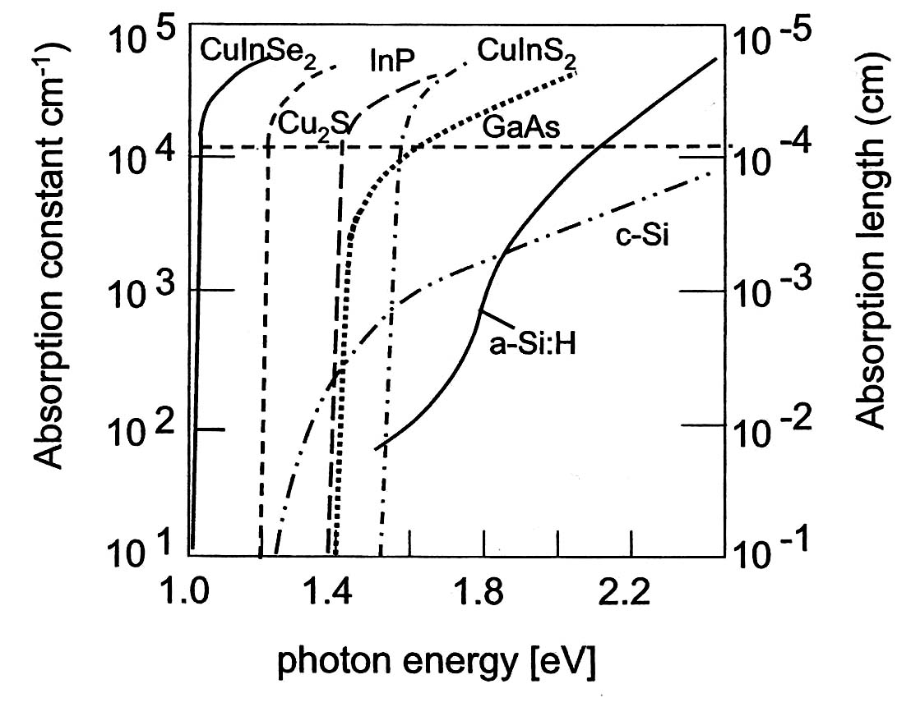
Absorption of semiconductors
-Si and Ge’s absorption coefficient
increase slowly with increased energy

Slide 26
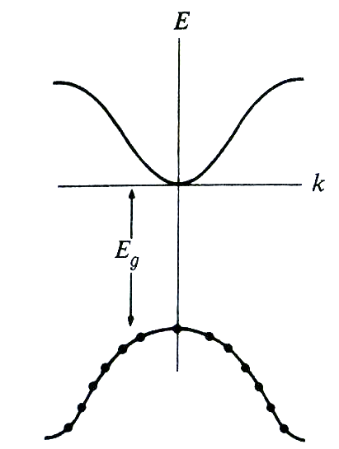
Pick suitable Eg (eV)
Theoretical maximum efficiency of a semiconductor
S(λ) =# of photons/area*time
bandgap of semiconductor should not be wide in order to get higher
-Electrons in the valence band can absorb energy of Eg, 2 Eg, 3Eg, but the excess energy can not be transformed to electric energy but transform to heat → need higher Eg
-very narrow band gap material can absorb most wavelength from sun, but transformed energy is small.
(neither
wide nor narrow)

Slide 27
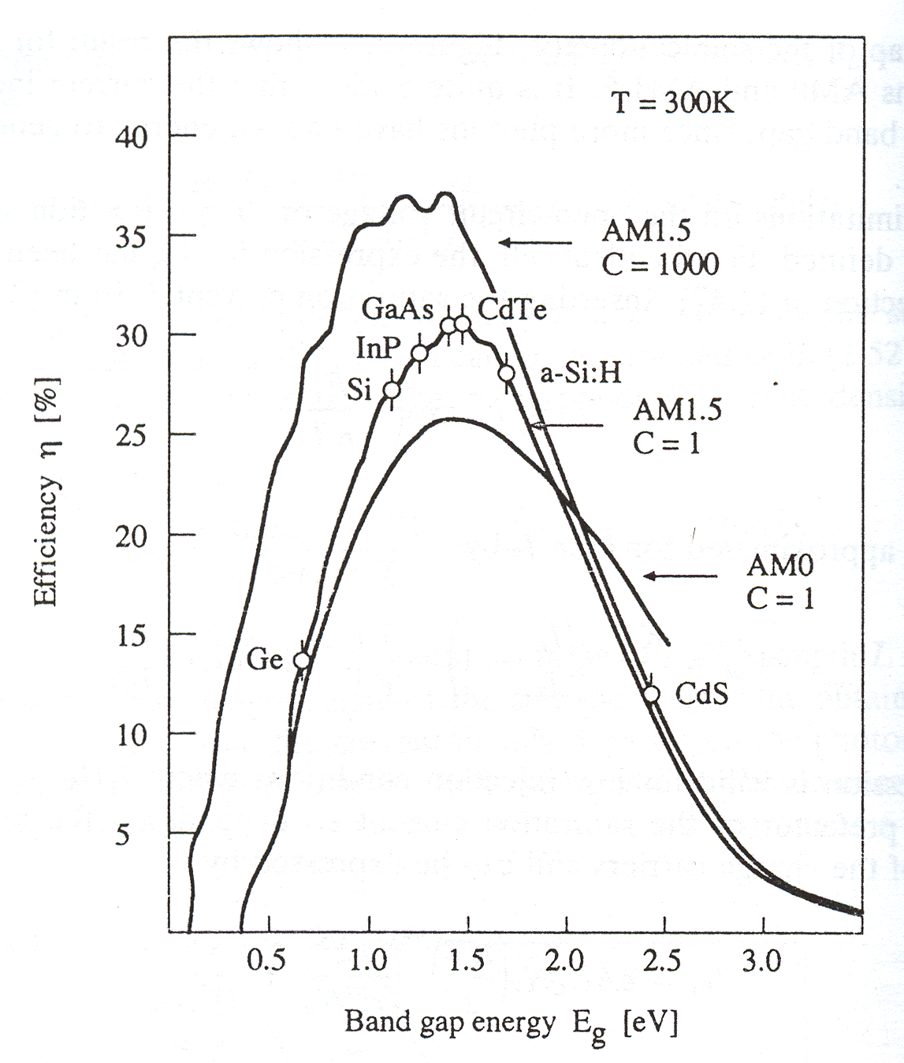
ηmax(%) vs Eg (eV) under AM1.5
real η_{max} is only around
30% due to loss of other facters
Eg:
1.0 – 1.5 eV is the best range

Slide 29
Semiconductor band, using Si as an example

Slide 30
Doping of Si: increase the conductivity of intrinsic Si
Donors: P, As, Sb (Column V elements ) , n-type, → provide one additional electron
Acceptors: B, Ga, In, (Column III elements), p-type→ provide one additional hole
Donors EB Acceptors EB
Sb 0.039 eV B 0.045 eV
P 0.044 eV Al 0.057 eV
As 0.049 eV Ga 0.065 eV
In 0.16 eV
P+
-
B-
Ec
-weakly bound
-bonding strength E_{B}~ 0.05 eV (Si bonding ~1.12 eV)
0.044 eV (P)
ED
Majority carrier - electron in a n-type material
hole in a p-type material
Minority carrier – hole in a n-type material
electron in a p-type material
EA
0.057 eV (Al)
Ev

Slide 31
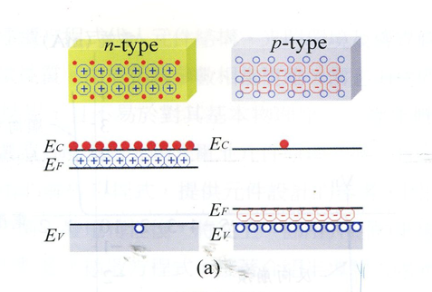
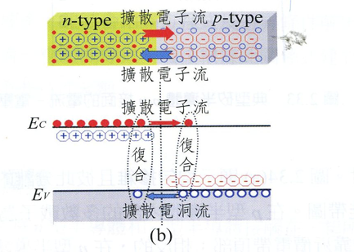
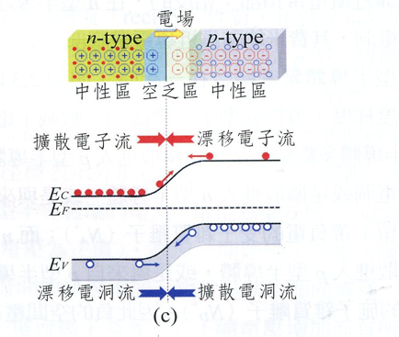
P-N junction

Slide 32
A PN junction photovoltaic device
PN junction provide a
Depletion region in where an electric
field is created for drifting
electron and hole
-incoming photon generate EHPs and
create current
-generated electrons and hole can
diffuse and drift in neural region and SCL, respectively
-Opencircuit voltage (Voc) develops between the terminals
of the device because the electrion reaches the
neutral n and p, respectively.

Slide 33
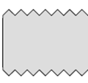
Device structure of a Si solar cell
(1)
Finger electrodes
Bus electrode
(2)
for current collection
(3)
0.2 μm
n
Incident light
surface texturization
200 μm
p
In order to capture more light
- finger electrodes were made to allow light pass through the device
a thin antireflection coating on the surface reduces light reflection and allow more
lighte to enter the device
-surface texturization to for multiple light reflection and increase light path

Slide 34
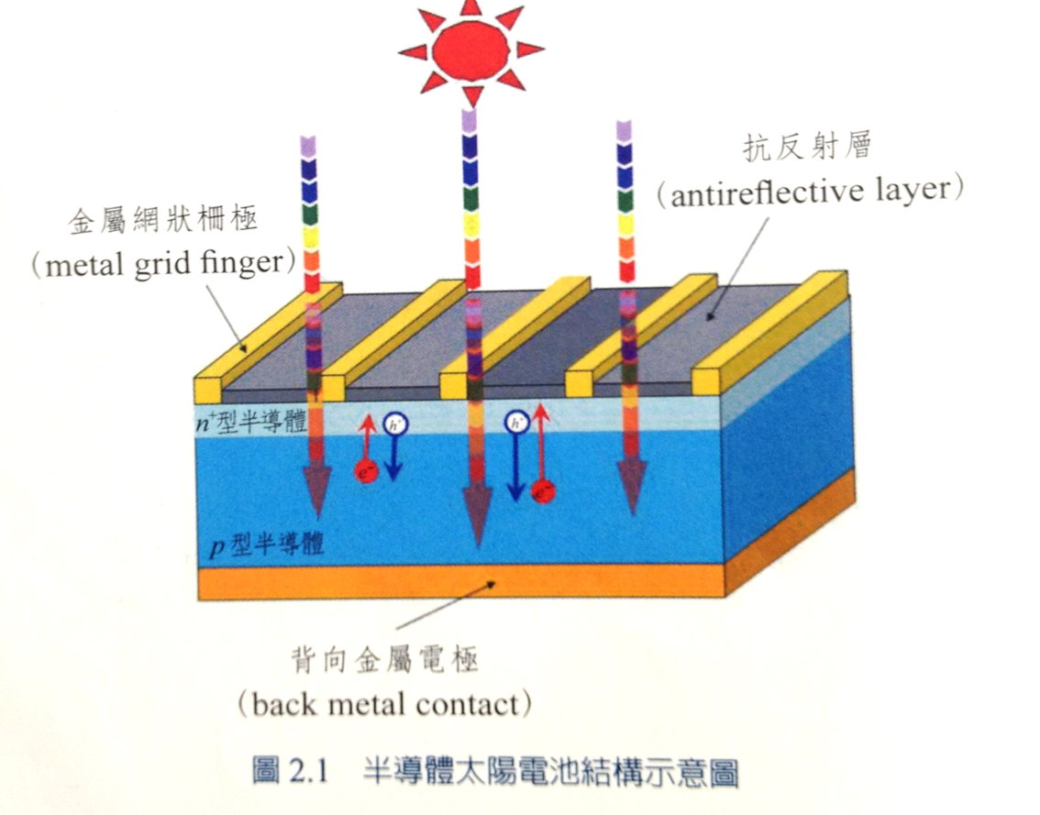
Schematic of a semocnoductor solar cell

Slide 35
Video

Slide 36
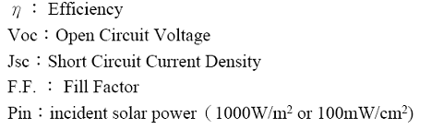
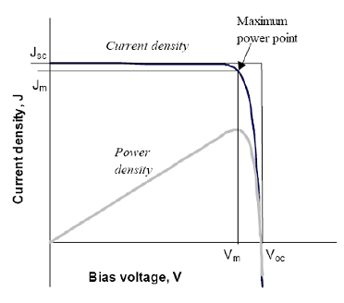
IV curve of a solar cell
Voc (open circuit voltage)
-when output current approaches zero,
the voltage develops between two terminals
ideally Voc~Eg at 0K and inverse proportional
to temperature
Jsc (short-circuit current)
-like the device connect the device with metal circuit,
close to photogenerated current
FF (fill factor): We want FF close to 1

Slide 37
Solar cell efficiency :an example
η and FF in this device ?
η=P_{MP} /P_{in} x100%=FF*V_{oc}J_{sc}/ P_{in} x100%
（輸出電功率/入射光功率)
P _{in} =100 mW/cm²
P_{MP}=V_{MP}*J_{MP}=0.55*5.9716=3.28mW/cm²
η =3.28/100*100%=3.28%
V_{oc}=0.72 V
J_{sc}=7.1464 mA/cm²
FF=V_{MP}*J_{MP}/V_{oc}*J_{sc}
=3.28/(0.72*7.14)=0.63
Jsc
(0.55,5.9716)
J_{MP}
V_{MP}
Voc
Voc: 開路電壓 (open circuit voltage), 當輸出電流趨近於零，相
對太陽電池兩電極端點沒有連接所得到的電壓
Jsc:短路電流(short circuit current)
如將照光的pn二極體兩端的金屬電極用金屬線連接, 造成短路, 此短路電流等於光電流

Slide 38
Various losses of solar energy of a Si solar cell during processing
Silicon band gap is 1.1 eV, and
the device loses all photon energy
less than 1.1 eV
Excessive photon energy
Near surface EHP recombination
Only 43.6% remaining!
Antireflection coating is not perfect
Voc is inverse proportional to
temperature, so not equals to Eg
device fabrication resistance
The highest efficient of a real
photovoltaic device that uses a
single crystal of Si
Is about 24.7% (澳洲新南威爾斯
大學）

Slide 39
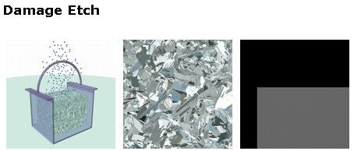
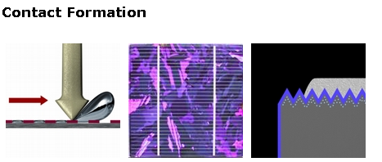
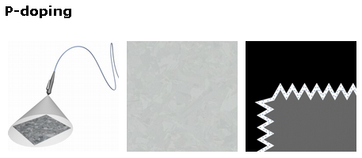
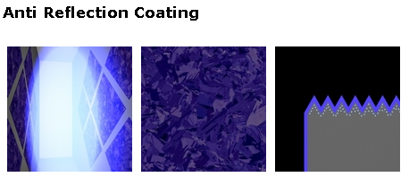
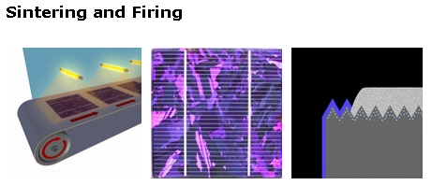
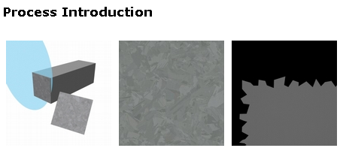
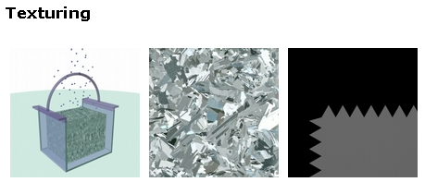
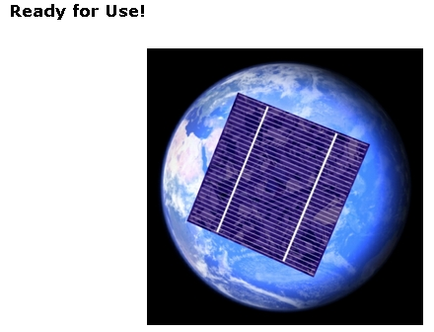
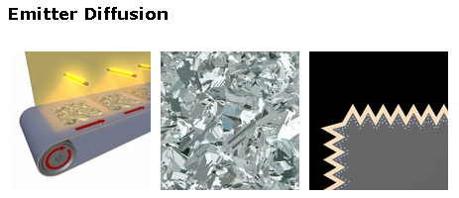
Single/poly crystalline Si solar cell fabrication process
P-type ingot
was cut
(the wafer are placed in a belt furnace
And heated about 900 °C
etch in a strong acidic
or alkaline solution
The reflectivity is still round 30%,H:SiNx is deposited
on the cell to reduce more the reflectivity
etch in a weak acidic
or alkaline solution
metal contacts are made by screen printing
liquid glass containing P is distributed on one side of the wafer by spraying or spinningand heated
Metallic contacts are heated and
Etch trough the antiflecton coating

Slide 40
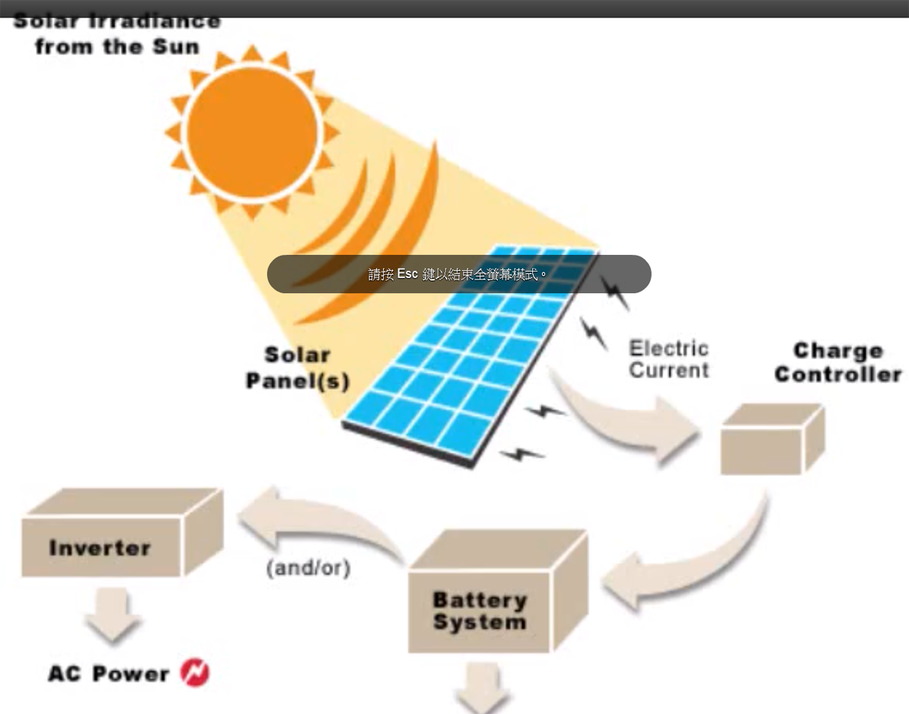
Solar cells installation
DC power

Slide 41
Next step of crystalline Si solar cell

Slide 42
貳、發展現況(續)
五、我國太陽光電產業鏈
Industry
Up Stream
Mid Stream
Down Stream
Poly-
Silicon
Ingots/
Wafer
Solar Cell
PV Module
PV System & Installation
Solar Grade
Silicon
Si Ingot
& Wafers
Wafer-based Solar Cell
－Mono-Si, Multi-Si, GaAs
Thin-film Solar Cell
－a-Si/μ-Si, CIS,
－Dye Sensitized Solar Cell
CPV Solar Cell
PV
Modules
Installation
System Parts
－Inverter, BOS…
Equipment
Product
頂晶
知光
英懋達
生耀
科風
茂暘
錸德
有晴
大晶
全能
安集
茂鑫
強茂
有成
友達
綠晁
鼎笙
17Companies
中美晶
綠能
合晶
統懋
峰毅
茂迪
旭晶能源
晶耀
達能
國碩
昱成光能
友達晶材
12 Companies
Installation：茂迪、台達電、廣運、友達、聯相、宇通、富陽、永盛能源、有成、綠能、大金、東城、冠宇宙、太陽動力、鼎鼎、聚恒、金華成、中國大陸電器、羅森、全面性、伸浦、崇越、統昱、永旭、台邦、傳典、高鋒、華旭環能、工易、耀能、上揚、錸德、光寶綠能、詠通、華城、亞力、駿成、曜晟、寶球、明宜、元太、伸浦、新世紀、金頓、海灣、泰新、安慶、昇暉、雄雞
System Parts：台玻、元璋、太美、城東、力鋼、元一、高鋒、法隆、泉鋼、盈正豫順、明碁材料、達方、台虹、碩禾、致嘉、台塑、暘益、台聚、新輝、昇貿、宏致、泰和、建和興、科宥
Equipment：均豪、廣運、欽揚、東遠、志聖、帆宣、北儒、翔勝、致茂、綠色
Product：亞通、東城、強而青、鯨威、日光能、茂迪、中國大陸電器、同昱、旭辰、旭邦、科宥、信合、千附、永炬、日曜、宇能、智柏、登陽 、誼成、森富國際、
>100 Companies
矽晶電池：茂迪、益通、旺能、昱晶、新日光、昇陽、茂矽、太陽光電、太極、燿華、長生能源、旭泓、亞崙、尚陽、強茂、樂福、聯景、元晶、英穩達、友達
矽薄膜電池：綠能、聯相、富陽、宇通、八陽、旭能
CIGS電池：綠陽、新能、太陽海、正峰新、亞化、威奈聯合、台積電
聚光型電池：全新、華上、禧通、台達電、晶電、宏捷、華旭、億芳、瀚昱、海德威、太聚、綠源、吉泰、亞飛、禾晶
DSSC：健鼎、福盈、永光、镸興、台塑
> 54Companies
Company
福聚太陽能
友達晶材
寶德能源
實聯能源
科冠
山陽科技
6 Companies
歷年廠家數：
2005＝40
2006＝50
2007＝76
2008＝100
2009＝123
2010＞160

Slide 43
歐洲與日本之電池產量由2006年市占率約30%下降至2011年的10%以下。
太陽光電生產基地持續向亞洲移動趨勢不變，中國大陸與臺灣生產比例近全球70%。
大陸挾其成本優勢與政策支持，成為全球最大製造國，2011年產值達2536億元人民幣。

Slide 44
Thin film solar cell: use Si as an example
- required thickness of thin film solar cell is around 0.5 μm, 1/500 of that of wafer based solar cell
- material cost is very low

Slide 45
Advantages of thin film solar cells
1. low raw materials are required for fabrication
2. light transmission is better
3. more competitive price (CdTe, US$1 per watt ; First
Solar, stock price is US$180 )
4. frameless design
5. Ideal for BIPV( building integrated photovoltaic)

