Slide 1
Fundamentals of Optoelectronic Materials and Devices
光電材料與元件基礎
Hsing-Yu Tuan (段興宇）
Department of Chemical Engineering, National Tsing-Hua University

Slide 2
Textbook in this lecture
Optoelectronics and photonics priciples and practices, S.O. Kasap 1999
Solid state electronic devices, Ben G. streetman and sanjay banerjee, fifth edition

Slide 3
Band gap schematic of Si

Slide 4
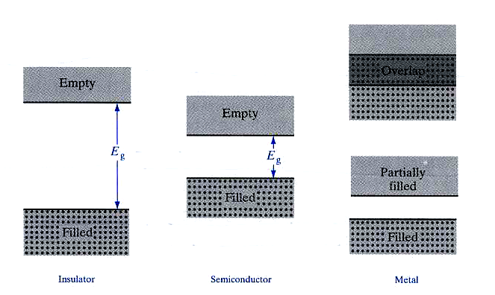
Distinction between insulator, semiconductor and metal
Insulator Semiconductor Metal
conduction band
plenty of
electrons
> 5 eV
valance band
-few electrons excited to conduction band
Ex, Si: 10¹⁰ / cm3
(note: Si has 5x10²² atoms/cm3)
-very few electrons excited to
valance band at room temperature
Streetman p62

Slide 5
Direct band gap and indirect band gap structure

Slide 6

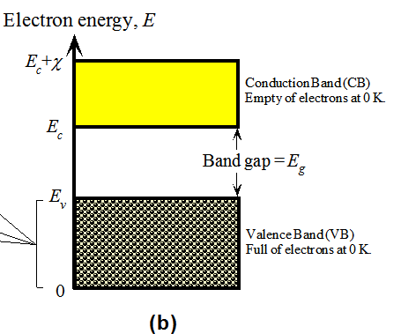
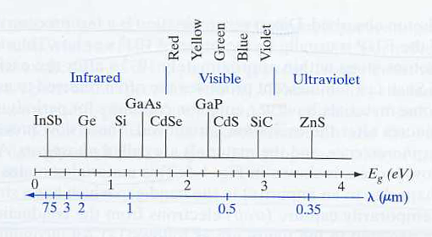
Semiconductor, band gap, and wavelength
顏色名 | 波長 (nm)
紫 | 380-450
藍 | 450-495
綠 | 595-570
黃 | 570-590
橙 | 590-620
紅 | 620-750
The band gap corresponds to the wavelength
of light that emits from the semiconductor
Eg=1240/λ eV

Slide 7
Carrier: electron and hole
Some electrons were excited to the conduction band at temperature >0K
For convenience, an empty state in the valence band is referred to as a hole
Electron-hole pair (EHP): conduction band electron and the hole are
created by the excitation of a valence band electron
-EHPs are free charge carriers in semiconductor materials
-Si, at room temperature has 10¹⁰ EHP/cm3 (Si: 5x10²² atoms/cm3)

Slide 8
Doped materials
Donors: P, As, Sb (Column V elements ) , n-type, → provide one additional electron
Acceptors: B, Ga, In, (Column III elements), p-type→ provide one additional hole
n
p
P+
-
B-
-weakly bound
-bonding strength E_{B}~ 0.05 eV (Si bonding ~1.12 eV)
Majority carrier - electron in a n-type material
hole in a p-type material
Minority carrier – hole in a n-type material
electron in a p-type material
The nomination is not limited to
Si, but for any semiconductors

Slide 9
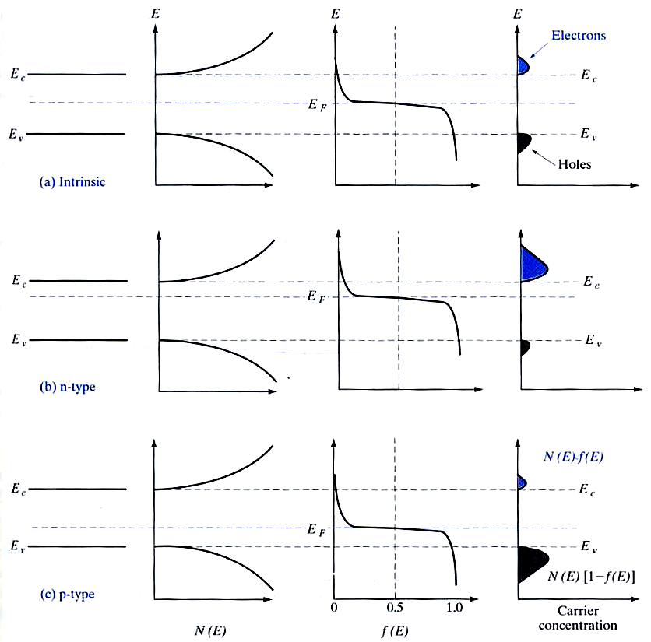
Equilibrium distribution of carriers in intrinsic and doped semiconductors
hole 1-f(E)
Ec
Ei
Ev
i
Intrinsic
n
fermi level shift
Ec
EF
Ei
Ev
Ec
Ei
EF
Ev
p
n-type
p-type
g(E)

Slide 10
R-G statistics
A technical men given to the mathematical characterization of recombination-generation process
R-G evaluates the time rate of change in the carrier concentrations
-The rate of change in the carrier concentration
n~no
perturbation
Ec
ET(R-G)censter
Ev
△P
n-type semiconductor
△p<<no
Low level injection implied
△p<<no n~no in an n-type material
△n<<Po p~po in an p-type material

Slide 11
n-type semiconductor after a perturbation
perturbation
perturbation
t=0
t>0
t->infinite
P0
△P
△P=0
n-type semiconductor
n-type semiconductor
n-type semiconductor
The change of minority carriers
dominate the recombination rate
To be approximately
Proportional to NT (R-G center numbers)
(R-G)
(since the multitude of electrons rapidly
fill any level that is vacant)
n~no
Ec
EF
ET(R-G)censter
Ev
To be approximately
Proportional to △P
(R-G)
The more holes available for
annihilation, the greater
the number of holes recombining
per second.
po
△P<<no
(R-G)
For holes in a n-type material;
(R-G)
For electrons in a
p-type material
Cp Cn is a positive proportionality constant

Slide 12
Minority Carrier lifetimes
We introduce the time constants
For holes in an n-type material
(R-G)
For electrons in an p-type material
(R-G)
-are called minority carrier lifetimes ; interpreted as the average time
an excess minority carrier will live in a sea of majority carriers
-In a Si with very few R-G center, lifetime is around 1 msec
- Typical minority carrier lifetimes in most Si device is around 1 μsec
Diffusion lengths
electron in a
p-type material
hole in an n-type material

Slide 13
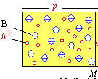
Charge neutrality
In a semiconductor with equilibrium state.
the charge should be neutral, otherwises,
there occurs an electric field
-
qp – qn + qND - qNA = 0
+
Charge/cm³
ND+ = number of positively charged donor sites
NA- = number of negative charged acceptor sites

Slide 14
Carrier Related terminology
Dopants: specific impurity atoms which are added to semiconductors in controlled amounts for the expressed purpose of increasing either the electron or the hole concentration
Intrinsic semiconductor: undoped semiconductor; a semiconductor whose properties are native to the material
Extrinsic semiconductor – doped semiconductor; a semiconductor whose propeties are controlled by added impurity atoms
Donor – impurity atom which increase the electron concentration; n-type dopant.
Acceptor – impurity atom which increase the hole concentration; p-type dopant
N-type material – a donor-doped material; a semiconductor containing more electrons than holes
P-type material – an acceptor-doped material; a semiconductor containing more holes than electrons
Majority carrier – the most abundant carrier in a given semiconductor sample; electrons in an n-type materials, holes in a p-type material.
Minority carrier – the least abundant carrier in a given semiconductor sample; holes in an n-type material, electrons in a p-type material.

Slide 15
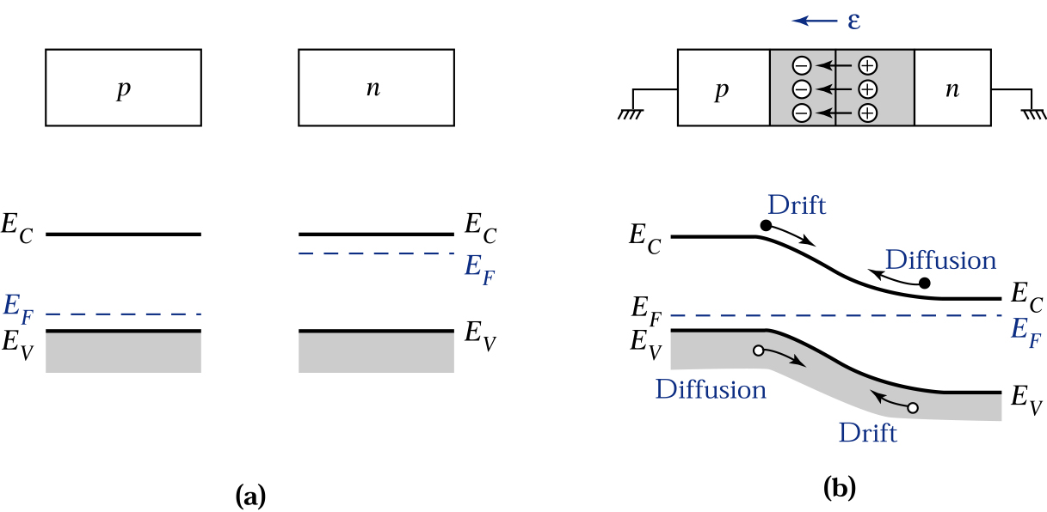
Equilibrium Fermi energy
When a p-type and a n-type material meet together: PN-Junction
Space charge in depletion region
the same as before
Uniformly doped p- and n-type semiconductors before joining
Electric field in the depletion region and the energy band diagram of a p-n junction in thermal equilibrium

Slide 16
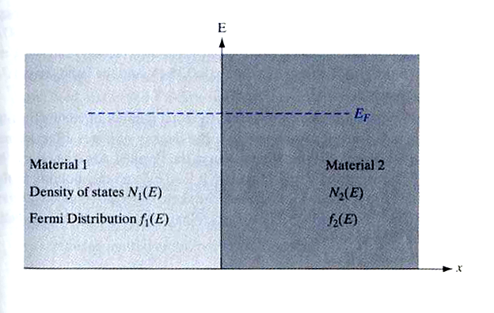
Invariance of the Fermi level at equilibrium
In the beginning of diffusion
Electrons transfer rate from 1 to 2 is proportional to
The number of filled states
Empty sites
Electrons transfer rate from 2 to 1 is proportional to
At equilibrium, not net transfer electrons, so these must be equal
=
dEF
=0
EF1=EF2
dx

Slide 17
Einstein Relation
Under equilibrium conditions the Fermi level inside a materials (or inside a group of materials in intimate contact) is invariant as a function of position; that is dEF/dx = dEF/dy=dEF/dz=0 under equilibrium conditions

Slide 18
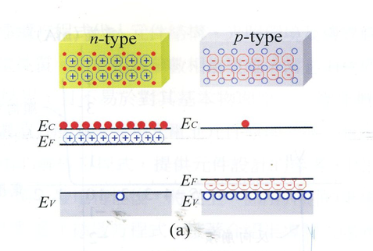
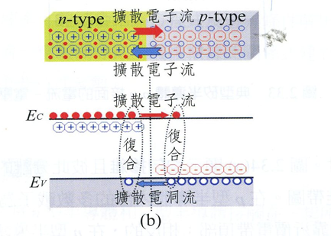
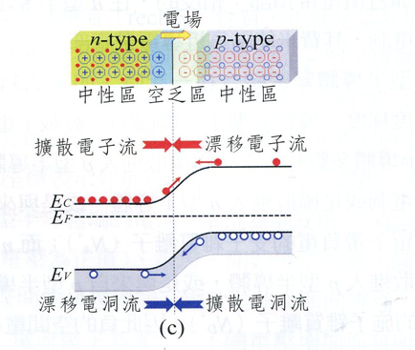
P-N junction:

Slide 19
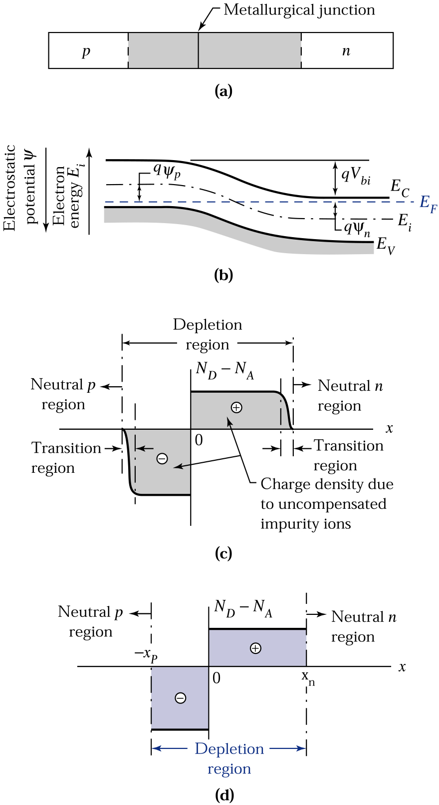
Space charge
-The n-side near the junction
Becomes depleted of majority carriers
And therefore has exposed positive donor ions
-Similar situation happens to p-side
-The region on both sides of the
junction M consequently becomes
depleted of free carriers in comparison
with the bulk p and n regions,
called – space charge layer, known as
depletion region
Space charge distribution
Rectangular approximation of the space charge distribution

Slide 20
Energy band diagram of an abrupt junction at thermal equilibrium
There will be a bulit-in voltage created in the junction
A p-n junction with abrupt doping changes at the metallurgical junction

Slide 21
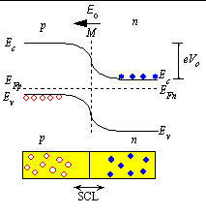
PN junction:summary
Story:
The carrier concentraion
difference between the n and p
regions causes the carriers to
diffuse. The diffusion, however,
Leads to a charge imbalance.
the charge imbalance in turn
produces an electric field, which
counteracts the diffusion so that
in thermal equilibrium the net
flow of carriers Is zero.
The charged region near the
metallurgical junction where
the mobile carriers have been
reduced is called the depletion
region
no carrier in the
depletion region
potential
charge density
E=-dV/dx
Vo: built-in-potential

Slide 22
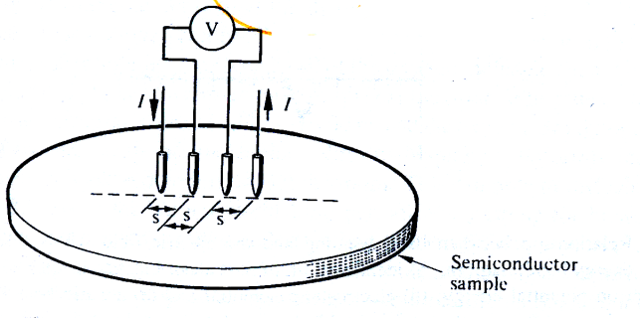
Energy band diagram in an applied field
n-type semiconductor
connected to a voltage
The applied voltage makes
the energy band bend and cause
the potential energy difference between
two sides of n-type semiconductor
-EF(A)-EF(B)=eV, meaning the electrostatic
PE barrier between A and B
E=-dV/dx

Slide 23
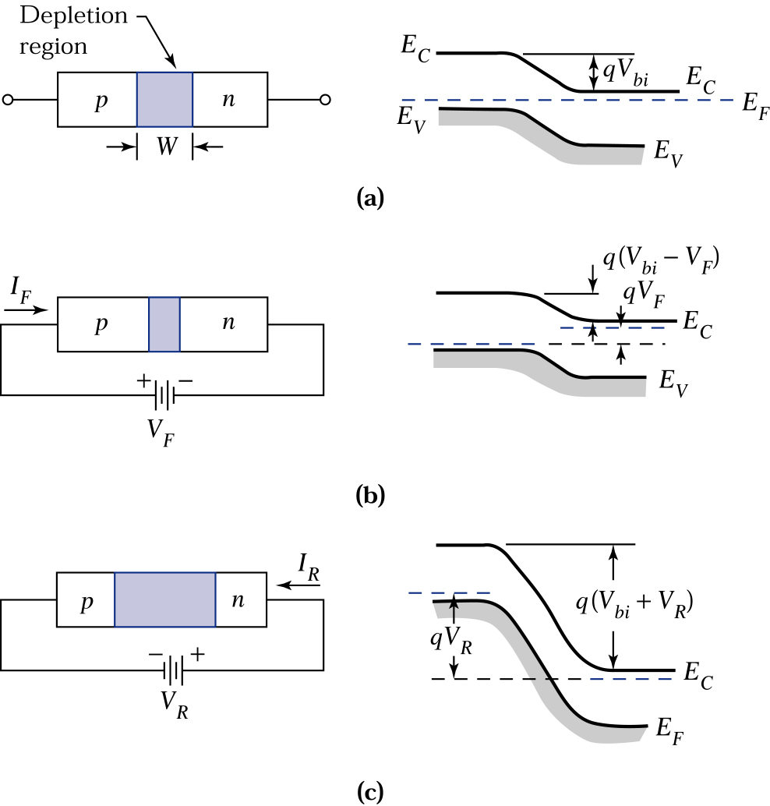
Depletion layer width and energy band diagrams of a p-n junction under various biasing conditions
Thermal-equilbrium condition
Forward-bias condition
Reverse-bias condition
The width of depletion layer
can be externally adjusted
by the applied voltage

Slide 24
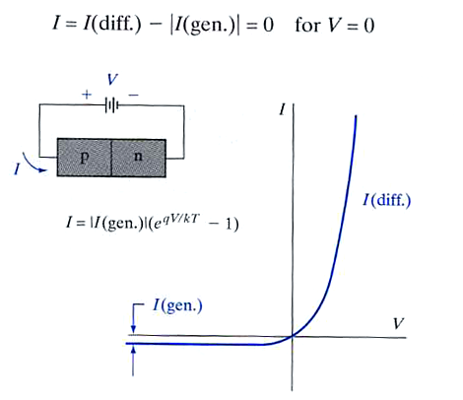
Forward and reverse bias effect for a pn junction
Fermi level equilibrium
Forward bias reduces the eVo to
e(Vo-V), so the electrons at Ec
in the n-side can overcome the the
potential barrier and diffuse to the p-side
A reverse bias, V=-Vr, Vr adds to the
built-in potential Vo, so the P.E barrier
becomes e(Vo+Vr), so there is hardly any
reverse current.

Slide 25
Fabrication of Light Emitting Diode using a pn junction structure

Slide 26
Light Emitting Diodes: Principle
built in voltage
Depletion region extends mainly into p-side
made by a junction consists of p-side with heavily-n-doped-side (n⁺)
the recombination of injected electrons in the depletion region as well as in the
neutral p-side and results in spontaneous emission of photons
-the recombination zone is called the active region
-light emission from EHP recombination as a result of minority carrier injection
is called injection electroluminescence

Slide 27
LED device structure
Narrow
-P-layer has to be narrow (a few microns) to allow the emitted photons escape
without being reabsorbed

Slide 28
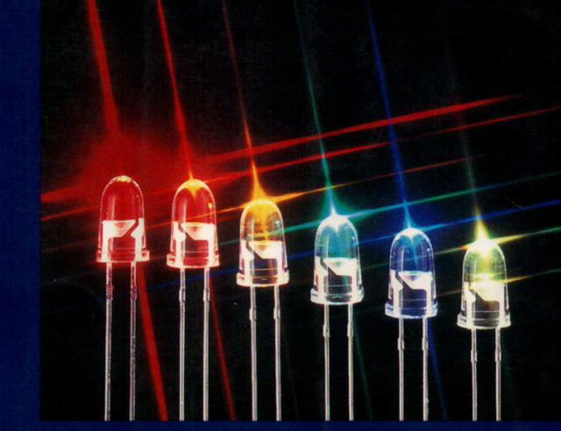
LED device structure
GaAs is around 16⁰
p

Slide 29
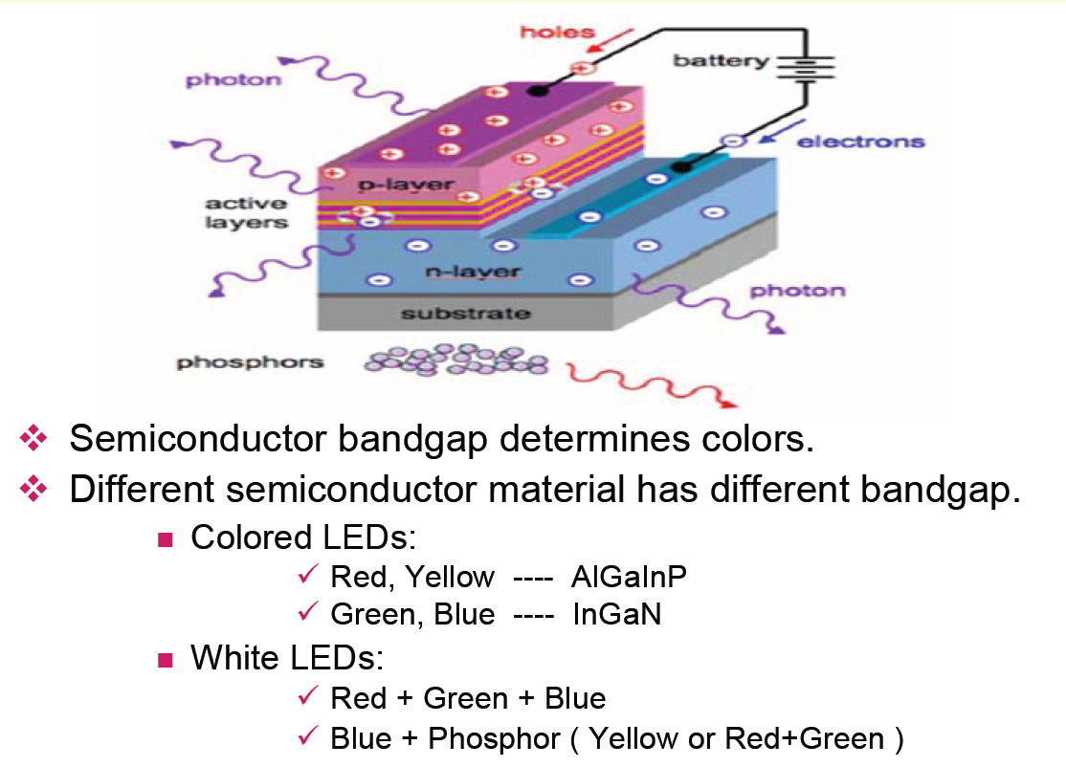
LED device illustration

Slide 30
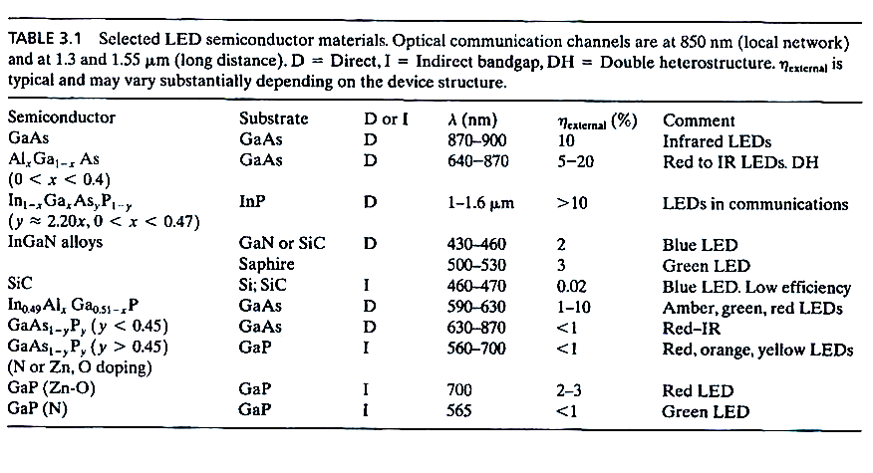
LED semiconductor materials
η_{external} = P_{out} (optical) x 100%
IV
1993 年日亞(Nichia)發展高效率藍光LED!

Slide 31
LED materials – mainly III-V based direct band gap
materials
- II-VI compounds are hard to be doped, so not usually be used

Slide 32
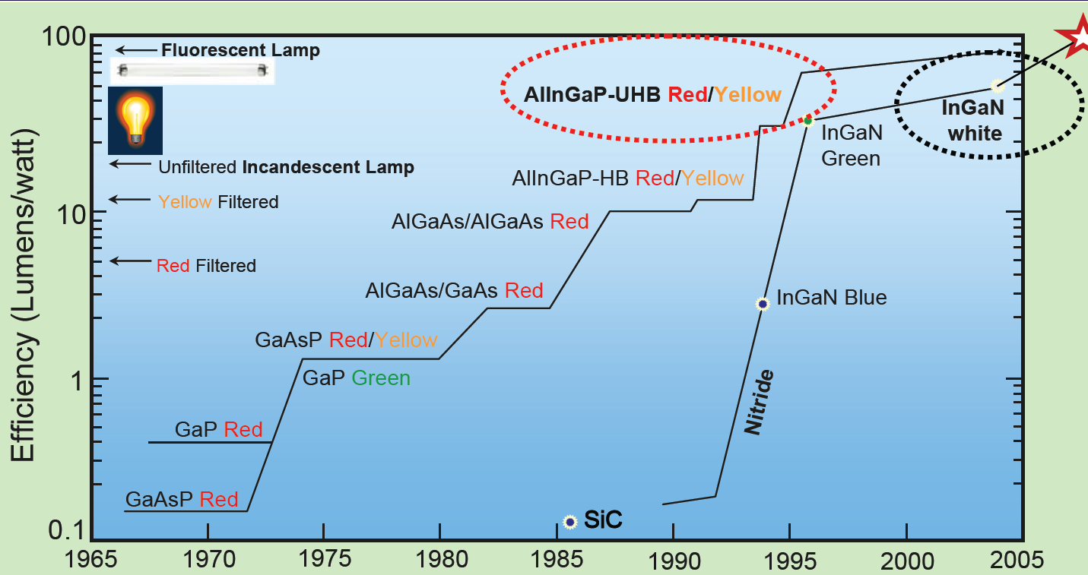
Evolution of light source

Slide 33
Tuning band gap by alloying or doping
Alloy
doping
y=0.45, λ=630 nm
Red light
Nitrogen doped indirect bandgap GaAs1-yPy allows can emit green, yellow, orange LEDs
Al doped SiC, GaN are can emit blue emission, however, Al doped SiC is indirect band gap
and GaN is very expansive

Slide 34
LED characteristics
E=hv
The energy of an emitted photon from an LED is not equal to the Eg
Electron (hole) concentration’s peak position is 1/2kBT above Ec or Ev
and direct recombination is proportional to the concentration
-The linewidth is defined as width between half-intensity equal to △hv , normally
is around 2.5-3 kBT

Slide 35
Output spectrum of a red GaAsP LED
Turn-on voltage:1.5V
- =24 nm is around 2.7kBT
-Turn-on voltage increase with the energy bandgap Eg, vlue LED is 3.5-4.5 V
yellow LED is around 2 V, GaAs infraed LED is around 1 V

Slide 36
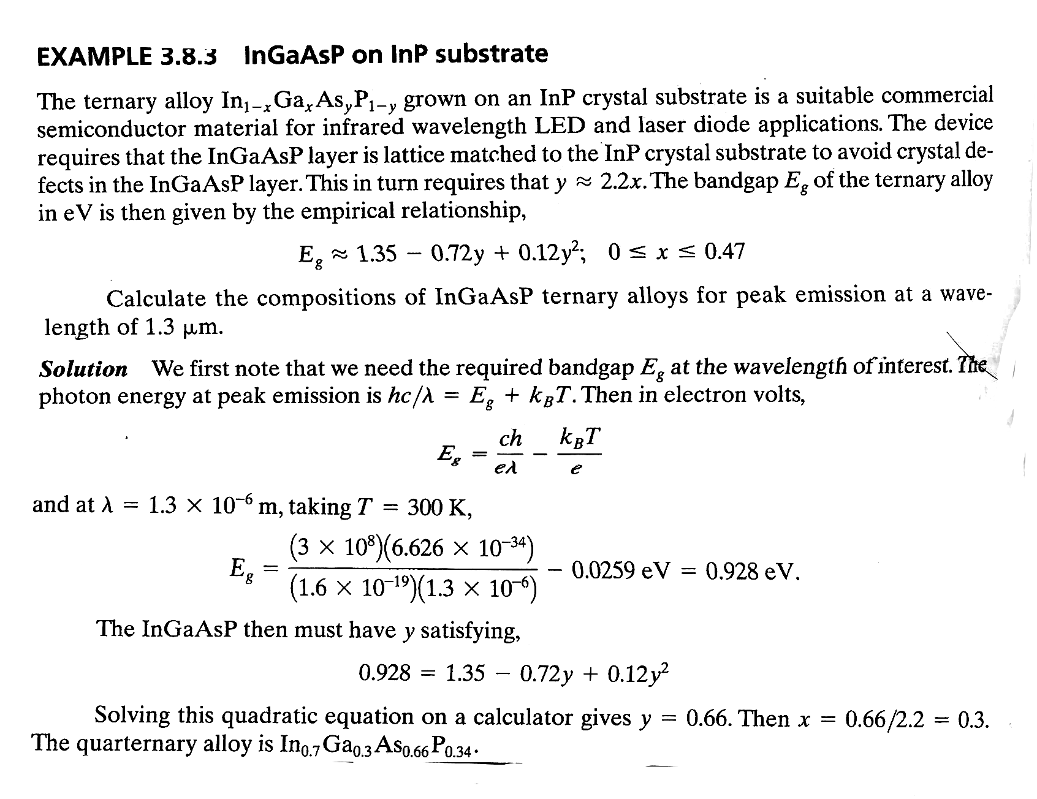
Peak emission

Slide 37
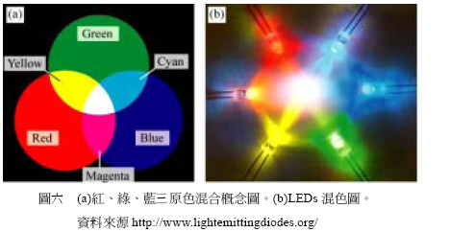
White light LED
White light for lighting – long service life, electricity effective, low driving voltage, safe
White light LED:
First example: Blue LED + YAG (yttrium aluminum garnet, 釔鋁石榴石) yellow phosphor (currently most popular, low cost & high efficiency) (at 1996)
- RGB LEDs (Red:green:blue = 3:6:1)
- UV LED (GaN) + RGB phosphors

Slide 38
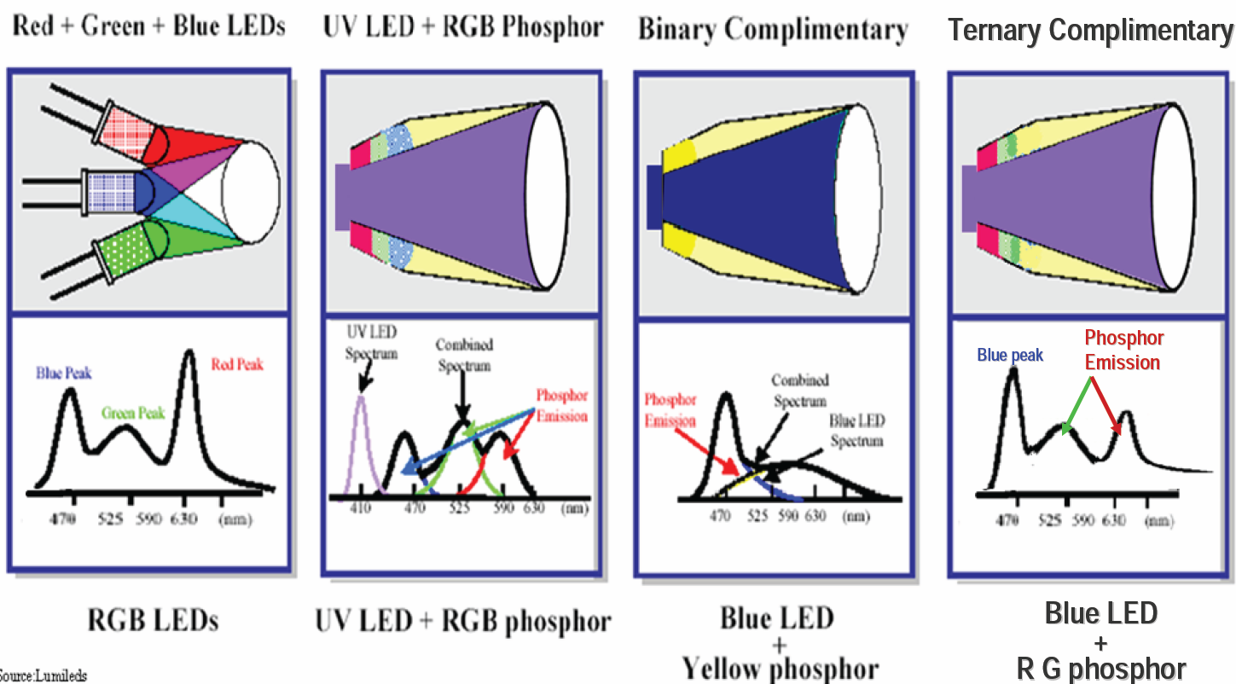
Various combination of white LED

Slide 39
Evolution of light source
LED has 80% lower energy vs. incandescent
LED has 39% lower energy vs. CFL
Efficiency now is
the best.
compact fluorescent light
Courtesy of Osram

Slide 40
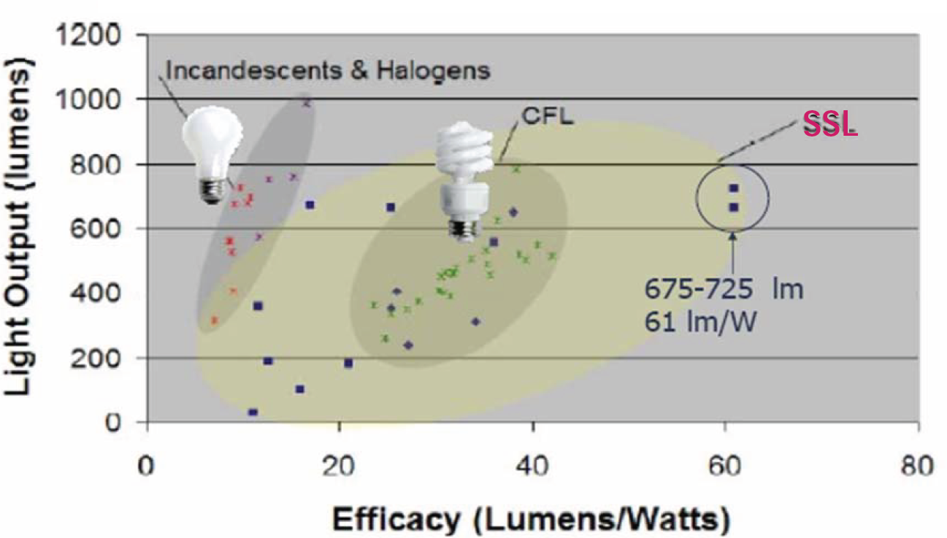
Light output V.S. Efficiency

Slide 41
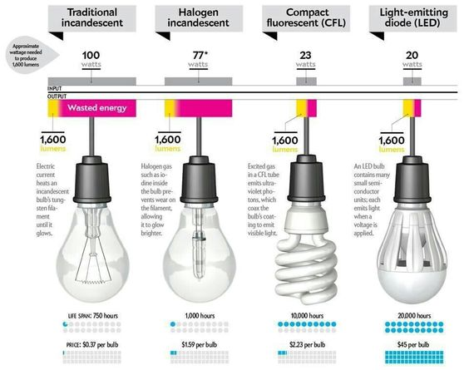
Cost comparison of light bulbs

Slide 42
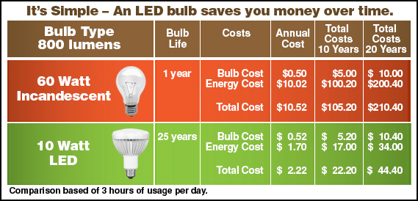
Cost comparison of light bulbs

Slide 43
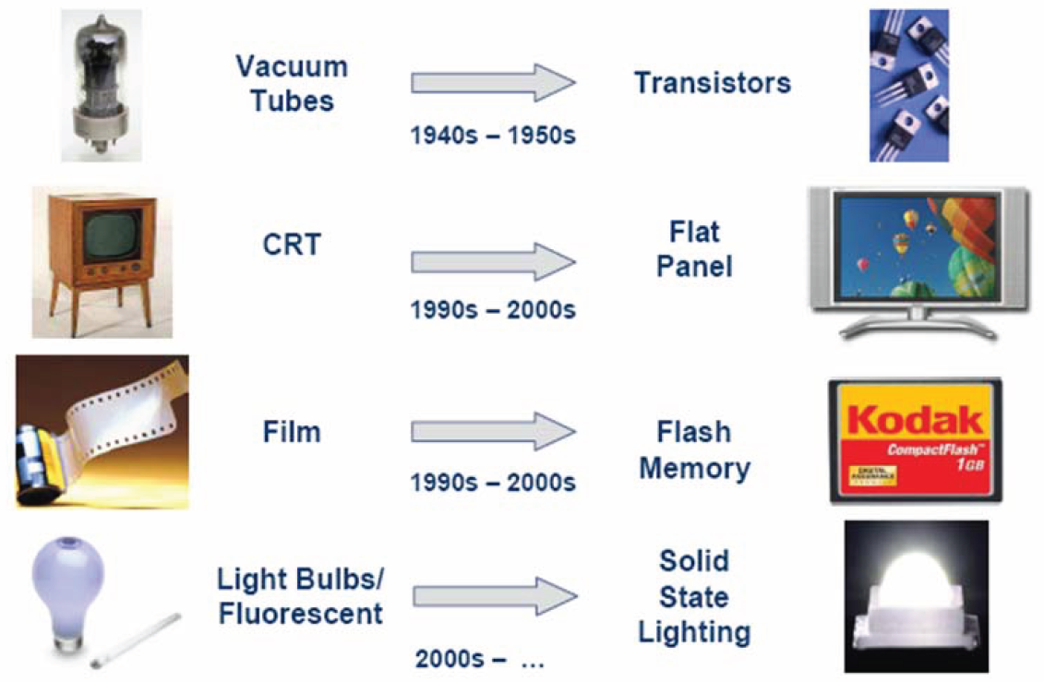
Is the technology revolution similar?

Slide 44
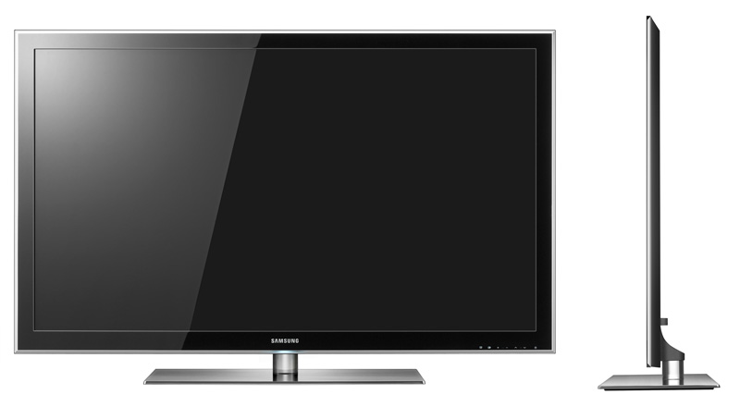
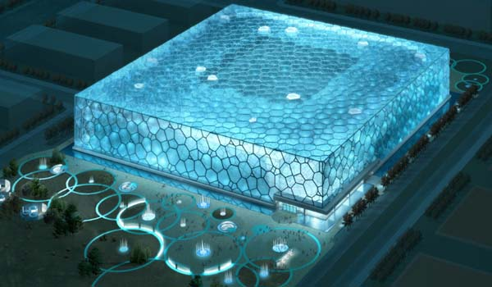
High tech product combined with LED
水立方

