Slide 1
Fundamentals of Optoelectronic Materials and Devices 光電材料與元件基礎
Hsing-Yu Tuan (段興宇）
Department of Chemical Engineering, National Tsing-Hua University

Slide 2
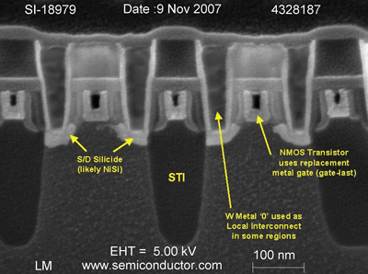
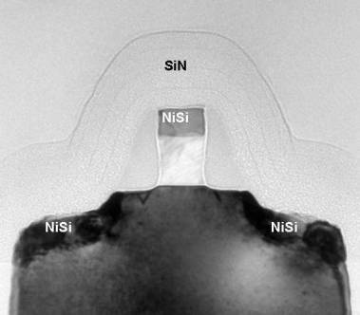
半導體奈米製程結點
Intel's 65nm nMOS transistor
在圖的 MOSFET 中，「閘極長度（Gate length）」大約 10 奈米，是所有構造中最細小也最難製作的，因此我們常常以閘極長度來代表半導體製程的進步程度，這就是所謂的「製程線寬」。
閘極長度會隨製程技術的進步而變小，從早期的 0.18 微米、0.13 微米，進步到 90 奈米、65 奈米、45 奈米、22 奈米，到目前最新製程 10 奈米。
當閘極長度愈小，則整個 MOSFET 就愈小，而同樣含有數十億個 MOSFET 的晶片就愈小，封裝以後的積體電路就愈小，最後做出來的手機就愈小。
10 奈米到底有多小呢？細菌大約 1 微米，病毒大約 100 奈米。
圖片來源：sandsbook散冊提供

Slide 3
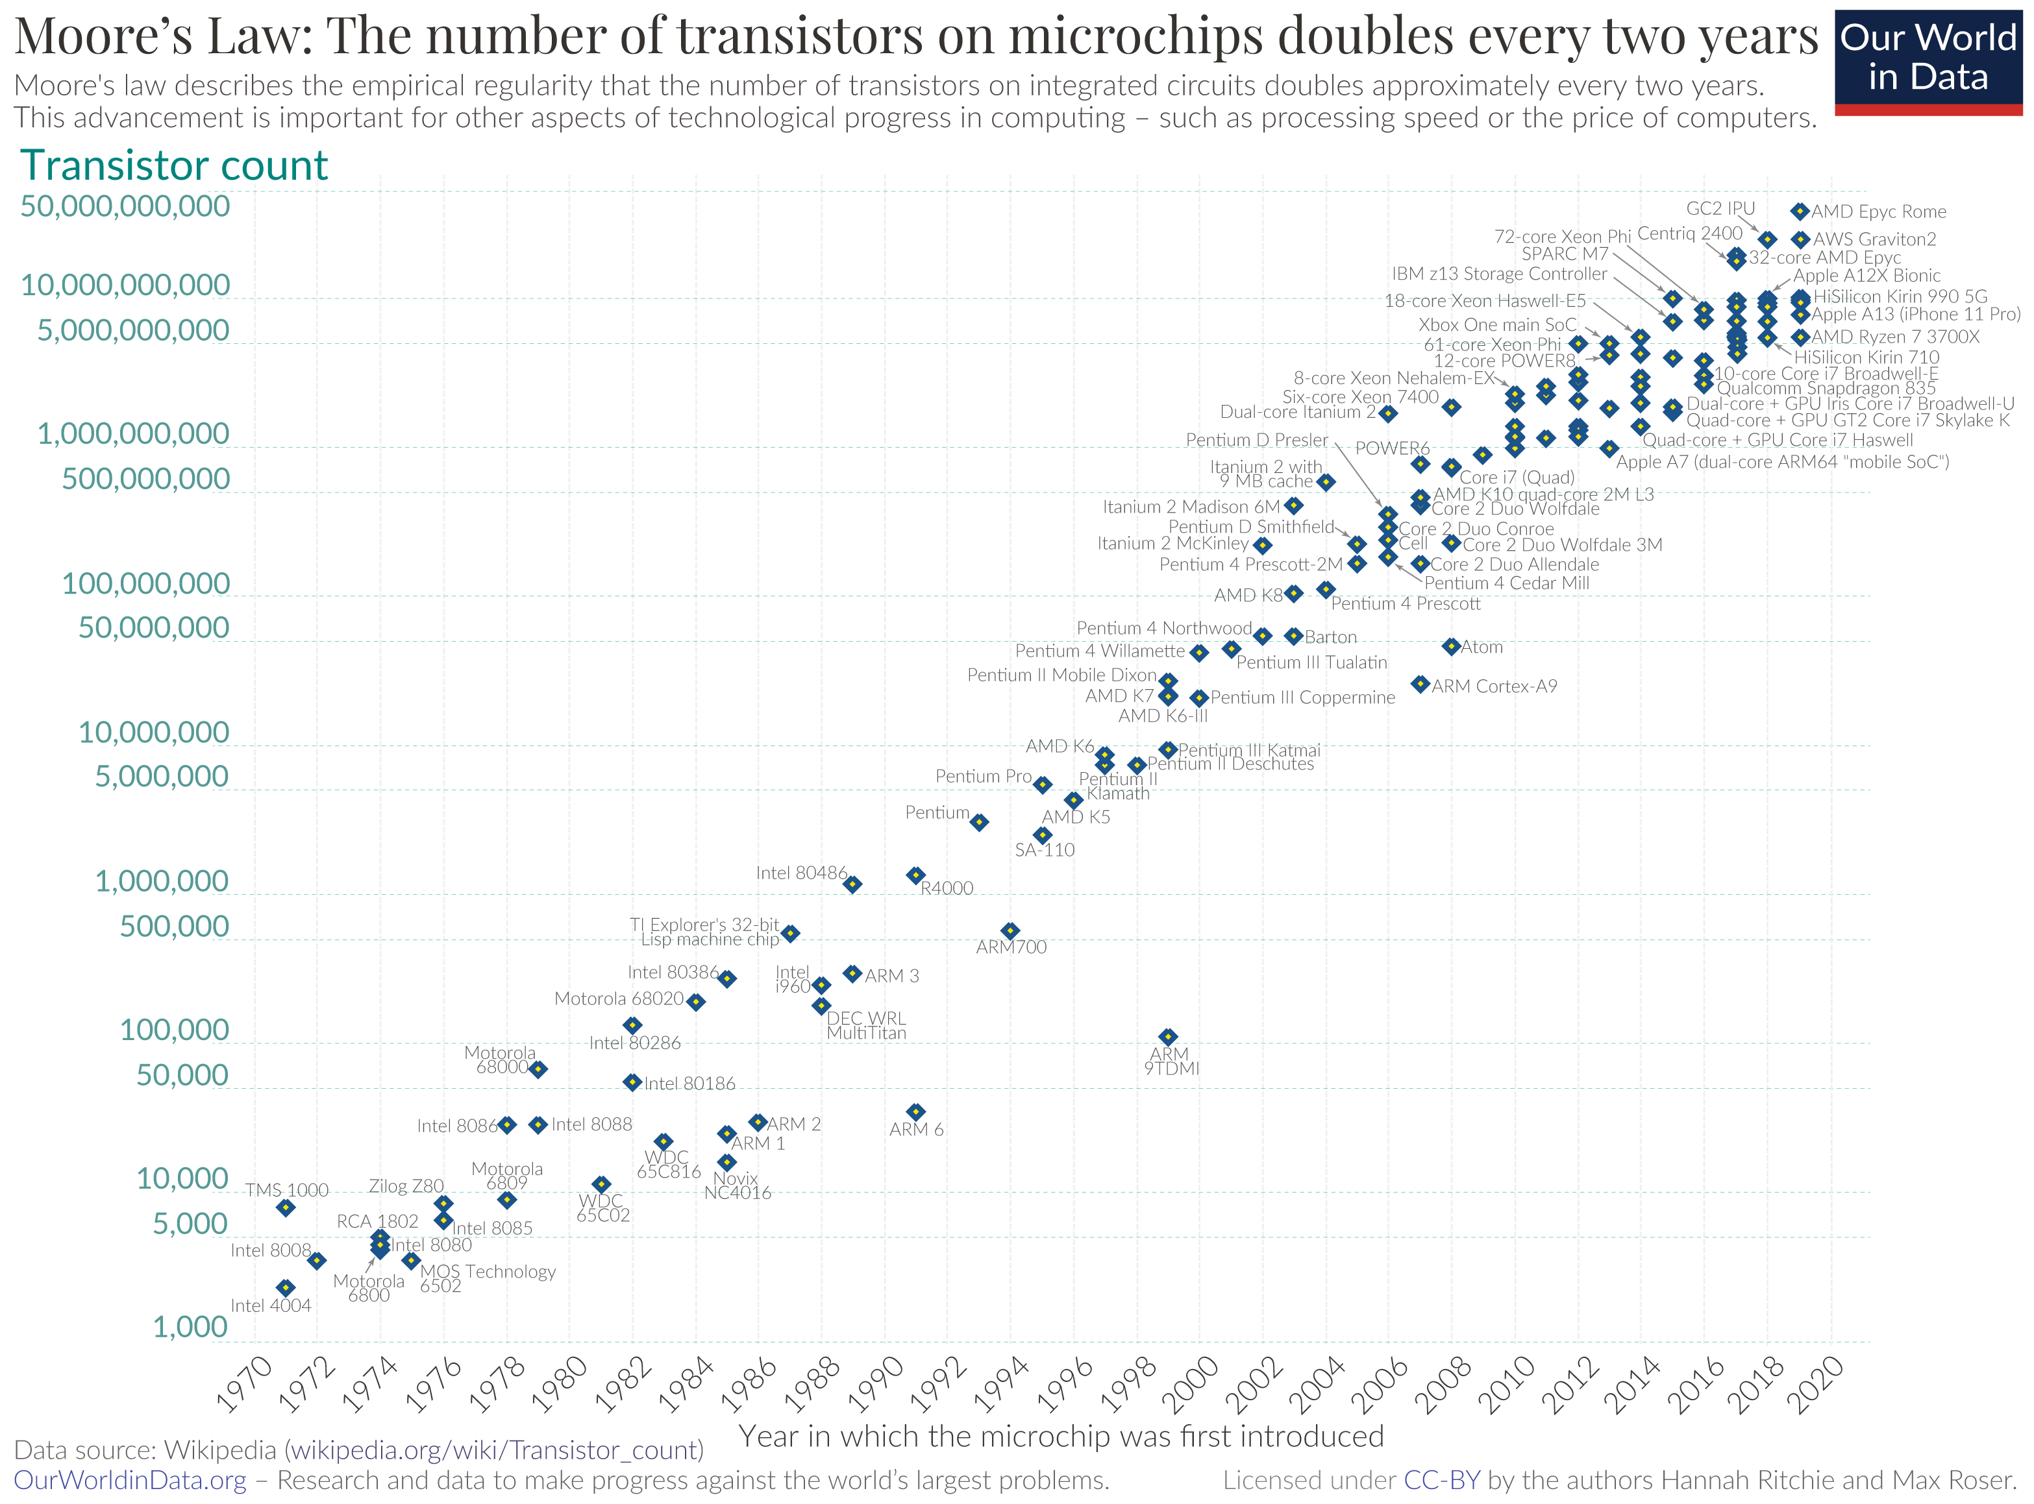
由英特爾（Intel）創始人之一高登·摩爾提出的。其內容為：積體電路上可容納的電晶體數目，約每隔兩年便會增加一倍
From wiki

Slide 4
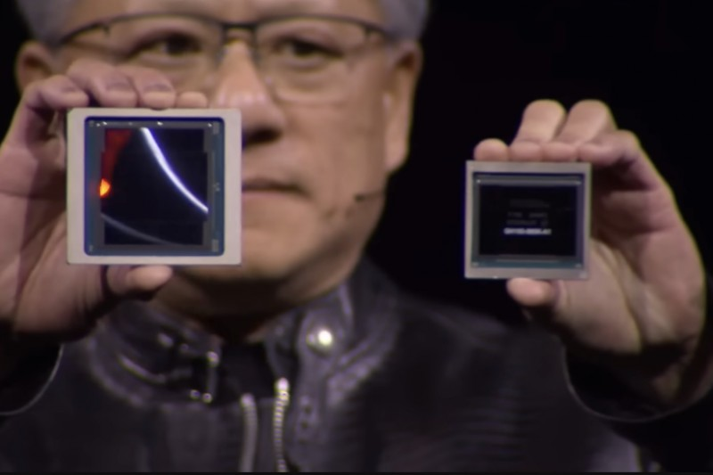
Nvidia正在吞食世界！」發表擁有2080億個電晶體的超級GPU Blackwell 2024-03-19
https://www.storm.mg/article/5058636

Slide 5
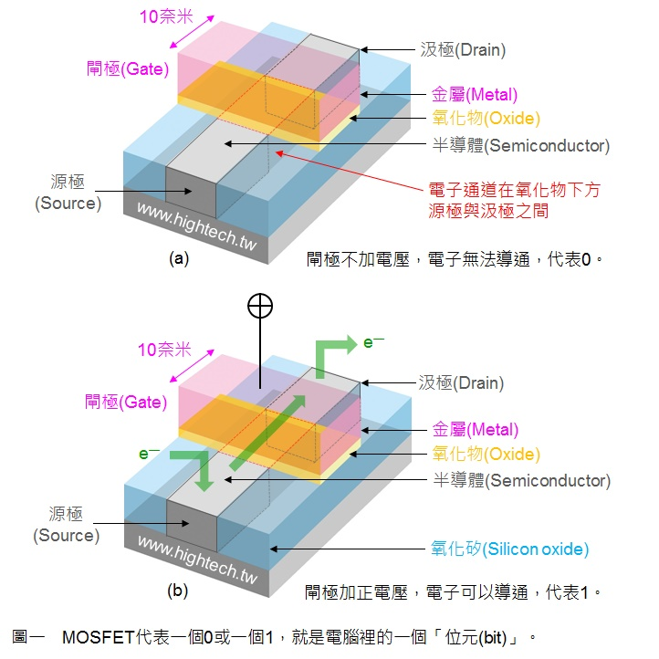
MOSFET的運作原理
如圖一所示，左邊灰色的區域（矽）叫做「源極（Source）」，右邊灰色的區域（矽）叫做「汲極（Drain）」，中間有塊金屬（紅色）突出來叫做「閘極（Gate）」，閘極下方有一層厚度很薄的氧化物（黄色），因為中間由上而下依序為金屬（Metal）、氧化物（Oxide）、半導體（Semiconductor），因此稱為「MOS」。
MOSFET 的工作原理很簡單，電子由左邊的源極流入，經過閘極下方的電子通道，由右邊的汲極流出，中間的閘極則可以決定是否讓電子由下方通過，有點像是水龍頭的開關一樣，因此稱為「閘」；電子是由源極流入，也就是電子的來源，因此稱為「源」；電子是由汲極流出，看看說文解字裡的介紹：汲者，引水於井也，也就是由這裡取出電子，因此稱為「汲」。
當閘極不加電壓，電子無法導通，代表這個元件處於「關（OFF）」的狀態，我們可以想像成這個位元是 0，如圖一（a）所示；
當閘極加正電壓，電子可以導通，代表這個元件處於「開（ON）」的狀態，我們可以想像成這個位元是 1，如圖一（b）所示。
From 作者 Dr. J

Slide 6
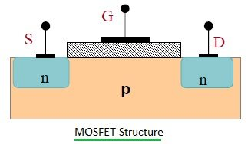
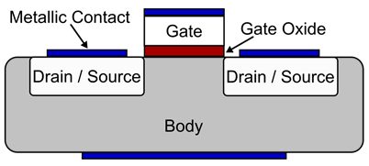
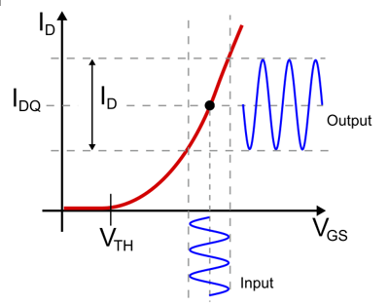
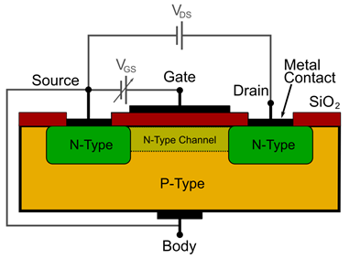
MOSFET的結構
金屬氧化物半導體場效應電晶體 (MOSFET) 是一種場效應電晶體 (FET) 電子器件。MOSFET的控制是通過向柵極施加特定的電壓來進行的。當MOSFET導通時，電流通過在 體區（稱為bulk或body）中形成的溝道，從MOSFET的漏極流向源極。

Slide 7
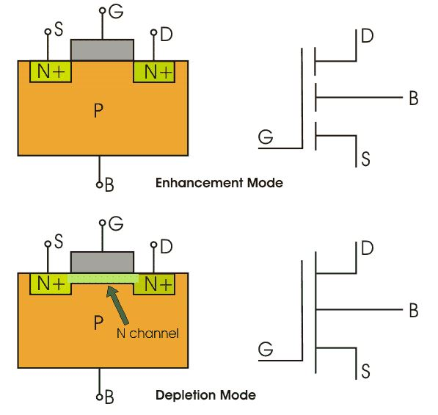
MOSFET的操作
汲極和源極為重摻雜N+區，基板為p型。 由於帶負電的​​電子的流動而產生電流，這就是被稱為 n 通道 MOSFET 的原因。當我們施加正閘極電壓時，氧化層下方的電洞會受到排斥力，並且電洞被向下推入與受主原子相關的束縛負電荷中。正閘極電壓也將電子從N+源極和汲極區域吸引到通道中，從而形成富電子通道。

Slide 8
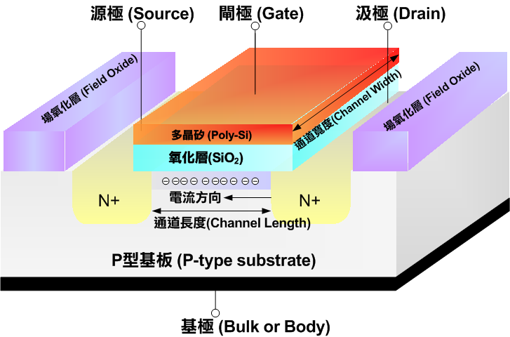
柵氧化層（英語：gate oxide），是用來把CMOS柵極與下方源極、漏極以及源漏極間導電溝道隔離開來的氧化介質層（如右圖）。通過將溝道上方的矽氧化為二氧化矽，柵氧化層得以形成，其厚度大約為5到200奈米，這層物質為絕緣體。柵氧化層上方為導電的柵極材料。柵氧化層充當了介質層，使得柵極能夠維持1到5毫伏每立方米的縱向電場，這個電場可以用來控制下方溝道的導通和關斷。
From wiki

Slide 9
我們可以想像一個 MOSFET 代表一個 0 或一個 1，就是電腦裡的一個「位元（bit）」。電腦是以 0 與 1 兩種數位訊號來運算；我們可以想像在矽晶片上有數十億個 MOSFET，就代表數十億個 0 與 1，再用金屬導線將這數十億個 MOSFET 的源極、汲極、閘極連結起來，電子訊號在這數十億個 0 與 1 之間流通就可以交互運算，最後得到使用者想要的加、減、乘、除運算結果，這就是電腦的基本工作原理。晶圓廠像台積電、聯電，就是在矽晶圓上製作數十億個 MOSFET 的工廠。

Slide 10
16 nm 以下的電晶體 FinFet
美國加州大學伯克萊分校胡正明、Tsu-Jae King-Liu、Jeffrey Bokor 等三位教授發明了「鰭式場效電晶體（Fin Field Effect Transistor，FinFET）」，把原本 2D 構造的 MOSFET 改為 3D 的 FinFET，如圖二所示，因為構造很像魚鰭 ，因此稱為「鰭式（Fin）」。

Slide 11
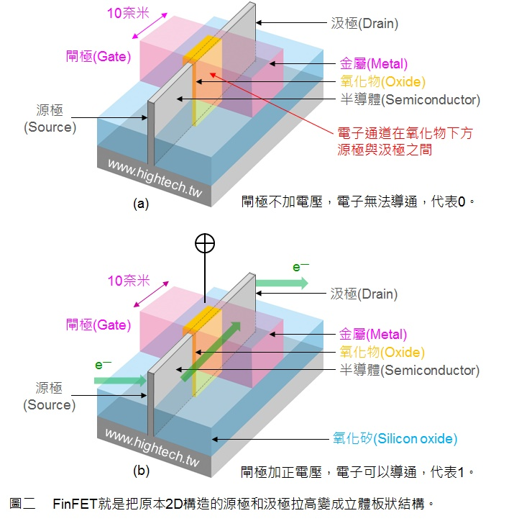
Finfet的結構
當閘極長度縮小到 20 奈米以下的時候，主要遇到兩個問題(1) 當閘極長度愈小，源極和汲極的距離就愈近，閘極下方的氧化物也愈薄，當閘極長度足夠短的時候，就會發生量子穿隧效應，電子有可能偷偷溜過去產生「漏電（Leakage）」
(2) 原本電子是否能由源極流到汲極是由閘極電壓來控制的，但是閘極長度愈小，則閘極與下方通道之間的接觸面積（圖一紅色虛線區域）愈小，也就是閘極對通道的影響力愈小，要如何才能保持閘極對通道的影響力（接觸面積）呢？
由圖中可以看出原本的源極和汲極拉高變成立體板狀結構，讓源極和汲極之間的通道變成板狀，則閘極與通道之間的接觸面積變大了（圖二黃色的氧化物與下方接觸的區域明顯比圖一紅色虛線區域還大），這樣一來即使閘極長度縮小到 20 奈米以下，仍然保留很大的接觸面積，可以控制電子是否能由源極流到汲極，因此可以更妥善的控制電流，同時降低漏電和動態功率耗損
From 作者 Dr. J

Slide 12
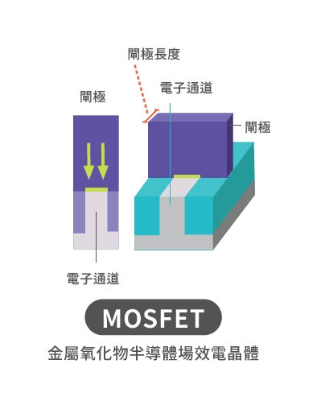
2奈米以下的電晶體型態: GAA
GAA電晶體的四個側邊都被閘極包圍著。相較於當前FinFET製程中的三個側面，這種途徑由於讓閘極能夠接觸電晶體的四個側面，從而改善了電晶體的結構。因此，GAA結構比起FinFET製程更能精確地控制電流。

Slide 13
RCA clean for silicon wafer surface
Contamination includes
organics, metals, and silicon oxide
Organic clean: remove insoluble organic contaminants
-solution: H2O:H2O2:NH4OH with 5:1:1
Oxide Strip: remove thin silicon dioxide layer
-solution: H2O: HF with 50:1
Ionic Clean: remove ionic and heavy metal ionics contaminants
-solution: H2O:H2O2:HCl with 6:1:1
Like a baby ☺

Slide 14
MOS transistor
Passivation layer
metal layer
Oxide layer
P
n
n
-A MOS (Metal-oxide-semiconductor)
transistor consists of different metal,
oxide, and semiconductor layers.
Intel's 65nm nMOS transistor

Slide 15
Four wafer-fabrication operations
Grown
SiO2
Layering
Add metal, insulator, semiconductor
thin layers onto the wafer surface
Patterning
-form pattern by removing selected portions
of added surface layers
Doping
-incorporate dopants into a wafer
Heat treatment
-remove contaminates, repair crystal structure
of treated wafers
deposited
layers
hole
island
diffusion
Ion
implantation
annealing

Slide 16
Layering
Grown
SiO2
Passivation layer
metal layer
deposited
layers
Oxide layer
P
n
n
Various layering methods were developed to layer a thin film on a wafer
Materials
-Metal, oxide, and semiconductor

Slide 17
Layering materials and methods
(CVD) (PVD) (PVD)
Methods include: thermal oxidation, chemical vapor deposition,
evaporation, electroplating, and sputtering
Ref.: Zant p 77

Slide 18
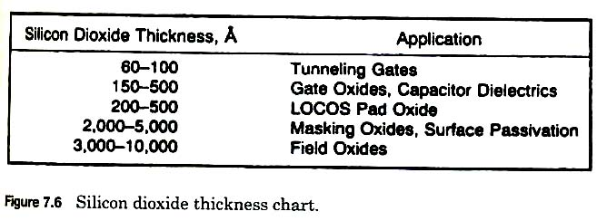
Thermal oxidation mechanism (layering)
Si (solid) +O2 (gas) → SiO2 (solid)
-Growth of SiO2 between 900-1200C
-Control thickness of SiO2 layer depending
on applications including surface passivation
, doping barrier and device dielectric
-SiO2 growth stage
*Linear growth
oxygen atoms combine readily with the
silicon atoms
X=B/A*t
*Parabolic growth
oxygen needs to diffuse into the wafer
react with Si (diffusion limited reaction
X=(Bt)^{1/2}
X=oxide thickness
B=parabolic rate constant
B/A=linear rate constant
t = oxidation time
Silicon dioxide growth states
initial
linear
parabolic
Zant P164

Slide 19
Patterning
Passivation layer
metal layer
hole
island
Oxide layer
P
n
n
-Create the desired shapes in the exact dimensions required by the circuit
design
-Locate them in their proper location on the wafer surface and in relation to the
other parts
-the most critical step of the four basic operations, typically need 20-40 individual
patterning steps

Slide 20
Patterning = photolithography+etching
Photo mask
projection
development
resist
etching
remove
Put a photoresist (here is negative resist)
by spinning coating on the surface of oxide layer
Put a photomask on the top of wafer and expose the layer to the light
Negative resist undergoes polymerization when exposed to light
Development of unexposed photoresist
Etch exposed oxide layer
Remove the photoresist again

Slide 21
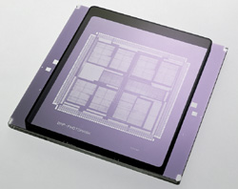
photomask and photoresist
Photoresist polarity
Negative Positive
Clear field
hole
island
Clear field
dark field
dark field
island
hole
An example:
Mask-reticle polarities
Clear field
Photoresist polarity
-negative: polymerize when exposing to light
-positive: not polymerize when exposing to light
hole
result
negative photoresist

Slide 22
Coating of photoresisit
spread
spin
spin even faster
Uniform thin film

Slide 23
Ten steps patterning process
1. Surface preparation – clean and dry wafer surface
2. Photoresist apply – spin coat a thin layer of photoresist on surface
3. Softbake - partial evaporation of photoresist solvents by heating
4. Alignment and exposure – Precise alignment of mask, exposure of photoresist
5. Development – Removal of unpolymerized resist
6. Hard bake – Additional evaporation of solvents
7. Develop inspect – inspect surface and check alignment and defects
8. Etch – Removal of top layer of wafer
9. Photoresist – remove photoresist layer from wafer
10.Final inspection – Surface inspection

Slide 24
Doping
Incorporate specific amounts of electrically active dopants (p-type or n-type) into the wafer surface
Formation of P-N junction
Doping techniques
- thermal diffusion
- ion implantation

Slide 25
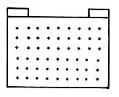
Formation of P-N junction by doping
P-type wafer made before
-Junction- the location where the number
of N-type and P-type dopants are equal
-PN junction is very important for making
field effect transistor (FET), Light emitting diode
(LED), solar cell etc….

Slide 26
Doping by thermal diffusion
Diffusion :
-the movement of one material through another due to concentration gradient
-continue until the concentration is under equilibrium
Thermal diffusion :
-deposition and drive-in oxidation

Slide 27
Thermal diffusion with Deposition
vancancy
movement
Interstitial
movement
Diffusion rate is controlled by
1. diffusivity of particular dopant
2. maximum solid solubility
Deposition steps
Preclean and etch – etched in HF to remove oxide formed on the surface
Deposition – loading cycle, actual doping cycle, exit cycle, all under nitrogen
Deglaze – diluted HF to remove thin oxide layer formed in 2
Evaluation – test the electrical properties

Slide 28
Thermal diffusion – Drive-in Oxidation
Redistribution of the dopant in the wafer
-heat to drive the dopant atoms deeper and wider into the wafer
Growth of a new oxide on the exposed silicon surface
-perform the oxidation on the surface
-operate as the oxidation process

Slide 29
Challenge of doping via thermal diffusion
Challenge
lateral diffusion
ultra thin junction
poor doping control
surface contamination interference
dislocation generation, due to high temperature operation
Future MOS transistor needs two requirements
Low dopant concentration control
Ultra thin junction

Slide 30
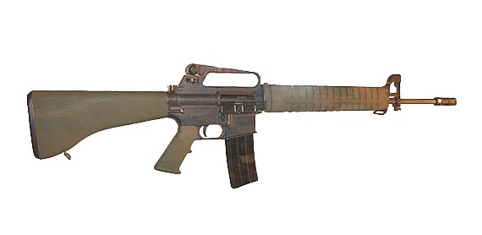
Ion implantation
A physical process
Like a cannon shoot a ball to penetrate the wall and go the inside of the wall
Advantages
-No side diffusion, operate at room temperature
-good control of the dopants location
-majority of doping steps for advanced circuits

Slide 31
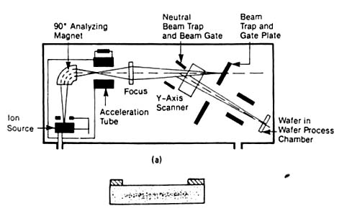
Ion implantation system
E- → BF3 → B+
BF+
BF2+
..etc
-Ionization chamber : a electron created from a filament collide with the dopant source
mass analyzing/ion selection by magnetic field
-acceleration tube : accelerate the ion to a high velocity
-neutral beam trap : collect netralized ions
Challenge: lattice damage, damage cluster, and vacancy-interstitial

Slide 32
Heat treatment
Goals:
to heal the wafer damage due to ion implantation: anneal the wafer at 1000 C to recover the crystal structure
To alloy metal with Si to metalsilide as
electrical contact at about 450 C
To soft bake or hard bake the wafers with photoresisit layers
Deposition

Slide 33
Silicon gate MOS transistor process steps: combination of four basic operations
layering
layering
Pattering,
layering,
, heat treatment
, doping
patterning, layering
passivation layer
metal layer
Oxide layer
P
n
n

Slide 34
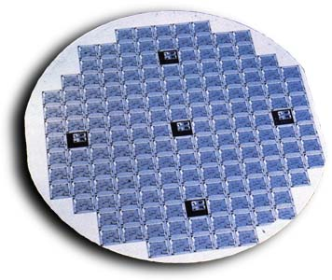
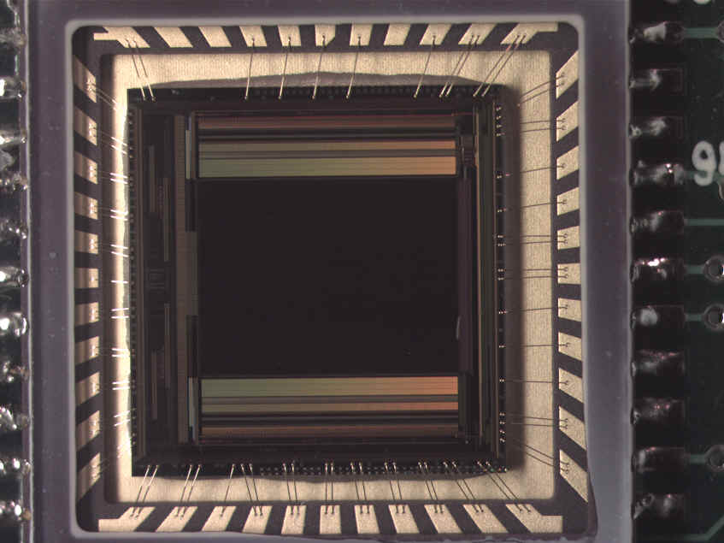
Packaging
http://www.siliconimaging.com
Procedures
-Die separation
-lead bonding
-chip/package connection
-enclosure
-Glod wire bonding

Slide 35
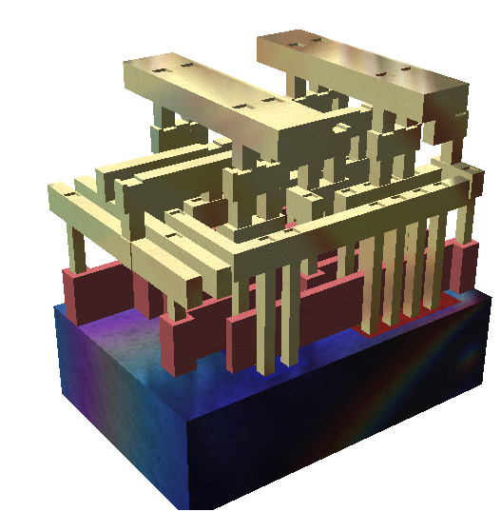
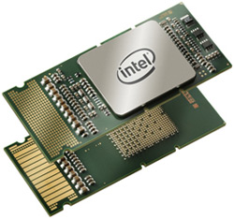
Integrated circuits (ICs)
- Combination of transistors, diodes, capacitors in a chip
Ultra large scale integration (ULSI) >1,000,000 components per chips
- Morre’s law: the number of transistors on a chip were doubling every 18 months
- Intel four core Itanium CPU- Tukwila has over 2 billion transistors on a chip
Courtesy of wiki

Slide 36
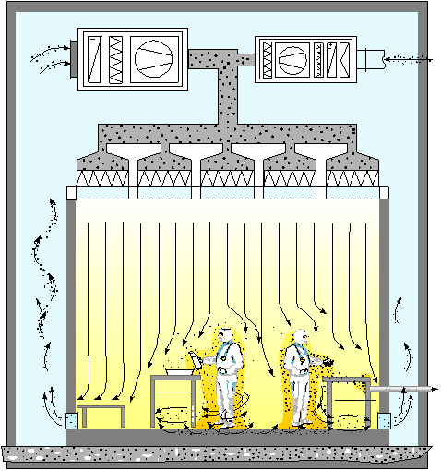
Cleanroom
Class | maximum particles/ft³(0.027m³) |  |  |  |  | ISO equivalent
 | ≥0.1 µm | ≥0.2 µm | ≥0.3 µm | ≥0.5 µm | ≥5 µm
1 | 35 | 7 | 3 | 1 |  | ISO 3
10 | 350 | 75 | 30 | 10 |  | ISO 4
100 |  | 750 | 300 | 100 |  | ISO 5
1,000 |  |  |  | 1,000 | 7 | ISO 6
10,000 |  |  |  | 10,000 | 70 | ISO 7
100,000 |  |  |  | 100,000 | 700 | ISO 8
How clean?
Ex: The land area of Taiwan: 35960 km2 → 190km
so there is only one particle larger than 0.3 m
-Most of IC devices are made in class 1 clean room
Courtesy of wiki

Slide 37
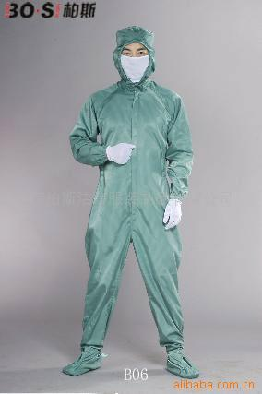
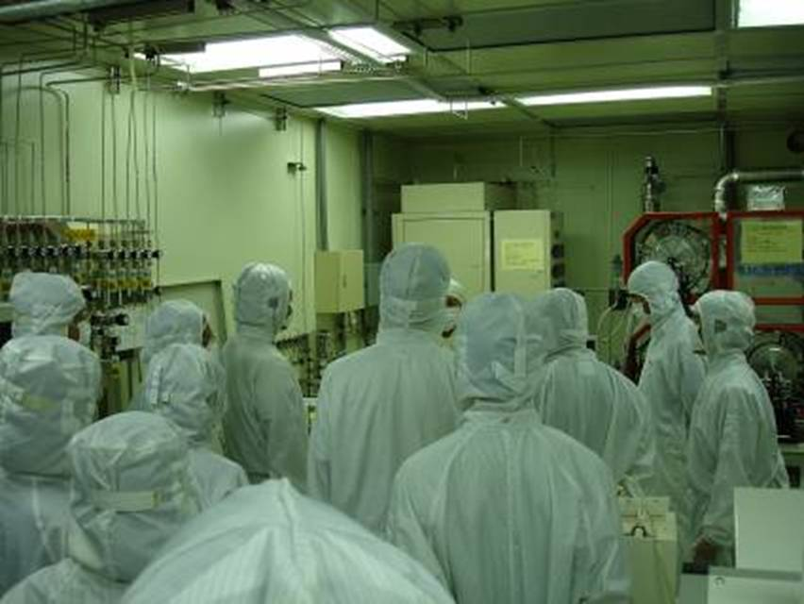
Clean cloth

Slide 38
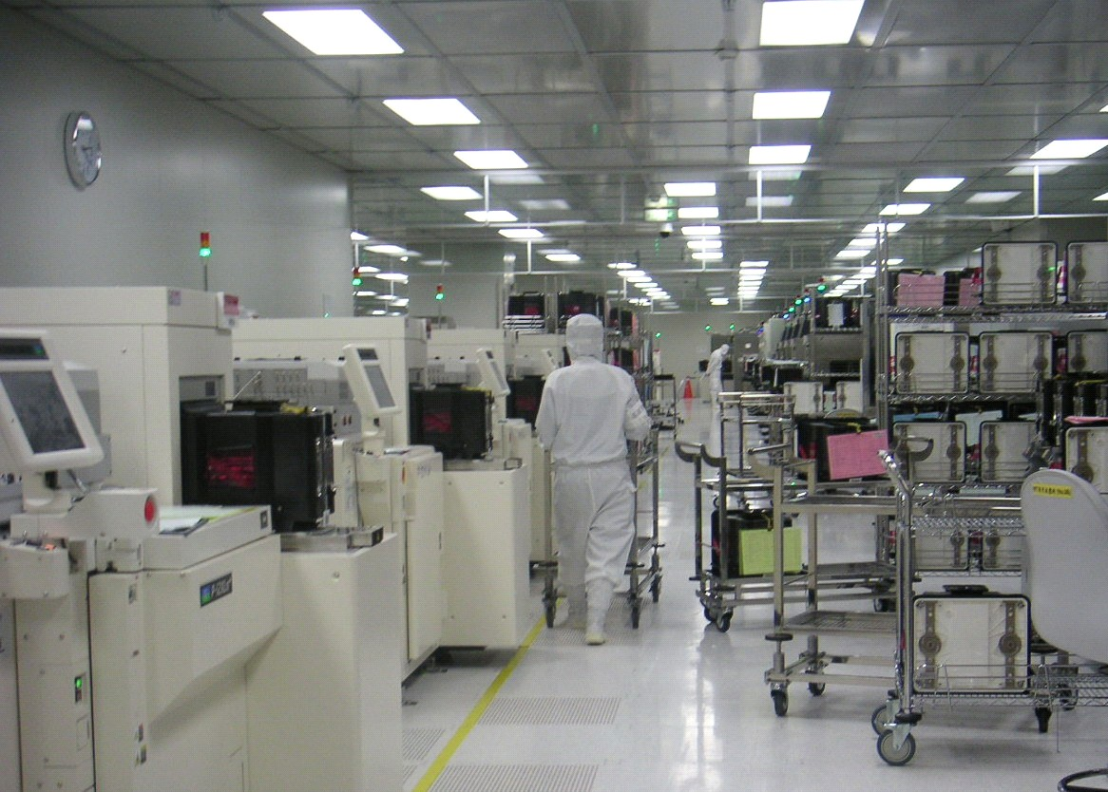
Work environment

Slide 39
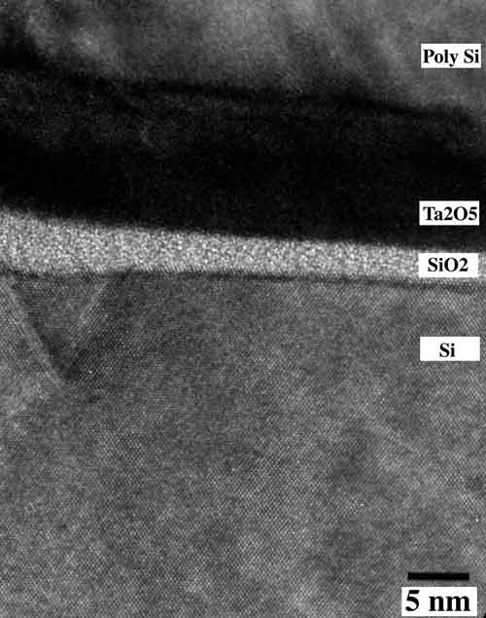
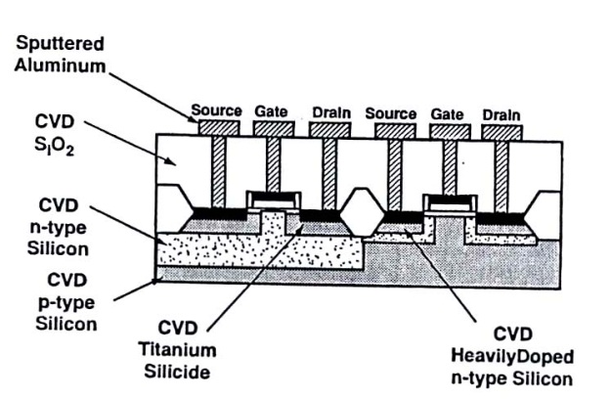
Chemical Vapor Deposition (CVD)
A process can be used to produce thin solid films from gaseous reactants (so-called precursors) via chemical reactions – the most important thin-film deposition process.
CVD can be extendedly used to produce ultra-fine (nano-sized) particles, fibers, foams, and powders.
CVD can be used to almost any kinds, any shape, and any size of materials with precise control.
Poly Si
Ta2O5
SiO2
Si

Slide 40
A Typical CVD Apparatus
Reactant supply
Chemical reactions in a CVD reactor
Exhaust system

Slide 41
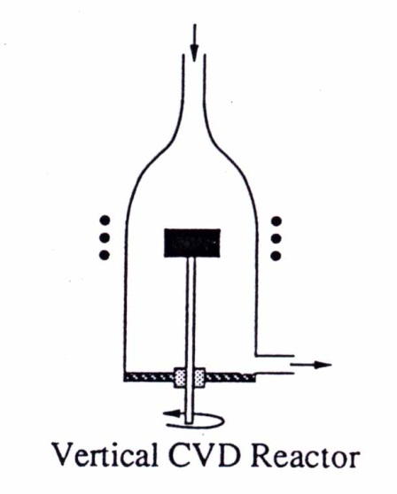
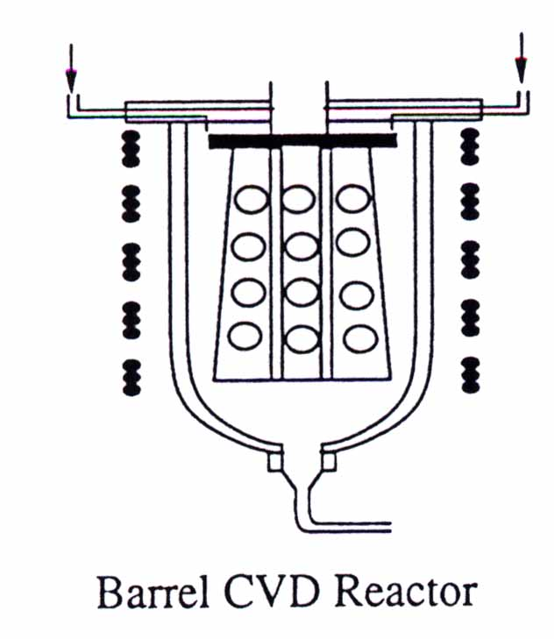
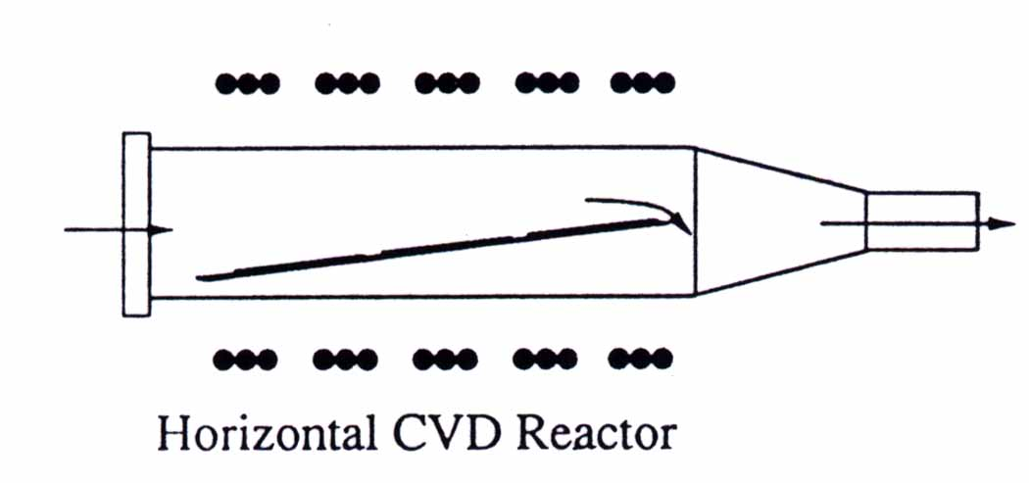
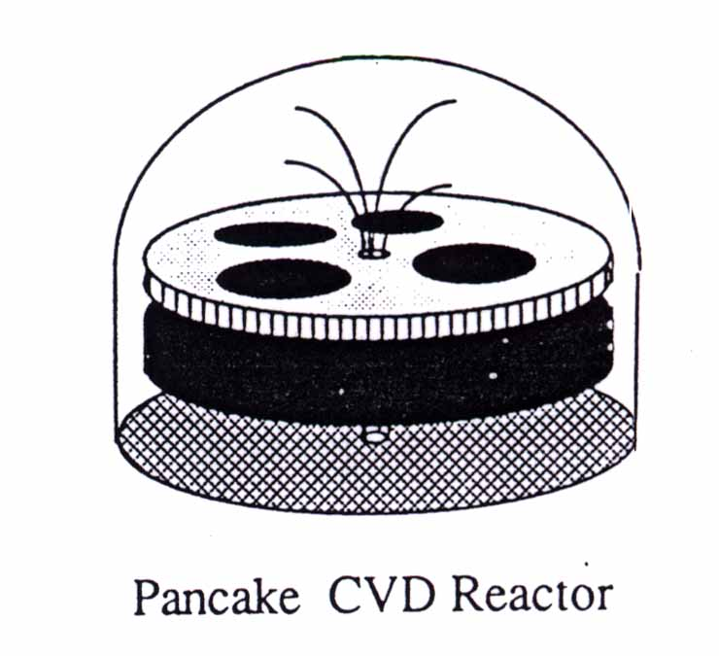
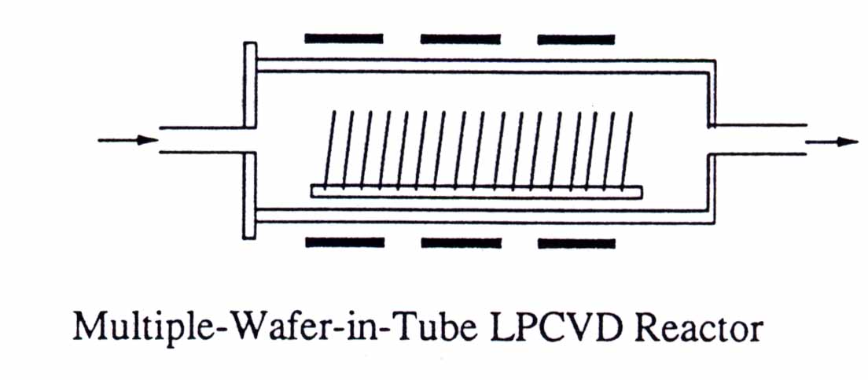
Classification of CVD reactors
By reactor configuration:
Hitchman, p. 34

Slide 42
CVD applications in chip fabrication
Electrical insulator
Silicon dioxide (SiO2)
-Insulator, diffusion mask, ion-implantation
mask, passivation against abrasion, schatches
and the penetration of impurities and moisture
Silicon nitride
-Hard, scratch-resistant, excellent diffusion barrier
for sodium and water to avoid corrosion
Semiconductors
Silicon, III-V and II-VI semiconductors
Electrical conductor for interconnection
MoSi2, TiSi2, WSi2, TaSi2, and CoSi2
-Low resistivity, thermal stability, diffusion barrier,
mitigation of the electromigration

Slide 43
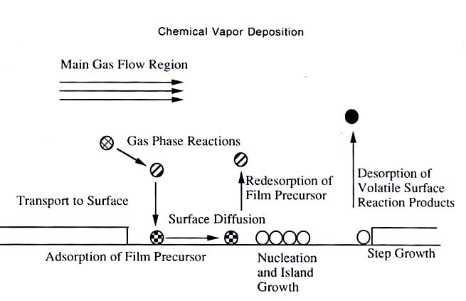
Scheme of CVD transport and reaction processes
Hitchman p.32

Slide 44
Film growth from chemical reactions in a CVD
Hitchman p 256

Slide 45
Chemistry of CVD
Reactions can occur in either gas-phase and surface, leading to the formation
of film precursors and byproducts
Types of reactions
-Pyrolysis, reduction, oxidation, hydrolysis, nitridation, carbidization, diproportionation
Reaction decomposition mechanism
- Gas-phase chemistry
- Surface chemistry

Slide 46
CVD precursors
general characteristics preferred:
1. stability at room temperature – not to react before being transported to reaction zone, easy storage and transfer
2. sufficient volatility at low temperatures – convenient for transportation to reaction zone
3. capability of being produced in a high degree of purity – to avoid introducing contaminants
4. ability to react without producing unwanted side products – to avoid low volatility, toxic side products
5. cost effective enough

Slide 47
Common CVD precursors
halides:
{F, Cl, Br, I} + more electropositive elements ➔
{AlBr₃, AlCl₃, BCl₃, BF₃, CCl₄, CF₄, CrCl₂, SiCl₄, TiCl₄, WF₆, ZrBr₄, ZrCl₄…}
metal-organics: (reactive, volatile, moisture sensitive, low decomposition temperatures, not restricted to metals)
M {in IIa, IIb, IIIa, IVa, Va, VIa} + one or more carbon (oxygen) atoms of an organic hydrocarbon groups (alkyls: -CH₃, - C₂H₅, …; aryls: -C₆H₅, …; acetylacetonates: -OC₅H₈O-, …) ➔
(CH₃)₃Al, (C₂H₅)₂B, (CH₃)₂Cd, (C₆H₅)₂Be, Ca(C₅H₈O₂)₂ …
metal carbonyls:
-(CO)- + transition metals with partially filled d-shell ➔
3d : Sc, Ti, V, Cr, Mn, Fe, Co, Ni
4d : Y, Zr, Nb, Mo, Tc, Ru, Rh, Pd, Ag
5d : Hf, Ta, W, Re, Os, Ir, Pt, Au
mononuclear, M(CO)_{x} : Cr(CO)₆, Fe(CO)₅, Ni(CO)₄, W(CO)₆
dinuclear, M₂(CO)_{x} : Mn₂(CO)₁₂, Fe₂(CO)₉, Co₂(CO)₈
polynuclear : Fe₃(CO)₁₂, Co₄(CO)₁₂
metal carbonyl complexes: Mn(CO)Cl, CoNO(CO)₃
hydrides:
H₂ + {IIIa,IVa,Va,VIa} → AsH₃, B₂H₆, SiH₄, NH₃, …

Slide 48
Chemistry of CVD, often involved reactions
Carbidization:
TiCl₄(g) + CH₄(g) → TiC(s) + 4 HCl(g)
TiCl₄(g) + C(s) + 2 H₂(g) → TiC(s) + 4 HCl(g)
Disproportionation:
2 GeI₂(g) → Ge(s) + GeI₄(g)
Pyrolysis (thermal decomposition):
hydrocarbon : CH₄(g) → C(s) + 2 H₂(g)
hydride : SiH₄(g) → Si(s) + 2H₂(g)
carbonyl : Ni(CO)₄(g) → Ni(s) + 4 CO(g)
metal-organics : CH₃SiCl₃(g) → SiC(s) + 3 HCl(g)
halide : WF₆(g) → W(s) + 3 F₂(g)
Reduction:
hydrogen : WF₆(g) + 3 H₂(g) → W(s) + 6 HF(g)
hydride : (CH₃)₃Ga(g) + AsH₃(g) → GaAs(s) + 3 CH₄(g)
metal : TiI₄(g) + 2 Zn(s) → Ti(s) + 2 ZnI₂(g)
Oxidation:
SiH₄(g) + O₂(g) → SiO₂(s) + 2 H₂(g)
SiH₄(g) + 4 N₂O(g) → SiO₂(s)+ 4 N₂(g) + 2 H₂O(g)
Hydrolysis:
SiCl₄(g) + 2 CO₂(g) +2 H₂(g) → SiO₂(s) + 4 HCl(g) + 2 CO(g)
Al₂Cl₆(g) + 3 H₂O(g) → Al₂O₃(s) + 6 HCl(g)
Nitridation:
3 SiH₄(g) + 4 NH₃(g) → Si₃N₄(s) + 12 H₂(g)
SiH₄(g) + 2 N₂(g) → Si₃N₄(s) + 6 H₂(g)

Slide 49
Detailed decomposition mechanism: Silane chemistry
Porolysis of SiH4 is extremely complex, having 27 reactions, with 120 elementary reactions has been proposed.
Some examples are as follows:
Initial decomposition reaction of SiH4
SiH4 → SiH2 + H2 (elimination of H2)
Homogeneous decomposition
SiH2 + H2 →SiH4 (reformation of silane)
SiH2 + SiH4 → Si2H6 (insert itself into silane)
SiH2 + Si2H6 → Si3H8 (insert itself into disilane)
- Careful temperature and pressure control are critical to lead to expected reactions

Slide 50
Surface reactions: silane decomposition
SiH4 (g) + s → H + SiH3
SiH3 + s → H + SiH2
2SiH2 → H2(g) + 2SiH
2SiH → H2(g) + 2s + Si film
2H → H2(g) + 2s
S: vancant sites and underlining d

Slide 51
Surface reactions of adsorbed alkyl aluminum compounds
Using triisobutylaluminum as a precursor to deposit aluminum film
175-300C
>600C
-Low temperature (175-300C), high purity Al film was formed
because of β-hydride elimination reactions dominate.
-High temperature (>600C), carbon incorporation in aluminum film because of
β-Methyl elimination reactions dominate

Slide 52
An example: In-situ phosphorus-doped polycrystalline Si
Precursors: SiH4+PH3/N2
Overall process: SiH4+xPH3/N2 → SiPx + xN2 + (1.5x+2)H2
Gas-phase reactions:
kR
SiH4(g) → SiH2(g) + H2 (g)
←
kR kD
SiH4(g) + SiH2(g) → Si2H6(g)
←
KD
Adsorption equilibria
kaS
SiH4(g) → SiH4(a)
←
kdS
kaR
SiH2(g) → SiH2(a)
←
kdR
kaD
Si2H6(g) → Si2H6(a)
←
kaPkdD
PH3(g) →PH3(a)
←
kaHkdP
H2(g)→H2(a)
←
kdH
Growth reactions
k4’
SiH4(a) → Si(s) +2H2(a)
k3’
Si2H6(a) → 2Si(s) + 3H2(a)
k2’
SiH2(a) → Si(s) + H2(a)
Hietchman p 201

Slide 53
Polycrystalline silicon layer

Slide 54
Thermodynamics of CVD
∆Gr= ∆Gf + RT lnQ Temperature is raised, ∆Gr more negative, and the
reaction proceeds.
Reaction 1: TiCl4 + 2BCl3 +5H2 → TiB2 + 10 HCl
Reaction 2: TiCl4 + B2H6 → TiB2 + H2 + 4HCl
Which reaction is more thermodynamically
favoriable?
Reaction 2 is more thermodynamically
favorable
Pierson P22

Slide 55
Kinetics and Mass transport mechanism
Deposition sequence
Boundary layer
Rate determining steps

Slide 56
Processes contributing to CVD growth
Reactant Gases Reactant Gases+ by-products
-------------------------------------------------------------------------------------
---------------------------------------------------------------------------------------
___________________________________________________
Gas-phase
reactions
Diffusion of reactants
Through boundary layer
Diffusion out of
by-products
Adsorption of reactants
On substrate
Desorption of adsorbed
species
Chemical reaction on substrate
Substrate

Slide 57
Boundary layer
Reaction: WF6+3H2 →W+6HF
Re = ρux
μ
ρ= mass density
u = flow density
x = distance from inlet in flow direction
μ= viscosity
x
D α x^{1/2} and u_{x}^{-1/2}
u_{x} ↓ → D ↑
D
-Boundary layer: the region in which the flow velocity changes from zero at the wall to
the same as the bulk gas speed
-The thickness of the boundary layer increases with lowered gas flow velocity
and with farer the distance from the tube inlet
Pierson p28

Slide 58
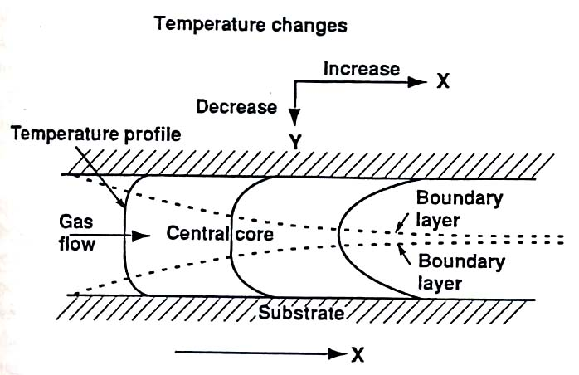
Velocity and temperature distribution profile
A steep velocity gradient is noticeable
when x is larger
-surface is the hottest
The shape distribution curve is similar
to that of velocity
Reactant Gas is inverse proportional to x
Pierson p30-31

Slide 59
Rate limiting Steps of a CVD reaction
- Diffusion is fast due to thin boundary layer
- Rate limiting step is surface reaction
- Diffusion is slow due to thick boundary layer
- Rate limiting step is mass transport diffusion
Pierson p33

Slide 60
T(K) vs growth rate for silicon deposition using various precursors
Area A: lower temperature
*Rate limiting step: (RLS)
Area B: higher temperature
*Rate limiting step:
growth rate is low
So, RLS is surface reaction
growth rate is high
So, RLS is mass transport diffusion
Pierson p34

Slide 61
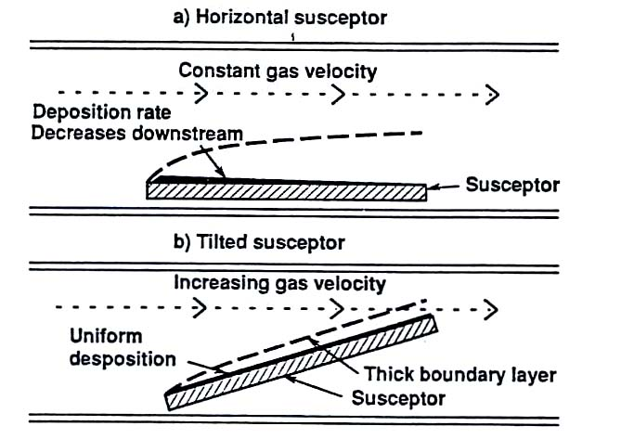
Control of deposition uniformity in a tubular reactor
-Deposition rate decreases downstream
because of thicker boundary layer along the tube
-Tilted susceptor makes boundary layers thiner
because the increase of velocity from
constriction of the flow → make the deposition
layer more uniform
Pierson p36

Slide 62
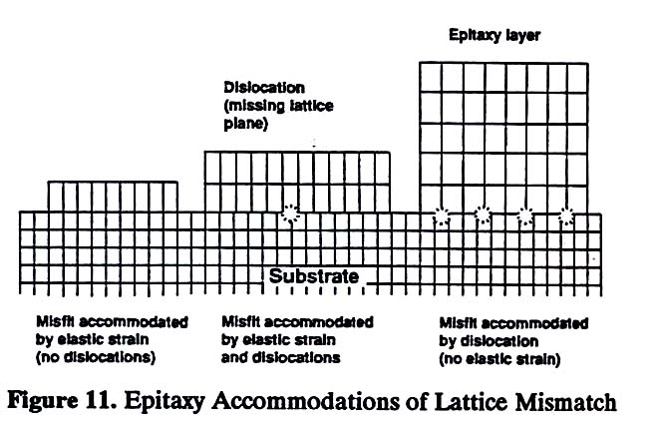
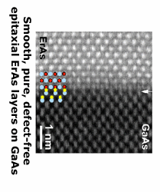
Deposition mechanism - Epitaxy
Defined as the growth of a crystalline film on a crystalline substrate
Homoepitaxy – deposited materials are the same as substrate
Heteroepitaxy - different
Lattice mismatch of deposited materials with substrate
needs to be small
Pierson p 38

Slide 63
Bandgap and lattice constant of semiconductor
Lattice mismatch larger than
8% is unlikely for deposited materials
epitaxially growth on corresponding substrate
Pierson p39

Slide 64
Nucleation and growth modes
Hitchman p37
Three-dimensional island growth-Volmer-Weber growth
film atoms are more strongly bound to each other than to the substrate (Si on SiO2, metals on insulators)
Layer-Plus-island growth-Stranski-Kastanov growth
Combination of two modes
Layer-by-layer-Franck-van der Merwe growth
Film atoms are equally or less strongly bonded to each other than to the substrate (silicon on silicon, homoepitaxy

Slide 65
A Typical CVD Apparatus
Reactant supply
Chemical reactions in a CVD reactor
Exhaust system

Slide 66
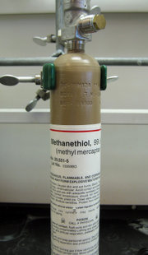
Reactant supply – gas precursor transport
A gas precursor tank
Flowmeters to control the transport rate
- Carrier gas like H2 or N2 or O2 is often used
Pierson p84

Slide 67
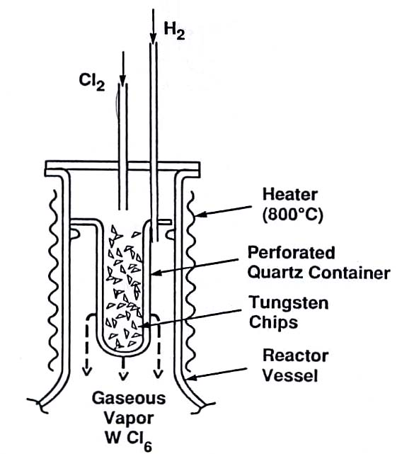
Reactant supply – liquid and solid precursor transport
W(s) + 3 Cl2(g) → WCl6(g) 800 oC
deposition step:
WCl6(g) + 3 H2(g) → W(s) + 6 HCl(g) at 800-1200 oC
Pierson p85-86

Slide 68
Exhaust system
Reactor
Water trap
Roots Pump
Vane Pump
(particle trap)
Neutralized reactants
Oil Demister
Atmosphere
Scrubber
CVD precursors: toxic, lethal, and pyrophoric

