Slide 1
Fundamentals of Optoelectronic Materials and Devices
光電材料與元件基礎
Hsing-Yu Tuan (段興宇）
Department of Chemical Engineering, National Tsing-Hua University

Slide 2
Semiconductor fundamentals
Basic concept :
-Band structure
-Carrier
References:
Optoelectronics and photonics priciples and practices, S.O. Kasap 1999
Solid state electronic devices, Ben G. streetman and sanjay banerjee, fifth edition

Slide 3
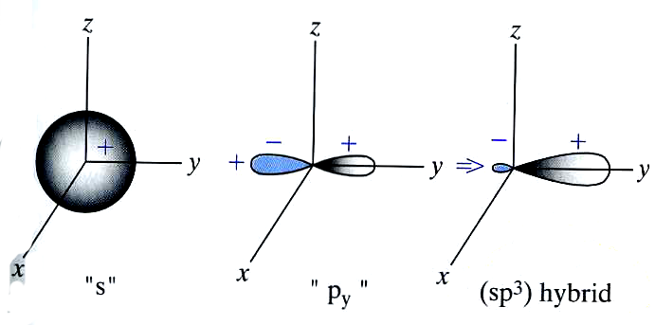
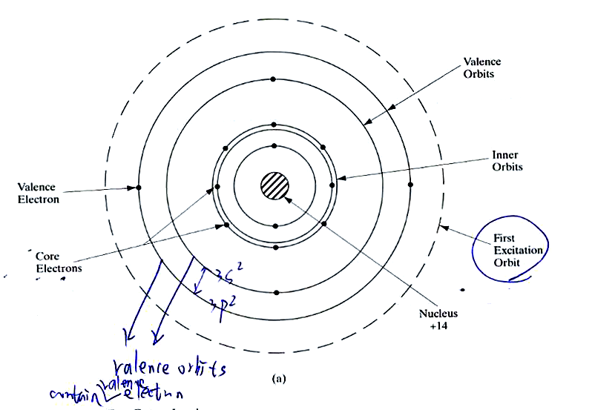
Electronic configuration and hybridized orbitals of Si
Valence electrons, i.e., the outmost electrons, in 3S and 3P orbital
could form bonding with atoms
of other materials
Electronic configuration of Si
1s²2s²2p⁶3s²3p²
Hybridation of s-oribitals and
p orbitals
Linear combinations of atomic orbitals
(LCAO)
When we bring individual atoms very
close together, the s- and p orbitals overlap
,making four mixed sp³ orbitals
(sigma bonding) created
Si: 14 electrons, 10 core electrons (1s²2s²2p⁶)
and 4 valence electrons (3s²3p²)
Streetman, p50
S orbital allows 2 electrons occupy
P orbital allow 6 electrons occupy
n, l, m s

Slide 4
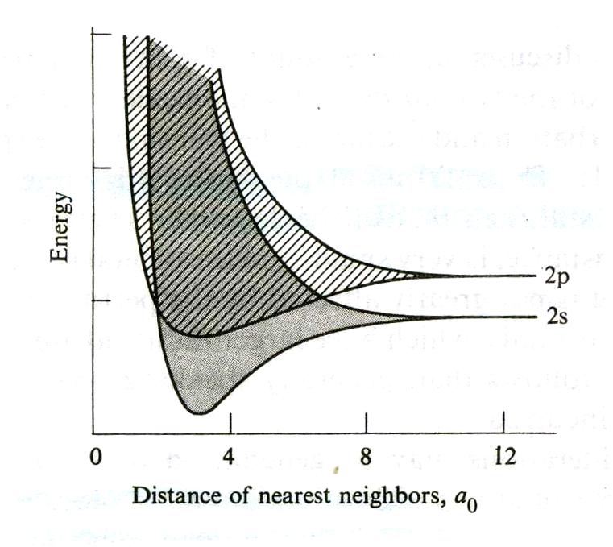
2s and 2p energy bands in a Li crystal
Energy band in a solid
2s and 2p bands for metallic Li plotted as
Functions of the lattice constant a
Atom
molecule
2p
2p
2s
2s
1s
1s
solid
overlap
forbidden
2p
2s
1s
energy gap:
the intervening regions separating these bands
the area is forbidden
In general, the higher the band the greater
its width
-if the width of the band is 5 eV, there are 10²³ level
, than the energy interval between two adjacent levels
Is only 5 x 10 ⁻²³
-for a<6a0 (lattice constant), the 2s and 2p bands
broaden to the point at which they begin to overlap
And the gap between them vanishes entirely. So lithium
has no band gap material under normal situation
-The evolution of the energy spectrum of
Li atom from an atom to a molecule and
to a solid
-The splitting of the 2p level is larger
than that of the 2s level, which is larger
still than that of the 1s level.

Slide 5
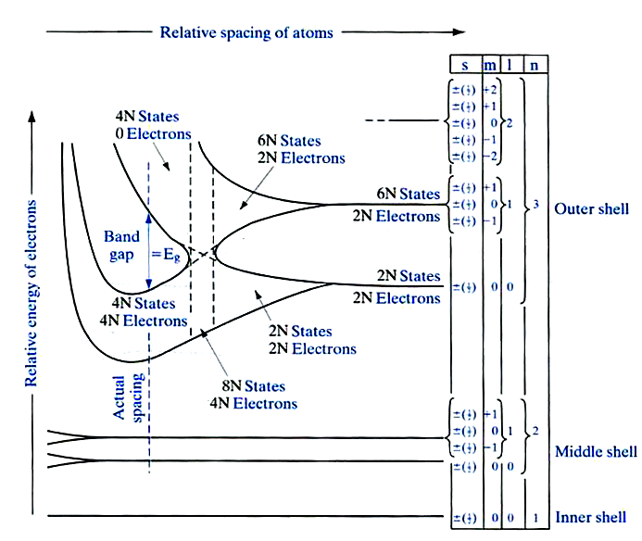
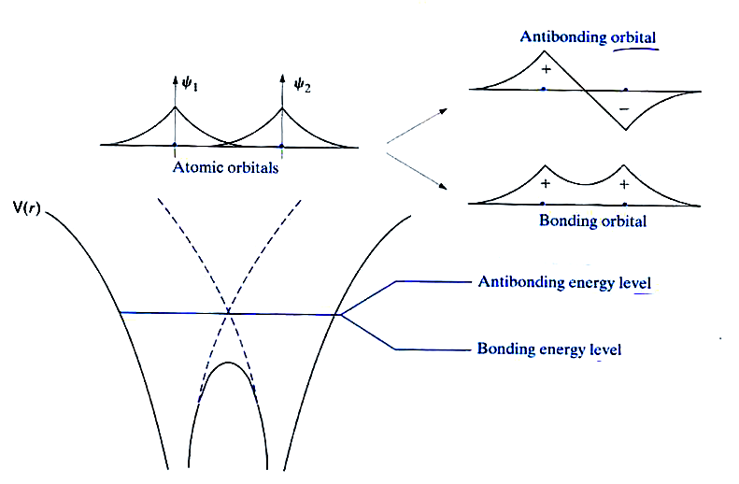
Energy level in a Si crystal
Linear combination of atomic orbitals:
2 atoms, forming bonding and antibonding energy level
Streetman, p59
-Electronic configuration of Si: 1s²2s²2p⁶3s²3p²
-N Si atoms → 2N, 2N, 6N, 2N, 6N states
3s-3p level contains 8N states (outer shell)
and split into 4N lower energy states (conduction band) and 4N higher energy states (valence band)
-N Si atoms have 4N outer electrons, at 0K, electrons only occupy in the 4N states in the valence band

Slide 6
Band gap schematic of Si

Slide 7
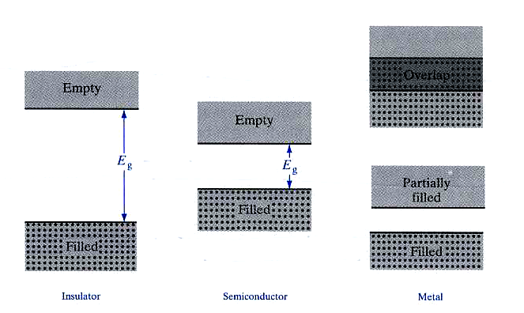
Distinction between insulator, semiconductor and metal
Insulator Semiconductor Metal
conduction band
plenty of
electrons
> 5 eV
valance band
-few electrons excited to conduction band
Ex, Si: 10¹⁰ / cm3
(note: Si has 5x10²² atoms/cm3)
-very few electrons excited to
valance band at room temperature
Streetman p62

Slide 8
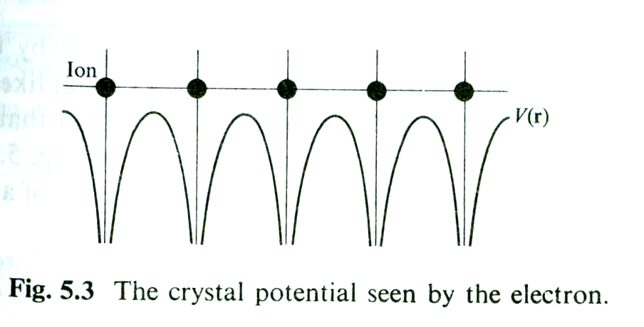
Energy bands in solids
The behavior of an electron in a crystalline solid is determined by studing the
appropriate Schrodinger equation
- V(r) is the crystal potential seen by the electron.
According to Bloch theorem:
-all functions are vector functions, that is, with directions
-the vector k is a quantity related to the momentum of the particle

Slide 9
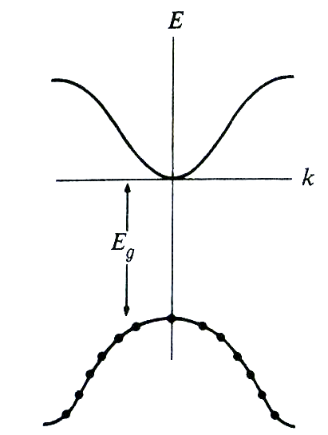
Band structure in a semioconductor
Simplest band structure of a semiconductor
Conduction band
E=0
Valence band

Slide 10
E-k diagram and energy band diagram

Slide 11
Direct band gap and indirect band gap structure

Slide 12
Carrier: electron and hole
Some electrons were excited to the conduction band at temperature >0K
For convenience, an empty state in the valence band is referred to as a hole
Electron-hole pair (EHP): conduction band electron and the hole are
created by the excitation of a valence band electron
-EHPs are free charge carriers in semiconductor materials
-Si, at room temperature has 10¹⁰ EHP/cm3 (Si: 5x10²² atoms/cm3)

Slide 13
Carrier generated in the semiconductor under incident light excitation

Slide 14
Carrier numbers in intrinsic material
n = number of electrons/cm³
p = number of holes/cm³
n=p=ni
ni=10¹⁰/cm³ in Si at room temperature
10¹³/cm³ in Ge at room temperature
Si has 5 x 10 ²² atoms/cm³, with four bonds per atoms
→2 x 10²³ valance band electrons
Less than one bond in 10¹³ broken in Si at room temperature
That is why need to dope Si and Ge

Slide 15
Doping
Donors: P, As, Sb (Column V elements ) , n-type, → provide one additional electron
Acceptors: B, Ga, In, (Column III elements), p-type→ provide one additional hole
P+
-
B-
-weakly bound
-bonding strength E_{B}~ 0.05 eV (Si bonding ~1.12 eV)
Majority carrier - electron in a n-type material
hole in a p-type material
Minority carrier – hole in a n-type material
electron in a p-type material

Slide 16
N-type Semiconductor schematic

Slide 17
p-type Semiconductor schematic

Slide 18
ED donor levels to the energy band diagram
Donors EB Acceptors EB
T=0 C
Sb 0.039 eV B 0.045 eV
P 0.044 eV Al 0.057 eV
As 0.049 eV Ga 0.065 eV
In 0.16 eV
Group V
Group III
Ec
Increase T
0.044 eV (P)
ED
EA
0.057 eV (Al)
Ev

Slide 19
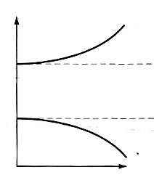
Density of states
Energy distribution of allowed states in each band
Tells one how many states exist at a given energy E
g(E)dE: the number of conduction band states/cm3 lying in the
energy range between E and E+dE
gc(E) is zero at Ec, and increases as the square roote
of energy when on proceeds upward into the conduction
band
The same as gv(E)
gc(E)dE: represents the number of conduction band
states/cm3 lying in the energy range between
E and E+dE (If E
more
states
Ec
gc(E)
E
Ec)
Ev
gv(E)
more
states

Slide 20
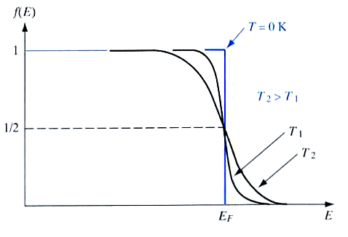
Fermi function
Fermi-Dirac distribution function for a electron
-EF=Fermi energy or Fermi level
-specifies how many of the existing states
at the energy E will be filled with an electron
-that is, under equilibrium conditions, the
probability that an available state at an energy
E will be occupied by an electron
-simply a probability density function
EF-3kT
EF+3kT
At fermi level, occupation probability is 1/2
-at room temperature, kT~0.026 eV and 3kT ~0.078 eV (Si’s EG: 1.12 eV)
Compared to Si band gap, the 3kT energy interval that appears prominently
In the T> 0 K is typically quite small
-So, there is very low probability of electron appear in conduction band at room temperature

Slide 21
Representation of intrinsic, n-type, p-type semiconductor materials using the energy band diagram
fermi level shift
Ec
Ei
Ev
Ec
EF
Ei
Ev
Ec
Ei
EF
Ev
Intrinsic n-type p-type

Slide 22
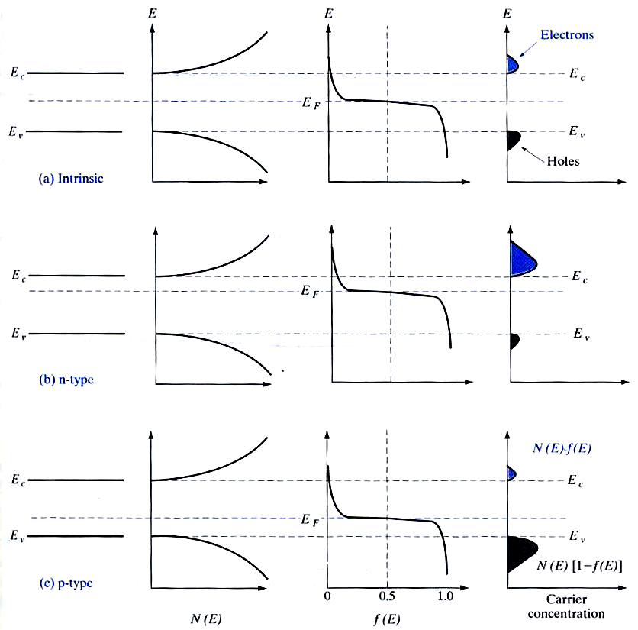
Equilibrium distribution of carriers in intrinsic and doped semiconductors
hole 1-f(E)
The concentration of electrons in
the conduction band
The concentration of holes in
the valence band
most carrier concentrations
near the band edges
g(E)

Slide 23
Color schematic

Slide 24
Carrier action
Drift:
electrons and holes move due to a electrical field E
Diffusion
electrons and holes move due to concentration gradient
+ -
E
Recombination - generation
Ec
heat or light
Ev

Slide 25
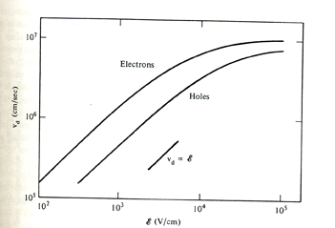
Drift current
I (current) = the charge per unit time crossing an arbitrarily chosen plan
for electron drift In,drift=qnvdA –electron drift current
Jn,drift= I/A=qnvd vd (constant drift velocity)
Vd=μxE
μ: mobility, cm²/V-sec
Jn,drift= qμnnE
Jp,drift= qμppE
Un~1360 cm²/V-sec in ND=10¹⁴/cm³ doped silicon
Up~490 cm²/V-sec in NA=10^{14/}cm³ doped Silicon

Slide 26
Diffusion on a microscopic scale in a hypothetical one-dimensional system
1024
512
512
512
384
384
256
256
128
128
t=0
320
256
256
192
: the number of particles
In a given compartment

Slide 27
Diffusion currents/total carrier currents
Total carrier current combined with diffusion and drift
Jp=qμppE - qDp
p
drift
diffusion
Jn=qμnnE + qDn
n

Slide 28
Carrier recombination – generation (R-G)
-
-
-
-
x
light
+
x
R-G centers
heat
heat
-like a trap
+
Ec
Ec
Ec
Ec
heat
ET
light
Ev
Ev
Ev
x
Ev
photogeneration
Direct thermal
generation
Direct thermal
recombination
Recombination
and generation
From indirect thermal
recombination-generation
process
The termal creation and anihilation of carriers typically dominated by indirect
thermal-generation
-R-G centers (E_{T}) are impurity atoms (gold in Si) or lattice defects, can trap
carrier easily

Slide 29
R-G statistics
A technical men given to the mathematical characterization of recombination-generation process
R-G evaluates the time rate of change in the carrier concentrations
-The rate of change in the carrier concentration
n~no
perturbation
Ec
ET(R-G)censter
Ev
△P
n-type semiconductor
△p<<no
Low level injection implied
△p<<no n~no in an n-type material
△n<<Po p~po in an p-type material

Slide 30
n-type semiconductor after a perturbation
perturbation
perturbation
t=0
t>0
t->infinite
P0
△P
△P=0
n-type semiconductor
n-type semiconductor
n-type semiconductor
The change of minority carriers
dominate the recombination rate
To be approximately
Proportional to NT (R-G center numbers)
(R-G)
(since the multitude of electrons rapidly
fill any level that is vacant)
n~no
Ec
EF
ET(R-G)censter
Ev
To be approximately
Proportional to △P
(R-G)
The more holes available for
annihilation, the greater
the number of holes recombining
per second.
po
△P<<no
(R-G)
For holes in a n-type material;
(R-G)
For electrons in a
p-type material
Cp Cn is a positive proportionality constant

Slide 31
Minority Carrier lifetimes
We introduce the time constants
For holes in an n-type material
(R-G)
For electrons in an p-type material
(R-G)
-are called minority carrier lifetimes ; interpreted as the average time
an excess minority carrier will live in a sea of majority carriers
-In a Si with very few R-G center, lifetime is around 1 msec
- Typical minority carrier lifetimes in most Si device is around 1 μsec
Diffusion lengths
electron in a
p-type material
hole in an n-type material

Slide 32
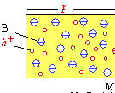
Charge neutrality
In a semiconductor with equilibrium state.
the charge should be neutral, otherwises,
there occurs an electric field
-
qp – qn + qND - qNA = 0
+
Charge/cm³
ND+ = number of positively charged donor sites
NA- = number of negative charged acceptor sites

Slide 33
Carrier Related terminology
Dopants: specific impurity atoms which are added to semiconductors in controlled amounts for the expressed purpose of increasing either the electron or the hole concentration
Intrinsic semiconductor: undoped semiconductor; a semiconductor whose properties are native to the material
Extrinsic semiconductor – doped semiconductor; a semiconductor whose propeties are controlled by added impurity atoms
Donor – impurity atom which increase the electron concentration; n-type dopant.
Acceptor – impurity atom which increase the hole concentration; p-type dopant
N-type material – a donor-doped material; a semiconductor containing more electrons than holes
P-type material – an acceptor-doped material; a semiconductor containing more holes than electrons
Majority carrier – the most abundant carrier in a given semiconductor sample; electrons in an n-type materials, holes in a p-type material.
Minority carrier – the least abundant carrier in a given semiconductor sample; holes in an n-type material, electrons in a p-type material.

