Slide 1
Fundamentals of Optoelectronic Materials and Devices 光電材料與元件基礎
Hsing-Yu Tuan (段興宇）
Department of Chemical Engineering, National Tsing-Hua University

Slide 2
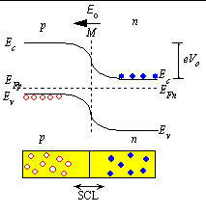
PN junction:summary
Story:
The carrier concentraion
difference between the n and p
regions causes the carriers to
diffuse. The diffusion, however,
Leads to a charge imbalance.
the charge imbalance in turn
produces an electric field, which
counteracts the diffusion so that
in thermal equilibrium the net
flow of carriers Is zero.
The charged region near the
metallurgical junction where
the mobile carriers have been
reduced is called the depletion
region
no carrier in the
depletion region
potential
charge density
E=-dV/dx
Vo: built-in-potential

Slide 3
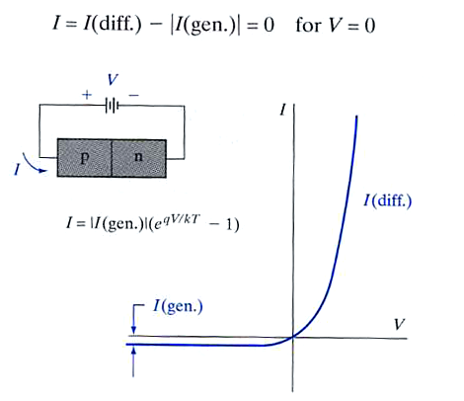
Forward and reverse bias effect for a pn junction
Fermi level equilibrium
Forward bias reduces the eVo to
e(Vo-V), so the electrons at Ec
in the n-side can overcome the the
potential barrier and diffuse to the p-side
A reverse bias, V=-Vr, Vr adds to the
built-in potential Vo, so the P.E barrier
becomes e(Vo+Vr), so there is hardly any
reverse current.

Slide 4
Fabrication of Light Emitting Diode using a pn junction structure

Slide 5
Light Emitting Diodes: Principle
built in voltage
Depletion region extends mainly into p-side
made by a junction consists of p-side with heavily-n-doped-side (n⁺)
the recombination of injected electrons in the depletion region as well as in the
neutral p-side and results in spontaneous emission of photons
-the recombination zone is called the active region
-light emission from EHP recombination as a result of minority carrier injection
is called injection electroluminescence

Slide 6
LED device structure
Narrow
-P-layer has to be narrow (a few microns) to allow the emitted photons escape
without being reabsorbed

Slide 7
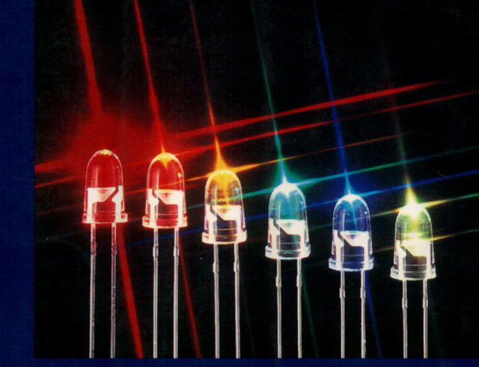
LED device structure
GaAs is around 16⁰
p

Slide 8
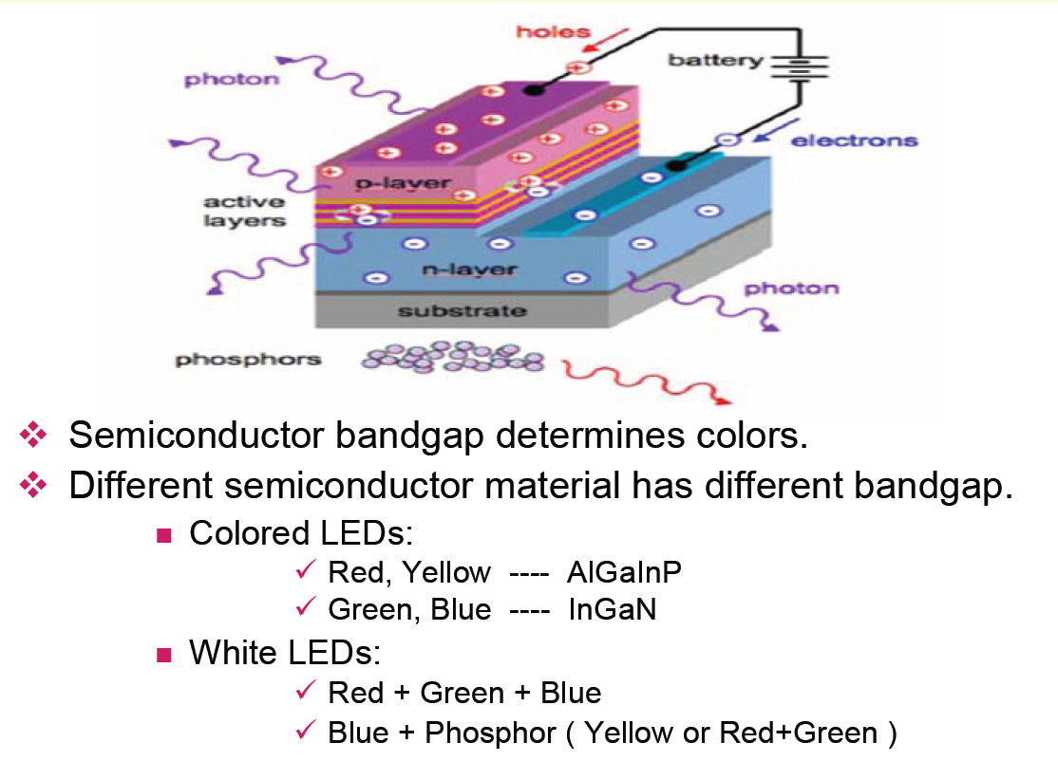
LED device illustration

Slide 9
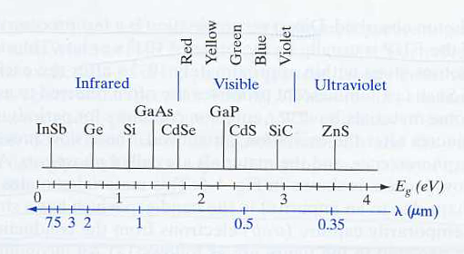
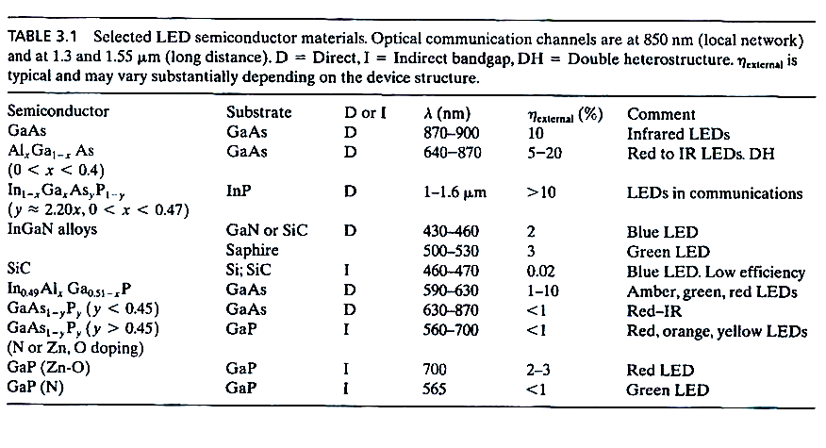
LED semiconductor materials
η_{external} = P_{out} (optical) x 100%
IV
1993 年日亞(Nichia)發展高效率藍光LED!

Slide 10
LED materials – mainly III-V based direct band gap
materials
- II-VI compounds are hard to be doped, so not usually be used

Slide 11
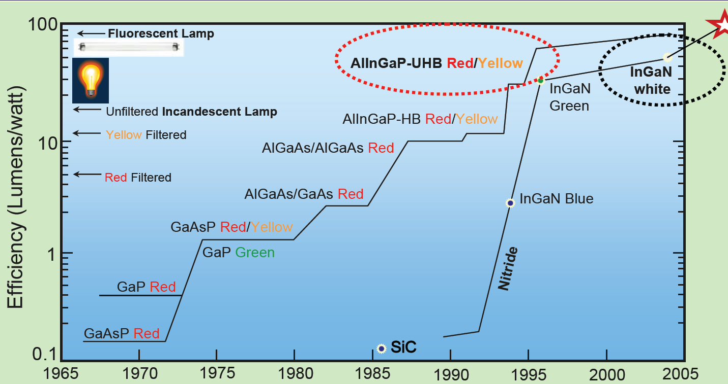
Evolution of light source

Slide 12
Tuning band gap by alloying or doping
Alloy
doping
y=0.45, λ=630 nm
Red light
Nitrogen doped indirect bandgap GaAs1-yPy allows can emit green, yellow, orange LEDs
Al doped SiC, GaN are can emit blue emission, however, Al doped SiC is indirect band gap
and GaN is very expansive

Slide 13
LED characteristics
E=hv
The energy of an emitted photon from an LED is not equal to the Eg
Electron (hole) concentration’s peak position is 1/2kBT above Ec or Ev
and direct recombination is proportional to the concentration
-The linewidth is defined as width between half-intensity equal to △hv , normally
is around 2.5-3 kBT

Slide 14
Output spectrum of a red GaAsP LED
Turn-on voltage:1.5V
- =24 nm is around 2.7kBT
-Turn-on voltage increase with the energy bandgap Eg, vlue LED is 3.5-4.5 V
yellow LED is around 2 V, GaAs infraed LED is around 1 V

Slide 15
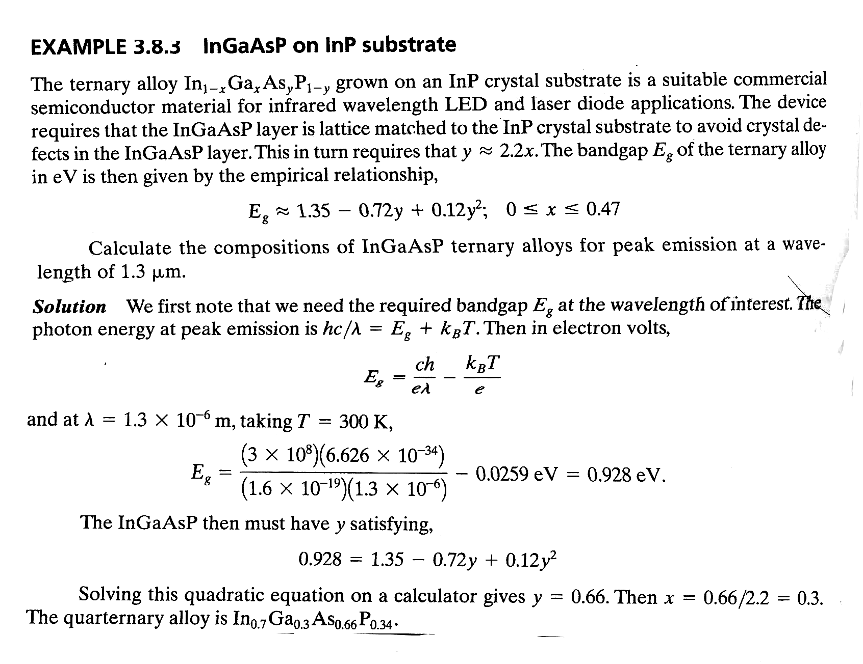
Peak emission

Slide 16
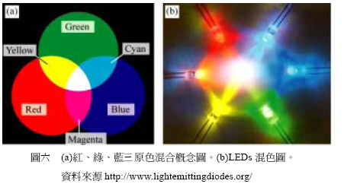
White light LED
White light for lighting – long service life, electricity effective, low driving voltage, safe
White light LED:
First example: Blue LED + YAG (yttrium aluminum garnet, 釔鋁石榴石) yellow phosphor (currently most popular, low cost & high efficiency) (at 1996)
- RGB LEDs (Red:green:blue = 3:6:1)
- UV LED (GaN) + RGB phosphors

Slide 17
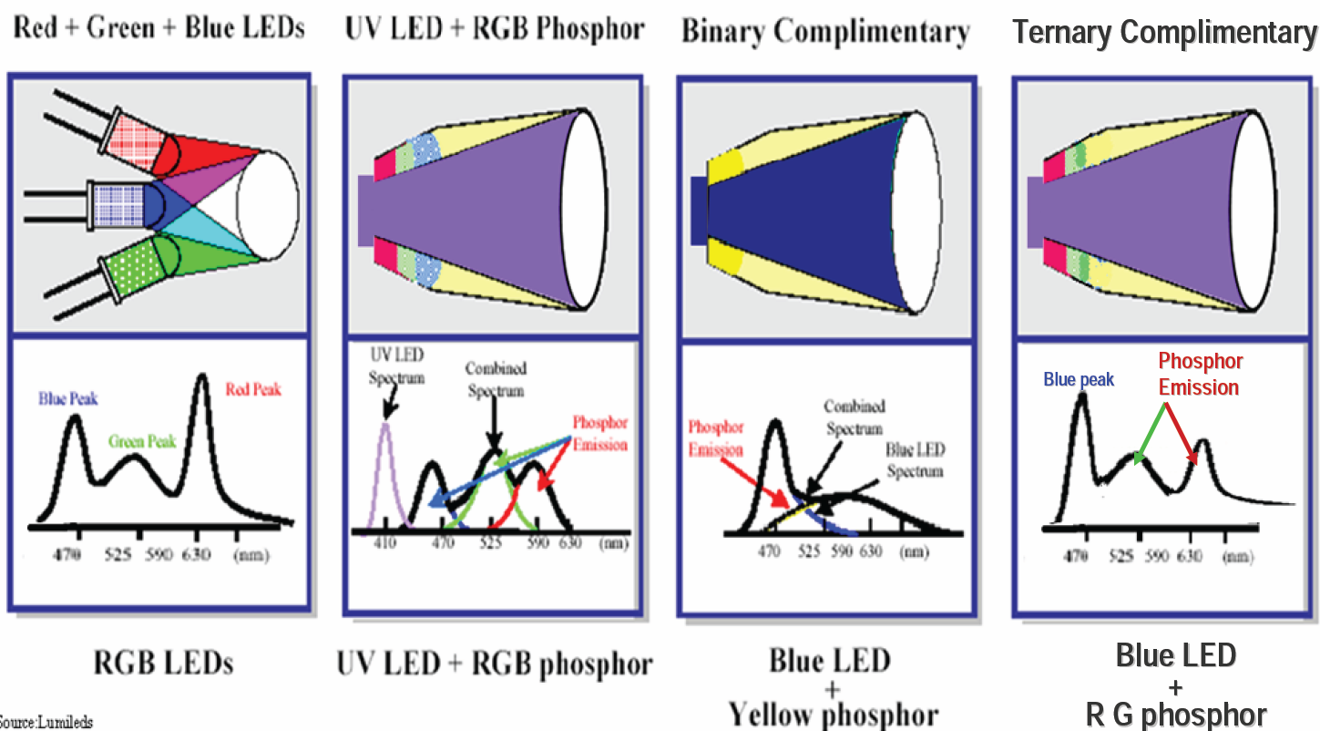
Various combination of white LED

Slide 18
Evolution of light source
LED has 80% lower energy vs. incandescent
LED has 39% lower energy vs. CFL
Efficiency now is
the best.
compact fluorescent light
Courtesy of Osram

Slide 19
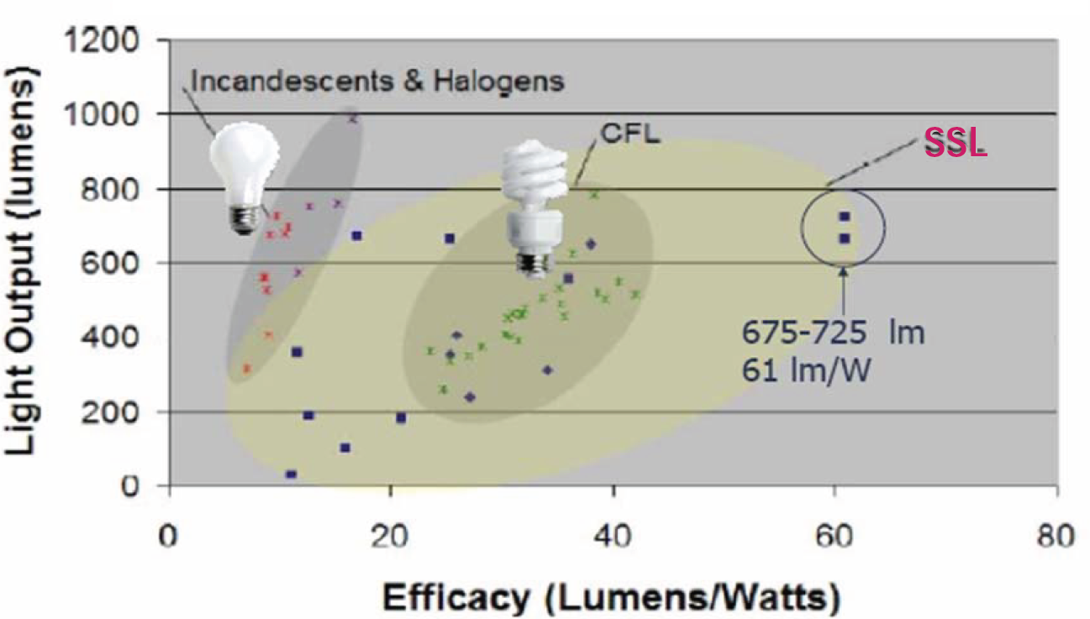
Light output V.S. Efficiency

Slide 20
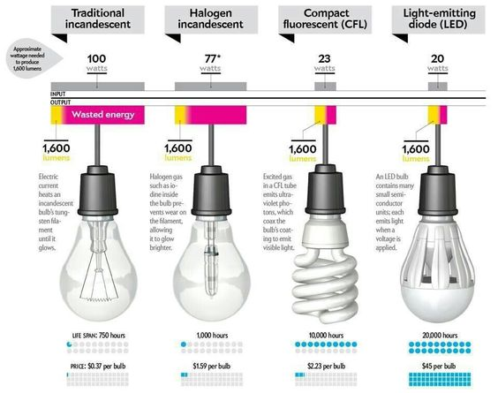
Cost comparison of light bulbs

Slide 21
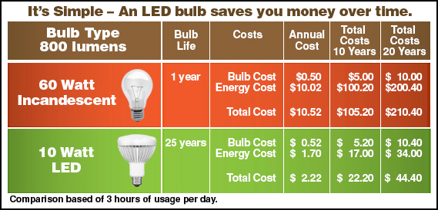
Cost comparison of light bulbs

Slide 22
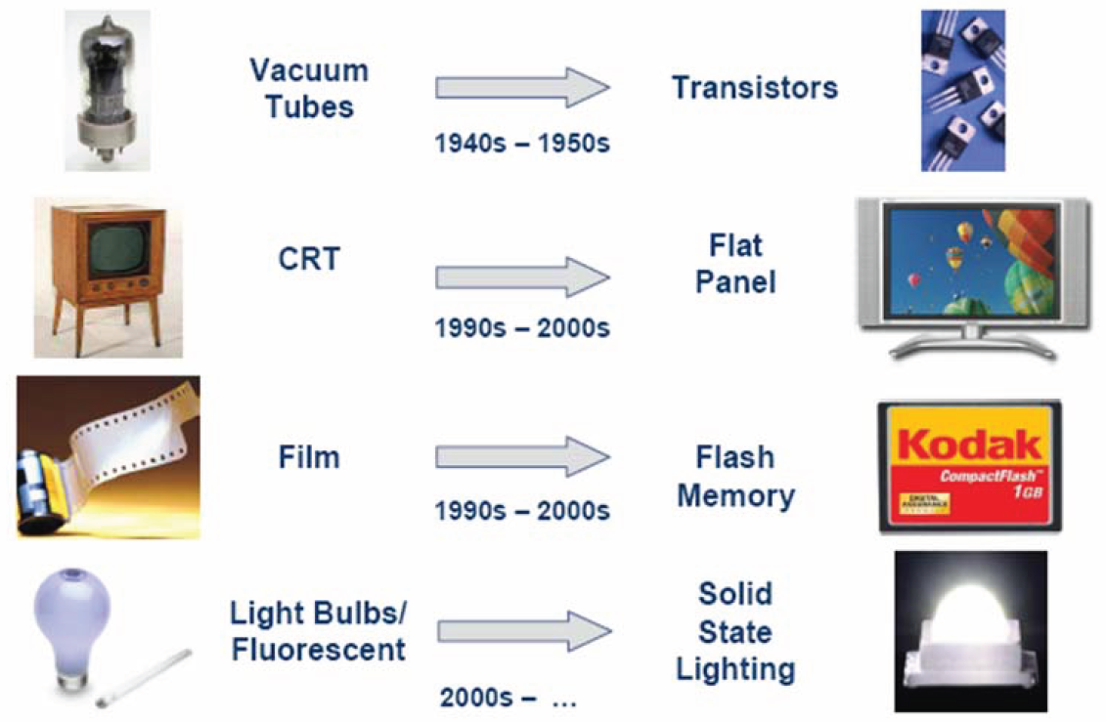
Is the technology revolution similar?

Slide 23

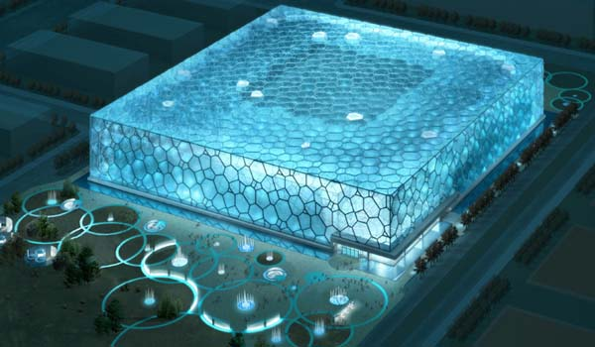
High tech product combined with LED
水立方

Slide 24
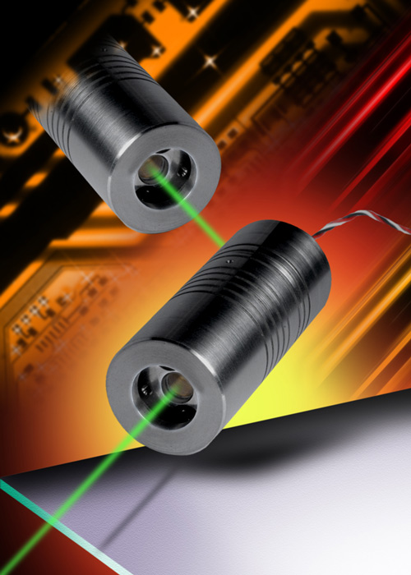
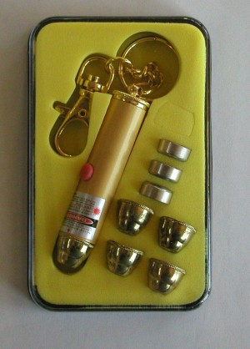
Fabrication of laser diode using pn junction structures
Laser: Light Amplification by Stimulated Emission of Radiation

Slide 25
Two keys for making a laser
population inversion
Optical cavity

Slide 26
Absorption, spontaneous, and stimulated emission
Emission: an electron at a higher energy level transits down to an unoccupied energy level
and it emits a emits a photon
Spontaneous emission: emitted photon from E2 to E1 in a random direction, which
provided by the E1 not already occupied by another electron
Stimulated emission:
Emitted photon is in phase with incoming photon
(the same direction, the same energy, the same polarization)
Incoming photons was magnified →there are more atoms at E2 than
at E1 (population inversion), so incoming photons were not absorbed
by another atom at E1
The key 1 of laser: population inversion

Slide 27
The way to achieve population inversion
Note:
-in normal case, only two energy levels can not achieve population inversion
-external excitation first excite electron from E1 to E3
-the emission from E2 to E1 is called lasing emission
-LASER: Light Amplification by Stimulated Emission of Radiation
- an example: Cr+3 ion in a crystal of alumina Al2O3 (saphire)

Slide 28
Er⁺³ doped glas fiber : an example

Slide 31
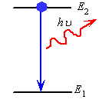
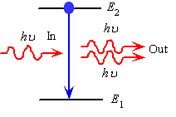
Make Stimulated emission rate larger
Spontaneous emission
Stimulated emission
R21 - downward transition rate from E2 to E1
R21 = A21N2+B21N2 (hv)
Spontaneous emission
Stimulated emission which requires
Photons to drive it
stimulated
We need a large photon concentration
with the wavelength we want!
- Need an optical cavity
spontaneous
-photon energy density per unit frequency
-the number of photons per unit volume with an energy hv=(E2-E1)

Slide 32
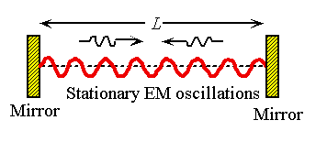
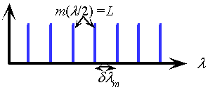
A optical cavity (optical resonator)
-We build a optical cavity to trap the wavelength
we want
-only standing waves with certain wavelength
can be maintained within the optical cavity
m:mode number (an interger)
Wavelength satisfy the left equation is called
A cavity mode

Slide 33
Laser diodes: utilization of PN junction
Compared to other lasers (sapphire, CO₂, HeNe, dye), semiconductor laser diodes are compact in size, electricity effective, efficient, long life, cheap, and versatile in color from UV to IR.
Applications – CD,VCD,DVD players, CDROM, laser printer, laser pointer, bar code scanner, etc.

Slide 34
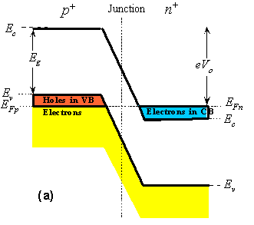
Degenerated semiconductor
the semiconductor that was excessively doped with donors or acceptors (10¹⁹-10²⁰ cm⁻³⁾ called degenerate semiconductor
such a semiconductor exhibits properties that are more metal-like
-degenerate doping: the Fermi level EFP in the p-side is in the valence
band(VB) and the EFn in the n-side is in the conduction band (CB)
-a laser diode consists of “degenerately” doped p+ side with “degenerated”
doped n+ side (p+n+ junction)

Slide 35
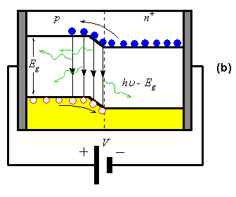
Structure: degenerately doped direct bandgap semiconductor pn junction
After applying large forward
bias V
LED
laser diode structure: degenerately doped direct bandgap semiconductor pn junction
depletion region (active region) is very narrow
population inversion occurs when applying a voltage larger eV > Eg:
the applied V diminishes the built-in potential to zero and electrons flow into the SCL
an incoming photon with energy Ec-Ev doesn’t excite an electron but stimulated by
falling electrons

Slide 36
Density of States and optical Gain in the active layer
the active region has an optical gain since an incoming photon is more likely
to cause stimulated emission than being absorbed
-the pumping mechanism caused by forward diode current is called injection pumping
-the pumping energy is supplied by the external battery

Slide 37
Build an optical resonator in a laser diode
an optical resonator
n: refractive index
-an optical cavity (resonator)) is required to implement a laser oscillator to build up the intensity of stimulated emissions.
-the ends of the crystal are cleaved to be flat and optically polished to
provide reflection and form an optical resonator
-this process can build up the intensity of the radiation in the cavity

Slide 38
Output power vs. diode current of a laser diode
Threshold current
-lasing radiation is only obtained when the optical gain in the medium can
overcome the photon losses from the cavity, which requires the diode current I
to exceed a threshold value Ith
-below Ith: spontaneous emission; above Ith: stimulated emission

Slide 39
Comparison of laser’s and LED’s light power versus current

Slide 40
Heterostructure laser diode
+
+
+
a heterostructured laser diode can significantly reduce the threshold current (Ith)
-we confine the injected electrons and holes to a narrow region, so that
less current is needed to make population inversion
-carriers are confined in the p-GaAs (active area) when the voltage is applied
-gaAs layer is very thin, so the concentration of injected electrons can be increased
quickly with moderate increases in forward current.

Slide 41
Schematic illustration of a double heterojunction laser diode

Slide 42
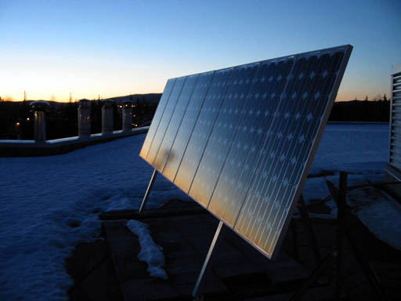
photovoltaic device (solar cell)

Slide 43
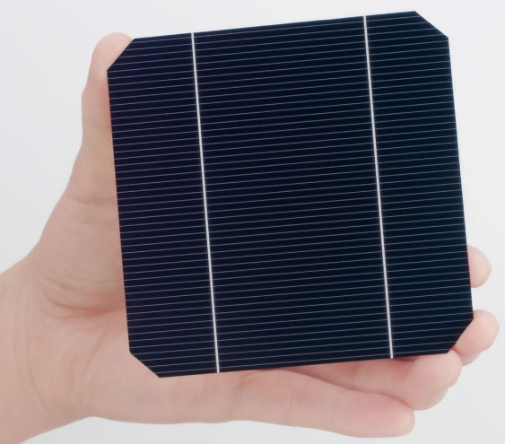
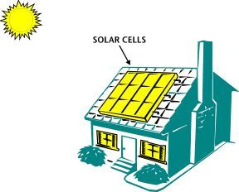
Solar cells
Solar light in
Electricity out

Slide 44
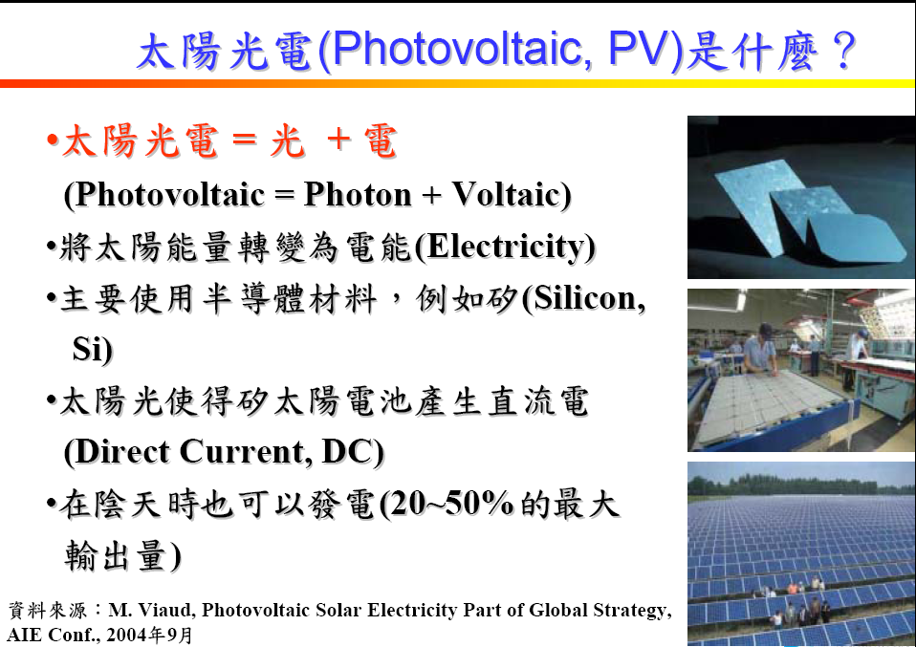

Slide 45
Generate electrons from materials by photons
Semiconductor, polymer or dyes
excited state
Separation of the
electron-hole
pair
electron
Conduction band
or HOMO
Valence band
or LUMO
Conduction band
or HOMO
Valence band
or LUMO
pair
So, materials used for solar cell application need to have discrete energy
gap for photogeneration of electron-hole pair

Slide 46
Elemental and Compound Semiconductors
I II III IV V VI
 |  | 5 B | 6 C | 7 N | 8 O
 |  | 13 Al | 14 Si | 15 P | 16 S
29 Cu | 30 Zn | 31 Ga | 32 Ge | 33 As | 34 Se
47 Ag | 48 Cd | 49 In | 50 Sn | 51 Sb | 52 Te
46
Notes:
46
You have heard many good things from me about CIGS solar cell. From here, I would like to give a brief introduction of CIGS material and its properties. CIGS is a I-III-VI compound semiconductor derived from II-VI compound. The group II element is replaced by group I and group III elements. Therefore, the I-III-VI compound has the atomic ratio of 1:1:2. Like other compound semiconductors, the elements belongs to the same group can be substituted to form solid solution such as Cu-In-Ga-Se quaternary compound or even Cu-In-Ga-Se-S pentanary compounds.

Slide 47
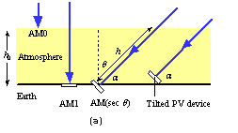
Definition of various radiation
m=h/ho=secθ
photovoltaic = photon + voltaic
AM0 ：太陽光在大氣層外的平均照度稱為AM0，其功率約1300W/m^2
AM1 (90 °) ：太陽光透過大氣層後與地表呈90度時的平均照度稱為AM1，其功率約925W/m^2
AM1.5 (45 °)： AM1.5用來表示地面的平均照度，是指陽光透過大氣層後，與地表呈45°時
的光強度，功率約844W/m^2，在國際規範(IEC 891、IEC 904-1)將AM1.5
的功率定義為1000W/m^2。

Slide 48
Pick right materials
- Good absorption coefficient to harvest
light
- Suitable band gap

Slide 49
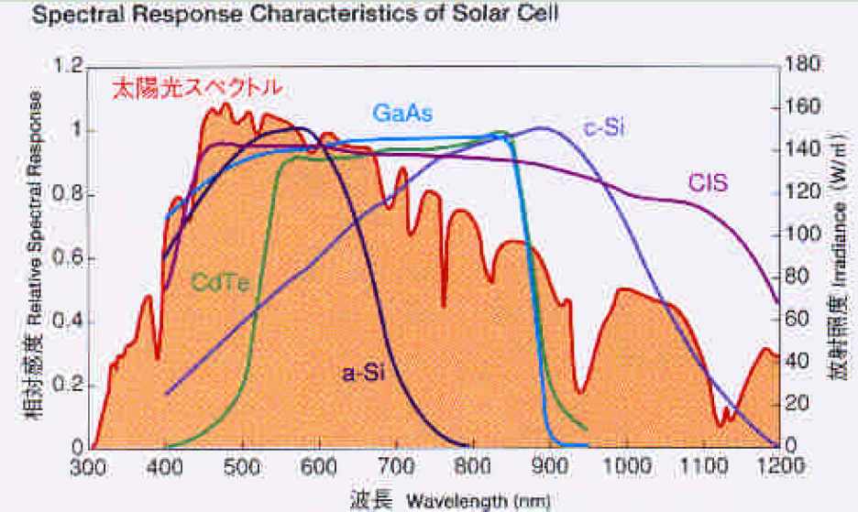
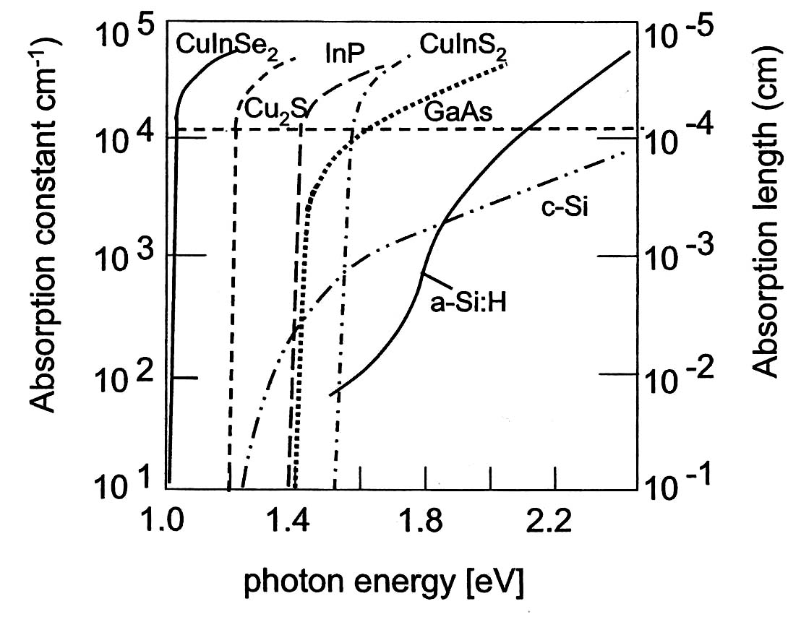
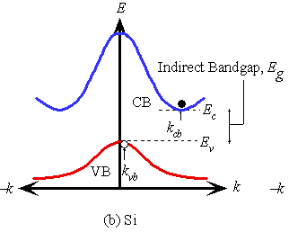
Absorption of semiconductors
Phonon emission o
r absorption
-We prefer direct semiconduct materials
since they can absorb light more efficiently
-Si and Ge’s absorption coefficient
increase slowly with increased energy

Slide 50
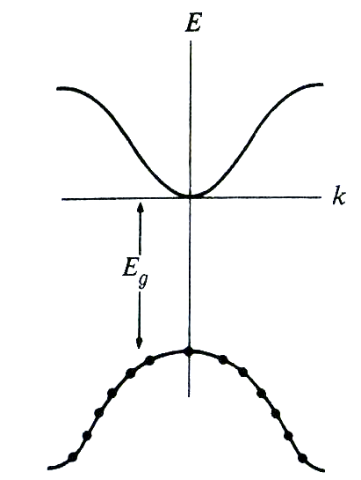
Pick suitable Eg (eV)
Theoretical maximum efficiency of a semiconductor
S(λ) =# of photons/area*time
bandgap of semiconductor should not be wide
→get higher S(λ)
-Electrons in the valence band can absorb energy of Eg, 2 Eg, 3Eg, but the excess energy can not be transformed to electric energy but transform to heat → need higher Eg
-very narrow band gap material can absorb most wavelength from sun, but transformed energy is small.

Slide 51
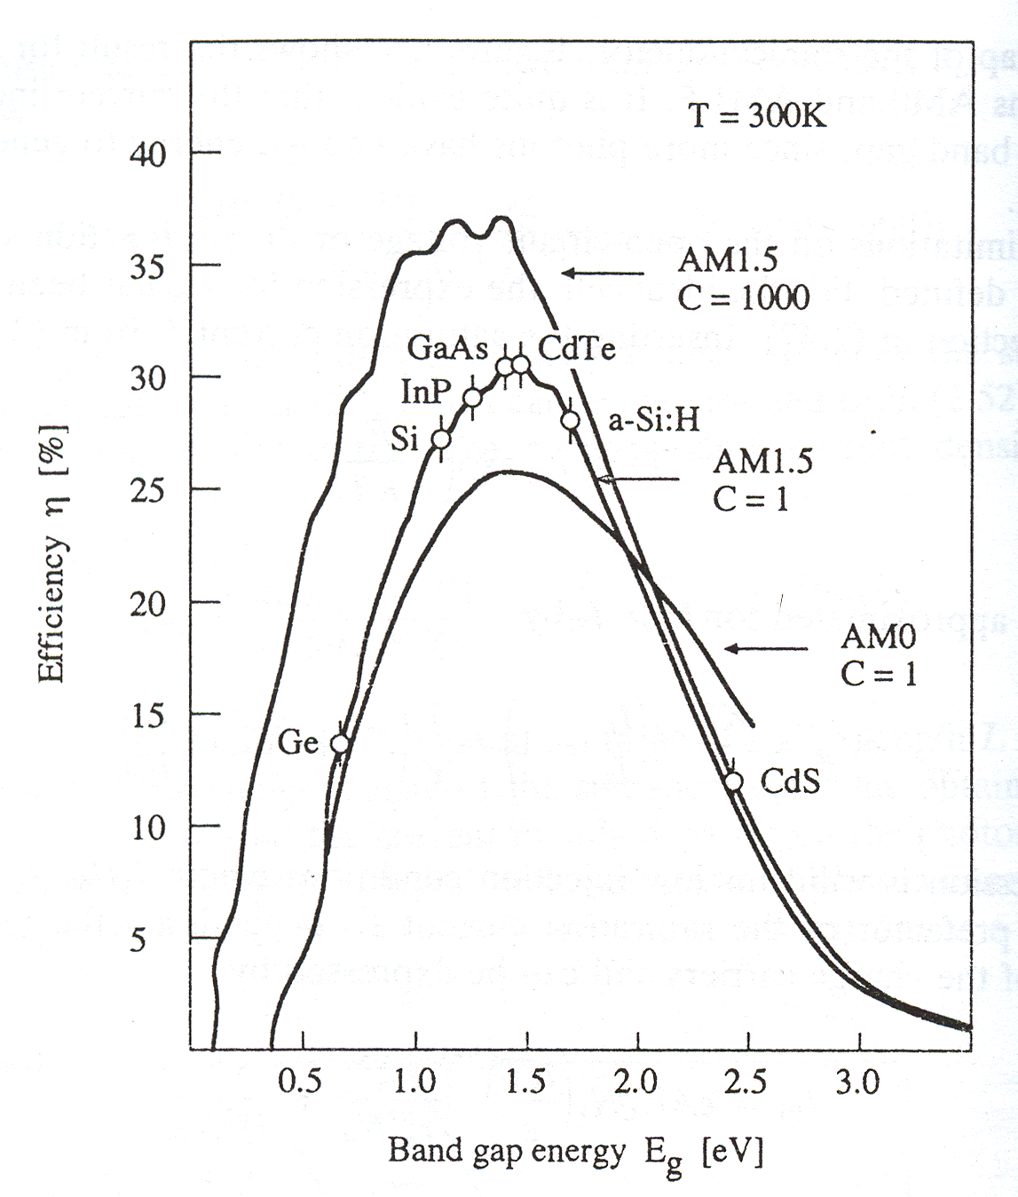
ηmax(%) vs Eg (eV) under AM1.5
real η_{max} is only around
30% due to loss of other facters
Eg:
1.0 – 1.5 eV is the best range

Slide 52
Absorption of semiconductor
Phonon emission o
r absorption
-We prefer direct semiconduct materials
since they can absorb light more efficiently
-Si and Ge’s absorption coefficient
increase slowly with increased energy

Slide 54
A PN junction photovoltaic device
-incoming photon generate EHPs and
separated by the build-in field Eo, drifts them apart
-generated electrons and hole can
diffuse and drift in neural region and SCL, respectively
-

Slide 55
A PN junction photovoltaic device
-The movement of minority carriers is critical for
the amount of generated current
-Without Eo it is not possible to drift apart
the photogenerated EHPs accumulate
excess electrons on the n-side and
excess holes on the p-side

Slide 56
A PN junction photovoltaic device
0.2 μm
200-500 μm
:life time
Electron diffusion length
-Silicon’s electron diffusion length is longer than
the hole diffusion length
-we make a device with very narrow n region and
longer p region
-n side: 0.2 μm or less ; p-side: 200-500 μm
Reason: (1) the electron diffusion length in Si
Is longer than the dole diffusion length
(2) At long wavelengths, around 1-1.2 μm, the
absorption coefficient α of Si is small and the
absorption depth (1/ α) is typically greater than 100 μm.
Only electrons within the Le to the depletion
Layer can contribute to the photovoltaic effect

Slide 57
Photogenerated carriers within the solar cell
At
Photocurrent Iph = eGoA(ln + W+Le)
Go = photogeneration rate

Slide 58
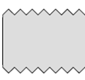
Device structure of a Si solar cell
(1)
Finger electrodes
Bus electrode
(2)
for current collection
(3)
0.2 μm
n
Incident light
surface texturization
200 μm
p
In order to capture more light
and to allow more photons into the device
- finger electrodes were made to allow light pass through the device
a thin antireflection coating on the surface reduces light reflection and allow more
lighte to enter the device
-surface texturization to for multiple light reflection and increase light path

