Slide 1
Fundamentals of Optoelectronic Materials and Devices
光電材料與元件基礎
Hsing-Yu Tuan (段興宇）
Department of Chemical Engineering, National Tsing-Hua University

Slide 2
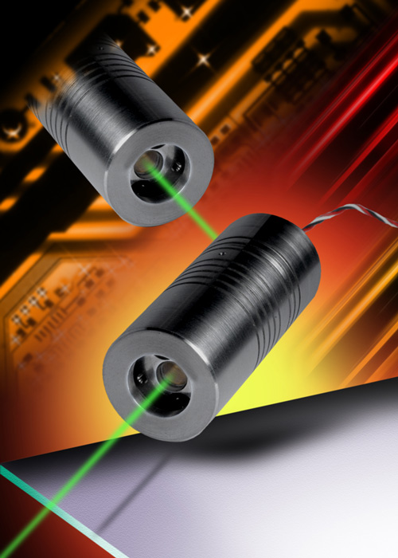
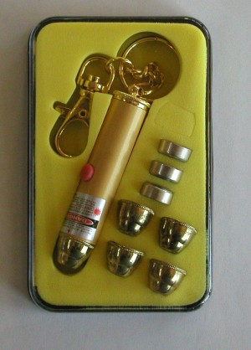
Fabrication of laser diode using pn junction structures
Laser: Light Amplification by Stimulated Emission of Radiation

Slide 3
Two keys for making a laser
population inversion
Optical cavity

Slide 4
Absorption, spontaneous, and stimulated emission
Emission: an electron at a higher energy level transits down to an unoccupied energy level
and it emits a emits a photon
Spontaneous emission: emitted photon from E2 to E1 in a random direction, which
provided by the E1 not already occupied by another electron
Stimulated emission:
Emitted photon is in phase with incoming photon
(the same direction, the same energy, the same polarization)
Incoming photons was magnified →there are more atoms at E2 than
at E1 (population inversion), so incoming photons were not absorbed
by another atom at E1
The key 1 of laser: population inversion

Slide 5
The way to achieve population inversion
Note:
-in normal case, only two energy levels can not achieve population inversion
-external excitation first excite electron from E1 to E3
-the emission from E2 to E1 is called lasing emission
-LASER: Light Amplification by Stimulated Emission of Radiation
- an example: Cr+3 ion in a crystal of alumina Al2O3 (saphire)

Slide 6
Er⁺³ doped glas fiber : an example

Slide 9
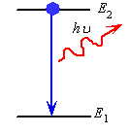
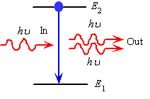
Make Stimulated emission rate larger
Spontaneous emission
Stimulated emission
R21 - downward transition rate from E2 to E1
R21 = A21N2+B21N2 (hv)
Spontaneous emission
Stimulated emission which requires
Photons to drive it
stimulated
We need a large photon concentration
with the wavelength we want!
- Need an optical cavity
spontaneous
-photon energy density per unit frequency
-the number of photons per unit volume with an energy hv=(E2-E1)

Slide 10
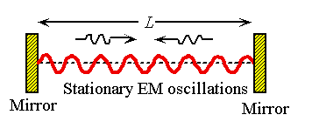
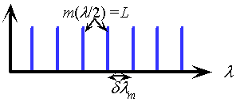
A optical cavity (optical resonator)
-We build a optical cavity to trap the wavelength
we want
-only standing waves with certain wavelength
can be maintained within the optical cavity
m:mode number (an interger)
Wavelength satisfy the left equation is called
A cavity mode

Slide 11
Laser diodes: utilization of PN junction
Compared to other lasers (sapphire, CO₂, HeNe, dye), semiconductor laser diodes are compact in size, electricity effective, efficient, long life, cheap, and versatile in color from UV to IR.
Applications – CD,VCD,DVD players, CDROM, laser printer, laser pointer, bar code scanner, etc.

Slide 12
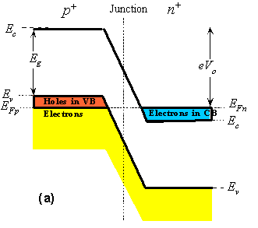
Degenerated semiconductor
the semiconductor that was excessively doped with donors or acceptors (10¹⁹-10²⁰ cm⁻³⁾ called degenerate semiconductor
such a semiconductor exhibits properties that are more metal-like
-degenerate doping: the Fermi level EFP in the p-side is in the valence
band(VB) and the EFn in the n-side is in the conduction band (CB)
-a laser diode consists of “degenerately” doped p+ side with “degenerated”
doped n+ side (p+n+ junction)

Slide 13
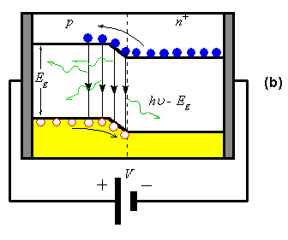
Structure: degenerately doped direct bandgap semiconductor pn junction
After applying large forward
bias V
LED
laser diode structure: degenerately doped direct bandgap semiconductor pn junction
depletion region (active region) is very narrow
population inversion occurs when applying a voltage larger eV > Eg:
the applied V diminishes the built-in potential to zero and electrons flow into the SCL
an incoming photon with energy Ec-Ev doesn’t excite an electron but stimulated by
falling electrons

Slide 14
Density of States and optical Gain in the active layer
the active region has an optical gain since an incoming photon is more likely
to cause stimulated emission than being absorbed
-the pumping mechanism caused by forward diode current is called injection pumping
-the pumping energy is supplied by the external battery

Slide 15
Build an optical resonator in a laser diode
an optical resonator
n: refractive index
-an optical cavity (resonator)) is required to implement a laser oscillator to build up the intensity of stimulated emissions.
-the ends of the crystal are cleaved to be flat and optically polished to
provide reflection and form an optical resonator
-this process can build up the intensity of the radiation in the cavity

Slide 16
Output power vs. diode current of a laser diode
Threshold current
-lasing radiation is only obtained when the optical gain in the medium can
overcome the photon losses from the cavity, which requires the diode current I
to exceed a threshold value Ith
-below Ith: spontaneous emission; above Ith: stimulated emission

Slide 17
Comparison of laser’s and LED’s light power versus current

Slide 18
Heterostructure laser diode
+
+
+
a heterostructured laser diode can significantly reduce the threshold current (Ith)
-we confine the injected electrons and holes to a narrow region, so that
less current is needed to make population inversion
-carriers are confined in the p-GaAs (active area) when the voltage is applied
-gaAs layer is very thin, so the concentration of injected electrons can be increased
quickly with moderate increases in forward current.

Slide 19
Schematic illustration of a double heterojunction laser diode

Slide 20
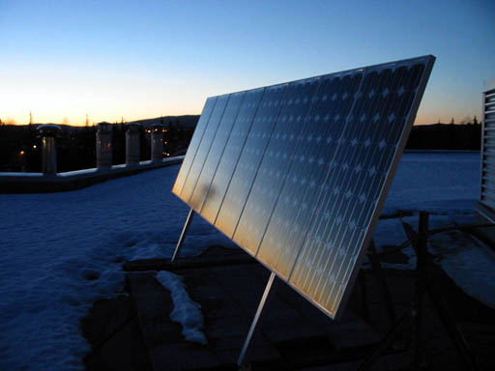
photovoltaic device (solar cell)

Slide 21
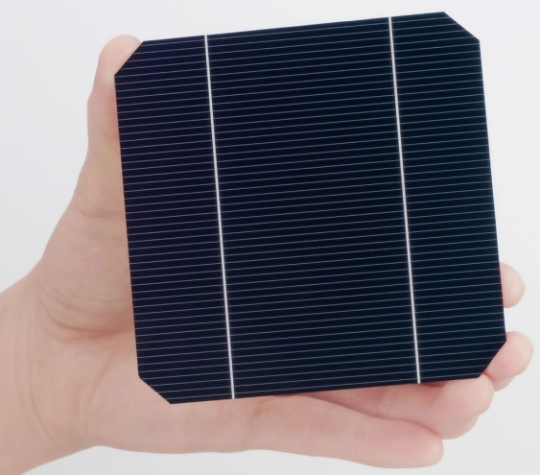
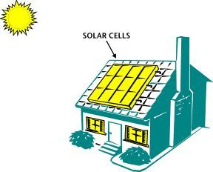
Solar cells
Solar light in
Electricity out

Slide 22
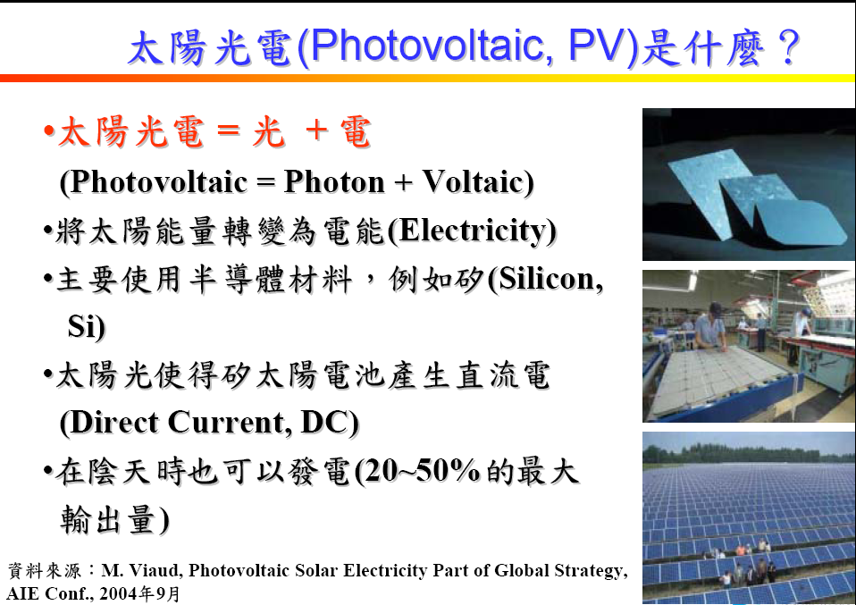

Slide 23
Generate electrons from materials by photons
Semiconductor, polymer or dyes
excited state
Separation of the
electron-hole
pair
electron
Conduction band
or HOMO
Valence band
or LUMO
Conduction band
or HOMO
Valence band
or LUMO
pair
So, materials used for solar cell application need to have discrete energy
gap for photogeneration of electron-hole pair

Slide 24
Elemental and Compound Semiconductors
I II III IV V VI
 |  | 5 B | 6 C | 7 N | 8 O
 |  | 13 Al | 14 Si | 15 P | 16 S
29 Cu | 30 Zn | 31 Ga | 32 Ge | 33 As | 34 Se
47 Ag | 48 Cd | 49 In | 50 Sn | 51 Sb | 52 Te
24
Notes:
24
You have heard many good things from me about CIGS solar cell. From here, I would like to give a brief introduction of CIGS material and its properties. CIGS is a I-III-VI compound semiconductor derived from II-VI compound. The group II element is replaced by group I and group III elements. Therefore, the I-III-VI compound has the atomic ratio of 1:1:2. Like other compound semiconductors, the elements belongs to the same group can be substituted to form solid solution such as Cu-In-Ga-Se quaternary compound or even Cu-In-Ga-Se-S pentanary compounds.

Slide 25
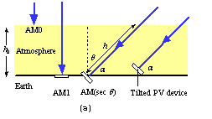
Definition of various radiation
m=h/ho=secθ
photovoltaic = photon + voltaic
AM0 ：太陽光在大氣層外的平均照度稱為AM0，其功率約1300W/m^2
AM1 (90 °) ：太陽光透過大氣層後與地表呈90度時的平均照度稱為AM1，其功率約925W/m^2
AM1.5 (45 °)： AM1.5用來表示地面的平均照度，是指陽光透過大氣層後，與地表呈45°時
的光強度，功率約844W/m^2，在國際規範(IEC 891、IEC 904-1)將AM1.5
的功率定義為1000W/m^2。

Slide 26
Pick right materials
- Good absorption coefficient to harvest
light
- Suitable band gap

Slide 27
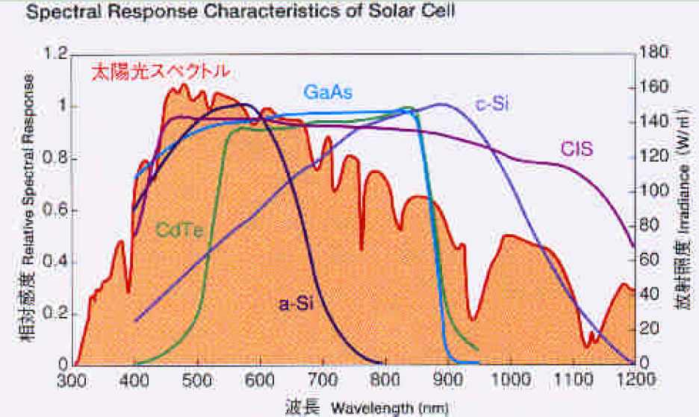
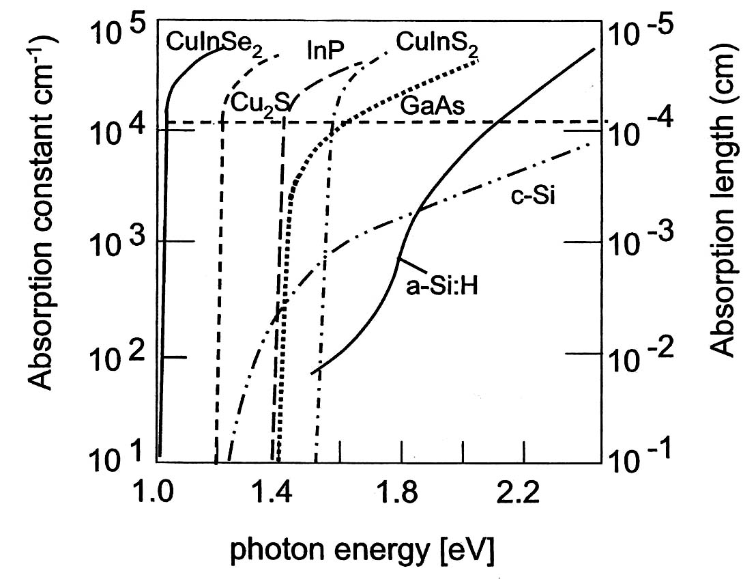
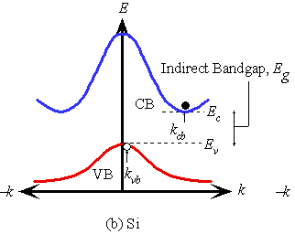
Absorption of semiconductors
Phonon emission o
r absorption
-We prefer direct semiconduct materials
since they can absorb light more efficiently
-Si and Ge’s absorption coefficient
increase slowly with increased energy

Slide 28
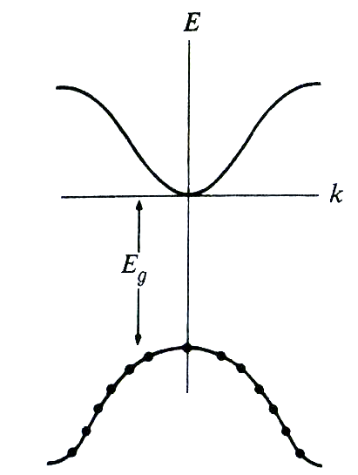
Pick suitable Eg (eV)
Theoretical maximum efficiency of a semiconductor
S(λ) =# of photons/area*time
bandgap of semiconductor should not be wide
→get higher S(λ)
-Electrons in the valence band can absorb energy of Eg, 2 Eg, 3Eg, but the excess energy can not be transformed to electric energy but transform to heat → need higher Eg
-very narrow band gap material can absorb most wavelength from sun, but transformed energy is small.

Slide 29
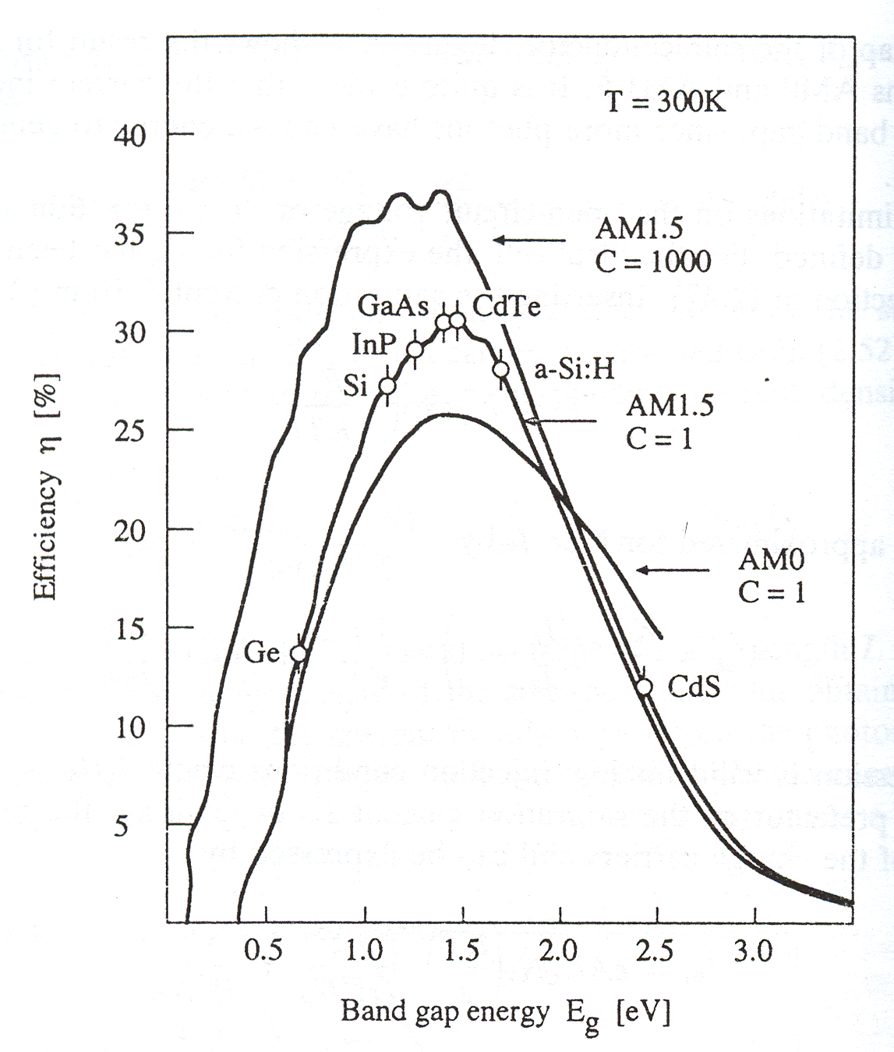
ηmax(%) vs Eg (eV) under AM1.5
real η_{max} is only around
30% due to loss of other facters
Eg:
1.0 – 1.5 eV is the best range

Slide 30
Absorption of semiconductor
Phonon emission o
r absorption
-We prefer direct semiconduct materials
since they can absorb light more efficiently
-Si and Ge’s absorption coefficient
increase slowly with increased energy

Slide 32
A PN junction photovoltaic device
-incoming photon generate EHPs and
separated by the build-in field Eo, drifts them apart
-generated electrons and hole can
diffuse and drift in neural region and SCL, respectively
-

Slide 33
A PN junction photovoltaic device
-The movement of minority carriers is critical for
the amount of generated current
-Without Eo it is not possible to drift apart
the photogenerated EHPs accumulate
excess electrons on the n-side and
excess holes on the p-side

Slide 34
A PN junction photovoltaic device
0.2 μm
200-500 μm
:life time
Electron diffusion length
-Silicon’s electron diffusion length is longer than
the hole diffusion length
-we make a device with very narrow n region and
longer p region
-n side: 0.2 μm or less ; p-side: 200-500 μm
Reason: (1) the electron diffusion length in Si
Is longer than the dole diffusion length
(2) At long wavelengths, around 1-1.2 μm, the
absorption coefficient α of Si is small and the
absorption depth (1/ α) is typically greater than 100 μm.
Only electrons within the Le to the depletion
Layer can contribute to the photovoltaic effect

Slide 35
Photogenerated carriers within the solar cell
At
Photocurrent Iph = eGoA(ln + W+Le)
Go = photogeneration rate

Slide 36
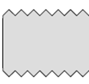
Device structure of a Si solar cell
(1)
Finger electrodes
Bus electrode
(2)
for current collection
(3)
0.2 μm
n
Incident light
surface texturization
200 μm
p
In order to capture more light
and to allow more photons into the device
- finger electrodes were made to allow light pass through the device
a thin antireflection coating on the surface reduces light reflection and allow more
lighte to enter the device
-surface texturization to for multiple light reflection and increase light path

Slide 37
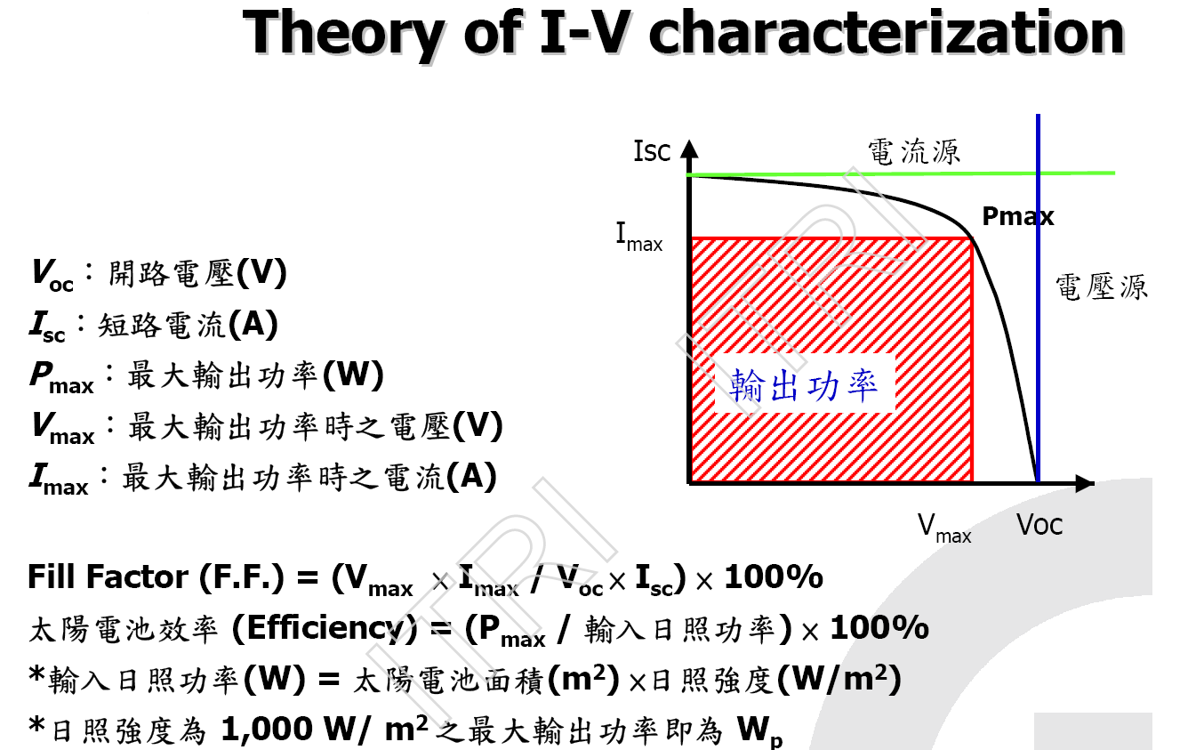

Slide 38
Voc and Jsc
metal conductor
Short circuit
An external load (metal) is connected
To the cell, and is a short circuit called
short circuit current – the maximum
photocurrent
Open-circuit voltage (Voc) develops between the terminals of the device because the electron reaches the neutral n and p, respectively.

Slide 39
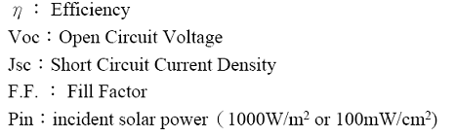
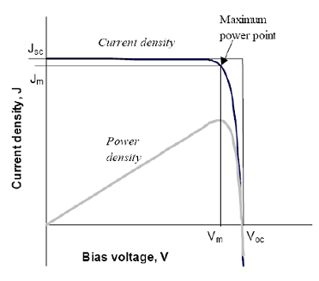
IV curve of a solar cell
Voc (open circuit voltage)
-when output current approaches zero,
the voltage develops between two terminals
ideally Voc~Eg at 0K and inverse proportional
to temperature
Jsc (short-circuit current)
-like the device connect the device with metal circuit,
close to photogenerated current
FF (fill factor): We want FF close to 1

Slide 40
Solar cell efficiency :an example
η and FF in this device ?
η=P_{MP} /P_{in} x100%=FF*V_{oc}J_{sc}/ P_{in} x100%
（輸出電功率/入射光功率)
P _{in} =100 mW/cm²
P_{MP}=V_{MP}*J_{MP}=0.55*5.9716=3.28mW/cm²
η =3.28/100*100%=3.28%
V_{oc}=0.72 V
J_{sc}=7.1464 mA/cm²
FF=V_{MP}*J_{MP}/V_{oc}*J_{sc}
=3.28/(0.72*7.14)=0.63
Jsc
(0.55,5.9716)
J_{MP}
V_{MP}
Voc
Voc: 開路電壓 (open circuit voltage), 當輸出電流趨近於零，相
對太陽電池兩電極端點沒有連接所得到的電壓
Jsc:短路電流(short circuit current)
如將照光的pn二極體兩端的金屬電極用金屬線連接, 造成短路, 此短路電流等於光電流

Slide 41
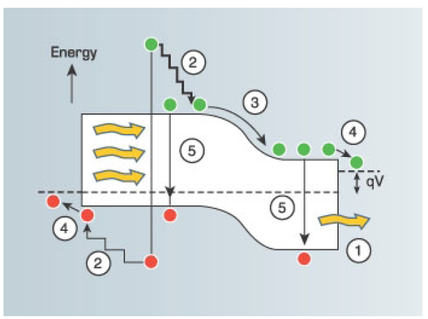
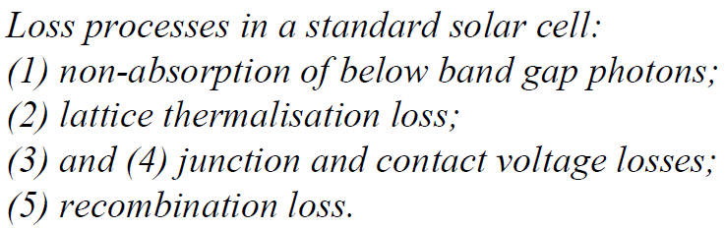
Theoretical efficiency limit

Slide 42
Various losses of solar energy of a Si solar cell during processing
Silicon band gap is 1.1 eV, and
the device loses all photon energy
less than 1.1 eV
- Excessive photon energy loss
-Crystal surfaces and interfaces
Contain a high concentration of
Recombination centers
Only 43.6% remaining!
Antireflection coating is not perfect
Voc is inverse proportional to
temperature, so not equals to Eg
device fabrication resistance
The highest efficient of a real
photovoltaic device that uses a
single crystal of Si
Is about 24.7% (澳洲新南威爾斯
大學）

Slide 43
Next step of crystalline Si solar cell

Slide 44
Various solar cells
crystalline
single crystalline
silicon
polycrystalline
thin film amorphous
single crystalline
III-V(GaAs)
solar cells
compound
poly crystalline
thin film
CIGS
CdTe
organic
dye sensitized
polymer

Slide 45
Thin film solar cell: use Si as an example
- required thickness of thin film solar cell is around 0.5 μm, 1/500 of that of wafer based solar cell
- material cost is very low

Slide 46
Photovoltaic materials and their cell ηcomparison
 | High Cost | Thin film solar cell
Materials | s-Si or poly Si | a-Si | CdTe | CIGS
manufacturing process | Crystal growth | PECVD | Sublimation | Evaporation/selenization
Cell efficiency | 21% | 13% | 16% | 19.9%
Potential for production cost <$1.00/Watt | Doubtful | Fair | Good | Very good
Flexible modules | No | Yes | No (rigid packing) | Yes
Stability | Very good | Intrinsic degradation | Contact degradation | No known degradation
Remarks | Shortage of raw Si wafer | manufactruing is xpensive -poor materials utilization | Borderline efficienci after decades | Need non-vaccum process for low lost production

Slide 47
Advantages of thin film solar cells
  1. low raw materials are required for fabrication
  2. light transmission is better
  3. more competitive price (CdTe, US$1 per watt ; First
  Solar, stock price is US$180 )
  4. frameless design
  5. Ideal for BIPV( building integrated photovoltaic)

Slide 48
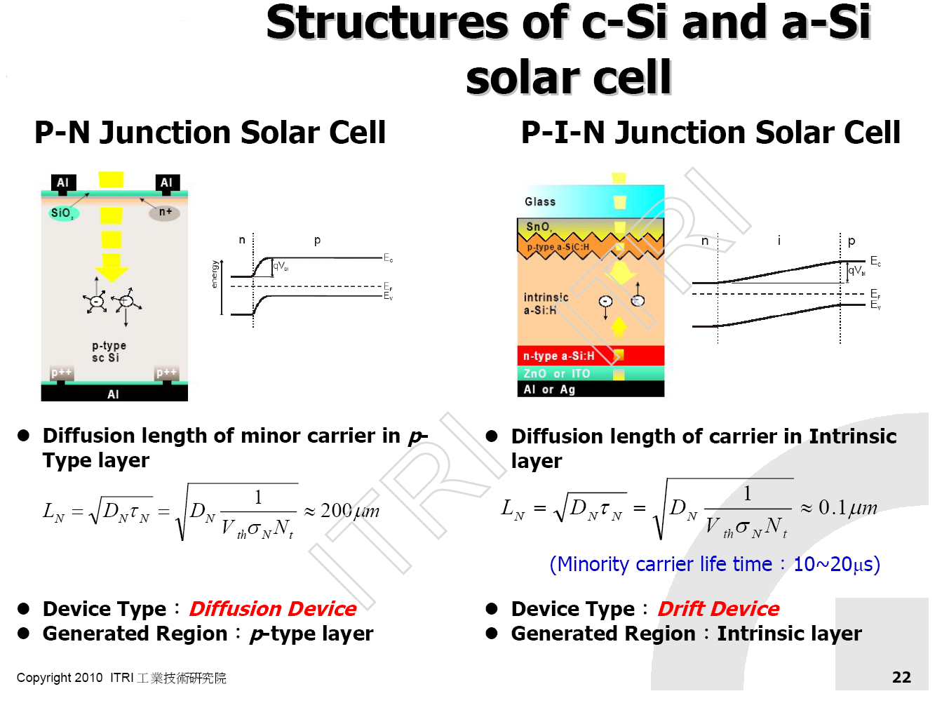
(very short)

Slide 49
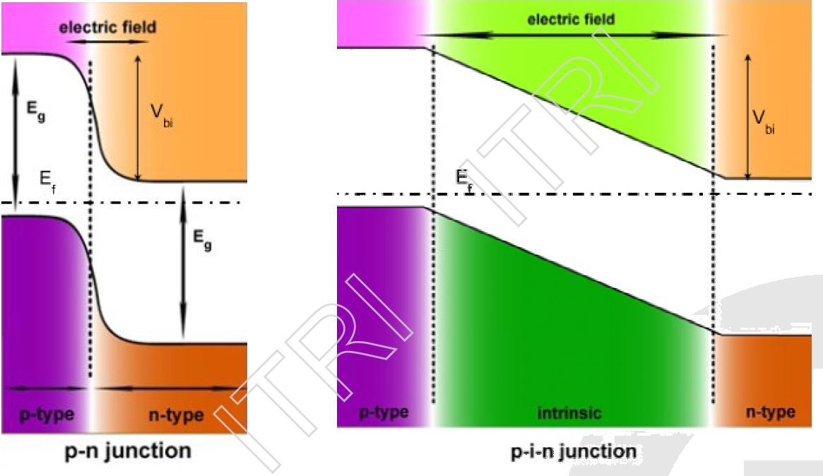
p-n junction and p-i-n junction

Slide 50
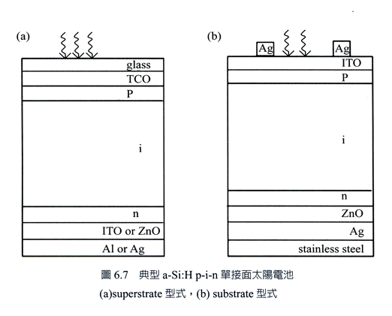
Amorphous Si solar cell : illustration
圖6.7
a-Si’s absorption coefficient at visible light is one order of magnitude than
c-Si , so only 10-30 nm is needed to capture most photon in the visible region
-thickness of p and n type are around 10-30nm, thickness of i layer is less than 500 nm

Slide 51
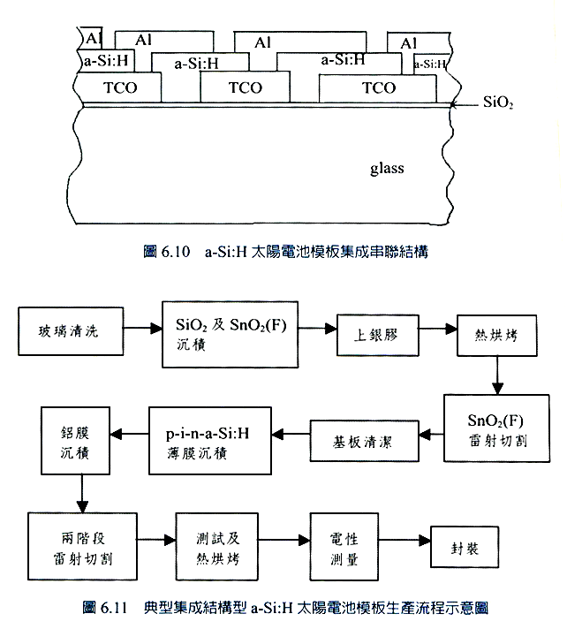
CVD

Slide 52

II-VI compound solar cell: CdTe
Abbreviated periodic table
I II III IV V VI
B C N O
Al Si P S
Cu Zn Ga Ge As Se
Ag Cd In Sn Sb Te
II-VI group as light
harvesting materials
band gap of CdTe : 1.5 eV

Slide 53
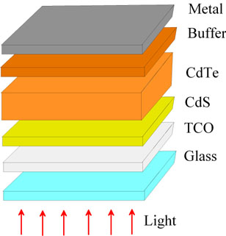
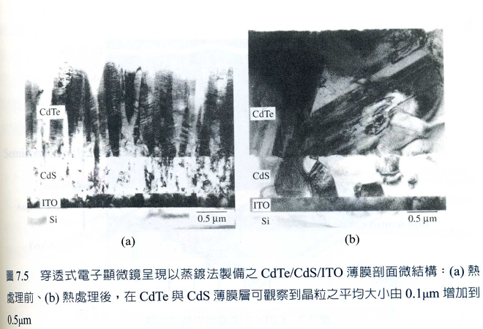
Device structure of CdTe solar cell
P-type: CdTe
n-type: CdS

Slide 54
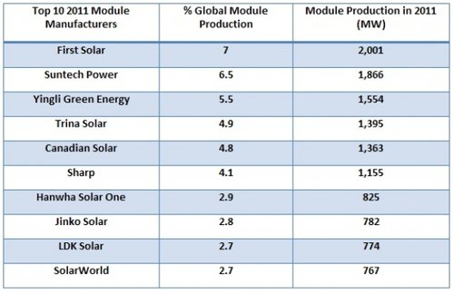
First solar: CdTe solar cells
2010年全世界生產成本最低的太陽能電池模組公司

Slide 55
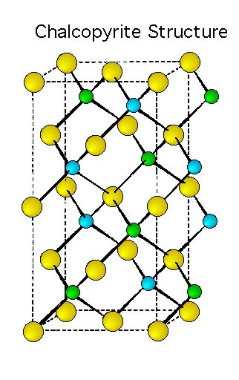
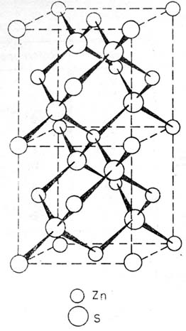
I-III-VI2 compound solar cells: CuInGaSe(S)
sphalerite structure
I-III-VI group
Abbreviated periodic table
I II III IV V VI
B C N O
Al Si P S
Cu Zn Ga Ge As Se
Ag Cd In Sn Sb Te
MI
MII
VI

Slide 56
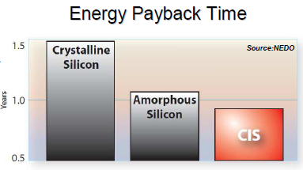
Band gap and optical absorption of CIGS
CISe2:1.0 eV
CIGS:1.0-1.6 eV
CIS:1.3-1.5 eV
Muller, semiconductor for solar cells, 1993
Efficiency = FFVocIsc
Pin
-CIGS’s band gap is in the range of 1.1 to 1.5 ev

Slide 57
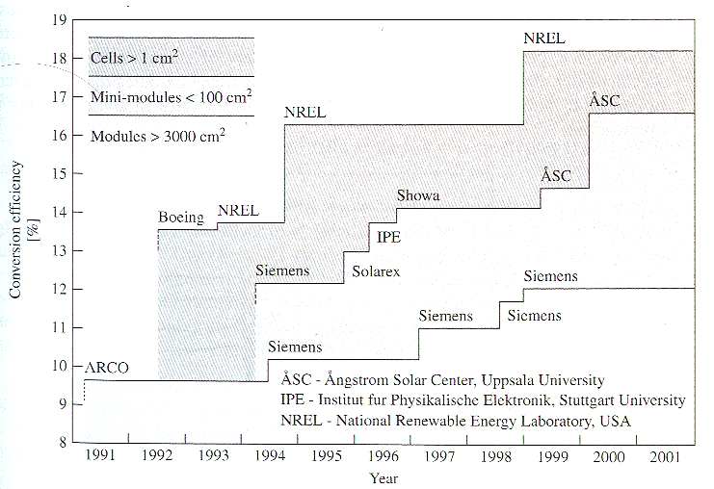
CIGS cell efficiency roadmap
November, 2008 , Record Makes Thin-Film Solar Cell Competitive with Silicon Efficiency
US National Renewable Energy Laboratory (NREL)
CIGS solar cell reaches 20.0% efficiency conversion

Slide 58
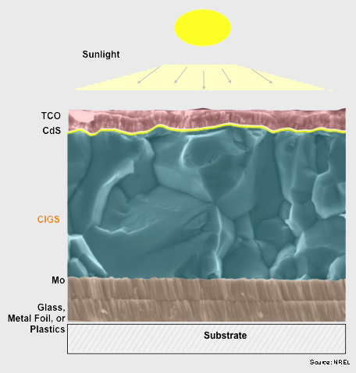
Cu(In,Ga)(S,Se)2 (CIGS) device structure
Schematic picture
Current collection grid
HR-ZnO/n+-ZnO (0.5µm)
P-type
Cu(InGa)Se2 (2µm)
n-typeCdS (0.05 µm)
Mo (0.5 µm)
Soda lime glass
total device thickness less than 5 µm (Crystalline Si module~200 µm)

Slide 59
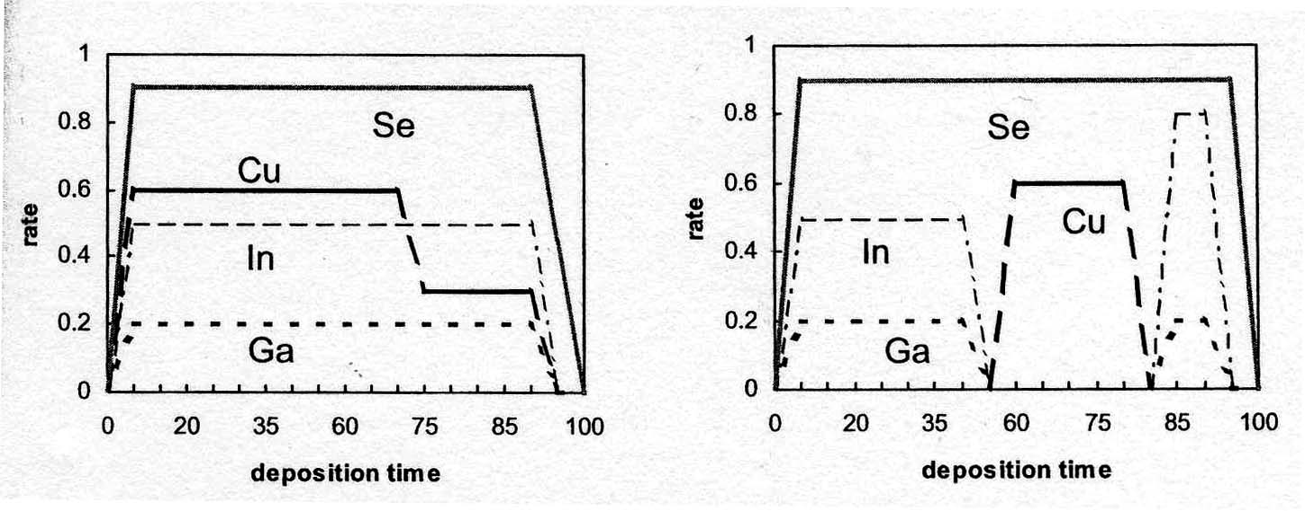
Vacuum-based techniques for CIGS film deposition
Heater and substrate
CIGS film deposition method:
Multistage coevaporation process in
a vacuum chamber
Evaporation sources
Drawbacks:
-difficult to achieve controlled-stoichiometry over large device areas
-manufacturing equipment is “very” expensive (> NT 0.1 billion)
-the deposition process is time-consuming
-low materials utilization (30-50%)
-low throughput
-Highest efficiency (lab scale: 18~20%)
-Usually UHV/MBE
-Cost prohibitive (but <cryst-Si)

Slide 60
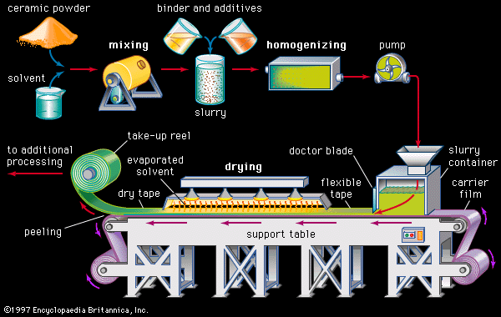
Non-Vacuum Processing
Synthesize colloidal nanocrystals with controlled CIGS stoichiometry
and deposit layer
Roll-to-roll manufractruing process
60
Notes:
60

Slide 61
ISET’s non-vacuum process
Substrate | Efficiency | Air Mass
Soda lime Glass | 13.6% | AM 1.5
Molybdenum Foil | 13.0% | AM 1.5
Titanium foil | 9.5% | AM 1.5
Polyimide film | 10.4% | AM 1.5
Stainless Stell | 9.6% | AM 1.5
61
Kapur V.K. thin solid film, 2003
Notes:
61

Slide 62
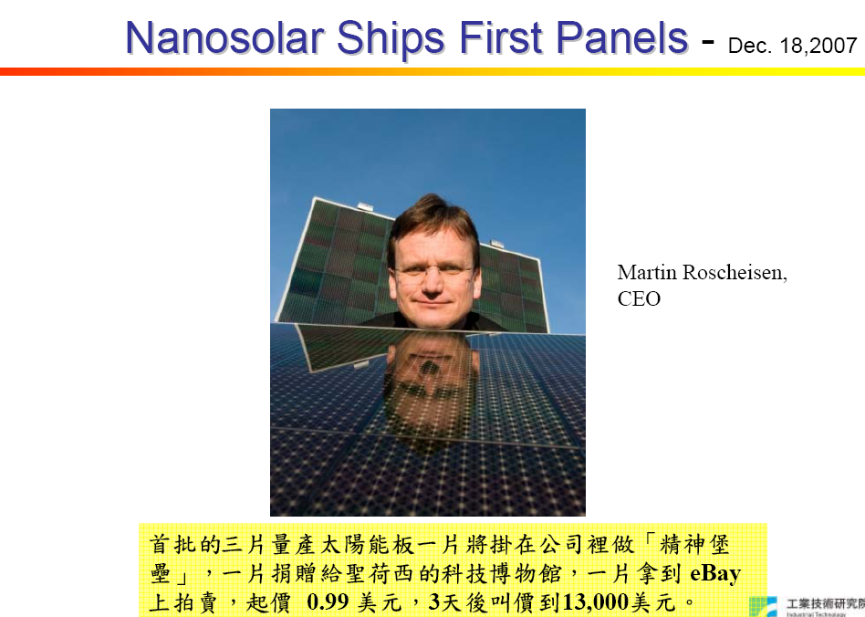
Nanosolar。破產，2013年7月

Slide 63
CIGS Rocks!
【時報記者沈培華台北報導】台積電 (2330) 新事業總經理蔡力行表示，
台積電將以CIGS薄膜產品進軍太陽能產業，以五年期間朝全球前五大廠邁進，
產能規模將達1GW規模，並看好此事業對台積電是有獲利與高成長潛力的新事業。
台積電今天舉行先進薄膜太陽能技術研發中心暨先期量產廠房動土典禮。
新事業總經理蔡力行表示，全球太陽能電池市場將持續成長，預期2009年至
2015年全球太陽能電池市場年複合成長率可望達23%；其中，銅銦鎵硒(CIGS)
因具有薄膜的低成本價格等優勢，成長率將最高，年複合成長率將達115%。
台積電因此將以CIGS薄膜產品為主力，進軍太陽能產業。
台積電先進薄膜太陽能廠第一期將投資約79.2億，預計2012年量產200百萬瓦(MW)
，終期產能為700百萬瓦(MW)。台積電董事長張忠謀並預估，2015年太陽能佔
台積電營收比重可望達10%。蔡力行表示，台積電三年內CIGS薄膜太陽能電池
模組轉換效率將達14%，產能規模將約300至500百萬瓦，預期3至5年轉換效率
將進一步提升至16%，產能規模將達1GW規模。

Slide 64
三星CIGS太陽能轉換率迎頭趕上，台積電陷轉換率冠軍保衛戰 Dec 24 2013
在 CIGS 太陽能電池領域，目前面板本身的轉換率，由 ZSW 以 20.8% 稱雄，而漢能旗下收購的 Solibro 正在積極追趕中，在模組轉換率方面，則一直是由台積電稱霸，但是如今，三星已經向台積電下了戰書。三星利用類似 Solar Frontie r的 2 步驟製程，成功的在 1.44 平方公尺的大面積達到 15.7% 的轉換率，由太陽能電池測試業者 TÜV Rheinland 認證。 先前《科技新報》報導，，2013年1月，台積電就已經以 15.1% 的轉換率拿下世界第一寶座，不過台積電精益求精，6 月 18 日，台積電宣布轉換率又提升 0.6%，來到 15.7%。這次三星也達到 15.7%，使得三星的 CIGS 模組轉換率與台積電並駕齊驅。雖然這個高效率的太陽能模組，是屬冠軍模組，現階段可能只佔生產出來產品的 5％ 到 10%，不能視為整廠的常態，不過在宣傳上卻有很大的功效。三星在 CIGS 轉換率競爭中先前一直處於鴨子划水狀態，一公布，就已經追上台積電，台積電可說陷入轉換率龍頭保衛戰，而在產能方面，三星也大手筆計畫在 2014 年建立 200 百萬瓦的產能，並計畫到 2015 年將產能擴大到超過1GW。三星表示，由於 CIGS 在高溫下表現佳的特性，在日照充足的所謂的日光帶，包括中東地區，CIGS 的市場將逐漸增加，三星表示當觀察到以建築物為基礎的太陽能市場興起，就會全力投入生產，並同時降低成本。台積電在與碲化鎘太陽能電池龍頭，美國第一太陽能（First Solar）的轉換率之戰上落後，第一太陽能目前的模組轉換率記錄是 16.1%，勝過 CIGS 陣營，如今同為 CIGS 陣營中又殺出三星，可說前後夾攻，台積電在太陽能領域將有一場硬仗要打。

Slide 65
不賭了！台積電關太陽能廠 2015/08/6
台積電董事長張忠謀當年一句「賭了！」讓台積電砸下79.2億元蓋廠、搶進太陽能產業，但經過6年努力，半導體龍頭大廠台積電昨宣布，旗下100％持股的台積太陽能公司，業務發展不具長期效益，預計在8月底結束工廠營運。台積太陽能董事長左大川坦言，仍未找到穩定獲利的模式，只好結束經營。
左大川表示，台積電相信太陽能電力一直都會是重要的綠色能源，而太陽能模組製造仍是一個健全且持續成長的產業，但在未能發展出一套穩定獲利的模式。面對工廠結束營運，台積電強調，將邀聘所有廠內約365名同仁至台積電工作、既有客戶的產品保固將不受影響。
法人表示，太陽能市場今年相當嚴峻，而台積太陽能主要生產薄膜太陽能電池產品具有相當優勢，但隨著中國大量投入太陽能電池發展，市場長年處於供過於求的狀態，產品平均價格難有突破，也壓縮到市場發展空間。
台積電指出，台積太陽能屬於市場後進者，缺乏經濟規模，雖然台積太陽能的銅銦鎵硒（CIGS）薄膜技術轉換效率領先全球，但成本不具競爭優勢。經過評估之後，就算以最精進的成本減抑計畫，也難挽成本劣勢。台積電表示，台積太陽能廠結束營運產生的虧損，將在2015年第3季認列完畢，預估對EPS影響0.07

Slide 66
 | Silicon Wafer cells | Vacuum-based thin film | Roll-printed thin film
Process | Si wafer processing | High vacuum depositon | Roll-to-roll printing
Process Yield | Robust | Fragile | Robust
Materials Utilization | 30% | 30-60% | Over 97%
Throughput | 1 | 2-5 | 10-25

Slide 67
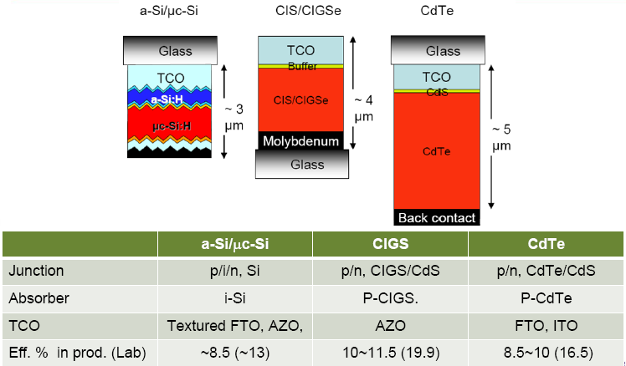
Comparison of three thin film solar cell
Semiconductor Taiwan 2008

Slide 68
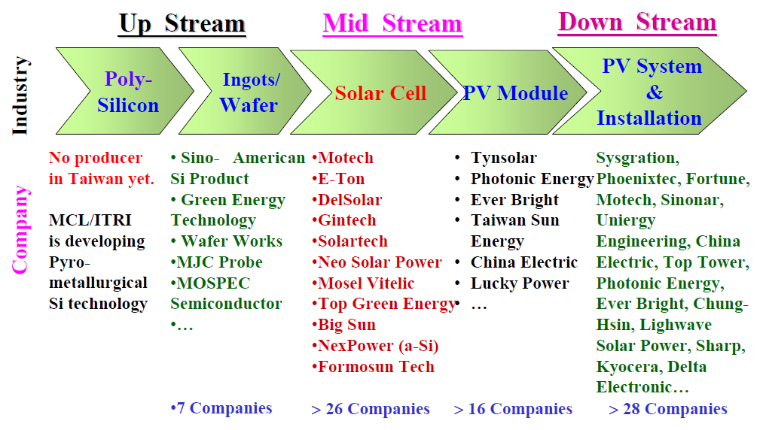
PV industry in Taiwan

Slide 69
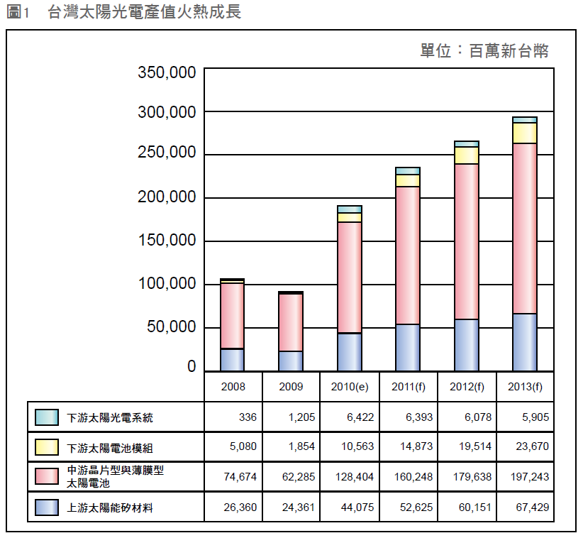
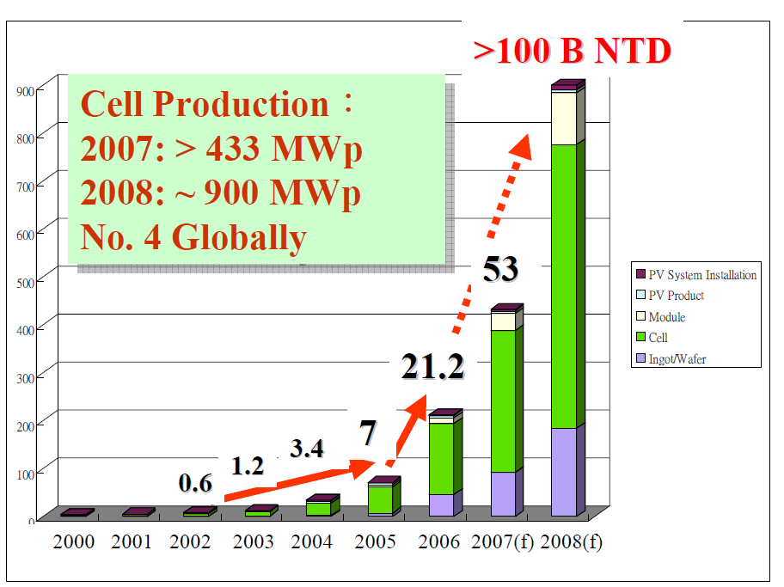
PV industry in Taiwan

Slide 70
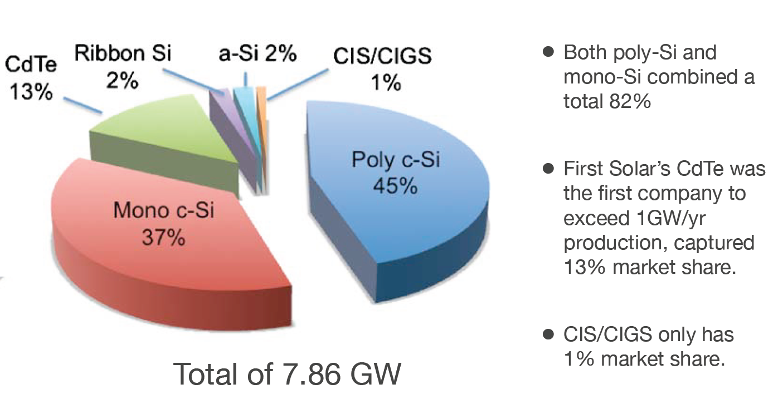
Market distribution in 2009

