Slide 1
CHE 4940 Fundamentals of Opto electronic Materials and Devices
(光電材料與元件基礎 2 學分)
課程說明:
教育化工系的同學，使認識光電材料與光電元件的基礎及其製程，
俾便未來運用化學工程技術在這些相關的產業之中。
內容主要分為三大部分: 光電材料與元件基本原理, 無機光電材料與元件
、有機光電材料與元件。
任課教師:
段興宇教授 (ext: 42509, hytuan@che.nthu.edu.tw, Room 311)
林昆翰教授 (ext: 33672, kunhan.lin@mx.nthu.edu.tw, Room 308)

Slide 2
教學進度： I. 光電材料與元件基本原理: 段興宇教授 M7M8
上課日期 | 授課內容
2/25 | Semiconductor fundamentals
3/11 | Principle of optoelectronic devices(I)
3/18 | Principle of optoelectronic devices (II)
3/25 | Principle of Semiconductor devices
4/01 | Integrated circuit (IC) manufacturing processes
4/15 | Chemical vapor deposition (CVD)
4/22 room 210 6:00-8:00 pm | Midterm

Slide 3
II有機光電材料與元件 Prof. 林昆翰 W5W6

Slide 4
成績評定
Part I. 期中考, 50%.
教學方式
Lectures (power point presentations)
1.投影片PDF檔下載：http://mx.nthu.edu.tw/~hytuan/

Slide 5
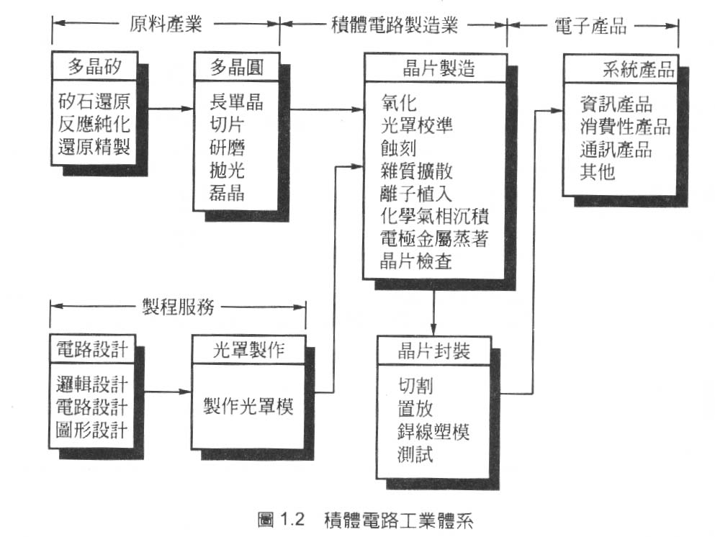
Overview of Integrated Circuits (IC) industry in Taiwan
中美晶、綠能
台積電（世界第一）、聯電、漢磊
向外國購買
聯發科等IC設計公司
台灣光罩
日月光

Slide 6
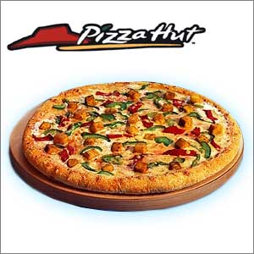
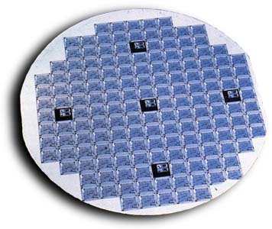
Pizza vs microchip fabrication

Slide 7
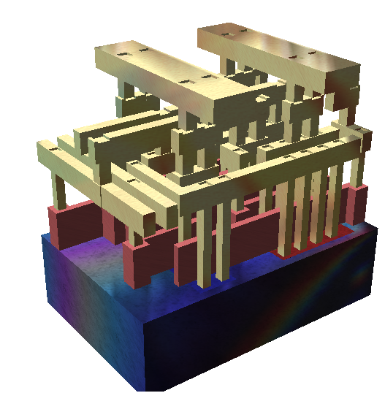
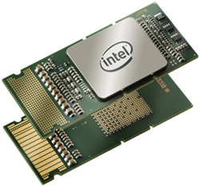
Integrated circuits (ICs)
- Combination of transistors, diodes, capacitors in a chip
Ultra large scale integration (ULSI) >1,000,000 components per chips
- Morre’s law: the number of transistors on a chip were doubling every 18 months
- Intel four core Itanium CPU- Tukwila has over 2 billion transistors on a chip
Courtesy of wiki

Slide 8
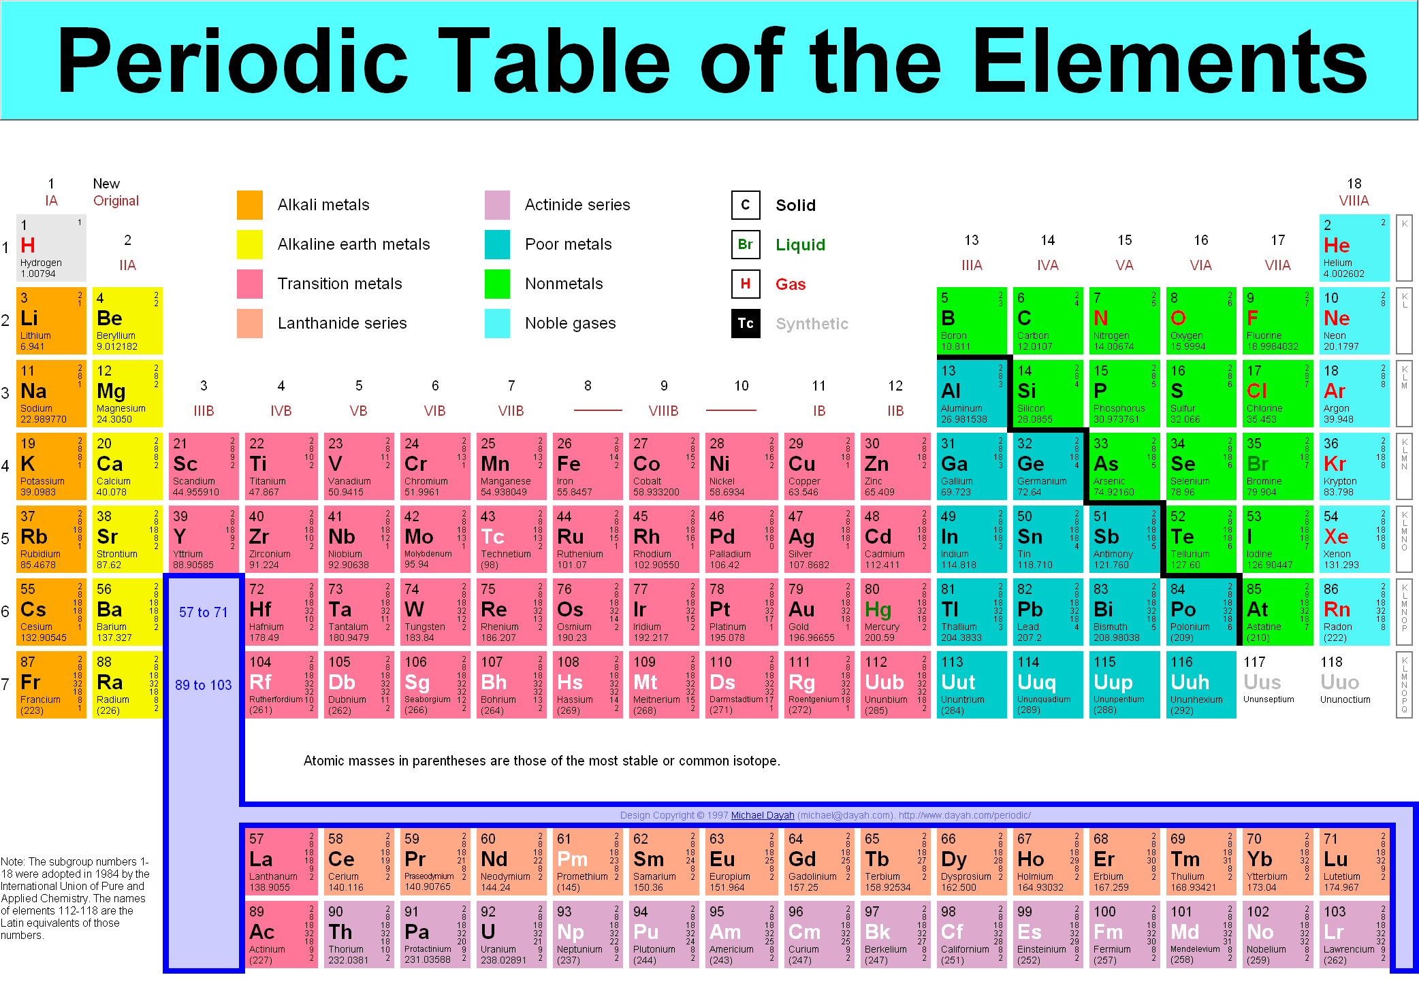

Slide 9
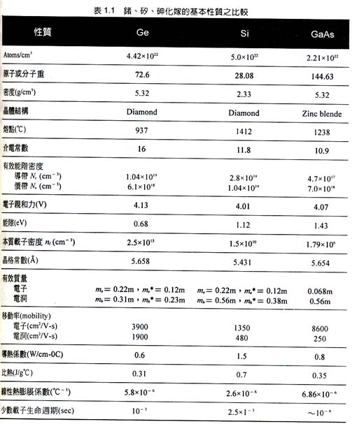
Si, Si, Si, why Silicon???
Silicon has smallest carrier mobility
compared with Ge and GaAs.
Drawback of Ge
-Ge’s device easily to leak at high temp.
-GeO2 is water soluble
-melting point of Ge is only 937 C
Drawback of GaAs
-hard to get high quality and large size wafer
-need additional procedures to form dielectic
materials
Advantage of Si
Cheap raw materials, e.g., rock, sand,
second most abundant element on earth,
appear as SiO2
- High melting point: 1415C
- stable silicon oxide (SiO2) as dielectric materials

Slide 10
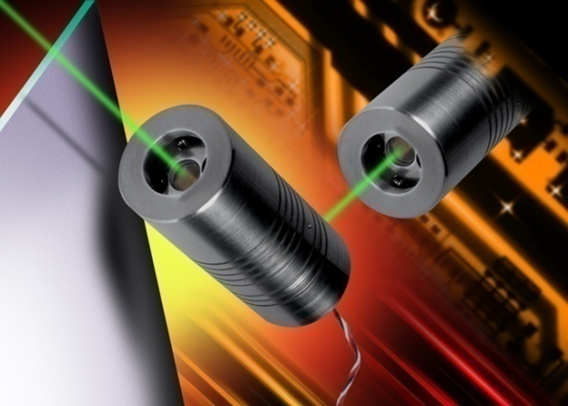
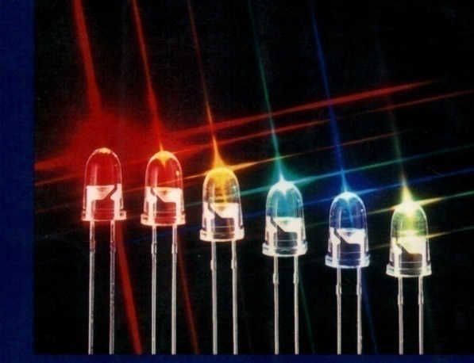
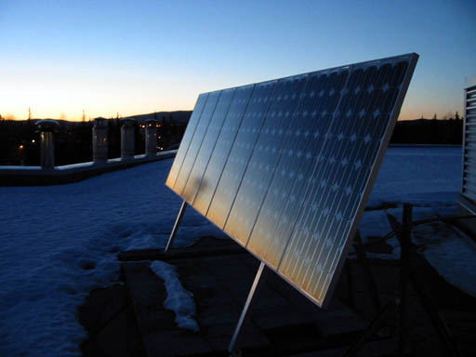
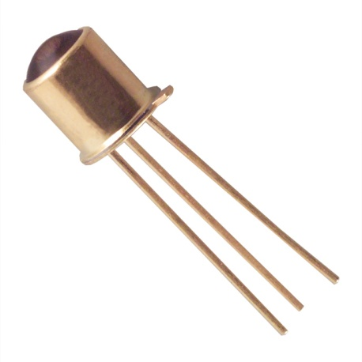
Optoelectronic devices using semiconductors: Si、III-V、I-III-VI, many semiconductors are candidates
LED (light emitting diodes)
Laser
Solar cell
Photodetector

Slide 11
The band gap of semiconductor optoelectronic materials corresponding to a optical spectrum
E=1.24/ λ (eV)
When E: electron volts
λ:μm
E= hc/λ
direct band gap materials
Compound (II-VI, III-V, IV-VI) semiconductors

Slide 12
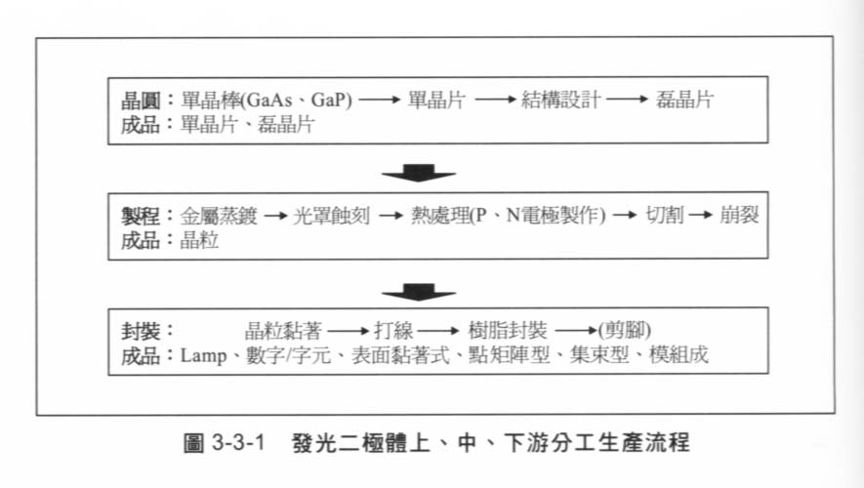
LED – basic manufacturing processes
經,3-76
Similar manufacturing process could be also applied to laser, solar cell industry

