Slide 1
Objects that Behave in Unusual Ways
Designed by:
Jaquelyn(109048207), Amanda (109048212), Sherry (109048117) , Lisa(109048121)

Slide 2
TABLE OF CONTENTS
01
03
02
04
TRANSPORTATION
MIRROR
COMMUNICATION
OTHERS

Slide 3
01
TRANS-
PORTATION

Slide 4
Broomsticks
01-1

Slide 5
"... No Muggle illustration of a witch is complete without a broom... they remind us that we were careless for far too many centuries to be surprised that broomsticks and magic are inextricably linked in the Muggle mind."
— Kennilworthy Whisp,
Quidditch Through the Ages

Slide 6
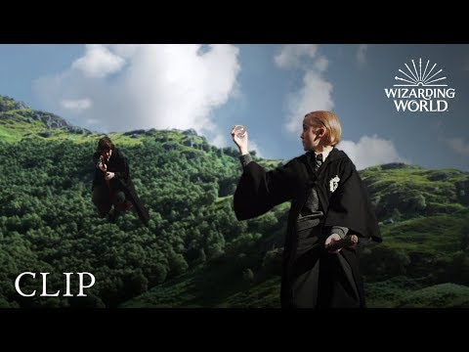

Slide 7
Floo Powder
01-2

Slide 8
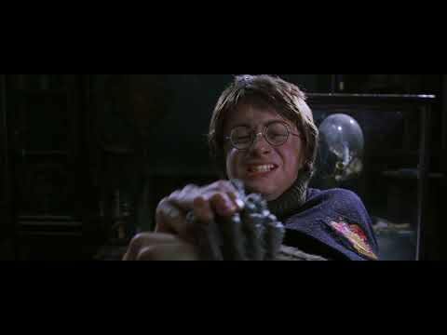
Notes:
In use for centuries, the Floo Network, while somewhat uncomfortable, has many advantages.
Firstly, unlike broomsticks, the Network can be used without fear of breaking the International Statute of Secrecy.
Secondly, unlike Apparition, there is little to no danger of serious injury.
Thirdly, it can be used to transport children, the elderly and the infirm.

Slide 9
01-3
Flying Carpet

Slide 10
"I sent him an owl about that just last week. If I've told him once I've told him a hundred times: Carpets are defined as a Muggle Artefact by the Registry of Proscribed Charmable Objects, but will he listen?"
--Arthur Weasley,
Harry Potter and the Goblet of Fire

Slide 11
01-4
Knight Bus

Slide 12
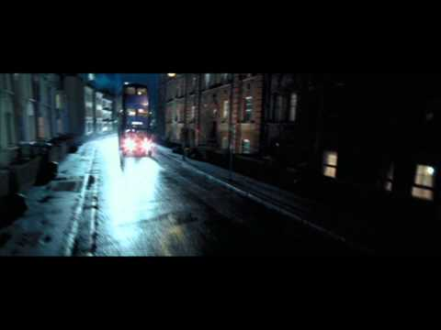

Slide 13
01-5
Vehicles

Slide 14
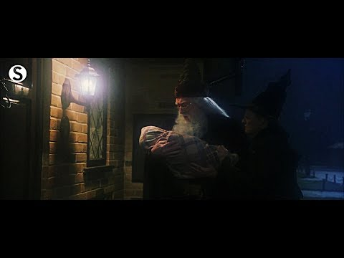

Slide 15
